Slide 1
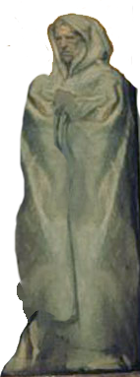
Nahum, Zephaniah & Habakkuk
Lesson 13 – Habakkuk’s Prayer

Slide 2
The purpose of the prophets was threefold:
To warn the nations of the coming judgment.
To explain why the judgment had come upon them.
To give assurance, at least to a remnant, of a hope that lay beyond the judgment.
Notes:
1. The purpose of the prophets was threefold:
a. To warn the nations of the coming judgment.
b. To explain why the judgment had come upon them.
To give assurance, at least to a remnant, of a hope that lay beyond the judgment.

Slide 3
The Role of the Prophets
They are Spokesmen for God, serving as “forthtellers,” speaking what God put in their mouth.
They are Preachers of the Covenant, relating their message to God’s previous promises to the nation of Israel. These covenants were made with or through Abraham, Moses, and David
They are historians, or Interpreters of the Israelites’ History. With out their interpretation God’s people would not know why an event was occurring.

Slide 4
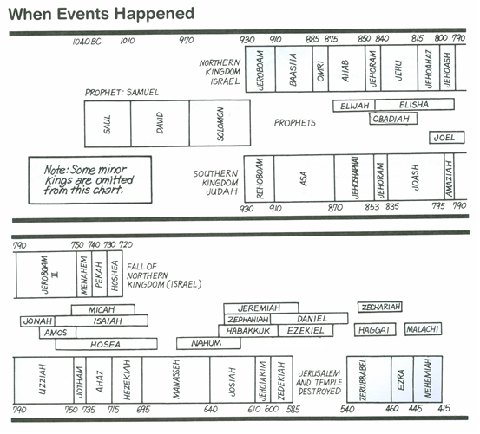
Kings & Prophets

Slide 5

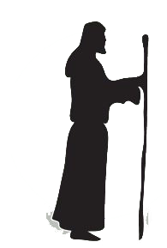

Outline - Habakkuk
I. Introduction - An Oracle (1:1)
II. First Cycle (1:2–11)
A. Habakkuk’s lament (1:2–4)
B. God’s response (1:5–11)
III. Second Cycle (1:12–2:20)
A. Habakkuk’s lament (1:12–2:1)
B. God’s response (2:2–20)
a. A vision (2:2–5)
i. Announcement (2:2–3)
ii. Life and death (2:4–5)
b. Taunting woes (2:6–20)
i. The pillager (2:6–8)
ii. The plotter (2:9–11)
iii. The promoter of violence (2:12–14)
iv. The debaucher (2:15–17)
v. The pagan idolater (2:18–20)
C. Habakkuk’s Prayer (3:1–19)
Who
Prophet
Habakkuk
Habakkuk probably lived to see the following events: the destruction of Nineveh by Babylon in 612 BC the battle of Haran in 609 in which Josiah died at Megiddo as he tried to hinder the Egyptians from reaching the battle; the final defeat of the Assyrians at the Battle of Carchemish (605); and possibly the fulfillment of his own prophecy of the Babylonian invasions of Judah in 605, 597, and 586.
Notes:
a. A vision (2:2–5)
i. Announcement (2:2–3)
ii. Life and death (2:4–5)
b. Taunting woes (2:6–20)
i. The pillager (2:6–8)
ii. The plotter (2:9–11)
iii. The promoter of violence (2:12–14)
iv. The debaucher (2:15–17)
v. The pagan idolator (2:18–20)
Baker, D. W. (1988). (Vol. 27, pp. 4748). Downers Grove, IL: InterVarsity Press.
Baker, D. W. (1988). Nahum, Habakkuk and Zephaniah: An Introduction and Commentary (Vol. 27, pp. 47–48). Downers Grove, IL: InterVarsity Press.

Slide 6
Key Themes
1. God is just and merciful, even though his people may not always understand his ways (2:4).
2. Wickedness will eventually be punished, and the righteous will ultimately see God’s justice (2:5–20).
3. God uses some wicked nations to punish other wicked nations, but ultimately God will judge all nations (1:6; 2:5–20).
4. The key phrase “but the righteous will live by his faith” summarizes the path of life God sets for his people
Notes:
Key Themes
1. God is just and merciful, even though his people may not always understand his ways (2:4).
2. Wickedness will eventually be punished, and the righteous will ultimately see God’s justice (2:5–20).
3. God uses some wicked nations to punish other wicked nations, but ultimately God will judge all nations (1:6; 2:5–20).
4. The key phrase “but the righteous will live by his faith” summarizes the path of life God sets for his people and is quoted three times in the NT (Rom. 1:17; Gal. 3:11; Heb. 10:38), each time highlighting a different aspect of the phrase’s meaning.
Crossway Bibles. (2008). (p. 1720). Wheaton, IL: Crossway Bibles.
Crossway Bibles. (2008). The ESV Study Bible (p. 1720). Wheaton, IL: Crossway Bibles.

Slide 7
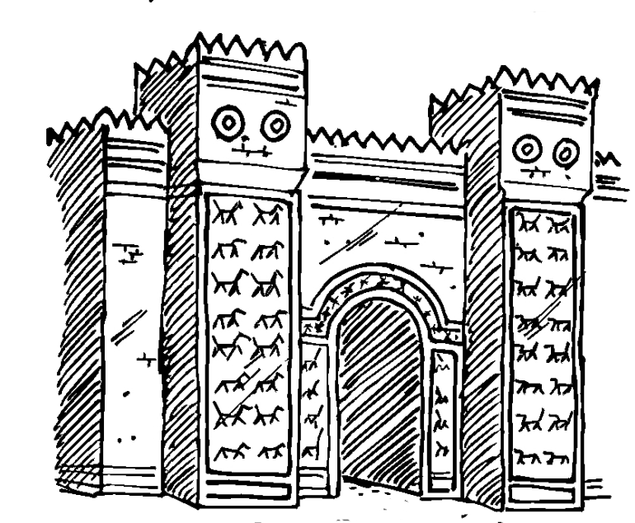
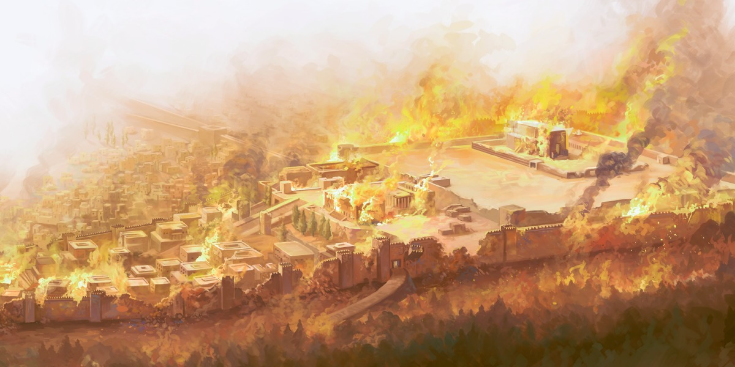
Assyria
Ashurnasirpal II 883-859
Shalmanser III 859-824
Tiglath-Pileser III (Pul) 745-727
Shalmaneser V 727-722
Esarhaddon
681-669
Sargon II
722-705
Sennacherib
705-681
Ashurbanipal
669-627
Tribute from Tyre & Sidon
Babylon rebels
626 BC
6 Campaigns Levant – Ahab at Qarqar 853 BC
Black Obelisk – Jehu giving tribute 841 BC
Killed brothers
Attacked Egypt 669 BC
Law Found 622 BC
Hoshea Rebels-Samaria
Northern Kingdom Falls 722 BC
(2 Kgs 17:1-6)
Ashur sacked
614
Conquered Samaria
713/712 BC revolt by Egypt Ashdod
Judah Edom & Moab
(2 kgs 17:24 Is 20)
Rebuilt Nineveh Subdued Babylon
Led attack on Judah 701 BC sacked Lachish
Trapped Hezekiah like Bird in a Cage
Killed by 2 of his sons 2 Kgs chap 18-19
Ahaz appeals to him to help with Israel/Syria 733 BC
Reduces Israel’s territory (2 Kgs 15:19,2916:7-10)
Conquered Thebes 663 BC
Brother ruler of Babylon Revolts 652 BC
Nineveh destroyed 612 BC
Haran Falls 610 BC
Neco of Egypt tries to help retake Haran 609 BC
Death of Josiah
Period of Weakness
823-745 BC
Battle of Carchemish – end of Assyria
605 BC
605 BC 1st Deportation Daniel
Nabopolassar 627-605 BC
Jeroboam II
793-753 BC
Hezekiah 727-697
Manasseh 697-642 BC
Josiah 640-609 BC
Nebuchadnezzar 605-562 BC
Jehoiakim 609-597 BC
597 BC 2nd Deportation Ezekiel
Lumber to Esarhaddon
& Ashurbanipal
Jonah 780 BC
Taken prisoner ~650 BC?
Zephaniah 641-628 BC
Habakkuk 612-605 BC
586 BC 3rd Deportation
Jerusalem Destroyed
Nahum 663-612 BC

Slide 8





Josiah’s Family
Nahum
Zephaniah
640-609
Age 8
Zebudah
Hamutal
Hamutal
Habakkuk
609-597
Age 25
609 (3 mon)
Age 23
597-586
Age 21
Nehushta
2Kgs 24:8 declares,
“Jehoiachin was 18 years old when he began to reign,”
2Chr 36:9 says “Jehoiachin was 8 years old when he began to reign
Copyist error or Start of Co-Regency vs Ruling alone
597
Age 8/18
Zerubbabel
Governor on Return
Shealtiel

Slide 9


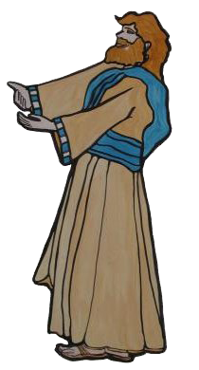

#18 Jehoiakim Card
Kings of Babylon
Nabopolassar
625-604
Nebuchadrezzar II
604-568
did what was evil in the sight of the Lord, according to all that his fathers had done
609 -597
made king by pharaoh Neco
Served Nebuchadnezzar
3 years then rebelled
Jerusalem falls in 597 – Daniel and Ezekiel
Prophets
Jeremiah (J)
Habakkuk (J)
builds his house by unrighteousness, and his upper rooms by injustice
eyes and heart only for your dishonest gain,
for shedding innocent blood,
practicing oppression and violence
burial with a donkey
murdered Uriah the prophet
burned scroll of Jeremiah
JOSIAH
& SONS

Slide 10
Habakkuk’s Questions
Chap 1 – Second Question
¹² Are You not from everlasting,
O Lord my God, my Holy One?
We shall not die.
O Lord, You have appointed them for judgment;
O Rock, You have marked them for correction.
¹³ You are of purer eyes than to behold evil,
And cannot look on wickedness.
Why do You look on those who deal treacherously,
And hold Your tongue when the wicked devours
A person more righteous than he?
¹⁴ Why do You make men like fish of the sea,
Like creeping things that have no ruler over them?
Chap 1 – First Question
² O Lord, how long shall I cry,
And You will not hear?
Even cry out to You, “Violence!”
And You will not save.
³ Why do You show me iniquity,
And cause me to see trouble?
For plundering and violence are before me;
There is strife, and contention arises.

Slide 11
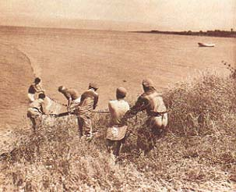
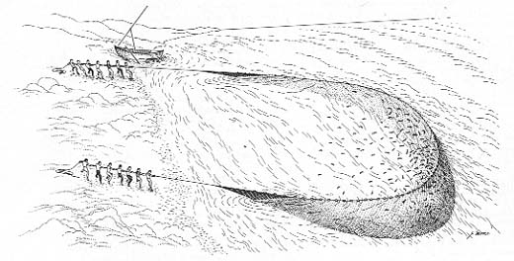
The Prophet’s Second Question
Habakkuk 1:14–17 (NKJV)
¹⁴ Why do You make men like fish of the sea,
Like creeping things that have no ruler over them?
¹⁵ They take up all of them with a hook,
They catch them in their net,
And gather them in their dragnet.
Therefore they rejoice and are glad.
¹⁶ Therefore they sacrifice to their net,
And burn incense to their dragnet;
Because by them their share is sumptuous
And their food plentiful.
¹⁷ Shall they therefore empty their net,
And continue to slay nations without pity?
The dragnet is spread 100 yards or more from shore and parallel to it. It is then hauled toward the shore with towing lines attached to each end by a team of 16 men for large nets, or a smaller team for smaller nets.
Biblical Archaeology Review 19:6, November/December 1993

Slide 12
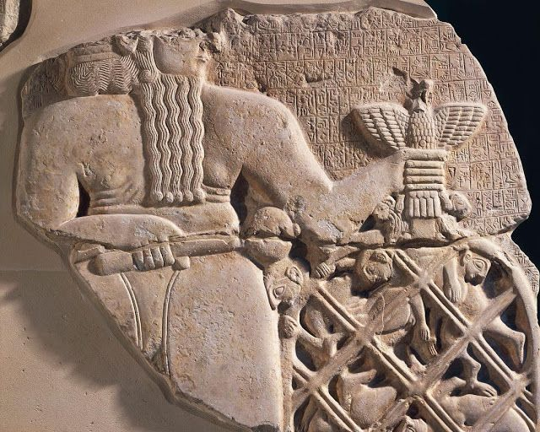
THE NET OF NINGIRSU
¹⁷ Shall they therefore empty their net,
And continue to slay nations without pity?
The Net full of prisoners symbolizes the capture of the enemies of the city. To indicate the impossibility of escape (Jastrow continues), “a prisoner who has thrust his head out of one of the meshes is being beaten back by a weapon in the hands of the god
https://www.gutenberg.org/files/57845/57845-h/57845-h.htm

Slide 13
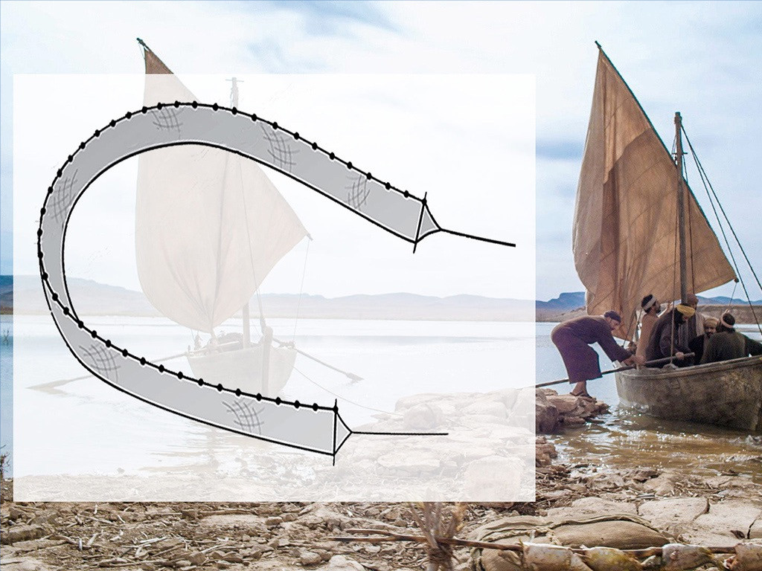

Slide 14
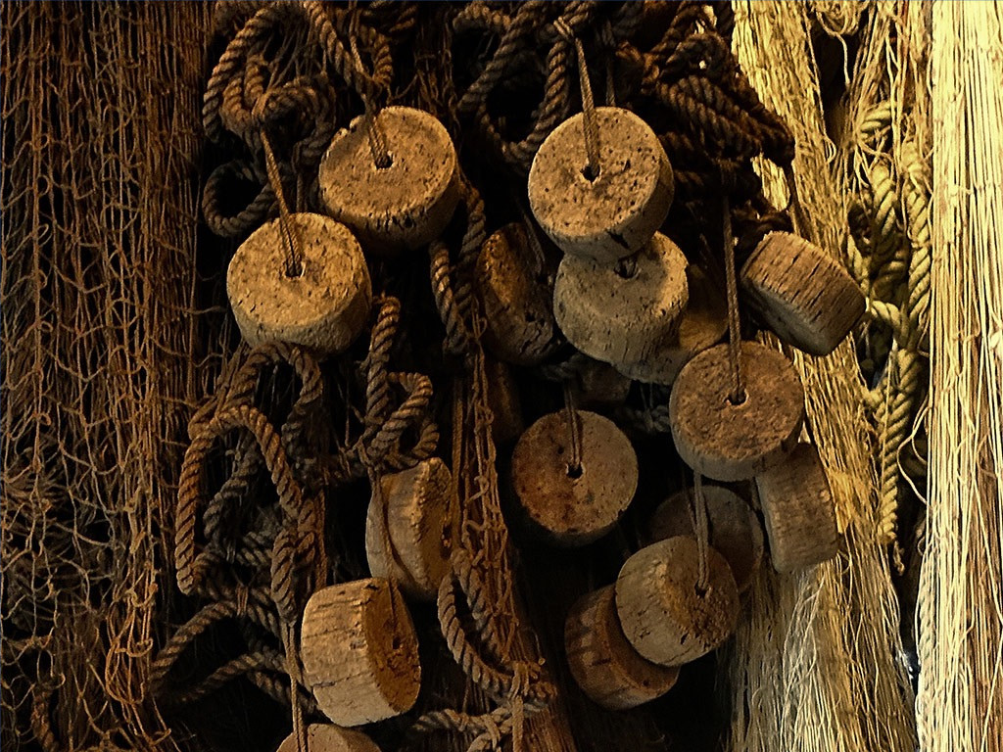

Slide 15
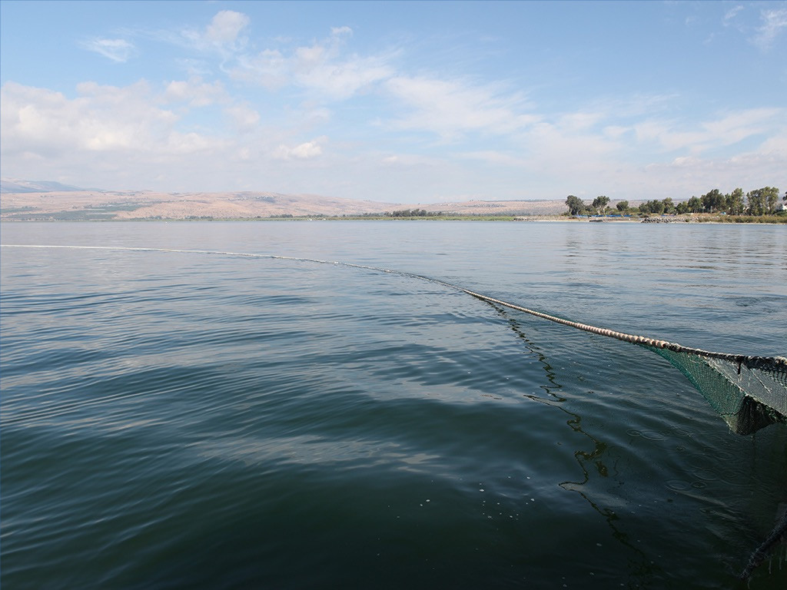

Slide 16
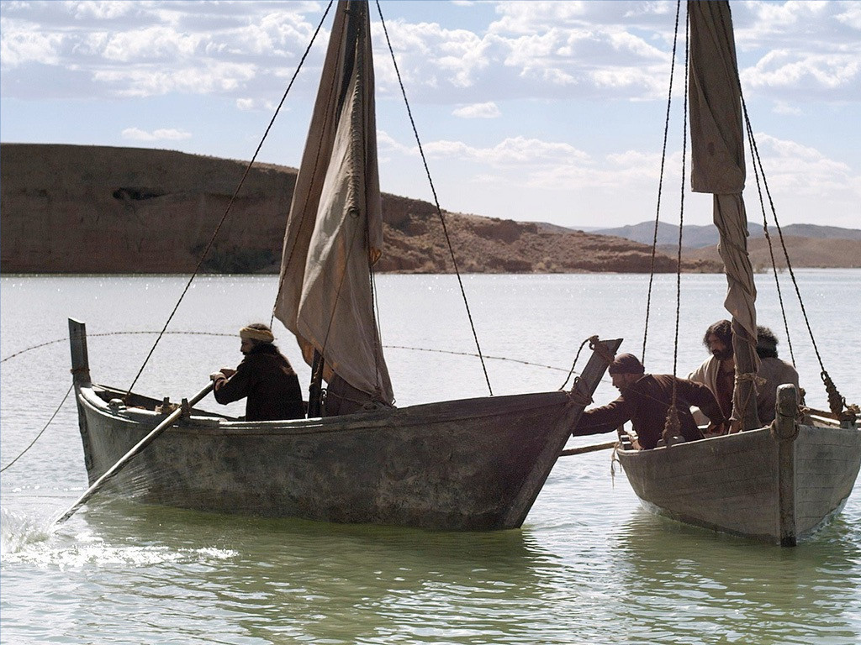

Slide 17
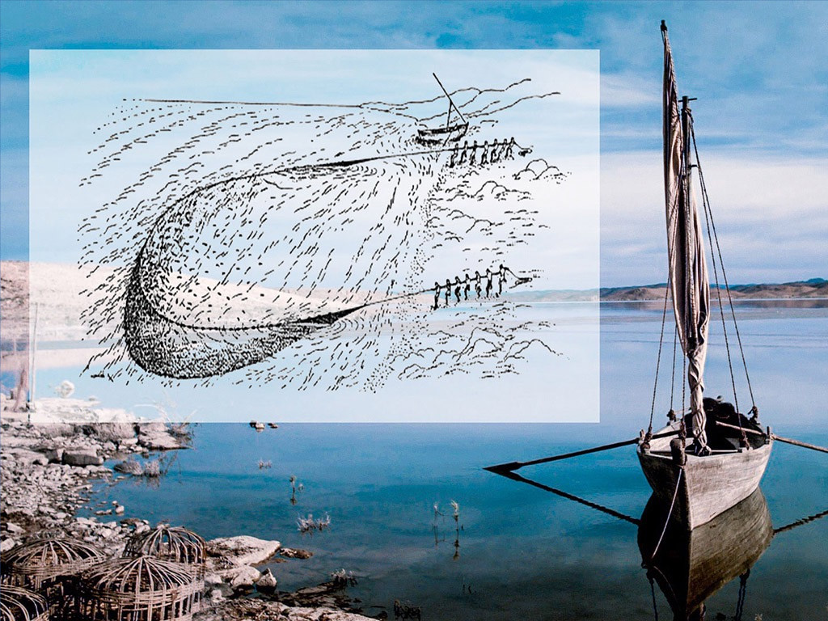

Slide 18
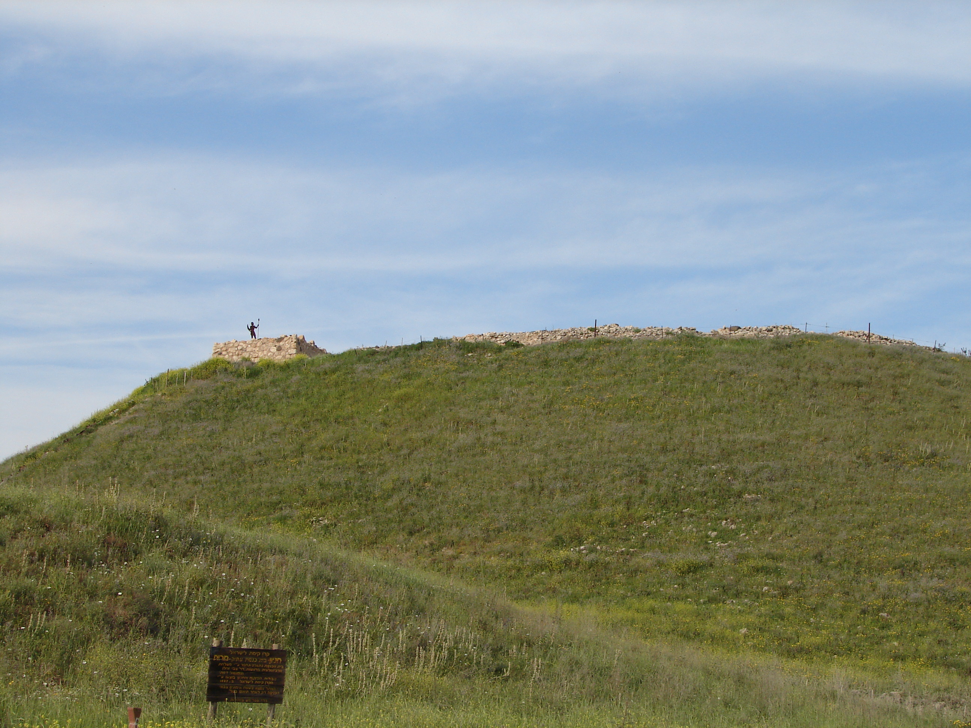
Habakkuk 2:1 (NKJV)
I will stand my watch
And set myself on the rampart,
And watch to see what He will say to me,
And what I will answer when I am corrected.
Walls of Hazor

Slide 19
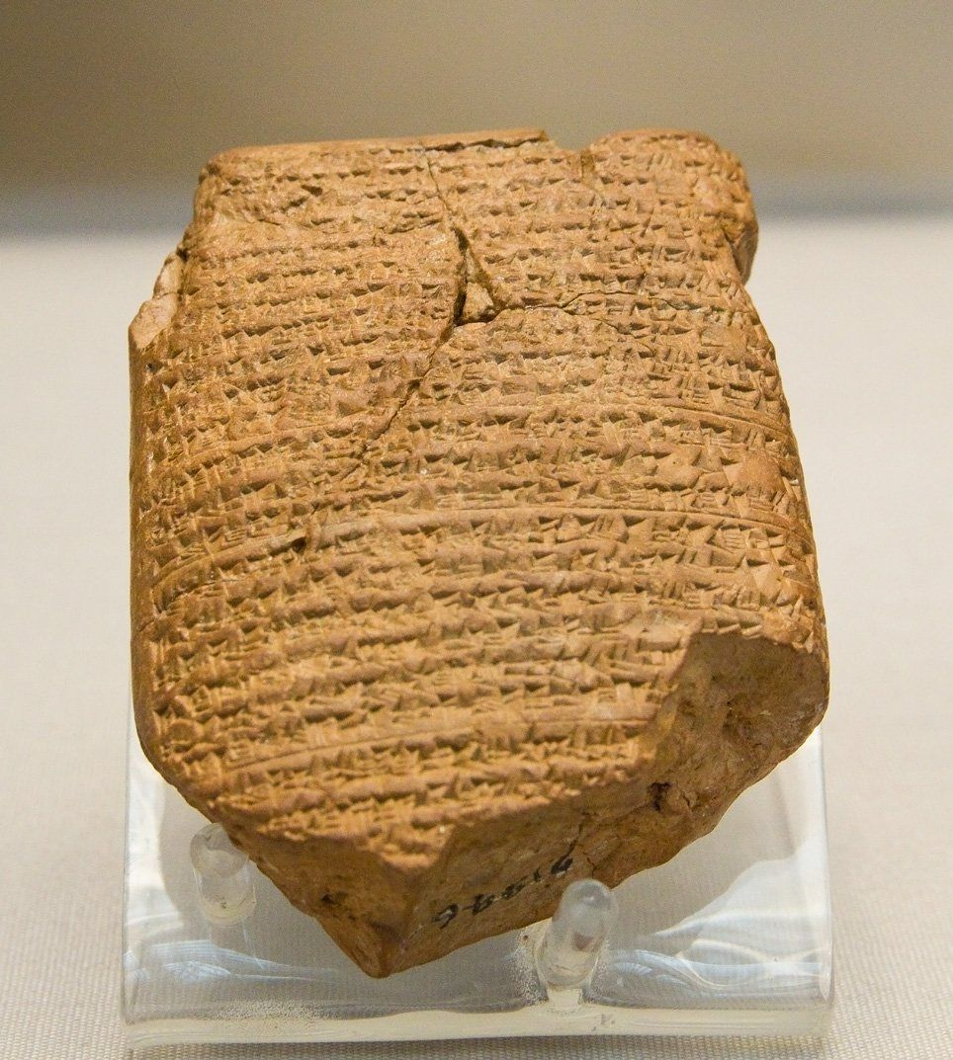
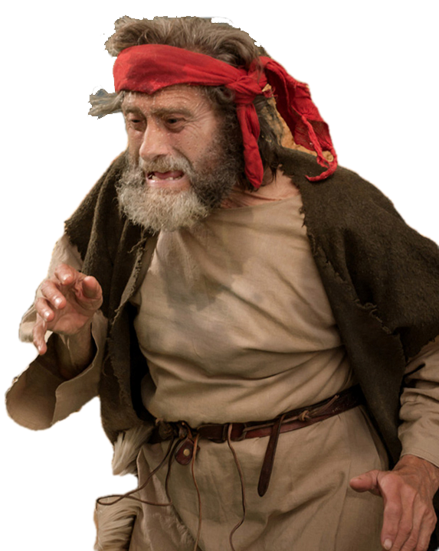
Lord’s 2nd Response
This ancient Babylonian tablet is part of the Babylonian Chronicles
Habakkuk 2:2–4 (NKJV)
The Just Live by Faith
² Then the Lord answered me and said:
“Write the vision
And make it plain on tablets,
That he may run who reads it.
³ For the vision is yet for an appointed time;
But at the end it will speak, and it will not lie.
Though it tarries, wait for it;
Because it will surely come,
It will not tarry.
⁴ “Behold the proud,
His soul is not upright in him;
But the just shall live by his faith.
This may refer to a herald spreading the message throughout the nation, or more generally to anyone fleeing the coming judgment.
Contrast
Notes:
This may refer to a herald spreading the message throughout the nation, or more generally to anyone fleeing the coming judgment.
Crossway Bibles. (2008). (p. 1723). Wheaton, IL: Crossway Bibles.
Crossway Bibles. (2008). The ESV Study Bible (p. 1723). Wheaton, IL: Crossway Bibles.
The choice of medium is apparently due to its durability, necessitated by the possible delay in fulfilment.
Baker, D. W. (1988). (Vol. 27, p. 57). Downers Grove, IL: InterVarsity Press.
Baker, D. W. (1988). Nahum, Habakkuk and Zephaniah: An Introduction and Commentary (Vol. 27, p. 57). Downers Grove, IL: InterVarsity Press.

Slide 20
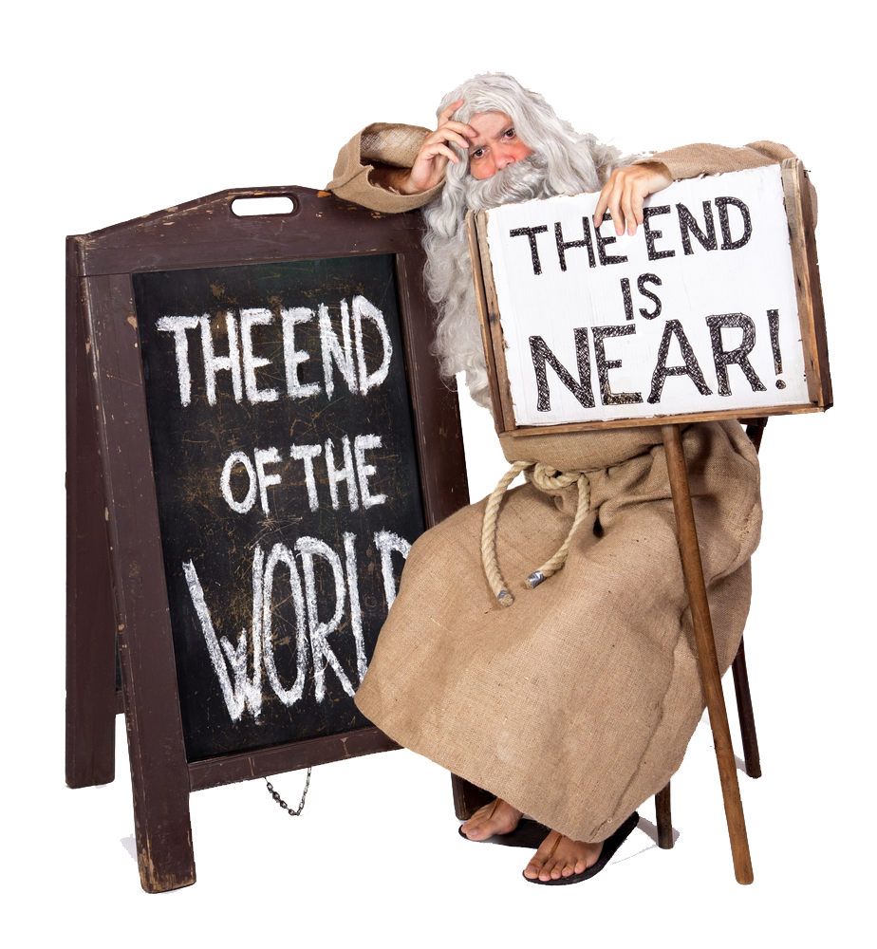
Lord’s 2nd Response
Habakkuk 2:2 (NET1)
² The LORD responded:
“Write down this message! Record it legibly on tablets, so the one who announces it may read it easily.
Habakkuk 2:2–4 (NKJV)
The Just Live by Faith
² Then the Lord answered me and said:
“Write the vision
And make it plain on tablets,
That he may run who reads it.
³ For the vision is yet for an appointed time;
But at the end it will speak, and it will not lie.
Though it tarries, wait for it;
Because it will surely come,
It will not tarry.
⁴ “Behold the proud,
His soul is not upright in him;
But the just shall live by his faith.
Habakkuk 2:2 (NIV)
² Then the LORD replied: "Write down the revelation and make it plain on tablets so that a herald may run with it.
Habakkuk 2:2 (TLB)
² And the Lord said to me, "Write my answer on a billboard, large and clear, so that anyone can read it at a glance and rush to tell the others.
This may refer to a herald spreading the message throughout the nation, or more generally to anyone fleeing the coming judgment.
Notes:
This may refer to a herald spreading the message throughout the nation, or more generally to anyone fleeing the coming judgment.
Crossway Bibles. (2008). (p. 1723). Wheaton, IL: Crossway Bibles.
Crossway Bibles. (2008). The ESV Study Bible (p. 1723). Wheaton, IL: Crossway Bibles.
The choice of medium is apparently due to its durability, necessitated by the possible delay in fulfilment.
Baker, D. W. (1988). (Vol. 27, p. 57). Downers Grove, IL: InterVarsity Press.
Baker, D. W. (1988). Nahum, Habakkuk and Zephaniah: An Introduction and Commentary (Vol. 27, p. 57). Downers Grove, IL: InterVarsity Press.
Habakkuk 2:2 (NIV)
² Then the LORD replied: "Write down the revelation and make it plain on tablets so that a herald may run with it.

Slide 21
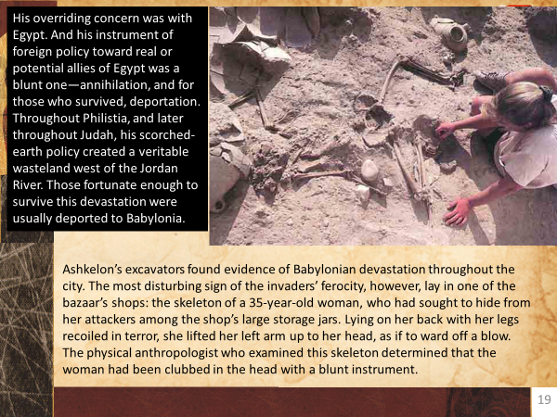
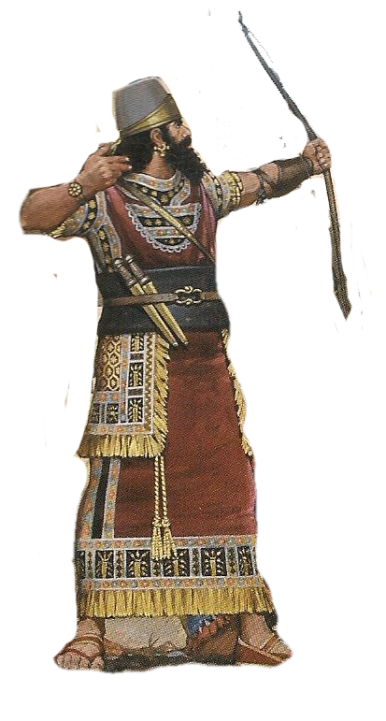
Taunting woes (2:6–20)
The pillager (2:6–8)
Habakkuk 2:6–8 (NKJV)
⁶ “Will not all these take up a proverb against him,
And a taunting riddle against him, and say,
‘Woe to him who increases
What is not his—how long?
And to him who loads himself with many pledges’?
  ⁷ Will not your creditors rise up suddenly?
  Will they not awaken who oppress you?
  And you will become their booty.
⁸ Because you have plundered many nations,
  All the remnant of the people shall plunder you,
Because of men’s blood
  And the violence of the land and the city,
  And of all who dwell in it.
Notes:
Taunting woes (2:6–20)
i. The pillager (2:6–8)
ii. The plotter (2:9–11)
iii. The promoter of violence (2:12–14)
iv. The debaucher (2:15–17)
v. The pagan idolater (2:18–20)

Slide 22
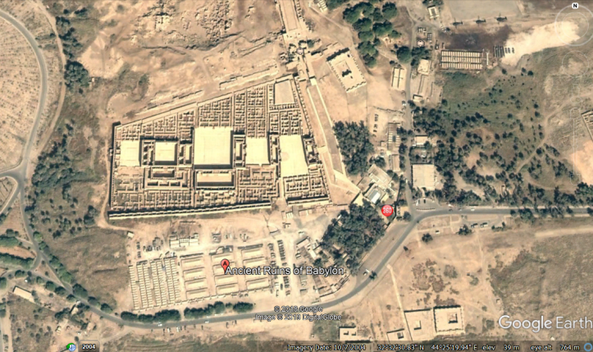
Taunting woes (2:6–20)
House – physical
House dynasty
The plotter (2:9–11)
Habakkuk 2:9–11 (NKJV)
⁹ “Woe to him who covets evil gain for his house,
That he may set his nest on high,
That he may be delivered from the power of disaster!
¹⁰ You give shameful counsel to your house,
Cutting off many peoples,
And sin against your soul.
¹¹ For the stone will cry out from the wall,
And the beam from the timbers will answer it.
King Nebuchadnezzar’s palace at Babylon. The ruins of ancient Babylon are located 60 miles south of modern-day Baghdad, Iraq.
the very building material of the intended ‘house’ will cry out in protest at the injustice
Notes:
Taunting woes (2:6–20)
i. The pillager (2:6–8)
ii. The plotter (2:9–11)
iii. The promoter of violence (2:12–14)
iv. The debaucher (2:15–17)
v. The pagan idolater (2:18–20)
the very building material of the intended ‘house’ (see vv. 9–10), will cry out in protest at the injustice
Baker, D. W. (1988). (Vol. 27, p. 63). Downers Grove, IL: InterVarsity Press.
Baker, D. W. (1988). Nahum, Habakkuk and Zephaniah: An Introduction and Commentary (Vol. 27, p. 63). Downers Grove, IL: InterVarsity Press.

Slide 23
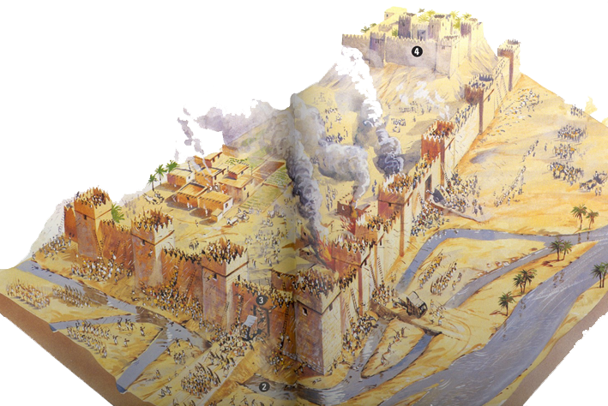
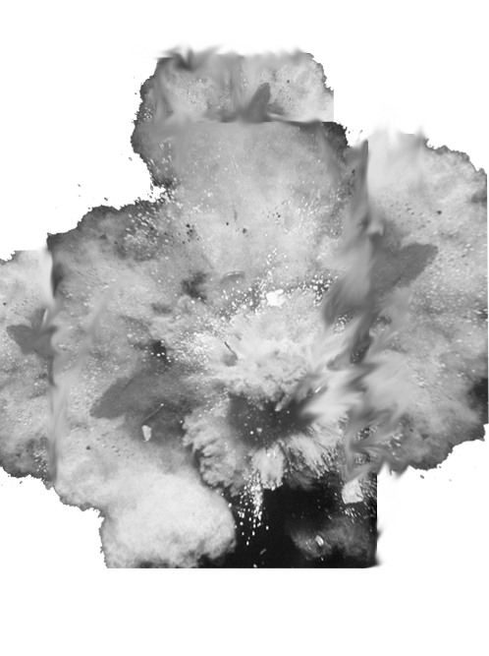
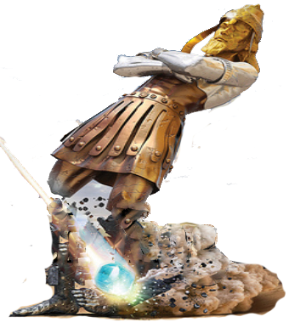
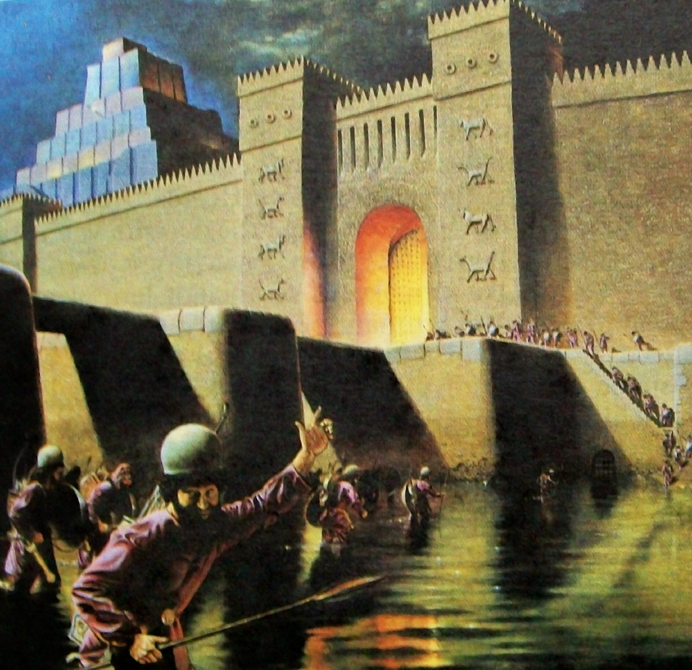
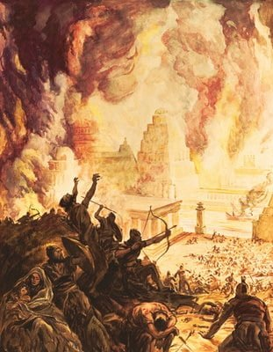
Taunting woes (2:6–20)
The promoter of violence (2:12–14)
Habakkuk 2:12–14 (NKJV)
¹² “Woe to him who builds a town with bloodshed,
Who establishes a city by iniquity!
¹³ Behold, is it not of the Lord of hosts
That the peoples labor to feed the fire,
And nations weary themselves in vain?
¹⁴ For the earth will be filled
With the knowledge of the glory of the Lord,
As the waters cover the sea.
Notes:
Taunting woes (2:6–20)
i. The pillager (2:6–8)
ii. The plotter (2:9–11)
iii. The promoter of violence (2:12–14)
iv. The debaucher (2:15–17)
v. The pagan idolater (2:18–20)
the very building material of the intended ‘house’ (see vv. 9–10), will cry out in protest at the injustice
Baker, D. W. (1988). (Vol. 27, p. 63). Downers Grove, IL: InterVarsity Press.
Baker, D. W. (1988). Nahum, Habakkuk and Zephaniah: An Introduction and Commentary (Vol. 27, p. 63). Downers Grove, IL: InterVarsity Press.

Slide 24

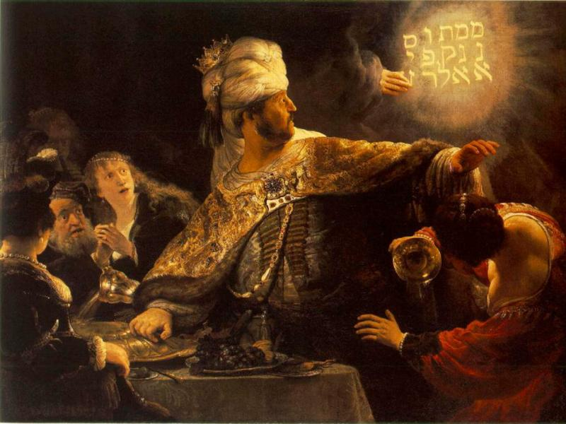
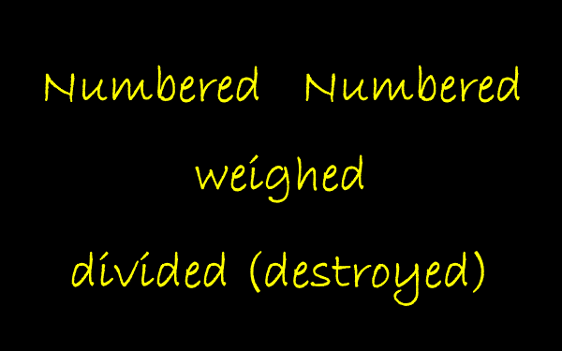
Taunting woes (2:6–20)
The debaucher (2:15–17)
Habakkuk 2:15–17 (NKJV)
¹⁵ “Woe to him who gives drink to his neighbor,
Pressing him to your bottle,
Even to make him drunk,
That you may look on his nakedness!
¹⁶ You are filled with shame instead of glory.
You also—drink!
And be exposed as uncircumcised!
The cup of the Lord’s right hand will be turned against you,
And utter shame will be on your glory.
¹⁷ For the violence done to Lebanon will cover you,
And the plunder of beasts which made them afraid,
Because of men’s blood
And the violence of the land and the city,
And of all who dwell in it.
Notes:
Taunting woes (2:6–20)
i. The pillager (2:6–8)
ii. The plotter (2:9–11)
iii. The promoter of violence (2:12–14)
iv. The debaucher (2:15–17)
v. The pagan idolater (2:18–20)

Slide 25
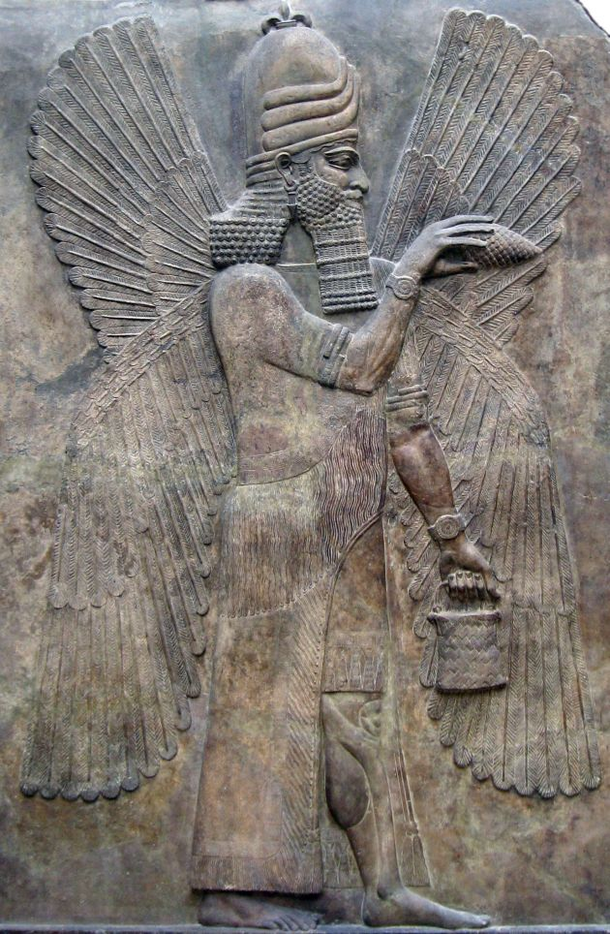
Taunting woes (2:6–20)
The pagan idolater (2:18–20)
Habakkuk 2:18–20 (NKJV)
¹⁸ “What profit is the image, that its maker should carve it,
The molded image, a teacher of lies,
That the maker of its mold should trust in it,
To make mute idols?
¹⁹ Woe to him who says to wood, ‘Awake!’
To silent stone, ‘Arise! It shall teach!’
Behold, it is overlaid with gold and silver,
Yet in it there is no breath at all.
²⁰ “But the Lord is in His holy temple.
Let all the earth keep silence before Him.”
Marduk – Babylonian god
Notes:
Taunting woes (2:6–20)
i. The pillager (2:6–8)
ii. The plotter (2:9–11)
iii. The promoter of violence (2:12–14)
iv. The debaucher (2:15–17)
v. The pagan idolater (2:18–20)

Slide 26
The Prophet’s Prayer
Habakkuk 2:2–4 (NKJV)
The Just Live by Faith
² Then the Lord answered me and said:
“Write the vision
And make it plain on tablets,
That he may run who reads it.
³ For the vision is yet for an appointed time;
But at the end it will speak, and it will not lie.
Though it tarries, wait for it;
Because it will surely come,
It will not tarry.
⁴ “Behold the proud,
His soul is not upright in him;
But the just shall live by his faith.
Habakkuk 3:1–2 (NKJV)
3 A prayer of Habakkuk the prophet,
on Shigionoth.
² O Lord, I have heard Your speech and was afraid;
O Lord, revive Your work in the midst of the years!
In the midst of the years make it known;
In wrath remember mercy.
Shigionoth occurs only twice in the OT (once in the singular and once in the plural) and may refer to an instrument or a type of psalm. The other usage of the word (Ps. 7:1) favors a type of psalm, and it may be related to Akkadian shigu, “a lament.”
Notes:
Shigionoth occurs only twice in the OT (once in the singular and once in the plural) and may refer to an instrument or a type of psalm. The other usage of the word (Ps. 7:1) favors a type of psalm, and it may be related to Akkadian shigu, “a lament.”
Crossway Bibles. (2008). (pp. 17251726). Wheaton, IL: Crossway Bibles.
Crossway Bibles. (2008). The ESV Study Bible (pp. 1725–1726). Wheaton, IL: Crossway Bibles.

Slide 27
Habakkuk 3:1 (YLT)
¹ A prayer of Habakkuk the prophet concerning erring ones:
Psalm 7 NKJV
Prayer and Praise for Deliverance from Enemies
A Meditation Of David, Which He Sang to the Lord Concerning the Words of Cush, a Benjamite.
¹ O Lord my God, in You I put my trust; Save me from all those who persecute me;
And deliver me,
² Lest they tear me like a lion,
Rending me in pieces, while there is none to deliver.
Habakkuk 3:1 (ASV)
¹ A prayer of Habakkuk the prophet, set to Shigionoth.
Shigionoth
Habakkuk 3:1 (NET1)
¹ This is a prayer of Habakkuk the prophet:
Need for Refuge when sought by Saul
Fleeing from Absalom 2 Sam 16
2 Samuel 16:5–6 (ESV)
Shimei Curses David
⁵ When King David came to Bahurim, there came out a man of the family of the house of Saul, whose name was Shimei, the son of Gera,
and as he came he cursed continually. ⁶ And he threw stones at David and at all the servants of King David, and all the people and all the mighty men were on his right hand and on his left.
Habakkuk 3:1 (TLB)
¹ This is the prayer of triumph that Habakkuk sang before the Lord:
Habakkuk 3:1 (NIV)
¹ A prayer of Habakkuk the prophet. On shigionoth.

Slide 28
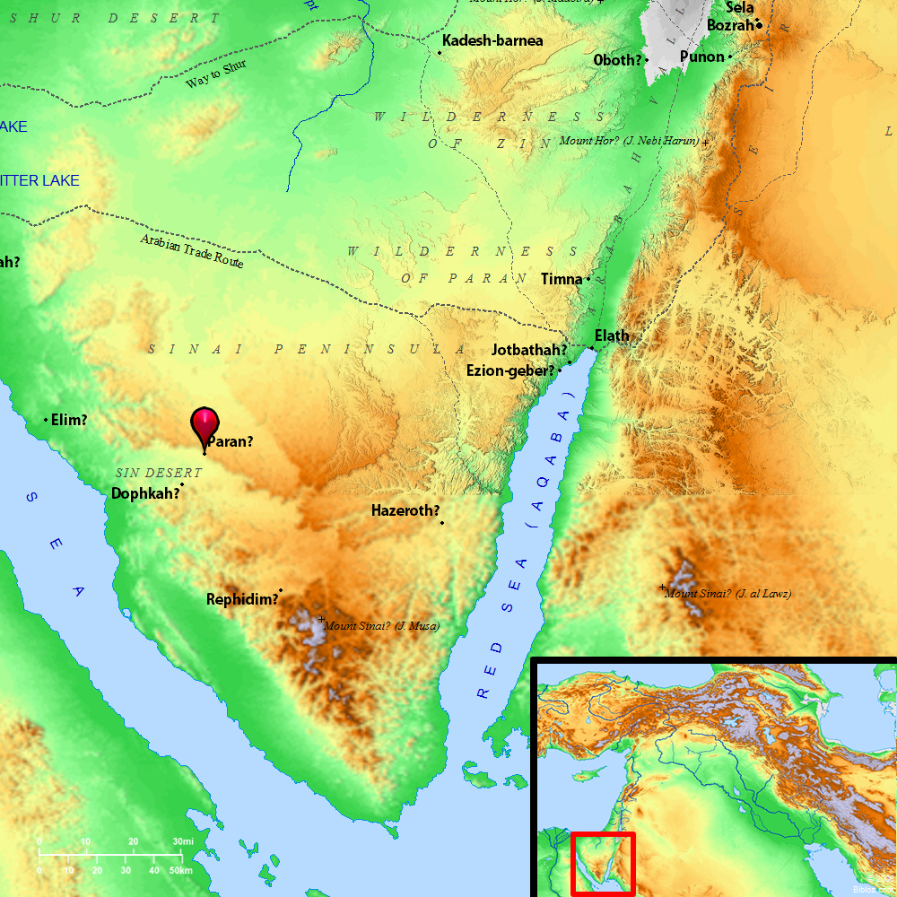
The Prophet’s Prayer
Habakkuk 3:1–2 (NKJV)
3 A prayer of Habakkuk the prophet, on Shigionoth.
² O Lord, I have heard Your speech and was afraid;
O Lord, revive Your work in the midst of the years!
In the midst of the years make it known;
In wrath remember mercy.
Psalm 7(NKJV)
¹ O Lord my God, in You I put my trust;
Save me from all those who persecute me;
And deliver me,
Habakkuk 3:3–5 (NKJV)
³ God came from Teman,
The Holy One from Mount Paran. Selah
His glory covered the heavens,
And the earth was full of His praise.
⁴ His brightness was like the light;
He had rays flashing from His hand,
And there His power was hidden.
⁵ Before Him went pestilence,
And fever followed at His feet.
Teman - South, a city and region in Eastern Idumaea, settled by Teman the grandson of Esau,
Sinai Peninsula
also came David when bereaved of Samuel's protection (1 Samuel 25:1).

Slide 29
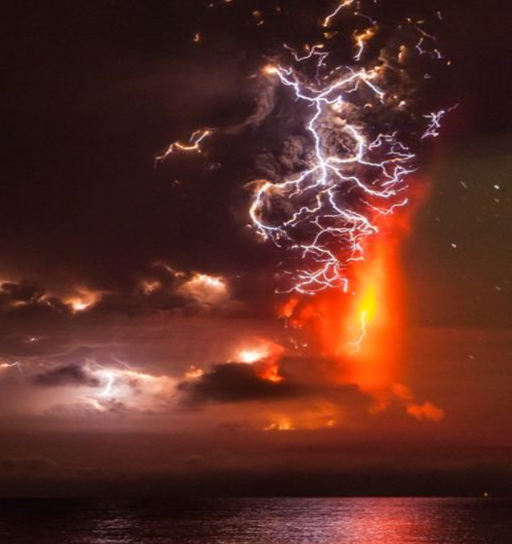
The Prophet’s Prayer
Habakkuk 3:1–2 (NKJV)
3 A prayer of Habakkuk the prophet, on Shigionoth.
² O Lord, I have heard Your speech and was afraid;
O Lord, revive Your work in the midst of the years!
In the midst of the years make it known;
In wrath remember mercy.
Habakkuk 3:3–5 (NKJV)
³ God came from Teman,
The Holy One from Mount Paran. Selah
His glory covered the heavens,
And the earth was full of His praise.
⁴ His brightness was like the light;
He had rays flashing from His hand,
And there His power was hidden.
⁵ Before Him went pestilence,
And fever followed at His feet.
Jeremiah 24:10 (NKJV)
¹⁰ And I will send the sword, the famine, and the pestilence among them, till they are consumed from the land that I gave to them and their fathers.’ ”

Slide 30


Jeremiah 24:10 (NKJV)
¹⁰ And I will send the sword, the famine, and the pestilence among them, till they are consumed from the land that I gave to them and their fathers.’ ”
Chapters
22:1-23
25-26
35-36
45-49:33
Chapters
14-17
21
22:24-30
23-24
27-34
37
49:34-51:64
Chapters
40-44
52
Chapters 1-13, 18-20

Slide 31
The Prophet’s Prayer
Joshua 2:9–11 (ESV) Rahab’s explains why
⁹ and said to the men, “I know that the Lord has given you the land, and that the fear of you has fallen upon us, and that all the inhabitants of the land melt away before you. ¹⁰ For we have heard how the Lord dried up the water of the Red Sea before you when you came out of Egypt, and what you did to the two kings of the Amorites who were beyond the Jordan, to Sihon and Og, whom you devoted to destruction. ¹¹ And as soon as we heard it, our hearts melted, and there was no spirit left in any man because of you, for the Lord your God, he is God in the heavens above and on the earth beneath.
Habakkuk 3:6–9 (NKJV)
⁶ He stood and measured the earth;
He looked and startled the nations.
And the everlasting mountains were scattered,
The perpetual hills bowed.
His ways are everlasting.
⁷ I saw the tents of Cushan in affliction;
The curtains of the land of Midian trembled.
⁸ O Lord, were You displeased with the rivers,
Was Your anger against the rivers,
Was Your wrath against the sea,
That You rode on Your horses,
Your chariots of salvation?
⁹ Your bow was made quite ready;
Oaths were sworn over Your arrows. Selah
You divided the earth with rivers.

Slide 32
The Prophet’s Prayer
God used his power over the Nile (Ex. 7:14–24) and Jordan Rivers (Josh. 3:14–17), as well as the Red Sea (Ex. 14:2–15:5), to demonstrate his greatness in the exodus. The chariot of salvation is a picture of God bringing deliverance to this people.
Habakkuk 3:6–9 (NKJV)
⁶ He stood and measured the earth;
He looked and startled the nations.
And the everlasting mountains were scattered,
The perpetual hills bowed.
His ways are everlasting.
⁷ I saw the tents of Cushan in affliction;
The curtains of the land of Midian trembled.
⁸ O Lord, were You displeased with the rivers,
Was Your anger against the rivers,
Was Your wrath against the sea,
That You rode on Your horses,
Your chariots of salvation?
⁹ Your bow was made quite ready;
Oaths were sworn over Your arrows. Selah
You divided the earth with rivers.
2 Kings 6:14–18 (NKJV)
¹⁴ Therefore he sent horses and chariots and a great army there, and they came by night and surrounded the city. ¹⁵ And when the servant of the man of God arose early and went out, there was an army, surrounding the city with horses and chariots. And his servant said to him, “Alas, my master! What shall we do?”
¹⁶ So he answered, “Do not fear, for those who are with us are more than those who are with them.” ¹⁷ And Elisha prayed, and said, “Lord, I pray, open his eyes that he may see.” Then the Lord opened the eyes of the young man, and he saw. And behold, the mountain was full of horses and chariots of fire all around Elisha. ¹⁸ So when the Syrians came down to him, Elisha prayed to the Lord, and said, “Strike this people, I pray, with blindness.” And He struck them with blindness according to the word of Elisha.

Slide 33
The Prophet’s Prayer
Habakkuk 3:10–15 (NKJV)
¹⁰ The mountains saw You and trembled;
The overflowing of the water passed by.
The deep uttered its voice,
And lifted its hands on high.
¹¹ The sun and moon stood still in their habitation;
At the light of Your arrows they went,
At the shining of Your glittering spear.
¹² You marched through the land in indignation;
You trampled the nations in anger.
¹³ You went forth for the salvation of Your people,
For salvation with Your Anointed.
You struck the head from the house of the wicked,
By laying bare from foundation to neck. Selah
¹⁴ You thrust through with his own arrows
The head of his villages.
They came out like a whirlwind to scatter me;
Their rejoicing was like feasting on the poor in secret.
¹⁵ You walked through the sea with Your horses,
Through the heap of great waters.

Slide 34
The Prophet’s Prayer
Habakkuk 3:16 (NKJV)
¹⁶ When I heard,
my body trembled;
My lips quivered at the voice;
Rottenness entered my bones;
And I trembled in myself,
That I might rest in the day of trouble.
When he comes up to the people,
He will invade them with his troops.
Habakkuk 2:2–4 (NKJV)
The Just Live by Faith
² Then the Lord answered me and said:
“Write the vision
And make it plain on tablets,
That he may run who reads it.
³ For the vision is yet for an appointed time;
But at the end it will speak, and it will not lie.
Though it tarries, wait for it;
Because it will surely come,
It will not tarry.
⁴ “Behold the proud,
His soul is not upright in him;
But the just shall live by his faith.

Slide 35
The Prophet’s Prayer
Habakkuk 3:17–19 (NKJV)
A Hymn of Faith
¹⁷ Though the fig tree may not blossom,
Nor fruit be on the vines;
Though the labor of the olive may fail,
And the fields yield no food;
Though the flock may be cut off from the fold,
And there be no herd in the stalls—
¹⁸ Yet I will rejoice in the Lord,
I will joy in the God of my salvation.
¹⁹ The Lord God is my strength;
He will make my feet like deer’s feet,
And He will make me walk on my high hills.
To the Chief Musician. With my stringed instruments.

Slide 36
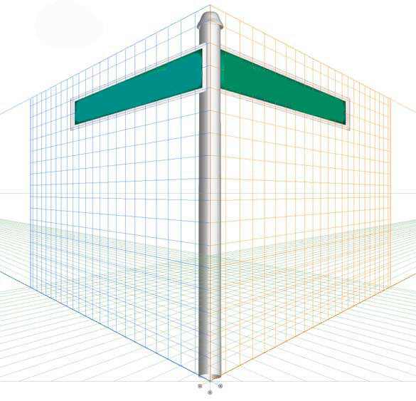
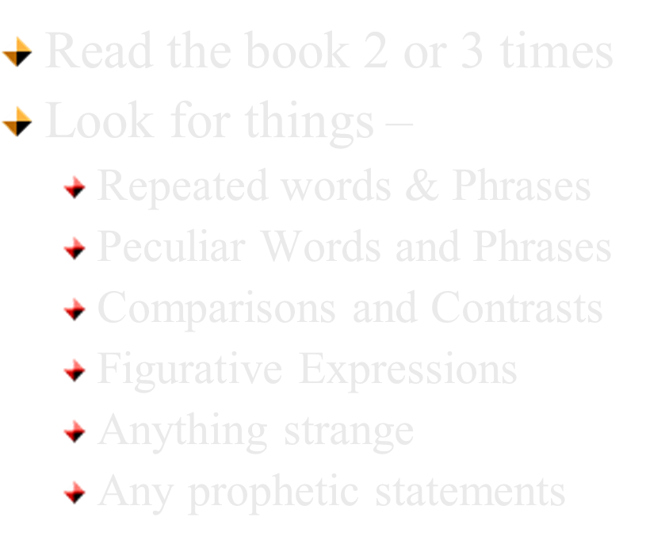
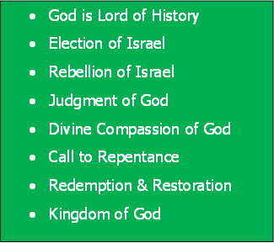
Bible Study Skills
Prophetic Paradigm
By Chapter

Slide 37

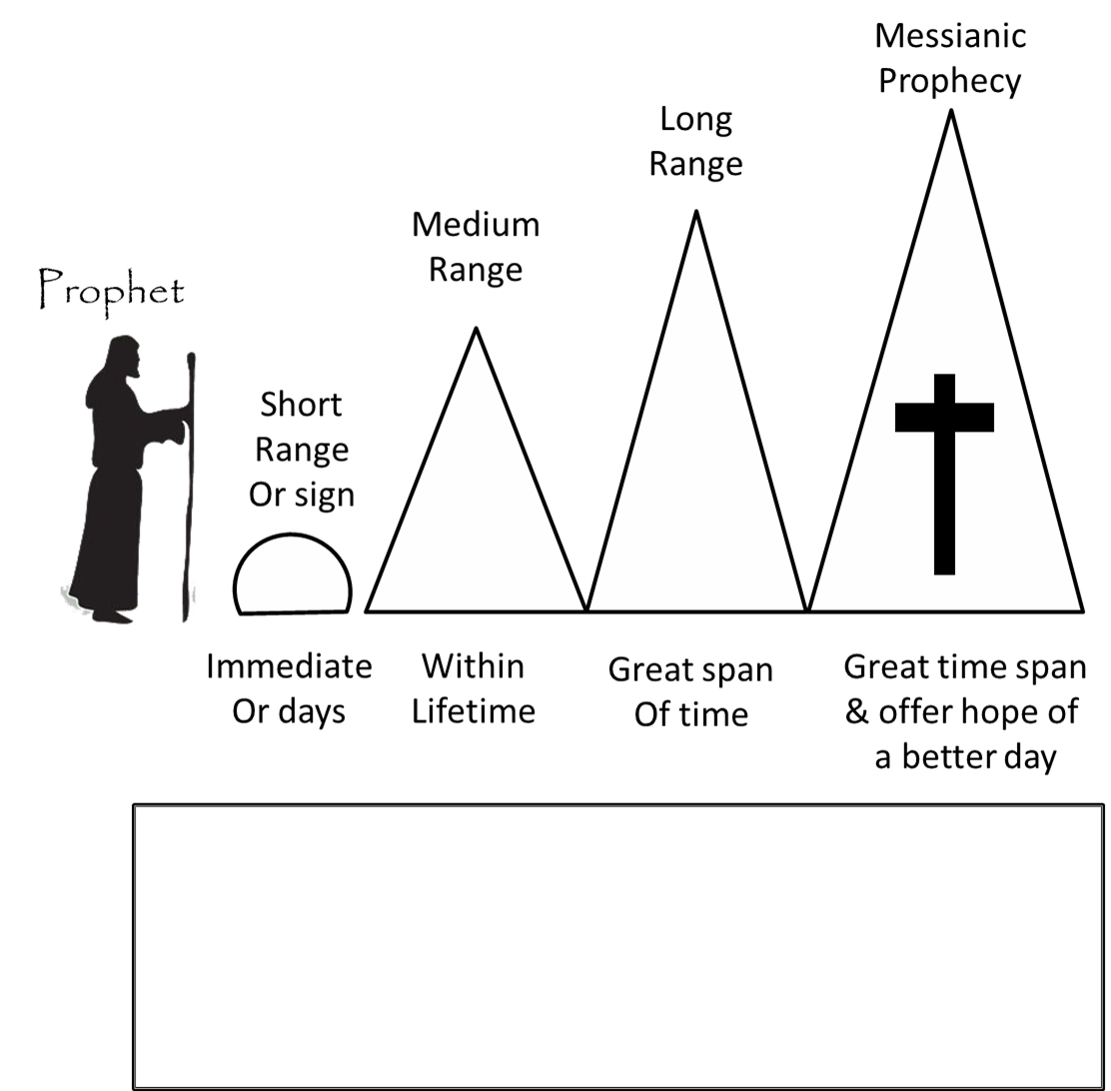
Habakkuk's Prophecies
What is the prophecy range?
612 BC
To 605 BC

