Slide 2
Class Schedule
Lesson | Date | Title | Text | Teacher
1 | S 10/27 | Founding of the Church in Thessalonica | Acts 17:1-15 | Grant
2 | W 10/30 | Introduction & Literary Features | 1 OR 2 Thessalonians | Grant
3 | S 11/3 | Thanksgiving / Progress of the Church | 1 Thessalonians 1:1-10 | Grant
4 | W 11/6 | Paul's Ministry in Thessalonica | 1 Thessalonians 2:1-16 | Grant
5 | S 11/10 | Re-Establishing Contact | 1 Thessalonians 2:17-3:13 | Phillip
6 | W 11/13 | Exhortation / Holy Conduct | 1 Thessalonians 4:1-12 | Phillip
7 | S 11/17 | The Coming of the Lord Jesus | 1 Thessalonians 4:13-5:11 | Grant
8 | W 11/20 | Communal Relations | 1 Thessalonians 5:12-28 | Phillip

Slide 3
Class Schedule
Lesson | Date | Title | Text | Teacher
9 | S 11/24 | Vindication of the Faithful | 2 Thessalonians 1:1-12 | Phillip
10 | S 12/1 | The Man of Lawlessness & Day of the Lord | 2 Thessalonians 2:1-12 | Phillip
11 | W 12/4 | Encouragement to Faithfulness | 2 Thessalonians 2:13-3:5 | Phillip
12 | S 12/7 | Congregational Admonitions | 2 Thessalonians 3:6-17 | Phillip
13 | W 12/10 | Review |  | Phillip

Slide 4
GOALS
Understanding of the Thessalonian church and way(s) that the letter addresses their situation
Appreciation for the ‘pastoral’ function of Paul’s apostolic ministry and writings
Highlight the use of ‘election’ and ‘holiness’ language for exhortation of the church
Discernment of the way the second coming of Christ impacts Christian faith and behavior

Slide 5
Lesson 1: Founding of the Church in Thessalonica

Slide 6
Lesson 1 Overview
Paul’s call to go to Macedonia (Acts 16:6-12)
Social and Religious Culture of Thessalonica
Early Converts among Jews and Gentiles (Acts 17:1-4)
Controversy and Departure (Acts 17:5-10)
The work of an Apostle in both presence and absence

Slide 7
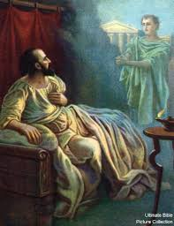
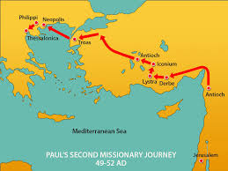
Paul’s call to go to Macedonia
Read Acts 16:6-12

Slide 8
Social & Religious Culture
Founded in 315BC by Cassander, king of Macedon (w/in Greek Empire)
After Roman takeover, became the capital city of the province of Macedonia
Major metropolitan area important for regional commerce
Population of up to 80,000
Near the Thermian Gulf and on the Via Egnatia

Slide 9
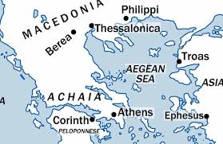
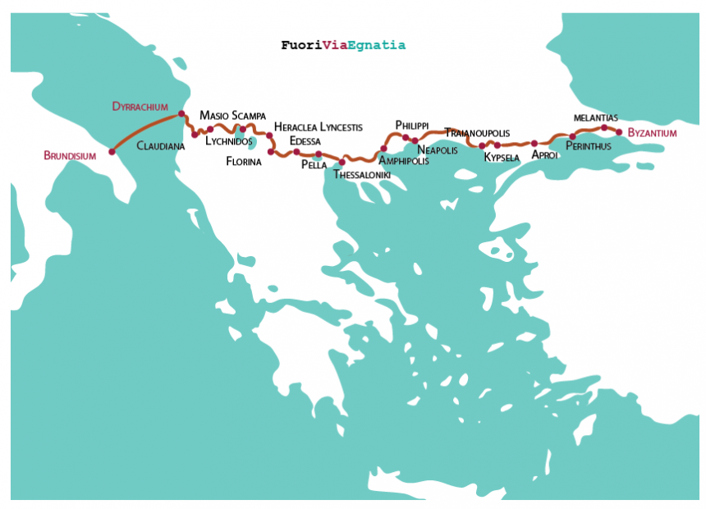
Social & Religious Culture

Slide 10
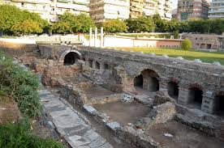
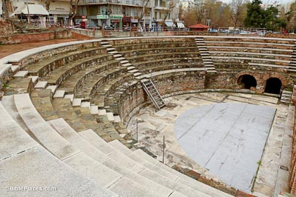
Social & Religious Culture
Thessalonica was a ‘free city’ of the Empire, allowed self-governance
‘demos’ – city council?
‘politarchs’ – city officials

Slide 11
Social & Religious Culture
A thoroughly pagan city, with known temples to several of the classic Greco-Roman gods/goddesses
Some evidence of religious devotion to other deities, including participation in the Imperial Cult, which honored the Roman Emperor as divine
As with most other major Mediterranean cities, a Jewish presence enough for a synagogue.

Slide 12
Early Converts
Read Acts 17:1-4
Paul, Silas, & Timothy come from Phillip to Thessalonica
A preaching stay of at least 3 weeks in the synagogue.
Paul’s initial preaching is geared toward a Jewish audience in reasoning from the Scriptures that Jesus was the Messiah

Slide 13
Early Converts
3 ‘groups’ of early believers:
“And some of [the Jews] were persuaded and joined Paul and Silas, as did a great many of the devout Greeks and not a few of the leading women.” – Acts 17:4
Q: Explain why Paul’s ‘custom’ is to initially preach in the synagogue. What is significant about the make-up of this church in light of that practice?

Slide 14
Early Converts
“and how you turned to God from idols to serve the living and true God” – 1 Thessalonians 1:9
“We want you to know, brothers,[a] about the grace of God that has been given among the churches of Macedonia, 2 for in a severe test of affliction, their abundance of joy and their extreme poverty have overflowed in a wealth of generosity on their part.” – 2 Corinthians 8:2

Slide 15
Early Converts
Both the Acts account and statements from the letters suggest a largely Greek/Gentile church
These were known as ‘devout,’ likely meaning they were ‘God-fearers’ of YHWH through their association with the synagogue (cf Acts 10:1-2)
A sizeable contingent of socially-prominent women, some of whom may have been primary financial supporters of the church
At least one known member, Jason, in whose house the church may have met.

Slide 16
Early Converts
The Thessalonian letters have much to say about Paul’s initial work to found and establish the church:
Preaching w/ ‘power’ & ‘Holy Spirit’ – 1:1:5
Working while preaching – 1:2:9; 2:3:8
Amid opposition: 1:2:2
Appointing some form of leaders – 1:5:12

Slide 17
Early Converts
“…we also constantly thank God that when you received the word of God which you heard from us, you accepted it not as the word of men, but for what it really is – the word of God – which also performs its work in you who believe.” – 1 Thessalonians 2:13

Slide 18
Early Converts
Also, a variety of statements on the teachings or traditions they had received from Paul
God as Father, Jesus as Messiah/Lord, HS as active
The integrity of Pauls’ character
Sexual ethics
The Day of the Lord
Social discipline and work ethic
Communal unity and sanctification

Slide 19
Controversy & Departure
Read Acts 17:5-10
One reason why the Thessalonian church may be heavily populated by Gentiles was because of the eventual Jewish response against Paul
The Jews have to rely on the Gentile populace – both a mob and the official leaders – to have their complaints heard.
Not finding Paul & Silas, they drag Jason before the leaders

Slide 20
Controversy & Departure
The formal accusations they make are significant:
“These men who have turned the world upside down have come here also, ⁷ and Jason has received them, and they are all acting against the decrees of Caesar, saying that there is another king, Jesus.” – Acts 17: 6-7
This suggests that Paul’s gospel of Christ as Lord was heard as a social/political challenge!

Slide 21
Controversy & Departure
The outcome is that Jason makes some kind of ‘pledge’ to have himself and other released. This probably suggests some kind of punitive monetary fine
Luke indicates that Paul’s departure from Thessalonica is the act of the church itself, as a measure of protection.

Slide 22
Apostleship in Presence & Absence
“Read in one way, Paul’s letters, including 1 Thessalonians, give the impression of scholastic communities meeting to discuss ethical and theological subjects. Although such an interpretation may be one-sided, the philosopher who gathers listeners around himself as he works at his craft was indeed a well-known ideal in antiquity, and 1 Thessalonians suggests that Paul operated in a similar manner in Thessalonica” – A. Malherbe

Slide 23
Apostleship in Presence & Absence
“Having so fond an affection for you, we were well-pleased to impart to you not only the gospel of God but also our own lives, because you had become very dear to us.” – 1 Thessalonians 2:8

Slide 24
Apostleship in Presence & Absence
“For you yourselves know how you ought to follow our example, because we did not act in an undisciplined manner among you…but with labor and hardship we kept working night and day so that we would not be a burden to any of you; not because we do not have the right to this, but in order to offer ourselves as a model for you, so that you would follow our example.” – 2 Thessalonians 3:7-9

Slide 25
Apostleship in Presence & Absence
Q: Combined, Acts and Thessalonians paint a picture of a struggling but devoted teacher who is driven away from his followers because he became a reputational risk within the society. In what ways would you expect that to affect the relationship between Paul and the church in his absence?

Slide 26
END OF LESSON 1

Slide 27
Lesson 2: Introduction and Literary Features to the Thessalonian Epistles

Slide 28
What do you know about the Thessalonian Epistles?

Slide 29
Lesson 2 Overview
Authorship, Occasion & Date
Purpose / Function
Style & Language
3 Models for Reading the Letters

Slide 30
Authorship, Date & Occasion
Authorship
Both letters are addressed from Paul, Silas & Timothy
Letters are dominated by ‘we’/‘us’ pronouns/verbs
97% of all personal pronouns and 1st person verbs are plural
Paul’s ‘signature’ in 2 Thessalonians

Slide 31
Authorship, Occasion & Date
Occasion – 1 Thessalonians
Paul refers to the separation from the Thessalonians as ‘a short time’ (1 Thessalonians 2:17)
Yet Paul’s urgency to follow up with them led him to send Timothy back to see them. Timothy’s return with a positive report is the immediate motivation to send 1 Thessalonians (3:1-6)
Acts 17:14 + 18:5 suggests Timothy came back with Silas

Slide 32
Authorship, Occasion & Date
Occasion – 1 Thessalonians
Piecing together Acts & Thessalonians would lead to this rough chronology of events:

Slide 33
Authorship, Occasion & Date
S
B
P
T
Thessalonica to Berea (all) (Acts 17:10-13) – 1 week

Slide 34
Authorship, Occasion & Date
S
B
T
P
Berea to Athens (Paul & Bereans) (Acts 17:14-15) – 3 weeks

Slide 35
Authorship, Occasion & Date
S
T
P
B
Athens to Berea (Bereans) (Acts 17:1) – 3 weeks

Slide 36
Authorship, Occasion & Date
S
B
T
P
Berea to Athens to Thessalonica (Timothy) (1 Th. 3:1-3) – 6 weeks

Slide 37
Authorship, Occasion & Date
B
P
T
S
Berea to Athens to Thessalonica (Timothy) (1 Th. 3:1-3) – 6 weeks

Slide 38
Authorship, Occasion & Date
B
T
P
S
Thessalonica/Athens to Corinth (all) (1 Th. 3:6-8, Acts 18:5) – 4 weeks

Slide 39
Authorship, Occasion & Date
Occasion – 1 Thessalonians
Piecing together Acts & Thessalonians would lead to this rough chronology of events:
Allowing for some time for Timothy to remain in Thessalonica, the entire timeline from departure from Thessalonica to the sending of the letter is no more than 6 months.

Slide 40
Authorship, Occasion & Date
Occasion – 1 Thessalonians
The mood of the letter supports this timeline.
Positive reputation in Macedonia & Achaia
Intensity of Paul’s fondness and absence from them
Reminders of what they were taught and know
Date – 1 Thessalonians
If the timeline is accurate, then Paul is writing from Corinth, during his 2nd MJ, in 50-51 AD
It is possible that this is the earliest known Christian writing!

Slide 41
Authorship, Occasion & Date
The Occasion for writing 2 Thessalonians is less clear.
The only firm indication is that Paul had learned of an erroneous teaching about the Coming of Jesus which he needed to counter
Both 1 & 2 Thessalonians contain deliberate teaching on the 2nd Coming of Christ. Both letters are written (in part) to clarify different (but specific) misunderstandings about these future events.
Date – 2 Thessalonians
Probably less than a year after 1 Thessalonians (51-2 AD)

Slide 42
Purpose / Function
1 Thessalonians is a ‘pastoral’ epistle.
Paul writes to ‘re-connect’ with a faithful church to provide them with spiritual encouragement and guidance (both moral and theological).
The function of these types of ‘paraenetic’ epistles in the Roman world was for the letter to stand in as the ‘presence’ the writer
Even in his absence, Paul’s presentation of himself in the letter as an apostolic ‘pastor’ or ‘shepherd’ of the church.

Slide 43
Style & Language
Paul’s ‘pastoral presence’ is manifested in various aspects of his language in the letter:
Recounting their positive history and relationship
“…we also constantly thank God that when you received the word of God which you heard from us, you accepted it not as the word of men, but for what it really is – the word of God – which also performs its work in you who believe.” – 1 Thessalonians 2:13

Slide 44
Style & Language
Paul’s ‘pastoral presence’ is manifested in various aspects of his language in the letter:
Recounting their positive history
Parental

Slide 45
Style & Language
Paul’s ‘pastoral presence’ is manifested in various aspects of his language in the letter:
Offering himself as an example for their behavior
“For you yourselves know how you ought to follow our example, because we did not act in an undisciplined manner among you…but with labor and hardship we kept working night and day so that we would not be a burden to any of you; not because we do not have the right to this, but in order to offer ourselves as a model for you, so that you would follow our example.” – 2 Thessalonians 3:7-9

Slide 46
Topics
Purpose & Function
Character of the Church
Dynamic, not static
Small enough for house
Socially prominent (women/Jason) or poor/artisan class?
Leadership?

Slide 48
Lesson 3: Thanksgiving for Progress of the Church 1 Thessalonians 1:1-10

Slide 49
Key Verse “For the word of the Lord has sounded forth from you, not only in Macedonia and Achaia, but also in every place your faith toward God has gone forth…” – 1 Thessalonians 1:8

Slide 50
Overview
Greeting (1:1)
Paul’s Prayers for the Thessalonians (1:2-5)
Reception of the Word (1:6-7)
Reputation of the Church (1:8-10

Slide 51
Greeting (1:1)
Reminder: This letter would have been written to be read aloud ‘in church’ (5:27)
Senders
Paul – the Apostle to the Gentiles
Silvanus – Paul’s main co-worker during his 2nd MJ
Timothy – a new(er) convert and evangelist from Lystra (Galatia)

Slide 52
Greeting (1:1)
The opening address is much like that of Pauls’ other letters. But…
No reference to Paul as Apostle
Church “of the Thessalonians” > “in God/Christ”
“Grace and Peace” from Paul(?)

Slide 53
Pauls’ Prayers (1:2-5)
Opening Thanksgiving establishes tone and themes of the entire letter
Fellowship with Paul through the Gospel
God’s choice through Christ and the Spirit
The church’s response as imitation of Paul’s work
Resurrection & Rescue

Slide 54
Pauls’ Prayers (1:2-5)
‘Giving Thanks’ is prayer language:
For all of them always
Work, Labor, Steadfastness – of the Thessalonians (not Paul’s own!)
Faith, Love, Hope – describes the efficient causes for the Thessalonians work

Slide 55
Pauls’ Prayers (1:2-5)
‘Brothers’ are related to each other and to God through His love and His choice.
Cf. Romans 9:24-25 (quoting Hosea 2:23)
“…[we] whom he as called, not from the Jews only but also from the Gentiles…As indeed he says in Hosea ‘Those who were not my people I will call ‘my people,’ and her who was not beloved I will call beloved.’”

Slide 56
Pauls’ Prayers (1:2-5)
‘We know…that he has chosen you.’
This is a description of the effect of the Gospel rather than its content.
Q: What is the link between God’s love for and election of the church in v.4, and the gospel preached to the church in v. 5, and the response of the church to that gospel in v. 6-7?

Slide 57
Pauls’ Prayers (1:2-5)
‘We know…that he has chosen you.’
Election occurs through Paul’s preaching, not prior to it
The power and conviction of Paul’s preaching by the Spirit (‘not in words only’) is what makes the Thessalonians chosen by God, with the result that they, in their faithfulness to the word, can identify themselves as God’s beloved and chosen people
And the power of the Gospel also is manifested in the character of those who preach it.

Slide 58
Reception of the Word (1:6-7)
“You know what kind (of men) we became among you…and you became imitators of us and the Lord”
“For your received the word in much tribulation with the joy of the Holy Spirit…”
This indicates not only their intimate knowledge of Pauls’ opposition but also of the climactic suffering of Jesus

Slide 59
Reception of the Word (1:6-7)
“You know what kind (of men) we became among you…and you became imitators of us and the Lord”
“…so that you became an example to all the faithful in Macedonia and Achaia
Their imitation is not just in tribulation, but in becoming an example themselves through their own ‘work’ and ‘labor.’

Slide 60
Reputation of the Church (1:8-10)
Word ‘sounded forth’ (as a trumpet or thunder)
Faith has gone out into ‘every place’
Formal Evangelism? Traveling conversions?
Surprisingly, Paul becomes aware of this positive work to bring more to the Gospel of Christ through the report of others in Macedonia and Achaia (possibly even in Corinth!)

Slide 61
Reputation of the Church (1:8-10)
The summary of these reports is that the Thessalonians had “turned to God from idols”
Cf. Joel 2:11-14
“Yet even now,” declares the Lord, “return to me with all your heart, with fasting, with weeping, and with mourning; and rend your hearts and not your garments.” Return to the Lord your God, for he is gracious and merciful, slow to anger, and abounding in steadfast love; and he relents over disaster. Who knows whether he will not turn and relent, and leave a blessing behind him,

Slide 62
Reputation of the Church (1:8-10)
The summary of these reports is that the Thessalonians had “turned to God from idols”
Cf. Acts 14:15
“Men, why are you doing these things? We also are men, of like nature with you, and we bring you good news, that you should turn from these vain things to a living God, who made the heaven and the earth and the sea and all that is in them.”

Slide 63
Reputation of the Church (1:8-10)
To ‘serve’ God – the bible often speaks of idolatry as a form of slavery
Cf. Gal. 4:8-9
Formerly, when you did not know God, you were enslaved to those that by nature are not gods. But now that you have come to know God, or rather to be known by God, how can you turn back again to the weak and worthless elementary principles of the world, whose slaves you want to be once more?

Slide 64
Reputation of the Church (1:8-10)
Opposed to the gods of Roman society, the God of the Gospel is ‘living’ and ‘true.’
Conversion to God as a decision about how to live in the world.
“These men who have turned the world upside down have come here also,…and they are all acting against the decrees of Caesar, saying that there is another king, Jesus.” – Acts 17:6-7

Slide 66
Reputation of the Church (1:8-10)
Turning to God involves serving God and ‘waiting’ for His Son
Q: What does service to God have to do with waiting for the Lord? How does God’s wrath factor into that?
The identification of Jesus as ‘raised from the dead’ anticipates the message of resurrection in ch. 4.
He is the ‘rescuer’ from God’s coming wrath

Slide 67
END OF LESSON 3

Slide 68
Lesson 4: Paul’s Ministry in Thessalonica 1 Thessalonians 2:1-16

Slide 69
Key Verse “Having so fond an affection for you, we were well-pleased to impart to you not only the gospel of god, but also our own lives, because you became very dear to us.” – 1 Thessalonians 2:8

Slide 70
Overview
Coming to Thessalonica (2:1-2)
Paul’s character as an evangelist (2:3-12)
Imitators in suffering (2:13-16)

Slide 71
Coming to Thessalonica (2:1-2)
Where does the Thanksgiving Prayer end??
1:5?
1:10?
2:12?
3:13?
“We give thanks to God always for all of you, constantly mentioning you in our prayers.”

Slide 72
Coming to Thessalonica (2:1-2)
2:1 – “For you yourselves know, brothers, that our coming to you was not in vain.”
1:9 – “For [the believers in Macedonia & Achaia (1:7)] report concerning us the kind of reception we had among you…”

Slide 73
Coming to Thessalonica (2:1-2)
“in vain” – can mean either ‘powerless’ or ‘without results,’ but in context probably means the former.
The focus in this section is on the power of God and the character of Christ reflected in how Paul ministered to these Christians, not the converts he gained.
“boldness in our God” - Confidence and/or ‘frankness/candor’
The remainder this description through v.12 is a commentary on Paul’s motivation for this boldness.

Slide 74
Paul’s Character as an Evangelist (2:3-12)
Error / Impurity / Deceit
Pleasing to men / Word of flattery
Pretext for greed / Seek glory from anyone
Q: Why does Paul spend so many words describing what his preaching and teaching was NOT?

Slide 75
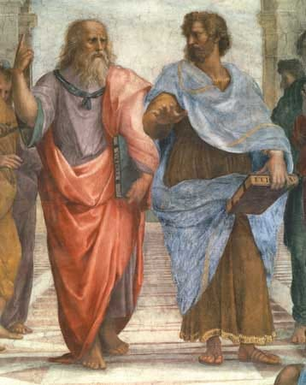
Paul’s Character as an Evangelist (2:3-12)
Paul uses standard language about the Greco-Roman tradition of traveling ‘philosopher-teachers’ in order to distance himself from that persona.
Antithesis allows Paul to speak not of his own abilities, but as enabled by God to be a faithful preacher and model of Christ.

Slide 76
Paul’s Character as an Evangelist (2:3-12)
Rather than avoiding or disregarding suffering, Paul is empowered through it (2:2)
Paul’s boldness was “in(by) our God.”
“opposition” (agoni) is a word referring to a contest in which one is typically opposed by another person. Here it refers to at least the accusations made by the Jews, but also may refer to other competing philosophical/religious ideas

Slide 77
Paul’s Character as an Evangelist (2:3-12)
Rather than countering falsehood with self-virtue, Paul leans on approval from God (2:3-4)
Paul’s ‘virtue’ is God’s approval and faithfulness to him as a preacher of the Gospel.
“Just as we have been approved by God to be entrusted with the Gospel, so we speak not as pleasing men, but God who examines our hearts.”

Slide 78
Paul’s Character as an Evangelist (2:3-12)
Rather than denying ambition by asserting authority, Paul responds with care and sacrifice (2:5-8)
v.6 – lit. ‘having power in weight to be as apostles of Christ.’
v.7 – BUT ‘we became gentle among you…’
v.8 – ‘…because you had become dear to us.’

Slide 79
Paul’s Character as an Evangelist (2:3-12)
Rather than denying ambition by asserting authority, Paul responds with care and sacrifice (2:5-8)
Q: How do the familial metaphors in this section underscore the relationship Paul is attempting to maintain with the church in this letter? How do they create relationships among the church members?

Slide 80
Paul’s Character as an Evangelist (2:3-12)
Paul’s teaching is inseparable from giving himself to those he taught (2:9-12)
“our toil and labor….night and day”
“not to be a burden to any of you”
“how holy and righteous and blameless was our conduct toward you”
“we exhorted…and encouraged and charged you”
“like a father with his children”

Slide 81
Paul’s Character as an Evangelist (2:3-12)
Cf. 1 Corinthians 9:18
“What then is my reward? That, when I preach the gospel, I may offer the gospel without charge, so as not to make full use of my right in the gospel.”

Slide 82
Paul’s Character as an Evangelist (2:3-12)
Ultimately, the point of Paul’s character was not purely moralistic virtue, but ‘walking worthy of God.’
‘who calls you’ – language of election/calling is meant to define God’s people
‘into his own kingdom and glory’ – both of these are eschatological terms for Paul, representing the future coming of the Lord Jesus and the resurrected state (1 Cor 15, Phil 3:20-21)

Slide 83
Imitators in Suffering (2:13-16)
‘For this reason…’ connects 2:13-16 back to God’s calling
A 2nd Thanksgiving for their faithfulness
‘the word of God which is at work in you believers.’
But which leads to suffering…
This also alludes to their separation from Paul which sets up 2:17-ch.3.

Slide 84
Imitators in Suffering (2:13-16)
Thessalonian suffering
From their own countrymen?
Violence/Persecution? Or Social marginalization?
Jewish denouncement
Harsh condemnation
Paul’s comments tie together those responsible for the killing of Jesus (and the OT) prophets and those who (like those from Thessalonica) have prevented him from preaching to Gentiles

Slide 85
END OF LESSON 4

Slide 87
Lesson 7: The Coming of the Lord Jesus 1 Thessalonians 4:13-5:11

Slide 88
Overview
Resurrection for those who ‘sleep’ (4:13-18)
The Day of the Lord as a ‘thief’ (5:1-5)
Warning to stay ‘sober’ (5:6-11)

Slide 89
Resurrection of ‘sleepers’ (4:11-18)
“Therefore encourage one another with these words.” – 1 Thessalonians 4:18
“Therefore encourage one another and build one another up, just as you are doing.” – 1 Thessalonians 5:11
Q: How does our outlook on ultimate future salvation affect our present behavior and lifestyle?

Slide 90
Resurrection of ‘sleepers’ (4:11-18)
Paul’s purpose in informing the church about the dead is to encourage proper conduct within the body of Christ
“But we do not want you to be uninformed, brothers, about those who are asleep, that you may not grieve as others do who have no hope.” – 1 Thessalonians 4:13
Notes:
In this section, Paul seems to be transitioning from encouragement to teaching, but that isn’t strictly the case. The irony of this scripture – perhaps the most well known in either of the Thessalonian letters – is that while it is the most detailed description of Christ’s Second Coming – the purpose of this teaching is to correct their ‘theology’ in order to encourage proper CONDUCT among the people in the church. Paul hasn’t transitioned from his overall purpose in the letter with this teaching. It is a teaching which consoles and comforts the church to live in and through Jesus as the Lord.

Slide 91
Resurrection of ‘sleepers’ (4:11-18)
The problem of ‘sleepers’
‘Sleep was a well-used metonymy for ‘death’ both in both Roman and Jewish culture
“And many of the bodies of the saints who had fallen asleep were raised…” – Mt. 27:52
“And falling to his knees [Stephen] cried out…and when he said this, he fell asleep.” – Acts 7:60

Slide 92
Resurrection of ‘sleepers’ (4:11-18)
The problem of ‘sleepers’
Paul has taught them about Christ’s resurrection, and His future return, but not fully integrated teaching about the resurrection of the dead
The death of Christians had led to a realization of the delay of Christ’s coming which negatively affected their moral perspective and sense of community.
Thus the emphasis on sequence of resurrection and ‘sober living’

Slide 93
Resurrection of ‘sleepers’ (4:11-18)
Christian Grief
Paul probably doesn’t mean Christians should not grieve at all, but that they shouldn’t grieve like those who are outside Christ
Most pagan belief in the afterlife, if any at all, was in the ‘immortality of the soul,’ but the hope for the dead in Christ is in His own resurrection.
Thus Christian hope is of a different content, leading to a different manner/measure of grief.

Slide 94
Resurrection of ‘sleepers’ (4:11-18)
The content of Christian hope is in v. 14:
“Since we believe that Jesus died and rose again”
EVEN SO / IN THE SAME MANNER
“God will bring with him those who have fallen asleep”
The connection of the two clauses works on the presumption that God raised Jesus (1:10)
And that God will ‘bring/gather’ the dead with Christ
What happened to Jesus will happen to all the dead in Christ (Cf. 1 Cor 15:20)

Slide 95
Resurrection of ‘sleepers’ (4:11-18)
Based on the truth of v.14, Paul’s consolation extends into the sequence of events at Christ’s coming (Gr. Parousia – arrival/presence)
‘a word of the Lord’ likely refers to a prophetic word from the exalted Lord Jesus combined with known traditional statements of Jesus (Cf. Lk. 21)
The insistence that the dead in Christ are raised first assures believers that their dead will certainly be present with them and the Lord

Slide 96
Resurrection of ‘sleepers’ (4:11-18)
Paul describes Christ’s coming from the perspective of those who remain alive
Either because he assumes this of himself
OR because he assumes the position of his readers
The description of Christ’s coming from heaven is with the sounds of triumph
Shout • Voice of the Archangel
Trumpet of God

Slide 97
Resurrection of ‘sleepers’ (4:11-18)
The imagery echoes the Roman imperial practice of a group of citizens going out to greet their victorious king with praise and honor
Both the sleepers and the living will meet the Lord in the clouds (Cf. Daniel 7:13-14)
Thus all will be together with the Lord

Slide 98
The Day of the Lord as ‘thief’ (5:1-5)
Times and Seasons
These refer to general chronology and the eras fixed by God which mark out history
The ‘Day of the Lord’ is a well-known OT image of the time when YHWH will bring judgement and salvation
“Behold, the day of the LORD is coming; cruel, with fury and burning anger to make the land a desolation; and he will exterminate sinners from it.”– Isaiah 13:9

Slide 99
The Day of the Lord as ‘thief’ (5:1-5)
Times and Seasons
These refer to general chronology and the eras fixed by God which mark out history
The ‘Day of the Lord’ is a well-known OT image of the time when YHWH will bring judgement and salvation
“Seek the LORD, all you humble of the earth… seek righteousness, seek humility. Perhaps you will be hidden in the day of the Lord’s anger.” – Zech. 2:3

Slide 100
The Day of the Lord as ‘thief’ (5:1-5)
Times and Seasons
These refer to general chronology and the eras fixed by God which mark out history
The ‘Day of the Lord’ is a well-known OT image of the time when YHWH will bring judgement and salvation
In this text, Paul attributes God’s judgement and salvation to the day of the Lord Jesus!

Slide 101
The Day of the Lord as ‘thief’ (5:1-5)
The image of this event as a ‘thief’ underscores the unknowability of the purposes of God
Ironically, what the Thessalonians know is that they can’t know it!
Possible connection to Jesus’ Temple discourse(?)

Slide 102
The Day of the Lord as ‘thief’ (5:1-5)
“Therefore be on the alert, for you do not know which day your Lord is coming. But be sure of this, that if the head of the house had known at what time of the night the thief was coming, he would have been on the alert and would not have allowed his house to be broken into. For this reason you also must be ready; for the Son of Man is coming at an hour when you do not think He will. - Matthew 24:42-44

Slide 103
The Day of the Lord as ‘thief’ (5:1-5)
The image of this event as a ‘thief’ underscores the unknowability of the purposes of God
Ironically, what the Thessalonians know is that they can’t know it!
Possible connection to Jesus’ Temple discourse(?)
Those who proclaim ‘Peace and Security!’ are those who trust in the lords of the world, and will suffer ruin and destruction

Slide 104
The Day of the Lord as ‘thief’ (5:1-5)
The image of the ‘thief’ is used to make the contrast between the ready followers of Christ and those who are not
Light/Darkness & Day/Night are NT terms used to help form Christian identity
“But you are a chosen race, a royal priesthood, a holy nation, a people for God’s possession, so that you may proclaim the excellencies of Him who has called you out of darkness into His marvelous light.” – 1 Peter 2:9

Slide 105
The Day of the Lord as ‘thief’ (5:1-5)
The image of the ‘thief’ is used to make the contrast between the ready followers of Christ and those who are not
Light/Darkness & Day/Night are NT terms used to help form Christian identity and morality
“…if we walk in the light as [God] is in the Light, we have fellowship with one another, and the blood of Jesus His Son cleanses us from all sin.” – 1 Jn. 1:7

Slide 106
The Day of the Lord as ‘thief’ (5:1-5)
Do this (-Love), knowing the time, that it is already the hour for you to awaken from sleep; for now salvation is nearer to us than when we believed. The night is almost gone, and the day is near. Therefore let us lay aside the deeds of darkness and put on the armor of light. Let us behave properly as in the day, not in carousing and drunkenness, not in sexual promiscuity and sensuality, not in strife and jealousy. – Romans 13:11-13

Slide 107
Warning to stay ‘sober’ (5:6-11)
“So then”…Paul extends the contrasting metaphors to instruction for how they should live
Q: What does Paul mean by instructions to ‘keep awake’ and ‘stay sober?’

Slide 108
Warning to stay ‘sober’ (5:6-11)
“So then”…Paul extends the contrasting metaphors to instruction for how they should live
‘Sleep’ here refers not to death as it had in ch. 4, but as a different metaphor for being unaware of spiritual realities
Rather, the exhortation is to be alert and sober – that is being aware of their spiritual lives.
These terms cash out the day/night metaphor in v. 7-8

Slide 109
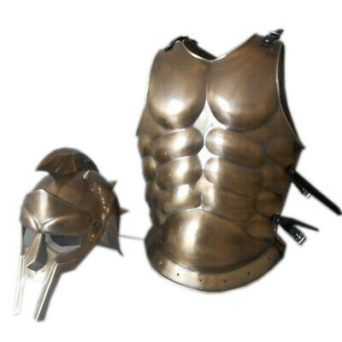
Warning to stay ‘sober’ (5:6-11)
Paul then transitions to another well-known metaphor in his writings – armor
Breastplate > Faith & Love
Helmet > Hope of Salvation
The Armor of God is worn by those who anticipate God’s salvation rather than God’s wrath

Slide 110
Warning to stay ‘sober’ (5:6-11)
God’s salvation is always obtained through the Lord Jesus
Paul’s final word in v. 10 ties together the two sections of this eschatological teaching to sum up that all of those faithful to Christ will have eternal fellowship with Him

