Slide 1
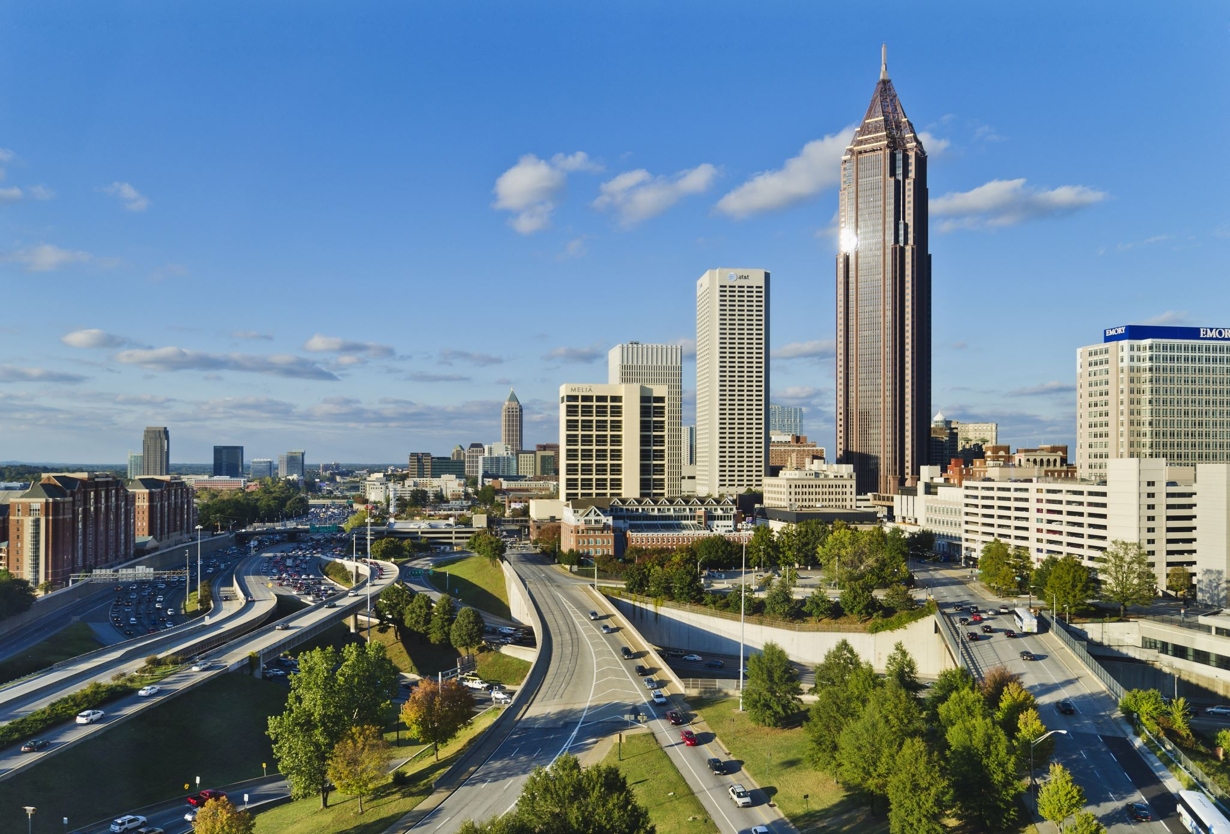
“Stirred by Reminder” – 2nd Peter 3:1 Embry Hills End of the Year Studies 2019
2nd Peter 3:1-2a“This is now, beloved, the second letter I am writing to you in which I am stirring up your sincere mind by way of reminder, ² that you should remember the words spoken beforehand”
Purpose of the studies:
To remind and reencourage some of our older members with themes that are familiar. (Because of the different speakers, it’ll give a fresh outlook on some of the subjects.)
To encourage some of newer members of themes that we still believe to be essential. (The themes are in the past, but their usefulness is still current.)
To show the importance of yearly focus on the theme. (It isn’t something we do for a year and then kick to the curb.)
Another potential benefit:
All the men speaking are men we have fellowship with.
Having an opportunity (15-20 mins) to hear about their works.
The more excited we are about the works that we’re participating in other places, the more I believe we will be excited to continue to spread the gospel here.
Schedule and Speakers
Wednesday, December 18 → Joe Hamm // Philadelphia
Lesson on “Sharing the Hope that is in Us (1 Peter 3:14-5)”
Sunday, December 22 → Blake Edwards // Downtown Atlanta
Lesson on “Building on the Rock (Ephesians 2:19-22)”
Wednesday, December 25 → Gardner Hall // New Jersey and New York City
Lesson on “Free in Christ (Galatians 5:1, 13-4)”
Sunday, December 29 → Roger Polanco // New York City (Manhattan and the Bronx)
Lesson on “Walk as Children of Light (Ephesians 5:8-14)”
Wednesday, January 1 → Ben Hall // New York City (Brooklyn)
Lesson on “Disciples like our Teacher (Luke 6:40)”

Slide 2
2 Schools of Thought in the Time of Isaiah
Assyria is bad,
Trust Egypt
Egypt is bad,
Trust Assyria
Your sin is bad,
Trust God

Slide 3
God’s Reasons for His People to Trust Him
God’s Glory
Idol’s Vanity
God Foretells
Cyrus’ Coming
God’s Servant
Suffers
God’s greatness is transcendent
God knows the future
God has given Himself

Slide 4
The Barren One is Barren No More (Is. 54)
“Shout for Joy”
“More numerous than the sons of the married woman”
“Enlarge the place of your tent; Stretch out the curtains of your dwellings, spare not; Lengthen your cords And strengthen your pegs.”
“For your husband is your Maker, Whose name is the LORD of hosts; And your Redeemer is the Holy One of Israel”
“No weapon that is formed against you will prosper”
“This is their heritage // their vindication comes from Me”

Slide 6
“Come to the Waters”

Slide 7
God’s Invitation His People (Is. 55)
1 "Ho! Every one who thirsts, come to the waters; And you who have no money come, buy and eat. Come, buy wine and milk Without money and without cost. 2 "Why do you spend money for what is not bread, And your wages for what does not satisfy? Listen carefully to Me, and eat what is good, And delight yourself in abundance. 3 "Incline your ear and come to Me. Listen, that you may live; And I will make an everlasting covenant with you, [According to] the faithful mercies shown to David

Slide 8
God Reassures Seekers (Is. 55)
6 Seek the LORD while He may be found; Call upon Him while He is near. 7 Let the wicked forsake his way And the unrighteous man his thoughts; And let him return to the LORD, And He will have compassion on him, And to our God, For He will abundantly pardon. 8 "For My thoughts are not your thoughts, Nor are your ways My ways," declares the LORD. 9 "For [as] the heavens are higher than the earth, So are My ways higher than your ways And My thoughts than your thoughts. 10 "For as the rain and the snow come down from heaven, And do not return there without watering the earth And making it bear and sprout, And furnishing seed to the sower and bread to the eater; 11 So will My word be which goes forth from My mouth; It will not return to Me empty, Without accomplishing what I desire, And without succeeding [in the matter] for which I sent it. 12 "For you will go out with joy And be led forth with peace; The mountains and the hills will break forth into shouts of joy before you, And all the trees of the field will clap [their] hands. 13 "Instead of the thorn bush the cypress will come up, And instead of the nettle the myrtle will come up, And it will be a memorial to the LORD, For an everlasting sign which will not be cut off."

Slide 9
God’s Invitation to All Peoples (Is. 56)
1 Thus says the LORD, "Preserve justice and do righteousness, For My salvation is about to come And My righteousness to be revealed. 2 "How blessed is the man who does this, And the son of man who takes hold of it; Who keeps from profaning the sabbath, And keeps his hand from doing any evil." 3 Let not the foreigner who has joined himself to the LORD say, "The LORD will surely separate me from His people." Nor let the eunuch say, "Behold, I am a dry tree." 4 For thus says the LORD, "To the eunuchs who keep My sabbaths, And choose what pleases Me, And hold fast My covenant, 5 To them I will give in My house and within My walls a memorial, And a name better than that of sons and daughters; I will give them an everlasting name which will not be cut off. 6 "Also the foreigners who join themselves to the LORD, To minister to Him, and to love the name of the LORD, To be His servants, every one who keeps from profaning the sabbath And holds fast My covenant; 7 Even those I will bring to My holy mountain And make them joyful in My house of prayer. Their burnt offerings and their sacrifices will be acceptable on My altar; For My house will be called a house of prayer for all the peoples." 8 The Lord GOD, who gathers the dispersed of Israel, declares, "Yet [others] I will gather to them, to those [already] gathered."

Slide 10
Come to the Waters
The invitation is universal.
You must choose to come.
You will not understand it all.
God will satisfy your longings.
Destitute
Eunuch
Foreigner
Sustenance in Abundance
Everlasting Name
A Place in the House
All the things that God is offering the people, isn’t just “given” by God, they are found in the very nature of God.

Slide 11
And I will make an everlasting covenant with you, [According to] the faithful mercies shown to David. 4 "Behold, I have made him a witness to the peoples, A leader and commander for the peoples. 5 "Behold, you will call a nation you do not know, And a nation which knows you not will run to you, Because of the LORD your God, even the Holy One of Israel; For He has glorified you."
Glory Received
Witness to the Peoples
Leaders and Commanders

