Slide 1
The Throne of God
Revelation 4-5

Slide 2
The Throne of God
Suffering Audience
“I, John, your brother and partner in the tribulation… on account of the word of God and the testimony of Jesus.” (Revelation 1:9)
“Do not fear what you are about to suffer. Behold, the devil is about to throw some of you into prison…” (Revelation 2:10)
“I saw under the altar the souls of those who had been slain for the word of God and for the witness they had borne.” (Revelation 6:9)
“The Revelation of Jesus Christ, which God gave Him to show His servants—things which must shortly take place. And He sent and signified it by His angel to His servant John.” (Revelation 1:1 – NKJV)

Slide 3
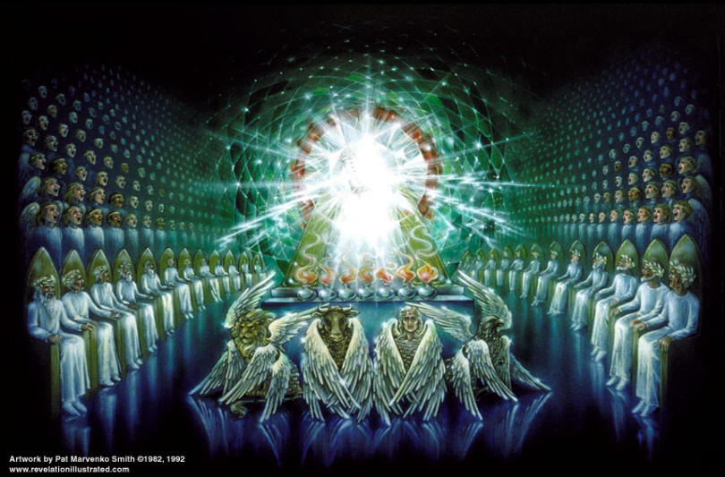

Slide 4
The Worship
Crescendo of Worship
4 Creatures (4:8)
24 Elders (4:10)
4 Creatures & 24 Elders (5:8)
4 Creatures, 24 Elders, & Myriad of Angels (5:11)
Everything in Heaven & on Earth (5:13-14)
Worship & Worthiness (4:11, 5:9, 5:12)
God the Creator (4:11)
Jesus the Redeemer (5:9, 5:12)

Slide 5
The Mission
“You have made them a kingdom and priests…” (5:10)
Teaching & Sacrificing
“¹⁰You are to distinguish between the holy and the common, and between the unclean and the clean, ¹¹and you are to teach the people of Israel all the statutes that the Lord has spoken to them by Moses.” (Leviticus 10:10-11)
“I appeal to you therefore, brothers, by the mercies of God, to present your bodies as a living sacrifice…” (Romans 12:1)
We Become Priests of Whatever We Worship

Slide 6
The Leader
He Was Slain For Us
“It is these who follow the Lamb wherever he goes. These have been redeemed from mankind…” (14:4)
“And they have conquered him by the blood of the Lamb and by the word of their testimony, for they loved not their lives even unto death.” (12:11)

