Slide 1
Philippians 2:14-16
¹⁴ Do all things without complaining and disputing ¹⁵ that you may become blameless and harmless, children of God without fault in the midst of a crooked and perverse generation, among whom you shine as lights in the world, ¹⁶ holding fast the word of life…

Slide 2
Early Christians did not say,
“LOOK WHAT THE WORLD IS COMING TO”
but,
“LOOK WHAT HAS COME TO THE WORLD!”

Slide 3
What had come into the dark world?
“There came a man sent from God, whose name was John. ⁷ He came as a witness, to testify about the Light, so that all might believe through him. ⁸ He was not the Light, but he came to testify about the Light. ⁹ There was the true Light which, coming into the world, enlightens every man” (John 1:6-9 NASB).
Jesus said, “As long as I am in the world, I am the light of the world” (John 9:5).
“You are the light of the world. A city that is set on a hill cannot be hidden” (Matthew 5:14).

Slide 4
Philippians 2:14-16
¹⁴ Do all things without complaining and disputing ¹⁵ that you may become blameless and harmless, children of God without fault in the midst of a crooked and perverse generation, among whom you shine as lights in the world, ¹⁶ holding fast the word of life…

Slide 5
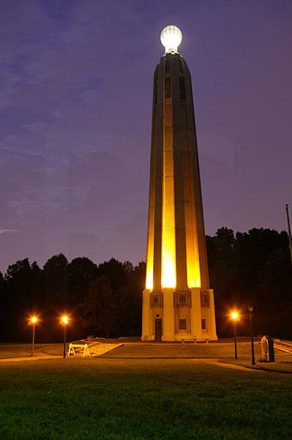
“I write so that you may know how you ought to conduct yourself in the house of God, which is the church of the living God, the pillar and ground of the truth”
(1 Timothy 3:15)

Slide 6
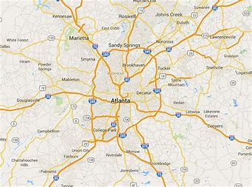
“among whom you shine as lights in the world” (plural)

Slide 7
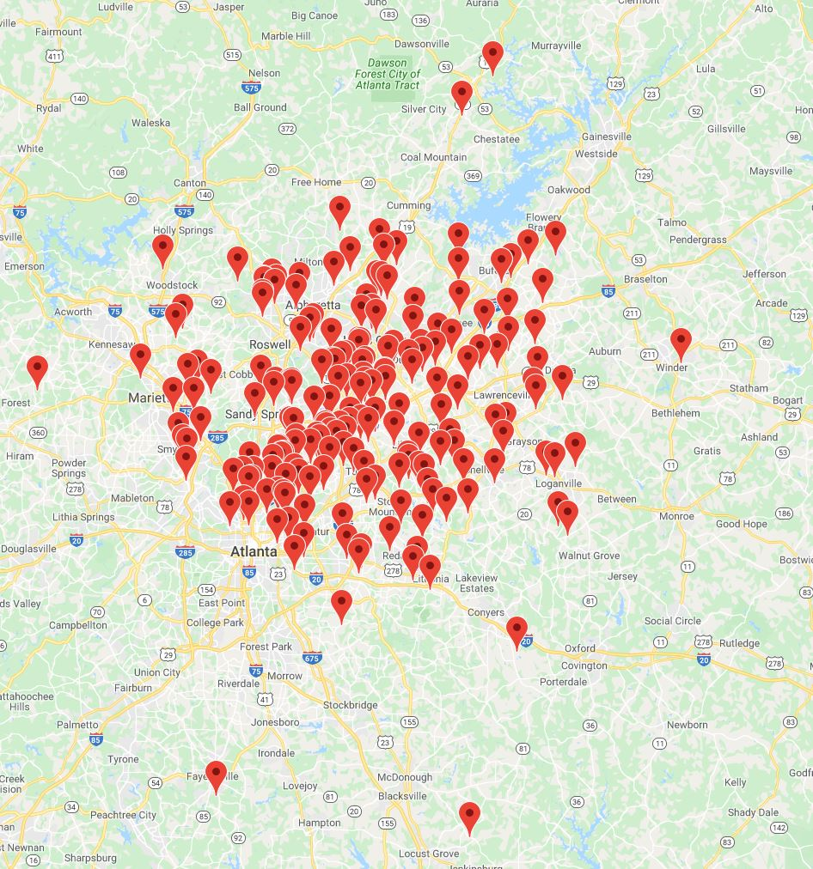

Slide 8
How do we “shine as lights in the world?
¹⁴ Do all things without complaining and disputing ¹⁵ that you may become blameless and harmless, children of God without fault in the midst of a crooked and perverse generation, among whom you shine as lights in the world, ¹⁶ holding fast the word of life…

Slide 9
How do we “shine as lights in the world?
¹⁴ Do all things without complaining and disputing ¹⁵ that you may become blameless and harmless, children of God without fault in the midst of a crooked and perverse generation, among whom you shine as lights in the world, ¹⁶ holding fast the word of life…
forth

Slide 10
In every location, people doing God’s will—
Without complaining
Without disputing
Blameless
Harmless
Children of God without fault
Holding fast the word of truth
Holding forth the word of truth

Slide 11
1 Peter 2:11-12
¹¹ Beloved, I beg you as sojourners and pilgrims, abstain from fleshly lusts which war against the soul, ¹² having your conduct honorable among the Gentiles, that when they speak against you as evildoers, they may, by your good works which they observe, glorify God in the day of visitation.

