Slide 1
I & II Peter, & Jude
Lesson 9

Slide 2
Class Schedule
Lesson | Title | Date
1 | Introduction to I Peter | Jan 5, 2020
2 | The Great Salvation (I Pet 1:1-12) | Jan 8, 2020
3 | Products of Salvation (I Peter 1:13-2:10) | Jan 12, 2020
4 | The Duties of the Christian (I Peter 2:11-3:12) | Jan 15, 2020
5 | Suffering (I Peter 3:13-4:19) | Jan 19, 2020
6 | Exhortations to Elders and Soldiers (I Peter 5:1-13) | Jan 22, 2020
7 | Introduction to II Peter and Jude | Jan 26, 2020
8 | Call to Growth (II Peter 1:1-21) | Jan 29, 2020
9 | Warnings Against False Teachers (II Peter 2:1-22) | Feb 2, 2020
10 | Warnings Against False Teachers (Jude) | Feb 5, 2020
11 | The Coming of the Lord (II Peter 3) | Feb 9, 2020
12 | Persecution and Ideological Struggles | Feb 12, 2020
13 | Review | Feb 16, 2020
II

Slide 3
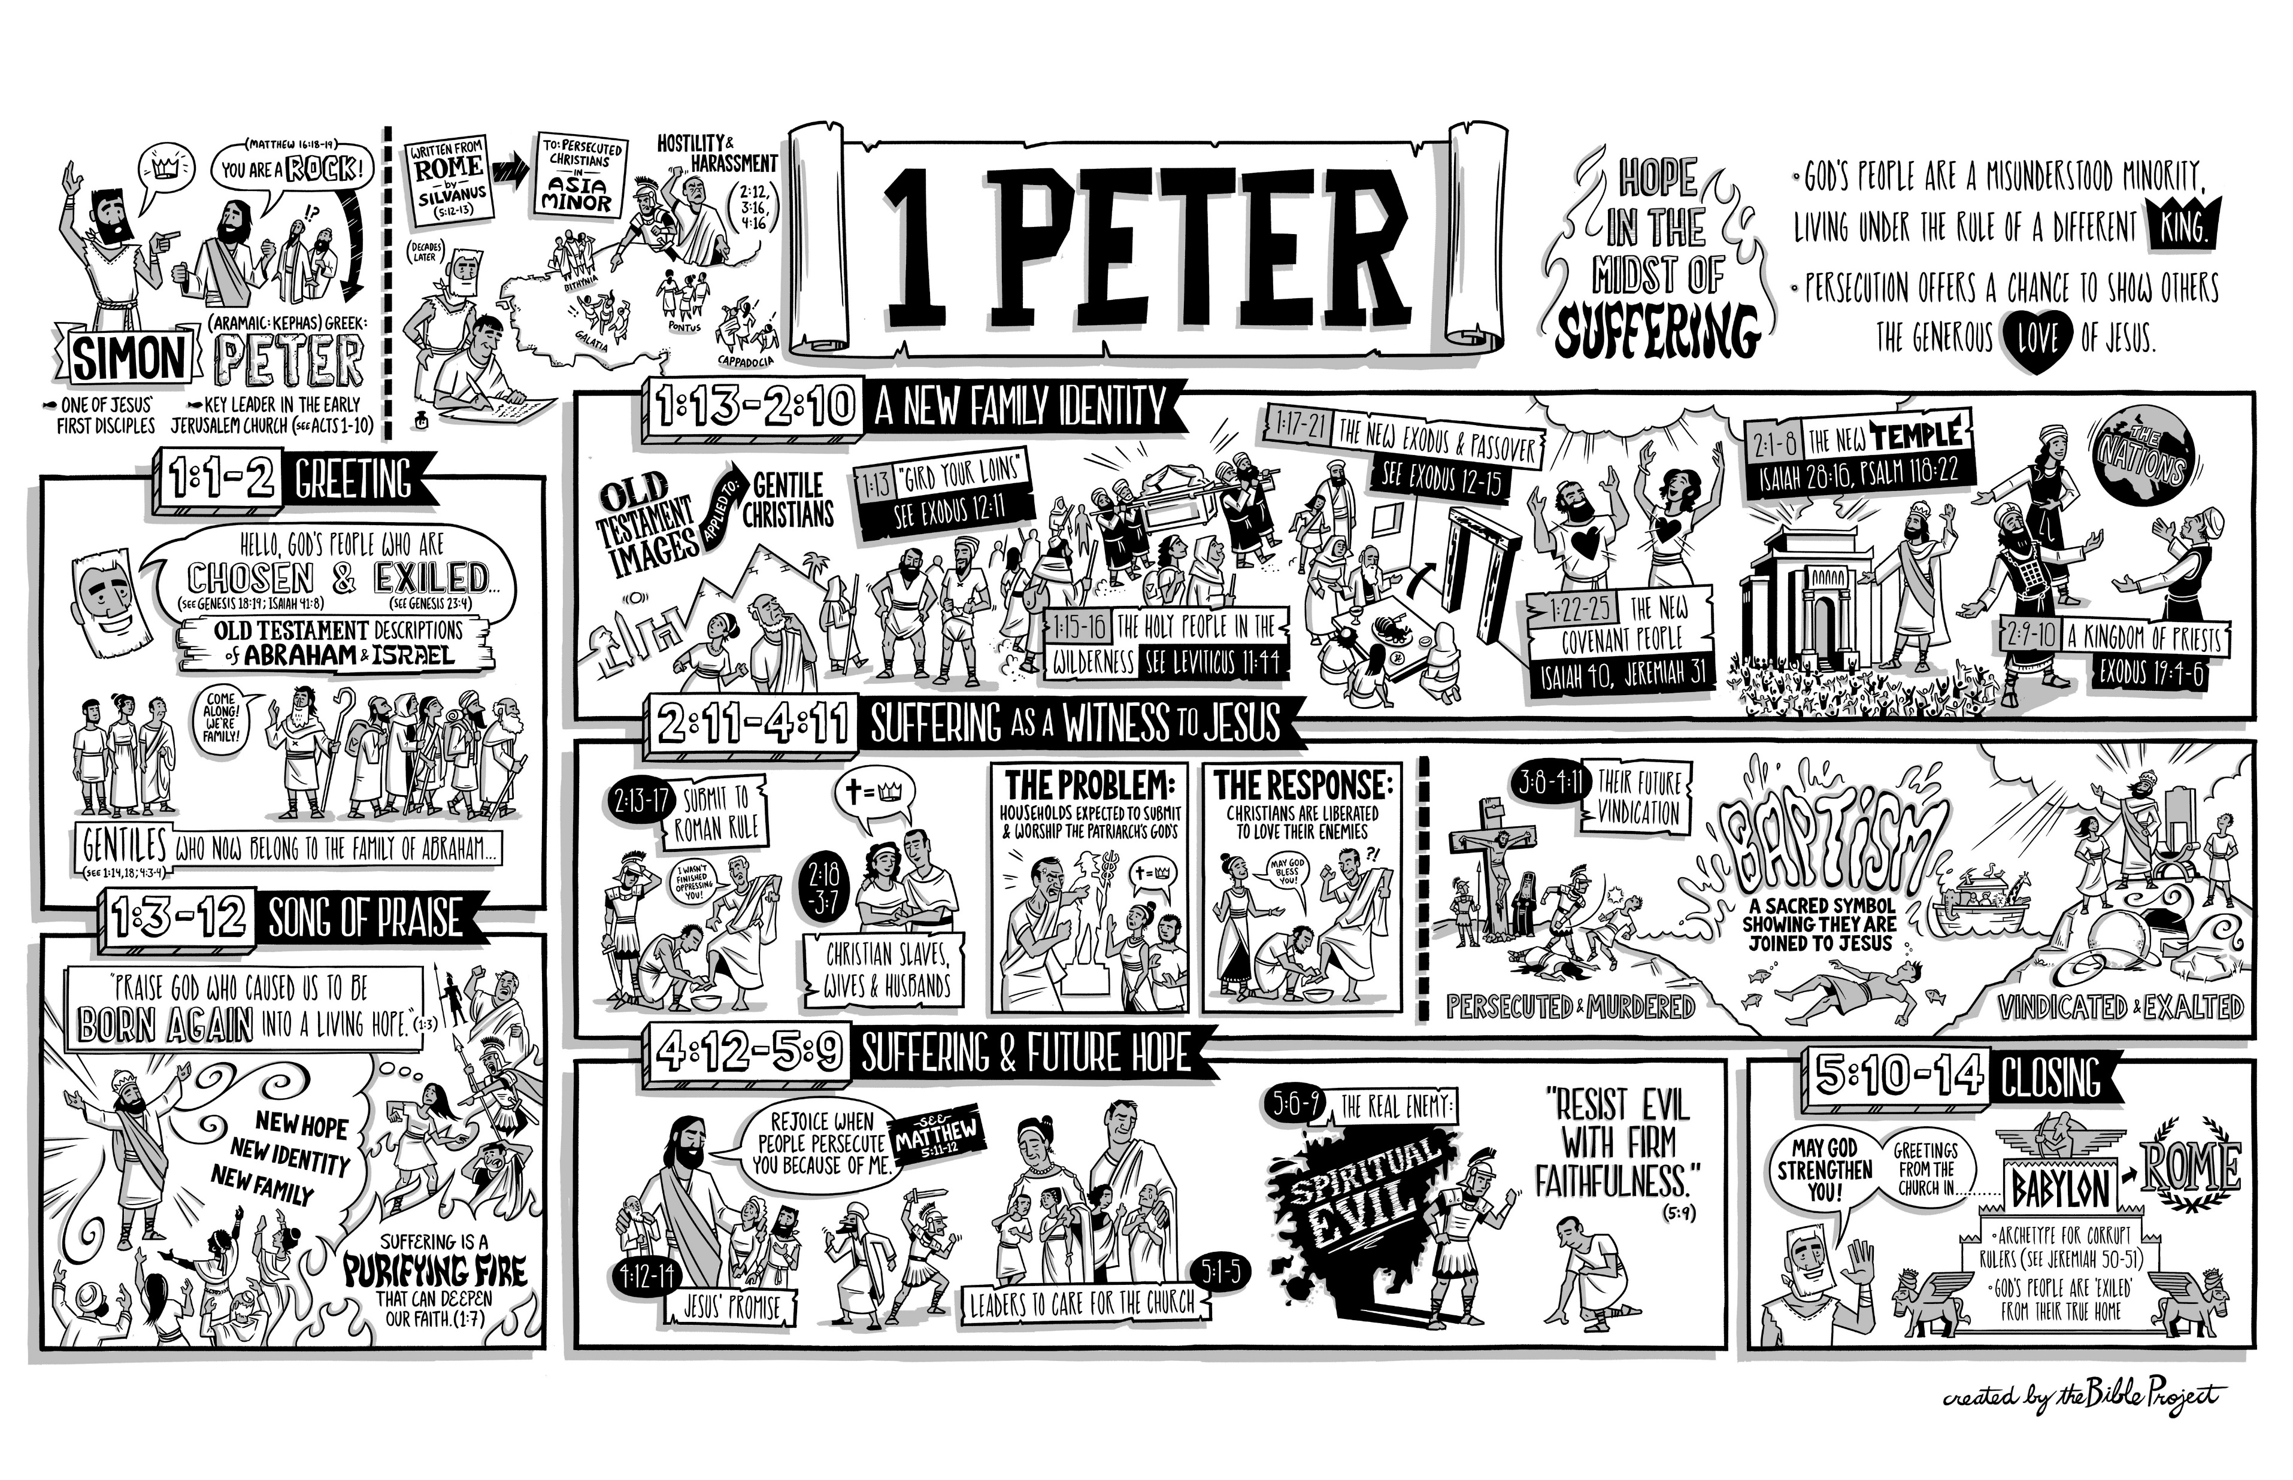

Slide 4
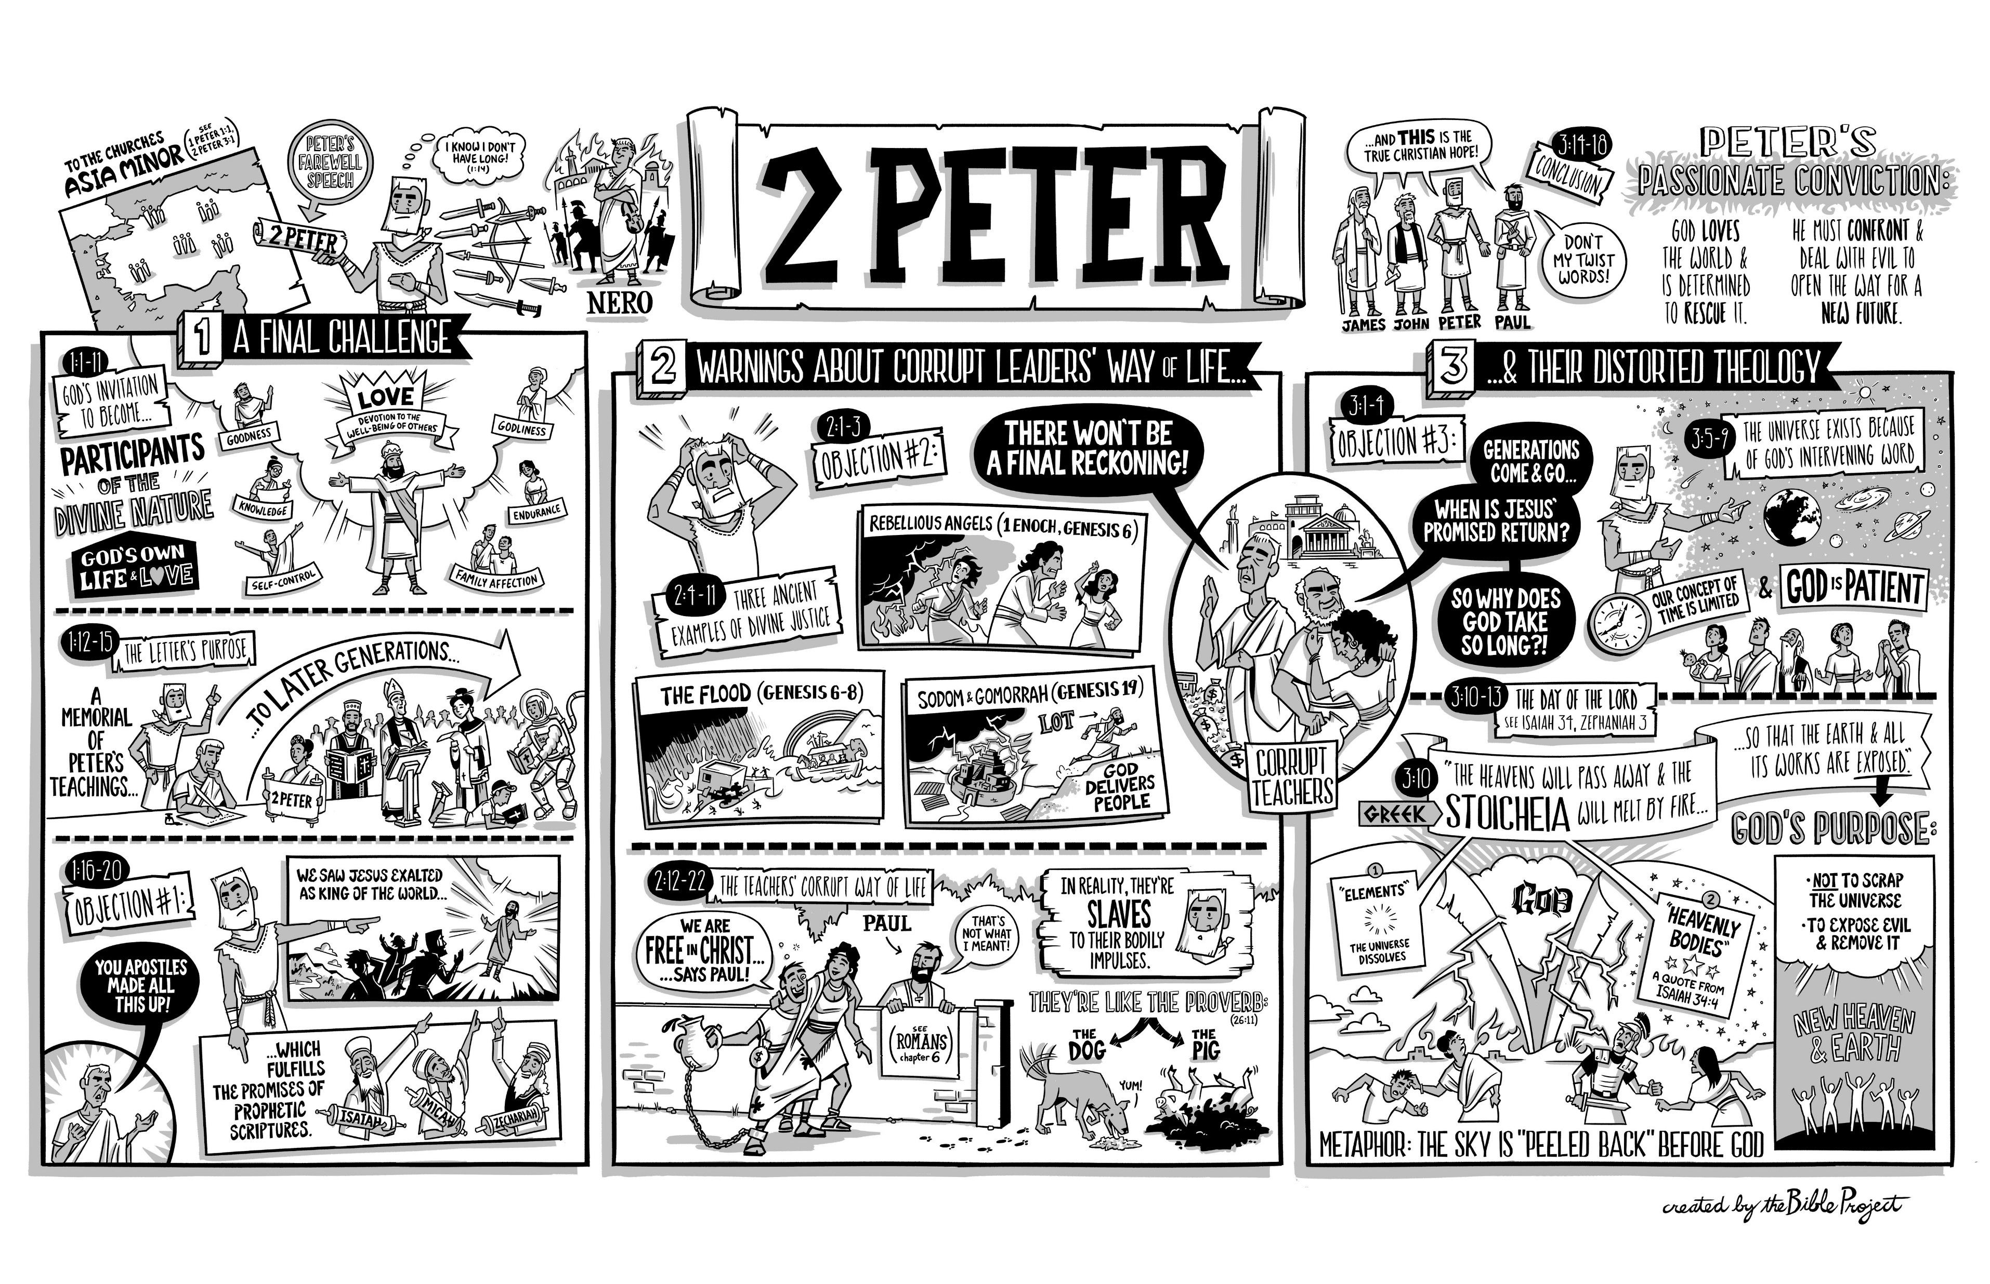

Slide 5
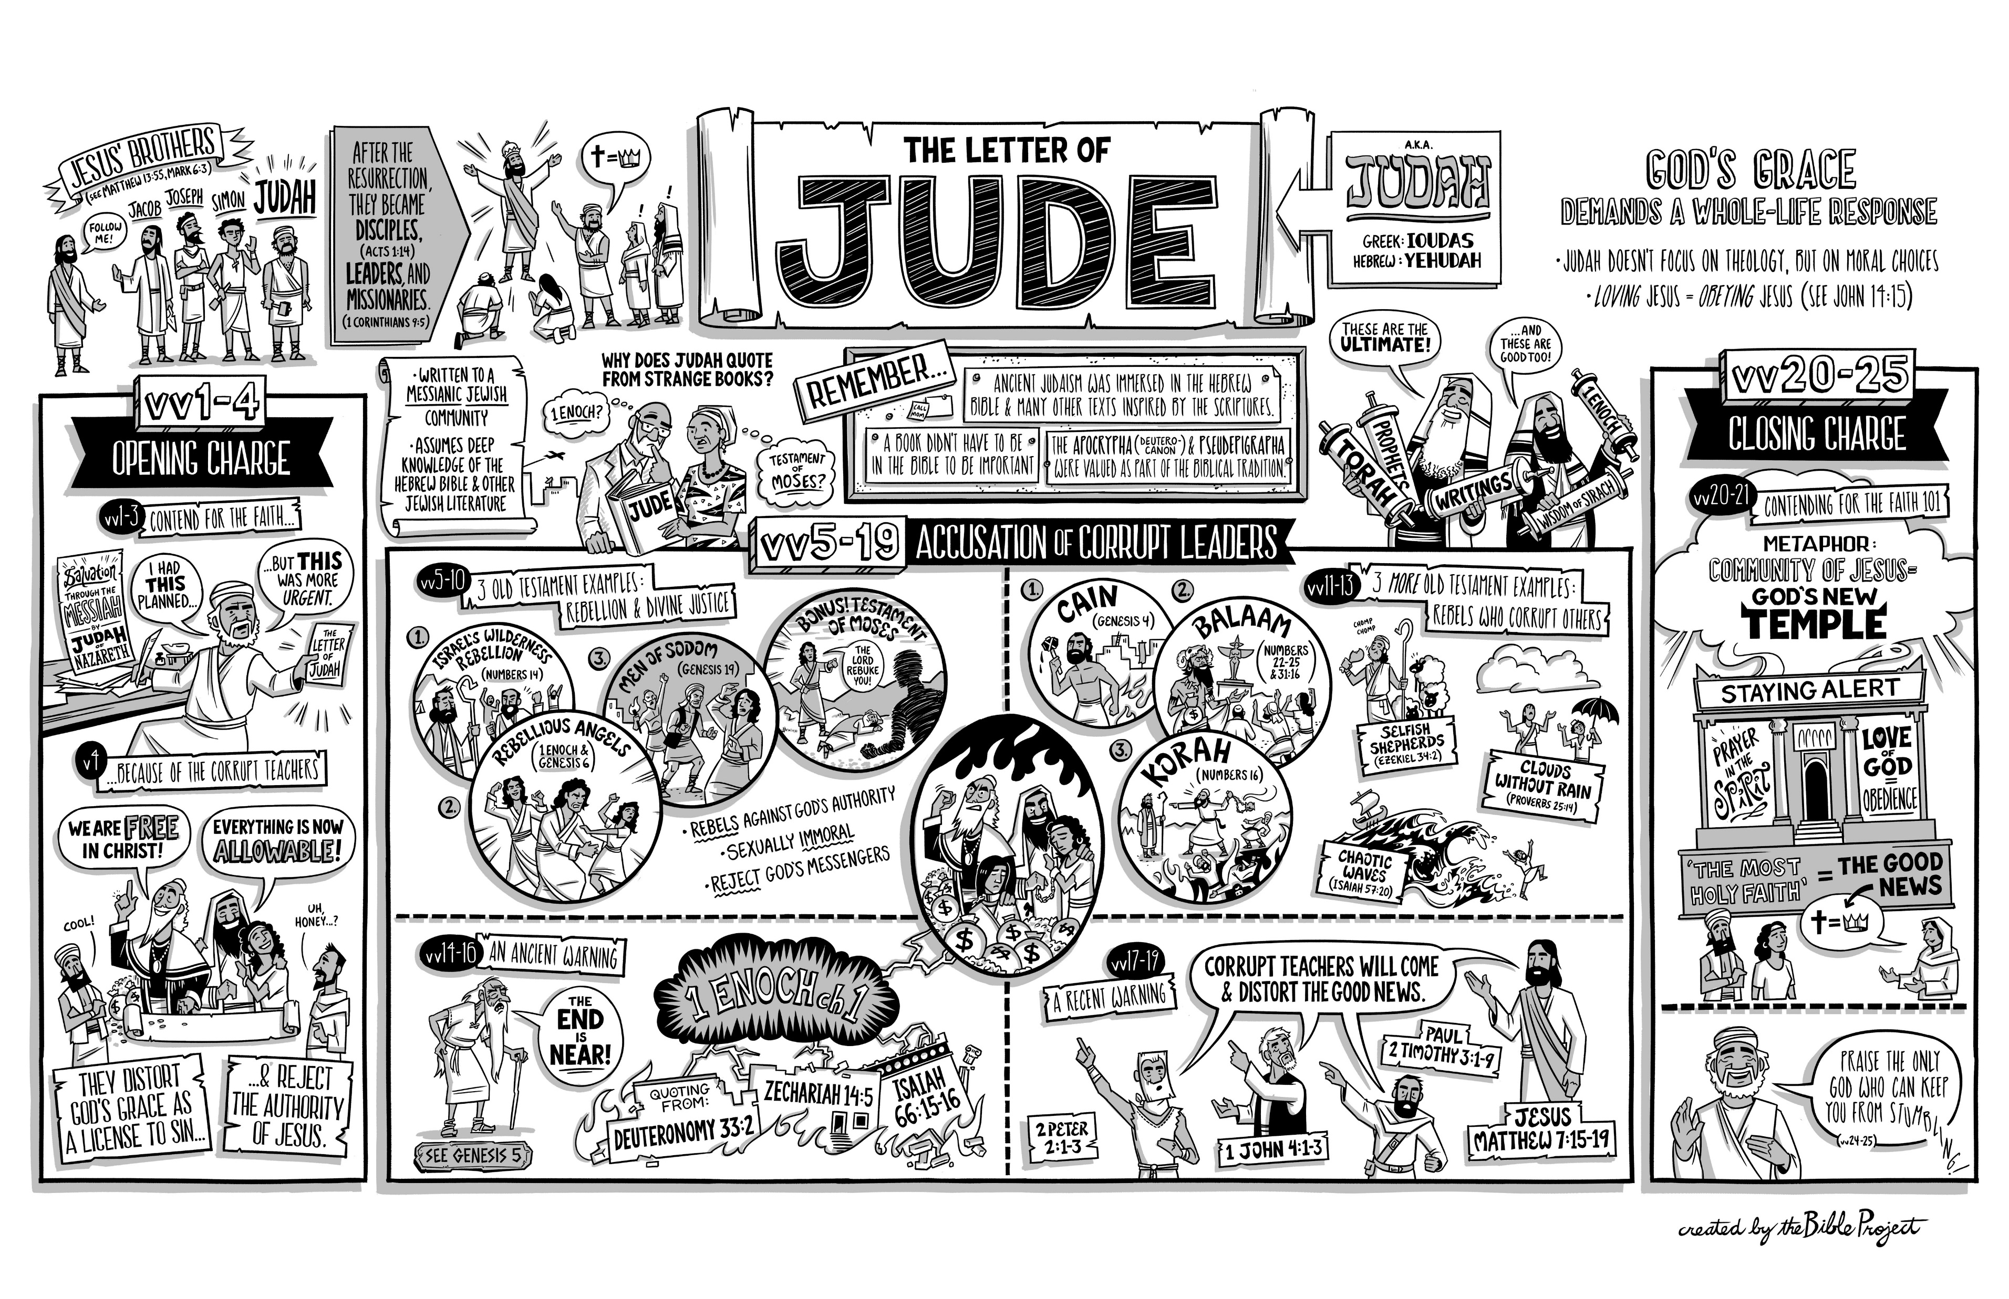

Slide 6
God’s Grace and the Living Hope
God’s Grace and Salvation 1st Peter 1:1 – 2:10
  Live in Hope (a Lively Hope) 1st Peter 1:1-12
  Live in Holiness 1st Peter 1:13 – 21
  Live in Harmony 1st Peter 1:22 – 2:10
God’s Grace and Submission 1st Peter 2:11 – 3:12
  Submit to Authorities 1st Peter 2:11-17
  Submit to Masters 1st Peter 2:18-25
  Submit in the Home 1st Peter 3:1-7
  Submit in the Church 1st Peter 3:8-12
God’s Grace and Suffering 1st Peter 3:13 – 5:11
  Make Jesus Christ Lord 1st Peter 3:13-22
  Have Christ’s Attitude 1st Peter 4:1-11
  Glorify Christ’s Name 1st Peter 4:12-19
  Look for Christ’s Return – Our Relationships 1st Peter 5:1-6
  Depend of Christ’s Grace 1st Peter 5:7-14

Slide 7
1st Peter Overview
Chapter 1 The Redemption of the Christian
  No Matter What Happens – We Have a Living / Lively Hope!
  We are Called to be Holy – therefore love one another earnestly from a pure heart.
Chapter 2 The Sanctification of the Christian
  Long for Pure Spiritual Milk
  Offer Spiritual Sacrifices Acceptable to God
  We are a Chosen Race, a Royal Priesthood, a Holy Nation, Possessed by Him
  Sojourners and Exiles – Abstain, Keep Conduct Honorable, Show Good Deeds
  Be Subject to Authority: Governments, Masters – Honor Everyone, Love Brothers
Chapter 3 The Relationships of the Christian
  Wives and Husbands
  Unity of Mind, Sympathy, Brotherly Love, Tender Hearted, Humble Mind
  Honor Christ – Be Ready to Give an Answer for the Hope you have
  Baptism Now Saves You (21)
Chapter 4 The Suffering of the Christian
  Arm Yourself with Correct Thinking, Be Self-Control, and Sober-Minded
  Keep Loving One Another - Serve, Show, Speak and Rejoice
Chapter 5 The Obligation of the Christian
  The Elect: Elders, Shepherd the Flock, Humble, Cast, Resist
  And God Will: Restore, Confirm, Strengthen, and Establish you

Slide 8
Major Point Outline of I Peter
Introduction (1:1,2)
The Great Salvation (1:3-12)
The Products of Salvation (1:13-2:10)
The Duties of the Christian (2:11-3:12)
Suffering as a Christian (3:13-4:19)
Exhortation to Shepherds (5:1-5)
Exhortations to Soldiers (5:6-11)
Conclusions (5:12,13)

Slide 9
2 Peter – Spiritual Knowledge
EXPLANATION: The Knowledge of Christ (2 Peter 1)
  The Gift of Knowledge (2 Peter 1:1-4)
  The Growth of Knowledge (2 Peter 1:5-11)
  The Ground of Knowledge (2 Peter 1:12-21)
EXAMINATION: The False Teachers (2 Peter 2)
  Their Condemnation – Destructiveness / Doom (2:1-9)
  Their Character – Depravity (2 Peter 2:10-17)
  Their Claims - Deceptions (2 Peter 2:18-22)
EXHORTATION: The True Christian (2 Peter 3)
  Be Mindful (2 Peter 3:1-7)
  Be Not Ignorant (2 Peter 3:8-10)
  Be Diligent (2 Peter 3:11-14)
  Beware (2 Peter 3:15-18)
3 Objections
You Apostles Made It All Up!
There will be no Final Reckoning
When is Jesus’ Promised Return?

Slide 10
2 Peter 1:1-11 – Knowing and Growing
Before Peter Can Describe Counterfeits, He Must Describe True Believers
The Christian Life Begins with Faith (1:1-4)
  This Faith is based on Our God and Savior Jesus Christ (1-2)
  This Faith Involves God’s Power (3)
    We have Everything we need to know for Life and Godliness (3)
  This Faith Involves God’s Promises (4)
This Faith Results in Spiritual Growth (1:5-7)
  Faith, Virtue, Knowledge, Self-Control, Godliness, Brotherly Affection, Love
Spiritual Growth Brings Results (1:8-11)
  Effectiveness and Fruitfulness (8) – If You Have these Qualities.
  Vision (9) – Help you to remember that you were cleansed.
  Security (10-11) – Be Diligent with these Qualities and Never Fall

Slide 11
2 Peter 1:12-21 – Wake Up and Remember
The Best Defense Against False Teachers is True Living Based on the Word of God
  The Christian who knows what he believes and why he believes it will rarely be seduced by the false teachers and their devious doctrines” Weirsbe
Men Die (Peter), but the Word Lives On (1:12-15)
  Men are not the foundation – but Jesus Christ is the Foundation (1 Cor 3:11)
    Peter was able to sleep in Prison (Acts 12:1ff)
  Peter’s Motives:
    I will not be Negligent (1:12) – Obey Christ’s Commands
    I think it Right (13) – Always Right to Remind the Saints of the Word of God
    Make Every Effort – Diligent – Endeavor (15) – Fulfill your responsibilities
    Help Us Recall / Remember (15) – He wanted to “stir you up” – Awake, Arouse
Experiences Fade, but the Word Remains (1:16-18)
  We Didn’t Make This Stuff Up – We Know What We Saw – Transfiguration
The World Darkens, But the Word Shines (1:19-21)
  It is the Sure Word (19a) – Pay attention to it! (Psalms 19:7; 93:5; 111:7; 119:128)
  It is a Shining Word (19b) – Psalms 119:105
  It is an Inspired Word (20-21)
Notes:
CONFIDENCE – PETER KNEW THAT GOD IS IN CONTROL
CONSECRATION - Peter had the peace of know the presence of God
PETER HAD COURAGE – HE KNEW HE DIDN’T NEED TO FEAR DEATH.
PETER HAD CONTENTMENT – REWARD

Slide 12
2 Peter 1:12-21 – Wake Up and Remember
The Best Defense Against False Teachers is True Living Based on the Word of God
  The Christian who knows what he believes and why he believes it will rarely be seduced by the false teachers and their devious doctrines” Weirsbe
Men Die (Peter), but the Word Lives On (1:12-15)
  Men are not the foundation – but Jesus Christ is the Foundation (1 Cor 3:11)
    Peter was able to sleep in Prison (Acts 12:1ff)
  Peter’s Motives:
    I will not be Negligent (1:12) – Obey Christ’s Commands
    I think it Right (13) – Always Right to Remind the Saints of the Word of God
    Make Every Effort – Diligent – Endeavor (15) – Fulfill your responsibilities
    Help Us Recall / Remember (15) – He wanted to “stir you up” – Awake, Arouse
Experiences Fade, but the Word Remains (1:16-18)
  We Didn’t Make This Stuff Up – We Know What We Saw – Transfiguration
The World Darkens, But the Word Shines (1:19-21)
  It is the Sure Word (19a) – Pay attention to it! (Psalms 19:7; 93:5; 111:7; 119:128)
  It is a Shining Word (19b) – Psalms 119:105
  It is an Inspired Word (20-21)
Psalms 19:7 - The law of the LORD is perfect,
reviving the soul;
the testimony of the LORD is sure,
making wise the simple;
Psalms 119:105 - Your word is a lamp to my feet
and a light to my path.
Notes:
CONFIDENCE – PETER KNEW THAT GOD IS IN CONTROL
CONSECRATION - Peter had the peace of know the presence of God
PETER HAD COURAGE – HE KNEW HE DIDN’T NEED TO FEAR DEATH.
PETER HAD CONTENTMENT – REWARD

Slide 13

Lesson 9
“By entertaining of strange persons, men sometimes entertain angels unawares (Hebrews 13:2), but by entertaining strange doctrines, many have entertained devils unawares” John Flavel
IT IS TIME TO BE ALERT

Slide 14
2 Peter – Spiritual Knowledge
EXPLANATION: The Knowledge of Christ (2 Peter 1)
  The Gift of Knowledge (2 Peter 1:1-4)
  The Growth of Knowledge (2 Peter 1:5-11)
  The Ground of Knowledge (2 Peter 1:12-21)
EXAMINATION: The False Teachers (2 Peter 2)
  Their Condemnation (2 Peter 2:1-9)
  Their Character (2 Peter 2:10-17)
  Their Claims (2 Peter 2:18-22)
EXHORTATION: The True Christian (2 Peter 3)
  Be Mindful (2 Peter 3:1-7)
  Be Not Ignorant (2 Peter 3:8-10)
  Be Diligent (2 Peter 3:11-14)
  Beware (2 Peter 3:15-18)
3 Objections
You Apostles Made It All Up!
There will be no Final Reckoning
When is Jesus’ Promised Return

Slide 15
2 Peter 2: Beware of Counterfeits
Satan is the Great Imitator (2 Corinthians 11:13-15)
  He has Fooled Eve in the Garden (Genesis 3:1-7; 2 Corinthians 11:1-4)
  He has false Christians (Matthew 13:38; John 8:44)
  He has a false Gospel (Galatians 1:6-9)
  He has a False Righteousness (Romans 9:30-10:4)
Israel was constantly led astray by false prophets
  But it was the Jewish False Prophets that did the most damage
    They claimed to speak for Jehovah (Ezekiel and Jeremiah exposed them)
    But the People Followed them Anyway! WHY?
  The Religion of False Prophets was Easy, Comfortable, and Popular
    Jeremiah 6:14 – Peace was what the People wanted to hear – even if false!
Jer 14:14 - And the Lord said to me: “The prophets are prophesying lies in my name. I did not send them, nor did I command them or speak to them. They are prophesying to you a lying vision, worthless divination, and the deceit of their own minds.

Slide 16
2 Peter 2:1-9 Beware of Counterfeits
The False Teachers Described (2:1-3)
DECEPTION (1a) – Their Message and Method was False. (Jeremiah 14:14)
  They brought “destructive heresies”
  Heresy – to make a choice, then came to mean “a sect or party”
  “Secretly” – to secretly bring alongside
  2:3 – They use False Words (Plastos – Plastic - Words that can be twisted to mean whatever.
DENIAL (1b)
  False Teachers are better known for what they Deny rather than what they Affirm
    Deny the Inspiration of the Bible, the Man’s Sin, Sacrificial death and Resurrection of Jesus, Necessity of Faith, Eternal Judgment, Deity of Christ
  Swift Destruction -
Sensuality (2)
  Jude 4 – turned the grace of God into Lasciviousness (Jeremiah 23:14, 32)
  God’s Word and Name are Blasphemed (Romans 2:24)
Greed (3) – Plastic Words, Great Loud Boasts (2:18)
  2 Timothy 4:1-4 – scratching our itching ears

Slide 17
2 Peter 2:1-9 Beware of Counterfeits
The False Teachers Described (2:1-3)
  DECEPTION (1a) – Their Message and Method was False. (Jeremiah 14:14)
    They brought “destructive heresies”
    Heresy – to make a choice, then came to mean “a sect or party”
    “Secretly” – to secretly bring alongside
    2:3 – They use False Words (Plastos – Plastic - Words that can be twisted to mean whatever.
  DENIAL (1b)
    False Teachers are better known for what they Deny rather than what they Affirm
      Deny the Inspiration of the Bible, the Man’s Sin, Sacrificial death and Resurrection of Jesus, Necessity of Faith, Eternal Judgment, Deity of Christ
    Swift Destruction -
  Sensuality (2)
    Jude 4 – turned the grace of God into Lasciviousness (Jeremiah 23:14, 32)
    God’s Word and Name are Blasphemed (Romans 2:24)
  Greed (3) – Plastic, Moulded, Formed Words, Great Loud Boasts (2:18)
    2 Timothy 4:1-4 – scratching our itching ears
Verse 3:
The MOTIVE of the false teachers is GREED
The METHOD of the false teachers is to Exploit you with stories they have made up.
The EFFECT of the false teachers is to lure other into similar paths of immorality and discredit the name of Christ
The RESULT is Condemnation and Destruction
Notes:
Verse 3:
1. The MOTIVE of the false teachers is GREED
The METHOD of the false teachers is to Exploit you with stores they have made up
The EFFECT of the false teachers is to lure other into similar paths of immorality and discredit the name of Christ
The END RESULT is Condemnation and Destruction

Slide 18
2 Peter 2:1-9 Beware of Counterfeits
The False Teachers Described (2:1-3)
The False Teachers Destroyed (2:4-6, 9B)
Since they had “forsaken the right way : 2 Peter 2:15 – They are Destroyed
Three Examples To Show Judgement Will Come
Fallen Angels (4)
  Jude 6 - Angels that did not stay in their position
  God Judges Rebellion and will not spare those who Reject His Will
The Flood (5) (Genesis 6:5 – thoughts of man’s heart was evil continually)
  People used the delay in judgment to “prove” there would be no Judgment
  2 Peter 3:3, 9 – false teachers used the delay to “prove” there would be no judgment.
  “the World of the Ungodly” – Irreverent or Disrespectful
Sodom and Gomorrah (6)
  The People Believed they were Safe; they rejected the message
  (Luke 17:28-29)
  Condemned (katastrophe) – Catastrophe. Ruin was Complete
  An Example of what happens to the Ungodly

Slide 19
2 Peter 2:1-9 Beware of Counterfeits
The False Teachers Described (2:1-3)
The False Teachers Destroyed (2:4-6, 9B)
The True Believers (2:5-9a) – How to stay true in this world!
Noah (5)
  Noah was “delivered” by being enabled to remain pure.
    2 Peter 1:4 – we to can “escape the corruption that is in the world” (John 17:15)
  Noah was “delivered” by the Flood (Water) – 1 Peter 3:20-21. Kept Safe
Lot (6-9a)
  Lot was surrounded by Wickedness and Evil – Yet he was Rescued
  Surrounded by Filthy Conduct, and Wickedness – Yet He Was Righteous (7)
  Lot may have had a choice, but sometimes we do not – Yet, we can be Rescued.
  2 Peter 3:14 – look toward Heaven – and be Diligent to be found by Him without Spot or Blemish and at Peace
God is Patient (3:9) –
  But Judgment is Coming – on those who Indulge, Defile, and Despise (10)
  Godly – piety/duty toward God Are You Tormented by the Evil Around You?
Notes:
Verse 7 – Vexed (kataponeo) – subdue, to wear out, to oppress, mistreated and weary
Verse 8 – Vexed (ebasanizen) – torture, torment (essentially mental), Lot felt his righteous soul tormented by the lawless deeds of the Sodomites

Slide 20
2 Peter 2:10-16 – Marked Men, Their Character
Their REVILING (2:10-12)
  The Reason (10): “Do your own thing”, Indulge, Defiled, Despise
    Pride - “Bold” - “Willful” (lived to please only themselves) – Arrogant, No Respect
  The Seriousness (11):
    They Do Not Respect Anyone! Speaking Evil of Others is a Great Sin
  The Judgement (12)
    Irrational Animals – Blaspheming about matters they do not understand
    As they seek to destroy the Faith, they actually destroy themselves,
Their REVELING / RIOTING (2:13-14a)
  Count it Pleasure to Revel in their Wrongdoing
  They are Blots and Blemishes (13)
  Revel in their Deceptions (13)
  They Feast Upon You (2:3)
  Insatiable for Sin (14)
  Entice Unsteady Souls (14) – “Bait” Offering Liberty (19), Fulfillment
  Hearts Trained for Greed (14)
  Accursed (14)

Slide 21
2 Peter 2:10-16 – Marked Men, Their Character
Their REVILING (2:10-12)
Their REVELING (2:13-14a)
Their REVOLTING (2:14B-16) - “Forsaken the right way” (15) Why?
They want to satisfy the cravings of their flesh. (14a)
They are Covetous and want to Exploit People for Personal Gain
  Hearts Trained for Greed (14b). Trained, Practice, Study, Manipulate to get what they want.
    Matthew 16:26 – what profit is it if a man gains the whole world but loses his soul?
  Balaam (Numbers 22-24) – He knew the Truth of God and the Will of God but Deliberately Abandoned the Right Way and Went Astray.
    Result – Israel did not maintain its separation, Israel compromised.
  Madness – Like the Prodigal Son who came to himself. Luke 15:17
The True Servant of God
  Is Humble and Seeks to Serve Others
  Does not seek Praise or Pay – He is Serving God with an Obedient Heart
  Honors God and the Authority of God
Notes:
Acts 13:10 (Hosea 14:9) Elymas (magician) will you not stop making crooked the straight paths of the Lord?

Slide 22
2 Peter 2:17-22 False Freedom (Their Claims)
It is Based on False Promises (2:17-18)
  1 Kings 8:56 – not one word has failed of all His good promises.
  “Springs without Water” (17) – Never Satisfying, Always Leaves you Wanting
    Jesus is the Living Water - John 4:13-14; John 7:38-39
  “Mists Driven by a Storm”
    There is a Noise, a Motion, something to Watch – but Nothing Profitable Happens
    They are Promoters of their Doctrines – Loud Boasts (inflated words that say nothing)
    They Entice Our Desires (Galatians 5:19-21 – works of the flesh)
    They Target Certain People – those who have barely escaped (18)
It is Offered by Slaves Themselves (19-20)
  They claim to be servants of God, but they are servants to Sin
    Money, Covetousness, Lust, Pride
  The Freedom in Christ: Truth (John 8:32), Sin (Romans 5:17; 8:1-3)
It is Offered by Dogs and Pigs (21-22)
  Knew the Way of Righteousness – Left It! Fell From Grace! (Heb 6:4-5; 10:26-27)
  Returned to the World

Slide 23
Lesson 9
“By entertaining of strange persons, men sometimes entertain angels unawares (Hebrews 13:2), but by entertaining strange doctrines, many have entertained devils unawares” John Flavel
IT IS TIME TO BE ALERT

Slide 24
Outline of Second Peter 2
False Teachers 2:1-22
    Prediction of their Coming 2:1-3
    Past Examples of God’s Judgment 2:4-10a
    Description of their Activities 2:10b-19
    Danger of Entanglement 2:19b-22
    False Teachers :
    The Destructiveness Of False Teachers
    The Doom Of False Teachers
    The Depravity Of False Teachers
    The Deceptions Of False Teachers

Slide 25
Where were they coming from?
2 Peter 2: 1 But there were also false prophets among the people, even as there will be false teachers among you, who will secretly bring in destructive heresies, even denying the Lord who bought them, and bring on themselves swift destruction. 2 And many will follow their destructive ways, because of whom the way of truth will be blasphemed. 3 By covetousness they will exploit you with deceptive words; for a long time their judgment has not been idle, and their destruction does not slumber.

Slide 26
Where were they coming from?
2 Peter 2: 1 But there were also false prophets among the people, even as there will be false teachers among you, who will secretly bring in destructive heresies, even denying the Lord who bought them, and bring on themselves swift destruction. 2 And many will follow their destructive ways, because of whom the way of truth will be blasphemed. 3 By covetousness they will exploit you with deceptive words; for a long time their judgment has not been idle, and their destruction does not slumber.

Slide 27
Where were they coming from?
What will they do?
2 Peter 2: 1 But there were also false prophets among the people, even as there will be false teachers among you, who will secretly bring in destructive heresies, even denying the Lord who bought them, and bring on themselves swift destruction. 2 And many will follow their destructive ways, because of whom the way of truth will be blasphemed. 3 By covetousness they will exploit you with deceptive words; for a long time their judgment has not been idle, and their destruction does not slumber.

Slide 28
Where were they coming from?
What will they do?
2 Peter 2: 1 But there were also false prophets among the people, even as there will be false teachers among you, who will secretly bring in destructive heresies, even denying the Lord who bought them, and bring on themselves swift destruction. 2 And many will follow their destructive ways, because of whom the way of truth will be blasphemed. 3 By covetousness they will exploit you with deceptive words; for a long time their judgment has not been idle, and their destruction does not slumber.

Slide 29
Outline of Second Peter 2
False Teachers 2:1-22
    Prediction of their Coming 2:1-3
    Past Examples of God’s Judgment 2:4-10a
    Description of their Activities 2:10b-19
    Danger of Entanglement 2:19b-22
    False Teachers :
    The Destructiveness Of False Teachers
    The Doom Of False Teachers
    The Depravity Of False Teachers
    The Deceptions Of False Teachers

Slide 30
Group Work
As a group list 2-3 false teachings / ‘destructive heresies’ that are a threat to Christians today.
With those 2-3 things in hand spend most of the time talking about what effective methods and/or teachings a false teacher(s) might use to really influence us/others to ‘buy-in’ to them.

Slide 31
Deceptions of False Teachers 2 Peter 2
18 For when they speak great swelling words of emptiness, they allure through the lusts of the flesh, through lewdness, the ones who have actually escaped from those who live in error. 19 While they promise them liberty, they themselves are slaves of corruption; for by whom a person is overcome, by him also he is brought into bondage. 20 For if, after they have escaped the pollutions of the world through the knowledge of the Lord and Savior Jesus Christ, they are again entangled in them and overcome, the latter end is worse for them than the beginning. 21 For it would have been better for them not to have known the way of righteousness, than having known it, to turn from the holy commandment delivered to them. 22 But it has happened to them according to the true proverb: “A dog returns to his own vomit,” and, “a sow, having washed, to her wallowing in the mire.”

Slide 32
Relationship of II Peter & Jude
But there were also false prophets among the people, even as there will be false teachers among you, who will secretly bring in destructive heresies, even denying the Lord who bought them … And many will follow their destructive ways, because of whom the way of truth will be blasphemed. By covetousness they will exploit you… (II Peter 2:1-3)
For certain men have crept in unnoticed, who long ago were marked out for this condemnation, ungodly men, who turn the grace of our God into licentiousness and deny the only Lord God and our Lord Jesus Christ. (Jude 4)
Peter said it would happen.
Jude said it had happened.
But you, beloved, remember the words which were spoken before by the apostles of our Lord Jesus Christ: how they told you that there would be mockers in the last time who would walk according to their own ungodly lusts. (Jude 17,18)
Beloved, I…write to you … that you may be mindful of the words which were spoken before by the holy prophets, and of the commandment of us the apostles of the Lord and Savior, knowing this first: that scoffers will come in the last days, walking according to their own lusts… (II Peter 3:1-3)

Slide 33
Offensive Doctrines (of I Peter) were Rejected by False Teachers.
“Offensive” Doctrines (I Peter)
Implied from II Peter
1:15; 2:16 Holy, Submissive Living Required
2:18,19 Promise Liberty in Matters of Morality
4:3; 2:11 Wrong to Follow Natural Desires
2:10 Walk after Flesh in Lusts of Defilement (cf Jude 4)
1:25; 2:2 Reliance on, Restriction
4:11a to Word of God
1:16 Say Scriptures are Fables
1:3,4,9 Reality of End of Time & Resurrection (Spiritual Nature of Man)
3:4 Say Things Just Continue; No Second Coming
1:21;3:22 Resurrection & Kingship of Jesus
1:16, 2:1 Deny Jesus’ Deity (and Implied Authority)
4:5,17,18 Coming Judgment & Punishment of Wicked (Accountability of Man)
3:4; 2:9 Deny, (Mock) the Idea of Judgment Day

Slide 34
What about Today?
2 Pet False Doctrine & Practices:
Today’s Example (Family)
Liberty Promised (2:19)
Everyone Has a Right…
Follow Natural Desires (J7,8,10,18)
Practice Justified by Feelings…
Grace allows Lasciviousness (J4)
Tolerance: “Grace” is Theology
Closed World (3:4)
“All Things Continue”
“No Coming” Judgment by God
Humanistic/Materialistic World View
Evolutionary Model of world
No Divine Law or Accountability
Scriptures are Fables (1:21)
Ridicule “Fundamentalists”: Sinai, Sodom, Judgment Day are Myths
Accept Bits of Jesus’ Teaching… but nothing Supernatural
Deny Deity of Jesus (J4, 2:1)

Slide 35
What about Today?
Appeal, Approach, & Character
Today’s Example (Family)
Intellectual Appeal (J16)
Go After Inexperienced (2:18)
Arrogant, Not Respectful (2:10, J8)
Appeal to Lusts (2:18; 3:3)
Discriminate Against Others (2:12; J10)
Mocking (3:3)
Deceptive Words (2:3)
Ungodly (J15) (Not God Directed)
Associated with Intellectual Elite
Young People are Targeted
Vocal, Rude, Advocate Disobedience
Appeal: Follow Desires, No Inhibitions
Attack if not “Politically Correct”
“Prudes, Bigoted, Homophobic, Bible Beaters, Haters” etc.
False Facts of Normalcy, etc.
Aim Religion at Human “Problems”

Slide 36
Doom of False Teachers 2 Peter 2
4 For if God did not spare the angels who sinned, but cast them down to hell and delivered them into chains of darkness, to be reserved for judgment; 5 and did not spare the ancient world, but saved Noah, one of eight people, a preacher of righteousness, bringing in the flood on the world of the ungodly; 6 and turning the cities of Sodom and Gomorrah into ashes, condemned them to destruction, making them an example to those who afterward would live ungodly; 7 and delivered righteous Lot, who was oppressed by the filthy conduct of the wicked 8 (for that righteous man, dwelling among them, tormented his righteous soul from day to day by seeing and hearing their lawless deeds)— 9 then the Lord knows how to deliver the godly out of temptations and to reserve the unjust under punishment for the day of judgment, 10 and especially those who walk according to the flesh in the lust of uncleanness and despise authority. They are presumptuous, self-willed. They are not afraid to speak evil of dignitaries, 11 whereas angels, who are greater in power and might, do not bring a reviling accusation against them before the Lord.

Slide 37
Jude Outline
1-4 Introduction and Purpose
5-7 Past Examples of God’s Judgment
8-13 Description of False Teachers
14-16 Enoch’s Prophecy
17-23 Exhortation
24,25 Conclusion

Slide 38
Jude
Servant of Jesus Christ
Brother of James
Remember predictions of Apostles
Keep yourselves in the love of God
  Bldg yourselves up in faith
  Praying in the Holy Spirit
  Waiting for the mercy of Jesus Christ
Have mercy on those who doubt
Save others by snatching
Have mercy with fear
Enoch prophesied about these ungodly men.
They are:
Grumblers
Malcontents
Loud-mouthed boasters
BUT
YOU
The called
Beloved in God the Father
Kept for Jesus Christ
Men
Hidden reefs
Selfish shepherds
Clouds without water
Autumn trees without fruit
Wild waves of the sea
Wandering stars
Mercy, Peace, Love
Multiplied to you
WOE!
Gone the way of Cain
Rushed into the error of Balaam
Perished in the rebellion of Korah
Common Salvation
Michael didn’t revile Satan.
These revile the unknown
Certain Persons
Crept in unnoticed
Long beforehand marked for condemnation
Ungodly persons
  Grace of God → licentiousness
  Deny Jesus Christ
Contend
Earnestly
for the Faith!
AGAINST
IN THE SAME WAY
Through dreaming
Defile the flesh
Reject authority
Revile glories
REMEMBER
Once-saved were destroyed for unbelief
Angels kept in darkness for judgment
Sodom and Gomorrah example of eternal fire.

Slide 39
Now to Him who is able to keep you from stumbling, and to make you stand in the presence of His glory blameless with great joy, to the only God our Savior, through Jesus Christ our Lord, be glory, majesty, dominion and authority, before all time and now and forever. Amen.

Slide 40
Jude’s Letter to EH 2013
Fight for the true faith!
The most dangerous false teachers come from within!
Keep YOURSELF in the love of God through an active faith and prayer.
Keep YOUR BRETHREN in the love of God through mercy and rescue.

Slide 42
I & II Peter, & Jude
Lesson 11

Slide 43
Quiz
1-3. Based on 1 Peter, describe the origin of a Christian’s behavior (3 steps/stages)
  Great Salvation, Products of Salvation (character), Submission in Relationships
4-11. What are the methods false teachers use?
  Intellectual appeal, Go after the inexperienced, Arrogance, Appeal to lusts, Discriminate, Mock, Use deceptive words, Distract from God

Slide 44
2 Peter 3:
1 Beloved, I now write to you this second epistle (in both of which I stir up your pure minds by way of reminder), 2 that you may be mindful of the words which were spoken before by the holy prophets, and of the commandment of us, the apostles of the Lord and Savior, 3 knowing this first: that scoffers will come in the last days, walking according to their own lusts, 4 and saying, “Where is the promise of His coming? For since the fathers fell asleep, all things continue as they were from the beginning of creation.”

Slide 45
2 Peter 3:
1 Beloved, I now write to you this second epistle (in both of which I stir up your pure minds by way of reminder), 2 that you may be mindful of the words which were spoken before by the holy prophets, and of the commandment of us, the apostles of the Lord and Savior, 3 knowing this first: that scoffers will come in the last days, walking according to their own lusts, 4 and saying, “Where is the promise of His coming? For since the fathers fell asleep, all things continue as they were from the beginning of creation.”

Slide 46
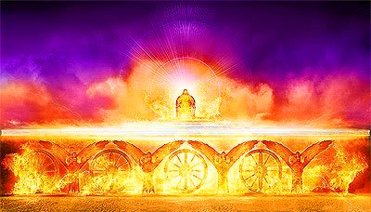
Mockers

Slide 47
2 Peter 3:
5 For this they willfully forget: that by the word of God the heavens were of old, and the earth standing out of water and in the water, 6 by which the world that then existed perished, being flooded with water. 7 But the heavens and the earth which are now preserved by the same word, are reserved for fire until the day of judgment and perdition of ungodly men

Slide 48
“By the Word of God”
II Peter 3
D
A
Y
o
f
E
T
E
R
N
I
T
Y
(v 18)
C
R
E
A
T
I
O
N
(v 5)
FLOOD
(v 6)
FIRE
(v 6)
“Longsuffering
Is Salvation”
(v 15)
“Repentance”
(v 9)
Past
Judgment
“World Perished”
Future
Judgment
“Elements Melt”
THE PROMISE OF HIS COMING!
(God: “One Day” “Thousand Years”)
as

Slide 49
2 Peter 3:
8 But, beloved, do not forget this one thing, that with the Lord one day is as a thousand years, and a thousand years as one day. 9 The Lord is not slack concerning His promise, as some count slackness, but is longsuffering toward us, not willing that any should perish but that all should come to repentance.

Slide 50
Birth-
Adult-
Death-
Maturity-
Time
∞
Time
Notes:
50

Slide 51
2 Peter 3:
10 But the day of the Lord will come as a thief in the night, in which the heavens will pass away with a great noise, and the elements will melt with fervent heat; both the earth and the works that are in it will be burned up. 11 Therefore, since all these things will be dissolved, what manner of persons ought you to be in holy conduct and godliness, 12 looking for and hastening the coming of the day of God, because of which the heavens will be dissolved, being on fire, and the elements will melt with fervent heat? 13 Nevertheless we, according to His promise, look for new heavens and a new earth in which righteousness dwells.

Slide 52
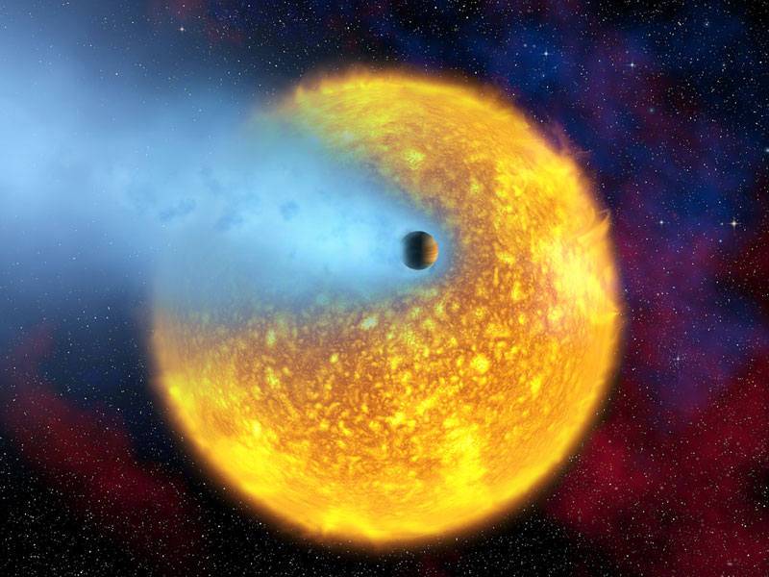

Slide 53
2 Peter 3:
10 But the day of the Lord will come as a thief in the night, in which the heavens will pass away with a great noise, and the elements will melt with fervent heat; both the earth and the works that are in it will be burned up. 11 Therefore, since all these things will be dissolved, what manner of persons ought you to be in holy conduct and godliness, 12 looking for and hastening the coming of the day of God, because of which the heavens will be dissolved, being on fire, and the elements will melt with fervent heat? 13 Nevertheless we, according to His promise, look for new heavens and a new earth in which righteousness dwells.

Slide 54
So, what do I do?
You therefore, beloved, knowing this beforehand, be on your guard so that you are not carried away by the error of unprincipled men and fall from your own steadfastness, but grow in the grace and knowledge of our Lord and Savior Jesus Christ.
“All these things destroyed.”
  Heavens
  Elements
  Earth
  Works
“What sort of people?”
  Holy conduct
  Godliness
  In peace
  Spotless
  Blameless

Slide 55
Why?
But according to His promise we are looking for new heavens and a new earth, in which righteousness dwells.

Slide 56
Group Work
Using information from Peter’s first letter, determine why Christians, who are: good citizens (2:13ff), good servants/employees (2:18ff), good husbands & wives (3:1ff), and generally mild-mannered and law abiding (3:8ff), would be persecuted/ Mocked as described in 1 & 2 Peter.

Slide 58
I & II Peter, & Jude
Lesson 12

Slide 59
Quiz
1-4. Give four reasons for maintaining our hope
  God is Merciful, Jesus is Alive, The Nature of Our Inheritance, We are Safely Guarded
4-?. What are some words used to describe the false teachers of 2 Peter 2 and Jude?
  False, greed, indulge in the lust of defiling passion and despise authority, bold, willful, irrational animals, creatures of instinct, insatiable for sin, defile the flesh, sensuality, waterless clouds, fruitless trees in late autumn twice dead uprooted, wandering stars

Slide 60
Trials
Persecution (1 Pet)
False Teaching (2 Pet/J)
From without
Faith emphasized
Can cause to give up
From within
Knowledge emphasized
Can lead astray

Slide 61
Persecution (1 Pet)
What kind?
  Speak against (2:12)
  Slandered / reviled (3:16)
  Maligned (4:4)
  Beaten? (2:20)
  Fiery trial? (4:12)

Slide 62
Evildoers!! … Right?
Put away (2:1)
  Malice
  Deceit
  Hypocrisy
  Envy
  Slander
Be subject (2:13-3:9)
  Gov’t
  Family
  Masters
  Brethren
So… why all the hate?

Slide 63
2 Peter 1: 8 For if these things are yours and abound, you will be neither barren nor unfruitful in the knowledge of our Lord Jesus Christ. 9 For he who lacks these things is shortsighted, even to blindness, and has forgotten that he was cleansed from his old sins.
Christ
Faith / Virtue
Knowledge /Self-control
Perseverance /Godliness
Brotherly kindness
Love
Notes:
James 1: 23 For if anyone is a hearer of the word and not a doer, he is like a man observing his natural face in a mirror; 24 for he observes himself, goes away, and immediately forgets what kind of man he was. 25 But he who looks into the perfect law of liberty and continues in it, and is not a forgetful hearer but a doer of the work, this one will be blessed in what he does.

Slide 64
Judgment
Servants of God (2:15,16)
Holiness (4:3-5)
Fate of disobedient, ungodly, sinner (4:17,18)

Slide 65
Group Work
Understanding now how false teachers operate and some of their tactics how would you respond to the following challenges:
Religion is a product of Man’s intellect
All things continue, there is no judgment
I have the ‘right’ to believe or do whatever I want
Teaching something that limits my ‘rights’ is a form of Hate
With enough knowledge you will understand there is no God
Teachings aren’t literally binding, just guidelines

Slide 66

Two World Views in Conflict (Then)
An Infinite, Intrusive,
Personal God
Nothing Infinite
Rejection of All
Other Religions
Man is Made a Partaker
Of the Divine Nature…
Through the
Knowledge of God
(II Pet 1:4)
Belief in Supernatural
Intervention
(“Power & Coming”)
Gods are Partakers
Of Human Nature
The
Christian
Judgment by an
Absolute, Unchanging
Standard of Truth
Man
Walks after the Flesh, in
The Lusts of Defilement
(II Pet 2:10)
“Having Escaped from the
Corruption that is in the
World through Lust”
(II Pet 1:4)
Conviction of Moral
Accountability

Slide 67
Two World Views in Conflict (Now)
An Infinite, Intrusive,
Personal God
Non-Personal,
Non-Intrusive God
Rejection of All
Other Religions
Man is Made a Partaker
Of the Divine Nature…
Through the
Knowledge of God
(II Pet 1:4)
Belief in Supernatural
Intervention
(“Power & Coming”)
Religion is a Product
Of Man’s Intellect
The
Christian
Judgment by an
Absolute, Unchanging
Standard of Truth
Man
Individual Determination
Of Moral Correctness
(Response to Desires)
“Having Escaped from the
Corruption that is in the
World through Lust”
(II Pet 1:4)
Conviction of Moral
Accountability

Slide 68
False Teachings (2 Pet/J)
Freedom from rules. “Grace.”
Sensuality – slavery to the senses
Teachings aren’t literally binding
The unfulfilled prophecy will remain so
Jesus was a teacher of good principles
There’s nothing to be “saved” from

Slide 69
Exiles
Christians don’t belong here.
  1:1,17
  2:11
  2:5,9

Slide 70
I & II Peter, & Jude
Lesson 13 - Review

Slide 71
Pre- Class work:
Make a list of the top 2-3 things you learned in this study.
Be prepared to share these things with others

Slide 72
Class Schedule:
Lesson | Title | Date
1 | Introduction to I Peter | Sunday, February 24
2 | The Great Salvation (I Pet 1:1-12) | Wednesday, February 27
3 | Products of Salvation (I Peter 1:13-2:10) | Sunday, March 3
4 | The Duties of the Christian (I Peter 2:11-3:12) | Wednesday, March 6
5 | Suffering (I Peter 3:13-4:19) | Sunday, March 10
6 | Exhortations to Elders and Soldiers (I Peter 5:1-13) | Wednesday, March 13
7 | Introduction to II Peter and Jude | Sunday, March 17
 | Meeting | Wednesday, March 20
8 | Call to Growth (II Peter 1:1-21) | Sunday, March 24, 2013
9 | Warnings Against False Teachers (II Peter 2:1-22) | Wednesday, March 27
10 | Warnings Against False Teachers (Jude) | Sunday, March 31
11 | The Coming of the Lord (II Peter 3) | Wednesday, April 3
12 | Persecution and Ideological Struggles | Sunday, April 7
13 | Review | Wednesday, April 10

Slide 73
How should we approach our Study tonight?
Lecture with occasional questions and comments interjected
‘Ask and answer’ review of the lesson 13 review questions
Group discussions that lead to class discussion about application of these 3 letters
Other?

Slide 74
Option ‘C’ – Process:
Review of topics
Break into groups to list top 2-3 things learned in this study and how they can help us serve Christ
Report out on Learnings and Applications
My list

Slide 75
Introduction 1:1,2
1 Peter, an apostle of Jesus Christ,
To the pilgrims of the Dispersion in Pontus, Galatia, Cappadocia, Asia, and Bithynia, 2 elect according to the foreknowledge of God the Father, in sanctification of the Spirit, for obedience and sprinkling of the blood of Jesus Christ:
1 Peter, an apostle of Jesus Christ, to the elect who are sojourners of the Dispersion in Pontus, Galatia, Cappadocia, Asia, and Bithynia,
2 according to the foreknowledge of God the Father, in sanctification of the Spirit, unto obedience and sprinkling of the blood of Jesus Christ: Grace to you and peace be multiplied.
1 Peter, an apostle of Jesus Christ, To those who reside as aliens, scattered throughout Pontus, Galatia, Cappadocia, Asia, and Bithynia, who are chosen 2 according to the foreknowledge of God the Father, by the sanctifying work of the Spirit, to obey Jesus Christ and be sprinkled with His blood: May grace and peace be yours in the fullest measure.
NKJ
ASV
NAS

Slide 76
Introduction 1:1,2
The Great Salvation 1:3-12
    The Nature of the Salvation 1:3-9
    The Revelation of the Salvation 1:10-12

Slide 77
The Great Salvation (I Pet 1:1-12 in time sequence)
Christ Mani-
fested (20)
Begotten
Again by the
Word (23)
Beforehand (11)
Now Have Been (12)
Prophets Prophesied of Grace to Come (10,11)
Prophets Searched to Know the time (10,11)
Told They Ministered to You (12)
Suffer-
ing
Glory
Announced to You (12)
In the Gospel
By Them that Preach
Sent by the Holy Spirit
of Christ (11)
Begotten
Again (3)
Now, For a
Little While (6)
Revelation of
Jesus Christ (7)
“The Last Time” (5)
Living Hope (3)
Guarded (5)
  By God’s Power
  Through Faith
Grief in Manifold Trials (6)
  Proof of Your Faith (7)
Loving & Believing Jesus (8)
Rejoicing (8)
  Joy Unspeakable
  Full of Glory
Inheritance (4)
  Incorruptible
  Undefiled
  Fades Not Away
  Reserved in Heaven
Salvation Revealed (5)
The “End” of Our Faith (9)
Salvation of Souls (9)

Slide 78
Introduction 1:1,2
The Great Salvation 1:3-12
    The Nature of the Salvation 1:3-9
    The Revelation of the Salvation 1:10-12
The Products of Salvation 1:13-2:10
    Hope! 13 Therefore gird up the loins of your mind, be sober, and rest your hope fully upon the grace that is to be brought to you at the revelation of Jesus Christ;
Hope
Grace

Slide 79

Introduction 1:1,2
The Great Salvation 1:3-12
    The Nature of the Salvation 1:3-9
    The Revelation of the Salvation 1:10-12
The Products of Salvation 1:13-2:10
    Hope! 13 Therefore gird up the loins of your mind, be sober, and rest your hope fully upon the grace that is to be brought to you at the revelation of Jesus Christ;
Hope
Grace

Slide 80

Introduction 1:1,2
The Great Salvation 1:3-12
    The Nature of the Salvation 1:3-9
    The Revelation of the Salvation 1:10-12
The Products of Salvation 1:13-2:10
    Hope! 13 Therefore gird up the loins of your mind, be sober, and rest your hope fully upon the grace that is to be brought to you at the revelation of Jesus Christ;
Hope

Slide 81
Introduction 1:1,2
The Great Salvation 1:3-12
    The Nature of the Salvation 1:3-9
    The Revelation of the Salvation 1:10-12
The Products of Salvation 1:13-2:10
    Holiness 1:13-16
    Reverence 1:17-21
    Love 1:22-25
    Growth 2:1-3
    Sacrifices 2:4-8
    Testimony 2:9,10
Hope
Obey
New
Holy
Fear
Love
Christ : Grace, Love, Mercy, Truth, Light, Holiness, Obedience, Resurrection

Slide 82
Introduction 1:1,2
The Great Salvation 1:3-12
    The Nature of the Salvation 1:3-9
    The Revelation of the Salvation 1:10-12
The Products of Salvation 1:13-2:10
    Holiness 1:13-16
    Reverence 1:17-21
    Love 1:22-25
    Growth 2:1-3
    Sacrifices 2:4-8
    Testimony 2:9,10
The Duties of the Christian 2:11-3:12
    Before Gentiles (Introduction) 2:11,12
    To the State 2:13-17
    To Masters 2:18-25
    To Family: Husbands, Wives, Brethren 3:1-12

Slide 83
Relationships Exhibiting Products of Salvation
(I Pet 2:13-3:12)
For the Lord’s sake (13)
Government (2:13-17)
subjection, honor
So is the will of God (15)
Employment (2:18-25)
subjection, patience
For Conscience toward God (20)
Family (3:1-7)
wives: subjection, pure conduct, meek spirit
husbands: dwell in knowledge, honor
This is acceptable with God (20)
In the sight of God of great price (3:4)
Me
[As] Holy women… who hoped in God (5)
Brotherhood (3:8-12)
As joint heirs of the grace of life (7)
like-minded, compassionate, loving, humble, blessing for evil
For hereunto were you called… (9)
For the eyes of the Lord are upon the righteous (12)

Slide 84
Introduction 1:1,2
The Great Salvation 1:3-12
    The Nature of the Salvation 1:3-9
    The Revelation of the Salvation 1:10-12
The Products of Salvation 1:13-2:10
    Holiness 1:13-16
    Reverence 1:17-21
    Love 1:22-25
    Growth 2:1-3
    Sacrifices 2:4-8
    Testimony 2:9,10
The Duties of the Christian 2:11-3:12
    Before Gentiles (Introduction) 2:11,12
    To the State 2:13-17
    To Masters 2:18-25
    To Family: Husbands, Wives, Brethren 3:1-12
Suffering as a Christian 3:13-4:19
    Suffering for Righteousness 3:13-17
    Christ, an Example of Suffering 3:18-22
    Purpose of Suffering 4:1-6
    Responsibilities to One Another 4:7-11
    Consolation of Suffering 4:12-19
Exhortation to Shepherds 5:1-5
Exhortations to Soldiers 5:6-11
Conclusions 5:12,13

Slide 85
Introduction 1:1,2
Call to Growth 1:3-11
    God’s Gifts 1:3-4
    Our Growth 1:5-7
    Reasons to Grow 1:8-11

Slide 86
Partakers of the Divine Nature
GOD
Election (10)
Call (10)
Promises (4)
All Things that
Pertain to Life
& Godliness
…Given (1:3)
Way of Righteous-ness (2:21)
Marvelous Light (I Pet 2:9)
Holy People… (I Pet 2:10)
Precious Faith (v 1)
Partakers of the Divine Nature (v 4)
By knowledge
Christian
Man
Corruption in the World (v 4)
Pollutions in the World (2:20)
Darkness (I Pet 2:9)
No People (I Pet 2:10)
The World

Slide 87
Introduction 1:1,2
Call to Growth 1:3-11
    God’s Gifts 1:3-4
    Our Growth 1:5-7
    Reasons to Grow 1:8-11
Certain Foundations 1:12-21
    Eyewitness Testimony of Apostles 1:12-18
    Confirmation of Prophecy 1:19-21
God
(Supernatural)
Creation
(II Pet 3:5)
Day of
Judgment &
Destruction
Of Ungodly
(II Pet 2:9;
3:7)
[Prophets]
Moved by
Holy Spirit
(II Pet 1:21)
Power &
Coming
Of Jesus
(II Pet 1:16)
Commands
[thru Apostles]
(II Pet 3:2,15)
Miracles
(II Pet 1:17,18)
(Acts 2:22)

Slide 88
Introduction 1:1,2
Call to Growth 1:3-11
    God’s Gifts 1:3-4
    Our Growth 1:5-7
    Reasons to Grow 1:8-11
Certain Foundations 1:12-21
    Eyewitness Testimony of Apostles 1:12-18
    Confirmation of Prophecy 1:19-21
False Teachers 2:1-22
    Prediction of their Coming 2:1-3
    Past Examples of God’s Judgment 2:4-10a
    Description of their Activities 2:10b-19
    Danger of Entanglement 2:19b-22

Slide 89
2 Peter 1:3 as His divine power has given to us all things that pertain to life and godliness,…
God
(Supernatural)
Forget
(3:5)
Deny
(2:1)
Twist /
Distort
(3:16)
“Private
Origin”
(1:20)
“Devised
Fables”
(1:16)
“All Things
Continue”
(3:4)
Power &
Coming
Of Jesus
(II Pet 1:16)
Miracles
(II Pet 1:17,18)
(Acts 2:22)
Day of
Judgment &
Destruction
Of Ungodly
(II Pet 2:9;
3:7)
Creation
(II Pet 3:5)
[Prophets]
Moved by
Holy Spirit
(II Pet 1:21)
Commands
[thru Apostles]
(II Pet 3:2,15)
Men
(In the World)

Slide 90
False Teachers (II Pet & Jude)
Liberty Promised (2:19)
Follow Natural Desires (J7,8,10,18)
Doctrine & Practices
Grace allows Lasciviousness (J4)
Closed World (3:4)
“All Things Continue”
“No Coming” Judgment by God
Scriptures are Fables (1:21)
Deny Deity of Jesus (J4, 2:1)
Intellectual Appeal (J16)
Go After Inexperienced (2:18)
Arrogant, Not Respectful (2:10, J8)
Appeal to Lusts (2:18; 3:3)
Discriminate Against Others (J6)
Mocking (3:3)
Deceptive Words (2:3)
Ungodly (J15) (Not God Directed)
Appeal, Approach, & Character

Slide 91
Introduction 1:1,2
Call to Growth 1:3-11
    God’s Gifts 1:3-4
    Our Growth 1:5-7
    Reasons to Grow 1:8-11
Certain Foundations 1:12-21
    Eyewitness Testimony of Apostles 1:12-18
    Confirmation of Prophecy 1:19-21
False Teachers 2:1-22
    Prediction of their Coming 2:1-3
    Past Examples of God’s Judgment 2:4-10a
    Description of their Activities 2:10b-19
    Danger of Entanglement 2:19b-22
Reminder of the Lord’s Coming 3:1-16
    Argument from the Flood 3:1-7
    Promise of the Day of the Lord 3:8-13
    Admonition to Diligence 3:14-16

Slide 93
Introduction 1:1,2
Call to Growth 1:3-11
    God’s Gifts 1:3-4
    Our Growth 1:5-7
    Reasons to Grow 1:8-11
Certain Foundations 1:12-21
    Eyewitness Testimony of Apostles 1:12-18
    Confirmation of Prophecy 1:19-21
False Teachers 2:1-22
    Prediction of their Coming 2:1-3
    Past Examples of God’s Judgment 2:4-10a
    Description of their Activities 2:10b-19
    Danger of Entanglement 2:19b-22
Reminder of the Lord’s Coming 3:1-16
    Argument from the Flood 3:1-7
    Promise of the Day of the Lord 3:8-13
    Admonition to Diligence 3:14-16
Conclusions 3:17,18

Slide 94
Summary Theme of the 2 Peter:
“Beware, But Grow”
2 Pe 3:17 You therefore, beloved, since you know this beforehand, beware lest you also fall from your own steadfastness, being led away with the error of the wicked; 18 but grow in the grace and knowledge of our Lord and Savior Jesus Christ.
“Beware” lest you fall, being led away with error – 17
“But Grow” in the grace and knowledge of our Lord and Savior - 18

Slide 95
Similarities in II Peter 2 & Jude
II Pet Jude
2:3 4 their condemnation written of old
2:1 4 crept in privately … denying the master
1:12 5 put in remembrance … though ye know
2:4 6 angels that sinned (kept not their habitation)
2:6 7 destruction of Sodom & Gomorrah
2:10 8 false teachers rail at dignities, despise rule
2:11 9 angels (Michael) didn’t dispute with the devil
2:12 10 rail at what they don’t understand … will be destroyed
2:15 11 example of Balaam
2:13 12 hidden (rocks) in (love) feasts
2:17 13 waves, foam, etc. …blackness reserved for them
2:18 16 uttering (speaking) great swelling words
2:18 16 enticing in lusts
3:2 17 remember words of the apostles

Slide 96
Group Work
Break into groups to list top 2-3 things learned in this study and how they can help us serve Christ.
Focus report-outs on uses of this knowledge and specific personal applications

Slide 97
True Teachings
God’s commands are absolute and unchanging; full obedience is required.
Immorality can cause one to be lost and should not be tolerated in the church.
The scriptures are verbally inspired and should be carefully followed.
Jesus rose, bodily, from the dead, and so will we.
Jesus is the Son of God and has absolute authority as our King.
There is a judgment day coming when the wicked will be punished.

Slide 98
Two World Views in Conflict (Then)
An Infinite, Intrusive,
Personal God
Nothing Infinite
Rejection of All
Other Religions
Man is Made a Partaker
Of the Divine Nature…
Through the
Knowledge of God
(II Pet 1:4)
Belief in Supernatural
Intervention
(“Power & Coming”)
Gods are Partakers
Of Human Nature
The
Christian
Judgment by an
Absolute, Unchanging
Standard of Truth
Man
Walks after the Flesh, in
The Lusts of Defilement
(II Pet 2:10)
“Having Escaped from the
Corruption that is in the
World through Lust”
(II Pet 1:4)
Conviction of Moral
Accountability

Slide 99
Two World Views in Conflict (Now)
An Infinite, Intrusive,
Personal God
Non-Personal,
Non-Intrusive God
Rejection of All
Other Religions
Man is Made a Partaker
Of the Divine Nature…
Through the
Knowledge of God
(II Pet 1:4)
Belief in Supernatural
Intervention
(“Power & Coming”)
Religion is a Product
Of Man’s Intellect
The
Christian
Judgment by an
Absolute, Unchanging
Standard of Truth
Man
Individual Determination
Of Moral Correctness
(Response to Desires)
“Having Escaped from the
Corruption that is in the
World through Lust”
(II Pet 1:4)
Conviction of Moral
Accountability

Slide 100
The Key Messages for us:
God Has Worked a Grand Plan…
  Of Which I am a part.
I must work to be Pure, and Grow…
  Which Will Protect Me from Falling, due to..
    Persecution
    False Teachers
God will Judge the Evil in the World…
  and will Preserve the Righteous
This is Not My Home…
  I’ll Only be Here for “A Little While”
  And the World & It’s Works will be Burned Up

Slide 101
Extra slides and Material follow this slide…..

Slide 102
The Problem of Persecution
Specific Persecutions
Thought (called) Strange (4:4)
Spoken of as Evil (4:4)
Spoken Against (3:16)
Good Manner of Life Reviled (3:16)
Accused of Evil Deeds (2:12)
Reproached in Connection with the Name of Christ (4:14)
“Offensive” Doctrines (I Peter)
1:15; 2:16 Holy, Submissive Living Required
4:3; 2:11 Wrong to Follow Natural Desires
1:25; 2:2 Reliance on, Restriction
4:11a To Word of God
1:3,4,9 Reality of End of Time & Resurrection (Spiritual Nature of Man)
Possible Reasons
Pure Living Seen as Implicit Condemnation (2:12)
Independence (Free) from Worldly Thought (2:16)
Independence from Worldly Influence (Fear) (3:13,14)
Offensive Doctrines (see 2:2; 3:15)
1:21;3:22 Resurrection & Kingship of Jesus
4:5,17,18 Coming Judgment & Punishment of Wicked (Accountability of Man)

Slide 103
False Teachers Positions (II Peter)
2:18,19 Promise Liberty in Matters of Morality (“Lifestyle”)
Jude 4 Grace of God = License (see also II Pet 3:16)
1:16 Say Scriptures are Fables, Not Inspired of God
3:4 Say Things Continue as Always: No (End) Second Coming
1:16; 2:1 Deny Jesus’ Deity (& Implied Authority)
3:4; 2:9 Deny (Mock) Idea of Judgment Day

Slide 104
Similarities in II Peter 2 & Jude
II Pet Jude
2:3 4 their condemnation written of old
2:1 4 crept in privately … denying the master
1:12 5 put in remembrance … though ye know
2:4 6 angels that sinned (kept not their habitation)
2:6 7 destruction of Sodom & Gomorrah
2:10 8 false teachers rail at dignities, despise rule
2:11 9 angels (Michael) didn’t dispute with the devil
2:12 10 rail at what they don’t understand … will be destroyed
2:15 11 example of Balaam
2:13 12 hidden (rocks) in (love) feasts
2:17 13 waves, foam, etc. …blackness reserved for them
2:18 16 uttering (speaking) great swelling words
2:18 16 enticing in lusts
3:2 17 remember words of the apostles

Slide 105
Similarities in II Peter 2 & Jude
II Pet Jude
3:3 18 in the last days … mockers will come
1:10 24 ye shall never (guard you from) stumble (ing)

Slide 106
Differences in II Peter 2 & Jude
Jude
5 Deliverance from Egypt & Later Judgment
11 Cain & Korah
12 Selfish Shepherds
13 Wandering Stars
14,15 Enoch’s Prophecy
18 Showing Respect of Persons
II Peter 2
5 Noah & the Flood
7,8 Lot & Sodom
14 Cannot Cease from Sin
19-22 Escaped Defilements, then Return: Worse

Slide 107
“By the Word of God”
II Peter 3
D
A
Y
o
f
E
T
E
R
N
I
T
Y
(v 18)
C
R
E
A
T
I
O
N
(v 5)
FLOOD
(v 6)
FIRE
(v 6)
“Longsuffering
Is Salvation”
(v 15)
“Repentance”
(v 9)
Past
Judgment
“World Perished”
Future
Judgment
“Elements Melt”
THE PROMISE OF HIS COMING!
(God: “One Day” “Thousand Years”)
as

Slide 108
Group Work
Using information from Peter’s first letter, determine why Christians, who are: good citizens (2:13ff), good servants/employees (2:18ff), good husbands & wives (3:1ff), and generally mild-mannered and law abiding (3:8ff), would be persecuted as described in First Peter.

