Slide 1
Christian World View Lesson 02 Truth and Knowledge

Slide 2
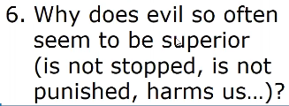

Slide 4
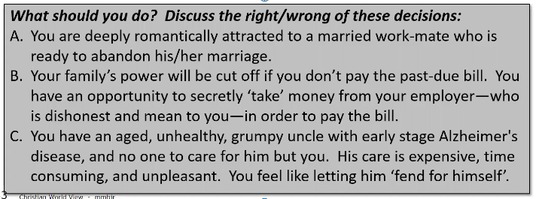

Slide 18
Ecclesiastes 11:9 (NKJV) ⁹ Rejoice, O young man, in your youth,
And let your heart cheer you in the days of your youth;
Walk in the ways of your heart,
And in the sight of your eyes;
But know that for all these God will bring you into judgment.
Romans 2:5-9 (NKJV) ⁵ But in accordance with your hardness and your impenitent heart you are treasuring up for yourself wrath in the day of wrath and revelation of the righteous judgment of God, ⁶ who "will render to each one according to his deeds": ⁷ eternal life to those who by patient continuance in doing good seek for glory, honor, and immortality; ⁸ but to those who are self-seeking and do not obey the truth, but obey unrighteousness--indignation and wrath, ⁹ tribulation and anguish, on every soul of man who does evil, of the Jew first and also of the Greek;
Matthew 16:26-27 (NKJV) ²⁶ For what profit is it to a man if he gains the whole world, and loses his own soul? Or what will a man give in exchange for his soul? ²⁷ For the Son of Man will come in the glory of His Father with His angels, and then He will reward each according to his works.
Romans 2:12 (NKJV) ¹² For as many as have sinned without law will also perish without law, and as many as have sinned in the law will be judged by the law
2 Corinthians 5:10 (NKJV) ¹⁰ For we must all appear before the judgment seat of Christ, that each one may receive the things done in the body, according to what he has done, whether good or bad.
Romans 2:16 (NKJV) ¹⁶ in the day when God will judge the secrets of men by Jesus Christ, according to my gospel.
2 Thessalonians 1:6-10 (NKJV) ⁶ since it is a righteous thing with God to repay with tribulation those who trouble you, ⁷ and to give you who are troubled rest with us when the Lord Jesus is revealed from heaven with His mighty angels, ⁸ in flaming fire taking vengeance on those who do not know God, and on those who do not obey the gospel of our Lord Jesus Christ. ⁹ These shall be punished with everlasting destruction from the presence of the Lord and from the glory of His power, ¹⁰ when He comes, in that Day, to be glorified in His saints and to be admired among all those who believe, because our testimony among you was believed.
Acts 10:42 (NKJV) ⁴² And He commanded us to preach to the people, and to testify that it is He who was ordained by God to be Judge of the living and the dead.
Acts 17:30-31 (NKJV) ³⁰ Truly, these times of ignorance God overlooked, but now commands all men everywhere to repent, ³¹ because He has appointed a day on which He will judge the world in righteousness by the Man whom He has ordained. He has given assurance of this to all by raising Him from the dead."

Slide 36
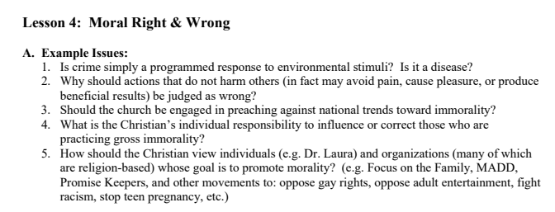

Slide 37
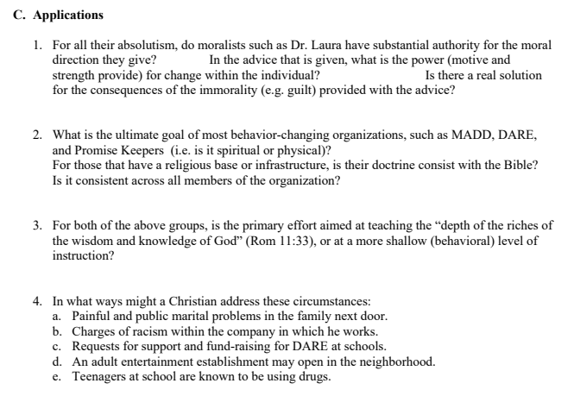

Slide 38
