Slide 1
Christian World View Lesson 02 Truth and Knowledge

Slide 3
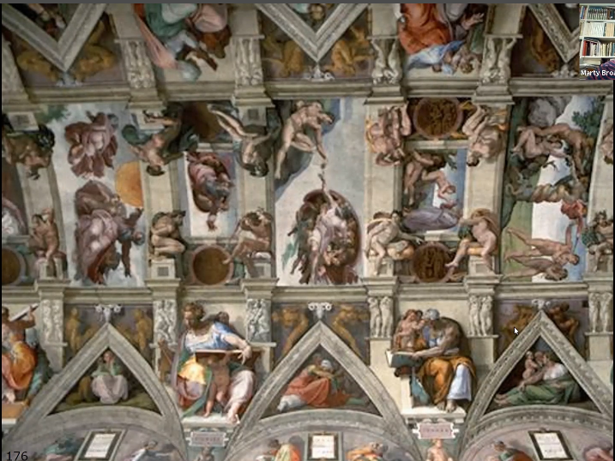

Slide 11
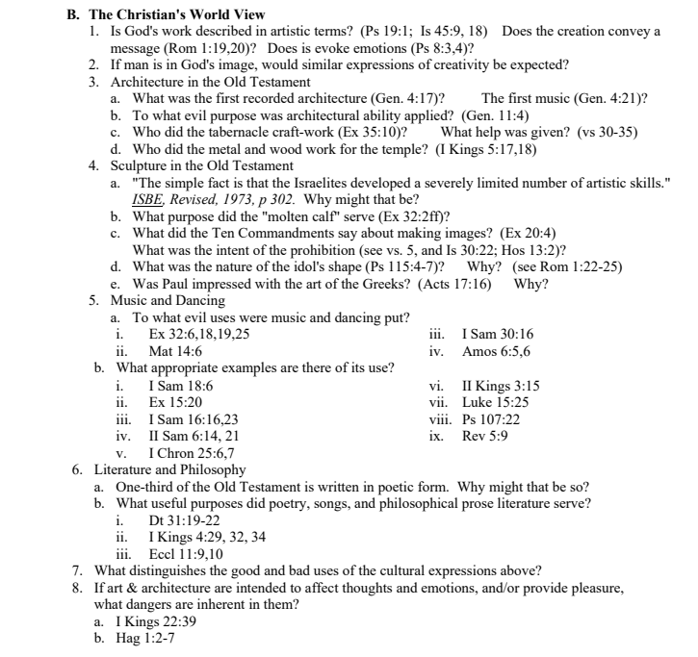

Slide 15
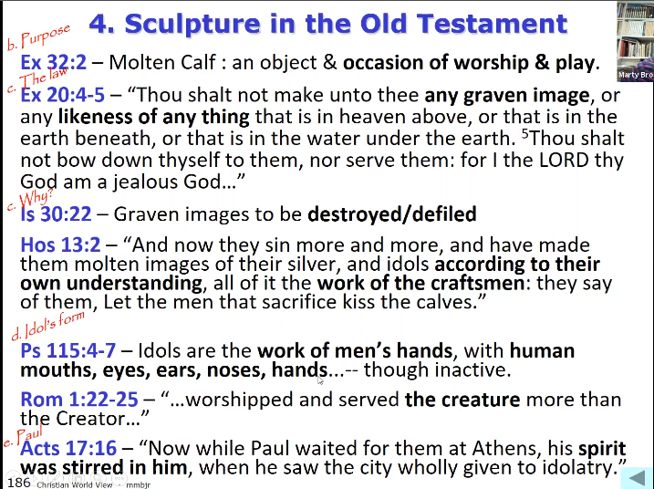

Slide 19
