Slide 1
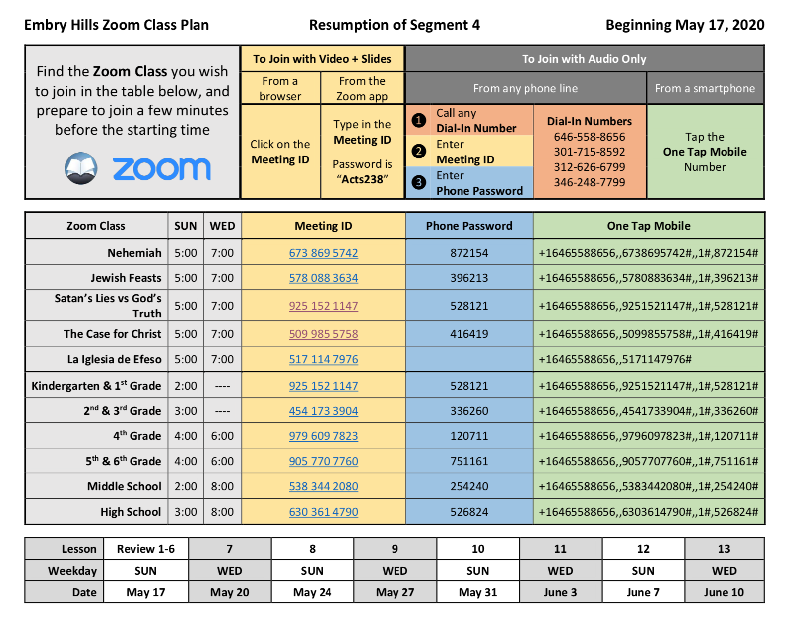

Slide 3
Excel Like Daniel
Notes:
There is so much to LOVE in this chapter.
We love it because of God’s deliverance. God’s care and power are on full display. As intimidating as the lions and lawyers can be – the LIVING GOD is the TRUE KING.
We love it because of Daniel. A man of excellent character, overcoming incredible odds.
We love it because of the friendships. Servants of God who inspire each other and stick together.
When we read about Daniel’s life, his choices, his hardships…He makes us want to be more faithful and more courageous. We stand up a little taller. We find more conviction and determination. We know that whatever lies infront of us: with God’s help, it can be overcome.
I want to invite you to the book of Daniel so that we spend some time with this man of God who was a model of excellence.

Slide 4
Daniel Is A Model of Excellence
Adapting To Babylonian Captivity (1:3-4)
Serving King Nebuchadnezzar (2:24-28)
Speaking Boldly at Belshazzar’s Feast (5:13-23)
Governing Under Darius the Mede (6:1-2)
Prospering During The Reign of Cyrus As The Jews Returned From Babylon. (1:21, 6:28)
Notes:
In Ever Changing Circumstances, Daniel Always Gave His Best...
Daniel lived with Godly Habits Across Every Area of His Life…
DANIEL IS A MODEL OF EXCELLENCE…
Excellent Habits
Excellent Work
Excellent Faith (Conviction)
Excellent Friends
Excellent Attitude (Humility)
Excellent Perspective (Government)

Slide 5
DANIEL’S WORK ETHIC: Challenging Problems call for Trustworthy People.
DANIEL’S FAITH IN GOD: Changing Environments call for Grounded Convictions.
DANIEL’S PERSPECTIVE: Complicated Decisions call for Godly Discernment.
Notes:
Today I want us to focus on just 3 that are on full display in chapter 6.
Give you the what and the why… Why = all of these difficulties and changes bring with them NEEDS. We NEED someone we can count on. We NEED to have a solid moral compass. We NEED the wisdom to make key judgment calls.
These were in high demand in Daniel’s day – and they are certainly in high demand now too!
Daniel navigates his difficult circumstances brilliantly…
Navigates – he’s not looking for the easy way, or the fast way, he’s looking for the RIGHT WAY.
We need these qualities every day – and like Daniel, we especially need them in trying situations.
If we can focus on these three qualities this week – they are going to help us grow closer to God and are going to help us navigate our challenges…

Slide 6
DANIEL’S WORK ETHIC Challenging Problems call for Trustworthy People.
Daniel 6:1-5
Daniel Rises Above His Peers Because of His Godly Spirit, Diligence, & Integrity.
Examine: The Who, What, When, & Where.
Ephesians 6:5-9
Daniel’s Commitment To Work Hard Does Not Overtake His Commitment To God.
God Is Calling His People To Give Their Best.
Ecclesiastes 9:10, Colossians 3:23-24
Notes:
Daniel Knew Who To Be, Before He Knew What To Do.
Bible.org: “I believe Darius recognized not only Daniel’s wisdom but his integrity and faithfulness. Here was a man he could trust in a leadership position who would not cause him to “suffer loss.” Recognizing his unique abilities, Darius planned to promote Daniel, placing him in charge of all the commissioners and the satraps.”
My Connection With God Comes First, & Improves My Connection With Everyone Else.
I Will Exercise My Convictions In Daily Choices, So That I’m Ready For Once In A Lifetime Challenges.
Daniel Reminds Us To Be (or I Am) Fully Aware that Every Talent I Possess Comes From God.
You Can Trust Me To Complete The Work I’ve Been Assigned. I Work On It Until It Is Done, & Done Right. You Can Trust Me To Be Where I’m Supposed To Be, When I’m Supposed To Be There. Doing What I’m Supposed To Do. Serving Who I Am Supposed To Serve. (Who, What, When, Where, Why & How of Trust)
Know That Excellence Brings Both Admiration & Attacks.

Slide 7
DANIEL’S FAITH IN GOD Changing Environments call for Grounded Convictions
Daniel 6:6-23
God Loves Faith That Is Built With Long-Standing Personal Habits. (10,16)
God Can Be Trusted In The Face of Danger. (11)
God Desires Faith Expressed In Our Word & Behavior That Is Holy & Upright. (14, 18, 22)
God Always Keeps His Promises. (9:1-2, 15-19)
Notes:
They aren’t just trying to discredit Daniel – they are trying to kill him.
Our Habits Will Help Us Navigate The Unexpected Challenges Tomorrow Always Brings.
Our Habits Will Be Shaped By Our Friendships.
DANGER: The political lions were just as vicious as the literal lions. Today, the academic lions that want to criticize this entire chapter and rip it to shreds are still attacking Daniel. They can’t accept his prophecies, they can’t accept his morality, and they can’t accept his accuracy speaking of king Darius – so they pounce on this book with pride – and just like Daniel’s enemies in the chapter – they will fail.
Friends: God is showing us the kind of FAITH that stands against the storms of life. It is built daily – in the small habits of Bible study, prayer, and obedience to God’s commands. Be a Daniel this week.

Slide 8
DANIEL’S PERSPECTIVE Complicated Decisions call for Godly Discernment.
On Public Service: Honor, Humility, & Boldness
On Government Errors: Daniel knew that imperfect people, make imperfect laws. (6:6-9)
On God’s Protection: (6:10, 22)
On God’s Dominion: He knew that God’s rule is supreme & everlasting. (6:26-28)
Notes:
“While these four godly Hebrews were willing to be called by Babylonian names, attend Babylonian schools, and even work for a Babylonian government, they were not willing to eat the food served at the king’s table.” – Bible.org
I know where I can give up my liberties and preferences, and I know where I absolutely will not compromise or be moved.
I can worship from home in a snow-storm, but when the ice begins to melt – I work my way back to the assembly, even if it means extra precautions like driving slower and wearing gloves and a coat.
Likewise, I can worship from home in a pandemic, but when the danger is reduced – I work my way back, taking extra precautions. In a snowstorm, People with 4-Wheel Drive come out first, then those in less steady cars come soon after. Likewise, people with stronger immune systems, will be here first – others will follow as they are able.
Contrast Ch. 1 and Ch. 6 – sometimes by God’s grace you can continue doing what is right, with little resistance. Sometimes you can continue doing what is right – so that others can learn from your example.
Daniel: His wisdom set him apart, but His faith kept him going.
God’s Protection: God had taken care of him for over 60 years… God wasn’t going to give up on him now.
Public Service: He could navigate difficult times, because he wasn’t playing sides – he was walking with God.
Government Errors: He knew there was corruption, He knew there was partiality, He knew there were emotional outburst. He knew that Government’s aren’t perfect. Only God is perfect. So his FAITH was in GOD, not in imperfect systems or people.

Slide 9
THIS WEEK: EXCEL LIKE DANIEL
Excel In Your Responsibilities: Give your very best, pick up any slack, tend to each task or team-member you’ve been entrusted with.
Excel In Your Faith: Yield in matters of liberty while staying true to your Godly habits. Rededicate yourself to prayer.
Excel In Your Perspective: Act with a calm and honorable spirit in the face of error and imperfection.
Notes:
While these four godly Hebrews were willing to be called by Babylonian names, attend Babylonian schools, and even work for a Babylonian government, they were not willing to eat the food served at the king’s table.
I know where I can give up my liberties and preferences, and I know where I absolutely will not compromise or be moved.
I can worship from home in a snow-storm, but when the ice begins to melt – I work my way back to the assembly, even if it means extra precautions like driving slower and wearing gloves and a coat.
Likewise, I can worship from home in a pandemic, but when the danger is reduced – I work my way back, taking extra precautions.
Contrast Ch. 1 and Ch. 6 – sometimes by God’s grace you can continue doing what is right, with little resistance. Sometimes you can continue doing what is right – so that others can learn from your example.
Daniel: His wisdom set him apart, but His faith kept him going.
God’s Protection: God had taken care of him for over 60 years… God wasn’t going to give up on him now.
Public Service: He could navigate difficult times, because he wasn’t playing sides – he was walking with God.
Government Errors: He knew there was corruption, He knew there was partiality, He knew there were emotional outburst. He knew that Government’s aren’t perfect. Only God is perfect. So his FAITH was in GOD, not in imperfect systems or people.

Slide 10
Excel Like Daniel
Notes:
Like Daniel, many things are out of our control…but we are people who love, strive for, and value excellence. We are going to go the distance…
There is so much to LOVE in this chapter.
We love it because of God’s deliverance. God’s care and power are on full display. As intimidating as the lions and lawyers can be – the LIVING GOD is the TRUE KING.
We love it because of Daniel. A man of excellent character, overcoming incredible odds.
We love it because of the friendships. Servants of God who inspire each other and stick together.
When we read about Daniel’s life, his choices, his hardships…He makes us want to be more faithful and more courageous. We stand up a little taller. We find more conviction and determination. We know that whatever lies infront of us: with God’s help, it can be overcome.
I want to invite you to the book of Daniel so that we spend some time with this man of God who was a model of excellence.

