Slide 1
Notes:
In 991 AD, the Viking Olaf Tryggvason (Trig-Va-Son) sailed his ships to England and began what is called “The Battle of Maldon.”
This battle was unique because the Vikings and the English were temporarily separated by the tidal pools of the Blackwater River that are raised and lowered with the tides.
So until the TIDE went out – and the waters became low enough to cross on foot – the soldiers were locked in a deadly standoff.
In the description of this battle, we have the very first recorded ENGLISH use of the word STEADFAST. It is used to describe the soliders who full of loyalty and courage. The soliders who stood shoulder to shoulder with their shields up on the front line to block the path of the Vikings.
These men were steadfast – even when bombarded by arrows and spears - they would not move – they would not give an inch.
Ever since, the word steadfast has been RICH with meaning. It is used to describe those who are unswerving in loyalty, faith, or friendship. It implies a steady unwavering course love, allegiance, or conviction.
This year our theme – is centered around a RICH word, in a RICH text, and I’m so thankful we are setting our course to grow in this wonderful quality.

Slide 2
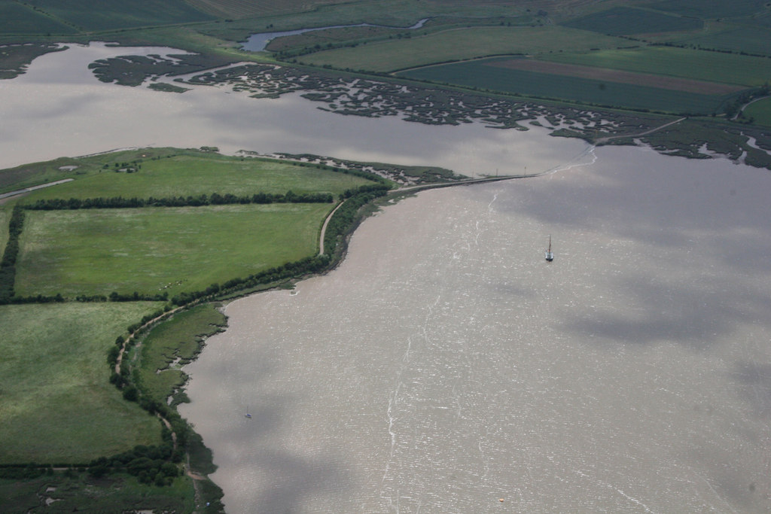
The Battle of Maldon August 11, 991 AD
Notes:
So until the TIDE went out – and the waters became low enough to cross on foot – the soldiers were locked in a deadly standoff.
Here is an arial picture of the battlefield today. The English troops from Essex – on the north, and the Vikings were on the Island. Instead of 240 yards of separation you see in this modern picture, it would have been only half that distance in the 10th century. Much closer to 120 (yards) .
What I want you to understand is…In the description of this battle, we have the very first recorded ENGLISH use of the word STEADFAST. It is used to describe the soliders - who full of loyalty and courage - stood shoulder to shoulder with their shields up on the front line to block the path of the Vikings.
These men were steadfast – even when bombarded by hateful threats, flying arrows, and sharp spears - they would not move – they would not give an inch.

Slide 3
Notes:
Ever since, the word steadfast has been RICH with meaning. It is used to describe those who are unswerving in loyalty, faith, or friendship. It implies a steady unwavering course love, allegiance, or conviction.
This year our theme – is centered around a RICH word, in a RICH text, and I’m so thankful we are setting our course to grow in this wonderful quality.
Actual Quote from the Battle of Maldon:
They all stood so firmly stiff-minded, the young warriors in the battle, thinking eagerly who they could soonest conquer with their swords, the life of fated men, the warriors with their weapons. Slaughter fell upon the earth. They stood steadfast:

Slide 4
Be Steadfast…
Steadfast: “is used to describe those who are unswerving in loyalty, faith, or friendship. It implies a steady unwavering course of love, allegiance, or conviction.”
Merriam-Webster.com
Notes:
Today, the steadfast and brave men who resisted the Vikings are remembered with this statue of the Earl from Essex.
This is the statue or the Earl who led his brave men to resist the Vikings, 1,109 years ago.
This year our theme – is centered around a RICH word, in a RICH text, and I’m so thankful we are setting our course to grow in this wonderful quality.

Slide 5
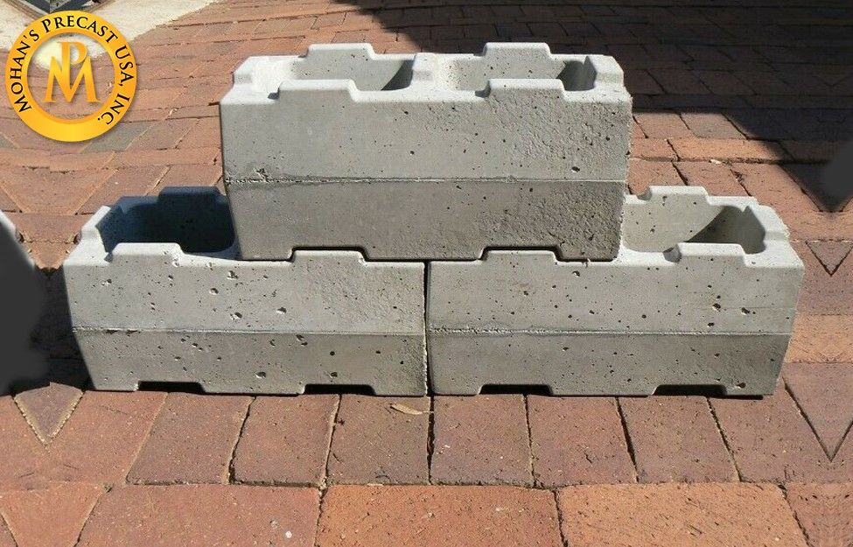
Steadfast In Faith & Purpose
Greek: Strong’s #1476 “hedraios.” Only 3 NT Uses.
Emphasis on Faith (Colossians 1:23)
Emphasis on Purpose (1 Corinthians 7:37)
Defining Steadfast
Greek: To Sit. To Firmly Hold Your Position.
English: Place + Firmly Fixed Place, such as in Homestead. Fast, such as in Fastened
Notes:
Pronounced: (He-DRY-os). (Hah more than hE)
Greek Definition: Sitting, To Put Your Full Weight Down On This Position.
CHOICE: Similar to “Stand Firm”, But Carries The Idea of Our Conclusion Reached & Full Mental & Physical Rest In This Place.
1 Cor 16:13 – literally means to stand stationary where you are. Paul uses this to describe those who are IN CHRIST – remaining in CHRIST.

Slide 6
Steadfast In Faith & Purpose
To “Be” Steadfast Requires A Choice. Luke 14:7-11
Choose Where To Sit with Humility & Wisdom.
Conscious Consideration.
Purposeful Choice.
Moral Motivation.
Ideally, Being Steadfast Begins With A Recognition of the Facts & A Determination To Respond Accordingly.
And Is Then Maintained With Honor & Devotion, Not Merely A Regretful Obligation.
Notes:
Pronounced: (He-DRY-os). (Hah more than hE)
Greek Definition: Sitting, To Put Your Full Weight Down On This Position.
CHOICE: Similar to “Stand Firm”, But Carries The Idea of Our Conclusion Reached & Full Mental & Physical Rest In This Place.
In placing the large concrete blocks: Ideally, you sit them down where they belong. You don’t just drop them somewhere and then build around them.

Slide 7
In 1 Corinthians 15, Becoming Steadfast Is A Response To Our CERTAIN Victory In Christ.
Paul’s Conclusion In Vs. 58 Is A Vivid Picture of What We Can Become.
Notes:
STEADFAST: We have total faith in the resurrection of Christ and of ourselves!
How steadfast will we be? We might guess this is determined by our personality.
Strong willed people – they will be very steadfast.
But more timid people – they will be pushed around.
Guess what: Our personality isn’t the determining factor. It is actually what we think of JESUS. The more fully we see HIM, HIS LIFE, HIS VICTORY… this motivates even the most timid people to take a stand.

Slide 8
1 Corinthians 15 Helps Christians…
Become Fully Convinced of the Truth & Value of The Gospel.
Accept The Possibility of All Difficulties Including Death.
Know They Are Not Alone, Even When Others Are Not Present.
Determine Not To Give Up or Retreat From Their Confession of Loyalty & Sacrifice.
View Our Coming Victory With Real & Meaningful Hope.
Notes:
Like the soldiers defending their homes in England…
Not Alone: Daniel in the Lions Den. Elijah (7,000 had not bowed the knees). Friends – in our growth over the next year, remember: We are not alone.
CONFESSION: 1 Tim. 6:12 “Fight the good fight of faith; take hold of the eternal life to which you were called, and you made the good confession in the presence of many witnesses.”
Steadfast Christians Are A Life-Changing Blessing…
They Are Leaders Who Will Not Compromise with Sin.
They Are Friends Who Will Not Ignore our Burdens.
They Are Examples Who Inspire our Faithfulness.

Slide 9
Steadfast Is Just The Beginning
Be Immovable: ametakinētos (Strongs #277)
“a” = Not “metakinētos” To Move Away
Maintaining Our Steadfast Faith, Even Under Pressure.
Be Always Abounding In The Work of the Lord
In Frequency: Constant
In Measure: Overflowing
In Effort: Diligently Excelling
Knowing That Your Toil Is Not In Vain In The Lord.
The Evil Influences (Then & Now) Are Fully Refuted.
Notes:
We will have more to say about these in future lessons…but I want to just introduce these concepts from our theme verse….
IMMOVABLE: Notice that our English dictionary employs words like “unswerving” and “unwavering.”
- Immovable Describes Not Just A Character Trait, But Describes This Trait UNDER PRESSURE.
- The Theme Lessons Will Explore The Pressures on the Corinthians and On Us That Seek To Move Us Away From Our Faith & Purpose.
ALWAYS ABOUNDING: Barnes quote is short and powerful. “Always engaged in doing the will of God; in promoting His glory, and advancing His kingdom. The phrase means not only to be engaged in this, but to be engaged diligently, laboriously; excelling in this. The “work of the Lord” here means that which the Lord requires; all the appropriate duties of Christians. Paul exhorts them to practice every Christian virtue, and to do all that they could do to further the gospel among people.”
NOT IN VAIN: “You’re just wasting your time…there is not resurrection.” or “You’re just wasting your time…come enjoy the pleasures of the world.” 1 Cor 15 is a chapter that answers these evil influences and fully PROVES – Being a Christian is the most meaningful, most important, most eternally rewarding decision we could ever make. It is NOT a VAIN choice. It is the MOST VICTORIOUS CHOICE!

Slide 10
Sermon Title | Sundays at 6:00 P.M.
Overview: Steadfast in The LORD | September 20, 2020
Hope & Victory: 1 Corinthians 15 | October 18, 2020
Steadfast in The Gospel | November 15, 2020
Steadfast in Sound Doctrine | December 20, 2020
Immovable Against False Teachings | January 17, 2021
Immovable Against Temptations & Evil Companions | February 21, 2021
Immovable Against Skepticism & Struggles | March 21, 2021
Depending on God’s Grace & Strength | April 18, 2021
Abounding In Our Work Together As A Church | May 16, 2021
Abounding In Personal Morality | June 20, 2021
Abounding In Personal Love & Good Deeds | July 18, 2021
Conclusion: Our Labor Is Not In Vain | August 15, 2021
Notes:
This is our COURSE. This is the path we are on…
Introducing the Theme.
Next Month: Study of the Chapter – see how Paul deals concept by concept with the issues they faced and we faced.
Then Dig Into each section of the chapter…
Look at Paul’s Steadfastness – not based on his personality or individual strength but on God’s grace.
The Great work they could do together, and we can do together.

Slide 11
The Blessings of 1 Corinthians 15
Brings honor to God by emphasizing His grace and sovereignty.
Brings stability to our lives by helping us stay grounded in the good news of Jesus’ life, death, and resurrection.
Brings hope to our outlook by explaining key facts about the final resurrection and victory prepared for Christians.
Brings success to our battles by directing us away from dangerous sins and influences.
Brings encouragement to our works by showing us the eternal difference our labors make.
Notes:
Call to Action…. Ch. That equips us, motivates us, sustains and empowers us…
Acknowledged as being difficult….
Come out on the other side.
Sets this Vision of where we are going, who we are becoming.
Not guessing, hoping – but KNOWING it is not in vain.
Group goal – ability to do this alone is really hard – but to do this together is super empowering.

Slide 12
Notes:
We have a lot to look forward to in this study, and today, I hope the lesson makes the idea of BEING STEAFAST in the Lord more real, and more clear than ever before. So that, TOGETHER, as a church family, We can help each other become…
“Therefore, my beloved brethren, be steadfast, immovable, always abounding in the work of the Lord, knowing that your toil is not in vain in the Lord.”
1 Corinthians 15:58
If you know you haven’t been steadfast – you’ve let sin get a foothold in your life. We are here to pray with you and help you come back to the Lord.
If you know you haven’t TAKEN your stand with JESUS, but have sin in your life that has left you DEAD. He offers LIFE!
If today you want to DEVOTE your life to HIM. You want to TAKE YOUR STAND with His kingdom, and give your life to His service. Then He wants to wash your sins away and bring you home.

