Slide 1
Faith of the Freed

Slide 2
Jesus’ Message in the Synagogue of Nazareth (Luke 4:16-21)
¹⁶ And He came to Nazareth, where He had been brought up; and as was His custom, He entered the synagogue on the Sabbath, and stood up to read. ¹⁷ And the book of the prophet Isaiah was handed to Him. And He opened the book and found the place where it was written,
¹⁸ “The Spirit of the Lord is upon Me, Because He anointed Me to preach the gospel to the poor. He has sent Me to proclaim release to the captives, And recovery of sight to the blind, To set free those who are oppressed, ¹⁹ To proclaim the favorable year of the Lord.”
²⁰ And He closed the book, gave it back to the attendant and sat down; and the eyes of all in the synagogue were fixed on Him. ²¹ And He began to say to them, “Today this Scripture has been fulfilled in your hearing.”
He is God’s designated servant with a special task.
Isaiah 61:1-2
What had been potential, long awaited promise and hope is at this moment reality.

Slide 3
Eating in a Pharisees House (7:36-50)
Now one of the Pharisees was requesting Him to dine with him, and He entered the Pharisee’s house and reclined at the table.
Pharisees (“separatist”) were a religious sect within Judaism in the first century. They prided themselves on maintaining a special level of righteousness which raised them above any violation of their interpretations of the Law. They demanded strict adherence to the Law of Moses by their interpretations of the Law.
Luke 7:15-17 - The dead man sat up and began to speak. And Jesus gave him back to his mother. ¹⁶ Fear gripped them all, and they began glorifying God, saying, “A great prophet has arisen among us!” and, “God has visited His people!” ¹⁷ This report concerning Him went out all over Judea and in all the surrounding district.

Slide 4
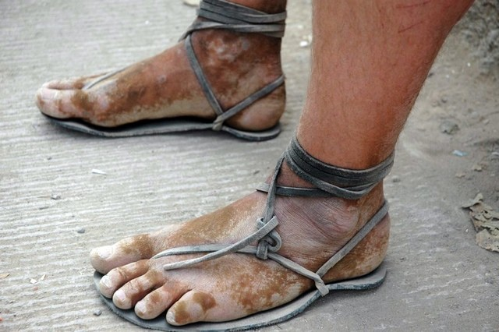
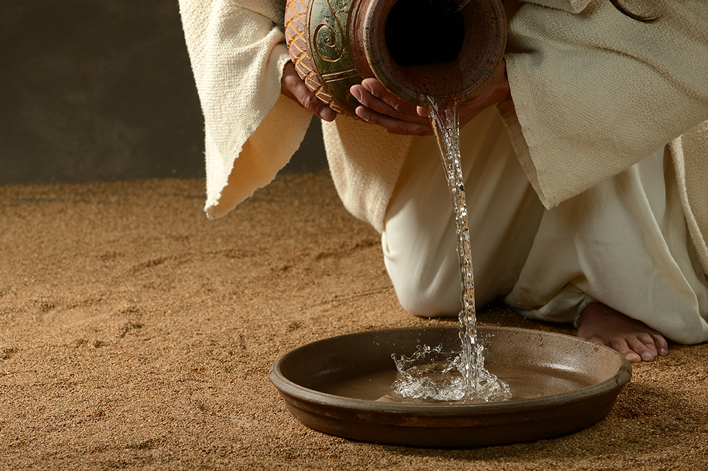
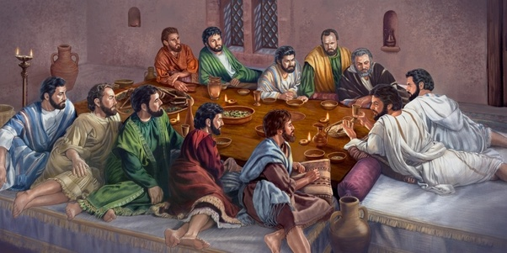
Cultural Customs
Bowl of water for dirty feet
Kiss
Anoint head with oil to indicate a blessing or to refresh
Open door policy to listen to dinner conversations
Posture when eating

Slide 5
Eating in a Pharisees House (7:36-50)
Now one of the Pharisees was requesting Him to dine with him, and He entered the Pharisee’s house and reclined at the table. ³⁷ And there was a woman in the city who was a sinner; and when she learned that He was reclining at the table in the Pharisee’s house, she brought an alabaster vial of perfume, ³⁸ and standing behind Him at His feet, weeping, she began to wet His feet with her tears, and kept wiping them with the hair of her head, and kissing His feet and anointing them with the perfume. ³⁹ Now when the Pharisee who had invited Him saw this, he said to himself, “If this man were a prophet He would know who and what sort of person this woman is who is touching Him, that she is a sinner.”
He saw what the woman had been. He did not take into consideration what her heart was like at the moment. Nor did he comprehend that he was a self-righteous hypocrite.

Slide 6
Eating in a Pharisees House (7:36-50)
⁴⁰ And Jesus answered him, “Simon, I have something to say to you.” And he replied, “Say it, Teacher.” ⁴¹ “A moneylender had two debtors: one owed five hundred denarii, and the other fifty. ⁴² When they were unable to repay, he graciously forgave them both. So which of them will love him more?” ⁴³ Simon answered and said, “I suppose the one whom he forgave more.” And He said to him, “You have judged correctly.” ⁴⁴ Turning toward the woman, He said to Simon, “Do you see this woman? I entered your house; you gave Me no water for My feet, but she has wet My feet with her tears and wiped them with her hair. ⁴⁵ You gave Me no kiss; but she, since the time I came in, has not ceased to kiss My feet. ⁴⁶ You did not anoint My head with oil, but she anointed My feet with perfume. ⁴⁷ For this reason I say to you, her sins, which are many, have been forgiven, for she loved much; but he who is forgiven little, loves little.” ⁴⁸ Then He said to her, “Your sins have been forgiven.” ⁴⁹ Those who were reclining at the table with Him began to say to themselves, “Who is this man who even forgives sins?” ⁵⁰ And He said to the woman, “Your faith has saved you; go in peace.”
He needed to understand that the one who realizes his own sinfulness appreciates grace more and thus loves God more.
The point Jesus is making has to do with the subjective recognition of sin.
He wanted Simon to see her heart and the motivation for her actions. But all the more, Jesus wanted Simon to see himself!
Therefore, I tell you, her many sins have been forgiven; that’s why she loved much. But the one who is forgiven little, loves little.” (Luke 7:47 HCSB)
Therefore, I tell you, her many sins have been forgiven – as her great love has shown. But whoever has been forgiven little loves little. (Luke 7:47 NIV)

Slide 7
Simon, the Pharisee
The Sinful Woman
Righteous/Spiritual Leader
Self-Righteous/ No spiritual need/Pride/ 50 denarii
Couldn’t pay debt – unable to see the reality of his debt
Sense of obligation, careful and calculated, insincere motives
Lacked hospitality, Judgmental, limited zeal
Public Perception
Detestable Sinner
Poor in Spirit/nothing to offer and in great need/ 500 denarii
Couldn’t pay debt
Forgiven
Deep gratitude and love that could not be hidden
Total Adoration, Sacrifice, great zeal, grace driven service
Self Awareness
Condition before God
“Those who are well have no need of a physician, but those who are sick. ³² I have not come to call the righteous but sinners to repentance.” (Luke 5:31-32)
Approach to Jesus
“…for everyone who exalts himself will be humbled, but he who humbles himself will be exalted.”(Luke 18:14)
Treatment of Jesus

Slide 8
Faith of the Freed
Formed by a recognition of debt and desire for forgiveness offered by Jesus
Am I deeply impacted by my sin? Do I see a need for forgiveness? (Isa 59:2; Eph 2:1-2; Psalm 51)
An imperfect sense of my debt can lead to self righteousness & pride.
Fueled by an appreciation of the compassion of Jesus
How much do I appreciate the compassion of Jesus?
My love and service to Jesus is grounded in the recognition and appreciation of His compassion (2 Peter 1:9)
Does Jesus’ compassion result in my compassion toward others?
Focused on offering everything in service to Jesus
Am I willing and eager to get down on my hands and knees and give Jesus whatever I have?
Do I care about criticism in my service to Jesus?

Slide 9
The Spirit of the Lord God is upon me, Because the Lord has anointed me To bring good news to the afflicted; He has sent me to bind up the brokenhearted, To proclaim liberty to captives And freedom to prisoners; ² To proclaim the favorable year of the Lord And the day of vengeance of our God; To comfort all who mourn,
³ To grant those who mourn in Zion, Giving them a garland instead of ashes, The oil of gladness instead of mourning, The mantle of praise instead of a spirit of fainting. So they will be called oaks of righteousness, The planting of the Lord, that He may be glorified.
Notes:
³ To grant those who mourn in Zion, Giving them a garland instead of ashes, The oil of gladness instead of mourning, The mantle of praise instead of a spirit of fainting.
So they will be called oaks of righteousness, The planting of the Lord, that He may be glorified.
⁴ Then they will rebuild the ancient ruins, They will raise up the former devastations; And they will repair the ruined cities, The desolations of many generations. ⁵ Strangers will stand and pasture your flocks, And foreigners will be your farmers and your vinedressers. ⁶ But you will be called the priests of the Lord; You will be spoken of as ministers of our God. You will eat the wealth of nations, And in their riches you will boast.
Its only with the zeal and grace driven obedience that we will become what God wants us to be. I want to end by going back to the Isaiah 61.
It is easy to stop the reading of Isaiah at this point since this is part of the text that Luke quotes to show that Jesus is the fulfillment of Isaiah’s coming anointed one. But notice that we are stopping in the middle of the sentence of this prophecy. We need to continue reading because Isaiah is going to describe our purpose and what we will do when Christ comes.
Notice in verse 3 the radical change that has occurred in Jesus. Verse 3 describes great comfort that we are able to have in Christ. The oil of gladness has replaced mourning. The garment of praise has replaced the faint spirit. Here we are crushed by our sins and separated from God. But Jesus comes and solves our sin problem. The faint spirit from the weight of our sins and mourning from our sinfulness has been replaced with praise and gladness. What Jesus has done in the cross changes our circumstances from doom to praise and hope
We fail to see the devastation that we do ourselves because of our sins. Isaiah’s prophecy opened with this picture of weakness and doom to help us see our condition before God. Listen to the picture:
But rebels and sinners shall be broken together, and those who forsake the Lord shall be consumed. For they shall be ashamed of the oaks that you desired; and you shall blush for the gardens that you have chosen. For you shall be like an oak whose leaf withers, and like a garden without water. And the strong shall become tinder, and his work a spark, and both of them shall burn together, with none to quench them. (Isaiah 1:28–31 ESV)
Do you hear the pictures of doom and emptiness? Our rebellion against God makes us like an oak with withered leaves and like a garden without water. The strong become tinder. We are devastated by our sins. But Jesus comes and listen to what changes about us in Isaiah 61:3. “They may be called oaks of righteousness, the planting of the Lord, that he may be glorified.” The corrupted people now are righteous. We were trees with withered leaves but now are the planting of the Lord. The imagery is very similar to Psalm 1 where we are planted trees sitting by the waters, yielding fruit and not withering. Notice that God has rescued us from our sins so that he would be glorified. The transformation that occurs in us brings God glory. The sinners who disregarded and rebelled against God have changed hearts that turn toward God and desire him. God is glorified as those faint spirits who are crushed by sins enjoy gladness and joy as they come to the Lord, receiving mercy and salvation. Our primary is calling is the glorification of God. We are displaying the splendor of God to the world.
We Are Builders
I want to see that there are two pictures given here about who we are in Christ that reflect our purpose as followers of Jesus. Isaiah 61:4-6 gives us these three pictures and through these three pictures we bring glory to God. The first picture is in verse 4.
They shall build up the ancient ruins; they shall raise up the former devastations; they shall repair the ruined cities, the devastations of many generations. (Isaiah 61:4 ESV)
Notice we are pictured as builders. We are pictured as restoring the kingdom in the world. Christ has given us a new status and a new name so that we can enter into a new activity. We are pictured as restoring the broken. I want us to think about how this idea changes our world view and how we view ourselves in this world. Christ has saved you. Christ has transformed you. Christ has given you a purpose: build. We are pictured as workers building in the kingdom of God. We sing songs from our songbook where we describe ourselves wanting to be workers for the Lord. These ideas come from the scriptures. In fact, in 1 Corinthians 3 you may remember that the apostle Paul describes himself as a skilled master builder building on top of the foundation of Jesus.
We do not come here to worship so that we can simply point out what a mess the city is. We do not come here and look at the spiritual condition and shrug our shoulders. We are pictured as people who will rebuild the ruins, repairing it and raising it up.
We Are Priests
The second picture highlights this role even further. Look at verses 5-6.
Strangers shall stand and tend your flocks; foreigners shall be your plowmen and vinedressers; but you shall be called the priests of the Lord; they shall speak of you as the ministers of our God; (Isaiah 61:5–6 ESV)
Now we need to understand the picture given to us. Remember that under the Law of Moses the priests were released from laboring in the fields because they were given a distinctive work of service before God. The rest of the tribes of Israel worked the land while the priests of the tribe of Levi worked daily in ministry to God. This is what is now being pictured of us as followers of Christ. We are set apart to operate as priests of God. The outsiders are supposed to speak of us as ministers of our God.
When we think about the role of priests in Israel’s history we can see the picture clearly. The purpose of the priesthood was to serve God and serve the people of Israel. The priests functioned between God and the people. The priests were to know the laws of God and teach them to the people. This is the first role we see ourselves in as priests of God. We are to bring the knowledge of God to the world. We look at the spiritually broken down walls of the people and we bring them the knowledge of God. Not only this, though, the priests represented the people before God. In this way the priests brought the people closer to God. The priests were to bring the people nearer to God. So we go into the world, bringing the world the knowledge of God. Then we help people come near to God. We serve God and we serve the world in this very important spiritual capacity
Conclusion
We live in a nation that needs restoration. Our nation is deep in spiritual decay. We are not called to perfect church attendance. We are not called to make sure you take the Lord’s Supper once a week. Your purpose as a follower of Jesus is not to sit here for the last hour in worship. You are the planting of the Lord. You are an oak of righteousness, a monument for God’s glory. You are priests, for you are to take God to the people and bring the people to God
_________________________________________________________________________________________________________________________________________________________________________________________________
The Result of the Year of the Lord’s Favor (61:3-7)
Why is God doing all of this for us? Notice the result of the Servant’s work in the middle of verse 3. These who are brokenhearted, captives, in darkness, and mourning are now going to be called oaks of righteousness, the planting of the Lord, so that God is glorified. We are a planting of the Lord to display God’s honor and splendor. We exist to show the glory of God. Even better, our transformation from blind, mourning, captives to oaks of righteousness is to show the splendor of our God.
God’s radical transformation of our lives empowers us participate in the work of the kingdom. This is not merely a call to get to work in God’s kingdom. Isaiah is picturing something glorious. The work of the Servant of redemption and liberty will cause such a dramatic change in our lives that we will be workers in God’s restored kingdom. We are given the privilege of working for the cause of Jesus. This is not about us. This is about what God has done for us. We are thrilled to be allowed to find our part of the work in God’s kingdom
Our Response (61:10-11)
Now the ball is back in our court. What will we do now that the Servant will come bringing the year of the Lord’s favor? “I will greatly rejoice in the Lord! My soul shall exult in my God!” (61:10). God will be our joy. God will be our rejoicing. Why? Why should we find our joy in the Lord now? “For he has clothed me with the garments of salvation; he has covered me with the robe of righteousness.” This is why we rejoice. God has made us beautiful. God has covered our sins with his salvation and with his righteousness (cf. Isaiah 60:17,20).
I continue to be amazed at how often Isaiah declares that God’s people will find their joy in the Lord and rejoice in God. God’s people will love God, hope in God, desire God, and live for God. The proclamation of the good news of Jesus is to move us to this response. He has taken us, who were captured by our sins, and set us free to be oaks of righteousness and priests of the Lord. With joy let us give our lives to the Lord.
We reach the lost, encourage the broken, strengthen the weak, teach one another, worship with each other, serve one another, and do all we can in this work because we are so overjoyed that God has taken us from captivity and made us oaks of righteousness. How amazing it is that God has enabled us to be his workers! Our work is not a duty but represents the favor of the Lord to make us workers of righteousness.
But there is even more. Outsiders are joining in the life of the people in working for the Lord. We saw this image in Isaiah 60:10 where outsiders/foreigners were building the walls of Zion. God gives us another amazing picture of who we are. First, he said that he will make us oaks of righteousness. Now God says that we will “be called the priests of the Lord.” “They shall speak of you as the ministers of our God” (60:6). This is staggering! God’s people were always intended to be priests of God
The Spirit of the Lord God is upon me, Because the Lord has anointed me To bring good news to the afflicted; He has sent me to bind up the brokenhearted, To proclaim liberty to captives And freedom to prisoners; ² To proclaim the favorable year of the Lord And the day of vengeance of our God; To comfort all who mourn, ³ To grant those who mourn in Zion, Giving them a garland instead of ashes, The oil of gladness instead of mourning, The mantle of praise instead of a spirit of fainting. So they will be called oaks of righteousness, The planting of the Lord, that He may be glorified.
⁴ Then they will rebuild the ancient ruins, They will raise up the former devastations; And they will repair the ruined cities, The desolations of many generations. ⁵ Strangers will stand and pasture your flocks, And foreigners will be your farmers and your vinedressers. ⁶ But you will be called the priests of the Lord; You will be spoken of as ministers of our God. You will eat the wealth of nations, And in their riches you will boast. ⁷ Instead of your shame you will have a double portion, And instead of humiliation they will shout for joy over their portion. Therefore they will possess a double portion in their land, Everlasting joy will be theirs. ⁸ For I, the Lord, love justice, I hate robbery in the burnt offering; And I will faithfully give them their recompense And make an everlasting covenant with them. ⁹ Then their offspring will be known among the nations, And their descendants in the midst of the peoples. All who see them will recognize them Because they are the offspring whom the Lord has blessed.
¹⁰ I will rejoice greatly in the Lord, My soul will exult in my God; For He has clothed me with garments of salvation, He has wrapped me with a robe of righteousness, As a bridegroom decks himself with a garland, And as a bride adorns herself with her jewels. ¹¹ For as the earth brings forth its sprouts, And as a garden causes the things sown in it to spring up, So the Lord God will cause righteousness and praise To spring up before all the nations.

