Slide 1
Kingdom Hearts
Notes:
It’s neat to see the way people use the word heart.
Some use it in sports to describe a dedicated player that “really has heart.”
Some use it in Holiday Hallmark movies to describe the affections felt in a racing “heart.”
But one of my favorite ways the word Heart is Used is to describe a person’s core.
When we want to make a strong and meaningful connection… To speak to the heart of a child or friend
When we want to go deep in the study of a topic… I want to get to the “heart of the matter.”
When we want to get to the core issues in a disagreement… we may ask, “what is at the heart of this problem.”
In the Bible the HEART is used to talk about our CENTER… And for a few sermons this month, I want us to go DEEP on understanding the HEART. Specifically, I want us to look at how JESUS talked about the HEART so that we can all have a HEART more like His.

Slide 2
In the Bible, the heart is the center of all we are. Center of Understanding & Faith (Rom 10:9-10) Center of Identity & Character (Luke 8:15) Center of Emotions & Actions (Matt. 11:29, Lk 6:45)
Notes:
As I just mentione the heart is at the “CENTER” of who we are. This is true even in passages that are using “heart” about non-humans. For example…In Matthew 12:40 as Jesus talks about Jonah in the belly of the great fish – he says the Son of Man will be in the “Heart” of the earth. Placed on the inside. Similarly Ps. 46:2 says even if the mountains slip into the “heart of the sea” – get the idea of the depths of the sea…
Understanding & Faith – used this way extensively. Proverbs 6:18 – a hear that devises wicked plans… thinking.. Heb 4:12…the thoughts and intents of the heart. The heart is the CENTER of our thinking.
Identity & Character – a Heart can be “good and honest” or a heart can be hard and stubborn. Proverbs tells us a heart can be Prideful or Humble. Colossians 3:12 tells us specific characteristics to put on in our hearts…
EMOTIONS & ACTIONS: our Heart can be filled with grief or filled with joy. Our heart can be meek and lowly, resulting in actions that are sacrificial and loving.
I’m using popular verses, because I want you to realize that we use this language frequently, but we don’t always stop to consider how CENTRAL the term heart is.
Because the HEART is at the CENTER of who we are – it is extremely important that we think carefully about WHAT is IN OUR HEARTS…
Look at the way Luke 6:45 describes this…

Slide 3
Luke 6:45
“The good man out of the good treasure of his heart brings forth what is good; and the evil man out of the evil treasure brings forth what is evil; for his mouth speaks from that which fills his heart.”

Slide 4
God sees exactly what is in our hearts. He wants to help us fill them with good treasure. • Acts 5:4, 8:21, 15:8 • Matt. 7:7-8, Jer. 29:13
Notes:
If the only thing we know is that God sees our hearts – that could be un-nerving. Wait – you mean he sees every evil thought, every stain…yes He does. But God’s knowledge doesn’t stop there! He actively helps us clean and purify them.
Choosing King David…
Acts 15:8 –
The Good News is that God will help us fill our hearts with righteousness when we seek Him.

Slide 5
God sees exactly what is in our hearts.
“While it remained unsold, did it not remain your own? And after it was sold, was it not under your control? Why is it that you have conceived this deed in your heart? You have not lied to men but to God.” Acts 5:4
“You have no part or portion in this matter, for your heart is not right before God.” Acts 8:21
“And God, who knows the heart, testified to them giving them the Holy Spirit, just as He also did to us;” Acts 15:8
Notes:
We didn’t turn and read these last week.
5:4 – God sees the greed, the deception, the pride in the hearts of Annanias & Sapharia. *Special note – deceitfulness in the heart is repeatidly mentioned as a major heart condition. (Prov 12:20, Jeremiah 17:9-10)
8:21 – God sees the worldliness, the selfishness in the heart of Simon the Sorcerer.
15:8 –God knew the hearts of the family of Cornelius – in their sincere faith and repentace.
Bonus point: the speaker in all 3 of these passages is Peter. This was the apostle who denied the Lord 3 times, but was also forgiven and restored… who told Jesus, “You KNOW that I love you…. You KNOW that I love you… You KNOW ALL THINGS; You KNOW that I love you…”
Peter had a vivid first person concept of GOD KNOWING HIS HEART. And he wants us to remember that GOD knows our hearts as well.
>> This makes God’s warning about Corrupt hearts especially meaningful and weighty. God never “miss-diagnoses” the heart. His warnings are 100% accurate, and must be taken very seriously if we want to be ready to stand before Him on the day of Judgment.

Slide 6
God Warns Us About Bankrupt Hearts
Beware The Hard Heart.
Proverbs 28:14
Beware The Darkened Heart.
Romans 1:21, Acts 28:27
Beware The Arrogant Heart.
Proverbs 18:12
Beware The Twisted Heart.
Proverbs 6:14.
Beware The Distant Heart.
Matthew 15:8
Beware The Divided Heart.
Matthew 6:24, James 1:8
Notes:
Do we have a heart like this…Do I? Do You? Do we?
Beware The Hard Heart.
Doesn’t listen. Doesn’t Yield. (Pr 28:14)
Beware The Darkened Heart.
(Rom 1:21). Doesn’t acknowledge God. (Acts 28:27)
Beware The Arrogant Heart.
Doesn’t trust in or lean on God, but on self.
Beware The Twisted Heart.
Proverbs 6:14. Always schemeing and divising troubling plans.
Beware The Far Heart.
External self-righteousness. Distant from Devotion to God. Matthew 15:8
Beware The Divided Heart:
Double Minded. Not fully loyal. Not pursuing one direction, but split between the two. Matthew 6:24, James 1:8
** Do you know who the BIG example of this kind of heart is in Scripture? It’s not the Babylonians, or some terrible nation God destroys. The CHIEF EXAMPLE of these kind of hearts in the Bible…is Israel. It’s the ones who had everything – but neglected it – and allowed the hearts to be turned to treasure the entircements on the world. ☹. That should actually break our hearts – and cause us to examine our own hearts even more. It isn’t the IGNORANT who so often have a heart like this. It is the BLESSED – who take their blessings for granted!

Slide 7
God Wants To Fill Our Hearts With Good Treasure.
“The good man out of the good treasure of his heart brings forth what is good; and the evil man out of the evil treasure brings forth what is evil; for his mouth speaks from that which fills his heart.”
Luke 6:45

Slide 8
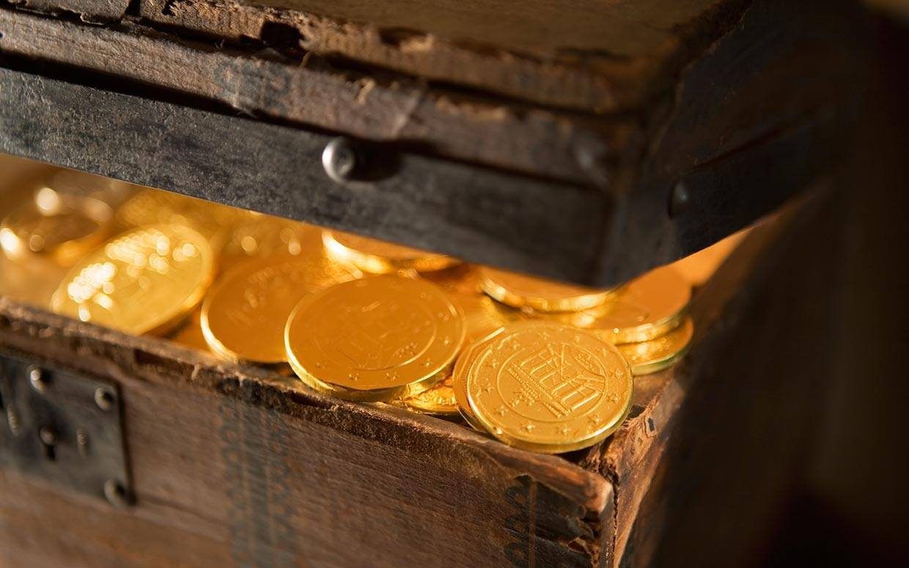
Notes:
Would you please imagine a few treasure chests inside your heart….one for each category…because Jesus would like to make a few deposits. Now you can ignore it and toss it aside…but I want to give you actual treasure that you can put in your heart…and you can add to it, with good deeds and personal study…but I want to open a few accounts – and make the initial deposit for you.
Make an initial deposit – and give you a way to make it grow.

Slide 9
Kingdom Hearts Are Rich In Honor. - 1 PETER 3:15
Who Can I Treat As Valuable & Important This Week?
Notes:
FIRST - How can I treat Christ as valuable and important this week?
Spend more time reading His words. Do things I know make Him happy. Etc… Repent of things I know He hates and wants to set me free from.
This Week, Let Paul’s Example in Philippians 1:20-21 Override All Other Pursuits.

Slide 10
Kingdom Hearts Are Rich In Contentment. - ACTS 20:35
What Can I Give To Ease The Struggle Someone Else Is Facing This Week?
Notes:
This Week, Let Paul’s Example in Philippians 1:20-21 Override All Other Pursuits.
You can give encouragement.
You can give prayers.
You can give a meal.
You can give attention or tears.
You can give a ride, a book, a gift card.
But it requires you to say: I have enough, and so I want you to have this.

Slide 11
Kingdom Hearts Are Rich In Patience. - PSALM 27:14
Where Can I Slow Down & Solve A Problem With Righteousness Instead of Rushing?
Notes:
This Week, Let Paul’s Example in Philippians 1:20-21 Override All Other Pursuits.
You can give encouragement.
You can give prayers.
You can give a meal.
You can give attention or tears.
You can give a ride, a book, a gift card.
But it requires you to say: I have enough, and so I want you to have this.

Slide 12
Kingdom Hearts Are Rich In Sincerity. - COLOSSIANS 3:22
What Work Can I Accomplish To The Highest Quality Even If No One Notices?
Notes:
This Week, Let Paul’s Example in Philippians 1:20-21 Override All Other Pursuits.
You can give encouragement.
You can give prayers.
You can give a meal.
You can give attention or tears.
You can give a ride, a book, a gift card.
But it requires you to say: I have enough, and so I want you to have this.

Slide 13
Kingdom Hearts Are Rich In Peace. - COLOSSIANS 3:15
What Disagreement, Difference, or Hurt Can I Set Aside & Forgive Knowing Christ Has Forgiven Me?
Notes:
Vs. 9-15 you see disagreements among Christians.

Slide 14
Like David, We Long For A Pure Heart
⁶ Behold, You desire truth in the innermost being,
And in the hidden part You will make me know wisdom.
⁷ Purify me with hyssop, and I shall be clean;
Wash me, and I shall be whiter than snow.
⁸ Make me to hear joy and gladness,
Let the bones which You have broken rejoice.
⁹ Hide Your face from my sins
And blot out all my iniquities.
¹⁰ Create in me a clean heart, O God,
And renew a steadfast spirit within me.
- Psalm 51:6-10
Notes:
Ps 51.

Slide 15
Kingdom Hearts
Notes:
It’s neat to see the way people use the word heart.
Some use it in sports to describe a dedicated player that “really has heart.”
Some use it in Holiday Hallmark movies to describe the affections felt in a racing “heart.”
But one of my favorite ways the word Heart is Used is to describe a person’s core.
When we want to make a strong and meaningful connection… To speak to the heart of a child or friend
When we want to go deep in the study of a topic… I want to get to the “heart of the matter.”
When we want to get to the core issues in a disagreement… we may ask, “what is at the heart of this problem.”
In the Bible the HEART is used to talk about our CENTER… And for a few sermons this month, I want us to go DEEP on understanding the HEART. Specifically, I want us to look at how JESUS talked about the HEART so that we can all have a HEART more like His.

