Slide 1
Old Testament Survey in 7 Lessons
Notes:
During the slideshow, hold down the Ctrl key and the left mouse pointer to make the laser pointer appear on the screen.

Slide 2
Class Schedule
Lesson | Bible Period | Bible Reference
1 | Creation and The Patriarchs | Genesis 1-50, Job
2 | Exodus & Wilderness Wanderings | Exodus, Leviticus, Numbers, Deuteronomy
3 | Conquest & Time of Judges | Joshua, Judges & Ruth, 1 Samuel 1-7
4 | United Kingdom | 1 Samuel 8-31 & 2 Samuel 1 Kings 1-11 1 Chron 1-2 Chron 9, Psalm, Proverbs, Ecclesiastes, Song of Solomon
5 | Divided Kingdom – Days of Israel & Judah | I Kings 12-2 Kings 17 2 Chron 10-28
6 | Judah Alone | 2 Kings 18-23 2 Chron 29-35
 | Fall of Judah & the Prophets | 2 Kings 23-25, 2 Chron 36, Jeremiah, Minor Prophets
7 | Exile & Remnant Returns | Jeremiah, Ezekiel & Daniel Ezra, Nehemiah, Esther

Slide 3
Objectives
Learn Major Bible Periods of Old Testament
Learn to Place Bible Events on a Timeline/In Order
Learn God’s Plan to bring Salvation to the World
Learn Main Topics of each Old Testament Book
Learn God’s relationship with man

Slide 4
Bible in Three Words
Problem
Sin
Promises
Fulfillment
Christ
Bruise heel
Bruise head
All the families of the earth shall be blessed
The divine author of the Old Testament …
Supplied authoritative instruction for God’s people.
Recorded the progression and purpose of God’s covenants in redemptive history.
Distinguished the Law, Prophets, and Writings.
Highlighted how the old (Mosaic) covenant was
established, enforced, and enjoyed.
What the Old Testament Authors Really Cared About: A Survey of Jesus' Bible.
Notes:
The divine author of the Old Testament …
Supplied authoritative kingdom instruction for God’s people.
Recorded the progression and purpose of God’s covenants in redemptive history.
Distinguished the Law, Prophets, and Writings.
Highlighted how the old (Mosaic) covenant was established, enforced, and enjoyed.
What the Old Testament Authors Really Cared About: A Survey of Jesus' Bible.

Slide 5
Period 7
Period 1
Judah Alone
Creation & Fall
Period 8
Period 4
Fall of Judah
Conquest & Judges
Period 2
Period 9
Patriarchs
Period 5
Exile
United Kingdom
Period 3
Exodus & Wanderings
Period 6
Period 10
Divided Kingdom
Return
2091-1876 BC
1445 BC
1405
To 1050 BC
1050-930 BC
930-722 BC
722-605 BC
Genesis
1-11
Genesis
12-50
Job
Exodus
Leviticus
Numbers
Deuteronomy
Joshua
Judges
Ruth
1 Samuel 1-7
1 Samuel 8-31
1 Kings 1-11
1 Chronicles
2 Chronicles 1-9
Psalms
Proverbs
Ecclesiastes
Song of Solomon
1 Kings 12-22
2 Kings 1-17
2 Chron 10-29
2 Kgs 18-22
2 Chron 29-35
605-586 BC
586-538 BC
538-~432 BC
2 Kgs 23-25
2 Chron 36
2 Chron 36
Daniel
Jeremiah
Ezekiel
Ezra
Nehemiah
Esther
Zechariah
Haggai
Malachi
Isaiah
Hosea
Joel
Amos
Obadiah
Jonah
Micah
Jeremiah
Lamentations
Ezekiel
Daniel
Nahum
Habakkuk
Zephaniah

Slide 6

Bible Periods
Period 1
Period 2
Period 3
Creation & Fall
The Patriarchs
Exodus & Wanderings
Pentateuch-Law
Period 4
Period 5
Period 6
Period 7
Conquest & Judges
United Kingdom
Divided Kingdom
Judah Alone
History – Poetry – Major & Minor Prophets
Period 8
Period 9
Fall of Judah
Exile
Return
Period 10
History –Major & Minor Prophets

Slide 7
Old Testament Books
L-03
Lesson 1 – Creation & Fall
Patriarchs
Lesson 2 – Exodus & Wilderness
Wanderings
Lesson 3 – Conquest & Judges
Lesson 4 – United Kingdom
Lesson 5 – Divided Kingdom
Joshua
L-05
Hosea
L-03
Judges
Joel
L-05
L-03
Ruth
Amos
L-05
L-03
L-04
L-05
1 Samuel
Obadiah
L-04
2 Samuel
L-05
Jonah
L-04
L-05
1 Kings
L-05
Micah
2 Kings
L-05
Nahum
L-04
Genesis
1 Chronicles
L-04
Job
Isaiah
Habakkuk
L-01
L-05
L-05
Exodus
2 Chronicles
Psalms
Jeremiah
Zephaniah
L-02
L-04
L-04
Leviticus
Ezra
L-04
Lamentations
L-02
Proverbs
Haggai
Numbers
Nehemiah
L-04
L-02
Ecclesiastes
Ezekiel
Zechariah
L-02
L-04
Deuteronomy
Esther
Song of Songs
Daniel
Malachi
LAW
HISTORY
POETRY
MAJOR
PROPHETS
MINOR
PROPHETS

Slide 8
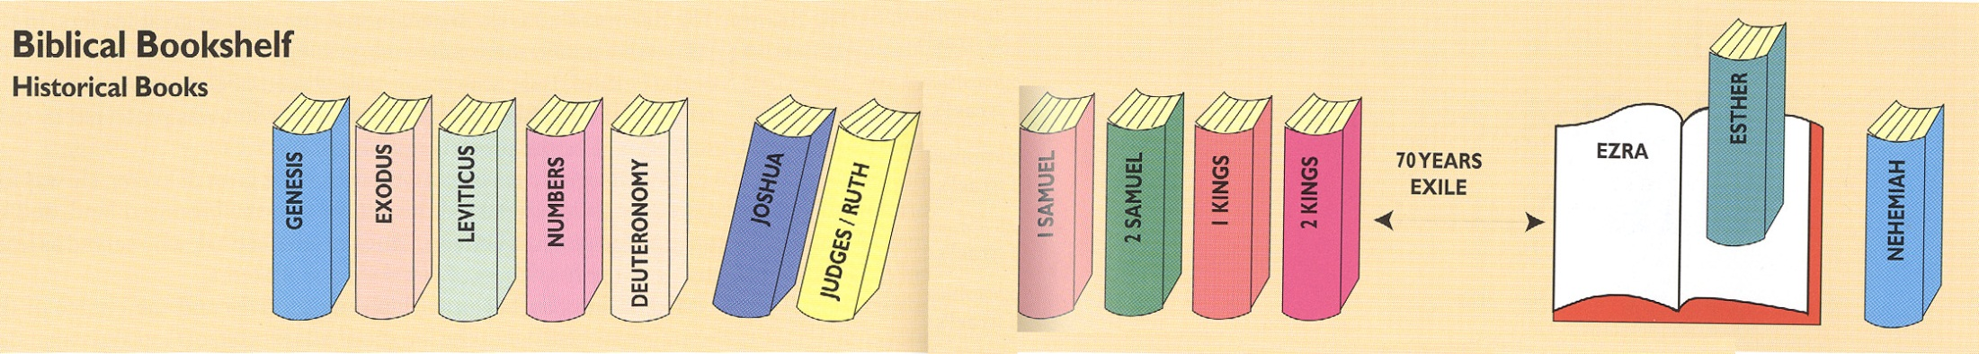
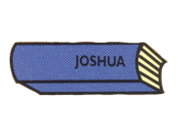

Genesis 1-11 Creation, Fall, Flood
Genesis 12-50 Patriarch
Exodus 1-18 Exodus of Israel from Egypt
Exodus 19–40 Covenant at Sinai
Leviticus 1-15 Offerings, Priesthood & Cleanness
Leviticus 16-27 Atonement, Holiness, Feasts,
Numbers 1-12 Sinai to Kadesh-Barnea
Numbers 13-36 40 Years of Wandering
Deuteronomy 1-26 Intro & Legal (Living in the Land
Deuteronomy 27-34 Blessings & Curses & Witness
Joshua 1 -12 Crossing into & Taking the Land
Joshua 13-24 Dividing the Land & Serving the Lord
Judges 1-16 Seven Cycles of Deliverance
Judges 17-21 Depravity of Israel
Ruth 1-4 Ruth’s Love

Slide 9






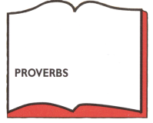
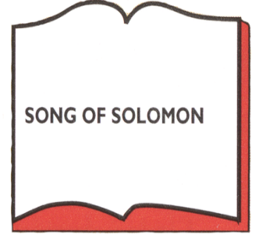


1 Samuel 1-7 Judgeship of Samuel
1 Samuel 8-24 Kingship of Saul
2 Samuel 1-10 David’s Triumphs
2 Samuel 11 David’s sins – Bathsheba
2 Samuel 12-24 David’s Troubles
1 Kings 1-11 Solomon
1 Chronicles 1-9 Genealogy of Tribes
1 Chronicles 10-29 Kingship of David
2 Chronicles 1-9 Solomon Temple & Deeds
Worship
Wisdom
Marriage
Vanity of Earthly
Suffering, sin
friends & God

Slide 10

1 Kings 1-11 Solomon
1 Kings 12-15 Early Divided Kings
1 Kings 16-22 Ahab (Omri Dynasty)
2 Kings 1-9 Ahab (Omri Dynasty)
2 Kings 9-15 Jehu (D3)
2 Kings 15-17 End of Israel (confusing dynasty)
2 Kings 18-23 Judah Alone
2 Kings 23-25 Fall of Judah
2 Chronicles 1-9 Solomon Temple & Deeds
2 Chron 10-16 Early Divided Kings of Judah
2 Chron 16-22 Judah Kings of Omri (Ahab) Dynasty
2 Chron 23-26 Judah Kings of Jehu Dynasty
2 Chron 27-28 Judah Kings of Confusing Dynasty/Israel Fall
2 Chron 29-35 Judah Alone
2 Chron 36 Fall of Judah

Slide 11


Israel
Judea
Edomites invaded Judah just as Judah was being ransacked - prophesies Edom's downfall
The
Judges
OBADIAH
845 Edom
JOEL
Judah see severe locust plague as a coming
Day of the LORD
830
Told to preach in Nineveh resulted in his being swallowed by a fish & city repenting
Kings & Prophets
JONAH
780 Nineveh
Israel, repent of injustice and idolatry or else go into exile
AMOS
Divided Kingdom
Israel & Judah
755
HOSEA
His life with adulterous wife like God & Israel
750-725
MICAH
Judah, repent of injustice and idolatry or else go into exile
735-700
ISAIAH
Isaiah 1-6 Reason for God’s Actions &
Isaiah’s Call
Isaiah 7-35 Immediate threat & Judgments
Isaiah 36-39 Historical account of siege
Isaiah 40-66 Cyrus, Future Threats & Hopes
740-690

Slide 12
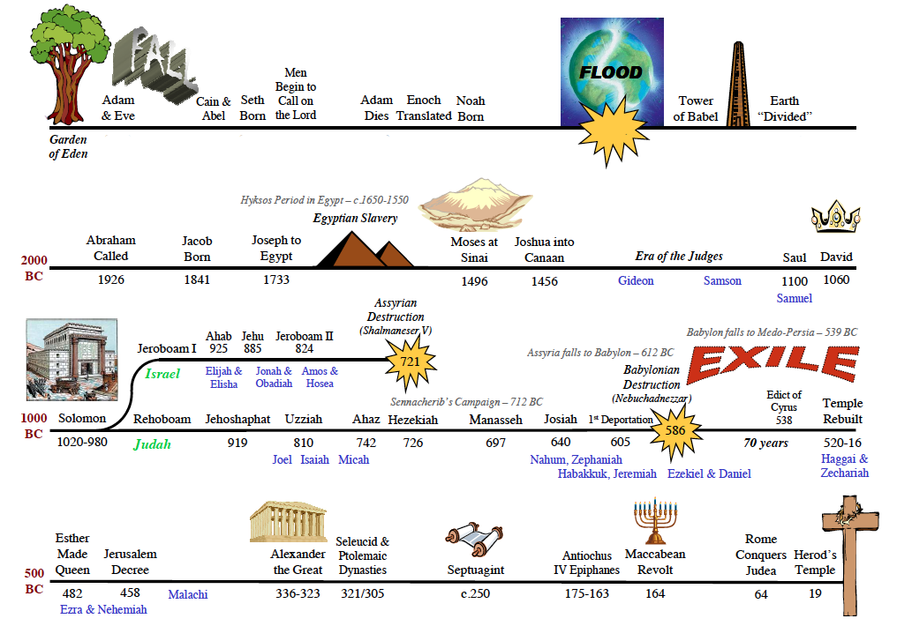

Period 1 Creation & Fall
Period 1 Creation & Fall
Jensen – Hyksos Period 1730-1570
Into Egypt
2091
2006
1876
~1447
1405
1050-1010
1010-970
Period 2 Patriarchs
Period 3 Exodus & Wandering
Period 4 Conquest & Judges
P. 5 United Kingdom
970-930
P. 5 United Kingdom
Period 6 Divided Kingdom
P. 7 Judah Alone
P. 8 Judah Falls
P. 9 Exile
P. 10 Return
486-464
445-432
P. 10 Return
Years of Silence with the Roar of Daniel
Notes:
486–464

Slide 13
Period 1 Creation & Fall
Period 1 Creation & Fall
Jensen – Hyksos Period 1730-1570
Into Egypt
2091
2006
1876
~1447
1405
1050-1010
1010-970
Period 2 Patriarchs
Period 3 Exodus & Wandering
Period 4 Conquest & Judges
P. 5 United Kingdom
970-930
P. 5 United Kingdom
Period 6 Divided Kingdom
P. 7 Judah Alone
P. 8 Judah Falls
P. 9 Exile
P. 10 Return
486-464
445-432
P. 10 Return
Years of Silence with the Roar of Daniel
Notes:
486–464

Slide 14
Period 1 Creation & Fall
Period 1 Creation & Fall
Jensen – Hyksos Period 1730-1570
Into Egypt
2091
2006
1876
~1447
1405
1050-1010
1010-970
Period 2 Patriarchs
Period 3 Exodus & Wandering
Period 4 Conquest & Judges
P. 5 United Kingdom
970-930
P. 5 United Kingdom
Period 6 Divided Kingdom
P. 7 Judah Alone
P. 8 Judah Falls
P. 9 Exile
P. 10 Return
486-464
445-432
P. 10 Return
Years of Silence with the Roar of Daniel
Notes:
486–464

Slide 15
Period 1 Creation & Fall
Period 1 Creation & Fall
Jensen – Hyksos Period 1730-1570
Into Egypt
2091
2006
1876
~1447
1405
1050-1010
1010-970
Period 2 Patriarchs
Period 3 Exodus & Wandering
Period 4 Conquest & Judges
P. 5 United Kingdom
970-930
P. 5 United Kingdom
Period 6 Divided Kingdom
P. 7 Judah Alone
P. 8 Judah Falls
P. 9 Exile
P. 10 Return
486-464
445-432
P. 10 Return
Years of Silence with the Roar of Daniel
Notes:
486–464

Slide 16
Period 1 Creation & Fall
Period 1 Creation & Fall
Jensen – Hyksos Period 1730-1570
Into Egypt
2091
2006
1876
~1447
1405
1050-1010
1010-970
Period 2 Patriarchs
Period 3 Exodus & Wandering
Period 4 Conquest & Judges
P. 5 United Kingdom
970-930
P. 5 United Kingdom
Period 6 Divided Kingdom
P. 7 Judah Alone
P. 8 Judah Falls
P. 9 Exile
P. 10 Return
486-464
445-432
P. 10 Return
Years of Silence with the Roar of Daniel
Notes:
486–464

Slide 17
Period 1 Creation & Fall
Period 1 Creation & Fall
Jensen – Hyksos Period 1730-1570
Into Egypt
2091
2006
1876
~1447
1405
1050-1010
1010-970
Period 2 Patriarchs
Period 3 Exodus & Wandering
Period 4 Conquest & Judges
P. 5 United Kingdom
970-930
P. 5 United Kingdom
Period 6 Divided Kingdom
P. 7 Judah Alone
P. 8 Judah Falls
P. 9 Exile
P. 10 Return
486-464
445-432
P. 10 Return
Years of Silence with the Roar of Daniel
Notes:
486–464

Slide 18
Period 1 Creation & Fall
Period 1 Creation & Fall
Jensen – Hyksos Period 1730-1570
Into Egypt
2091
2006
1876
~1447
1405
1050-1010
1010-970
Period 2 Patriarchs
Period 3 Exodus & Wandering
Period 4 Conquest & Judges
P. 5 United Kingdom
970-930
P. 5 United Kingdom
Period 6 Divided Kingdom
P. 7 Judah Alone
P. 8 Judah Falls
P. 9 Exile
P. 10 Return
486-464
445-432
P. 10 Return
Years of Silence with the Roar of Daniel
Notes:
486–464

Slide 19
Period 1 Creation & Fall
Period 1 Creation & Fall
Jensen – Hyksos Period 1730-1570
Into Egypt
2091
2006
1876
~1447
1405
1050-1010
1010-970
Period 2 Patriarchs
Period 3 Exodus & Wandering
Period 4 Conquest & Judges
P. 5 United Kingdom
970-930
P. 5 United Kingdom
Period 6 Divided Kingdom
P. 7 Judah Alone
P. 8 Judah Falls
P. 9 Exile
P. 10 Return
486-464
445-432
P. 10 Return
Years of Silence with the Roar of Daniel
Notes:
486–464

Slide 20
Period 1 Creation & Fall
Period 1 Creation & Fall
Jensen – Hyksos Period 1730-1570
Into Egypt
2091
2006
1876
~1447
1405
1050-1010
1010-970
Period 2 Patriarchs
Period 3 Exodus & Wandering
Period 4 Conquest & Judges
P. 5 United Kingdom
970-930
P. 5 United Kingdom
Period 6 Divided Kingdom
P. 7 Judah Alone
P. 8 Judah Falls
P. 9 Exile
P. 10 Return
486-464
445-432
P. 10 Return
Years of Silence with the Roar of Daniel
Notes:
486–464

Slide 21
Period 1 Creation & Fall
Period 1 Creation & Fall
Jensen – Hyksos Period 1730-1570
Into Egypt
2091
2006
1876
~1447
1405
1050-1010
1010-970
Period 2 Patriarchs
Period 3 Exodus & Wandering
Period 4 Conquest & Judges
P. 5 United Kingdom
970-930
P. 5 United Kingdom
Period 6 Divided Kingdom
P. 7 Judah Alone
P. 8 Judah Falls
P. 9 Exile
P. 10 Return
486-464
445-432
P. 10 Return
Years of Silence with the Roar of Daniel
Notes:
486–464

Slide 22
Period 1 Creation & Fall
Period 1 Creation & Fall
Jensen – Hyksos Period 1730-1570
Into Egypt
2091
2006
1876
~1447
1405
1050-1010
1010-970
Period 2 Patriarchs
Period 3 Exodus & Wandering
Period 4 Conquest & Judges
P. 5 United Kingdom
970-930
P. 5 United Kingdom
Period 6 Divided Kingdom
P. 7 Judah Alone
P. 8 Judah Falls
P. 9 Exile
P. 10 Return
486-464
445-432
P. 10 Return
Years of Silence with the Roar of Daniel
Notes:
486–464

Slide 23
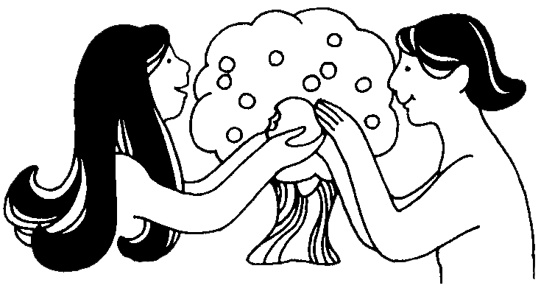
Creation & Fall
Period 1
Creation & Fall
Book - Genesis
Author – Moses
Date of Writing – 1446/45 BC (at Mt Sinai)
Theme – Origins/Beginnings and Promises
BIBLE PERIOD | MAIN ACTORS | MAIN ACTION
CREATION AND FALL Genesis 1 -11 |  | “Four Great Events”
From the undated past up to 2165 b.c. | Adam, Abel, Enoch, Noah | Creation Fall Flood Tower of Babel

Slide 24
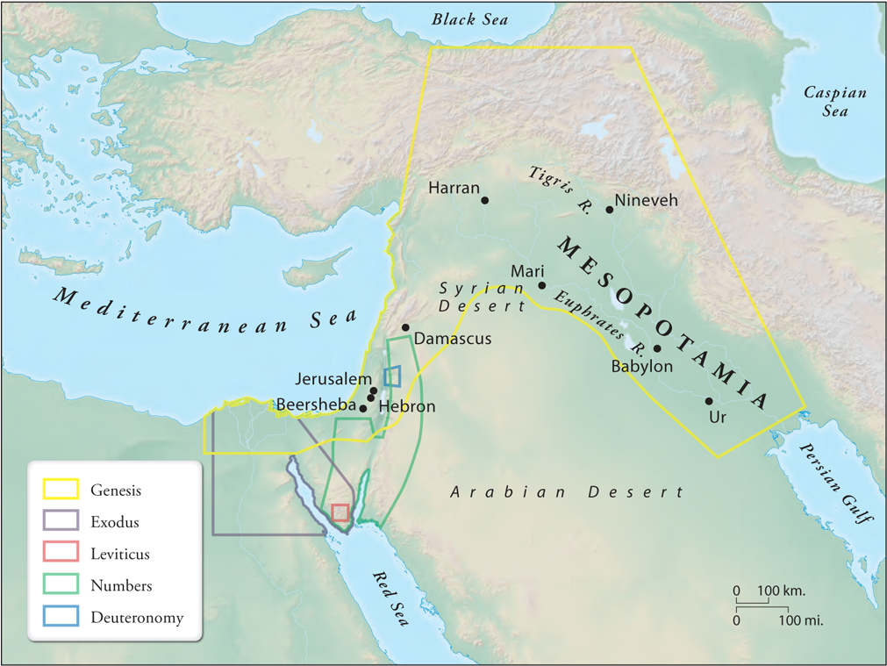
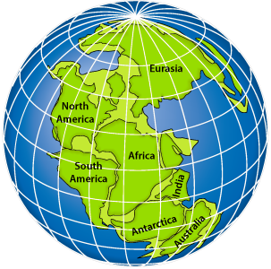
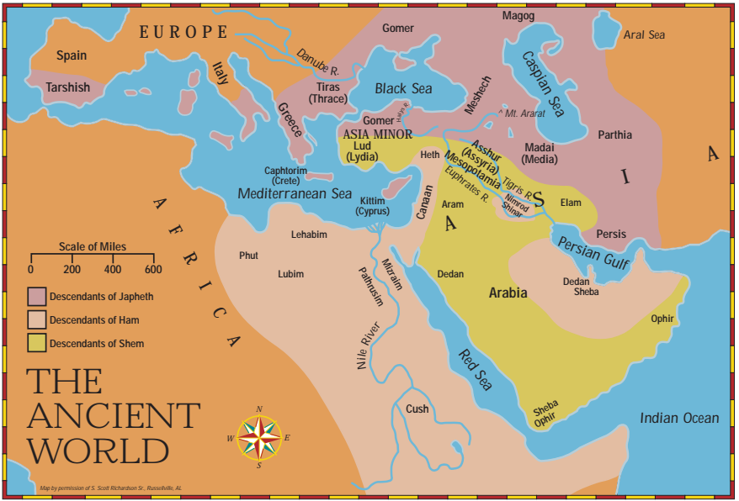
Genesis 1-11
Creation & Fall-Flood
Genesis 12-50
~2166-1800 BC
The Patriarchs
Abraham
Isaac
Jacob & Sons

Slide 25
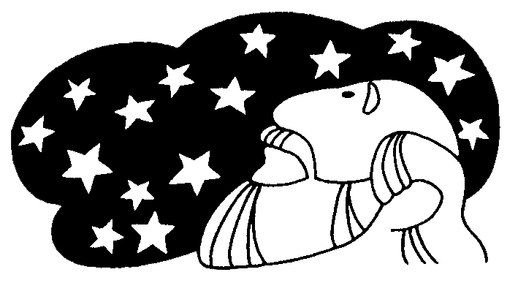
Patriarchs
Period 2
The Patriarchs
Book - Genesis
Author – Moses
Date of Writing – 1446/45 BC (at Mt Sinai)
Theme – Origins/Beginnings and Promises
BIBLE PERIOD | MAIN ACTORS | MAIN ACTION
PATRIARCHAL Genesis 12-50, Job | Four Great Men in Genesis & Job
2165 to 1804 b.c. | Abraham, Sarah, Rebekah, Rachel, Leah, Isaac, Jacob, Joseph, Job | Beginning of Hebrew Nation Giving of Abrahamic Covenant Jews Move into Egypt God Allows Satan to Test Job

Slide 26
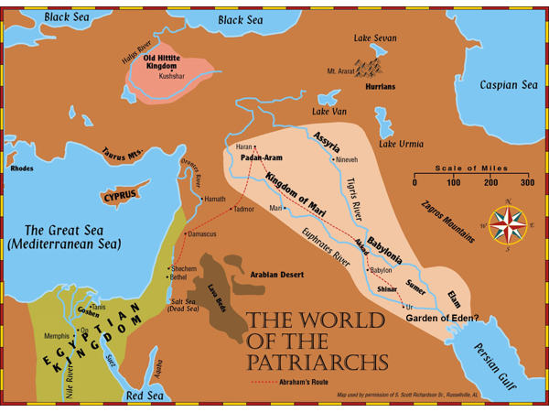
Genesis 1-11
Creation & Fall-Flood
Genesis 12-50
~2166-1800 BC
The Patriarchs
Abraham
Isaac
Jacob & Sons

Slide 27
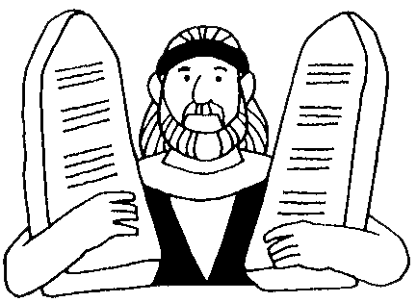
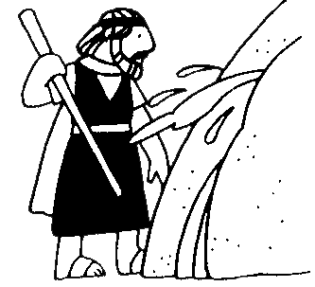
Exodus & Wanderings
Period 3
Exodus & Wanderings
BIBLE PERIOD | MAIN ACTORS | MAIN ACTION
Exodus & Law Giving
1804 to 1405 b.c. | Moses, Aaron, Miriam | Deliverance from Egypt Building of the Tabernacle Giving of the Law
Wilderness Wanderings Numbers, Deuteronomy 1445 to 1405 b.c. | Moses, Aaron, Miriam | The Failure at Kadesh-Barnea 40 years in Wilderness

Slide 28
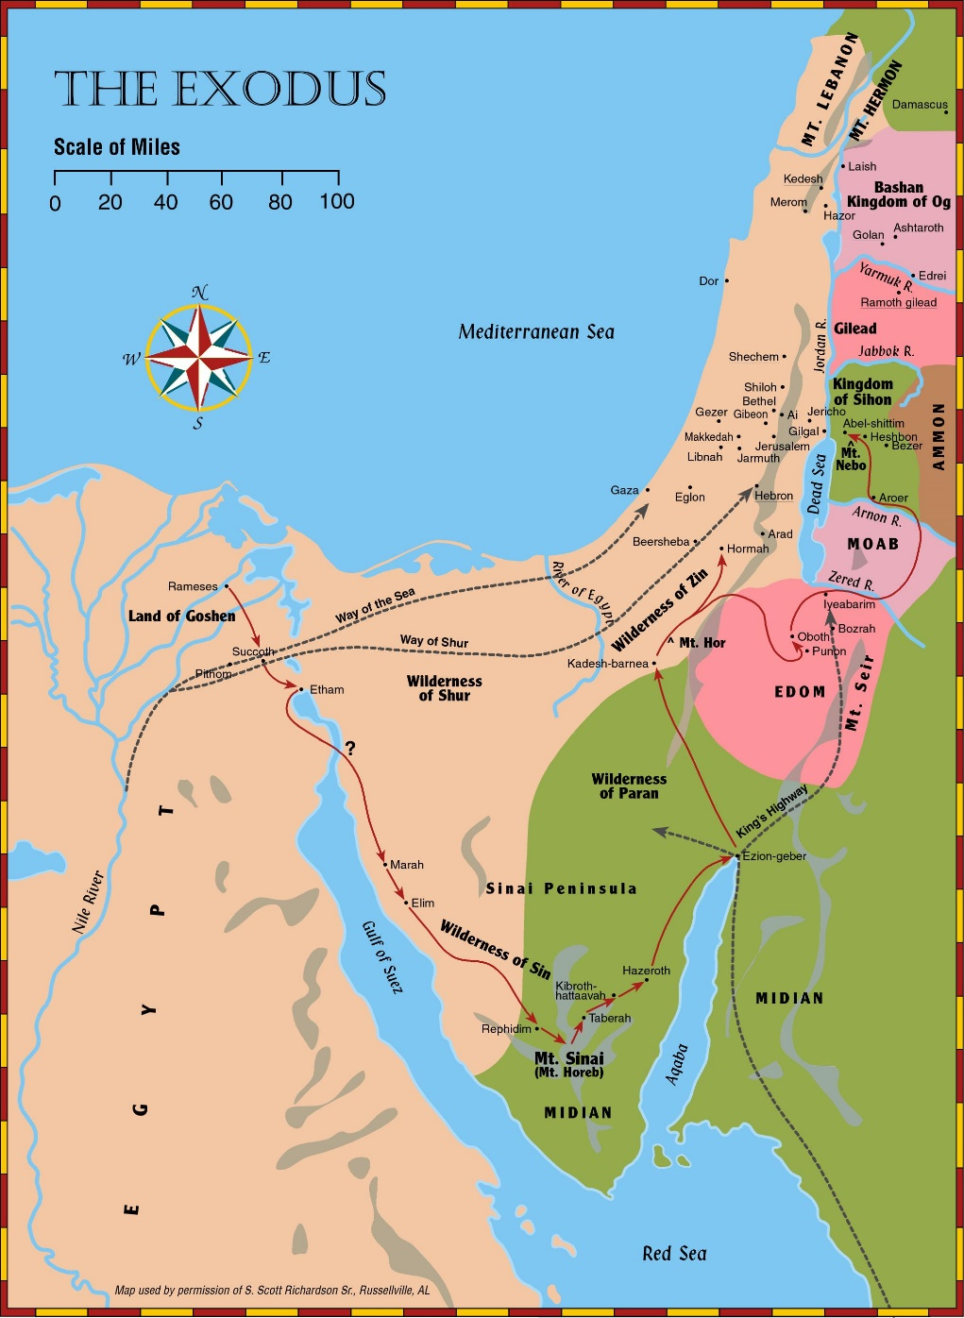
Exodus & Wilderness Wanderings
Exodus, Lev, Num,
Deut, Joshua
~1525-1405 BC
120 years (Life of Moses)

Slide 29
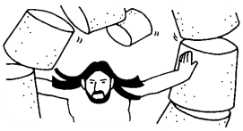
Conquest & Judges
Period 4
Conquest & Judges
BIBLE PERIOD | MAIN ACTORS | MAIN ACTION
Conquest of Land Joshua 1405 to 1382 b.c. | Joshua, Caleb, Rahab | Invasion of the Land Subjection of the Land Division of the Land
Judges Judges & Ruth 1382 to 1043 b.c. | Ehud, Barak, Deborah, Gideon, Jephthah, Samson Ruth, Naomi, Boaz Hannah, Eli, Samuel | 12 Judges Marriage of a Moabite Girl The Prayer of a Mother The Death of a Priest

Slide 30
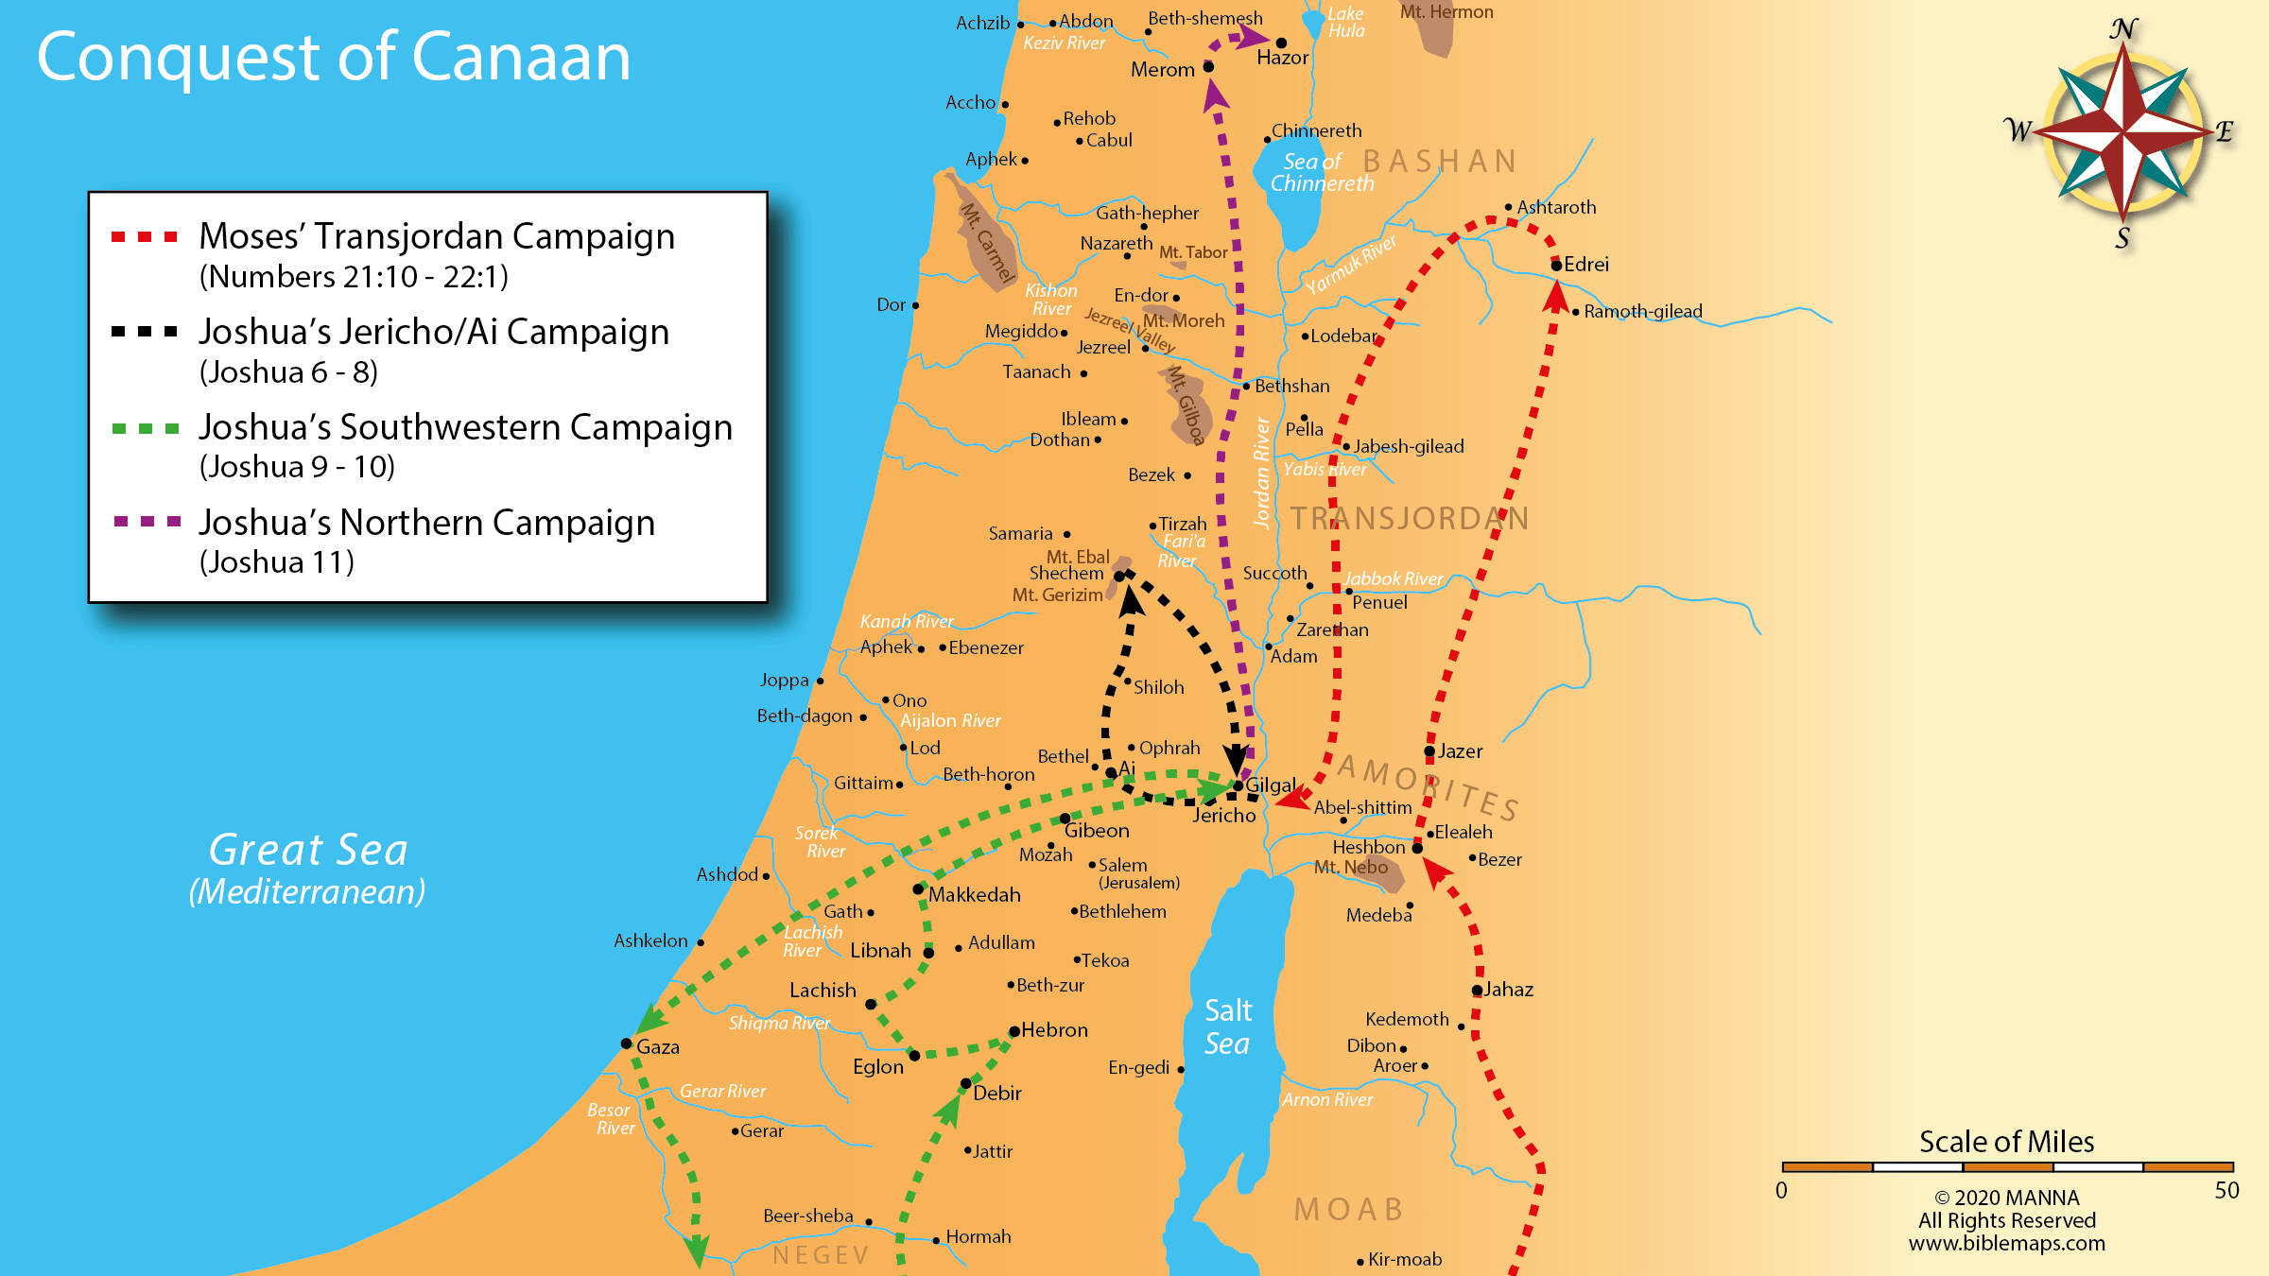
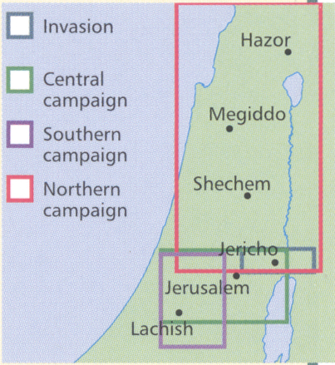
Central
Exodus & Conquest
Southern
Exodus, Lev, Num,
Deut, Joshua
~1525-1390 BC
Northern

Slide 31
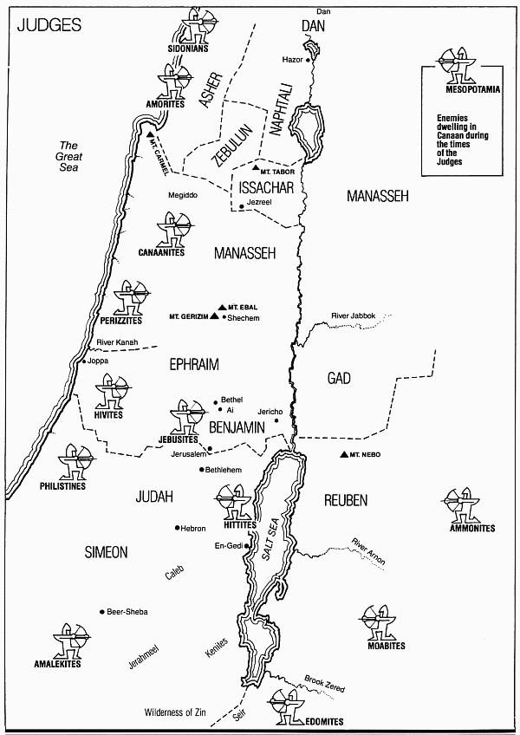
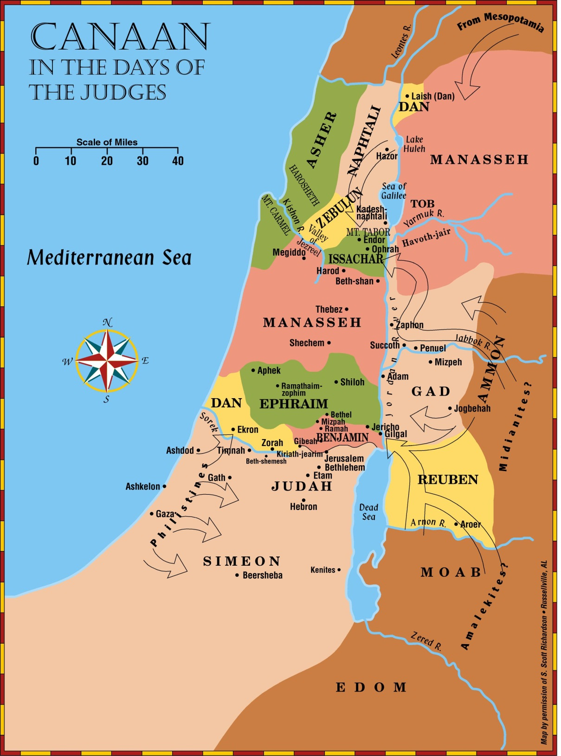
The
Judges
Judges, Ruth
~1390-1040 BC

Slide 32
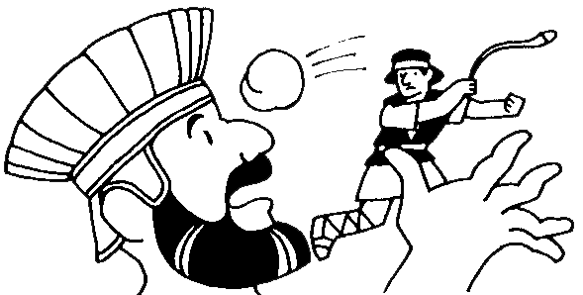
United Kingdom
Period 5
United Kingdom
BIBLE PERIOD | MAIN ACTORS | MAIN ACTION
United Kingdom 1&2 Samuel, I Kings, & 1&2 Chronicles 1040 to 931 b.c. | Saul, David, Solomon, Joab, Abner, Absalom, Goliath, Nathan, Jonathan, Queen of Sheba | Establishment of the Monarchy The Capture of Jerusalem by David The Bringing of the Ark into Jerusalem The Giving of the Davidic Covenant The Construction of the First Temple

Slide 33
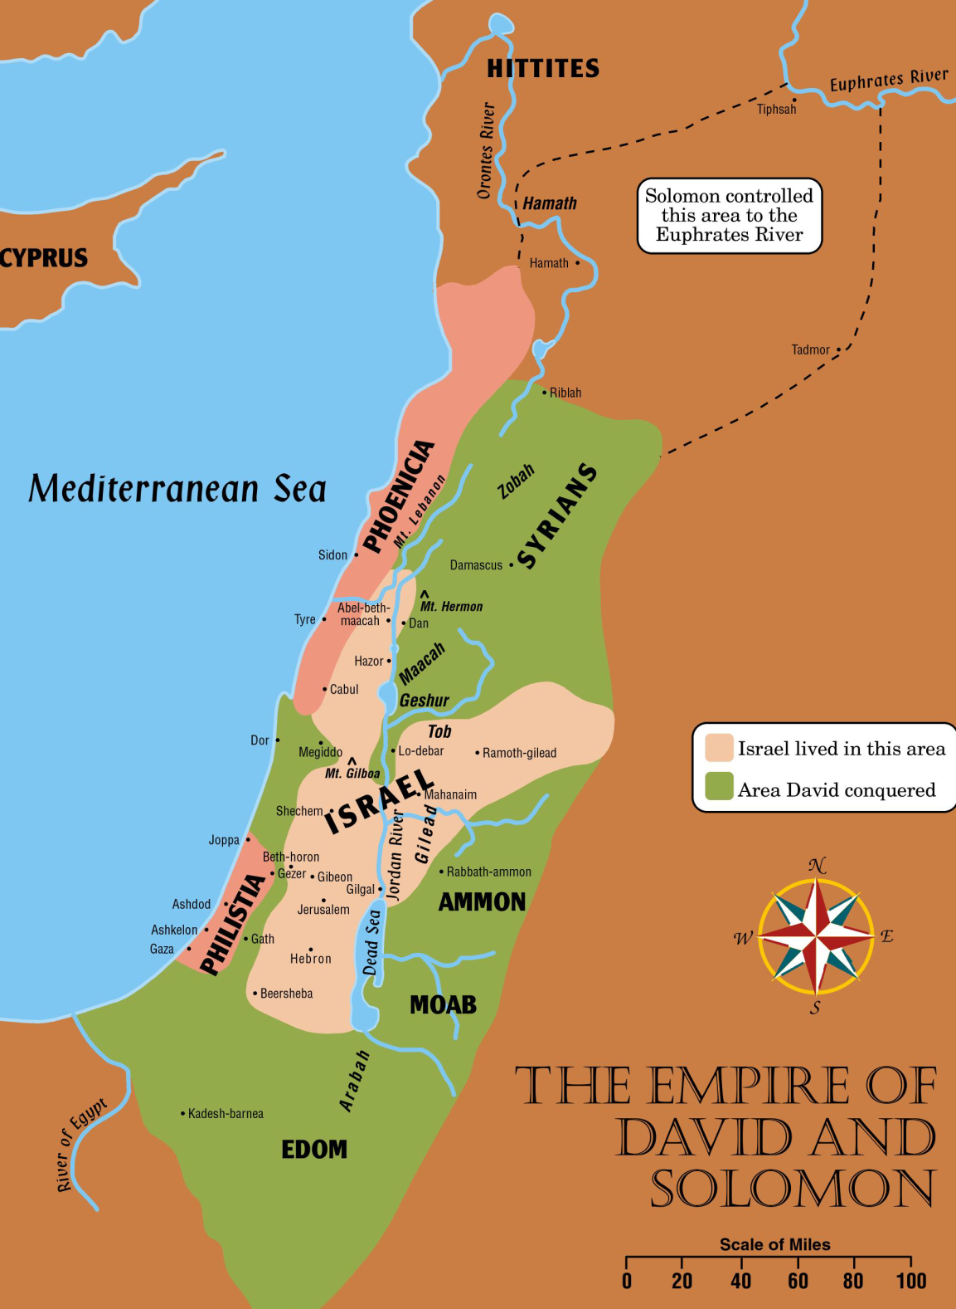
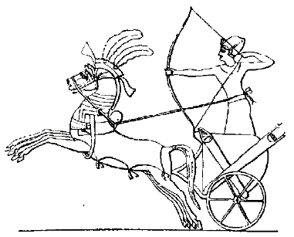
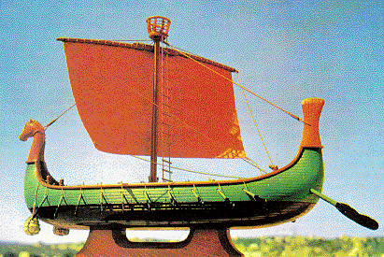
I Kings 10 ²⁹ … and so through the king’s traders they were exported to all the kings of the Hittites and the kings of Syria.
I Kings 10 ^{:14}Now the weight of gold that came to Solomon in one year was 666 talents of gold, ¹⁵besides that which came from the explorers and from the business of the merchants, and from all the kings of the west and from the governors of the land
United Kingdom
Samuel, Kings, Chron
Major/Minor Prophets
Psalms, etc
1040-930 BC
I Kings 10 ²⁹A chariot could be imported from Egypt for 600 shekels of silver and a horse for 150…
I Kings 10 ²²For the king had a fleet of ships of Tarshish at sea with the fleet of Hiram. Once every three years the fleet of ships of Tarshish used to come bringing gold, silver, ivory, apes, and peacocks

Slide 34

Describe 5 things about Israel and Judah.

Slide 35
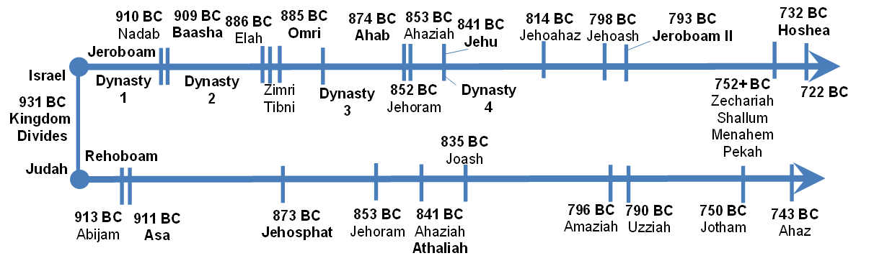
Divided Kingdom
Period 6
Divided Kingdom
BIBLE PERIOD | MAIN ACTORS | MAIN ACTION
Divided Kingdom Israel & Judah I & 2 Kings, & 2 Chronicles 931 to 722 b.c. | Jeroboam, Omri, Ahab, Jezebel, Jehu, Jeroboam II, Hoshea Prophets - Elijah, Elisha, Joel, Jonah, Amos, Hosea, Micah, Isaiah Rehoboam, Asa, Jehoshaphat, Athaliah Uzziah, Ahaz | Israel’s Tragic Civil War Capture of Israel by the Assyrians Jerusalem saved from the Assyrians Preaching Oral & Written Prophets

Slide 36
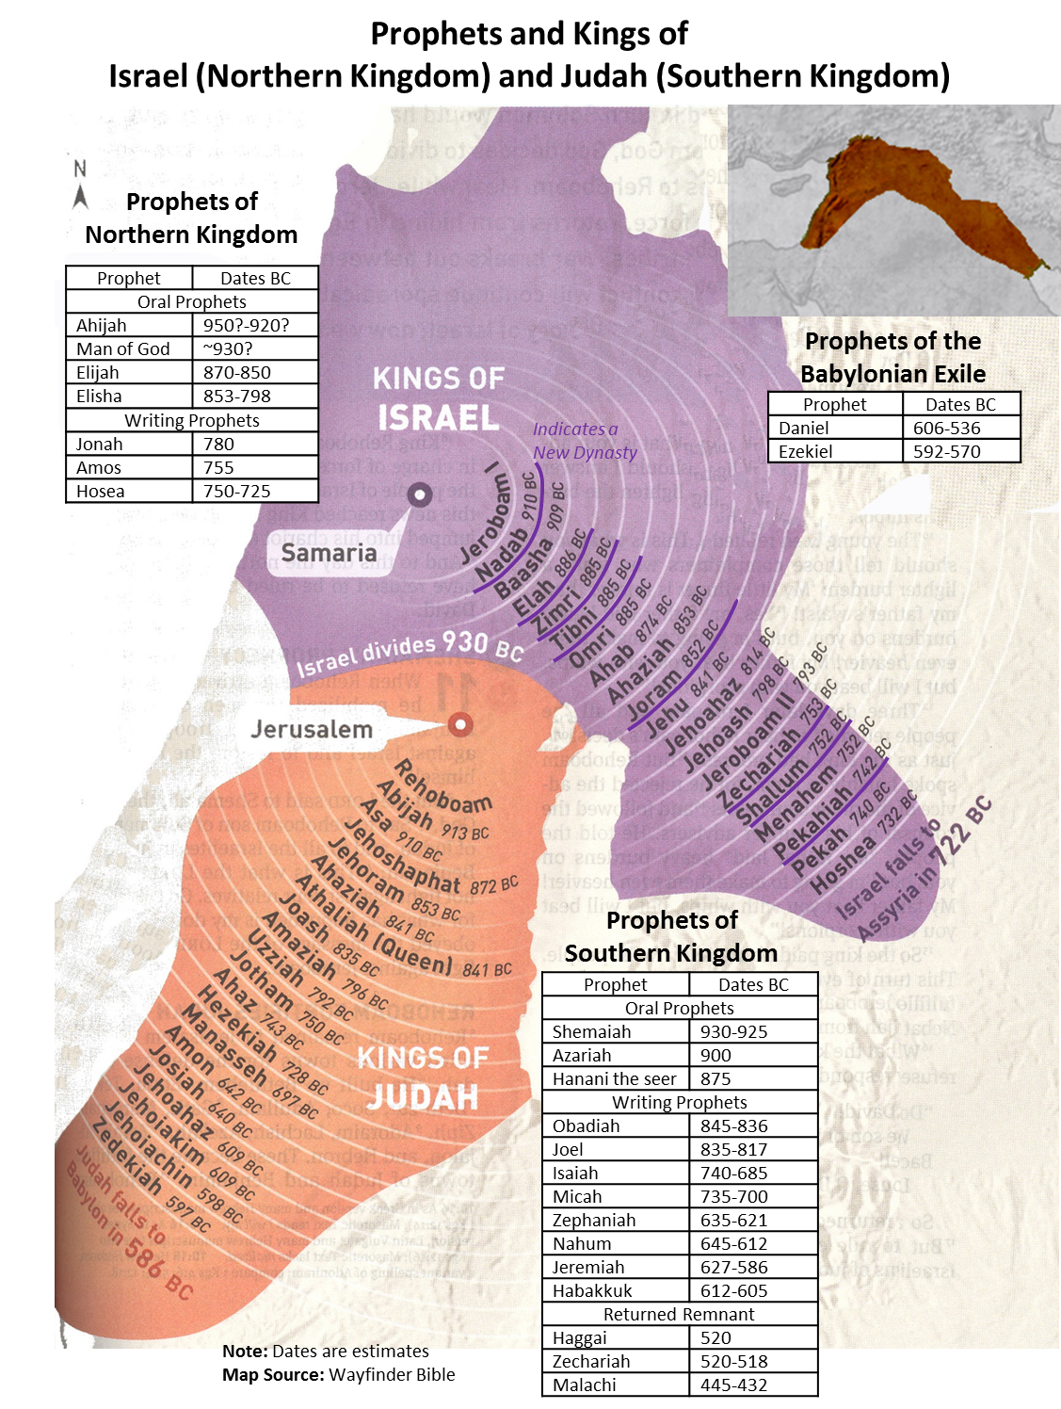

Slide 37
Kings of United & Divided Kingdom
United
Kingdom
Divided Kingdom
Judah Alone
Early Kings – Israel
Dynasty 1&2
Omri
Dynasty 3
Jehu
Dynasty 4
Confusing
Dynasties
Hezekiah
Hezekiah
(728-686)
Manasseh
Amon
1
Jereboam
Nadab
3
Omri
Ahab
(874-853)
Ahaziah
Jehoram
4
Jehu
(841-814)
Jehoahaz
Jehoash
Jereboam II
(793-753)
Zechariah
Shallum
Menahem
Pekaiah
Pekah
Hosea
(732-722)
5
Saul
(1050-1010)
David
(1010-970)
Solomon
(970-930)
2
Baasha
Elah
Josiah &
Sons
Zimri ~ 885
Tibni
Josiah
(640-609)
Jehoahaz
Jehoiakim
Jehoiachin
Zedekiah
(597-586)
Early Kings – Judah
Dynasty 1&2
Omri
Dynasty 3
Jehu
Dynasty 4
Confusing
Dynasties
Rehoboam
Abijam
Asa
(930-870)
Jehosphat
(873-848)
Jehoram
Ahaziah
Athaliah
Joash
Amaziah
Azariah/Uzziah
(790-739)
Jotham
Ahaz
Hezekiah
Judah Return
Zerubbabel (538-515)
Ezra (458-456)
Nehemiah (444-432)

Slide 38

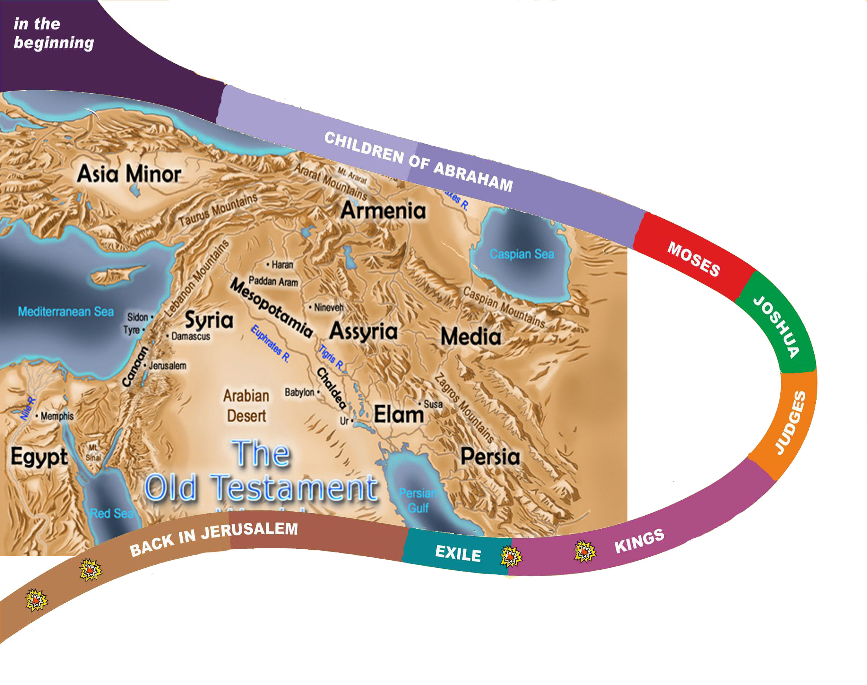
Adam & Eve
Tree of knowing good and evil - he shall bruise your head
Wickedness of men - every intention of the thoughts of his heart was only evil continual
- But Noah found favor in the eyes of the LORD.
Flood
Call of Abraham
2091 BC
Promise to Abraham >> Land, Seed, All Nations Blessed
Promise to Isaac, Jacob /Sojourner for 400 yrs in Egypt
Moses & “I AM WHO I AM/ Law
10 Plagues. People Mummer,
40 Years Wilderness Wanders
Promise of Seed/Nation
1445 BC
1405
Joshua -choose this day whom you will serve, But as for me and my house, we will serve the Lord. Not one word has failed of all the good things that the LORD your God promised concerning you
Promise of Land
~1380
Judges -another generation after them who did not know the LORD or the work that he had done for Israel. Everyone did what was right in his own eyes.
1050
Saul – people pleaser
1010
930
David, a Man after God’s Heart, Sinned,
A throne forever
> All Blessed
~420 BC
End of OT
538
586
722
Solomon, Wise, built Temple but to many wives
Notes:
God’s Covenant with Abram
15 After these things the word of the LORD came to Abram in a vision: “Fear not, Abram, I am your shield; your reward shall be very great.” 2 But Abram said, “O Lord GOD, what will you give me, for I continue childless, and the heir of my house is Eliezer of Damascus?” 3 And Abram said, “Behold, you have given me no offspring, and a member of my household will be my heir.” 4 And behold, the word of the LORD came to him: “This man shall not be your heir; your very own son shall be your heir.” 5 And he brought him outside and said, “Look toward heaven, and number the stars, if you are able to number them.” Then he said to him, “So shall your offspring be.” 6 And he believed the LORD, and he counted it to him as righteousness.
7 And he said to him, “I am the LORD who brought you out from Ur of the Chaldeans to give you this land to possess.” 8 But he said, “O Lord GOD, how am I to know that I shall possess it?” 9 He said to him, “Bring me a heifer three years old, a female goat three years old, a ram three years old, a turtledove, and a young pigeon.” 10 And he brought him all these, cut them in half, and laid each half over against the other. But he did not cut the birds in half. 11 And when birds of prey came down on the carcasses, Abram drove them away.
12 As the sun was going down, a deep sleep fell on Abram. And behold, dreadful and great darkness fell upon him. 13 Then the LORD said to Abram, “Know for certain that your offspring will be sojourners in a land that is not theirs and will be servants there, and they will be afflicted for four hundred years. 14 But I will bring judgment on the nation that they serve, and afterward they shall come out with great possessions. 15 As for you, you shall go to your fathers in peace; you shall be buried in a good old age. 16 And they shall come back here in the fourth generation, for the iniquity of the Amorites is not yet complete.”
The Holy Bible: English Standard Version. (2016). (Ge 15:1–16). Wheaton, IL: Crossway Bibles.

Slide 39
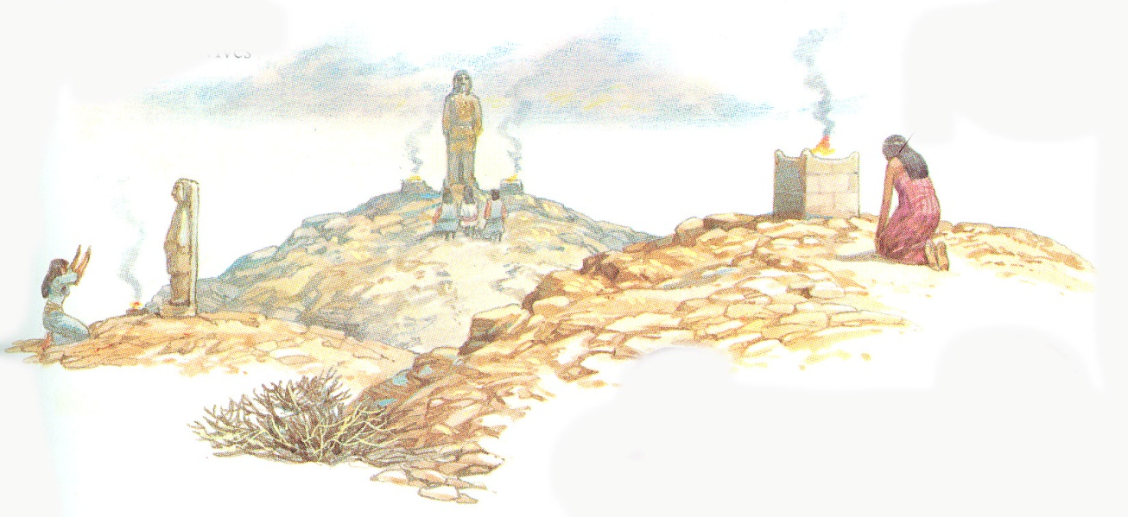
What gods did Solomon build idols/altars for his wives?
1 Kings 11:4-8(NKJV)
⁴For it was so, when Solomon was old, that his wives turned his heart after other gods; and his heart was not loyal to the Lord his God, as was the heart of his father David.
⁵For Solomon went after Ashtoreth the goddess of the Sidonians, and after Milcom the abomination of the Ammonites.
⁶Solomon did evil in the sight of the Lord, and did not fully follow the Lord, as did his father David.
⁷Then Solomon built a high place for Chemosh the abomination of Moab, on the hill that is east of Jerusalem, and for Molech the abomination of the people of Ammon.
⁸And he did likewise for all his foreign wives, who burned incense and sacrificed to their gods.

Slide 40
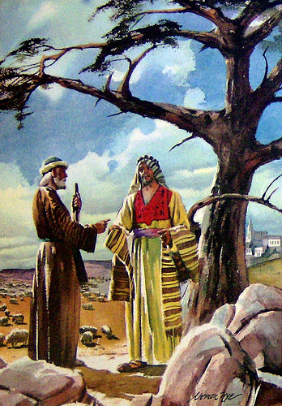
Jeroboam & Ahijah
1 Kings 11:37-38(ESV)
³⁷And I will take you, and you shall reign over all that your soul desires, and you shall be king over Israel.
³⁸And if you will listen to all that I command you, and will walk in my ways, and do what is right in my eyes by keeping my statutes and my commandments, as David my servant did, I will be with you and will build you a sure house, as I built for David, and I will give Israel to you.

Slide 41
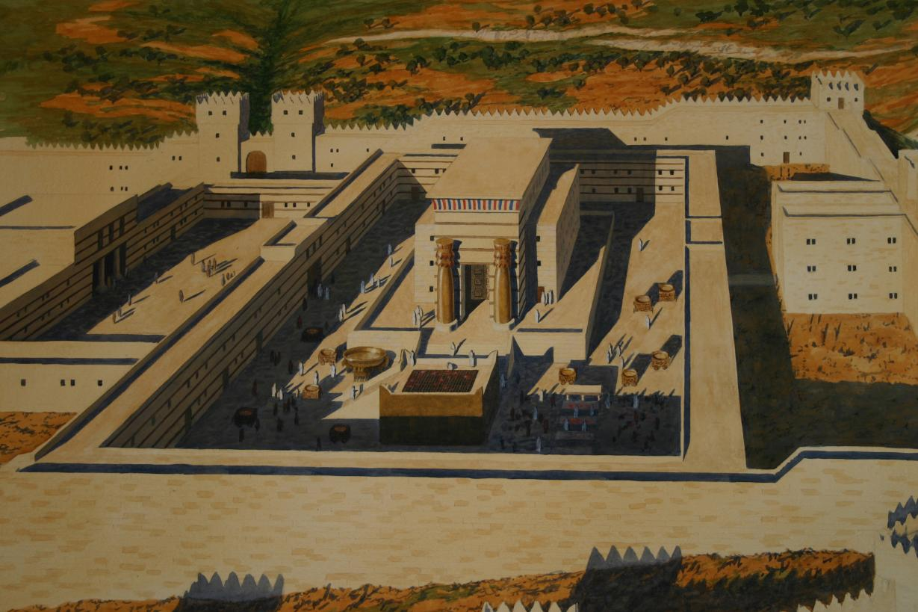
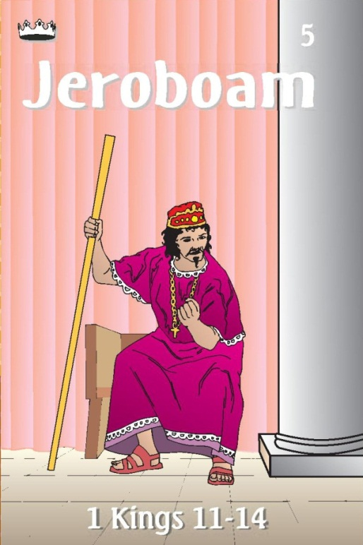
1 Kings 12:26 - 28 ²⁶And Jeroboam said in his heart, “Now the kingdom will turn back to the house of David. ²⁷If this people go up to offer sacrifices in the temple of the Lord at Jerusalem, then the heart of this people will turn again to their lord, to Rehoboam king of Judah, and they will kill me and return to Rehoboam king of Judah.”

Slide 42

Jeroboam Make Bad Decisions
²⁸So the king took counsel and made two calves of gold. And he said to the people, “You have gone up to Jerusalem long enough. Behold your gods, O Israel, who brought you up out of the land of Egypt.”
1 Kings 12:31 - 32
³¹He also made temples on high places
and appointed priests from among all the people, who were not of the Levites.
³²And Jeroboam appointed a feast on the fifteenth day of the eighth month like the feast that was in Judah,
and he offered sacrifices on the altar.

Slide 43
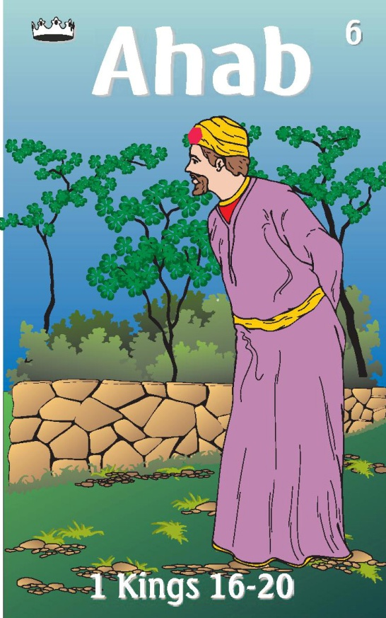
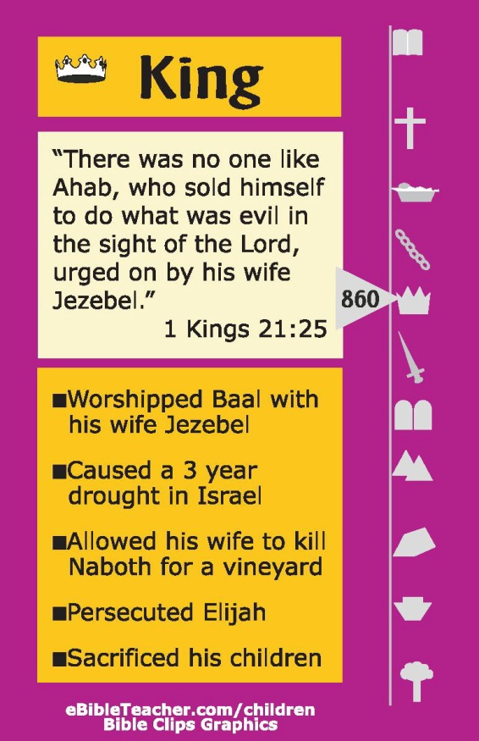

Ahab Card
1 Kings 16:30-33(NKJV)
³⁰Now Ahab the son of Omri
did evil in the sight of the Lord, more than all who were before him.
³¹And it came to pass, as though it had been a trivial thing for him to walk in the sins of Jeroboam the son of Nebat,
that he took as wife Jezebel the daughter of Ethbaal, king of the Sidonians;
and he went and served Baal and worshiped him.
³²Then he set up an altar for Baal in the temple of Baal, which he had built in Samaria.
³³And Ahab made a wooden image. Ahab did more to provoke the Lord God of Israel to anger than all the kings of Israel who were before him.
1
2
874
-833
3
4
17 And Elijah the Tishbite, of the inhabitants of Gilead, said to Ahab, “As the LORD God of Israel lives, before whom I stand, there shall not be dew nor rain these years, except at my word.”
1 Kings 17:1 (NKJV)
Killed by stray arrow
5
6
7

Slide 44
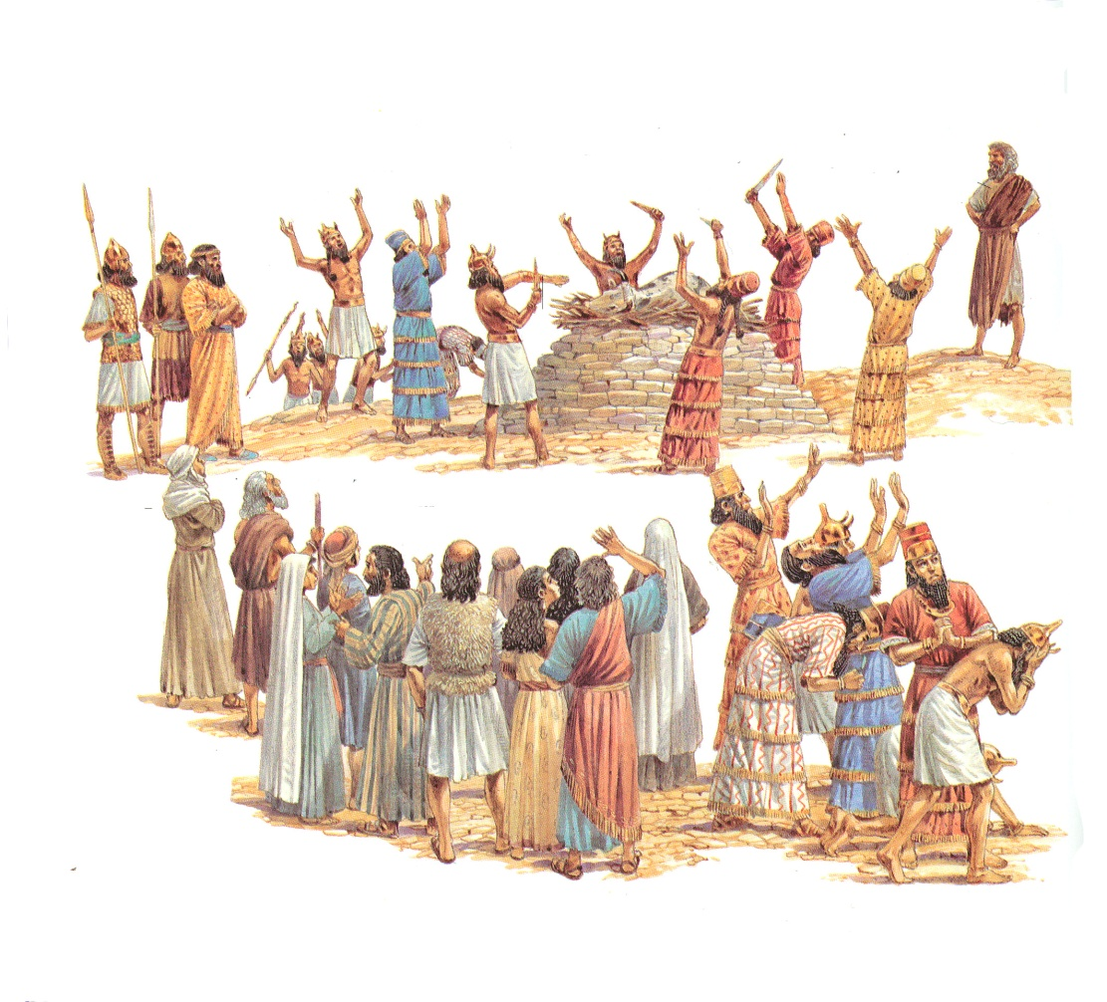
Elijah and Baal Prophets
1 Kings 18:20-24(NKJV)
²⁰So Ahab sent for all the children of Israel, and gathered the prophets together on Mount Carmel.
²¹And Elijah came to all the people, and said, “How long will you falter between two opinions? If the Lord is God, follow Him; but if Baal, follow him.” But the people answered him not a word.
²²Then Elijah said to the people, “I alone am left a prophet of the Lord; but Baal’s prophets are four hundred and fifty men.
²³Therefore let them give us two bulls; and let them choose one bull for themselves, cut it in pieces, and lay it on the wood, but put no fire under it; and I will prepare the other bull, and lay it on the wood, but put no fire under it.
²⁴Then you call on the name of your gods, and I will call on the name of the Lord; and the God who answers by fire, He is God.” So all the people answered and said, “It is well spoken.”

Slide 45
Jehoshaphat’s Seeks God
II Chr 17
³ The Lord was with Jehoshaphat,
because he walked in the earlier ways of his father David.
He did not seek the Baals, ⁴but sought the God of his father and walked in his commandments, and not according to the practices of Israel.
⁶ His heart was courageous in the ways of the Lord. And furthermore, he took the high places and the Asherim out of Judah.
⁷In the third year of his reign he sent his officials…to teach in the cities of Judah; … ⁹And they taught in Judah, having the Book of the Law of the Lord with them. They went about through all the cities of Judah and taught among the people.

Slide 46
Jehoshaphat – Making Mistakes
Made Peace with ________________
Joined in War with _______________
Son married ____________________
Partnership with _________________
Israel
Ahab
Athaliah d. of Ahab
Ahaziah – King of Israel

Slide 47
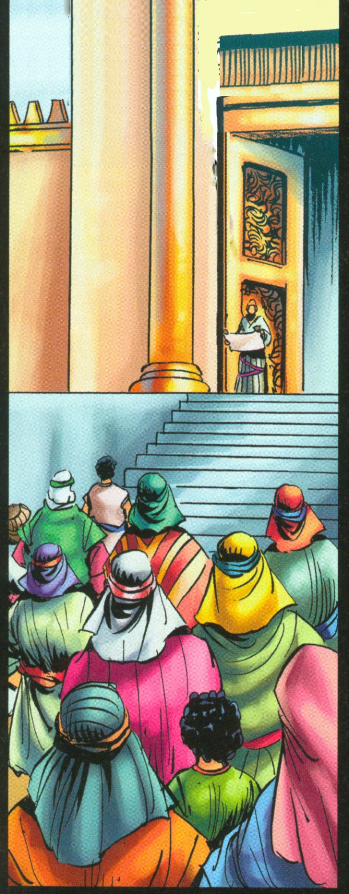
Joash’s Reign – Chr 23:16 – 24:27
³And all the assembly made a covenant with the king in the house of God. And Jehoiada said to them, “Behold, the king’s son! Let him reign, as the Lord spoke concerning the sons of David.
2 Kings 11:17(ESV)
¹⁷And Jehoiada made a covenant between the Lord and the king and people, that they should be the Lord’s people, and also between the king and the people. And the priest posted watchmen over the house of the Lord.
^{24:2}And Joash did what was right in the eyes of the Lord all the days of Jehoiada the priest.

Slide 48
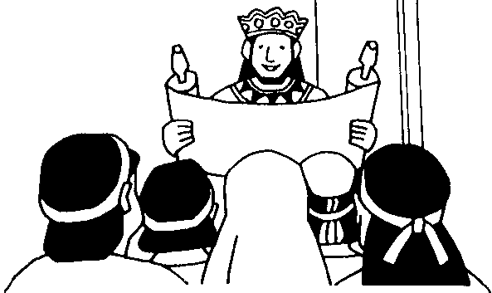

Covenant to Follow the Law
2 Chronicles 15:12-14(ESV)
¹²And they entered into a covenant to seek the Lord, the God of their fathers,
with all their heart and with all their soul,
¹³but that whoever would not seek the Lord, the God of Israel, should be put to death, whether young or old, man or woman.
¹⁴They swore an oath to the Lord with a loud voice and with shouting and with trumpets and with horns.
Asa
911-870
Joash
835-796
2 Kings 11:17(ESV)
¹⁷And Jehoiada made a covenant between the Lord and the king and people, that they should be the Lord’s people, and also between the king and the people.
2 Kings 23:3(ESV)
³And the king stood by the pillar and made a covenant before the Lord, to walk after the Lord and to keep his commandments and his testimonies and his statutes with all his heart and all his soul, to perform the words of this covenant that were written in this book. And all the people joined in the covenant.
Josiah
640-609

Slide 49
Joash’s Reign – Chr 23:16 – 24:27
2 Chronicles 24:19–22 (ESV)
Joash’s Treachery
¹⁹ Yet he sent prophets among them to bring them back to the Lord. These testified against them, but they would not pay attention.
²⁰ Then the Spirit of God clothed Zechariah the son of Jehoiada the priest, and he stood above the people, and said to them, “Thus says God, ‘Why do you break the commandments of the Lord, so that you cannot prosper? Because you have forsaken the Lord, he has forsaken you.’ ” ²¹ But they conspired against him, and by command of the king they stoned him with stones in the court of the house of the Lord. ²² Thus Joash the king did not remember the kindness that Jehoiada, Zechariah’s father, had shown him, but killed his son. And when he was dying, he said, “May the Lord see and avenge!”

Slide 50
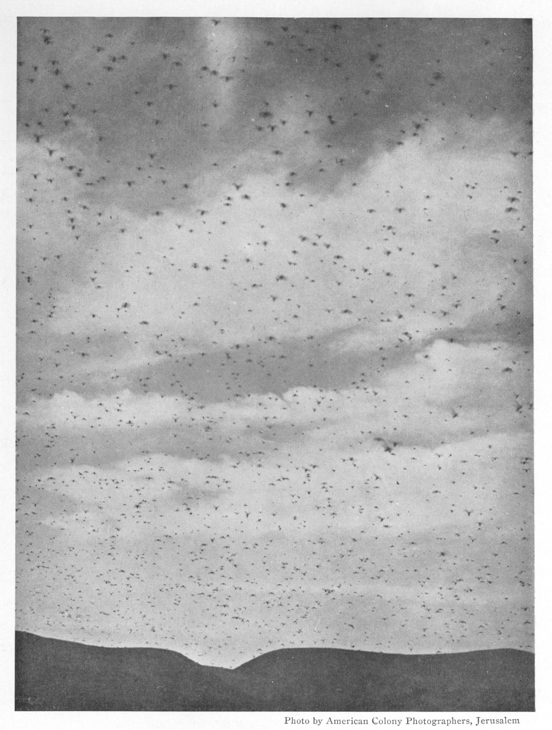
Remember the Coming of the Locust Joel 1:2-3
An Invasion of Locusts
² Hear this, you elders;
give ear, all inhabitants of the land!
Has such a thing happened in your days,
or in the days of your fathers?
³ Tell your children of it,
and let your children tell their children,
and their children to another generation
1
2
2
3
3
4
1915 Locust Plague
1945 Children Generation
1975 Children’s Children
2005 Children’s Children’s
Children

Slide 51
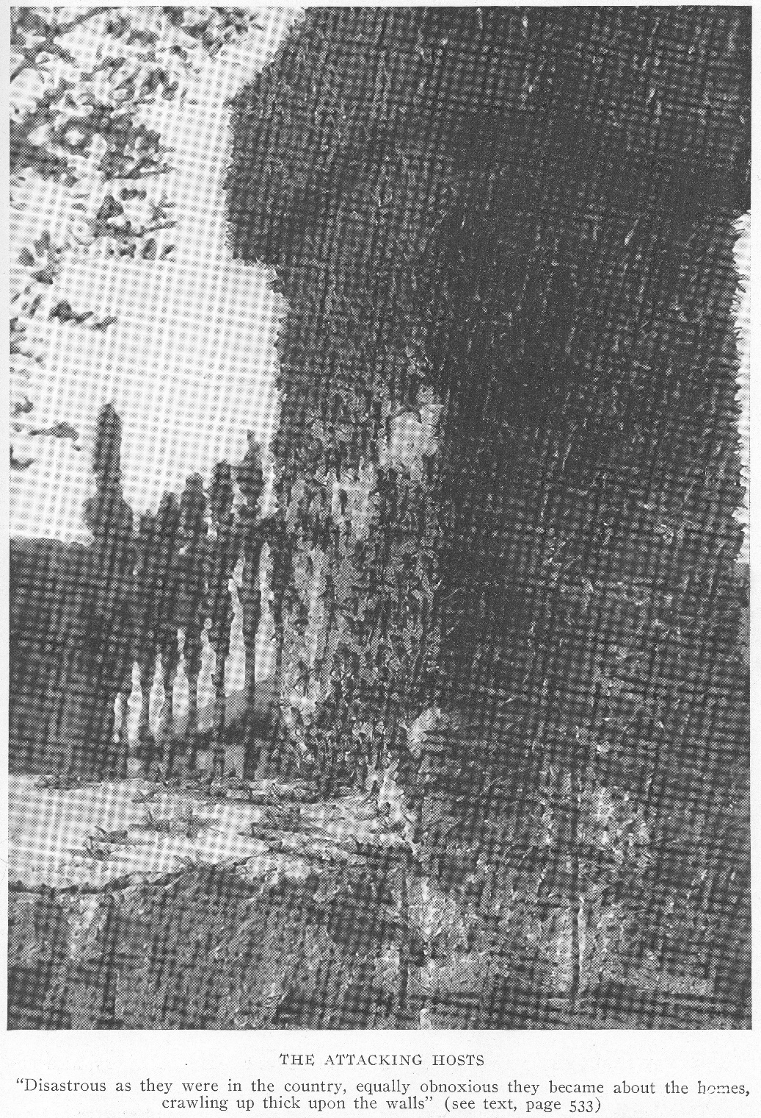
Joel 2:7 (NKJV)
⁷ They run like mighty men,
They climb the wall like men of war;
Every one marches in formation,
And they do not break ranks.

Slide 52
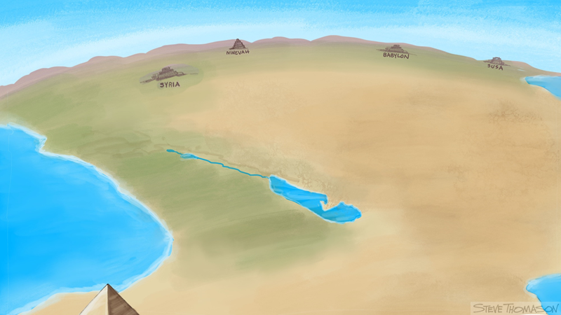

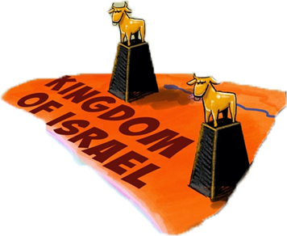


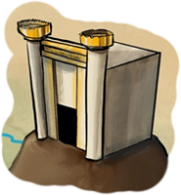
Syria/Aram
Assyria
Babylon
Persia
Invading Armies/Locust of Joel
Jerusalem
EGYPT

Slide 53
Kings of Judah Before Fall of Israel
Army
Size
Early Kings
Omri
Confusing
Jehu
Judah Alone
Fall

Slide 54
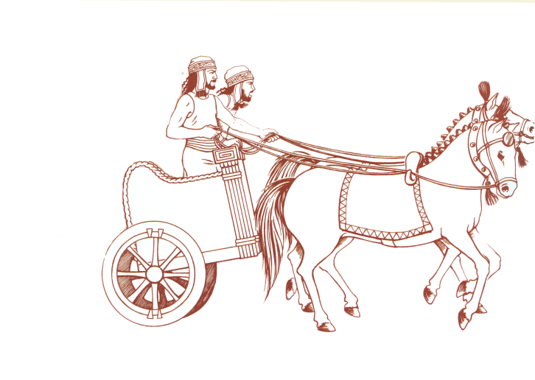


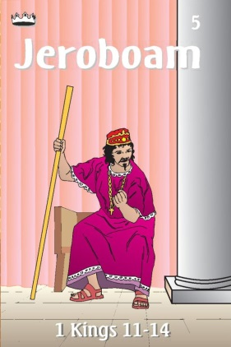


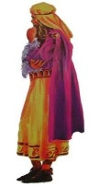
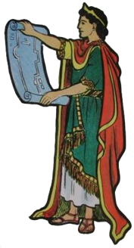

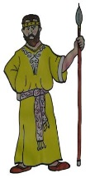
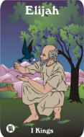
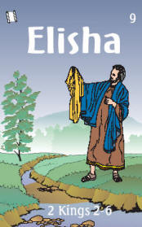

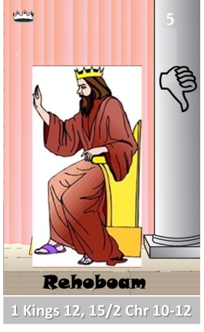
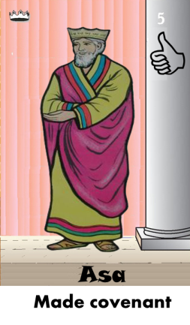
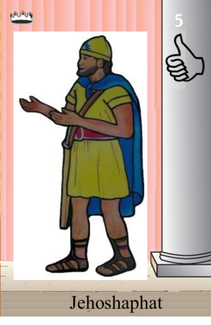



Ahaziah
Jehoram
Killed by Jehu
Baasha
Jehu
Ahijah
Man of God
Rocks for
Mizpah & Geba
Early Kings
Omri Kings
Jehu Kings
Brings in Syria
Obadiah - 830
Killed by Jehu
Shemaiah
Azariah
Hanani the Seer

Slide 55



















Jehu
841-814
Jehoahaz
Jehoash
Elisha &
the Arrows
Jeroboam II
Zechariah
Tiglath-pileser III
(745–727 b.c.)
793-753
Jehu Kings
Confusing
Brings in Assyria
Joash
Amaziah
Uzziah
Jotham
Ahaz
Jehoiada Made covenant

Slide 56
Confusing
Judah Alone
Tiglath-pileser III
(745–727 b.c.)
Shallum 752
Menahem 752-742
Pekahiah 742-740
Pekah(752) 740-732
Hoshea 732-722
Uzziah
Jotham
Ahaz

Slide 57







Confusing
Judah Alone
Tiglath-pileser III
(745–727 b.c.)
Shallum 752
Menahem 752-742
Pekahiah 742-740
Pekah(752) 740-732
Hoshea 732-722
697-642
640-609
Made covenant
They were stoned — As Zechariah, the son of Jehoiada, 2 Chronicles 24:21. they were sawn asunder — As, according to the tradition of the Jews, Isaiah was by Manasseh
Uzziah
Jotham
Ahaz

Slide 58

Seeking Help
Asa ask Syria for Help 2
2 Chr 16:2
Ahaz ask Assyria to help 2 Chr 28:16

Slide 59

Ahijah
Jehu
Man of God
Micaiah
Man of God
Syria
Shemaiah
Azariah
Hanani
Assyria
Babylon/Persia

Slide 60


Slide 61


Prophets of the Assyrian Period
Obadiah (~845 BC)
Joel (~830)
Jonah (~780)
Amos (~755)
Hosea (750-725)
Isaiah (740-690)
Micah (735-700)

Slide 62


Slide 63

Prophetic Waves
Assyrian Threat
Syrian Threat
Babylonian Threat
Romans
Moses
Exodus
Persian
Written
Israel Falls
Abraham
Judah Falls
Judges
Kingdom Divides
Captivity
& Return
United Kingdom
Oral
Daniel
roars
Greeks
2100
1400
1100
1000
900
800
700
600
500
400
100
0
~30
100
605
597
586
538
458
444
722
Christ
Exile
Return
Notes:
Prophet waves –
God tends to give the last gen before day of the Lord a chance to repent – ie lots of prophet activity
Between the Testament ok
400 years of silince not so much, Daniel roars In Between the Testament

