Slide 1

Victories & Serpents
Numbers 21

Slide 3
 | Passage | Nature of Complaint | God’s Response | Moses’ Response
A | Numbers 11:1-3 | Misfortunes | Sends Fire | Intercedes (11:2)
B | Numbers 11:4-35 | Food | Overabundance of Quail / Great Plague | Complains to God (11:10-15)
C | Numbers 12:1-16 | Leadership of Moses | Leprosy on Miriam | Intercedes (12:13)
D | Numbers 13:1-14:45 | Promised Land Too Intimidating | Sentenced to 40 Years of Wandering | Intercedes (14:11-20)
C | Numbers 16:1-17:12 | Leadership of Moses & Aaron | Sends Earthquake & Plague | Intercedes (16:22; 43-50)
B | Numbers 20:2-13 | Food & Water | Water From Rock | Lacks Faith (20:10-13)
A | Numbers 21:4-9 | Various Misfortunes | Sends Fiery Serpents | Intercedes (21:7-9)

Slide 4

Victories & Serpents
Introductory Thoughts
  Numbers 21, in a Sense, Begins the Conquest
    Other Nations Initiate the Battles (vs. 1, 23, 33)
    Moses Led the Trans-Jordan Conquest
  Moses Knows He’s Not Entering Land, But Still Serves
Outline of Section
  Victory Over Arad (vs. 1-3)
  The Bronze Serpent (vs. 4-9)
  Travelling Towards the Land (vs. 10-20)
  Victory Over Sihon (vs. 21-31)
  Victory Over Og (vs. 32-35)

Slide 5
Victory Over Arad (vs. 1-3)
The Problem (vs. 1)
  Israel Attacked by The King of Arad
    Called “The Canaanite” (The People God Promised to Overthrow; cf. Gen. 15:18-21; Ex. 23:28)
    Some Israelites Taken Captive (It Seems the Discouragements From Ch. 20 Are Continuing)
  May Not be a Problem Had Edom Allowed Passageway (20:14-21)
    Edom’s Hatred Towards Israel Had Serious Ripple Effects
The Solution (vs. 2-3)
  Vow to the Lord
    “If You Give, We will Devote” (We Should Devote to What What We Are Given)
    Vow Shows Increased Devotion to God
  “The Lord Heeded the Voice of Israel” (God Listened to Their Prayer)
    Precursor of Future Victories
    First Victory Since Amalek (Exodus 17:8-16)
    “Hormah” is the Place They Were Previously Defeated (cf. 14:45)

Slide 6
The Bronze Serpent (vs. 4-9)
The Complaint (vs. 4-5)
  Israel Grew Impatient Due to Longer Travels (cf. 20:14-21)
    Impatience Was a Problem at Mount Sinai (Exodus 32)
    When We Are Impatient, We Seek to Take Matters in Our Own Hands
  Illogical Complaint (Demonstration of Thanklessness)
    “Why Have You Brought us Here to Die?” (They Caused Themselves to Die in the Wilderness)
    “There is No Food & Water” (God Has Consistently Provided For Them)
    “We Loathe This Worthless Food” (They Just Complained They Had No Food)
  Do We Itemize Our Complaints or Our Blessings?
The Fiery Serpents (vs. 6; cf. Deut. 8:15)
  Meaning of “Fiery”: Sensation of Bite / Supernaturally on Fire / Fiery Coloration?
  “Many People of Israel Died”
    God Believes This is an Appropriate Response to Complaining (What Do I Deserve?)
    The Serpent – Satan – Has Caused Even More to Die

Slide 7
The Bronze Serpent (vs. 4-9)
The Bronze Serpent (vs. 7-9)
  Israel Confesses Sin & Asks For Intercession
    From Speaking Against Moses to Pleading For His Help
    Adversity Caused Them to Reprioritize
    Last Complaint About Food in Numbers
  Moses Prays for the People
    Where Would the New Generation Be Without Moses’ Prayer?
    Would You Have Prayed For These People After they Complained to You?
    We Have a Greater High Priest Who Lives to Make Intercession For Us
  Solution
    Look Upon a Fiery Serpent That Moses Makes & Live (Doesn’t Remove the Serpents)
    God Offered a Way of Escape to a Rebellious People
    Symbol of Death Becomes Symbol of Life
    Jesus Would Also be “Lifted Up” & Bring Salvation (cf. John 3:14-16)
  Bronze Serpent Worshipped 700 Years Later (2 Kings 18:4)

Slide 8
Travelling Towards the Land (21:10-20)
Observations on Travels
  Emphasis on Moab (vs. 11, 13, 20; 22:1)
    Marching Closer to the Promised Land
  Full Travelogue in Numbers 33
  Debates on Route Israel Travelled
Poem #1 (vs. 14-15)
  From the “Book of the Wars”
    Collection of Israelite Battles?
    Like the Book of Jashar (Jos. 10:13; 2 Sam. 1:18)
  Waheb & Suphah Source of Arnon River?
Poem #2 (vs. 16-18a)
  God Provides Water From a Well (Last Time Was a Rock; God Provides in Many Ways)
  Rejoicing Over a Well that Provided Water
  Complaining Turned to Rejoicing

Slide 9
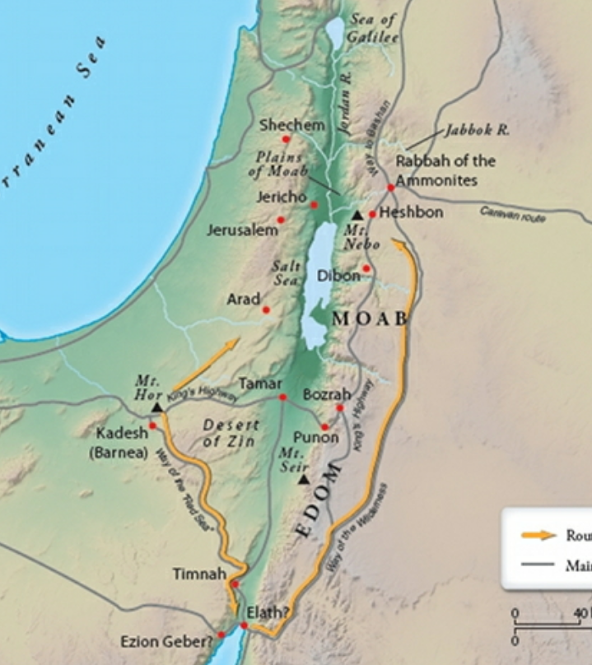
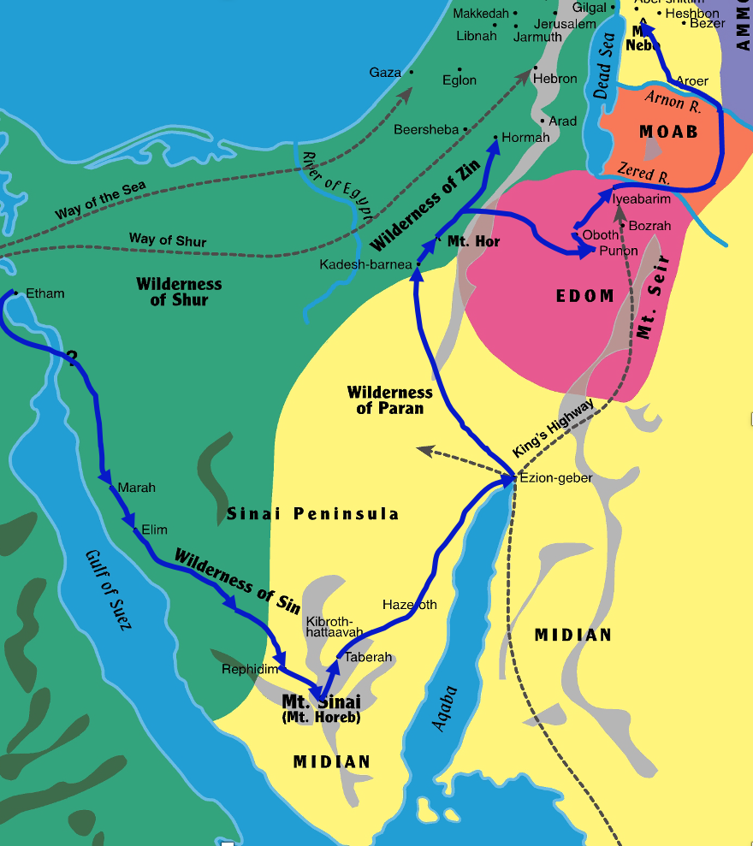

Slide 10
Victory Over Sihon (vs. 21-31)
The Diplomatic Request (vs. 21-22)
  Like the Request Made to Edom (Numbers 20:14-17)
  “Sihon did not trust Israel to pass through his territory, so Sihon gathered all his people together…” (Judges 11:20)
The Battle (vs. 23-26, 31)
  Sihon Instigates a Battle and Loses (Israel Not the Aggressive Party)
  Israel Settled in the Amorite Cities; Heshbon Singled Out (vs. 31)
    These Cities Previously Occupied by Moabites (vs. 26)
    May Explain Why New King of Moab is Terrified (Numbers 22:1-3)
  This Victory Used to Encourage Future Victories (cf. vs. 34)
Poem Celebrating Former Sihon’s Former Conquest (vs. 27-30)
  Ancient Amorite Poem Praising Sihon’s Strength
  Chemosh Has Let Them Down (Like All False Gods)
  Sihon Defeated Moab; Israel Defeated Sihon (God is With Them)

Slide 11
Victory Over Og (vs. 32-35)
Dispossessing Jazer (vs. 32)
  Jazer May Have Belonged to Sihon or Og
  Spies Sent & Israel “Dispossessed” Them
Battling Og (vs. 33-35)
  Bashan / Edrei – 30 Miles East of Sea of Galilee
  “For only Og the king of Bashan was left of the remnant of the Rephaim. Behold, his bed was a bed of iron… Nine cubits was its length, and four cubits its breadth…” (Deut. 3:11)
  Victory
    Earlier They Were Scared of Giants; Now They Are Victorious Over Them
    God Assured Them Victory Before the Battle Began (vs. 34)
    Israel Took Sixty Cities (cf. Deut. 3:4)
    Victory on One Side of Jordan Promises Victory on Other Side
    Victory Over One Sin Promises Victory Over More

