Slide 1
External Resources for Study

Slide 2
Lesson | Topic | Date | Teacher
Lesson 14 | External Resources for Bible Study | Sunday, January 3 | Erik
Lesson 15 | 1 Corinthians 6 | Wednesday, January 6 | Erik
Lesson 16 | 1 Corinthians 7 | Sunday, January 10 | Dave
Lesson 17 | Reading as Interpretation | Wednesday, January 13 | Erik
Lesson 18 | 1 Corinthians 8-9 | Sunday, January 17 | Erik
Lesson 19 | 1 Corinthians 10 | Wednesday, January 20 | Dave
Lesson 20 | “Second Level” Readings | Sunday, January 24 | Dave
Lesson 21 | 1 Corinthians 11 | Wednesday, January 27 | Dave
Lesson 22 | 1 Corinthians 12 | Sunday, January 31 | Erik
Lesson 23 | 1 Corinthians 13 | Wednesday, February 3 | Erik
Lesson 24 | 1 Corinthians 14 | Sunday, February 7 | Erik
Lesson 25 | 1 Corinthians 15 | Wednesday, February 10 | Erik
Lesson 26 | 1 Corinthians 16 & Review | Sunday, February 14 | Erik

Slide 3
External Resources
Introductory Thoughts
Why Might External Resources Be Helpful?
“The way of a fool is right in his own eyes, but a wise man listens to advice.” (Pro. 12:15)
Outline of Class
A Warning About External Resources
Types of External Resources

Slide 4
Warning About External Resources
Correcting Apollos (Acts 18:24-28)
Preaching in Synagogue at Ephesus
Eloquent & Competent in Scriptures
“Only Knew Baptism of John”
Corrected by Priscilla & Aquila
Correcting Bible Students in Ephesus (Acts 19:1-7)
Paul Came to Ephesus
12 “Disciples” Who Only Know of John’s Baptism
Students of “Apollos” Needed Same Correction

Slide 5
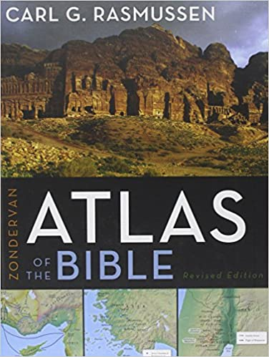
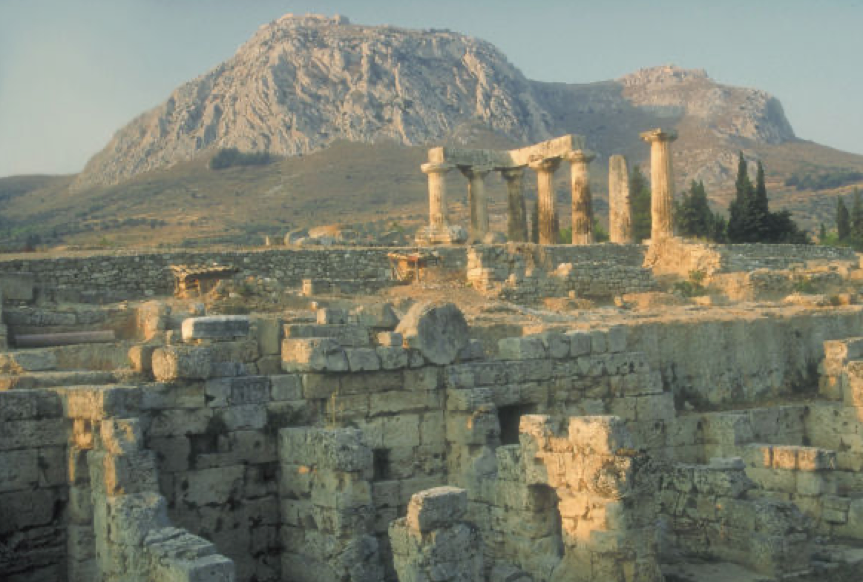
Types of External Resources
Atlas
Maps & History of Cities
Geography / Topography

Slide 6
Types of External Resources
Bible Dictionary
Like a Bible Encyclopedia
Brief Summaries/Definitions
Corinth: “A celebrated city of the Peloponnesus, capital of Corinthia, which lay North of Argolis, and with the Isthmus joined the peninsula to the mainland. Corinth had three good harbors (Lechaeum, on the Corinthian, and Cenchrea and Schoenus on the Saronic Gulf), and Thus commanded the traffic of both the eastern and the western seas…”

Slide 7
Types of External Resources
Concordance
Locations Words Are Used
Amount Words Are Used
Keyed to Translations
Good for Word Studies
Available on Free Software

Slide 8
Types of External Resources
Hebrew/Greek Word Studies
Provides Definitions of Original Words
Dr. Spiros Zodhiates
“Wisdom” (1 Cor. 1:17)
(I) Skill in the affairs of life, practical wisdom, wise management as shown in forming the best plans and selecting the best means, including the idea of sound judgment and good sense (Act 6:3; Act 7:10; Col 1:28; Col 3:16; Col 4:5). Stóma (G4750), mouth, and sophían in Luk 21:15 means wise utterance. See Sept: 1Ki 2:6.
(II) In a higher sense, wisdom, deep knowledge, natural and moral insight, learning, science, implying cultivation of mind and enlightened understanding.

Slide 9
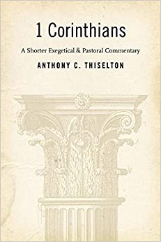
Types of External Resources
Commentaries
Help With Specific Books
Section by Section / Verse by Verse
“﻿The allusion to the third day should not be restricted to a single Old Testament passage that includes this exact phrase, such as Hos. 6:2. ‘According to the scriptures’ governs the biblical frame of reference that provides an ﻿understanding of resurrection as such as God's vindication of his faithful Servant-Son, rather than more narrowly alluding only to the third day.”

Slide 10
Types of External Resources
Study Bibles
Puts Many Resources Together in One Book
Condensed Notes Get to the Point

Slide 11
Types of External Resources
Other Resources
Audio/Written Sermons
Survey Books
What Additional Resources Do You Enjoy?
When Have Resources Especially Helped You?

