Slide 1

Apostasy & Accounting
Numbers 25-26

Slide 3

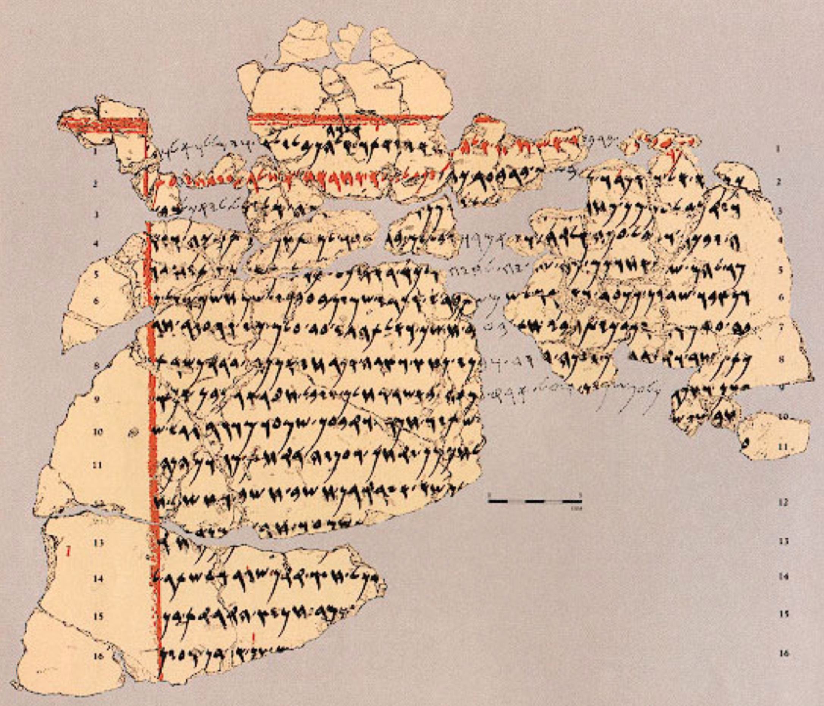
Apostasy & Accounting
Introductory Thoughts
  Threats Against Israel
    External Forces (Numbers 22-24)
    Internal Temptations (Numbers 25)
  Balaam Involved in Both Attacks
Outline of Section
  Apostasy (Numbers 25)
  Accounting (Numbers 26)
Deir Alla Inscrption
Town 8 KM East of Jordan
Discovered in 1967
“The sayings of Balaam, son of Beor, the man who was a seer of the gods. Lo! Gods came to him in the night and spoke to him according to these words…”

Slide 4
Apostasy (25:1-18)
The Sins (vs. 1-3)
  Israel “Whored” With Daughters of Moab (Midian Also Involved; vs. 6, 18)
  Israel “Yoked” Himself to Baal (First Mention of “Baal” In the Bible)
    Accepting Invitations From Women to Worship Baal
    Romantic/Sexual Relationships Have Great Power Over our Faith
    Idolatry And Immorality Are Always Tied Closely
    The Challenge of Conforming to the World is Constantly Before Israel
  Balaam’s Role in Arranging These Circumstances
    “Behold, these, on Balaam's advice, caused the people of Israel to act treacherously against the LORD in the incident of Peor, and so the plague came among the congregation of the LORD.” (Numbers 31:16)
    “But I have a few things against you: you have some there who hold the teaching of Balaam, who taught Balak to put a stumbling block before the sons of Israel, so that they might eat food sacrificed to idols and practice sexual immorality.” (Revelation 2:14)
  Persistence of the Enemy
    Balaam Couldn’t Harm Israel With Curses (Ch. 22-24)
    Balaam Preyed on the Weaknesses Within Israel (Ch. 25)
    Satan is Always Looking for a Weakness to Exploit

Slide 5
The Zeal of Phinehas (25:1-18)
Instructions for Judgment (vs. 4-5)
  Chiefs of the People Must Be Hanged/Impaled (Leaders Didn’t Stop It?)
  Moses Tell Judges to Kill those Who Yoked Themselves to Baal
  Judgments Will Turn God’s Wrath Away
  Swift Judgments Common at “Turning Points” In Scripture
Phinehas Kills Adulterers (vs. 6-9)
  Son of Eleazar, Grandson of Aaron (Exodus 6:25)
  Two People Shamelessly Walking Into Tent (“In the Sight of…” Israelites)
  Phinehas Impales Adulterers With a Spear
    Phinehas in Charge of Guarding Sanctuary (Num. 3:32; 1 Chron. 9:20)
    Sin Must Be Put to Death (cf. Colossians 3:5)
    Intervention of Priest Saved Many Lives (Consistent Theme in Numbers)
    Graphic Picture of the Need for Church “Discipline”
  The Death Count
    24,000 in Numbers 25:9 (Emphasizes Total Death Toll)
    23,000 in 1 Corinthians 10:8 (Emphasizes “Single Day” Death Toll)

Slide 6
The Zeal of Phinehas (25:1-18)
Covenant With Phinehas (vs. 10-13)
  Phinehas Acted With “Jealousy” or Zeal (vs. 11, 13)
    Two Kinds of Jealousy
      Sinful: When Something Doesn’t Belong to You
      Righteous: When Something Does Belong to You (Acted With Heart For God)
    Saul of Tarsus May Have Been Influenced by This Story
  What Causes us to Be Angry/Jealous?
  Given a “Covenant of Peace” (Reaffirms Aaron’s Priesthood)
    Succession of Priesthood Will Go Through His Children
    Taking a “Hard Stand” On Certain Matters is Pleasing to God
Consequences of the Apostasy (vs. 14-18)
  Names of Adulterers
    Zimri: Son of a Chief Among Simeon (vs. 14)
    Cozbi: Daughter of the King of Midian (cf. Numbers 31:8)
    “Important” People Not Immune From Judgment
  “Strike Down” the Midianites
    Battle Happens in Numbers 31 (Also in Judges 6-8)
    Balaam is Killed in Numbers 31:7-8
    Israel Told When/Who to Fight in War (They Didn’t Determine it For Themselves)

Slide 7
Accounting (26:1-65)
Instructions (vs. 1-4)
  Introduces New Section (Numbers 26-36 Similar to Numbers 1-10)
  Number the Men for War (War Was Just Commanded in Numbers 25:16-18)
Census (vs. 5-51)
  Examples of Rebellion
    Korah’s Rebellion (vs. 9-11)
    Er & Onan (vs. 19; cf. Genesis 38)
    Nadab & Abihu (vs. 61)
    Whole Faithless Generation (vs. 64-65)
  Sons of Korah Survived & Went to Write Some Psalms (vs. 11; cf. Psalm 84, 85, 87)
  Daughters Listed in Census (vs. 33, 46)
Principles of Land Assignments (vs. 52-65)
  Land Given In Proportion to Tribe Sizes (vs. 54)
  Location Chosen by lot (vs. 55; cf. Proverbs 16:33)
  No Inheritance for Levites (vs. 62)
  Joshua & Caleb Listed as Exceptions (vs. 65)
  Instructions Promise That They Will Conquer the Land

Slide 8
Tribe | First Census | Second Census | Difference
Reuben | 46,500 | 43,730 | -2,770
Simeon | 59,300 | 22,200 | -37,100
Gad | 45,650 | 40,500 | -5,150
Judah | 74,600 | 76,500 | +1,900
Issachar | 54,400 | 64,300 | +9,900
Zebulun | 57,400 | 60,500 | +3,100
Manasseh | 32,200 | 52,700 | +20,500
Ephraim | 40,500 | 32,500 | -8,000
Benjamin | 35,400 | 45,600 | +10,200
Dan | 62,700 | 64,400 | +1,700
Asher | 41,500 | 53,400 | +11,900
Naphtali | 53,400 | 45,400 | -8,000
Totals | 603,550 | 601,730 | -1,820
Observations
  Net Decline of .3%
  Simeon’s Major Loss (cf. 25:14)
  Manasseh’s Major Gain
  Judah Remains Largest Tribe
Lessons
  Sin Hinders Progress
  Sin Doesn’t Overthrow God’s Promises

