Slide 1
Church History
Lesson 6

Slide 2
Review
Division in Catholic Church: East vs. West (Roman)
Increasing corruption in Roman Church
Effect of Renaissance (Awakening)
Pre-Reformation Leaders: Wycliffe, Hus, Savonarola
Reformation began as effort to reform Roman Church
Usually dated to Luther’s 95 theses
PROTESTING the sale of indulgencies.

Slide 3
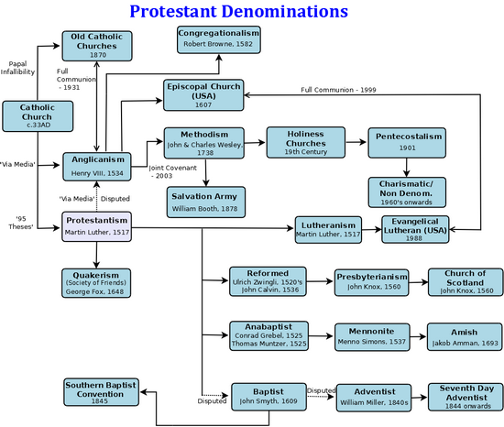
v
v

Slide 9
JESUS CHRIST
1. New Authority
2. Churches no longer autonomous
Remember little groups of Christians who didn’t go along with all of this!
3. Churches no longer independent
Reformed
4. Churches not sufficient
Emperor
Ecumenical Council
Metropolitan
Metropolitan
Metropolitan
Country
Country
Country
Country
Bishop
Bishop
Bishop
Bishop
E,E,E,E
E,E,
E,E,E,E
E,E,E,
E,E,E,

Slide 10
Remember little groups of Christians who didn’t go along with all of this!

