Slide 1
Assignments for Sunday Zoom Class at 5 Any volunteers for a short report on:
Fornication
Uncleanness
Evil Desire
Covetousness
Anger
Wrath
Malice
Blasphemy
Filthy Language

Slide 2
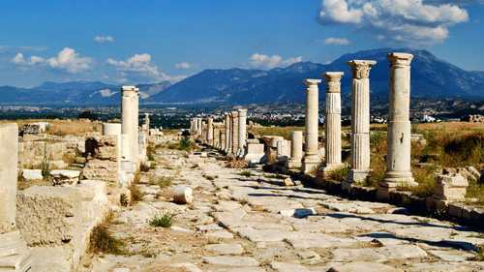
Colossians and Philemon
Lesson 6

Slide 3
Read Colossians 2:11—3:4
Learning what we can about Baptism

Slide 4
BAPTISM
The Action:
The Purpose:
The Subjects:
The Bond Formed
Immersion and Emersion
Putting off body of sins of the flesh
Forgiveness of all trespasses
Those dead in trespasses (Not Infants)
Buried with Christ
Made alive with Christ “through faith in the working of God”
Raised with Christ
raised us up together, and made us sit together In the heavenly places in Christ Jesus (Eph.2:6).
Will be glorified with Him (Col. 3:4)

Slide 5
Consequences of Scriptural Baptism
Since you have Died with Christ, therefore—(Col. 2:16-23)
You are no longer subject to the Law (Romans 7:1-4)
It was nailed to the cross (Col. 2:16-17)
Its ordinances were but a shadow of the substance—Christ.
Since you were Raised with Christ, therefore—(Colossians 3:1-4)
What are some things in the Law of Moses that some try to bind on Christians today?
Sabbath
No pork and other food restrictions
Fasting as a religious ritual
Tithing

Slide 6
Consequences of Scriptural Baptism
Since you have Died with Christ, therefore—(Col. 2:16-23)
You are no longer subject to the Law (Jewish Influence) See Rom. 7:1-4
It was nailed to the cross (Col. 2:16-17)
Its ordinances were but a shadow of the substance—Christ.
“Let no one cheat you of your reward, (Possibly Pagans)
“taking delight in false humility and worship of angels, intruding into those things which he has not seen, vainly puffed up by his fleshly mind.
why, as though living in the world, do you subject yourselves to regulations— ²¹ “Do not touch, do not taste, do not handle,” ²² which all concern things which perish with the using—according to the commandments and doctrines of men? ²³ These things indeed have an appearance of wisdom in self-imposed religion, false humility, and neglect of the body, but are of no value against the indulgence of the flesh.”,

Slide 7
The Real Problem:
“not holding fast to the Head, from whom all the body, nourished and knit together by joints and ligaments, grows with the increase that is from God” (2:19)
Ephesians 4:15-16 “Speaking the truth in love, may grow up in all things into Him who is the head—Christ— ¹⁶ from whom the whole body, joined and knit together by what every joint supplies, according to the effective working by which every part does its share, causes growth of the body for the edifying of itself in love.

Slide 8
What are some religious practices that are expected of us that do not come from the head?
Infant Baptism
Observance of Easter, Christmas
Observance of Ash Wednesday and Lent
Instrumental Music
Recreation Programs
Fellowship Halls
These things appear to be wise, but they do not come from the Head, Christ!

Slide 9
Consequences of Scriptural Baptism
Since you have Died with Christ, therefore—(Col. 2:16-23)
You are no longer subject to the Law (Romans 7:1-4)
It was nailed to the cross (Col. 2:16-17)
Its ordinances were but a shadow of the substance—Christ.
“Let no one cheat you of your reward,
Since you were Raised with Christ, therefore—(Colossians 3:1-4)
Seek things that are above where Christ is (3:1).
Set your mind on things above, not on things on earth (3:2)
Your life is hidden with Christ in God (3:3)
When He appears, you will appear with Him in glory! (3:4)

Slide 10
Colossians 2:6-10
⁶ As you therefore have received Christ Jesus the Lord, so walk in Him, ⁷ rooted and built up in Him and established in the faith, as you have been taught, abounding in it with thanksgiving.
⁸ Beware lest anyone cheat you through philosophy and empty deceit, according to the tradition of men, according to the basic principles of the world, and not according to Christ.. ⁹ For in Him dwells all the fullness of the Godhead bodily; ¹⁰ and you are complete in Him, who is the head of all]principality and power.

