Slide 1
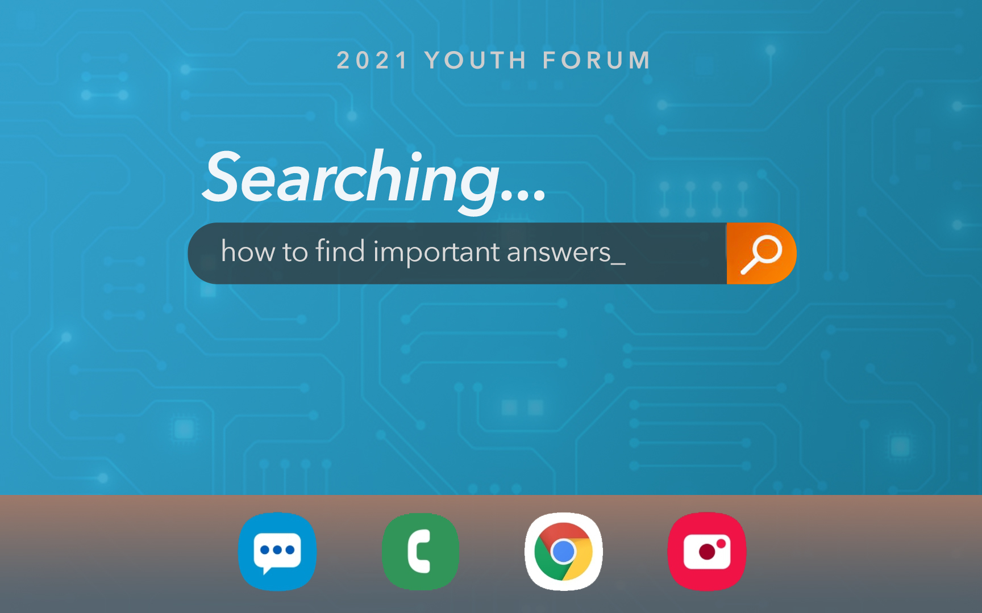
Youth Forum 2021

Slide 2
Lesson 2: Finding Answers In The Followers of Christ

Slide 3
The Internet Is So Fast, So Full, and So Available… Why Ask A Christian?
Notes:
Sometimes the internet is just plain WRONG. You can’t trust everything on TV, and you certainly can’t trust every so-called expert online.
- Driving Directions are
The internet only answers the questions you search – not the questions you SHOULD BE searching.
- How do I get a credit card? When what you should be asking is: How do I exercise patience and self-control and only buy things I can pay for now.

Slide 4
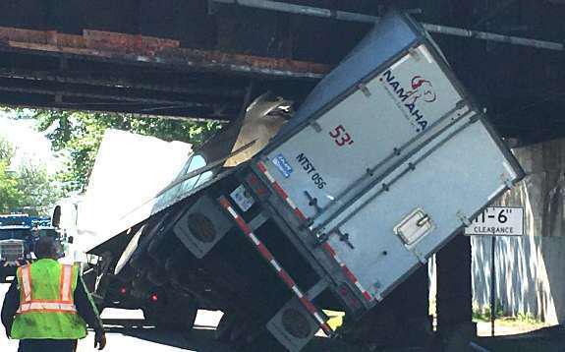
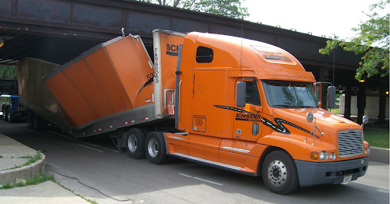
The Internet Is So Fast, So Full, and So Available… Why Ask A Christian?
Notes:
The internet only answers the questions you search – not the questions you SHOULD BE searching.
- How do I get a credit card? When what you should be asking is: How do I exercise patience and self-control and only buy things I can pay for now?

Slide 5
Why Ask A Christian? Because The Internet Will Not Always Lead You In the RIGHT Direction.
Notes:
Sometimes the internet is just plain WRONG. You can’t trust everything on TV, and you certainly can’t trust every so-called expert online.
Driving Directions are
The internet is NOT always going to Lead you in the Right Direction!

Slide 6
3 Essential Bible Lessons
We Need The Wisdom of People Who Are Older.
1 Kings 12:3-16
We Need The Example of People Who Are Christlike.
1 Corinthians 4:14-16, 11:1, Philippians 4:9
We Need The Leadership of People Who Care The Most About Our Souls.
Hebrews 13:7,17
Notes:
“I do not write these things to shame you, but to admonish you as my beloved children. For if you were to have countless tutors in Christ, yet you would not have many fathers, for in Christ Jesus I became your father through the gospel. Therefore, I exhort you, be imitators of me.”
1 Corinthians 4:14-16 (Who did this well in vs 17?)
“Be imitators of me, just as I also am of Christ”
1 Corinthians 11:1
1 Thess 1:6, Phil 4:9
Most About Our Souls: your coach cares most about your next touchdown. Your guidance counselor cares most about your career or college.
But SPIRITUAL LEADERS – they care the MOST about your SOUL. Every decision will be made to help you go to heaven. Every choice weighed based not just on the earthly consequences – but on the heavenly consequences.
WE NEED answers that are bigger than human observations alone can address. For Moral Foundation that is eternal and right. Answers based on wisdom that is HIGHER than humans have. Help navigating issues that are too big for us to foresee.

Slide 7
Finding A Follower To Imitate
A Christian Who Wants Nothing But The Best For You.
Shawn Bain/Paul & Timothy
A Christian With Results You’d Love To Duplicate.
David Banning / Hebrews 13:7
A Christian Who Is A Spiritual Leader.
Brother Webb, Marty Pickup / Hebrews 13:17
A Christian Who Embodies Christ Face to Face.
Shawn Bain, Leroy Shumake / Hebrews 13:24
Notes:
2 Samuel 13:3 – please don’t just ask a worldly friend…they will give the most terrible advice.

Slide 8
Some Questions I’m Really Glad I Asked…
What career should I pursue?
Is instrumental music for worship really wrong?
Did Jesus really rise from the dead?
Notes:
Career – Linda White
Instrumental Music – My dad
Jesus – Jim Deason

Slide 9
When I Look For Answers In Followers of Christ…
• I Get Answers+
Luke 10:29, 37
Luke 20:22-26
• I Get Answers That Are Counter-Cultural.
Matthew 5:11-12
John 15:18-20
• I Get Answers To Avoid Pain & Regret.
Eccl. 11:9-12:1
Notes:
Disney+ Discovery+ AppleTV+
All these streaming services are saying: We will give you everything you want – plus a little bit more!
Something I love about our elders is that I get Answers+
This is what Jesus did too. When people asked questions, he didn’t just give them answers – He helped them understand the bigger picture and why these things were important to God.
COUNTER: Not what we expect. Things that make us different.
AVOID: - Eccl is telling us how to use your youth.

Slide 10
Avoiding The Pain & Regret: Eccl. 11:9-12:1
In their 40’s or 50’s only fools look back at their youth and wish they had spent more time in sin.
The drugs, lust, disrespect, lies, greed, faithlessness, and pride of their youth have all revealed their true nature of pain and regret.
But many people in their 40’s and 50’s look back at their youth and wish they had spent more time listening to God. They wish they had followed the path of honesty, devotion, love, peace, and purity.
Notes:
I can’t quite say “no one” because the Bible is clear that there are FOOLS. Fools who hurt themselves again and again.

Slide 11
Case Study: Timothy Found Answers With Paul
What Did Timothy Learn?
1 Corinthians 4:17
What Did Timothy See?
2 Timothy 3:10-14
What Kind of Heart Did Timothy Develop?
Philippians 2:19-20, 1 Timothy 6:6-11
What Was Timothy Given To Treasure?
1 Timothy 6:20-21, 2 Timothy 1:13-14
Notes:
Work with people near you…

Slide 12
Case Study: Timothy Found Answers In Paul
Timothy Learned Solid, Consistent Commandments for Every Church + Every Christian In Every Place.
1 Corinthians 4:17
Timothy Saw What It Looks Like To Keep Going With A Good Heart + Great Endurance In Hard Times.
2 Timothy 3:10-14
Timothy Developed A Heart for People & For The Concerns of Jesus Christ + A Heart of Contentment.
Philippians 2:19-20, 1 Timothy 6:6-11
Timothy Treasured The Truth of the Gospel Entrusted To Him, In A World Full of Lies & Arrogant Know-It-Alls.
1 Timothy 6:20-21
Notes:
Review Group Work Answers…

Slide 13
We Are Surrounded By Wonderful Christians With Wonderful Answers. In Each Section, List A Bible Character & A Christian You Know Can Provide Great Answers…
Notes:
Hebrews 12:1 – they were so surrounded by people of faith…

Slide 14
The Answers Are RIGHT THERE! Grab Them!
Key Text: Proverbs 19:8, 20-21
Some Answers Can Be OBSERVED.
Some Answers Can Be HEARD or READ.
Some Answers Can Be DISCOVERED.
Some Answers Come With TIME, SO INVEST YOURS.
Notes:
I want every teen to be even more active in getting answers to questions about faith and life from mature Christians.
Active in Watching
Active in Listening
Active in Asking
Active in Friendships
Observed… I can see the difference that going to church every time possible makes.
Heard…I can listen closely, follow in my Bible, take notes, etc… to learn what pleases God.
Read…Old Tracts…
Discovered…I can approach any mature Christian with my questions…

Slide 15
There Are Answers To Important Questions
“Can you tell me more about…”
“What did you do, when you had to face…”
“Can you please show me what Bible verses talk about…”
“Lots of people talk about __________. What is actually pleasing to God?”

Slide 16
There Are Answers To Sad Questions
What happens if we are lukewarm?
What happens if I marry a weak Christian?
What does maturity look like on a daily basis?
Does it matter if I worship with a faithful church?

Slide 17
You can txt us any question, any time, about anything. 859-537-8142 Phillip Shumake 347-446-9319 Bill Sanchez 651-263-4927 Erik Borlaug
Notes:
You can txt me – even to say…. Phillip, can you please give me ___(Russ, or James, or Sam, or Jack, or Adam)____’s number. I want to ask him a question…

Slide 18
²⁰ As they were passing by in the morning, they saw the fig tree withered from the roots up. ²¹ Being reminded, Peter said to Him, “Rabbi, look, the fig tree which You cursed has withered.” ²² And Jesus answered saying to them, “Have faith in God.” Mark 11:20-22
Notes:
Jesus has the ANSWERS we need – and just like Peter’s question about the FIG tree – we need answers grounded DEEPLY in FAITH in GOD, our Gracious Father.
You are surrounded by people who can give you ANSWERS that are BETTER than the internet. Answers that incorporate FAITH & TRUTH. These are the BEST answers you could ever receive.

Slide 19
Youth Forum 2021

