Slide 1
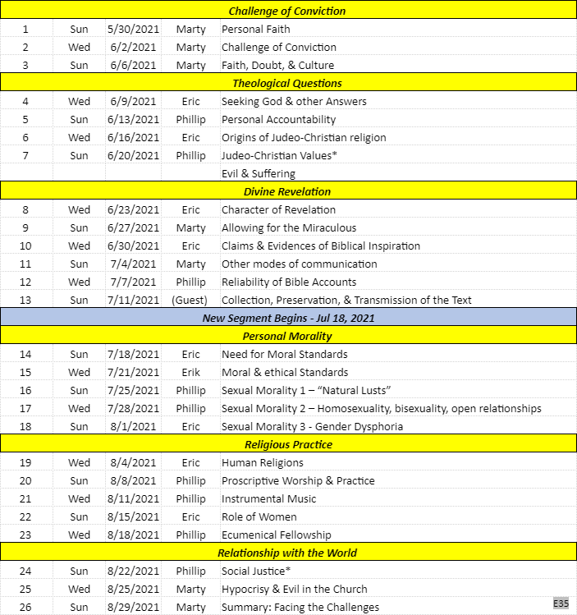
Modern Challenges to our Faith (5/30-8/29)

Slide 2
Tenets of Apostacy (Warnings from II Peter)
Embry Hills – Mar 2021
Notes:
Tenet: a principle or belief, especially one of the main principles of a religion or philosophy
Apostacy: the abandonment or renunciation of a religious or political belief
Modern Challenges: Origin of Religions; Divine Revelation; Personal Morality; Religious Authority;

Slide 3
Background of Peter’s Letters
Written 65-67 AD, shorty before Peter’s death
Little new doctrine; many “gospel” reminders (e.g. I Pet 3:18; II Pet 1:9)
Both emphasize the Word & righteous living (e.g. I Pet 1:25; II Pet 1:19) (e.g. I Pet 4:3; II Pet 3:11)
I Peter purpose: prepare for suffering
II Peter purpose: prepare for false teachers
You therefore, beloved, since you know this beforehand, beware lest you also fall from your own steadfastness, being led away with the error of the wicked… (II Pet 3:17)

Slide 4
II Peter 1:19-2:3
And so we have the prophetic word confirmed, which you do well to heed as a light that shines in a dark place, until the day dawns and the morning star rises in your hearts; ²⁰ knowing this first, that no prophecy of Scripture is of any private interpretation, ²¹ for prophecy never came by the will of man, but holy men of God spoke as they were moved by the Holy Spirit.
^{2:1} But there were also false prophets among the people, even as there will be false teachers among you, who will secretly bring in destructive heresies, even denying the Lord who bought them, and bring on themselves swift destruction. ² And many will follow their destructive ways, because of whom the way of truth will be blasphemed.

Slide 5
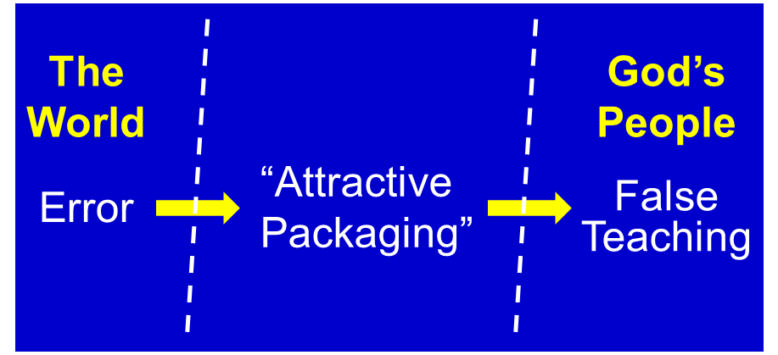
The False Teaching
Process (II Pet 1:19-2:3)
Contrast to Holy Spirit-led prophecy (1:21)
Taught from among Christians (2:1)
Something “brought in” (2:1)
Many will follow (2:2)
Discredits “the Way” (2:2)

Slide 6
The False Teaching
Process (II Pet 1:19-2:3)
Perennial Problem (II Pet 2:1-11)
Noah, “a preacher of righteousness” (2:5)
Lot, “righteous and oppressed by wicked” (2:6-7)
Balaam, “forsook the right way” (2:15-16)
Israelite/Jewish Nation (2:1, Dt 13:1; Jer 5:30-31)
Angels (2:4)
“An astonishing and horrible thing Has been committed in the land: ³¹ The prophets prophesy falsely, And the priests rule by their own power; And My people love to have it so…

Slide 7
The False Teaching
Process (II Pet 1:19-2:3)
Perennial Problem (II Pet 2:1-11)
God’s Judgement (& Deliverance) is Certain
“Swift destruction” (2:1)
“Is not idle, not asleep” (2:3)
“Made to be caught & destroyed” (2:12)
“Utterly perish” (2:12-13)
“Eternal blackness of darkness” (2:16)
“Day of judgment/perdition of ungodly men” (3:7)

Slide 8
Tenets of the Apostacy
Closed World (Physical Only)
Ignore Creation & deny other miracles (3:5-6)
Apostles’ testimonies (scriptures) are fables (1:16)
Deny that Jesus is God (2:1)
Reject the reality of Judgment (3:4)

Slide 9
Tenets of the Apostacy
Closed World (Physical Only)
“Natural” = Good
“Entice by fleshly desires, by sensuality” (2:18, NAS)
“Walking according to their own lusts [desires]” (3:3)

Slide 10
Tenets of the Apostacy
Closed World (Physical Only)
“Natural” = Good
Liberation is the Goal
“they promise them liberty” (2:19)

Slide 11
Tactics of the Apostacy
Arrogant Arguments: Intellectual Appeal
“…uttering great swelling [arrogant] vanity” (2:18)
“…deceptive [feigned, plastois] words” (2:3)

Slide 12
Tactics of the Apostacy
Arrogant Arguments: Intellectual Appeal
Ridicule and Mocking
“mockers… with their mockery” (3:3)
“reviling where they have no knowledge” (2:12, NAS)
“not afraid to speak evil of dignitaries” (2:10)
Notes:
2:10 – “dignitaries” → [doxa] “glories,” “angelic majesties,” NAS

Slide 13
Tactics of the Apostacy
Arrogant Arguments: Intellectual Appeal
Ridicule and Mocking
Target the Weak
“enticing unstable souls” (2:14)
“they entice…those who barely [certainly] escape from the ones who live in error” (2:18, NAS)
“…untaught and unstable…” (3:16)

Slide 14
The Real Tenets of the Apostacy
Public Tenets
Real Tenets
Closed World
Despise Authority
“who…despise authority. They are presumptuous, self-willed.. They are not afraid to speak evil of dignitaries” (2:10)
“Natural” = Good
Goal: Liberation
Notes:
2:10 – “dignitaries” → [doxa] “glories,” “angelic majesties,” NAS
2:12 – “natural” → instinctive [only]; “brute” – [alogos] unreasoning, irrational

Slide 15
The Real Tenets of the Apostacy
Public Tenets
Real Tenets
Closed World
Despise Authority
“Natural” = Good
Driven only by Desires/Lust
“Walking according to their own lusts” (3:3)
“…Like natural, brute beasts” (2:12)
“Eyes full of adultery…cannot cease from sin (2:14)
“They themselves are slaves of corruption” (2:19)
Goal: Liberation
Note: It’s not just about ideas…
Notes:
2:10 – “dignitaries” → [doxa] “glories,” “angelic majesties,” NAS
2:12 – “natural” → instinctive [only]; “brute” – [alogos] unreasoning, irrational

Slide 16
The Real Tenets of the Apostacy
Public Tenets
Real Tenets
Closed World
Despise Authority
“Natural” = Good
Driven only by Desires/Lust
Goal: Liberation
Goal: Exploitation
“By covetousness they will exploit [make merchandise of] you.” (2:3)
“They have a heart trained in covetous practices.” (2:14)
“Following the way of Balaam” (2:15)
Notes:
2:10 – “dignitaries” → [doxa] “glories,” “angelic majesties,” NAS
2:12 – “natural” → instinctive [only]; “brute” – [alogos] unreasoning, irrational

Slide 17
Protection – Remembering…
The Emptiness of the Tenets
No allowance or explanation for supernatural, good/ evil, beginning/end, purpose, humanity…
Promised freedom results in slavery (progressive desires, addiction, overwhelming life complexity…)
No hope for justice
No meaning beyond physical desires…

Slide 18
Protection – Remembering…
The Emptiness of the Tenets
The Evidences for the Truth
Eyewitness testimony of Jesus’ power & coming (1:16-18)
The “confirmed” prophetic word (1:19-21)
The past works of God: creation, flood, Sodom… (2:5-9; 3:5)

Slide 19
Protection – Remembering…
The Emptiness of the Tenets
The Evidences for the Truth
The Promises of Deliverance & Judgement
“…by which have been given to us exceedingly great and precious promises, that through these you may be partakers of the divine nature…” (1:4)
“…the Lord knows how to deliver the godly out of temptations and to reserve the unjust under punishment for the day of judgment.” (2:9)
”We, according to His promise, look for new heavens and a new earth in which righteousness dwells.” (3:13)

Slide 20
You therefore, beloved, since you know this beforehand, beware lest you also fall from your own steadfastness, being led away with the error of the wicked; ¹⁸ but grow in the grace and knowledge of our Lord and Savior Jesus Christ. (II Peter 3:17-18)

