Slide 1
The Immigration of Ruth
Ruth 1:1-22

Slide 3
The Immigration of Ruth
“In the Days…” (cf. Esther 1:1)
Ruth Was a Gentile; Esther Was a Jew
Ruth Was a Gentile Living Among Jews; Esther was a Jew living Among Gentiles
Ruth Married a Jew; Esther Married a Gentile.
God Mentioned in Ruth; God Not Mentioned in Esther
“When the Judges Ruled…”
“There Was Famine in the Land…”
“When I break your supply of bread...” (Leviticus 26:26)
Israel & Moab
Moab’s Incestuous Origins (Genesis 19)
Moab & Balaam (Numbers 22-24)
Moab & Seduction (Numbers 25)
Moab’s Subjugation of Israel (Judges 3)

Slide 4
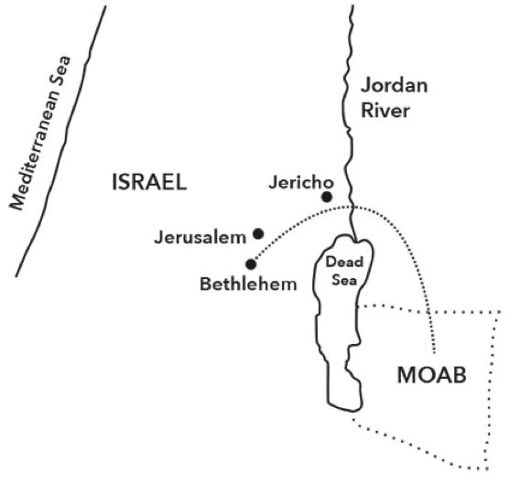
The Immigration of Ruth
“House of Bread”
“Ruth the Moabite, the widow of Mahlon…” (Ruth 4:10)
“In the Fields…” (vs. 6)
Naomi = Pleasant
Mara = Bitter

Slide 5
The Lament of Naomi
“A lament grieves that the world is unbalanced. It grieves at the gap between reality and God’s promise. It believes in a God who is there, who can act in time and space. It doesn’t drift into cynicism or unbelief, but engages God passionately with what’s wrong.”
“Casting all your anxieties on him, because he cares for you” (1 Peter 5:7)

Slide 6
The Decision of Ruth
A New God
A New People
“Bearing with one another and, if one has a complaint against another, forgiving each other; as the Lord has forgiven you, so you also must forgive.” (Col. 3:13)
Naomi’s Role in Ruth’s Decision?

Slide 7
The Providence of God
Grain
Friendship
A Blessed Future

