Slide 1
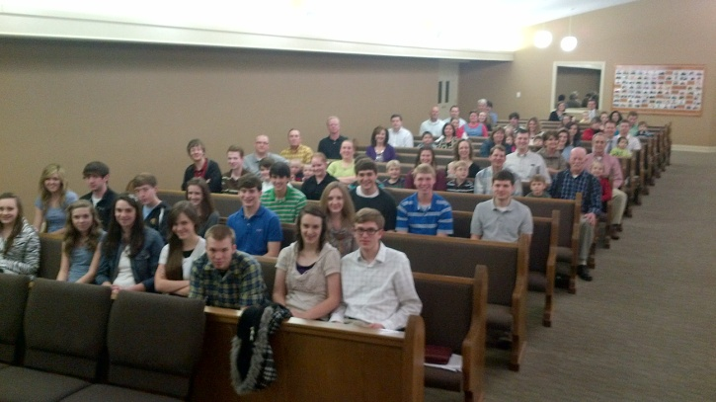
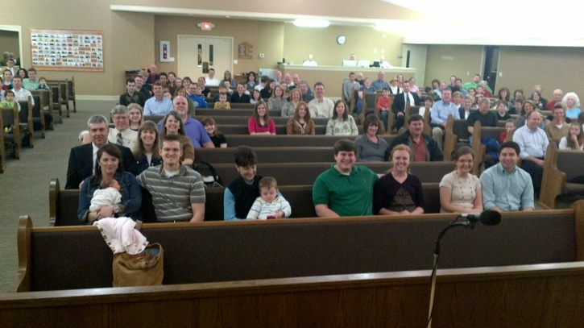
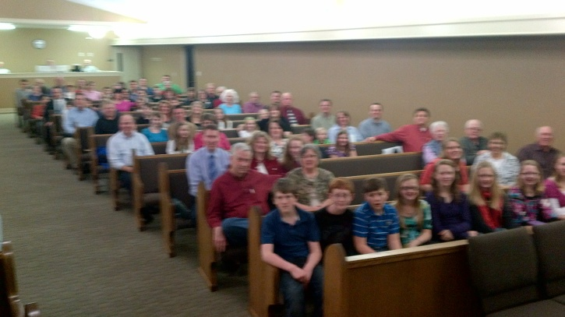
Visiting other churches of Christ

Slide 2
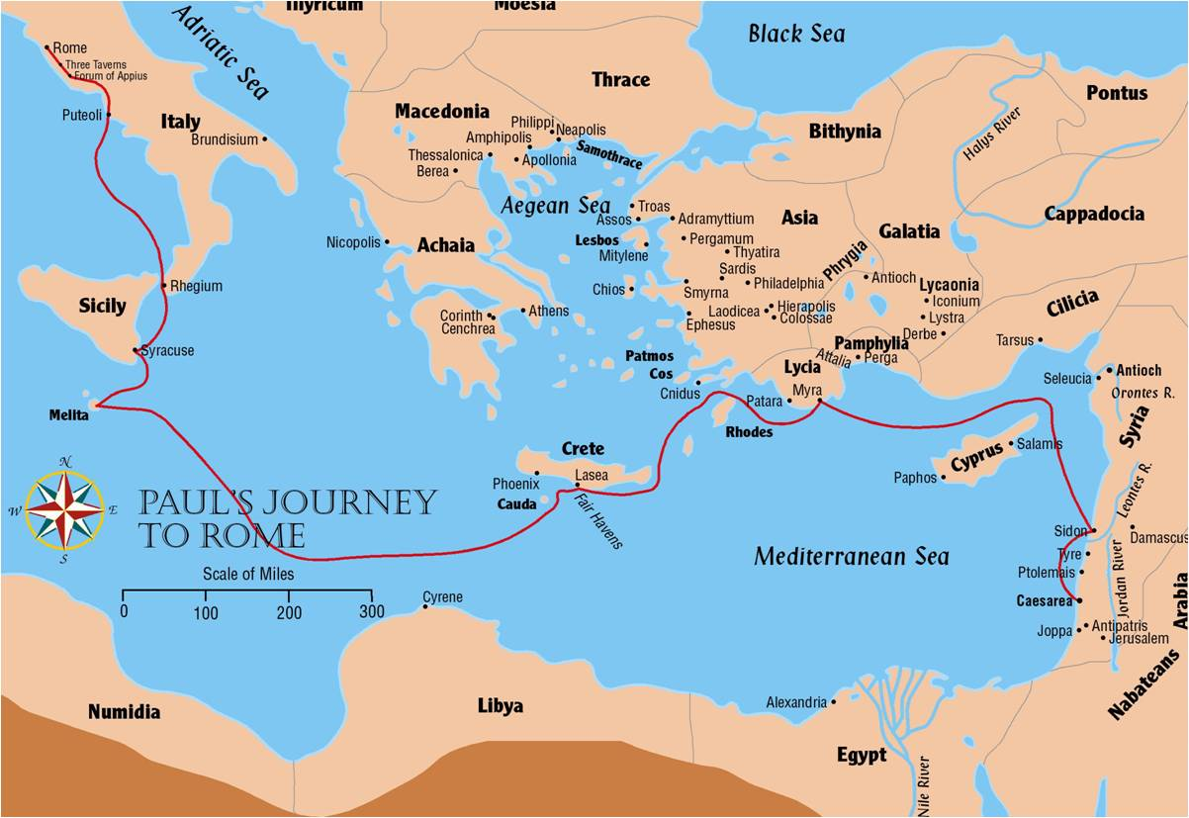
Visiting other churches of Christ
Acts 28:11-16
Acts 21:4-6
Acts 21:7
Acts 21:8-16

Slide 3
Visiting other churches of Christ
Blessings From Meeting Other Churches
Mutual Encouragement
Romans 1:9-12
Seeing We Are Part Of A Bigger Family
Ephesians 2:19
Revelation 7:9-10
Knowing That We Are Not Alone
1 Kings 19:10,18
1 Peter 5:9, 2:17

Slide 4
Visiting other churches of Christ
Ways To Meet With Other Churches
Visit ‘Gospel Meetings’ Of Nearby Churches
Visit Assemblies Of Nearby Churches
Visit Churches When You Are Traveling
How To Find A Church To Meet With
Be committed and prepare in advance.
Seek good recommendations.
Be diligent to find a faithful church.

Slide 5
Hebrews 10:24-25 John 13:34
“And let us consider one another in order to stir up love and good works,
not forsaking the assembling of ourselves together …”
“love one another”

