Slide 1
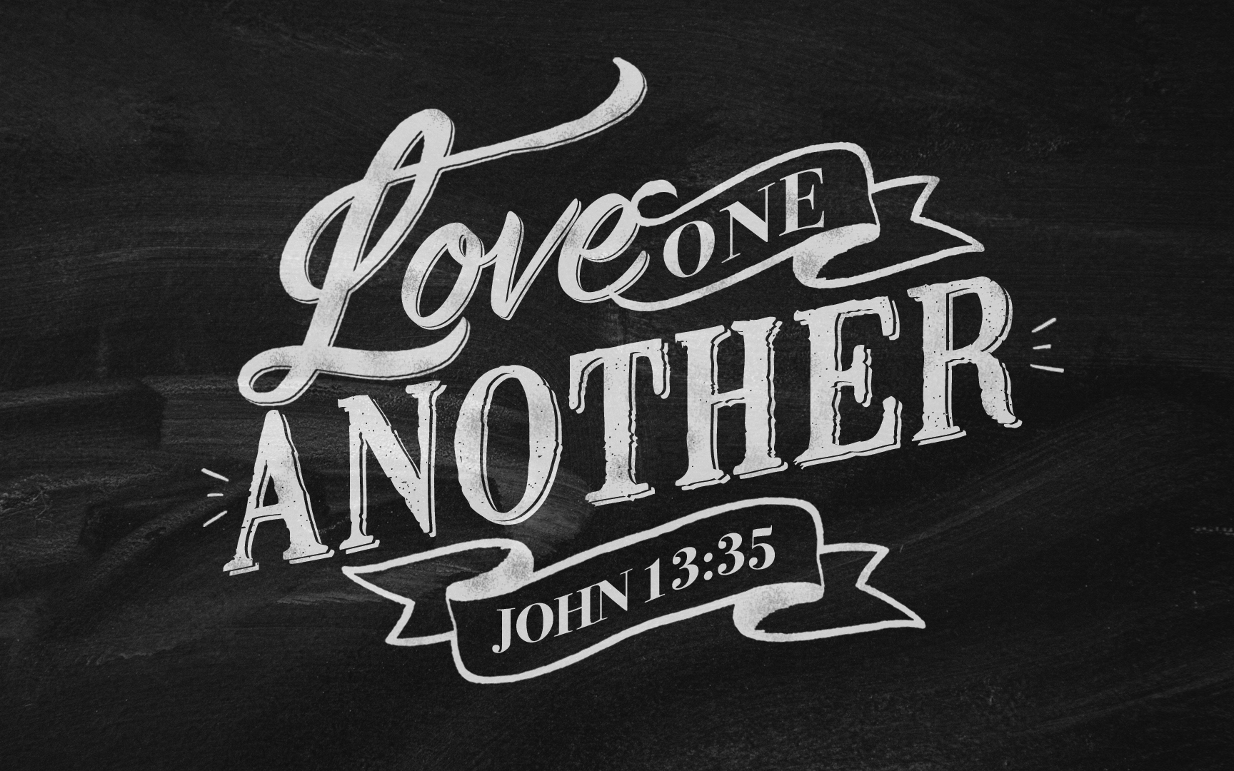

Slide 2
Lesson | Topic | Date
Lessons 1-3 | Disciples Who Love One Another
Lesson 1 | “By This, The World Will Know…” (John 13:35) | September
Lesson 2 | Why Christianity Can Create Community | October
Lesson 3 | Reasons We Don’t Need One Another | November
Lessons 4-6 | Love One Another In Deed
Lesson 4 | Honor One Another (Romans 12:10) | December
Lesson 5 | Welcome One Another (1 Peter 4:9, Rom 15:7) | January
Lesson 6 | Serve One Another (Galatians 5:13) | February
Lesson 7-10 | Love One Another In Truth
Lesson 7 | Stir Up One Another (Heb. 10:24-25,) | March
Lesson 8 | Confer With One Another (Acts 4:15) (1:14) | April
Lesson 9 | Confess & Pray with One Another (James 5:16) | May
Lesson 10 | Addressing One Another in Song (Eph. 5:19) | June
Lesson 11 | Forbear with One Another (Colossians 3:13) | July
 | Abide In God’s Love
Lesson 12 | The Test of our Love for God (1 John 4:7) | August
Notes:
Confer, Sing, Confess, & Pray are all – speech related.

Slide 3
Reasons We Choose to Be Part of This Church
Sinful/Poor
Born into a similar church
It’s my identity
Business contacts – worldly benefits
To be with others like myself
Convenience
Social reasons
Connection with God and godly people
Have my physical needs addressed
For the intellectual activity
Godly friends for my children
Good moral teaching for children
Better
but
Inadequate

Slide 4
A Question - Mark 12:28-33
“Which commandment is the most important of all?” ²⁹ Jesus answered, “The most important is, ‘Hear, O Israel: The Lord our God, the Lord is one. ³⁰ And you shall love the Lord your God with all your heart and with all your soul and with all your mind and with all your strength.’ ³¹ The second is this: ‘You shall love your neighbor as yourself.’ There is no other commandment greater than these.” ³² And the scribe said to him, “You are right, Teacher. You have truly said that he is one, and there is no other besides him. ³³ And to love him with all the heart and with all the understanding and with all the strength, and to love one's neighbor as oneself, is much more than all whole burnt offerings and sacrifices.”

Slide 5
A Question - Luke 10:25-28
²⁵ And behold, a lawyer stood up to put him to the test, saying, “Teacher, what shall I do to inherit eternal life?” ²⁶ He said to him, “What is written in the Law? How do you read it?” ²⁷ And he answered, “You shall love the Lord your God with all your heart and with all your soul and with all your strength and with all your mind, and your neighbor as yourself.” ²⁸ And he said to him, “You have answered correctly; do this, and you will live.”

Slide 6
Theme Verse – John 13:34-35
“A new commandment I give to you, that you love one another, even as I have loved you, that you also love one another. By this all men will know that you are My disciples, if you have love for one another.”

Slide 7
A Promise to Remake Us – Deut. 30:2-10
² and return to the Lord your God, you and your children, and obey his voice in all that I command you today, with all your heart and with all your soul, ³ then the Lord your God will restore your fortunes and have mercy on you, and he will gather you again from all the peoples where the Lord your God has scattered you . . . ⁶ And the Lord your God will circumcise your heart and the heart of your offspring, so that you will love the Lord your God with all your heart and with all your soul, that you may live. . . ⁸ And you shall again obey the voice of the Lord and keep all his commandments that I command you today. . . ¹⁰ when you obey the voice of the Lord your God, to keep his commandments and his statutes that are written in this Book of the Law, when you turn to the Lord your God with all your heart and with all your soul.
But when?

Slide 8
A Promise to Remake Us – Deut. 30:11-12
¹¹ “For this commandment that I command you today is not too hard for you, neither is it far off. ¹² It is not in heaven, that you should say, ‘Who will ascend to heaven for us and bring it to us, that we may hear it and do it?’ ¹³ Neither is it beyond the sea, that you should say, ‘Who will go over the sea for us and bring it to us, that we may hear it and do it?’ ¹⁴ But the word is very near you. It is in your mouth and in your heart, so that you can do it.
Sound familiar?

Slide 9
A Promise to Remake Us – Ezekiel 36:26-28
²⁶ And I will give you a new heart, and a new spirit I will put within you. And I will remove the heart of stone from your flesh and give you a heart of flesh. ²⁷ And I will put my Spirit within you, and cause you to walk in my statutes and be careful to obey my rules.

Slide 10
A Promise to Remake Us – Ezekiel 37:26-28
²⁶ I will make a covenant of peace with them. It shall be an everlasting covenant with them. And I will set them in their land and multiply them, and will set my sanctuary in their midst forevermore. ²⁷ My dwelling place shall be with them, and I will be their God, and they shall be my people. ²⁸ Then the nations will know that I am the Lord who sanctifies Israel, when my sanctuary is in their midst forevermore.”

Slide 11
Fulfillment
We are the temple of God – I Cor 3:16-17 (plural)
¹⁶ Do you not know that you are God's temple and that God's Spirit dwells in you? ¹⁷ If anyone destroys God's temple, God will destroy him. For God's temple is holy, and you are that temple.
I Corinthians 6:19-20 (singular) do you not know that your body is a temple of the Holy Spirit within you, whom you have from God?
God makes his dwelling place among us – II Cor. 6:16
we are the temple of the living God; as God said,
“I will make my dwelling among them and walk among them,
and I will be their God, and they shall be my people.

Slide 12
Practical Considerations

