Slide 1
When you consider Jesus, what’s the first image that comes to your mind?

Slide 2
Crash course on the book of Revelation
1 The Revelation of Jesus Christ, which God gave Him to show to His bond-servants, the things which must soon take place…3 Blessed is he who reads and those who hear the words of the prophecy, and heed the things which are written in it; for the time is near.

Slide 3
Crash course on the book of Revelation
1 The Revelation of Jesus Christ, which God gave Him to show to His bond-servants, the things which must soon take place…3 Blessed is he who reads and those who hear the words of the prophecy, and heed the things which are written in it; for the time is near.
Overview
The glorified, living Son of Man (1)
Letters to the churches of Asia (2-3)
Scene of throne in Heaven (4-5)
Collection of 7s with 2 interludes (6-21)
Scrolls = message
Trumpets = warning
Bowls = wrath
God and His people together (21-22)
Themes / Notes
The book was intended to reveal not to be mythicized.
Apocalyptic style revealed change from present distress.
God sees His people amidst their trials.
God was, is, and will be victorious.

Slide 4
If you were a member of one of the 7 churches, where would your take home lesson be found?

Slide 5
Crash course on the book of Revelation
1 The Revelation of Jesus Christ, which God gave Him to show to His bond-servants, the things which must soon take place…3 Blessed is he who reads and those who hear the words of the prophecy, and heed the things which are written in it; for the time is near.
Overview
The glorified, living Son of Man (1)
Letters to the churches of Asia (2-3)
Scene of throne in Heaven (4-5)
Collection of 7s with 2 interludes (6-21)
Scrolls = message
Trumpets = warning
Bowls = wrath
God and His people together (21-22)
Themes / Notes
The book was intended to reveal not to be mythicized.
Apocalyptic style revealed change from present distress.
God sees His people amidst their trials.
God was, is, and will be victorious.

Slide 6
Crash course on the book of Revelation
1 The Revelation of Jesus Christ, which God gave Him to show to His bond-servants, the things which must soon take place…3 Blessed is he who reads and those who hear the words of the prophecy, and heed the things which are written in it; for the time is near.
Overview
The glorified, living Son of Man (1)
Letters to the churches of Asia (2-3)
Scene of throne in Heaven (4-5)
Collection of 7s with 2 interludes (6-21)
Scrolls = message
Trumpets = warning
Bowls = wrath
God and His people together (21-22)
Themes / Notes
The book was intended to reveal not to be mythicized.
Apocalyptic style revealed change from present distress.
God sees His people amidst their trials.
God was, is, and will be victorious.

Slide 7
But why would small seemingly insignificant people have any hope that things would change?
Why bother hearing and heeding God’s word?

Slide 8
The Jesus that John saw
12 Then I turned to see the voice that was speaking with me. And having turned I saw seven golden lampstands; 13 and in the middle of the lampstands [I saw] one like a son of man, clothed in a robe reaching to the feet, and girded across His chest with a golden sash. 14 His head and His hair were white like white wool, like snow; and His eyes were like a flame of fire. 15 His feet [were] like burnished bronze, when it has been made to glow in a furnace, and His voice [was] like the sound of many waters. 16 In His right hand He held seven stars, and out of His mouth came a sharp two-edged sword; and His face was like the sun shining in its strength. 17 When I saw Him, I fell at His feet like a dead man.

Slide 9
The Jesus that John saw
Jesus was not disconnected from His people.
12 Then I turned to see the voice that was speaking with me. And having turned I saw seven golden lampstands; 13 and in the middle of the lampstands [I saw] one like a son of man, clothed in a robe reaching to the feet, and girded across His chest with a golden sash. 14 His head and His hair were white like white wool, like snow; and His eyes were like a flame of fire. 15 His feet [were] like burnished bronze, when it has been made to glow in a furnace, and His voice [was] like the sound of many waters. 16 In His right hand He held seven stars, and out of His mouth came a sharp two-edged sword; and His face was like the sun shining in its strength. 17 When I saw Him, I fell at His feet like a dead man.

Slide 10
The Jesus that John saw
Jesus was not disconnected from His people.
12 Then I turned to see the voice that was speaking with me. And having turned I saw seven golden lampstands; 13 and in the middle of the lampstands [I saw] one like a son of man, clothed in a robe reaching to the feet, and girded across His chest with a golden sash. 14 His head and His hair were white like white wool, like snow; and His eyes were like a flame of fire. 15 His feet [were] like burnished bronze, when it has been made to glow in a furnace, and His voice [was] like the sound of many waters. 16 In His right hand He held seven stars, and out of His mouth came a sharp two-edged sword; and His face was like the sun shining in its strength. 17 When I saw Him, I fell at His feet like a dead man.
Jesus is dressed in holy garments (Ex.28:4 – for glory and beauty)

Slide 11
The Jesus that John saw
Jesus was not disconnected from His people.
12 Then I turned to see the voice that was speaking with me. And having turned I saw seven golden lampstands; 13 and in the middle of the lampstands [I saw] one like a son of man, clothed in a robe reaching to the feet, and girded across His chest with a golden sash. 14 His head and His hair were white like white wool, like snow; and His eyes were like a flame of fire. 15 His feet [were] like burnished bronze, when it has been made to glow in a furnace, and His voice [was] like the sound of many waters. 16 In His right hand He held seven stars, and out of His mouth came a sharp two-edged sword; and His face was like the sun shining in its strength. 17 When I saw Him, I fell at His feet like a dead man.
Jesus is dressed in holy garments
Jesus is holy, pure and perfect. Think Ancient of Days (Daniel 7:9)

Slide 12
The Jesus that John saw
Jesus was not disconnected from His people.
12 Then I turned to see the voice that was speaking with me. And having turned I saw seven golden lampstands; 13 and in the middle of the lampstands [I saw] one like a son of man, clothed in a robe reaching to the feet, and girded across His chest with a golden sash. 14 His head and His hair were white like white wool, like snow; and His eyes were like a flame of fire. 15 His feet [were] like burnished bronze, when it has been made to glow in a furnace, and His voice [was] like the sound of many waters. 16 In His right hand He held seven stars, and out of His mouth came a sharp two-edged sword; and His face was like the sun shining in its strength. 17 When I saw Him, I fell at His feet like a dead man.
Jesus is dressed in holy garments
Jesus is holy, pure and perfect
Jesus sees everything, everything is laid bare in His sight. (Heb 4:13)

Slide 13
The Jesus that John saw
Jesus was not disconnected from His people.
12 Then I turned to see the voice that was speaking with me. And having turned I saw seven golden lampstands; 13 and in the middle of the lampstands [I saw] one like a son of man, clothed in a robe reaching to the feet, and girded across His chest with a golden sash. 14 His head and His hair were white like white wool, like snow; and His eyes were like a flame of fire. 15 His feet [were] like burnished bronze, when it has been made to glow in a furnace, and His voice [was] like the sound of many waters. 16 In His right hand He held seven stars, and out of His mouth came a sharp two-edged sword; and His face was like the sun shining in its strength. 17 When I saw Him, I fell at His feet like a dead man.
Jesus is dressed in holy garments
Jesus is holy, pure and perfect
Jesus sees everything, its laid bare in His sight
There is nothing that will ultimately be in the way of Jesus.

Slide 14
The Jesus that John saw
Jesus was not disconnected from His people.
12 Then I turned to see the voice that was speaking with me. And having turned I saw seven golden lampstands; 13 and in the middle of the lampstands [I saw] one like a son of man, clothed in a robe reaching to the feet, and girded across His chest with a golden sash. 14 His head and His hair were white like white wool, like snow; and His eyes were like a flame of fire. 15 His feet [were] like burnished bronze, when it has been made to glow in a furnace, and His voice [was] like the sound of many waters. 16 In His right hand He held seven stars, and out of His mouth came a sharp two-edged sword; and His face was like the sun shining in its strength. 17 When I saw Him, I fell at His feet like a dead man.
Jesus is dressed in holy garments
Jesus is holy, pure and perfect
Jesus sees everything, its laid bare in His sight
There is nothing that will ultimately be in the way of Jesus
It would be impossible to ignore the voice/words of Jesus. (Isaiah 6:4)

Slide 15
The Jesus that John saw
Jesus was not disconnected from His people.
12 Then I turned to see the voice that was speaking with me. And having turned I saw seven golden lampstands; 13 and in the middle of the lampstands [I saw] one like a son of man, clothed in a robe reaching to the feet, and girded across His chest with a golden sash. 14 His head and His hair were white like white wool, like snow; and His eyes were like a flame of fire. 15 His feet [were] like burnished bronze, when it has been made to glow in a furnace, and His voice [was] like the sound of many waters. 16 In His right hand He held seven stars, and out of His mouth came a sharp two-edged sword; and His face was like the sun shining in its strength. 17 When I saw Him, I fell at His feet like a dead man.
Jesus is dressed in holy garments
Jesus is holy, pure and perfect
Jesus sees everything, its laid bare in His sight
There is nothing that will ultimately be in the way of Jesus
It would be impossible to ignore the voice/words of Jesus.
Jesus is greater than we can even possibly fathom. (think Isaiah 40:13)

Slide 16
The Jesus that John saw
Jesus was not disconnected from His people.
12 Then I turned to see the voice that was speaking with me. And having turned I saw seven golden lampstands; 13 and in the middle of the lampstands [I saw] one like a son of man, clothed in a robe reaching to the feet, and girded across His chest with a golden sash. 14 His head and His hair were white like white wool, like snow; and His eyes were like a flame of fire. 15 His feet [were] like burnished bronze, when it has been made to glow in a furnace, and His voice [was] like the sound of many waters. 16 In His right hand He held seven stars, and out of His mouth came a sharp two-edged sword; and His face was like the sun shining in its strength. 17 When I saw Him, I fell at His feet like a dead man.
Jesus is dressed in holy garments
Jesus is holy, pure and perfect
Jesus sees everything, its laid bare in His sight
There is nothing that will ultimately be in the way of Jesus
It would be impossible to ignore the voice/words of Jesus.
Jesus is greater than we can even possibly fathom
Jesus’ words will penetrate and reveal people’s hearts. (Hebrews 4)

Slide 17
The Jesus that John saw
Jesus was not disconnected from His people.
12 Then I turned to see the voice that was speaking with me. And having turned I saw seven golden lampstands; 13 and in the middle of the lampstands [I saw] one like a son of man, clothed in a robe reaching to the feet, and girded across His chest with a golden sash. 14 His head and His hair were white like white wool, like snow; and His eyes were like a flame of fire. 15 His feet [were] like burnished bronze, when it has been made to glow in a furnace, and His voice [was] like the sound of many waters. 16 In His right hand He held seven stars, and out of His mouth came a sharp two-edged sword; and His face was like the sun shining in its strength. 17 When I saw Him, I fell at His feet like a dead man.
Jesus is dressed in holy garments
Jesus is holy, pure and perfect
Jesus sees everything, its laid bare in His sight
There is nothing that will ultimately be in the way of Jesus
It would be impossible to ignore the voice/words of Jesus.
Jesus is greater than we can even possibly fathom
Jesus’ words will penetrate and reveal people’s hearts
Jesus is endowed with the glory of God

Slide 18
Portraits of the Glorified Son of Man
Who was this Jesus?
The Life-Giving Slain Lamb of God
The Alpha and the Omega
The LORD God Almighty
Son of Man
Bright and Morning Star
The Faithful Witness
The Lion of Judah, Root of Jesse
The Divine Warrior
Ruler of the Kings of the Earth
The Amen
Notes:
The Lamb of God that slain to give life (redeemer of His people)
The Alpha and the Omega (the fullness, completeness of Christ and His Kingdom)
The LORD God Almighty (Controls all things)
Son of Man
Bright and Morning Star (you can hope and trust in Him)
The Faithful Witness (who brought the Everlasting Covenant to God’s people)
The Lion of Judah, Root of Jesse (the One who prophesied of)
The Divine Warrior (Who vindicates and frees oppressed people)
Ruler of the Kings of the Earth (The Sovereign Lordship of Christ)

Slide 19
Portraits of the Glorified Son of Man
God the Son
The Life-Giving Slain Lamb of God
The Alpha and the Omega
The LORD God Almighty
Son of Man
Bright and Morning Star
The Faithful Witness
The Lion of Judah, Root of Jesse
The Divine Warrior
Ruler of the Kings of the Earth
The Amen
Notes:
The Lamb of God that slain to give life (redeemer of His people)
The Alpha and the Omega (the fullness, completeness of Christ and His Kingdom)
The LORD God Almighty (Controls all things)
Son of Man
Bright and Morning Star (you can hope and trust in Him)
The Faithful Witness (who brought the Everlasting Covenant to God’s people)
The Lion of Judah, Root of Jesse (the One who prophesied of)
The Divine Warrior (Who vindicates and frees oppressed people)
Ruler of the Kings of the Earth (The Sovereign Lordship of Christ)

Slide 20
When God the Son sees us…
To Him who loves us and released us from our sins by His blood 6 and He has made us [to be] a kingdom, priests to His God and Father to Him [be] the glory and the dominion forever and ever. Amen.

Slide 21
When God the Son sees us…
To Him who loves us and released us from our sins by His blood 6 and He has made us [to be] a kingdom, priests to His God and Father to Him [be] the glory and the dominion forever and ever. Amen.

Slide 22
When God the Son sees us…
To Him who loves us and released us from our sins by His blood 6 and He has made us [to be] a kingdom, priests to His God and Father to Him [be] the glory and the dominion forever and ever. Amen.

Slide 23
When God the Son sees us…
To Him who loves us and released us from our sins by His blood 6 and He has made us [to be] a kingdom, priests to His God and Father to Him [be] the glory and the dominion forever and ever. Amen.

Slide 24
If this Son of Man views us like this, we should…
Remember God, the Son of Man
Have confidence in who He’s asked you to be.
Reveal His message to the world.
Have more faith in Him than fear over your circumstance.
Read, listen, and heed His words.

Slide 25
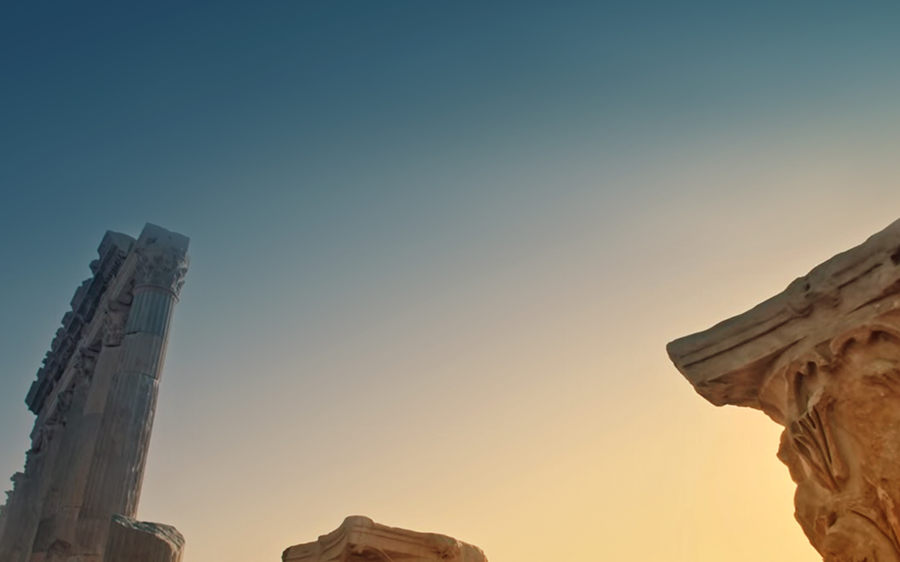
Remember the greatness of the God, Son of Man

