Slide 1
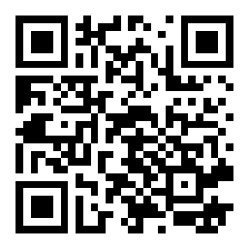
Hosea & Amos: Lesson 9
Please connect with your smartphone below to participate in our class activities

Slide 2
Hosea & Amos prophesied:
ⓘ Start presenting to display the poll results on this slide.

Slide 3
The prophet Hosea:
ⓘ Start presenting to display the poll results on this slide.

Slide 4
The prophet Amos:
ⓘ Start presenting to display the poll results on this slide.

Slide 5
Imagine This Scenario
You are an Israelite farmer in the Northern Kingdom
You assume responsibility for your family’s land at a young age
Through God’s blessing and your hard work and wisdom, your farm prospers
You expand your farming operation by acquiring land from other farmers
Your success in years when others fail allows you to rescue those farmers
You get their land, they work for you, their debts are paid, everyone wins
Your sons and their sons continue to grow your agribusiness
After 50 years, you accumulate such wealth that you can live a comfortable, even luxurious life that you can pass down to your heirs
What would God have to say?

Slide 6
After 50 years of expanding your profitable farming enterprise, what would the Law of God say?
ⓘ Start presenting to display the poll results on this slide.

Slide 7
Leviticus 25

Slide 8
Leviticus 25

Slide 9
Leviticus 25

Slide 10
Leviticus 25

Slide 11
Leviticus 25: The Year of Jubilee
Reminds the people that the land belongs to God, not them
Reminds the people that they were all once slaves in Egypt, but now are servants of God (and not any man)
Obligates the wealthy to take care of the poor
Prevents any family from losing their inheritance
Prevents any family from becoming wealthy at the expense of others
Because they sell the righteous for money
And the needy for a pair of sandals.
(Amos 2:6b)
Who oppress the poor, who crush the needy, Who say to your husbands, “Bring now, that we may drink!”
(Amos 4:1b)
… you impose heavy rent on the poor and exact a tribute of grain from them …
(Amos 5:11a)
… who distress the righteous and accept bribes
And turn aside the poor in the gate …
(Amos 5:12b)

Slide 12
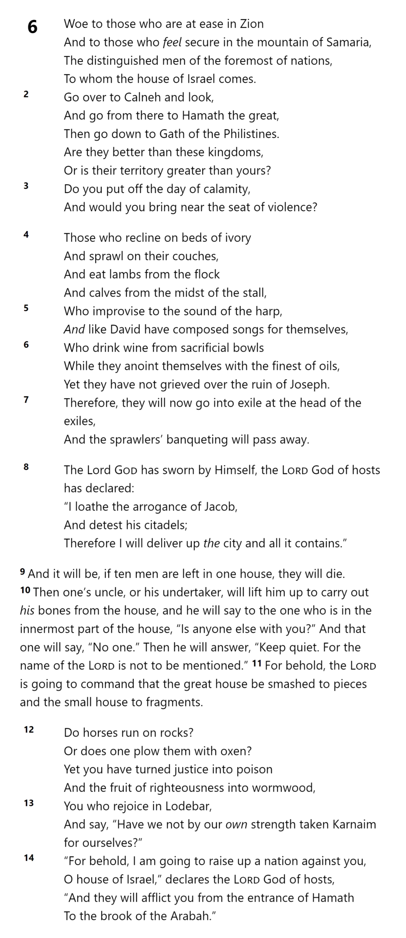
AMOS 6

Slide 13
AMOS 6

Slide 14
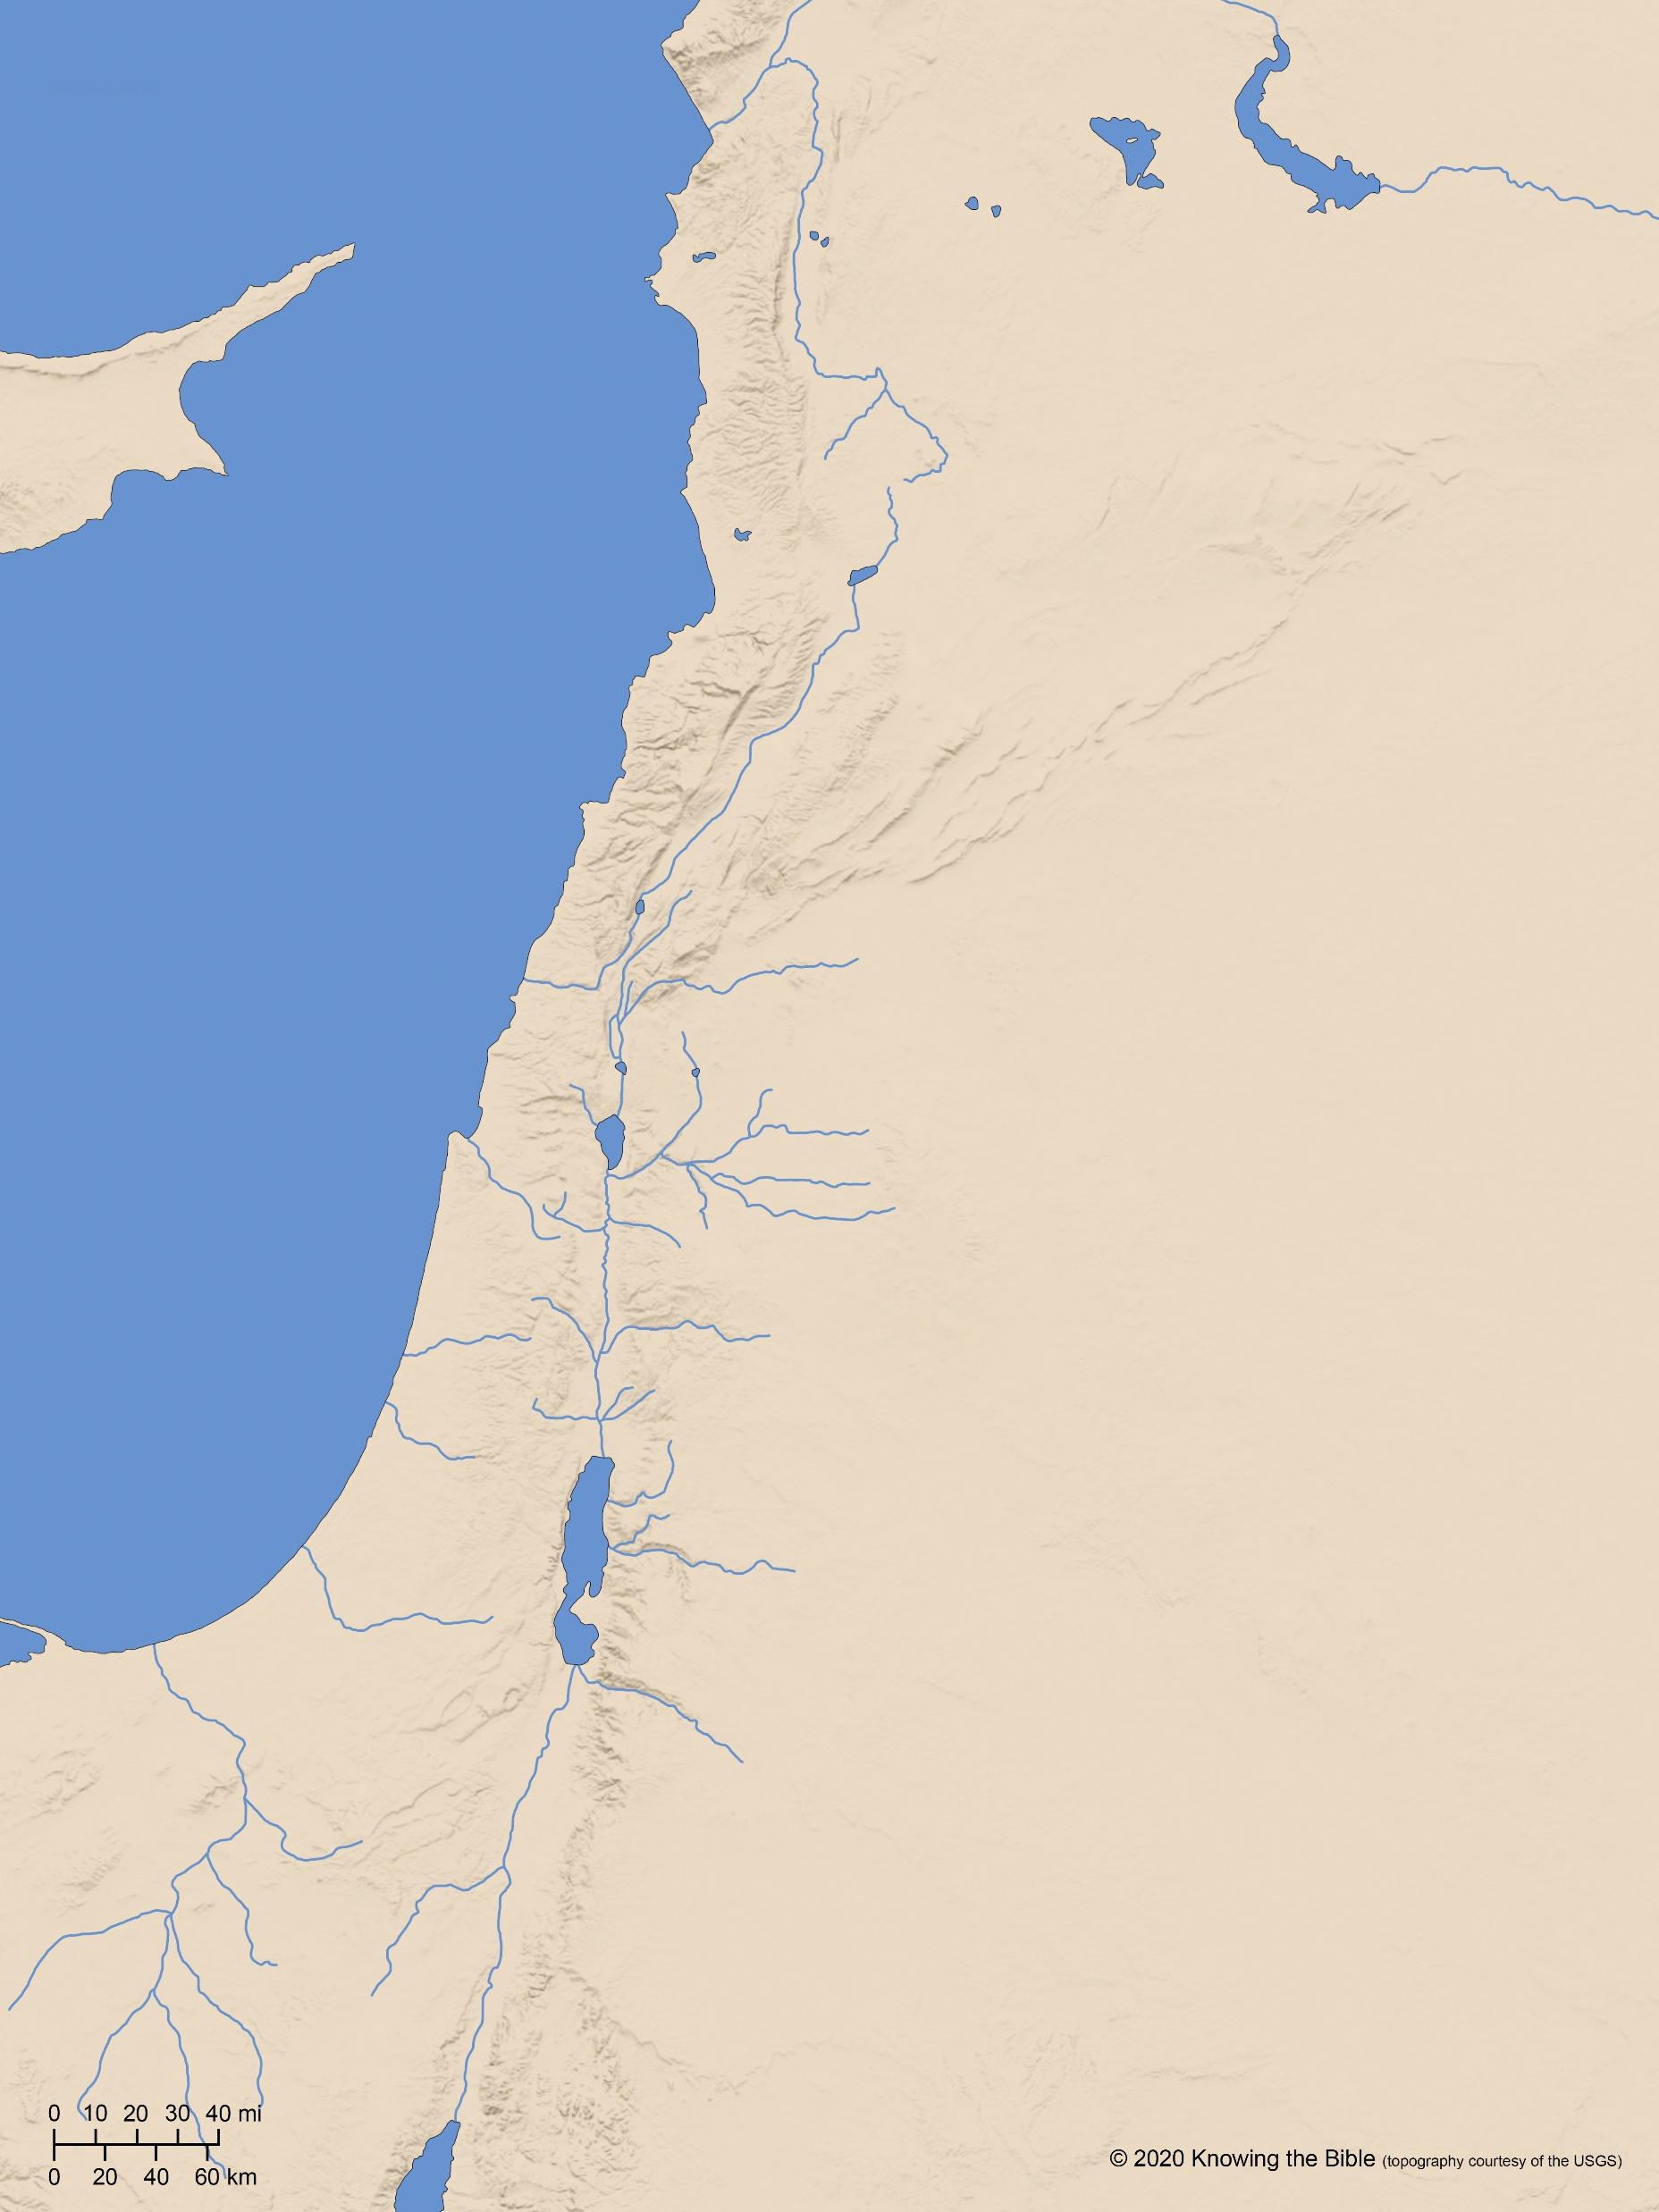
Calneh?
ASSYRIA
Hamath
Dan
Jezreel
Gilead
Samaria
Israel
Bethel
Ammon
Jerusalem
Ekron
Philistia
Ashdod
Tekoa
Ashkelon
Gath
Judah
Gaza
Moab
Edom

Slide 15
Calneh?
ASSYRIA
Hamath
Ekron
Ashdod
Ashkelon
Gath
Gaza
Dan
Jezreel
Gilead
Samaria
Israel
Bethel
Ammon
Jerusalem
Philistia
Tekoa
Judah
Moab
Edom

Slide 16
Calneh?
ASSYRIA
Hamath
Dan
Jezreel
Gilead
Samaria
Israel
Ekron
Bethel
Ashdod
Ammon
Ashkelon
Gath
Jerusalem
Philistia
Gaza
Tekoa
Judah
Moab
Edom

Slide 17
AMOS 6

Slide 18
AMOS 6

Slide 19
AMOS 6

Slide 20
AMOS 6

Slide 21
What false things do we rely on for security rather than the Lord?
ⓘ Start presenting to display the poll results on this slide.

Slide 22
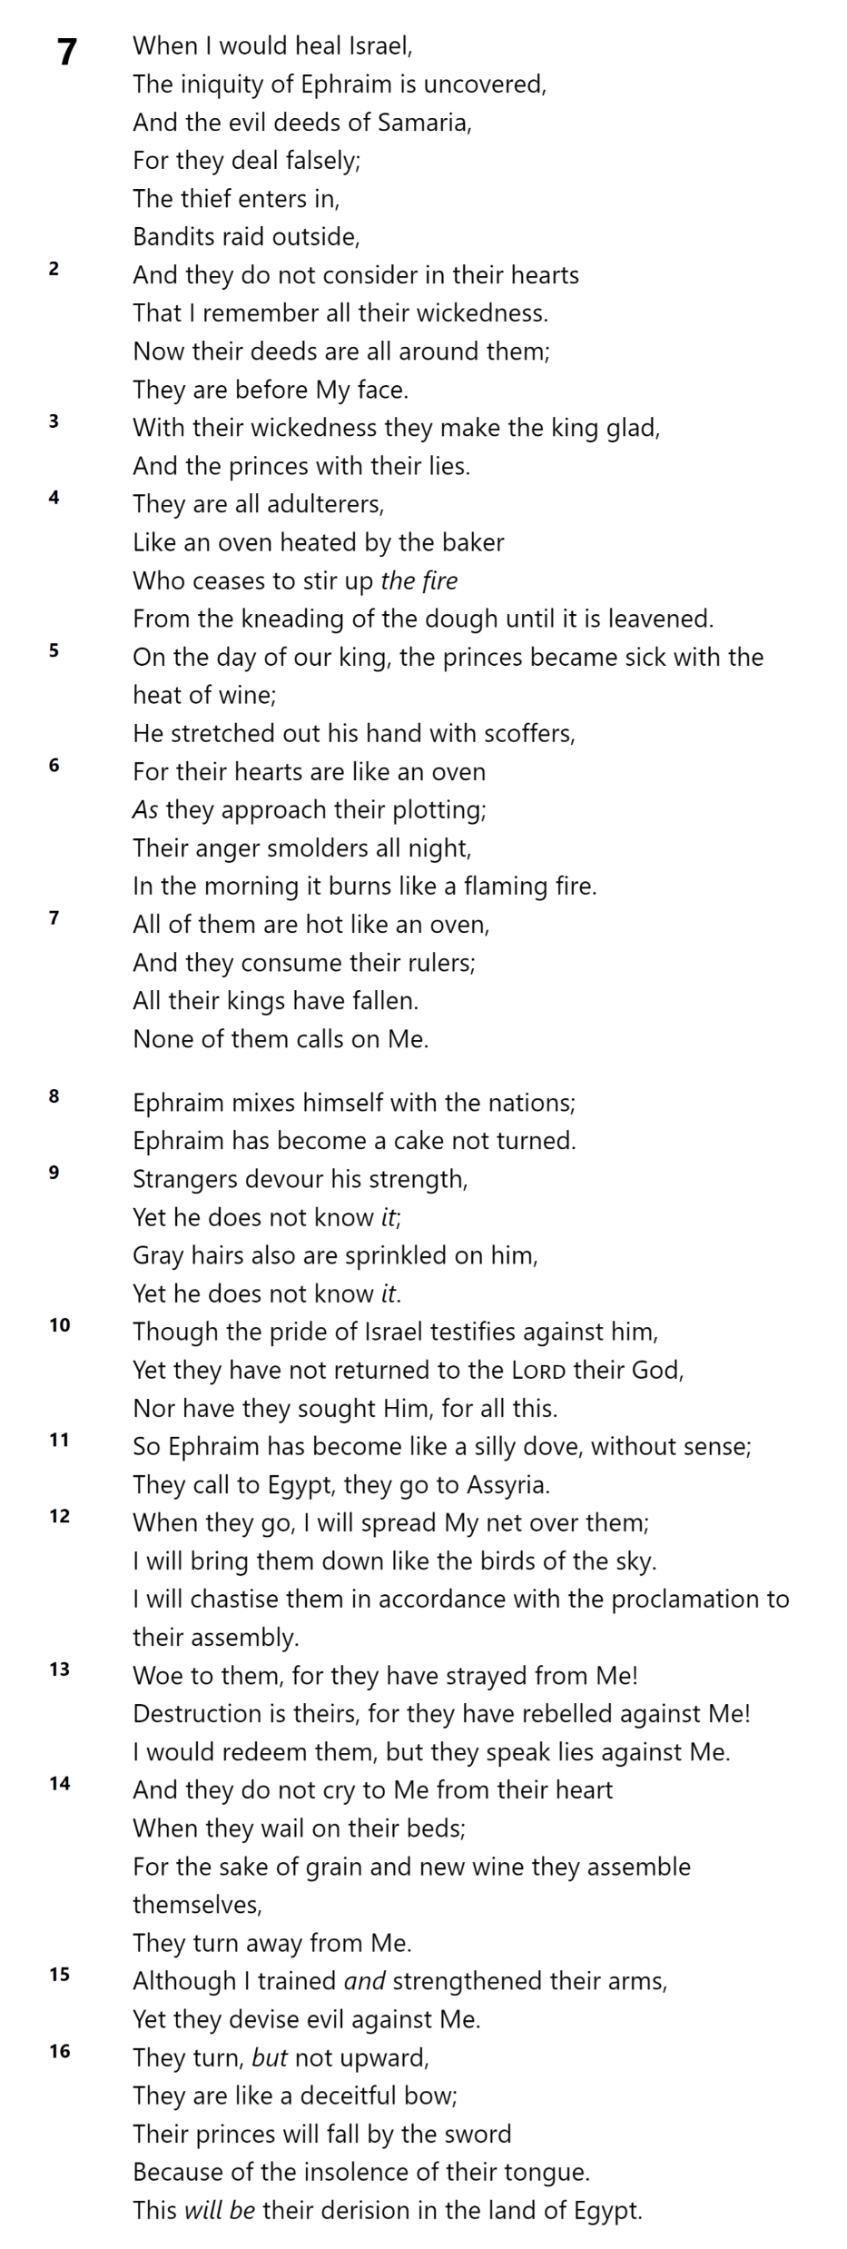
Hosea 7

Slide 23
790
JEROBOAM II
780
770
760
Zechariah
6 mos
Shallum
1 mo
750
MENAHEM
Pekahiah (2 yrs)
PEKAH
740
730
HOSHEA
Hosea 7
720

Slide 24
Hosea 7

Slide 25
Hosea 7

Slide 26
When we are in trouble, where do we often turn for help instead of the Lord?
ⓘ Start presenting to display the poll results on this slide.

Slide 27
Which image is *NOT* used to describe Israel in Hosea 7?
ⓘ Start presenting to display the poll results on this slide.

Slide 28
