Slide 1
Ps. 115; Isaiah 44; 2 Cor. 3-4

Slide 2
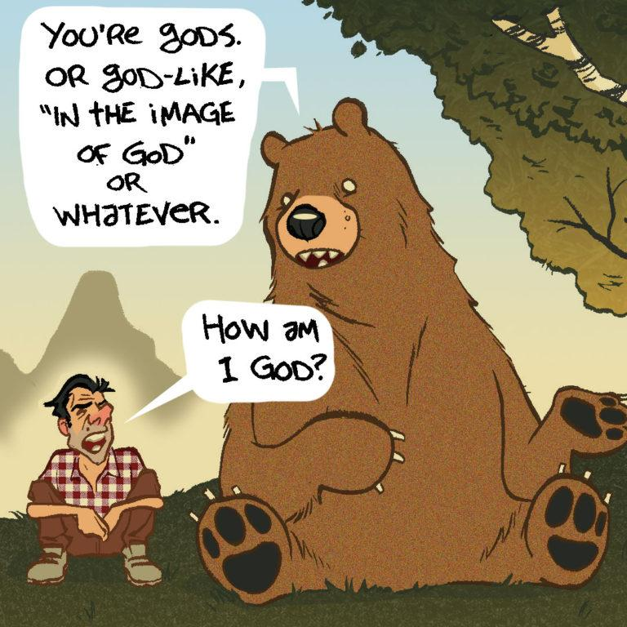

Slide 3
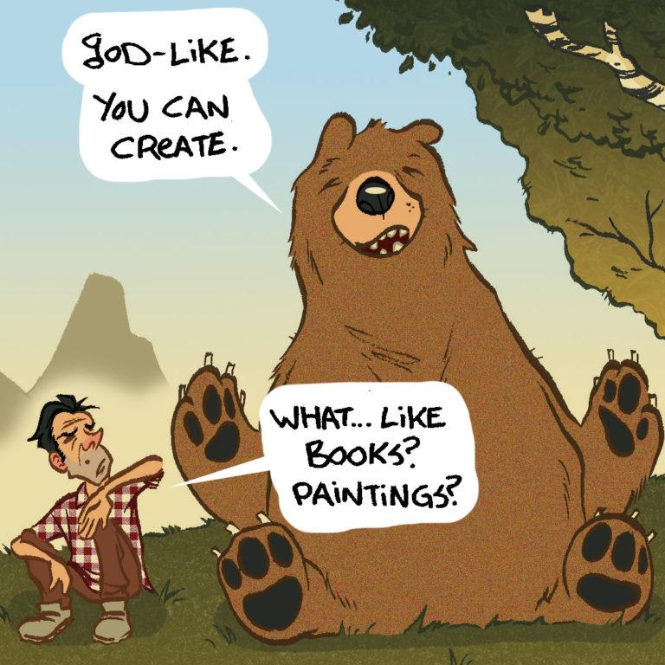

Slide 4
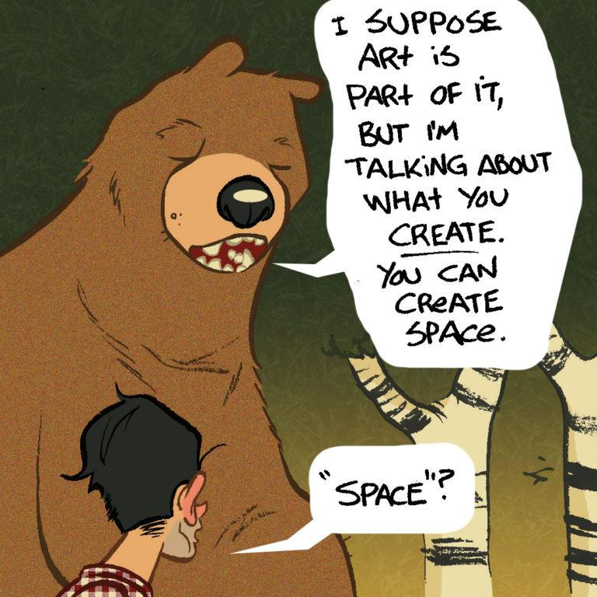

Slide 5
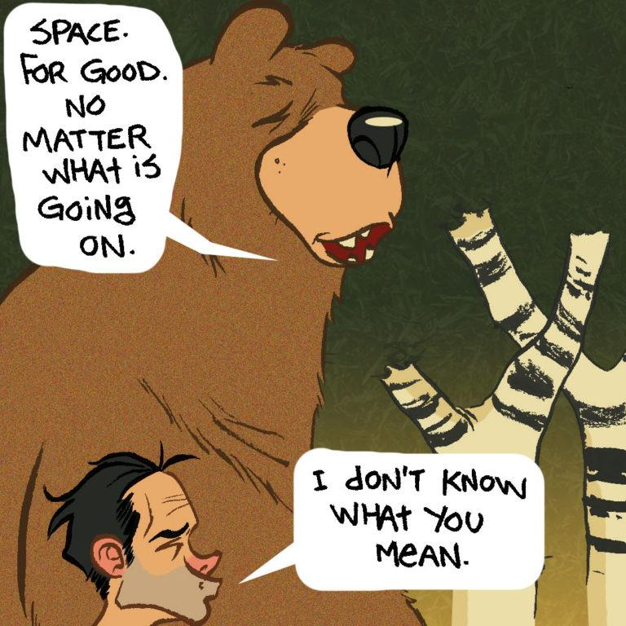

Slide 6
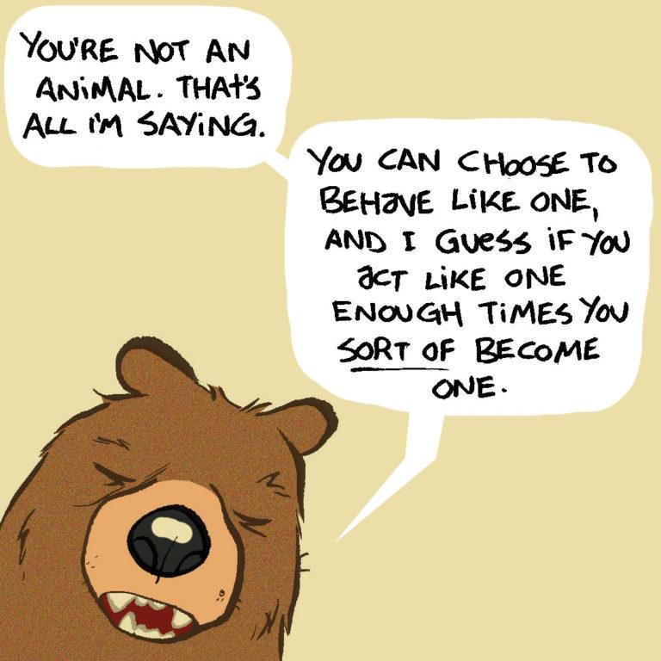

Slide 7
Ps. 115; Isaiah 44; 2 Cor. 3-4

Slide 8
Psalm 115:1-8
1 Not to us, O Lord, not to us,
But to Your name give glory
Because of Your lovingkindness, because of Your truth.
2 Why should the nations say,
“Where, now, is their God?”
3 But our God is in the heavens;
He does whatever He pleases.
4 Their idols are silver and gold,
The work of man’s hands.
5 They have mouths, but they cannot speak;
They have eyes, but they cannot see;
6 They have ears, but they cannot hear;
They have noses, but they cannot smell;
7 They have hands, but they cannot feel;
They have feet, but they cannot walk;
They cannot make a sound with their throat.
8 Those who make them will become like them,
Everyone who trusts in them.

Slide 9
Isaiah 44:9-20
9 All who make idols are nothing,
and the things they treasure are worthless.
Those who would speak up for them are blind;
they are ignorant, to their own shame.
10 Who shapes a god and casts an idol,
which can profit nothing?
11 People who do that will be put to shame;
such craftsmen are only human beings.
Let them all come together and take their stand;
they will be brought down to terror and shame.
1. The idol can do NOTHING

Slide 10
Isaiah 44:9-20
12 The blacksmith takes a tool
and works with it in the coals;
he shapes an idol with hammers,
he forges it with the might of his arm.
He gets hungry and loses his strength;
he drinks no water and grows faint.
13 The carpenter measures with a line
and makes an outline with a marker;
he roughs it out with chisels
and marks it with compasses.
He shapes it in human form,
human form in all its glory,
that it may dwell in a shrine.
2. The idol is MADE BY MAN

Slide 11
Isaiah 44:9-20
14 He cut down cedars,
or perhaps took a cypress or oak.
He let it grow among the trees of the forest,
or planted a pine, and the rain made it grow.
15 It is used as fuel for burning;
some of it he takes and warms himself,
he kindles a fire and bakes bread.
But he also fashions a god and worships it;
he makes an idol and bows down to it.
16 Half of the wood he burns in the fire;
over it he prepares his meal,
he roasts his meat and eats his fill.
He also warms himself and says,
“Ah! I am warm; I see the fire.”
17 From the rest he makes a god, his idol;
he bows down to it and worships.
He prays to it and says,
“Save me! You are my god!”
3. The idol is TEMPORARY

Slide 12
Isaiah 44:9-20
18 They know nothing, they understand nothing;
their eyes are plastered over so they cannot see,
and their minds closed so they cannot understand.
19 No one stops to think,
no one has the knowledge or understanding to say,
“Half of it I used for fuel;
I even baked bread over its coals,
I roasted meat and I ate.
Shall I make a detestable thing from what is left?
Shall I bow down to a block of wood?”
20 Such a person feeds on ashes; a deluded heart misleads him;
he cannot save himself, or say,
“Is not this thing in my right hand a lie?”

Slide 13
The Idol of:
LAZINESS
By: Steve Trammell
The Idol of:
Self
By: Dustin Merkle
The Idol of:
EXPERIENCE
By: Joshua Carter

Slide 14
2 Corinthians 3:18
18 And we all, who with unveiled faces contemplate the Lord’s glory, are being transformed into his image with ever-increasing glory, which comes from the Lord, who is the Spirit.

Slide 15
2 Corinthians 4:1-6
Therefore, since through God’s mercy we have this ministry, we do not lose heart. 2 Rather, we have renounced secret and shameful ways; we do not use deception, nor do we distort the word of God. On the contrary, by setting forth the truth plainly we commend ourselves to everyone’s conscience in the sight of God. 3 And even if our gospel is veiled, it is veiled to those who are perishing. 4 The god of this age has blinded the minds of unbelievers, so that they cannot see the light of the gospel that displays the glory of Christ, who is the image of God. 5 For what we preach is not ourselves, but Jesus Christ as Lord, and ourselves as your servants for Jesus’ sake. 6 For God, who said, “Let light shine out of darkness,” made his light shine in our hearts to give us the light of the knowledge of God’s glory displayed in the face of Christ.
1. Do not lose heart.
2. Do not act shamefully
3. Do not act deceptively
4. Do not change the Word
5. Do not walk blindly
6. Do not walk pridefully

Slide 16
