Slide 1
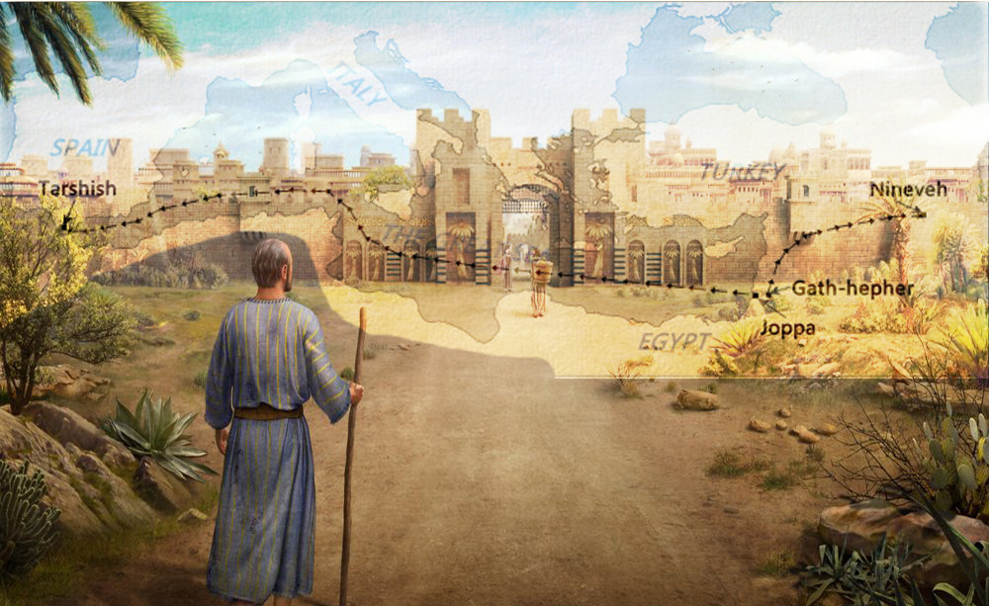
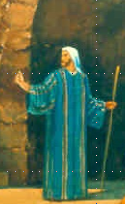
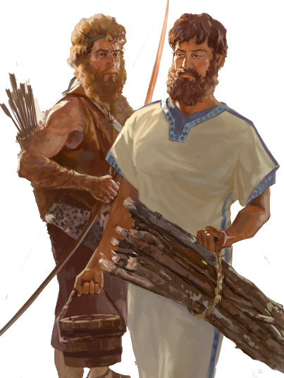
Lesson 4
Jonah in Nineveh Chap 3-4

Slide 2
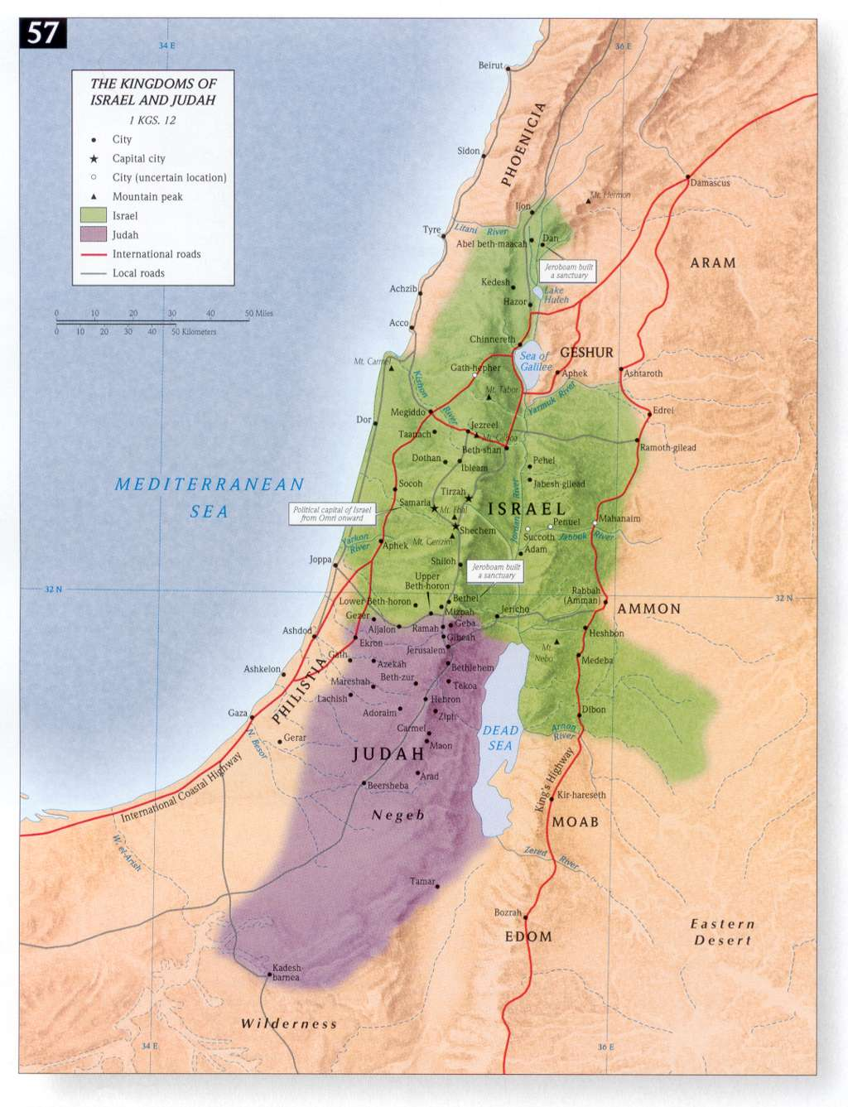
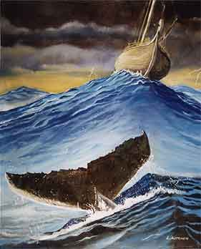
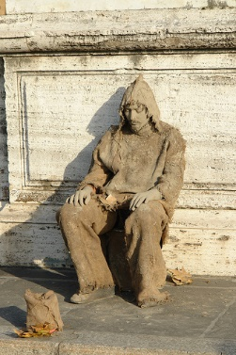
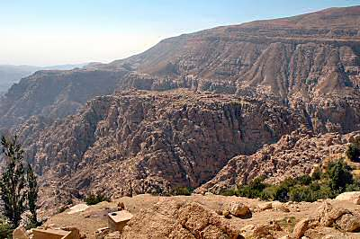
Where are the 4 Prophets?
NINEVEH
Obadiah Edom Punished
Jonah Nineveh repent or
be overthrown in 40 days
Joel Day of the Lord is great and terrible, who can endure
Micah do justly, love mercy & walk
humbly with your God
JONAH
ISRAEL
JOEL
MICAH
EDOM
OBADIAH
JUDAH

Slide 3
Class Objectives
Evidence of the Inspiration of the Scriptures
Learn timeline and events occurring for the prophets
Establish a connection between the Old Testament to the New Testament
Examine what God desires for His people as told us by the prophets
Exercise our Bible Study Skills

Slide 4
The purpose of the prophets was threefold
1
2
3
To warn the nations of the coming judgment.
To explain why the judgment had come upon them.
To give assurance, at least to a remnant, of a hope that lay beyond the judgment.
Notes:
1. The purpose of the prophets was threefold:
a. To warn the nations of the coming judgment.
b. To explain why the judgment had come upon them.
To give assurance, at least to a remnant, of a hope that lay beyond the judgment.

Slide 5
The Role of the Prophets
They are Spokesmen for God, serving as “forthtellers,” speaking what God put in their mouth.
They are Preachers of the Covenant, relating their message to God’s previous promises to the nation of Israel. These covenants were made with or through Abraham, Moses, and David
They are historians, or Interpreters of the Israelites’ History. With out their interpretation God’s people would not know why an event was occurring.

Slide 6
Prophetic Waves
Assyrian Threat
Syrian Threat
Babylonian Threat
Romans
Moses
Exodus
Persian
Written
Israel Falls
Abraham
Judah Falls
Judges
Kingdom Divides
Captivity
& Return
United Kingdom
Oral
Daniel
roars
Greeks
2100
1400
1100
1000
900
800
700
600
500
400
100
0
~30
100
605
597
586
538
458
444
722
Christ
Exile
Return
Notes:
Prophet waves –
God tends to give the last gen before day of the Lord a chance to repent – ie lots of prophet activity
Between the Testament ok
400 years of silince not so much, Daniel roars In Between the Testament

Slide 8
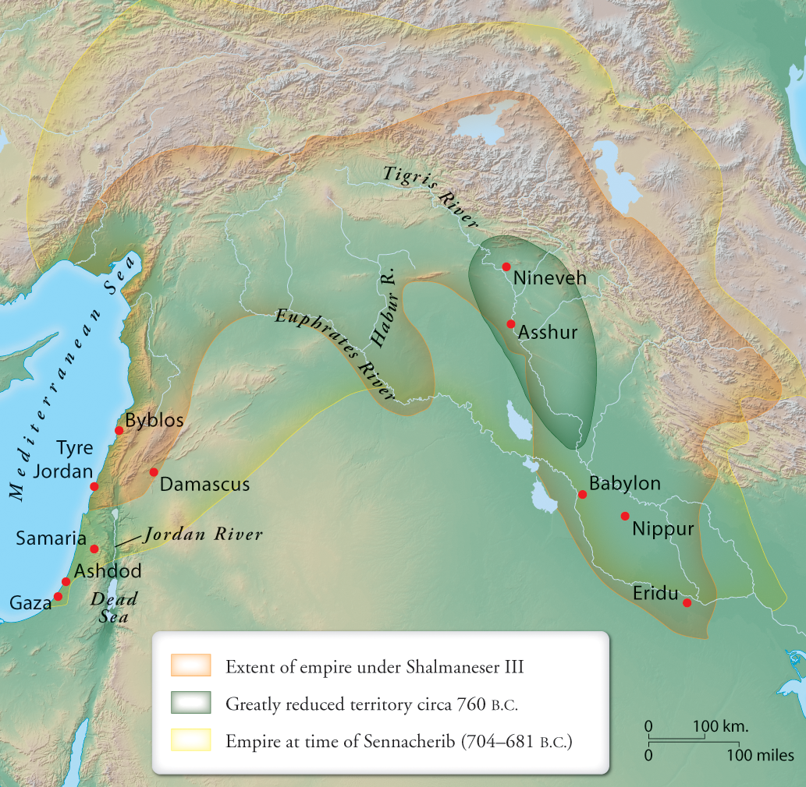
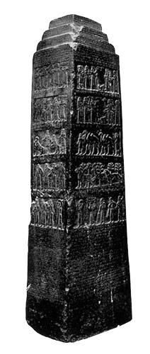
859-824 BC
Ahab-Jehu
Jeroboam II
Hezekiah/Manasseh

Slide 9
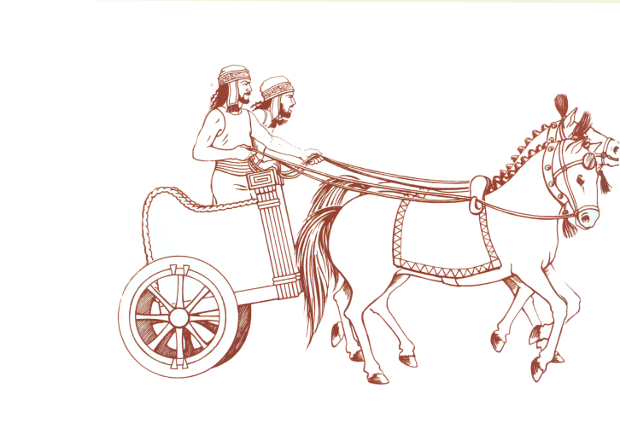
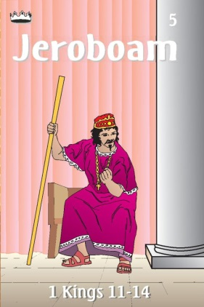
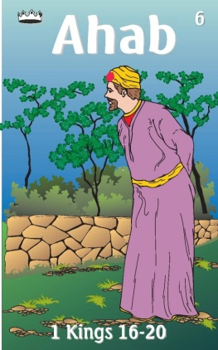
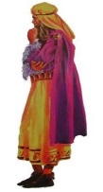
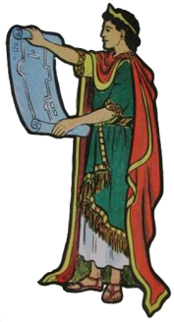
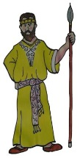
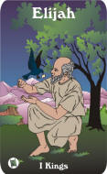
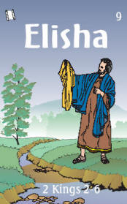
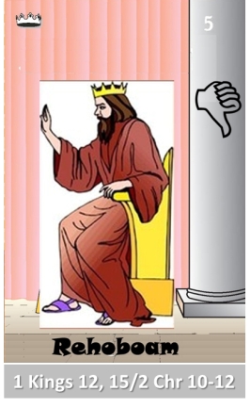
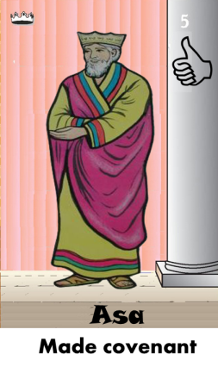
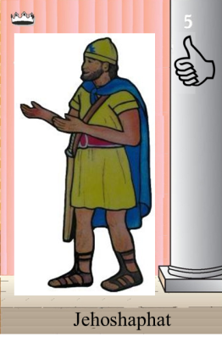
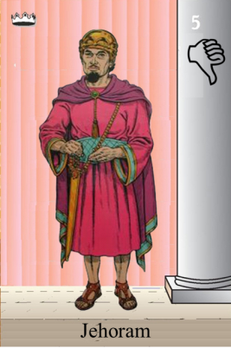
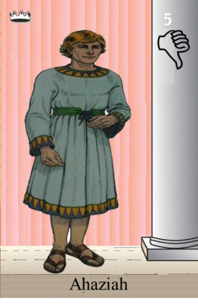
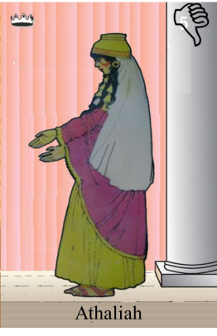
Ahaziah
Jehoram
Killed by Jehu
Baasha
Jehu
Ahijah
Man of God
Rocks for
Mizpah & Geba
Early Kings
Omri Kings
Jehu Kings
Brings in Syria
Obadiah 845-836
Killed by Jehu
Shemaiah
Azariah
Hanani the Seer
Notes:
Jeroboam – not Judha
Baasha & Asa – rocks for fort/Asa turns to Syria not God
Ahab worst King of Israel – God responds – Elijah, troubler of Israel
Elisha – troubles Syria to help Israel God’s compassion
Jehu so well wipes out Ahab’s house – to the fifth king, driving skills with chariot
Obadiah days of Jehoram

Slide 10
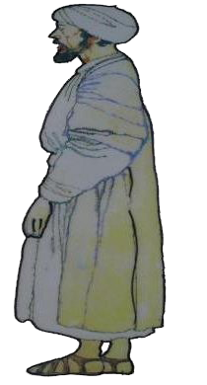
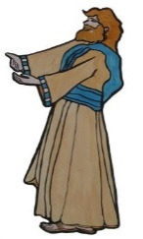
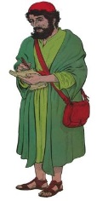
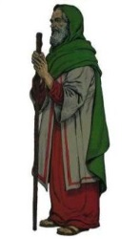
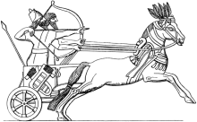
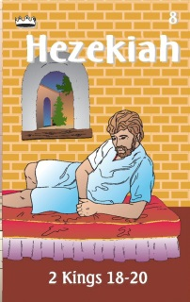
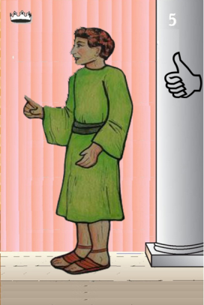
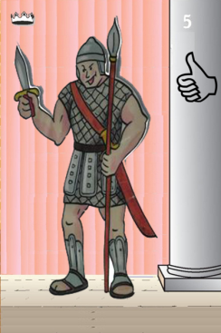
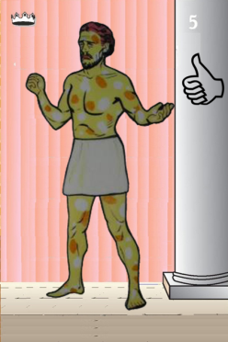
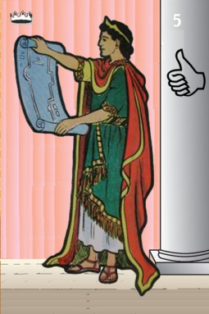
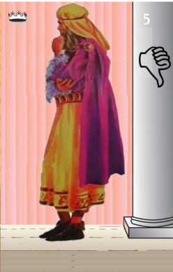
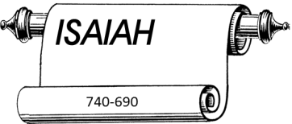
Jehu
841-814
Jehoahaz
Jehoash
Elisha &
the Arrows
Jeroboam II
Zechariah
Tiglath-pileser III
(745–727 b.c.)
793-753
Jehu Kings
Confusing
Brings in Assyria
Joash
Amaziah
Uzziah
Jotham
Ahaz
Jehoiada Made covenant
Notes:
Joel in days dya so f Joash when Jehoiada rules
Jeroboam II – Jonah and Amos
Isaiah – starts in last year of Uzziah
Micah – same time as of Isaiah – days of Ahaz
Ahaz – anybody but God would he turn/worship

Slide 11
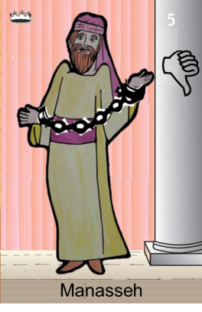
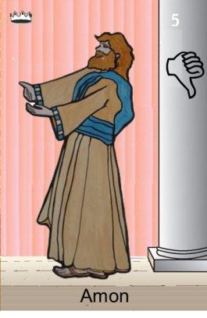
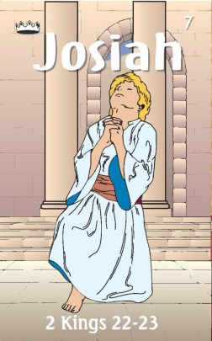
Confusing
Judah Alone
Tiglath-pileser III
(745–727 b.c.)
Revolt of 652 BC
Maybe occasion of Manasseh
Being taken captive
Shallum 752
Menahem 752-742
Pekahiah 742-740
Pekah(752) 740-732
Hoshea 732-722
697-642
640-609
Made covenant
Brings in Aayria
Uzziah
Jotham
Ahaz

Slide 12
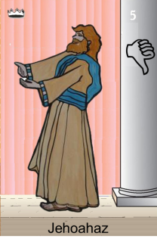
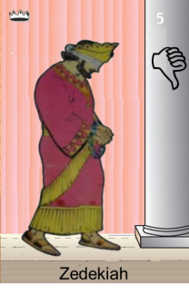
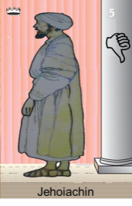
Confusing
Judah Alone
Tiglath-pileser III
(745–727 b.c.)
697-642
640-609
Shallum 752
Menahem 752-742
Pekahiah 742-740
Pekah(752) 740-732
Hoshea 732-722
Made covenant
609
609-597
Egypt
597-586
Babylon
Uzziah
Jotham
Ahaz
597
Babylon
Notes:
Manasseh worse king but repents – born in last 15 years of Hezekiah

Slide 13
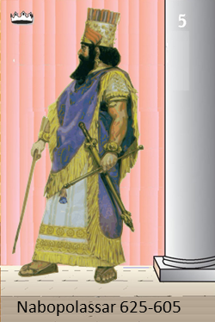
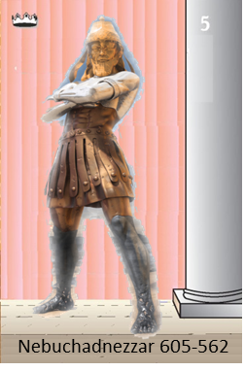
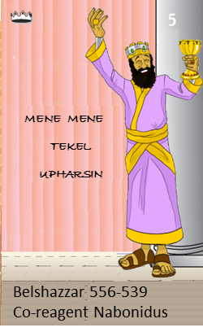
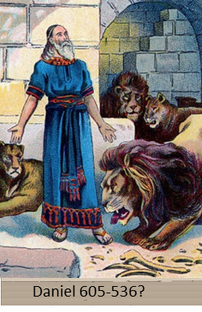
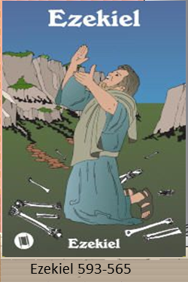
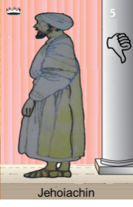
Judah Alone
605-538 BC
Return From Exile
640-609
Babylonian Captivity
538-425?
Daniel
605 BC
597 BC
586 BC

Slide 14
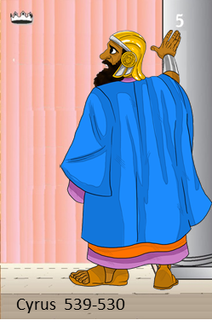
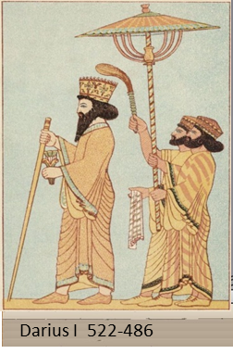
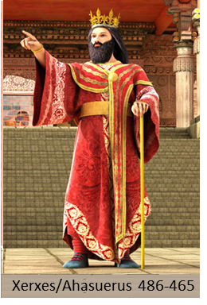
538-425? BC
Return From Exile
640-609
Cyrus Cylinder
Freeing People
537 Rebuild Altar
516 Rebuild Temple

Slide 16
What was Jonah Commanded to do?
Jonah 1:1-3(NKJV) ¹Now the word of the Lord came to Jonah the son of Amittai, saying, ²“Arise, go to Nineveh, that great city, and cry out against it; for their wickedness has come up before Me.” ³But Jonah arose to flee to Tarshish from the presence of the Lord. He went down to Joppa, and found a ship going to Tarshish; so he paid the fare, and went down into it, to go with them to Tarshish from the presence of the Lord.

Slide 19
Jonah’s Psalm of Thanksgiving
Jonah 2:2–9 (NKJV) ² And he said:
“I cried out to the Lord because of my affliction, And He answered me.
“Out of the belly of Sheol (From the depths of the grave) I cried,
And You heard my voice.
³ For You cast me into the deep,
Into the heart of the seas,
And the floods surrounded me;
All Your billows and Your waves passed over me.
⁴ Then I said, ‘I have been cast out of Your sight;
Yet I will look again toward Your holy temple.’
⁵The waters surrounded me, even to my soul;
The deep closed around me;
Weeds were wrapped around my head.
⁶ I went down to the moorings of the mountains (roots of the mountains);
The earth with its bars closed behind me forever;
Yet You have brought up my life from the pit,
O Lord, my God.
^{7“}When my soul fainted within me, I remembered the Lord;
And my prayer went up to You,
Into Your holy temple.
Center of the Message
Notes:
Jonah’s psalm of thanks from within the belly of the fish. The song primarily recounts Jonah’s distress in the water and gives thanks for his rescue.
The amazing context of this poetic prayer is Jonah’s gratitude while inside the fish. He fully expected to die in the water. His thanksgiving within the belly of a fish is a proclamation of joy, with the realization that God has delivered him in spite of his running. Though he is not yet on dry land, his faith reaches a new dimension of understanding. He seems to have no doubt that, as he was delivered from drowning, he will also eventually be delivered safely to the shore.
Here for the first time Jonah speaks directly to Yahweh in response to his physical and unusual deliverance. This is the prophet at his best, giving thanks for deliverance before he is on dry land. Surprisingly, perhaps, he does not mention the small problem of his residency in the fish. He demonstrates his comprehension of the miracle of deliverance and his full dependence on the mercy and compassion of Yahweh. He is grateful to be in Yahweh’s keeping, even as he remains in the fish’s belly.
Bruckner, J. (2004). (p. 69). Zondervan Publishing House.
Bruckner, J. (2004). Jonah, Nahum, Habakkuk, Zephaniah (p. 69). Zondervan Publishing House.

Slide 20
What is the Sign of Jonah?

Slide 21
How long was Jonah in the fish?
Jonah 1
¹⁷Now the Lord had prepared a great fish to swallow Jonah. And Jonah was in the belly of the fish three days and three nights.
Jonah 2
¹Then Jonah prayed to the Lord his God from the fish’s belly.

Slide 22
Matthew 12
Minor
Prophets
³⁸Then some of the scribes and Pharisees answered, saying, “Teacher, we want to see a sign from You.”
³⁹But He answered and said to them, “An evil and adulterous generation seeks after a sign, and no sign will be given to it except the sign of the prophet Jonah.
⁴⁰For as Jonah was three days and three nights in the belly of the great fish, so will the Son of Man be three days and three nights in the heart of the earth.
⁴¹The men of Nineveh will rise up in the judgment with this generation and condemn it, because they repented at the preaching of Jonah; and indeed a greater than Jonah is here.
⁴²The queen of the South will rise up in the judgment with this generation and condemn it, for she came from the ends of the earth to hear the wisdom of Solomon; and indeed a greater than Solomon is here.
The Second Period, or the Later Galilean Ministry (One Year)
(From the “Second” Passover, April 28 A.D. to the “Third”, April 29 A.D.)
Notes:
The Second Period, or the Later Galilean Ministry (One Year)
(From the “Second” Passover, April 28 A.D. to the “Third”, April 29 A.D.)
Copple, G. M. (2006). (p. 53). New Hope Gospel Ministries.
Copple, G. M. (2006). Getting to Know Jesus: Harmony of the Gospels (p. 53). New Hope Gospel Ministries.

Slide 23
Matthew 16
Minor
Prophets
(In Foreign Parts: Mostly Outside Galilee)
(From the Great Crisis in Galilee, April 29 A.D. to the Final Departure from Galilee, October 29 A.D.)
¹Then the Pharisees and Sadducees came and testing Him asked that He would show them a sign from heaven.
⁴A wicked and adulterous generation seeks after a sign, and no sign shall be given to it except the sign of the prophet Jonah.”
¹³When Jesus came into the region of Caesarea Philippi, He asked His disciples, saying, “Who do men say that I, the Son of Man, am?”
²¹From that time Jesus began to show to His disciples that He must go to Jerusalem, and suffer many things from the elders and chief priests and scribes, and be killed, and be raised the third day.
Notes:
(In Foreign Parts: Mostly Outside Galilee)
(From the Great Crisis in Galilee, April 29 A.D. to the Final Departure from Galilee, October 29 A.D.)
Copple, G. M. (2006). (p. 129). New Hope Gospel Ministries.
Copple, G. M. (2006). Getting to Know Jesus: Harmony of the Gospels (p. 129). New Hope Gospel Ministries.

Slide 24
Sign of Jonah
Minor
Prophets
Luke 11:29 – 30, 32 (NKJV)
²⁹And while the crowds were thickly gathered together, He began to say, “This is an evil generation. It seeks a sign, and no sign will be given to it except the sign of Jonah the prophet.
³⁰For as Jonah became a sign to the Ninevites, so also the Son of Man will be to this generation.
³²The men of Nineveh will rise up in the judgment with this generation and condemn it, for they repented at the preaching of Jonah; and indeed a greater than Jonah is here.

Slide 25
Jonah 2:5-6 (ESV) ⁵ The waters closed in over me to take my life;
the deep surrounded me; weeds were wrapped about my head ⁶ at the roots of the mountains.
I went down to the land whose bars closed upon me forever;
yet you brought up my life from the pit, O LORD my God.

Slide 26
Minor
Prophets
Sign of Jonah saved Nineveh
3 Days & Nights in Fish
Jonah 4:11 And should I not pity Nineveh, that great city, in which are more than one hundred and twenty thousand persons who cannot discern between their right hand and their left—and much livestock?”
Sign of Jesus saved World
Resurrection from the grave

Slide 27
Day & Night 1
Saturday
Day& Night 2
Sunday
Day 1

Slide 28
Jonah’s Repentance
Prays for Forgiveness
Obeys God’s Word
Jonah 2:7 - 9 (NKJV)
⁷ “When my soul fainted within me,
I remembered the Lord;
And my prayer went up to You,
Into Your holy temple.
⁸ “Those who regard worthless idols
Forsake their own Mercy.
⁹ But I will sacrifice to You
With the voice of thanksgiving;
I will pay what I have vowed.
Salvation is of the Lord.”
Jonah 3:2-3 (NKJV)
2“Arise, go to Nineveh, that great city, and preach to it the message that I tell you.”
³So Jonah arose and went to Nineveh, according to the word of the LORD. Now Nineveh was an exceedingly great city, a three-day journey in extent.

Slide 31
God’s Message to Nineveh Jonah 1 & 3 Is there a Difference?
Minor
Prophets
Jonah 1:2 (NKJV)
Arise, go to Nineveh, that great city, and
cry out against it; for their wickedness has come up before Me.”
Jonah 3:2 (NKJV)
Arise, go to Nineveh, that great city, and
preach to it the message that I tell you.”
³So Jonah arose and went to Nineveh, according to the word of the LORD. Now Nineveh was an exceedingly great city, a three-day journey in extent. ⁴And Jonah began to enter the city on the first day’s walk. Then he cried out and said, “Yet forty days, and Nineveh shall be overthrown!”

Slide 32
God’s Message to Nineveh Jonah 1 & 3 Is there a Difference?
Minor
Prophets
The Hebrew root hapak can mean “turn over,” that is, “destroy” (as with Sodom in Gen. 19), or “turn around,” meaning “bring to repentance.”
Bruckner, J. (2004). Jonah, Nahum, Habakkuk, Zephaniah (p. 91). Zondervan Publishing House.
Jonah 1:2 (NKJV)
Arise, go to Nineveh, that great city, and
cry out against it; for their wickedness has come up before Me.”
Strong’s Hebrew 2015
hāp̱aḵ
The verb is used to describe the simple act of turning something over (2 Kgs. 21:13; Hos. 7:8) but also to indicate turning back from something (Ps. 78:9).
Jonah 3:2 (NKJV)
Arise, go to Nineveh, that great city, and
preach to it the message that I tell you.”
³So Jonah arose and went to Nineveh, according to the word of the LORD. Now Nineveh was an exceedingly great city, a three-day journey in extent. ⁴And Jonah began to enter the city on the first day’s walk. Then he cried out and said, “Yet forty days, and Nineveh shall be overthrown!”
The Hebrew root hapak can mean “turn over,” that is, “destroy” (as with Sodom in Gen. 19), or “turn around,” meaning “bring to repentance.”
Bruckner, J. (2004).
Notes:
2015 . הָפַךְ hāp̱aḵ: A verb meaning to turn around, to change, to throw down, to overturn, to pervert, to destroy, to be turned against, to turn here and there, to wander. The verb is used to describe the simple act of turning something over (2 Kgs. 21:13; Hos. 7:8) but also to indicate turning back from something (Ps. 78:9). These turnings indicate that Jerusalem would lose all its inhabitants by being turned over as a dish is turned over after wiping it; “Ephraim has become a cake not turned,” that is, overdone on one side, uncooked on the other, and not edible (Hos. 7:8 NASB).
The verb becomes more figurative when it describes the act of overthrowing or destroying. Second Kings 21:13 is relevant here also, but Haggai speaks of God overthrowing the thrones of kingdoms (Persia) as well as chariots and riders (Hag. 2:22). Even more violently, the verb describes the overthrow of the enemies of God and His people; Sodom and Gomorrah were especially singled out (Gen. 19:21, 25; Deut. 29:23[22]; cf. 2 Sam. 10:3). The word also indicates a change or is used to indicate defeat in battle when an army turned in flight (Josh. 7:8) or simply the change in direction of something (1 Kgs. 22:34). Metaphorically, the word comes to mean to change (by turning). For example, the Lord changed the curse of Balaam into a blessing (Deut. 23:5[6]); He will change the mourning of His people into joy and gladness (Jer. 31:13). The simple stem is also found in a reflexive sense; the men of Israel turned themselves about in battle against the Benjamites (Judg. 20:39, 41; cf. 2 Kgs. 5:26; 2 Chr. 9:12).
The verb is used a few times in the reflexive stems to indicate turning oneself about: The Israelites are pictured as having turned themselves back against their enemies (Josh. 8:20); and Pharaoh changed his heart in himself (Ex. 14:5; Hos. 11:8), thus changing his mind. The word is used in the sense of being overwhelmed or overcome by pain (1 Sam. 4:19); the clouds rolled about (Job. 37:12); the sword placed by the Lord to guard the Garden of Eden turned itself about (Gen. 3:24); and the earth’s surface was shaped and moved like clay being impressed under a seal (Job 38:14).
Baker, W., & Carpenter, E. E. (2003). In The complete word study dictionary: Old Testament (p. 270). AMG Publishers.

Slide 33
Jonah 3:3 (NKJV) 3 So Jonah arose and went to Nineveh, according to the word of the LORD. Now Nineveh was an exceedingly great city, a three-day journey in extent.

Slide 34
Nineveh
Jonah 3:3 (NKJV) 3 So Jonah arose and went to Nineveh, according to the word of the LORD. Now Nineveh was an exceedingly great city, a three-day journey in extent.

Slide 35
Nineveh
18 miles = 1 Day

Slide 36
People Respond
⁵So the people of Nineveh believed God, proclaimed a fast, and put on sackcloth, from the greatest to the least of them.

Slide 37
King of Nineveh’s Decree
Jonah 3:7 - 9 (NKJV)
⁷And he caused it to be proclaimed and published throughout Nineveh by the decree of the king and his nobles, saying, Let neither man nor beast, herd nor flock, taste anything; do not let them eat, or drink water.
⁸ But let man and beast be covered
with sackcloth, and cry mightily to God; yes,
let every one turn from his evil way
and from the violence that is in his hands.
⁹Who can tell if God will turn and relent,
and turn away from His fierce anger,
so that we may not perish?

Slide 38
Sackcloth
SACKCLOTH A garment of coarse material fashioned from goat or camel hair worn as a sign of mourning or anguish, also marked by fasting and sitting on an ash heap
(Isa. 58:5). Jonah 3:8 notes even animals mourned in sackcloth. The shape of the garment could have been either a loose-fitting sack placed over the shoulders or a loin cloth. The word sack is a transliteration of the Hebrew word rather than a translation.

Slide 39
What did God decide to do? God’s Merciful Nature
Jonah 3:10 (NKJV)
¹⁰ Then God saw their works, that they turned from their evil way; and God relented from the disaster that He had said He would bring upon them, and He did not do it.
Jonah 4:2 (NKJV) ²So he prayed to the Lord, and said, “Ah, Lord, was not this what I said when I was still in my country? Therefore, I fled previously to Tarshish; for I know that You are a gracious and merciful God, slow to anger and abundant in lovingkindness, One who relents from doing harm.

Slide 40
Prophets of the Assyrian Period
Joel 2
¹³ So rend your heart, and not your garments;
Return to the Lord your God,
For He is gracious and merciful,
Slow to anger, and of great kindness;
And He relents from doing harm.
Obadiah (~845 BC)
Joel (~830)
Jonah (~780)
Amos (~755)
Hosea (750-725)
Isaiah (740-690)
Micah (735-700)

Slide 41
God’s Merciful Nature
Numbers 14:18 (NKJV)
¹⁸‘The Lord is longsuffering and abundant in mercy, forgiving iniquity and transgression; but He by no means clears the guilty, visiting the iniquity of the fathers on the children to the third and fourth generation.’

Slide 42
What was Jonah’s reaction to the city not being destroyed?
¹But it displeased Jonah exceedingly, and he became angry.
²So he prayed to the LORD, and said, “Ah, LORD, was not this what I said when I was still in my country?
Therefore, I fled previously to Tarshish;
for I know that You are a gracious and merciful God,
slow to anger and abundant in lovingkindness,
One who relents from doing harm.
³Therefore now, O LORD, please take my life from me, for it is better for me to die than to live!”
⁴Then the LORD said, “Is it right for you to be angry?”
What does Jonah’s reaction say about his repentance?

Slide 43
Jonah & the Plant
Jonah 4:6 - 9 (NKJV)
So, Jonah went out of the city and sat on the east side of the city. There he made himself a shelter and sat under it in the shade, till he might see what would become of the city.

Slide 44
Jonah & the Plant
Jonah 4:6 - 9 (NKJV)
⁶And the Lord God prepared a plant and made it come up over Jonah, that it might be shade for his head to deliver him from his misery.
So, Jonah was very grateful for the plant.
⁷But as morning dawned the next day God prepared a worm, and it so damaged the plant that it withered. ⁸And it happened, when the sun arose, that God prepared a vehement east wind; and the sun beat on Jonah’s head, so that he grew faint. Then he wished death for himself, and said, “It is better for me to die than to live.” ⁹Then God said to Jonah, “Is it right for you to be angry about the plant?” And he said, “It is right for me to be angry, even to death!”

Slide 45
God’s Lesson for Jonah & Us
Jonah 4:10 - 11 (NKJV)
¹⁰But the Lord said, “You have had pity on the plant for which you have not labored, nor made it grow, which came up in a night and perished in a night.
¹¹And should I not pity Nineveh, that great city, in which are more than one hundred and twenty thousand persons who cannot discern between their right hand and their left—and much livestock?”

Slide 46
Some More Questions
How did works save the people of Nineveh?
Jonah 3:10 (NKJV)
¹⁰Then God saw their works, that they turned from their evil way; and God relented from the disaster that He had said He would bring upon them, and He did not do it.

Slide 47
Some More Questions
Do you think Jonah finally took God’s lesson of pity and concern for Nineveh to heart?

Slide 48
Jonah 1-4

