Slide 1
The Fruit of Goodness
The Fruit of The Spirit (Galatians 5:22-23)

Slide 2
Galatians 5:22-23 (ESV)
“But the fruit of the Spirit is love, joy, peace, patience, kindness, goodness, faithfulness, gentleness, self-control; against such things there is no law.”

Slide 3
What is “Goodness”? (5:22)
ESV/NAS/ NLT/NET/HCSB | NIV | GNT | NKJV | ASV | YLT | KJV
Love | Love | Love | Love | Love | Love | Love
Joy | Joy | Joy | Joy | Joy | Joy | Joy
Peace | Peace | Peace | Peace | Peace | Peace | Peace
Patience | Forbearance | Patience | Longsuffering | Longsuffering | Longsuffering | Longsuffering
Kindness | Kindness | Kindness | Kindness | Kindness | Kindness | Gentleness
Goodness | Goodness | Goodness | Goodness | Goodness | Goodness | Goodness
Faithfulness | Faithfulness | Faithfulness | Faithfulness | Faith | Faith | Faith
Gentleness | Gentleness | Humility | Gentleness | Meekness | Meekness | Meekness
Self-Control | Self-Control | Self-Control | Self-Control | Self-Control | Temperance | Temperance

Slide 4
What is “Goodness”? (5:22)
agathosune
“signifies that moral quality which is described by the adjective agathos”
agathos
“describes that which, being ‘good’ in its character or constitution, is beneficial in its effect”
chrestotes = “kindness” (the previous fruit in the list of v.22)

Slide 5
What is “Goodness”? (5:22)
Romans 15:14
“Now I myself am confident concerning you, my brethren, that you also are full of goodness, filled with all knowledge, able also to admonish one another.”
Ephesians 5:9
“(for the fruit of the Spirit is in all goodness, righteousness, and truth),”
2 Thessalonians 1:11
“Therefore we also pray always for you that our God would count you worthy of this calling, and fulfill all the good pleasure of His goodness and the work of faith with power.” (or, “and fulfill every desire for goodness and the work of faith with power.”)
Galatians 5:22 – our text

Slide 6
What is “Goodness”? (5:22)
Vine, p.274, chrestotes = “kindness”:
“It signifies ‘not merely goodness as a quality, rather it is goodness in action, goodness expressing itself in deeds; yet not goodness expressing itself in indignation against sin, for it is contrasted with severity in Rom. 11:22, but in grace and tenderness and compassion.’”.
“Therefore, consider the goodness (kindness, dmh) and severity of God: on those who fell, severity; but toward you, goodness, if you continue in His goodness. Otherwise you will also be cut off.” – ROMANS 11:22

Slide 7
What is “Goodness”? (5:22)
Vine, p.274, agathosune = “goodness”:
“Trench, following Jerome, distinguishes between chrestotes and agathosune in that the former describes the kindlier aspects of “goodness,” the latter includes also the sterner qualities by which doing “good” to others is not necessarily by gentle means…”
Jerome:
“…since among the Greeks chrestotes signifies … a gentle, charming, and calm virtue, suited to the company of all good people, attracting their friendship, delightful in encouragement and moderate in manners. Also the Stoics define it thus: chrestotes is a virtue willingly ready to do good. Agathosune is not much different, for it also seems ready to do good. But it differs in that it can be more harsh and with a countenance wrinkled by strict standards for one to do well and to excel in what is demanded.”

Slide 8
What is “Goodness”? (5:22)
Vine, p.274, agathosune = “goodness”:
“(Trench) illustrates the latter by the act of Christ in cleansing the temple, Matt. 21:12,13, and in denouncing the scribes and Pharisees, 23:13-29; but chrestotes by His dealings with the penitent woman, Luke 7:37-50.”
“Then Jesus went into the temple of God and drove out all those who bought and sold in the temple, and overturned the tables of the money changers and the seats of those who sold doves. And He said to them, ‘It is written, ‘My house shall be called a house of prayer,’ but you have made it a ‘den of thieves.’”– MATTHEW 21:12-13

Slide 9
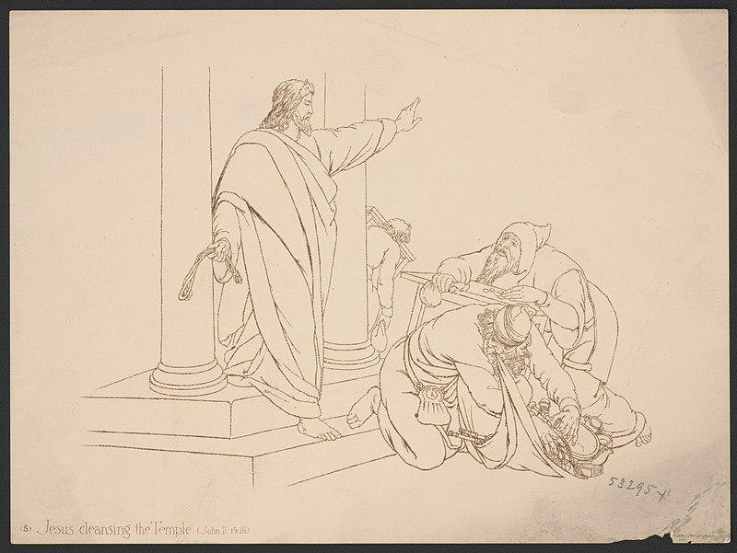
What characterized Jesus’ “goodness”?
Zeal to uphold God’s design and purpose
Acting upon that zeal
Trusting outcomes to God.

Slide 10
The Rich, Young Ruler (Matt. 19:16-22)
“Now behold, one came and said to Him, ‘Good Teacher, what good thing shall I do that I may have eternal life?’
“So He said to him, ‘Why do you call Me good? No one is good but One, that is, God…’”
God is the only “good” one.
God defines what is “good” (cf. Gen. 1, 2 Tim. 3:17)
Did Jesus do “good” by telling the young man to sell all?
The young man failed to produce the “good”. Why?

Slide 11
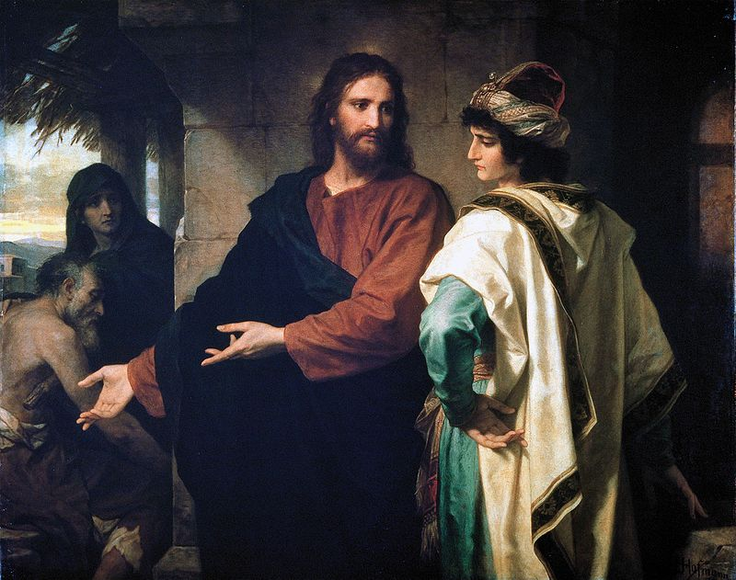
Why did the young man fail to produce the “good”?
Zeal to uphold God’s design and purpose?
Acting upon that zeal?
Trusting outcomes to God?

Slide 12
“The Good” (Vine, p.273)
Prove it – Rom. 12:2
Cleave to it – Rom. 12:9
Do it – Rom. 13:3, Gal. 6:10, 1 Pet. 3:11, John 5:29
Work it – Rom. 2:10, Eph. 4:28, Eph. 6:8
Follow after it - 1 Thess. 5:15
Imitate it – 1 Pet. 3:13, 3 John 11
Overcome evil with it – Rom. 12:21

Slide 13
How Do I Find Ability To Produce The Good?
Romans 7:18

Slide 14
My Understanding of the Structure of Romans 7-8
7:4
7:5
7:7-25
8:1-14
7:6
In the flesh
In Christ

Slide 15
I beseech you therefore, brethren, by the mercies of God, that you present your bodies a living sacrifice, holy, acceptable to God, which is your reasonable service.
ROMANS 12:1

