Slide 1
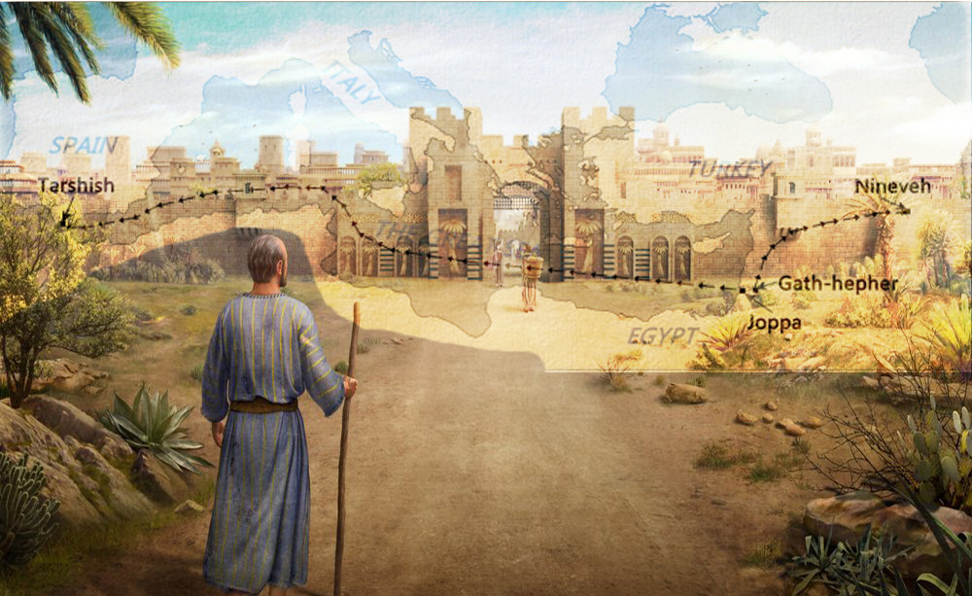
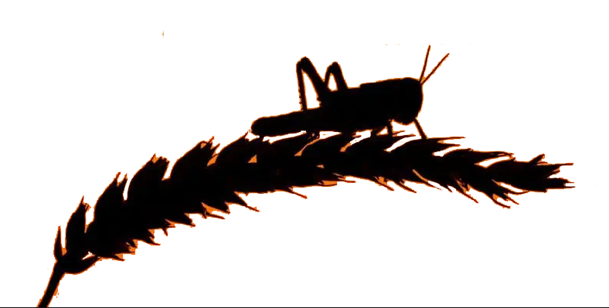
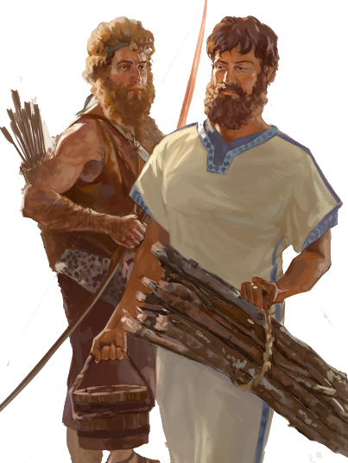
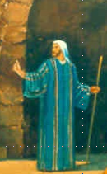
Lesson 10
Micah 1:1-3:12
Notes:
Joel 2:12-32 & Acts 2:1-21
Joel 3

Slide 2
Class Objectives
Evidence of the Inspiration of the Scriptures
Learn timeline and events occurring for the prophets
Establish a connection between the Old Testament to the New Testament
Examine what God desires for His people as told us by the prophets
Exercise our Bible Study Skills

Slide 3
The Role of the Prophets
They are Spokesmen for God, serving as “forthtellers,” speaking what God put in their mouth.
They are Preachers of the Covenant, relating their message to God’s previous promises to the nation of Israel. These covenants were made with or through Abraham, Moses, and David
They are historians, or Interpreters of the Israelites’ History. With out their interpretation God’s people would not know why an event was occurring.

Slide 4
The purpose of the prophets was threefold
1
2
3
To warn the nations of the coming judgment.
To explain why the judgment had come upon them.
To give assurance, at least to a remnant, of a hope that lay beyond the judgment.
Notes:
1. The purpose of the prophets was threefold:
a. To warn the nations of the coming judgment.
b. To explain why the judgment had come upon them.
To give assurance, at least to a remnant, of a hope that lay beyond the judgment.

Slide 5
Overview of the Twelve Prophets
PRE-EXILIC (BEFORE 586 BC)
POST-EXILIC (AFTER 586 BC)
Divided
Kingdom
Judah
Alone
HOSEA
JOEL
AMOS
OBADIAH
JONAH
MICAH
NAHUM
HABAKKUK
ZEPHANIAH
HAGGAI
ZECAHRIAH
MALACHI
DIRECTED TO:
JEWISH KINGDOMS
GENTILE KINGDOMS
ISRAEL
JUDAH
ASSYRA-NINEVEH
EDOM
HOSEA
AMOS
JOEL
MICAH HABAKKUK ZEPHANIAH HAGGAI ZECHARIAH MALACHI
JONAH
NAHUM
OBADIAH
POST-EXILIC (AFTER 586 BC)

Slide 7
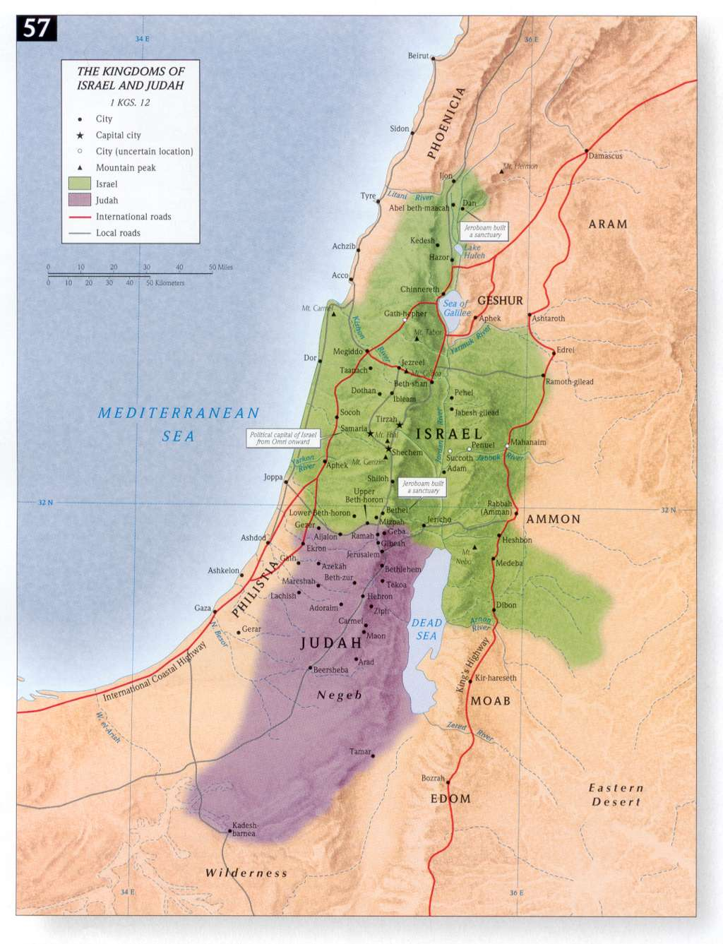
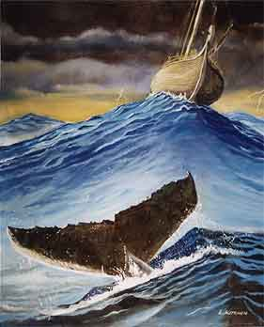
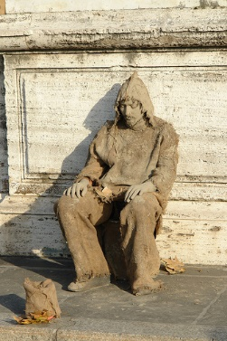
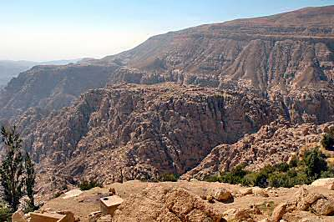
Where are the 4 Prophets?
NINEVEH
Obadiah Edom Punished
Jonah Nineveh repent or
be overthrown in 40 days
Joel Day of the Lord is great and terrible, who can endure
Micah do justly, love mercy & walk
humbly with your God
JONAH
ISRAEL
JOEL
MICAH
EDOM
OBADIAH
JUDAH

Slide 9
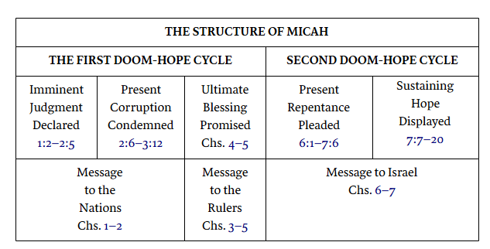
The Book of Micah consists largely of prophetic oracles supplemented with laments and dialogue with the sinners. The book is divided into three sermons each distinguished from the other by the word hear (1:2; 3:1; 6:1). The first sermon is directed to the nations (chs. 1–2), the second to the rulers (chs. 3–5), and the third to Israel (chs. 6–7).
There is balance of content in this book. One-third of Micah’s book exposes the sins of his countrymen; another third pictures the punishment God is about to send; and the final third holds out the hope of restoration once that discipline has ended. Both prophets addressed the same people and problems. If Isaiah stressed faith, Micah stressed works.
Yet in Micah the Morasthite there is combined Amos’s passion for justice and Hosea’s heart of love. In this book are some of the most outstanding prophecies in the Old Testament.
The Book of Micah is quoted three times in later biblical history: 1) by the elders of Judah in order to save Jeremiah’s life (Jeremiah 26:18; cf. Micah 3:12), 2) by the chief priests and scribes in Jesus’ day (Matthew 2:5–8; cf. Micah 5:2), and 3) by Jesus when sending out the twelve (Matthew 10:35; cf. Micah 7:6).
Smith, J. E. (2009). The Old Testament Books Made Simple (p. 205). College Press Publishing Company
According to Payne the Book of Micah contains forty specific predictions. These predictions involve seventy-three verses or about seventy percent of the book. The major prediction—about a fourth of the predictive verses—focus on the single episode of Sennacherib’s invasion of Judah in 701 B.C.. Other important predictions include the total destruction of Samaria (1:1–7); the birth of Messiah in Bethlehem (5:2–5); and the exaltation of messianic Jerusalem (4:1–8).
Smith, J. E. (1994). The Minor Prophets (p. 139). College Press.
.
Micah writes in order to bring God’s “lawsuit” against his people (3:8). He indicts Samaria and Jerusalem for their sins (1:2–7), with both Assyria (5:5–6) and Babylon (4:10) looming as instruments of the divine sentence.
Crossway Bibles. (2008). The ESV Study Bible (p. 1693). Crossway Bibles.

Slide 10
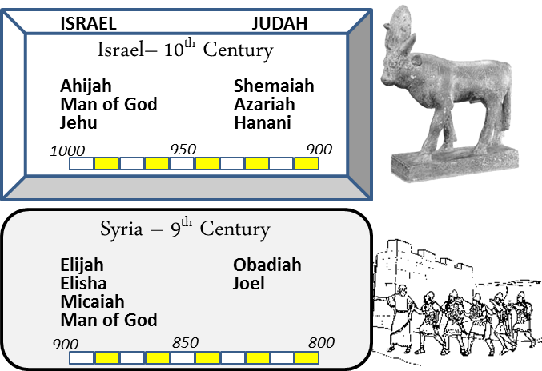
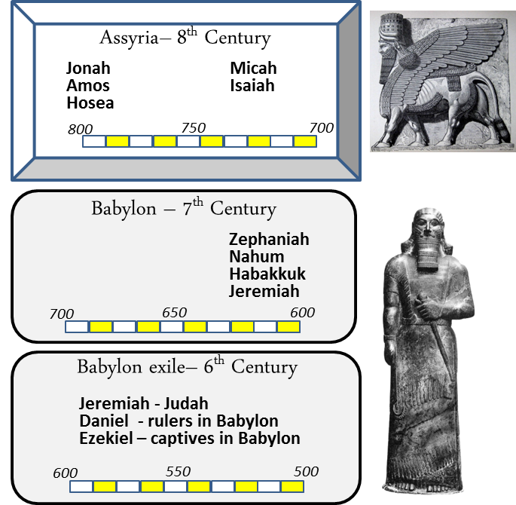
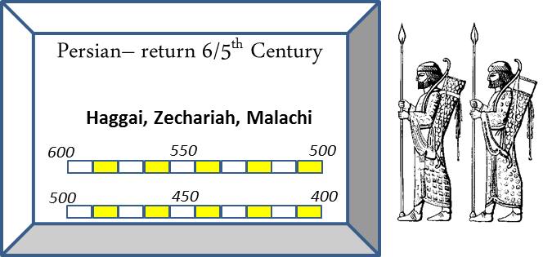
When
Obadiah
845 BC
Joel
835-817 BC
~100 yrs
Jonah
780-755 BC
Micah
735-700 BC

Slide 11
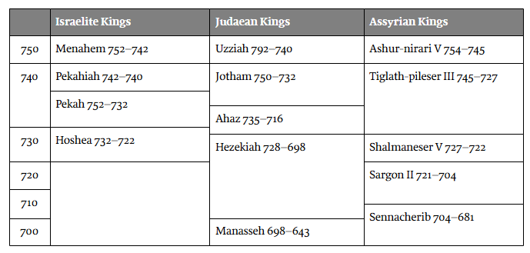
Timing for Micah
Jotham
2 Kgs 15:32-38 & 2 Chr 27
Did right in eyes of the Lord according to as FATHER Uzziah did
Ordered his ways before the Lord
Did not offer incense like father
High places not removed
Ahaz
Bad
2 Kgs 16:1-20 & 2 Chr 28
Did not do right
Walked in the ways of the
Kings of Israel
Burned sons as an offering
Had idol put in temple
Moved altar/offered to new idol
Shut Up Doors of The Temple
Scarificed & made offerings on high places, on hills under every green tree
Good
Bad
(735–700 bc)
Good
Micah 1:1
The word of the Lord that came to Micah of Moresheth in the days of Jotham, Ahaz, and Hezekiah, kings of Judah, which he saw concerning Samaria and Jerusalem.
Jotham - Did right in eyes of the Lord according to as FATHER Uzziah
Ahaz - Walked in the ways of the Kings of Israel
Hezekiah - Did right in eyes of the Lord according David He trusted in the Lord the God of Israel-none like him
Hezekiah
2 Kgs 18-20 & 2 Chr 29-32
Good
Did right in eyes of the Lord according David He trusted in the Lord the God of Israel-none like him
opened the doors of the house of the Lord and repaired them
Consecrated the priest
Atonement made for all of Israel
So there was great joy in Jerusalem, for since the time of Solomon the son of David king of Israel there had been nothing like this in Jerusalem

Slide 12
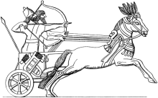
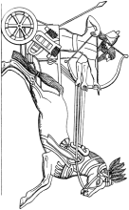
Kings & Prophets –Micah
Jotham
Prepared
his ways
before
Lord
Uzziah dies
740
Pekah
rebelled
Assyria
takes
North Israel
Tiglath-pileser III
(745–727 b.c.)
Isaiah
Micah
730
Ahaz
Worship
Baal
Hoshea
Rebels
Samaria
falls
697-642 BC
650 carried away?
Shalmeneser V
(727–722 b.c.)
720
Sargon II
(722–705 b.c.)
Philistines
fall
710
Sennacherib
(705–681b.c.)
Jerusalem
sieged
Nahum
Hezekiah
Held fast
to the Lord
700
Hezekiah
Sick –
add 15 yrs
Ashurbanipal
(669–627b.c.)
690
Manasseh
12 yrs old
Made idols
later
repented
680

Slide 13
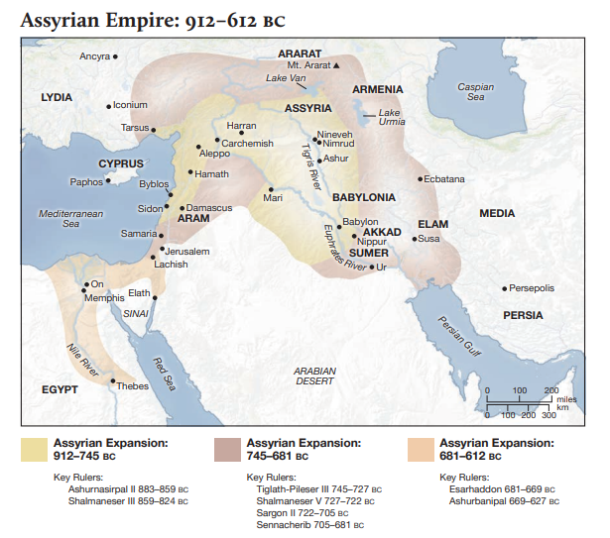
859-824 BC Shalmaneser III
Ahab-Jehu
Jeroboam II/Jonah
Micah
735-700 BC
745-681 BC Tiglath-Pileser III
Sennacherib
Ahaz/Hezekiah/Manasseh
681-627 BC Ashurbanipal
Manasseh/Nahum

Slide 14
Outline of Micah
Judgment 1:1-3:12
Judgment on People (1:1-2:13)
Judgment on Leaders (3:1-3:12)
Promises of Restoration 4:1-5:15
Promise of Coming Kingdom (4:1-4:5)
Promise of Coming Captivity (4:6-5:1)
Promise of Coming King (5:2-5:15)
Plea for Repentance 6:1-7:20
First Plea of God (6:1-6:9)
Second Plea of God (6:10-7:6)
Promise of Final Salvation (7:7-7:20)

Slide 15
Lesson 8
The book is divided into three sermons each distinguished from the other by the word hear (1:2; 3:1; 6:1).
The first sermon is directed to the nations (chs. 1–2),
the second to the rulers (chs. 3–5),
and the third to Israel (chs. 6–7).
Minor
Prophets
1:2 Hear, all you peoples! Listen, O earth, and all that is in it! Let the Lord God be a witness against you, The Lord from His holy temple.
Micah Overview
1:2 Hear, all you peoples!
3:1 “Hear now,
3:4 But He will not hear them
3:9 Now hear this,
5:15 On the nations that have not heard.”
6:1 Hear now what the Lord says:
6:2 Hear, O you mountains, the Lord’s complaint,
(People)
6:9 “Hear the rod!
7:7 My God will hear me.

Slide 16
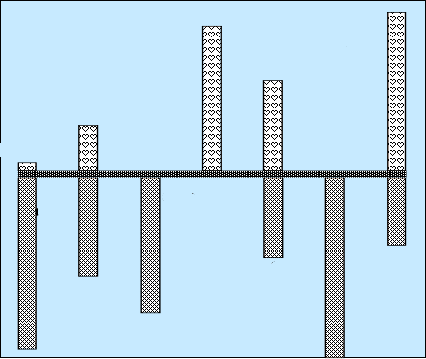
Hear Micah
Sermon 5
Woe is me
Minor
Prophets
Sermon 3
He has Laid
Siege
4:1-13
God will hear me
Mentions
Samaria
& Jerusalem
Words of Comfort & Hope
2:12-13
Sermon 4
Hear now
7:7-20
5:2-9
1:1
Hear All you People
Hear Now
He will not hear
Now hear this
5:1, 10-15
7:1-6
2:1-11
3:1-12
6:1-16
1:2-16
Nations not heard
Words of Warning/Judgment
Focus on
Jerusalem
Hear Now
Hear Lord’s complaint
Hear the rod
Sermon 1
Hear All
You Peoples
Sermon 2
Hear now

Slide 17
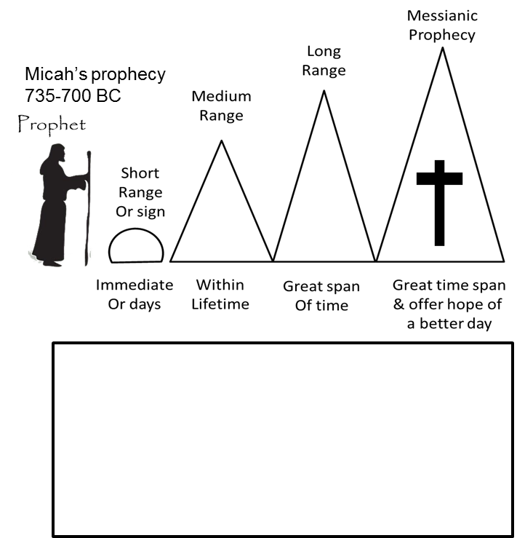
Place the following prophecies
under the correct prophecy range
1:6-7 Fall of Samaria in 722 BC
1:9-16 Invasion of Judah by Sennacherib (701 BC)
3:12,7:13 Fall of Jerusalem (586 BC)
4:10 Exile in Babylon (586 BC)
4:10 Return fr captivity (~516 BC)
5:2 Birth of Jesus (~4 BC)
4:1-5 Kingdom of God

Slide 18
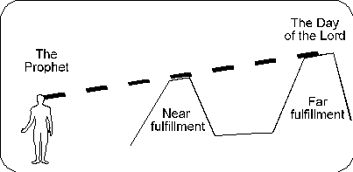
Prophecy – Near & Far
Days of Micah
Jotham (750-731 BC)
Ahaz (735-715 BC)
Hezekiah (~725-698 BC)
Within Few years of prophecy
Lifetime
Of prophet
Place the following prophecies
under the correct prophecy range
1:6-7 Fall of Samaria in 722 BC
1:9-16 Invasion of Judah by Sennacherib (701 BC)
3:12,7:13 Fall of Jerusalem (586 BC)
4:10 Exile in Babylon (586 BC)
4:10 Return fr captivity (~516 BC)
5:2 Birth of Jesus (~4 BC)
4:1-5 Kingdom of God
MICAH
740/735 AD
Long
Range
Prophecies
Medium
Range
Prophecies
Messianic
Short
Term
Samaria Heap
733/722 BC
1:6, 5:3-15
Sennacherib
– 701 BC
1:9
6:/7:
Babylonian Captivity
604, 597, 586 BC
Micah 2:4-5/3:16
5:3-15, 6:/7:
Gather Remnant
2:12-13
4:1-13
5:2
Micah 2:12 (NKJV) ¹² "I will surely assemble all of you, O Jacob, I will surely gather the remnant of Israel..
Micah 2:13 (NKJV) ¹³ …And go out by it; Their king will pass before them, With the LORD at their head."
Micah 1:6 (NKJV) "Therefore I will make Samaria a heap of ruins in the field, Places for planting a vineyard; I will pour down her stones into the valley, And I will uncover her foundations.
Micah 1:9 (NKJV) For her wounds are incurable. For it has come to Judah; It has come to the gate of My people-- To Jerusalem.
Micah 2:4 (NKJV) In that day one shall take up a proverb against you, And lament with a bitter lamentation, saying: 'We are utterly destroyed! He has changed the heritage of my people; How He has removed it from me! To a turncoat He has divided our fields.' "
Notes:
Two passages in Micah qualify as personal messianic predictions. First, in 2:12–13 Messiah breaks through barriers to lead his people out of bondage. Second, in 5:1–5, Micah predicts the birth of a great future Ruler in Bethlehem. Micah also describes the Messiah’s kingdom in the last days—a kingdom that will attract the Gentiles (4:1–4).
Smith, J. E. (2009). (pp. 204205). College Press Publishing Company.
Smith, J. E. (2009). The Old Testament Books Made Simple (pp. 204–205). College Press Publishing Company.

Slide 19
Sermon 1 (Micah1-2)
1:2-5
Hear, all you peoples!
Behold Lord is coming out of His place
Source of sins – Samaria/Jerusalem
God is Lord of History
1:6-8
Therefore – Samaria a heap of ruins in the field
Therefore I will wail & howl – like jackals-ostriches
1:9-16
For her wounds are incurable – come to gate of Jerusalem
The cities to gate of Jerusalem
Judgment
2:1-2
Woe to those who work wickedness on their beds
Covet fields
2:3-5
Therefore –devising disaster/”We are utterly destroyed
Rebellion
People tell prophets not to prattle
Do not My words do good
My people risen up as an enemy
2:6-9
2:10-11
Even a prophet speaks of wine & drink is a prattler to these people
2:12-13
Gather remnant of Israel like sheep in a fold
Redemption/Restoration

Slide 20
Micah 1:3 - 4 (NKJV)
³ For behold, the Lord is coming out of His place;
He will come down
And tread on the high places of the earth.
⁴ The mountains will melt under Him,
And the valleys will split
Like wax before the fire,
Like waters poured down a steep place.
Judgment on People (1:1-2:13)

Slide 21
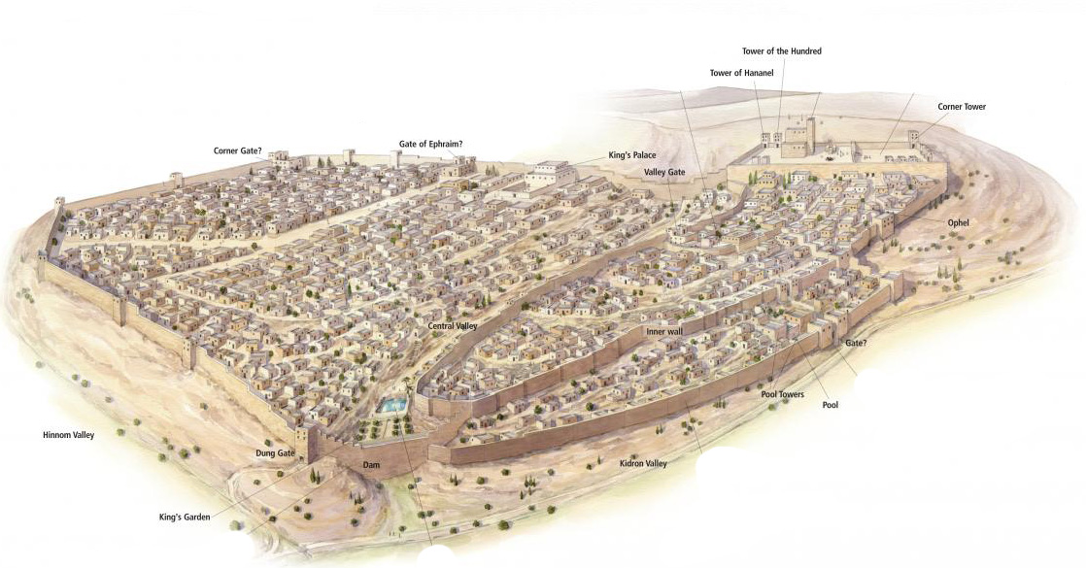
Jerusalem in the Time of Hezekiah (c. 725–686 b.c.)
Micah 1:5 (NKJV) ⁵ All this is for the transgression of Jacob And for the sins of the house of Israel. What is the transgression of Jacob? Is it not Samaria?
And what are the high places of Judah? Are they not Jerusalem?
Jotham - Did right in eyes of the Lord according to as FATHER Uzziah
Ahaz - Walked in the ways of the Kings of Israel
Hezekiah - Did right in eyes of the Lord according David He trusted in the Lord the God of Israel-none like him
Notes:
Jerusalem in the Time of Hezekiah (c. 725–686 b.c.)
During the reign of King Hezekiah, the city of Jerusalem expanded more than ever before. Many refugees from the Assyrian invasion settled on the Western Hill, as the ancient city built by King Solomon on the Eastern Hill was not able to absorb them. New city walls encircled both hills, and thus Jerusalem became a city that was “bound firmly together” (Ps. 122:3).
21

Slide 22
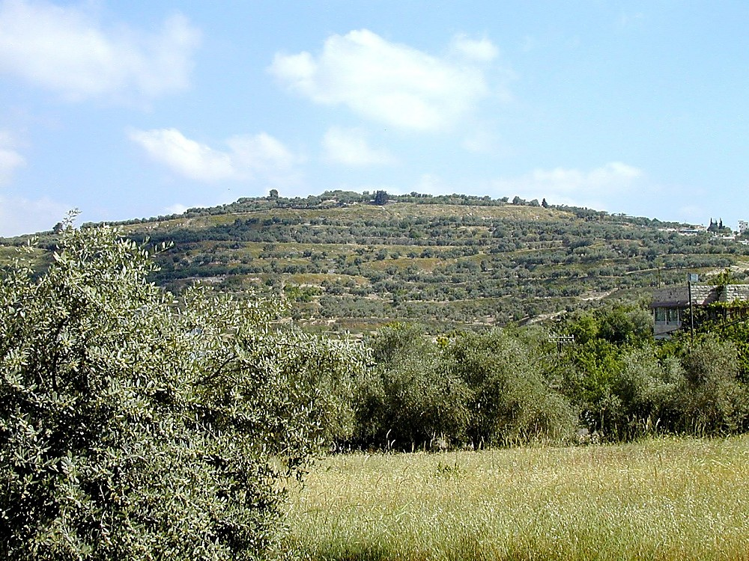
Tell Samaria from south
Micah 1:6 (NKJV)
⁶ “Therefore I will make Samaria a heap of ruins in the field,
Places for planting a vineyard;
I will pour down her stones into the valley,
And I will uncover her foundations.
Tell Samaria from south
Judgment on People (1:1-2:13)
Notes:
Samaria: Introduction
The site may have been as large as 150 acres (as large as Hezekiah’s Jerusalem). At 100 people per acre, the population would equal 15,000.
The importance of the site diminished with non-westward-looking rulers. “For as long as there ruled in the land a power with no interests towards the coast and sea, Samaria was forced to yield again to central Shechem the supremacy which Ahab and Herod, with their western obligations, had taken from Shechem to give her” (G. A. Smith 1931: 229).
Isaiah 28:1 (NIV) “Woe to that wreath, the pride of Ephraim’s drunkards, to the fading flower, his glorious beauty, set on the head of a fertile valley–to that city, the pride of those laid low by wine!”
Geographical Situation
Samaria was in the tribal territory of the sons of Joseph (Josh 16-17).
It was in a good position for defense, as illustrated by history. The summit sits 300 ft above the valleys below.
It withstood lengthy sieges:
By the Syrians (2 Kings 6).
By the Assyrians–it withstood a 3 year Assyrian siege before capture (2 Ki 17:5).
By the Hasmoneans–it resisted Hasmonean capture for one year.
“‘It must before the invention of gun-powder have been almost impregnable’ (Conder). The sieges of Samaria were always prolonged” (G. A. Smith 1931: 228).
It was centrally located on the Trans-Samaria highway, looking towards the west. Samaria was the capital of the northern kingdom from the time of Omri (880 B.C.) to the final conquest of the nation (722 B.C.). In this period of time, the two powerful dynasties of Omri and Jehu dominated the city and country, followed only by a quick succession of weak and short-lived rulers.
Mountains surround and overlook Samaria on three sides, but Samaria has a view to the west. Thus the city faced toward Phoenicia, with easy access by a gentle valley to the coastal plain or through Dothan Valley to Jezreel Valley. It was 23 mi from the coast.
Omri made a treaty with the king of Tyre, marrying his son Ahab to Jezebel.
A temple was built to Baal in Samaria.
Omri recognized that he needed this link to Tyre. It gave him a good market for selling his grain, gave him a link to sea, and further facilitated the international relations which prospered his kingdom economically.
“Forts and isolated defensive towers protected important strategic points and roads in the kingdom. About a dozen fortresses, discovered in a survey of the vicinity of Samaria, created a defensive belt around the capital and protected all its access roads” (Mazar 1990: 416).

Slide 23
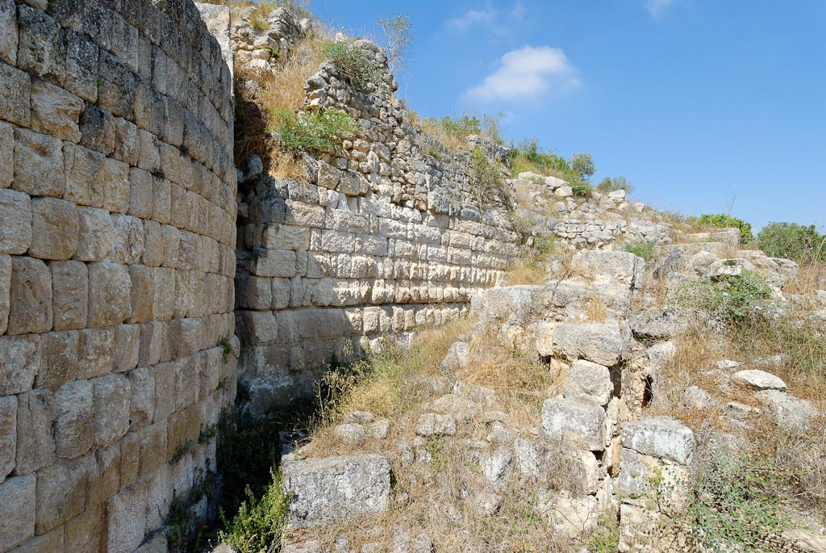
Micah 1:6 (NKJV)
⁶ “Therefore I will make Samaria a heap of ruins in the field,
Places for planting a vineyard;
I will pour down her stones into the valley,
And I will uncover her foundations.
Samaria Israelite wall
Notes:
tb070507730

Slide 24
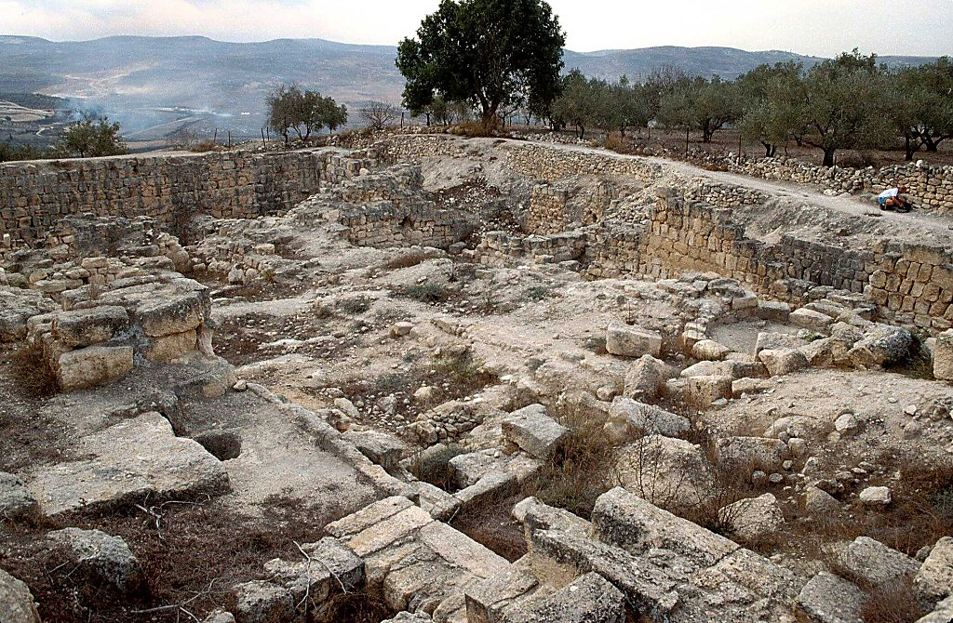
Samaria ruins of Iron Age acropolis
Micah 1:6 (NKJV)
⁶ “Therefore I will make Samaria a heap of ruins in the field,
Places for planting a vineyard;
I will pour down her stones into the valley,
And I will uncover her foundations.
Samaria ruins of Iron Age acropolis
Notes:
Acropolis
“The extent of the planning and building operations on the acropolis of Samaria was unprecedented in the architectural history of the country, except perhaps in Solomon’s buildings in Jerusalem” (Mazar 1990: 406).
The royal enclosures at Samaria and Jerusalem were well-planned and equaled the size of an average town (the acropolis of Samaria was about 6.5 acres; the acropolis in Jerusalem may have been larger).
Royal enclosures were fortified and often built on a leveled, raised platform.
Royal compounds with large, lime-paved courtyards were common.
The royal palace at Samaria was the lodging place of the kings of Israel (1 Ki 20:43; 21:1, 2; 22:39; 2 Ki 1:2; 15:25).
“A smaller structure on the acropolis contained a hoard of carved ivories–the most important collection of such artwork from Iron Age Israel...Furthermore, only in this structure at Samaria was it possible to discern various building phases and to determine the internal development of pottery” (Mazar 1990: 408).

Slide 25
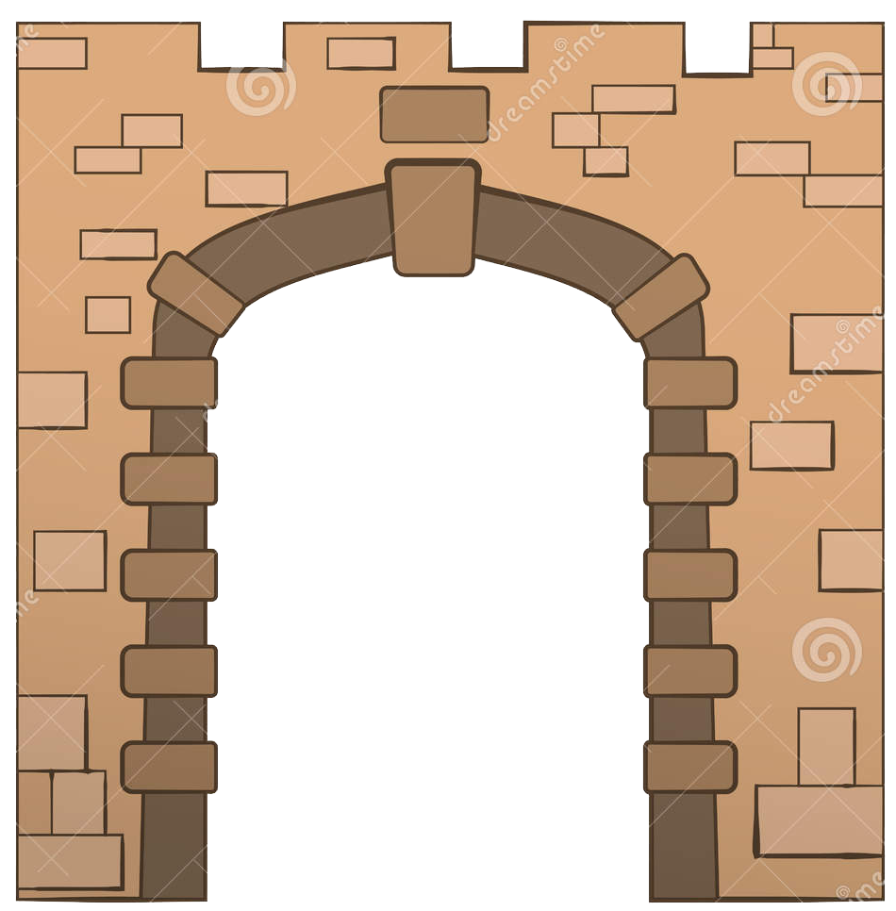
Micah 1:9 (NKJV)
For her wounds are incurable. (Samaria)
For it has come to Judah;
It has come to the gate of My people—
To Jerusalem.

Slide 26
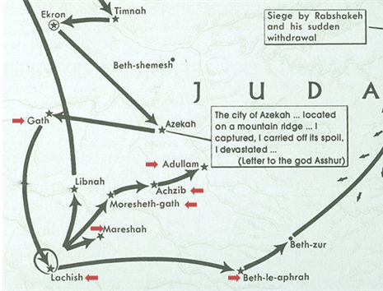
Micah’s Word Play
Micah makes a play on words in listing each of the cities that will fall to Sennacherib before him comes to the gates of Jerusalem in 701 BC
1:10 Tell it not in Gath or “Tell Town”
1:10 Roll yourself in the dust.
In Beth Aphrah or “house of dust”
1:11 Pass by in naked shame, you inhabitant
of Shaphir or “fair/beautiful”
1:11 The inhabitant does not go out in Zaanan
or “to march out of town”
1:11 Beth Ezel mourns - place taken away
or ”neighbor town”
1:12 Maroth or “bitter town” pined for good
1:13 Lachish or “Horse town” ,Harness the
chariot to the swift steeds
1:14 give presents to Moresheth Gath or “one
who is betrothed”
1:14 Achzib or “deceitful” shall be a lie to the
kings of Israel
1:15 I will yet bring an heir to you, O inhabitant of Mareshah or “heir town”
1:15 glory of Israel shall come to Adullam or “wild beast cave – David hid in cave near by”
10
15
14
14
15
13

Slide 27
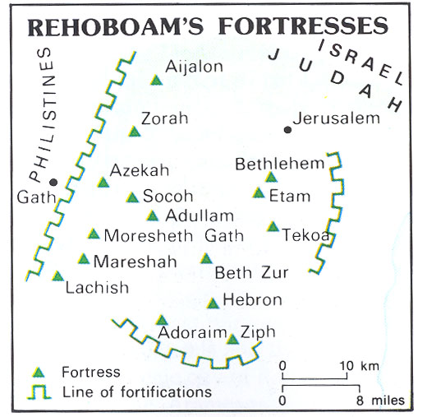
Rehoboam’s Fortresses & Micah’s Cities of Destruction
2 Chronicles 11:5 - 12 (NKJV)
⁵So Rehoboam dwelt in Jerusalem, and built cities for defense in Judah. ⁶And he built Bethlehem, Etam, Tekoa, ⁷Beth Zur, Sochoh, Adullam, ⁸ Gath, Mareshah, Ziph, ⁹Adoraim, Lachish, Azekah, ¹⁰Zorah, Aijalon, and Hebron, which are in Judah and Benjamin, fortified cities.
¹¹And he fortified the strongholds, and put captains in them, and stores of food, oil, and wine. ¹²Also in every city he put shields and spears, and made them very strong, having Judah and Benjamin on his side.

Slide 28
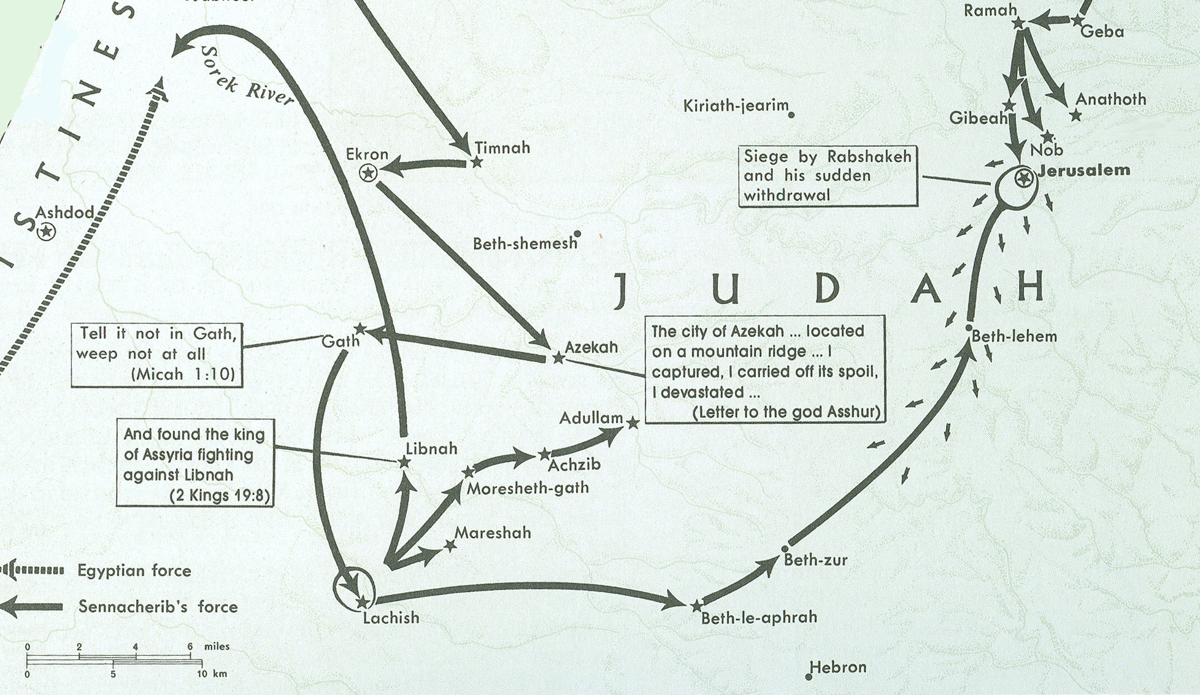
Sennacherib in Philistia & Judah 701 BC
Beth-le-aphrah/ophrah
“ TELL TOWN”
Micah’s
hometown

Slide 29
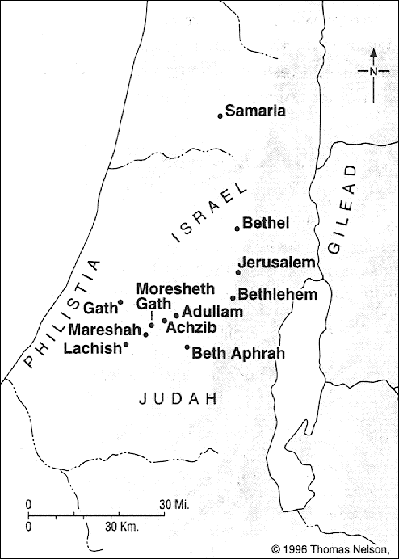

Slide 30
Sennacherib in Philistia & Judah 701 BC
Gath vs 10
“Tell Town”
Beth-le-aphrah/ophrah
Tell it not in Gath
Micah’s
hometown
Micah’s
hometown

Slide 31
Sennacherib in Philistia & Judah 701 BC
Beth-le-aphrah vs 10
"house of dust"
Dust Town
Beth-le-aphrah/ophrah
Roll yourself in
the dust.
Micah’s
hometown
Micah’s
hometown

Slide 32
Sennacherib in Philistia & Judah 701 BC
Lachish vs 12
Horse town
Steeds (larekesh)
Harness chariot to swift (courier) horses
Micah’s
hometown

Slide 33
Sennacherib in Philistia & Judah 701 BC
Moresheth-gath
Vs 14
Azab - deceitful
'akhzibh, "lying" or "disappointing"):
Me’orasah
“one who is betrothed”
You shall be a lie to the kings of Israel
You shall give presents
Micah’s
hometown

Slide 34
Sennacherib in Philistia & Judah 701 BC
Achzib vs 14
Azab - deceitful
'akhzibh, "lying" or "disappointing"):
Azab - deceitful
'akhzibh, "lying" or "disappointing“
/place of deceit
You shall be a lie to the kings of Israel
You shall be a lie to the kings of Israel
Micah’s
hometown
Notes:
Therefore you must give parting gifts to Moresheth-gath [Micah’s home town]; the houses of Achzib [place of deceit] shall be a deception to the kings of Israel.

Slide 35
Sennacherib in Philistia & Judah 701 BC
Maraeshah
vs 15
Azab - deceitful
'akhzibh, "lying" or "disappointing"):
Heir town
You shall be a lie to the kings of Israel
I will yet bring an heir to you
Micah’s
hometown

Slide 36
Sennacherib in Philistia & Judah 701 BC
Adullam
vs 15
Azab - deceitful
'akhzibh, "lying" or "disappointing"):
glory of Israel/
to hide in the caves, as did David
You shall be a lie to the kings of Israel
The glory of Israel shall come
Micah’s
hometown

Slide 37
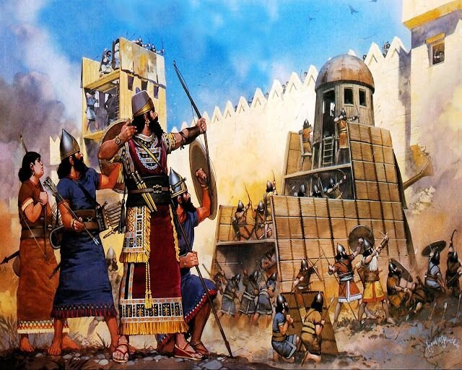
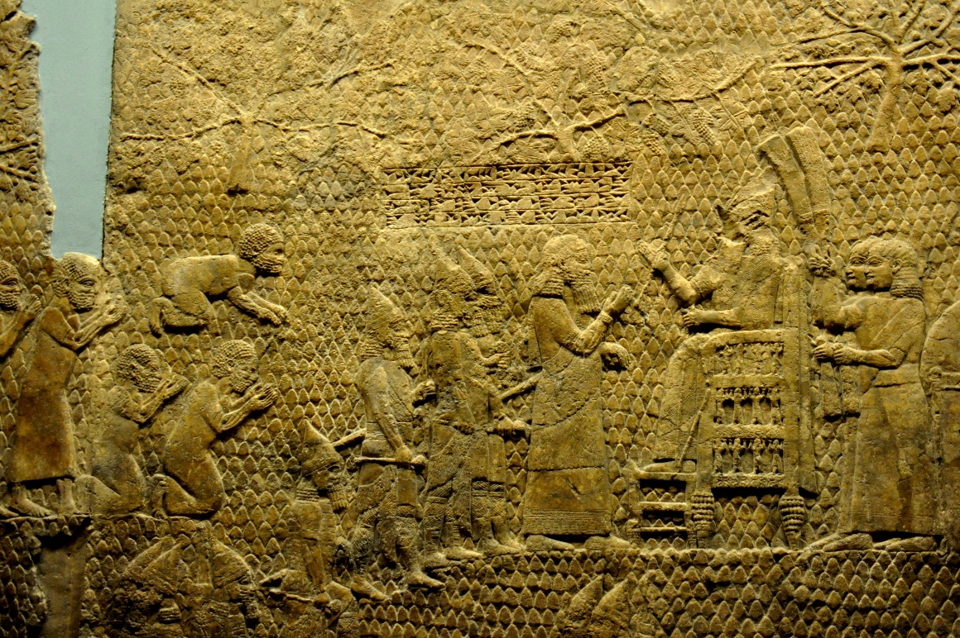
Sennacherib in Philistia & Judah 701 BC
Micah 1:16 (NKJV)
Make yourself bald and cut off your hair,
Because of your precious children;
Enlarge your baldness like an eagle,
For they shall go from you into captivity.
Captives at Lachish
Job 1:20 (NKJV)
Then Job arose, tore his robe, and shaved his head; and he fell to the ground and worshiped.

Slide 38
Hear Micah
Sermon 5
Woe is me
Minor
Prophets
Sermon 3
He has Laid
Siege
4:1-13
God will hear me
Mentions
Samaria
& Jerusalem
Words of Comfort & Hope
2:12-13
Sermon 4
Hear now
7:7-20
5:2-9
1:1
Hear All you People
Hear Now
He will not hear
Now hear this
5:1, 10-15
7:1-6
2:1-11
3:1-12
6:1-16
1:2-16
Nations not heard
Words of Warning/Judgment
Focus on
Jerusalem
Hear Now
Hear Lord’s complaint
Hear the rod
Sermon 1
Hear All
You Peoples
Sermon 2
Hear now

Slide 39
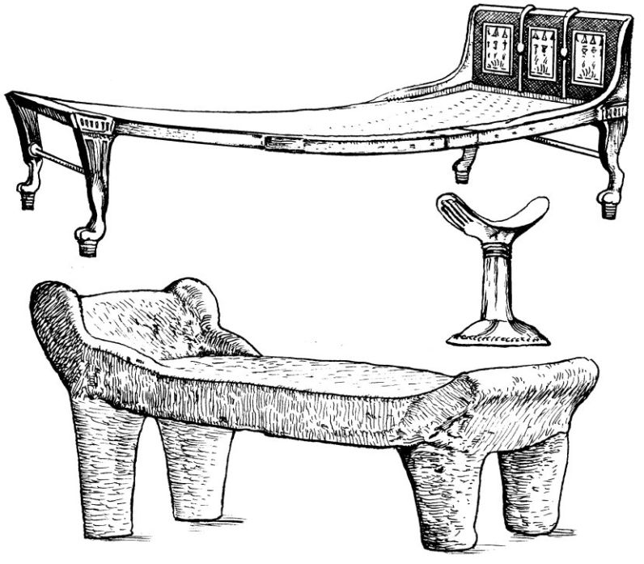
Beds of Ivory
Micah 2
¹ Woe to those who devise iniquity,
And work out evil on their beds!
At morning light they practice it,
Because it is in the power of their hand.
² They covet fields and take them by violence,
Also houses, and seize them.
So they oppress a man and his house,
A man and his inheritance.
Amos 6:3-7(NKJV) ³ Woe to you who put far off the day of doom, Who cause the seat of violence to come near; ⁴ Who lie on beds of ivory, Stretch out on your couches, Eat lambs from the flock And calves from the midst of the stall; ⁵ Who sing idly to the sound of stringed instruments, And invent for yourselves musical instruments like David; ⁶ Who drink wine from bowls, And anoint yourselves with the best ointments, But are not grieved for the affliction of Joseph. ⁷ Therefore they shall now go captive as the first of the captives, And those who recline at banquets shall be removed.

Slide 40
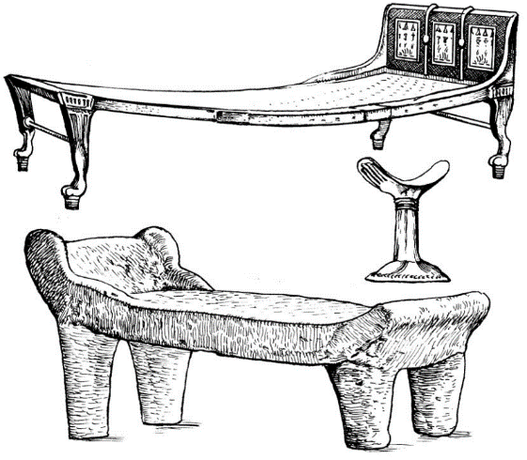
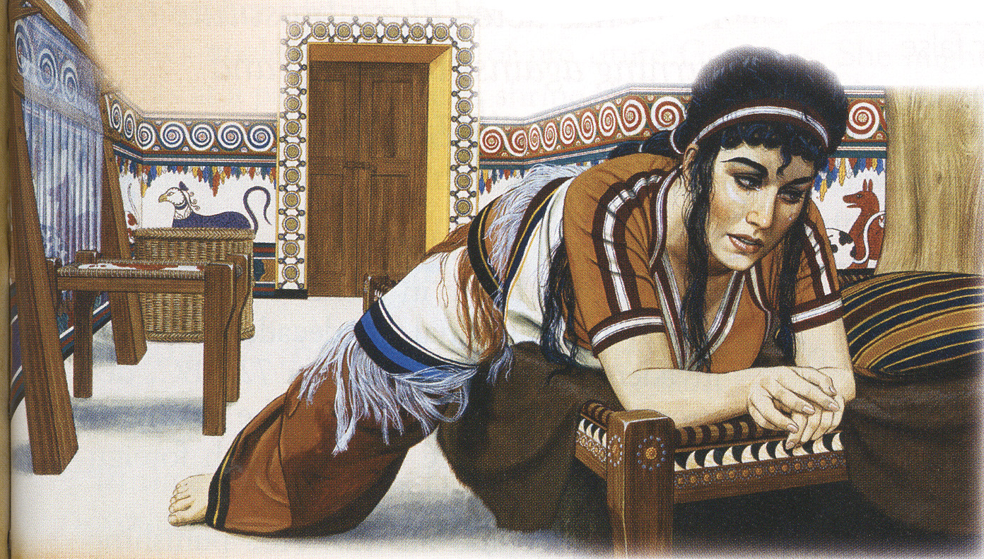
Woe to beds
⁴ Who lie on beds of ivory, Stretch out on your couches, Eat lambs from the flock And calves from the midst of the stall;
Woe to those who devise iniquity,
And work out evil on their beds!
At morning light they practice it,
Because it is in the power of their hand.
Amos
Micah
Judgment on People (1:1-2:13)

Slide 41
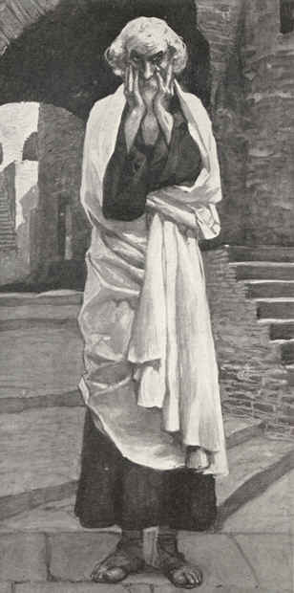
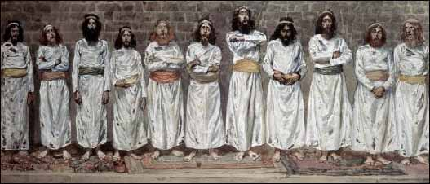
Micah 2:6
TLB:⁶“Don’t say such things,” the people say. “Don’t harp on things like that. It’s disgraceful, that sort of talk. Such evils surely will not come our way.”
Micah
NKJV:⁶“Do not prattle,” you say to those who prophesy.
So they shall not prophesy to you;
They shall not return insult for insult.
NKJV:⁶“Do not prattle,” you say to those who prophesy.
So they shall not prophesy £to you;
£They shall not return insult for insult.
KJV:⁶Prophesy ye not, say they to them that prophesy: they shall not prophesy to them, that they shall not take shame.
ESV:⁶“Do not preach”—thus they preach—
“one should not preach of such things;
disgrace will not overtake us.”
Judgment on People (1:1-2:13)
People

Slide 42
Micah 2:11
TLB:¹¹“I’ll preach to you the joys of wine and drink”—that is the kind of drunken, lying prophet that you like!
NKJV:¹¹If a man should walk in a false spirit
And speak a lie, saying,
‘I will prophesy to you of wine and drink,’
Even he would be the prattler of this people.
KJV:¹¹If a man walking in the spirit and falsehood do lie, saying, I will prophesy unto thee of wine and of strong drink; he shall even be the prophet of this people.
ESV:¹¹If a man should go about and utter wind and lies,
saying, “I will preach to you of wine and strong drink,”
he would be the preacher for this people!
ASV:¹¹If a man walking in a spirit of falsehood do lie, saying, I will prophesy unto thee of wine and of strong drink; he shall even be the prophet of this people.

Slide 43
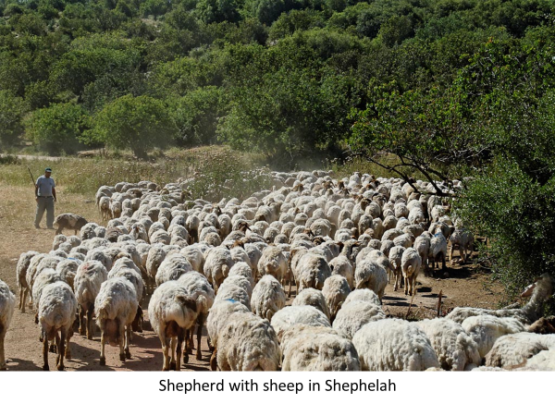
Prophet’s Visual Aids
Micah 2:12 (NKJV)
"I will surely assemble all of you, O Jacob, I will surely gather the remnant of Israel;
I will put them together like sheep of the fold, Like a flock in the midst of their pasture; They shall make a loud noise because of so many people.

Slide 44
Hear Micah
Sermon 5
Woe is me
Minor
Prophets
Sermon 3
He has Laid
Siege
4:1-13
God will hear me
Mentions
Samaria
& Jerusalem
Words of Comfort & Hope
2:12-13
Sermon 4
Hear now
7:7-20
5:2-9
1:1
Hear All you People
Hear Now
He will not hear
Now hear this
5:1, 10-15
7:1-6
2:1-11
3:1-12
6:1-16
1:2-16
Nations not heard
Words of Warning/Judgment
Focus on
Jerusalem
Hear Now
Hear Lord’s complaint
Hear the rod
Sermon 1
Hear All
You Peoples
Sermon 2
Hear now

Slide 45
Jerusalem in the Time of Hezekiah (c. 725–686 b.c.)
Rulers of Judah
Micah 3:1 (NKJV)
⁹ Now hear this,
You heads of the house of Jacob
And rulers of the house of Israel,
Who abhor justice
And pervert all equity,
¹⁰ Who build up Zion with bloodshed
And Jerusalem with iniquity:
Notes:
Jerusalem in the Time of Hezekiah (c. 725–686 b.c.)
During the reign of King Hezekiah, the city of Jerusalem expanded more than ever before. Many refugees from the Assyrian invasion settled on the Western Hill, as the ancient city built by King Solomon on the Eastern Hill was not able to absorb them. New city walls encircled both hills, and thus Jerusalem became a city that was “bound firmly together” (Ps. 122:3).
45

Slide 46
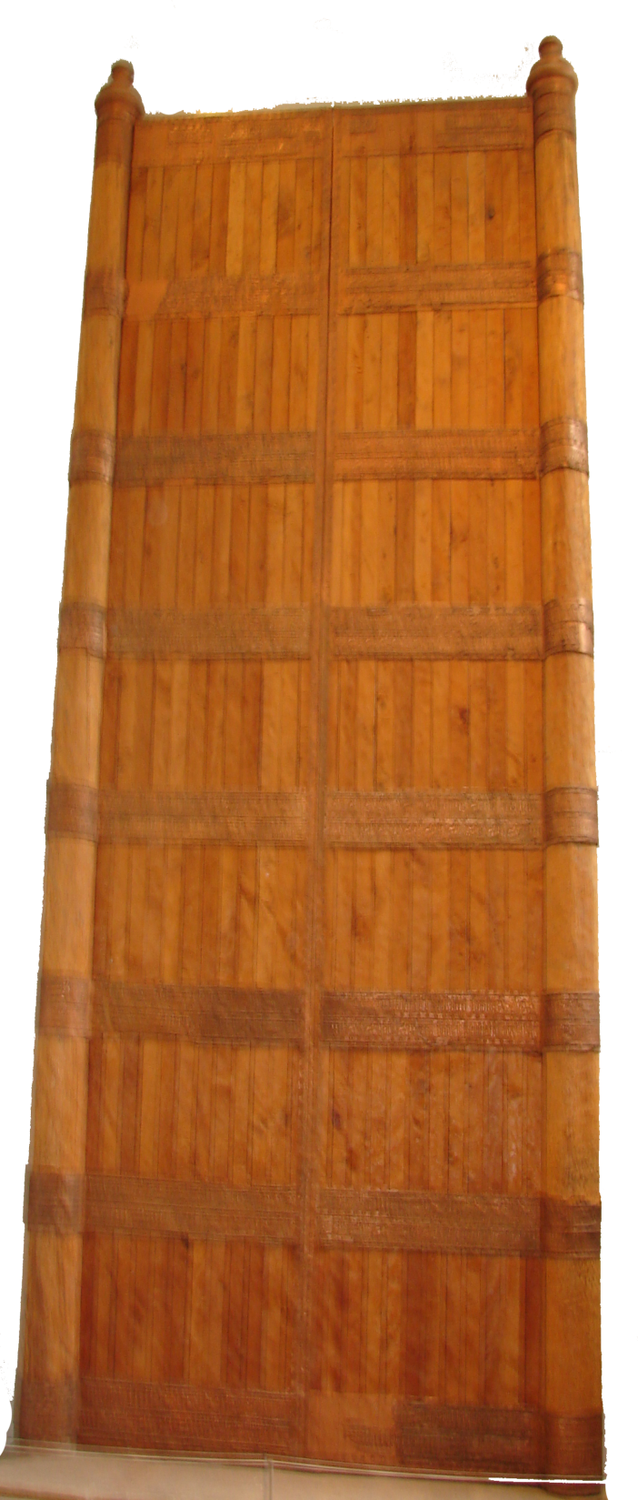
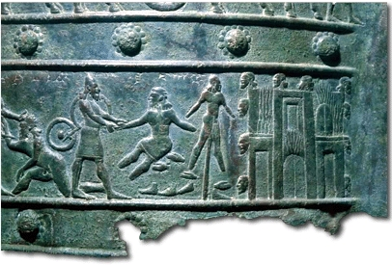
Shalmaneser III (858-824 BC) bronze bands of a massive pair of wooden gates
Micah 3:3 (ESV) ³ who eat the flesh of my people, and flay their skin from off them, and break their bones in pieces and chop them up like meat in a pot, like flesh in a cauldron.
Rulers of Jacob & Israel
Micah 3:3
who eat the flesh of my people, and flay their skin from off them, and break their bones in pieces and chop them up like meat in a pot, like flesh in a cauldron.
an Assyrian soldier grasps the hand of a captive whose other hand and feet have been cut off.
a prisoner, bereft of hands and feet, impaled on a stake
Dismembered hands and feet litter the ground
Micah 3:4
Then they will cry to the Lord,
But He will not hear them;
He will even hide
His face from them at that time,
Because they have been evil in
their deeds.
BAR 17:01 (Jan/Feb 1991).
Notes:
Dismembered and displayed, the victims of Shalmaneser III (858–824 B.C.) become grisly ornaments, as shown in this detail from a bronze relief that once decorated the wooden gates of a temple or palace at Balawat, near modern Mosul. Severed heads hang from the walls of Kulisi, at right, as flames (represented by parallel vertical lines) consume this ancient city near the source of the Tigris River. Beside the city we see a prisoner, bereft of hands and feet, impaled on a stake. At left, an Assyrian soldier grasps the hand of a captive whose other hand and feet have been cut off. Dismembered hands and feet litter the ground.Editor, H. S. (2004; 2004). BAR 17:01 (Jan/Feb 1991). Biblical Archaeology Society.

Slide 47
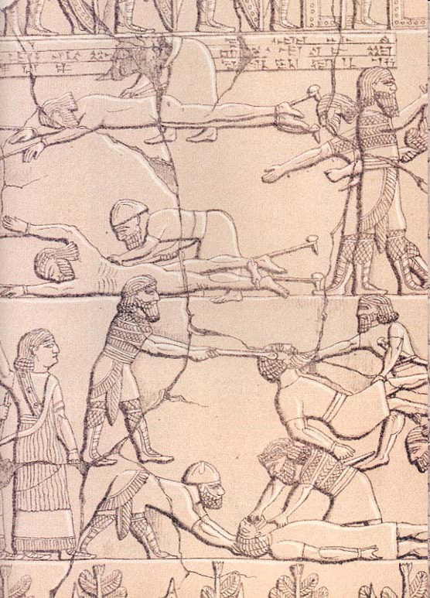
Proud of his deeds
Rulers of Jacob & Israel
Micah 3:2
You who hate good and love evil;
Who strip the skin from My people,
And the flesh from their bones;
Ashurbanipal (668–627 B.C.)
fastened to the ground with ropes and stakes
two Assyrians, bending over them with knives, flay them
an Assyrian probably uses strings to carry away a head
an Assyrian steadies the head of an Elamite prisoner, while another Assyrian tears out the man’s tongue
BAR 17:01 (Jan/Feb 1991).
Notes:
Proud of his deeds, Ashurbanipal (668–627 B.C.) preserved for posterity this ghastly record of how he dealt with his Elamite enemies, who lived to the southeast of Assyria. The upper register of the relief shows two naked men lying supine, fastened to the ground with ropes and stakes, while two Assyrians, bending over them with knives, flay them. To the right of this scene, an Assyrian probably uses strings to carry away a head. In the lower register, at the bottom edge, an Assyrian steadies the head of an Elamite prisoner, while another Assyrian tears out the man’s tongue. Above them, two Assyrians throw down the next victim, whose arms are tied behind his back.Editor, H. S. (2004; 2004). BAR 17:01 (Jan/Feb 1991). Biblical Archaeology Society.

Slide 48
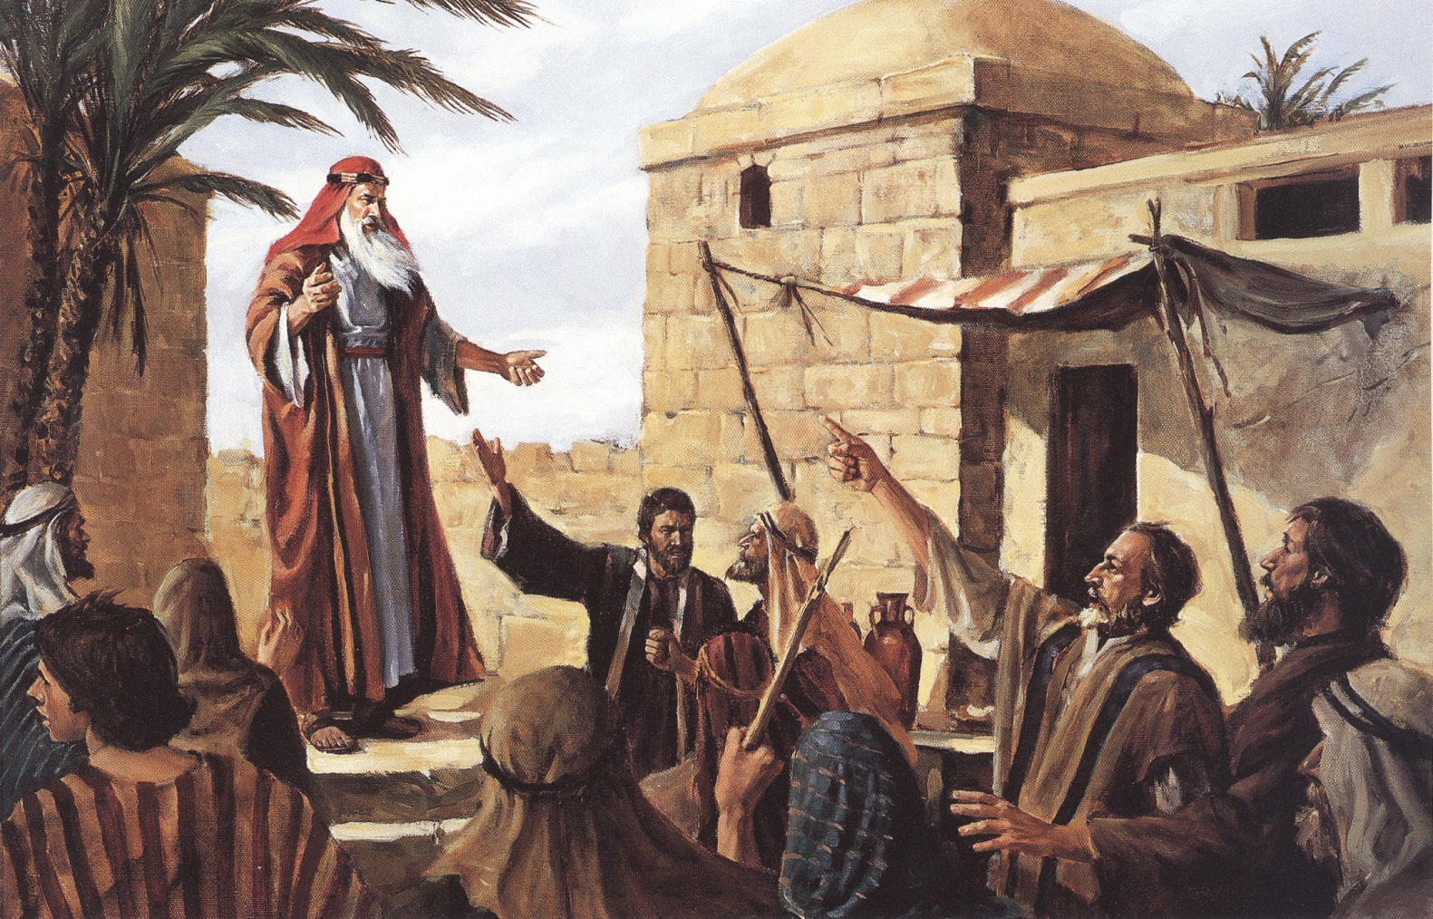
Prophets
Micah 3:5
⁵ Thus says the Lord concerning the prophets
Who make my people stray;
Who chant “Peace”
While they chew with their teeth,
But who prepare war against him
Who puts nothing into their mouths:

Slide 49
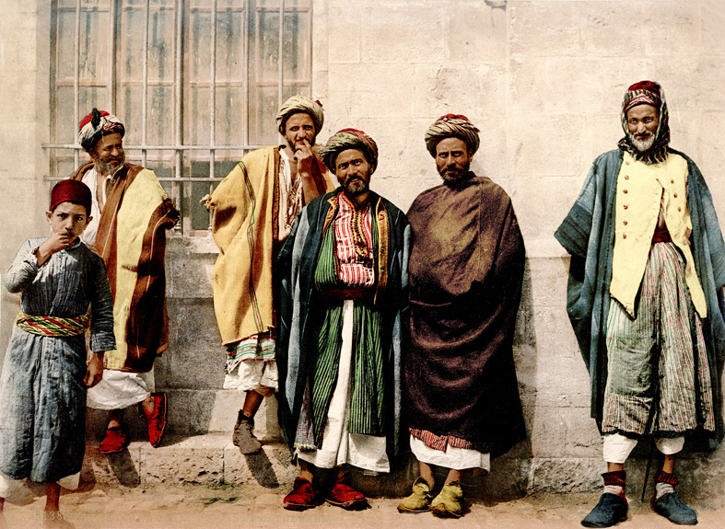
Christian Peasants from the Bethlehem region.
Prophets
Micah 3:6-7
⁶ “Therefore you shall have night without vision,
And you shall have darkness without divination;
The sun shall go down on the prophets,
And the day shall be dark for them.
⁷ So the seers shall be ashamed,
And the diviners abashed;
Indeed they shall all cover their lips;
For there is no answer from
God.”
Notes:
Christian Peasants from the Bethlehem region.
This is a photochrome print made by the Photochrom Co., Zurich (sometimes also known as the Photoglob Co.). It shows a group of 5 men and one boy from the Bethlehem region. Written on back: “Christian peasants from Villages near Bethlehem. Gift of (1957) Miss Estelle Blythe, 70 Woodstock Road Bedford... (?)” Written in gold letters on front “15138 PZ Paussans des Environs de Bethlehem”

Slide 50
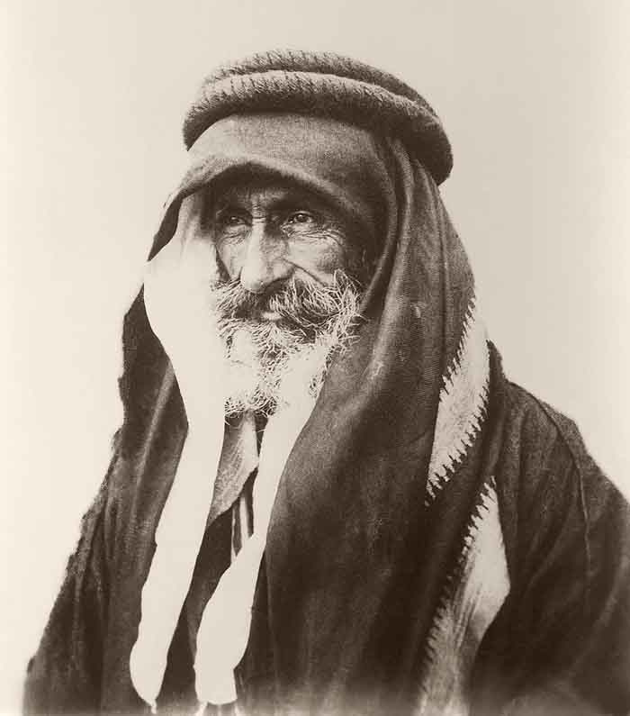
Portrait of Sheikh Khalil Senaah (against a wall background) at Kerak.
How is Micah contrasted to the Prophets of “Peace”?
Micah 3:6-7
⁶ “Therefore you shall have night without vision,
And you shall have darkness without divination;
The sun shall go down on the prophets,
And the day shall be dark for them.
⁷ So the seers shall be ashamed,
And the diviners abashed;
Indeed they shall all cover their lips;
For there is no answer from God.”
This is a loose gelatine paper print made from a negative by C.A.Hornstein (active 1894-1914) taken
Micah 3:8
⁸ But truly I am full of power by the Spirit of the Lord,
And of justice and might,
To declare to Jacob his transgression
And to Israel his sin.

Slide 51
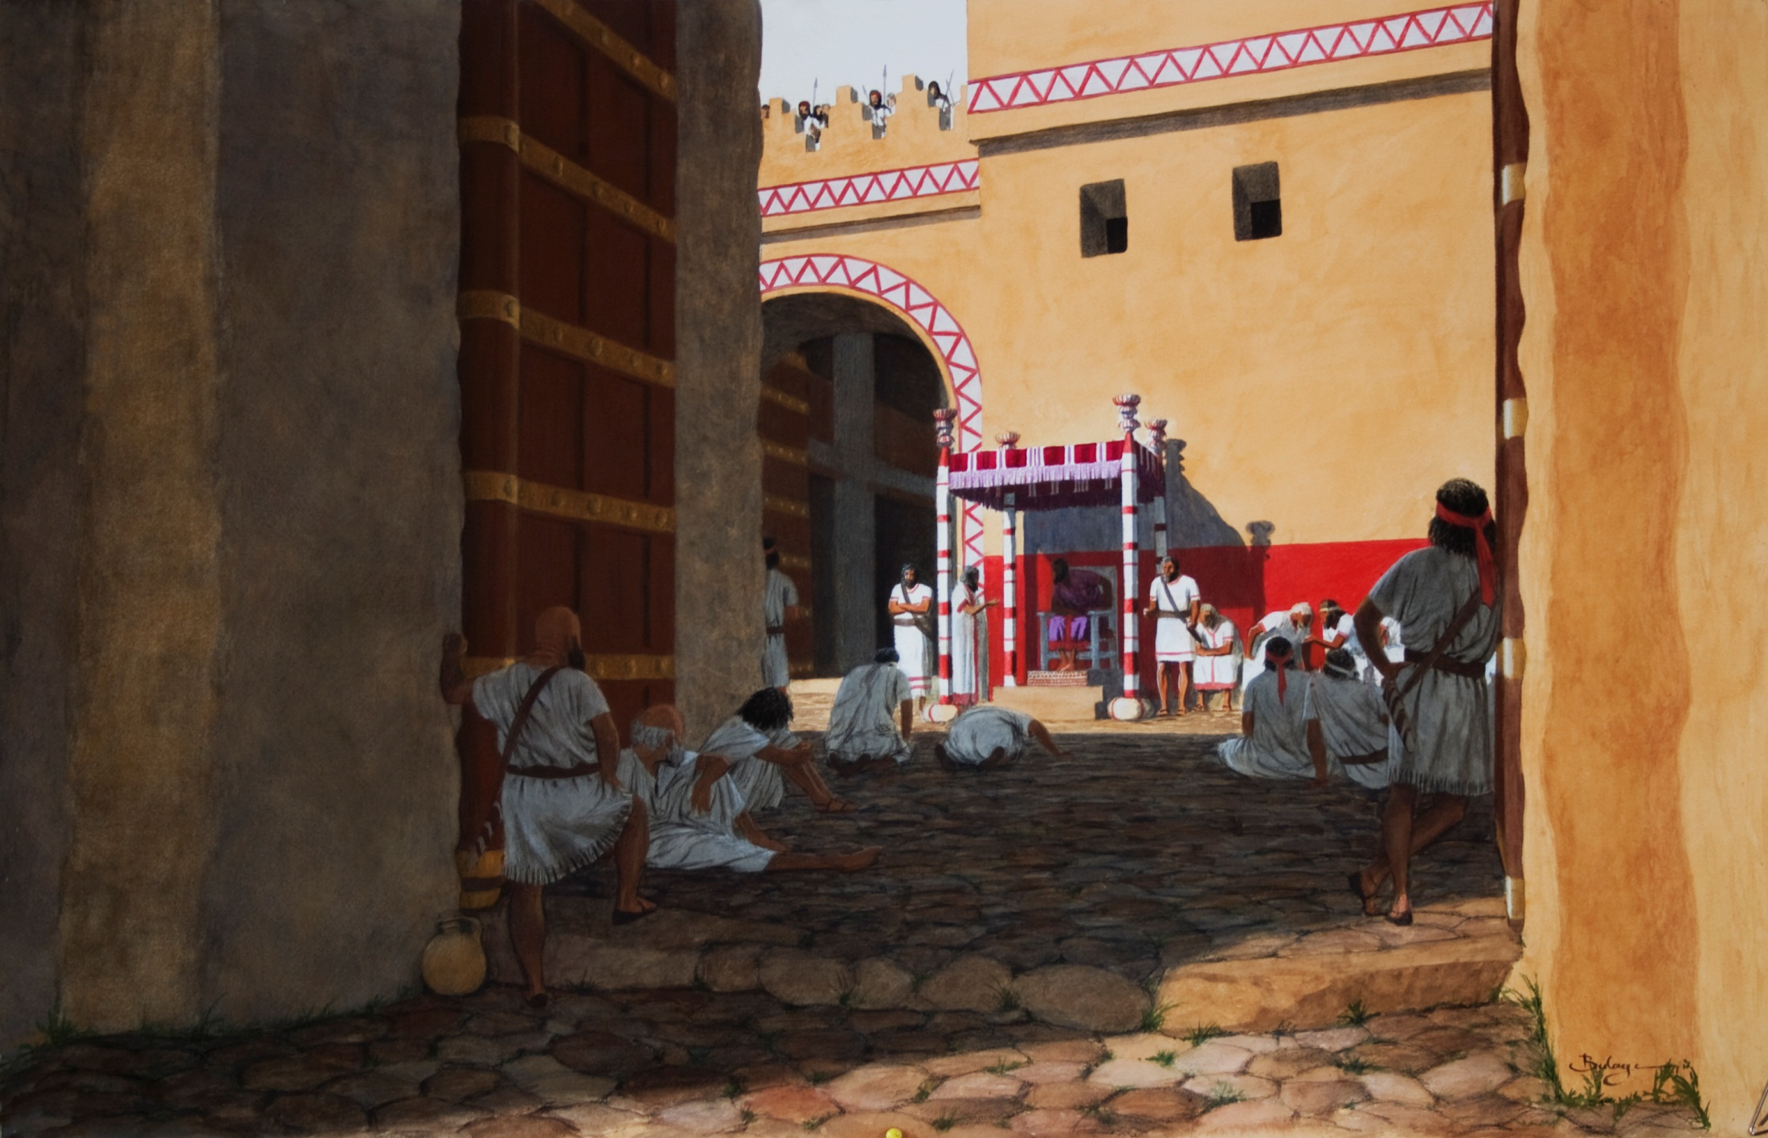
Micah 3:9-11
⁹ Now hear this,
…rulers of the house of Israel,
…judge for a bribe,
….priests teach for pay,
…prophets divine for money.
Yet they lean on the Lord, and say,
“Is not the Lord among us?
No harm can come upon us.”
¹² Therefore because of you
Zion shall be plowed like a field,
Jerusalem shall become heaps of ruins,
And the mountain of the temple
Like the bare hills of the forest.

Slide 52
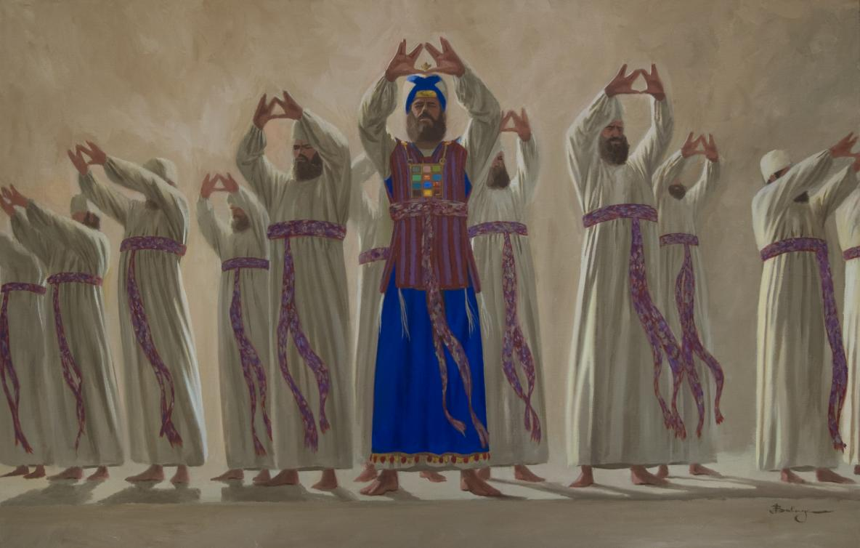
Micah 3:9-11
⁹ Now hear this,
…rulers of the house of Israel,
…judge for a bribe,
….priests teach for pay,
…prophets divine for money.
Yet they lean on the Lord, and say,
“Is not the Lord among us?
No harm can come upon us.”
¹² Therefore because of you
Zion shall be plowed like a field,
Jerusalem shall become heaps of ruins,
And the mountain of the temple
Like the bare hills of the forest.

Slide 53
Prophets
Micah 3:9-11
⁹ Now hear this,
…rulers of the house of Israel,
…judge for a bribe,
….priests teach for pay,
…prophets divine for money.
Yet they lean on the Lord, and say,
“Is not the Lord among us?
No harm can come upon us.”
¹² Therefore because of you
Zion shall be plowed like a field,
Jerusalem shall become heaps of ruins,
And the mountain of the temple
Like the bare hills of the forest.

Slide 54
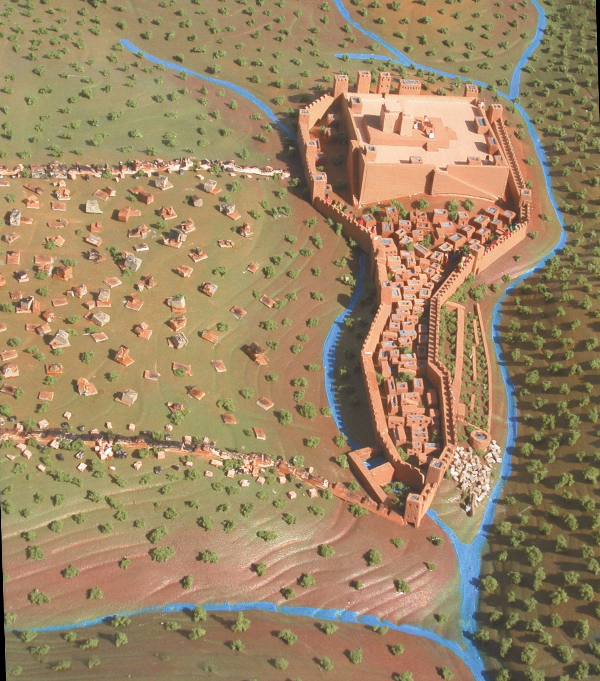
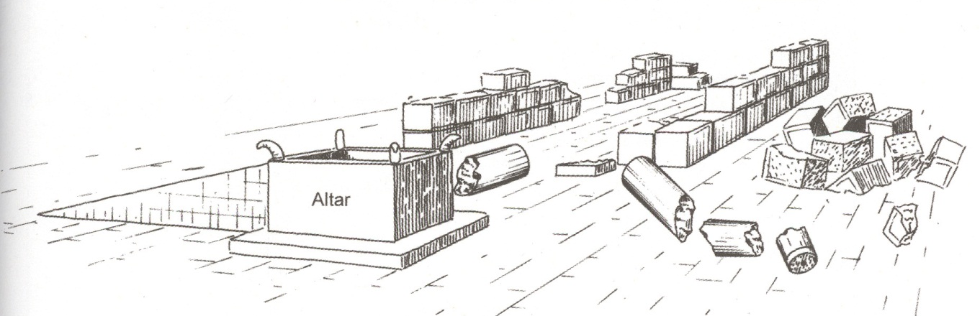
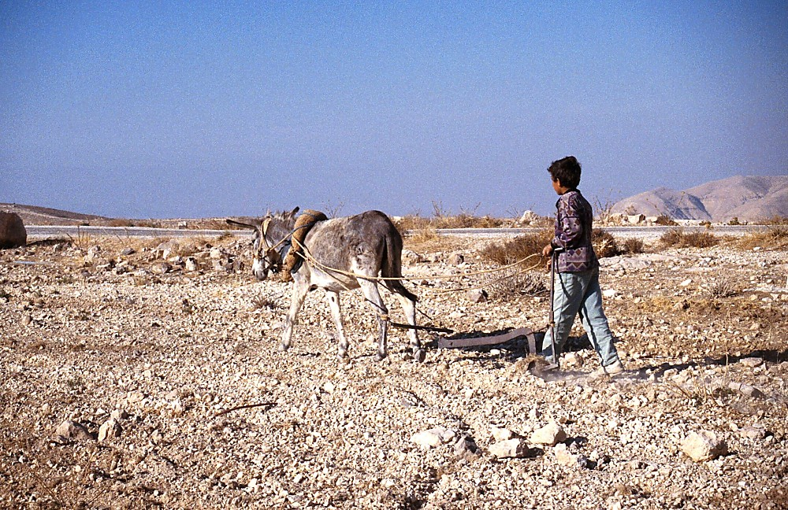
Micah 3:9-11
⁹ Now hear this,
…rulers of the house of Israel,
…judge for a bribe,
….priests teach for pay,
…prophets divine for money.
Yet they lean on the Lord, and say,
“Is not the Lord among us?
No harm can come upon us.”
¹² Therefore because of you
Zion shall be plowed like a field,
Jerusalem shall become heaps of ruins,
And the mountain of the temple
Like the bare hills of the forest.

Slide 55
"For the mountain of Zion, which is desolate, the foxes walk upon it." Lamentations 5:18

Slide 56
3:1 Is it not for you to know justice?
3:2 You who hate good and love evil;
Who strip the skin from My people,
And the flesh from their bones;
3:3 You who hate good and love evil;
Who strip the skin from My people,
And the flesh from their bones;
3:5 Thus says the Lord concerning the prophets
Who make my people stray;
Who chant “Peace”
3:9 …Who abhor justice And pervert all equity,
3:10 Who build up Zion with bloodshed
And Jerusalem with iniquity:
3:4
Then they will cry to the Lord,
But He will not hear them;
He will even hide His face from them at that time,
Because they have been evil in their deeds.
3:6 “Therefore you shall have night without vision,
And you shall have darkness without divination;
3:12 Therefore because of you
Zion shall be plowed like a
field,
Jerusalem shall become
heaps of ruins
3:11 Her heads judge for a bribe,
Her priests teach for pay,
And her prophets divine for money.

Slide 57
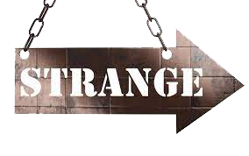
Strange/Peculiar Words-Phrases

Slide 58
List Your Favorite Verse/s Micah
Micah 6:8(ESV) ⁸ He has told you, O man, what is good;
and what does the Lord require of you
but to do justice, and to love kindness,
and to walk humbly with your God?

