Slide 1
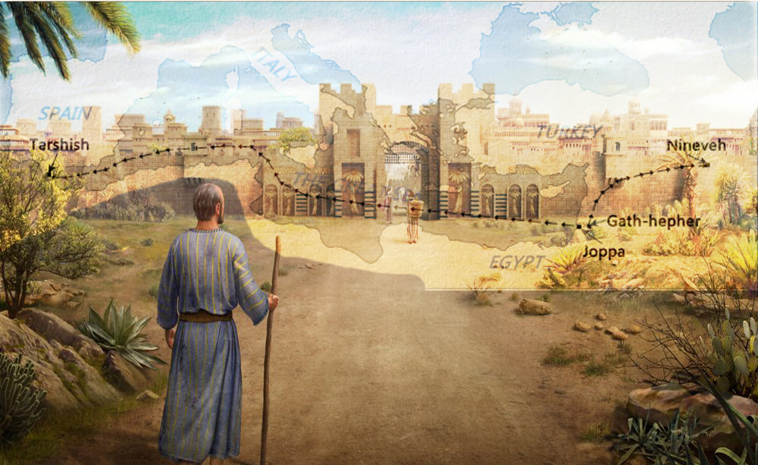
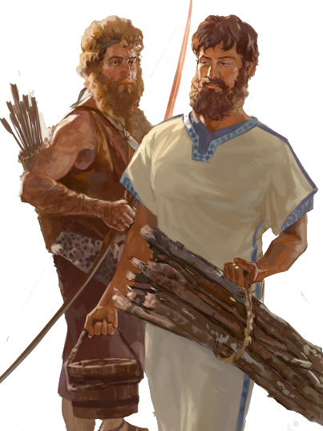
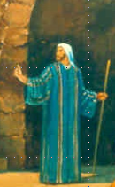
Lesson 13
Micah 7 The Final Restoration of Israel
Notes:
Joel 2:12-32 & Acts 2:1-21
Joel 3

Slide 2
Class Objectives
Evidence of the Inspiration of the Scriptures
Learn timeline and events occurring for the prophets
Establish a connection between the Old Testament to the New Testament
Examine what God desires for His people as told us by the prophets
Exercise our Bible Study Skills

Slide 3
The Role of the Prophets
They are Spokesmen for God, serving as “forthtellers,” speaking what God put in their mouth.
They are Preachers of the Covenant, relating their message to God’s previous promises to the nation of Israel. These covenants were made with or through Abraham, Moses, and David
They are historians, or Interpreters of the Israelites’ History. With out their interpretation God’s people would not know why an event was occurring.

Slide 4
The purpose of the prophets was threefold
1
2
3
To warn the nations of the coming judgment.
To explain why the judgment had come upon them.
To give assurance, at least to a remnant, of a hope that lay beyond the judgment.
Notes:
1. The purpose of the prophets was threefold:
a. To warn the nations of the coming judgment.
b. To explain why the judgment had come upon them.
To give assurance, at least to a remnant, of a hope that lay beyond the judgment.

Slide 5
Outline of Micah
Judgment 1:1-3:12
Judgment on People (1:1-2:13)
Judgment on Leaders (3:1-3:12)
Promises of Restoration 4:1-5:15
Promise of Coming Kingdom (4:1-4:5)
Promise of Coming Captivity (4:6-5:1)
Promise of Coming King (5:2-5:15)
Plea for Repentance 6:1-7:20
First Plea of God (6:1-6:9)
Second Plea of God (6:10-7:6)
Promise of Final Salvation (7:7-7:20)

Slide 6
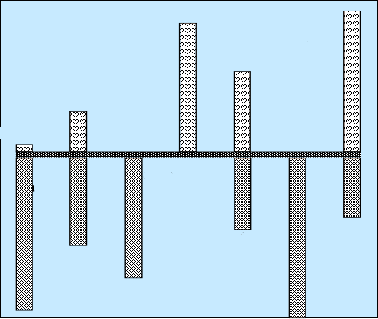
Hear Micah
Sermon 5
Woe is me
Minor
Prophets
Sermon 3
He has Laid
Siege
4:1-13
God will hear me
Mentions
Samaria
& Jerusalem
Words of Comfort & Hope
2:12-13
Sermon 4
Hear now
7:7-20
5:2-9
1:1
Hear All you People
Hear Now
He will not hear
Now hear this
5:1, 10-15
7:1-6
2:1-11
3:1-12
6:1-16
1:2-16
Nations not heard
Words of Warning/Judgment
Focus on
Jerusalem
Hear Now
Hear Lord’s complaint
Hear the rod
Sermon 1
Hear All
You Peoples
Sermon 2
Hear now

Slide 7
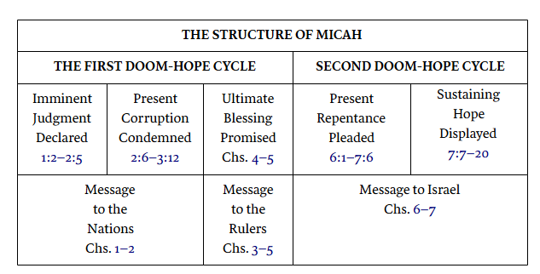
Lesson 8
1:2 Hear, all you peoples! Listen, O earth, and all that is in it! Let the Lord God be a witness against you, The Lord from His holy temple.
The book is divided into three sermons each distinguished from the other by the word hear (1:2; 3:1; 6:1).
The first sermon is directed to the nations (chs. 1–2),
the second to the rulers (chs. 3–5),
and the third to Israel (chs. 6–7).
Minor
Prophets
Micah Overview
1:2 Hear, all you peoples!
3:1 “Hear now,
3:4 But He will not hear them
3:9 Now hear this,
5:15 On the nations that have not heard.”
6:1 Hear now what the Lord says:
6:2 Hear, O you mountains, the Lord’s complaint,
6:9 “Hear the rod!
7:7 My God will hear me.

Slide 8
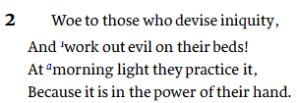
1:2 Hear, all you peoples!
1:6 “Therefore I will make Samaria a heap of ruins in the field,.
1:8 Therefore I will wail and howl… 9 For her wounds are incurable.
For it has come to Judah; It has come to the gate of My people—To Jerusalem.
3:9 Now hear this,
5:15 On the nations that have not heard.”
3:1 “Hear now, O heads of Jacob…
3:4 But He will not hear them (Rulers)
2:3 Therefore thus says the Lord: “Behold, against this family I am devising disaster,
2:5 Therefore you will have no one to determine boundaries by lot
In the assembly of the Lord.

Slide 9
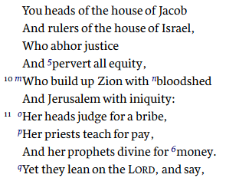
3:1 “Hear now, O heads of Jacob…
3:4 But He will not hear them (Rulers)
3:5 Thus says the Lord concerning the prophets
Who make my people stray;
Who chant “Peace”
While they chew with their teeth,
But who prepare war against him
Who puts nothing into their mouths:
3:6–7 “Therefore you shall have night without vision,
And you shall have darkness without divination;…
For there is no answer from God.”
5:15 On the nations that have not heard.”
6:1 Hear now what the Lord says:
3:9 Now hear this,
6:2 Hear, O you mountains, the Lord’s complaint,
6:9 “Hear the rod!
7:7 My God will hear me.
3:12 Therefore because of you
Zion shall be plowed like a field,
Jerusalem shall become heaps of ruins,
And the mountain of the temple
Like the bare hills of the forest.

Slide 10
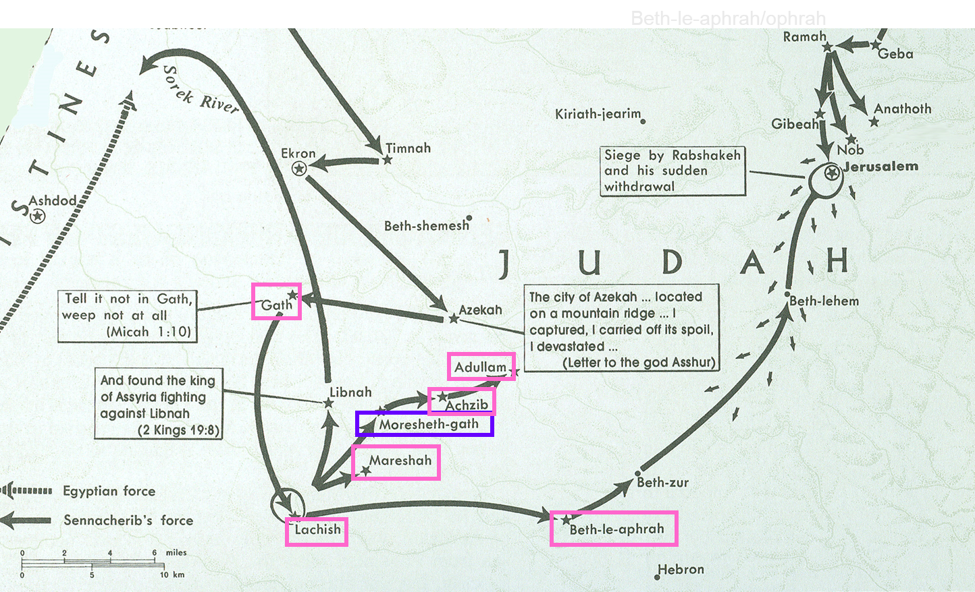
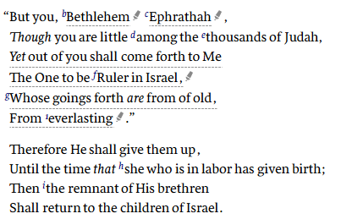
Promise of Coming Kingdom (4:1-4:5)
Promise of Coming Captivity (4:6-5:1)
Promise of Coming King (5:2-5:15)
5:15 On the nations that have not heard.”

Slide 11
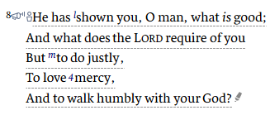
6:1 Hear now what the Lord says:
6:2 Hear, O you mountains, the Lord’s complaint,

Slide 12
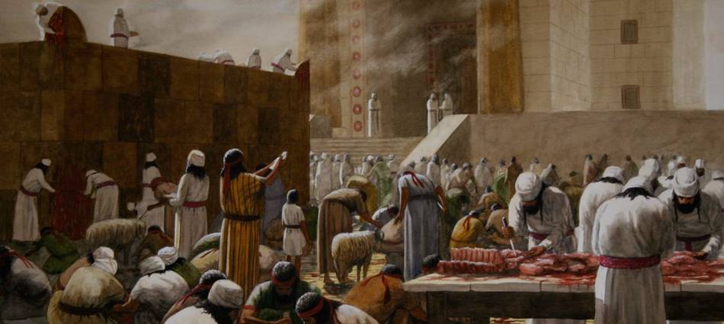
⁶ With what shall I come before the Lord,
And bow myself before the High God?
Shall I come before Him with burnt offerings,
With calves a year old?
⁷ Will the Lord be pleased with thousands of rams,
Ten thousand rivers of oil?
Shall I give my firstborn for my transgression,
The fruit of my body for the sin of my soul?
⁸ He has shown you, O man, what is good;
And what does the Lord require of you
But to do justly,
To love mercy,
And to walk humbly with your God?

Slide 13
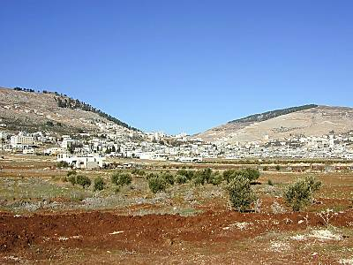
Which Tribes Sat at Mt of Curses & Blessings?
Mt. Gerizim
Blessings
Mt. Ebal
Curses
Simeon
Levi
Judah
Issachar
Joseph
(Ephraim &
Manasseh)
Benjamin
Reuben
Gad
Asher
Zebulun
Dan
Naphtali

Slide 14
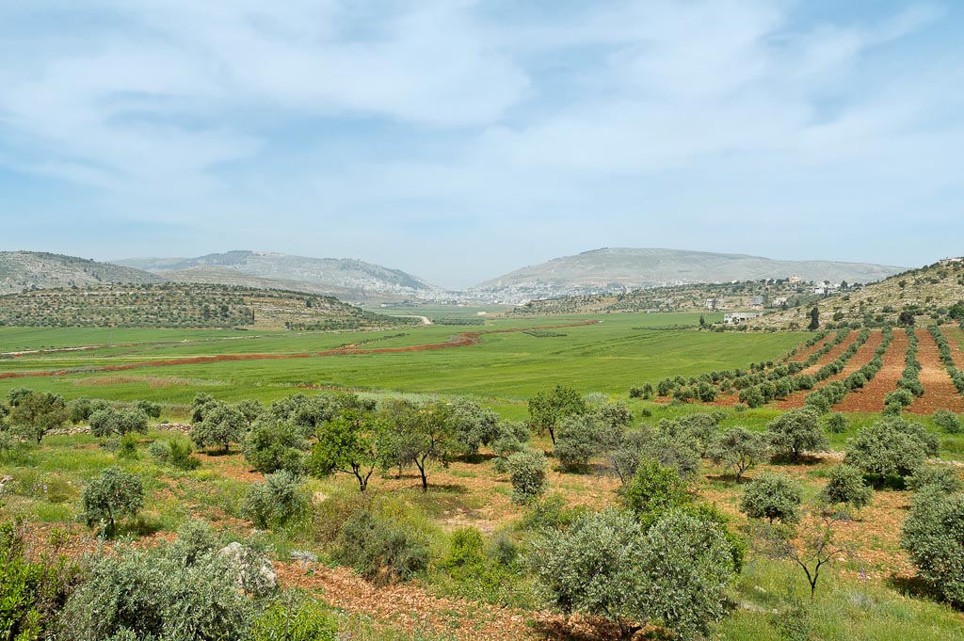
Deuteronomy 10:10-13(NKJV) ¹¹Then the Lord said to me, ‘Arise, begin your journey before the people, that they may go in and possess the land which I swore to their fathers to give them.’ ¹²“And now, Israel, what does the Lord your God require of you, but
to fear the Lord your God,
to walk in all His ways and
to love Him,
to serve the Lord your God with all your heart and with all your soul, ¹³and to keep the commandments of the Lord and His statutes which I command you today for your good?
⁸ He has shown you, O man, what is good;
And what does the Lord require of you
But to do justly,
To love mercy,
And to walk humbly with your God?
Matthew 22:35–40 (Mark 12:28–34)
The Greatest Commandment
³⁵ Then one of them, a lawyer, asked Him a question, testing Him, and saying, ³⁶ “Teacher, which is the great commandment in the law?”
³⁷ Jesus said to him, “ ‘You shall love the Lord your God with all your heart, with all your soul, and with all your mind.’ ³⁸ This is the first and great commandment. ³⁹ And the second is like it: ‘You shall love your neighbor as yourself.’ ⁴⁰ On these two commandments hang all the Law and the Prophets.”
Mount Gerizim, Shechem, and Mount Ebal from east
Notes:
tb050106458

Slide 15
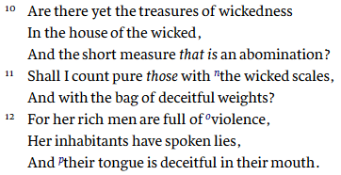
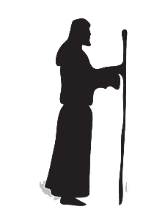
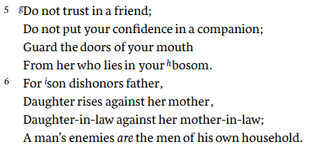
6:1 Hear now what the Lord says:
6:2 Hear, O you mountains, the Lord’s complaint,
6:9 “Hear the rod!
Therefore – curses of Deuteronomy
7:7 Therefore I will look to the LORD… My God will hear me.

Slide 16
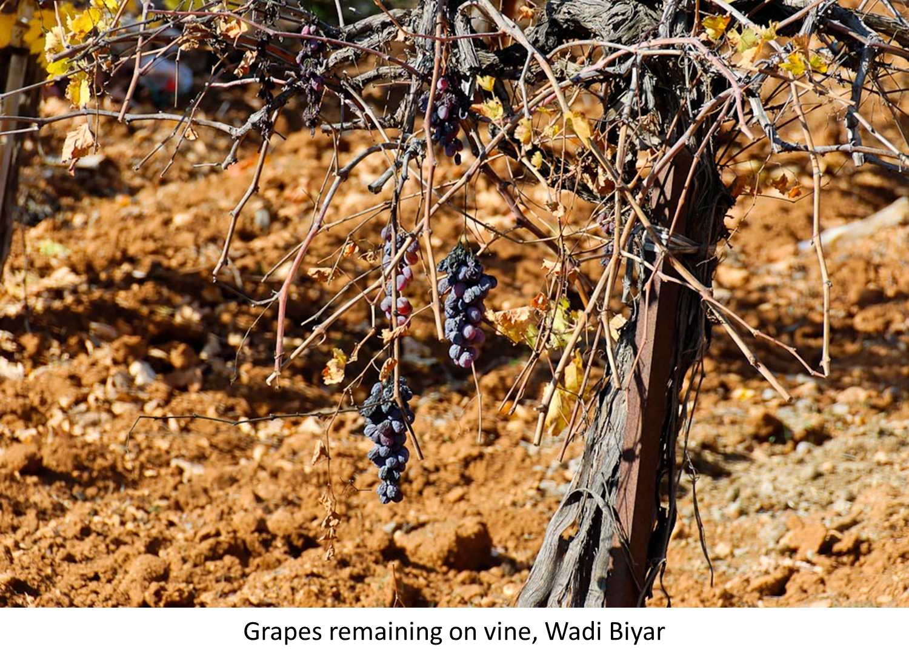
Who is Speaking in Micah 7:1-8
Micah 7
¹ Woe is me!
For I am like those who gather summer fruits,
Like those who glean vintage grapes;
There is no cluster to eat
Of the first-ripe fruit which my soul desires.
² The faithful man has perished from the earth,
And there is no one upright among men.
They all lie in wait for blood;
Every man hunts his brother with a net.
⁷ Therefore I will look to the Lord;
I will wait for the God of my salvation;
My God will hear me.
⁸ Do not rejoice over me, my enemy;
When I fall, I will arise;
When I sit in darkness,
The Lord will be a light to me.
Micah

Slide 17
Feeling of “Woe is Me!” 7:1
Micah 2
¹ Woe to those who devise iniquity,
And work out evil on their beds!
At morning light they practice it,
Because it is in the power of their hand.
Micah 7
¹ Woe is me!
For I am like those who gather summer fruits,
Like those who glean vintage grapes;
There is no cluster to eat
Of the first-ripe fruit which my soul desires.
² The faithful man has perished from the earth,
And there is no one upright among men.
They all lie in wait for blood;
Every man hunts his brother with a net.
⁷ Therefore I will look to the Lord;
I will wait for the God of my salvation;
My God will hear me.
⁸ Do not rejoice over me, my enemy;
When I fall, I will arise;
When I sit in darkness,
The Lord will be a light to me.

Slide 18
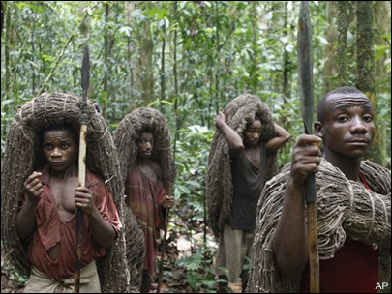
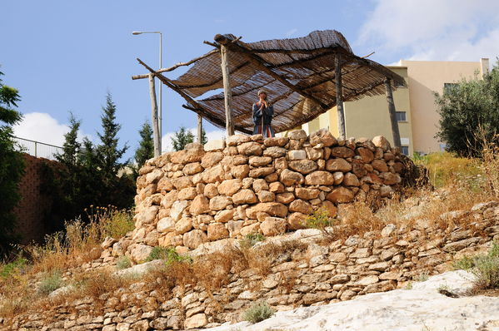
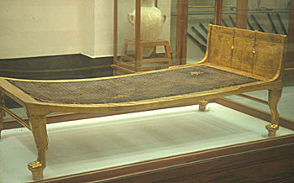
Wickedness of the people
Micah 7
² The faithful man has perished from the earth,
And there is no one upright among men.
They all lie in wait for blood;
Every man hunts his brother with a net.
³ That they may successfully do evil with both hands—
The prince asks for gifts,
The judge seeks a bribe,
And the great man utters his evil desire;
So they scheme together.
⁴ The best of them is like a brier;
The most upright is sharper than a thorn hedge;
The day of your watchman and your punishment comes;
Now shall be their perplexity.
⁵ Do not trust in a friend;
Do not put your confidence in a companion;
Guard the doors of your mouth
From her who lies in your bosom.
⁶ For son dishonors father,
Daughter rises against her mother,
Daughter-in-law against her mother-in-law;
A man’s enemies are the men of his own household.
Notes:
Matthew 10:16 (ESV)
Persecution Will Come
16 “Behold, I am sending you out as sheep in the midst of wolves, so be wise as serpents and innocent as doves.
Matthew 10:34–35 (ESV)
Not Peace, but a Sword
34 “Do not think that I have come to bring peace to the earth. I have not come to bring peace, but a sword. 35 For I have come to set a man against his father, and a daughter against her mother, and a daughter-in-law against her mother-in-law.
Luke 12:49–53 (ESV)
Not Peace, but Division
49 “I came to cast fire on the earth, and would that it were already kindled! 50 I have a baptism to be baptized with, and how great is my distress until it is accomplished! 51 Do you think that I have come to give peace on earth? No, I tell you, but rather division. 52 For from now on in one house there will be five divided, three against two and two against three. 53 They will be divided, father against son and son against father, mother against daughter and daughter against mother, mother-in-law against her daughter-in-law and daughter-in-law against mother-in-law.”

Slide 19
Micah 7
⁵ Do not trust in a friend;
Do not put your confidence in a companion;
Guard the doors of your mouth
From her who lies in your bosom.
⁶ For son dishonors father,
Daughter rises against her mother,
Daughter-in-law against her mother-in-law;
A man’s enemies are the men of his own household.
Micah 4:3 (NKJV)
He shall judge between many peoples,
And rebuke strong nations afar off;
They shall beat their swords into plowshares,
And their spears into pruning hooks;
Nation shall not lift up sword against nation,
Neither shall they learn war anymore.
Isaiah 2:4 (NKJV)
He shall judge between the nations,
And rebuke many people;
They shall beat their swords into plowshares,
And their spears into pruning hooks;
Nation shall not lift up sword against nation,
Neither shall they learn war anymore.
Joel 3
⁹ Proclaim this among the nations:
“Prepare for war!
Wake up the mighty men,
Let all the men of war draw near,
Let them come up.
¹⁰ Beat your plowshares into swords
And your pruning hooks into spears;
Let the weak say, ‘I am strong.’”
¹¹ Assemble and come, all you nations,
And gather together all around.
Cause Your mighty ones to go down there, O Lord.
Notes:
Matthew 10:16 (ESV)
Persecution Will Come
16 “Behold, I am sending you out as sheep in the midst of wolves, so be wise as serpents and innocent as doves.
Matthew 10:34–35 (ESV)
Not Peace, but a Sword
34 “Do not think that I have come to bring peace to the earth. I have not come to bring peace, but a sword. 35 For I have come to set a man against his father, and a daughter against her mother, and a daughter-in-law against her mother-in-law.
Luke 12:49–53 (ESV)
Not Peace, but Division
49 “I came to cast fire on the earth, and would that it were already kindled! 50 I have a baptism to be baptized with, and how great is my distress until it is accomplished! 51 Do you think that I have come to give peace on earth? No, I tell you, but rather division. 52 For from now on in one house there will be five divided, three against two and two against three. 53 They will be divided, father against son and son against father, mother against daughter and daughter against mother, mother-in-law against her daughter-in-law and daughter-in-law against mother-in-law.”

Slide 20
Micah 7
⁵ Do not trust in a friend;
Do not put your confidence in a companion;
Guard the doors of your mouth
From her who lies in your bosom.
⁶ For son dishonors father,
Daughter rises against her mother,
Daughter-in-law against her mother-in-law;
A man’s enemies are the men of his own household.
Micah 4:3 (NKJV)
He shall judge between many peoples,
And rebuke strong nations afar off;
They shall beat their swords into plowshares,
And their spears into pruning hooks;
Nation shall not lift up sword against nation,
Neither shall they learn war anymore.
Isaiah 2:4 (NKJV)
He shall judge between the nations,
And rebuke many people;
They shall beat their swords into plowshares,
And their spears into pruning hooks;
Nation shall not lift up sword against nation,
Neither shall they learn war anymore.
Luke 12:49–53 (NKJV)
Christ Warns of the Costs of Discipleship
⁴⁹ “I came to send fire on the earth, and how I wish it were already kindled!
⁵⁰ But I have a baptism to be baptized with, and how distressed I am till it is accomplished!
⁵¹ Do you suppose that I came to give peace on earth? I tell you, not at all, but rather division.
⁵² For from now on five in one house will be divided: three against two, and two against three. ⁵³ Father will be divided against son and son against father, mother against daughter and daughter against mother, mother-in-law against her daughter-in-law and daughter-in-law against her mother-in-law.”
Notes:
Matthew 10:16 (ESV)
Persecution Will Come
16 “Behold, I am sending you out as sheep in the midst of wolves, so be wise as serpents and innocent as doves.
Matthew 10:34–35 (ESV)
Not Peace, but a Sword
34 “Do not think that I have come to bring peace to the earth. I have not come to bring peace, but a sword. 35 For I have come to set a man against his father, and a daughter against her mother, and a daughter-in-law against her mother-in-law.
Luke 12:49–53 (ESV)
Not Peace, but Division
49 “I came to cast fire on the earth, and would that it were already kindled! 50 I have a baptism to be baptized with, and how great is my distress until it is accomplished! 51 Do you think that I have come to give peace on earth? No, I tell you, but rather division. 52 For from now on in one house there will be five divided, three against two and two against three. 53 They will be divided, father against son and son against father, mother against daughter and daughter against mother, mother-in-law against her daughter-in-law and daughter-in-law against mother-in-law.”
Luke 12:49–53 (NKJV)
Christ Warns of the Costs of Discipleship
49 “I came to send fire on the earth, and how I wish it were already kindled! 50 But I have a baptism to be baptized with, and how distressed I am till it is accomplished! 51 Do you suppose that I came to give peace on earth? I tell you, not at all, but rather division. 52 For from now on five in one house will be divided: three against two, and two against three. 53 Father will be divided against son and son against father, mother against daughter and daughter against mother, mother-in-law against her daughter-in-law and daughter-in-law against her mother-in-law.”

Slide 21
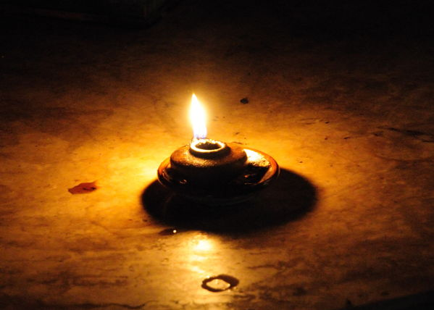
What is the attitude of the God-fearing individual as expressed in verses 7 to 8?
Psalm 130:5–6 (ESV)
5 I wait for the Lord, my soul waits,
and in his word I hope;
6 my soul waits for the Lord
more than watchmen for the morning,
more than watchmen for the morning.
Micah 7
⁷ Therefore I will look to the Lord;
I will wait for the God of my salvation;
My God will hear me.
⁸ Do not rejoice over me, my enemy;
When I fall, I will arise;
When I sit in darkness,
The Lord will be a light to me.

Slide 22
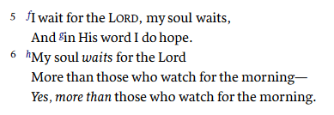
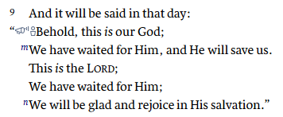
What is the attitude of the God-fearing individual as expressed in verses 7 to 8?
Psalms 130 Waiting for the Redemption of the Lord
Isaiah 25 Praise to God
Psalm 130:5–6 (ESV)
5 I wait for the Lord, my soul waits,
and in his word I hope;
6 my soul waits for the Lord
more than watchmen for the morning,
more than watchmen for the morning.
Promise of Final Salvation
Micah 7
⁷ Therefore I will look to the Lord;
I will wait for the God of my salvation;
My God will hear me.
⁸ Do not rejoice over me, my enemy;
When I fall, I will arise;
When I sit in darkness,
The Lord will be a light to me.

Slide 23
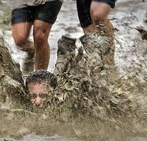
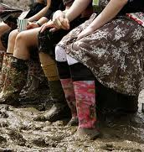
What is Speaker waiting for and put up with in Verse 9?
Micah 7
⁸ Do not rejoice over me, my enemy;
When I fall, I will arise;
When I sit in darkness,
The Lord will be a light to me.
⁹ I will bear the indignation of the Lord,
Because I have sinned against Him,
Until He pleads my case
And executes justice for me.
He will bring me forth to the light;
I will see His righteousness.
¹⁰ Then she who is my enemy will see,
And shame will cover her who said to me,
“Where is the Lord your God?”
My eyes will see her;
Now she will be trampled down
Like mud in the streets.
Jeremiah 2:6(ESV) – Israel Forsakes Jehovah ⁶ They did not say, ‘Where is the Lord who brought us up from the land of Egypt, who led us in the wilderness, in a land of deserts and pits, in a land of drought and deep darkness, in a land that none passes through, where no man dwells?’
⁸ The priests did not say, ‘Where is the Lord?’ Those who handle the law did not know me; the shepherds£ transgressed against me; the prophets prophesied by Baal and went after things that do not profit.
Promise of Final Salvation

Slide 24
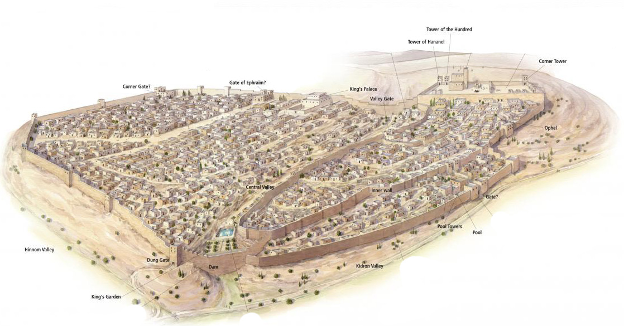
Micah 7
¹¹ In the day when your walls are to be built,
In that day the decree shall go far and wide.
¹² In that day they shall come to you
From Assyria and the fortified cities,
From the fortress to the River,
From sea to sea,
And mountain to mountain.
¹³ Yet the land shall be desolate
Because of those who dwell in it,
And for the fruit of their deeds.
Broadwall

Slide 25
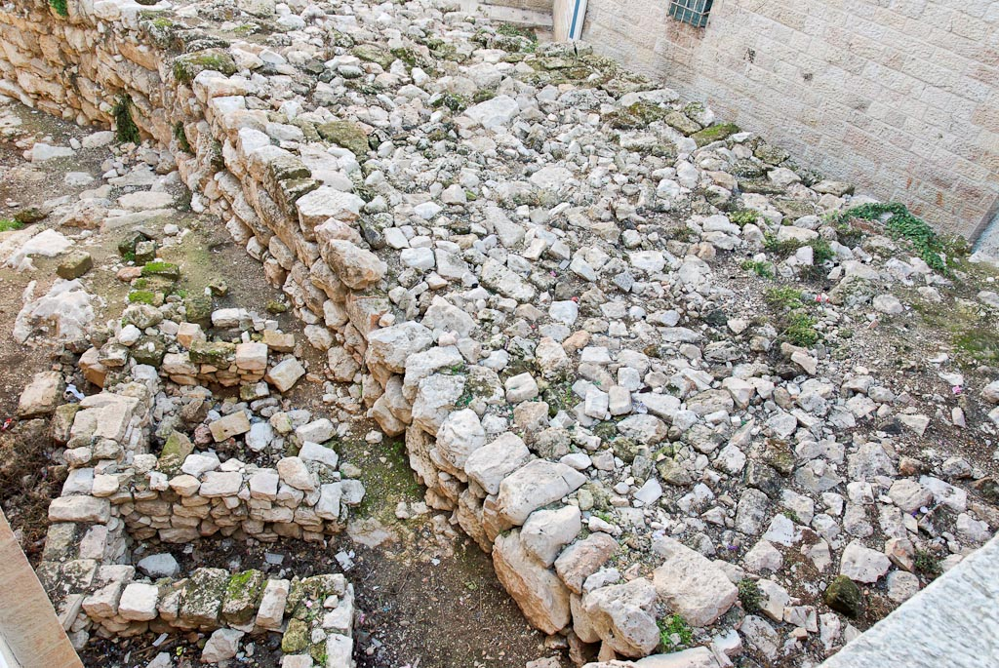
Micah 7
¹¹ In the day when your walls are to be built,
In that day the decree shall go far and wide.
¹² In that day they shall come to you
From Assyria and the fortified cities,
From the fortress to the River,
From sea to sea,
And mountain to mountain.
¹³ Yet the land shall be desolate
Because of those who dwell in it,
And for the fruit of their deeds.
Broad Wall with houses
Notes:
Excavators found some houses that had been destroyed during the construction of the wall. This may be referenced in Isaiah 22:10: “You counted the houses in Jerusalem, and demolished houses so you could have material to reinforce the wall” (NET).
tb010910261

Slide 26
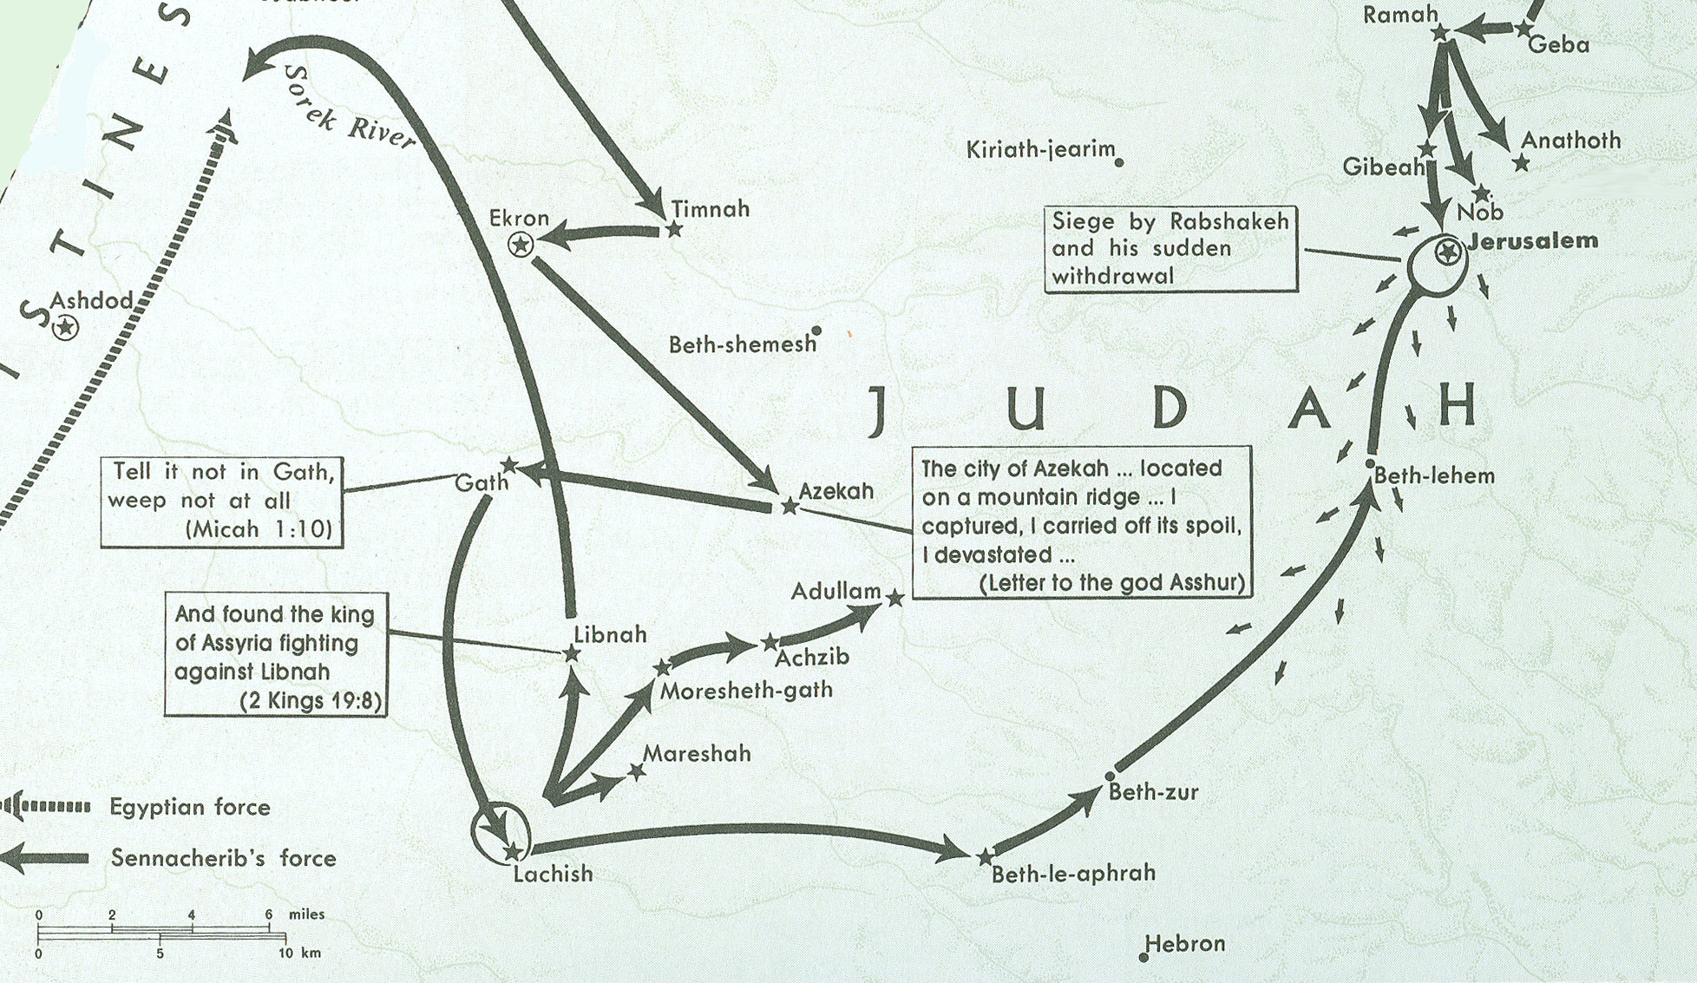
Sennacherib in Philistia & Judah 701 BC
Micah 5
¹ Now gather yourself in troops,
O daughter of troops;
He has laid siege against us;
They will strike the judge of Israel with a rod on the cheek.
² “But you, Bethlehem Ephrathah,
Though you are little among the thousands of Judah,
Yet out of you shall come forth to Me
The One to be Ruler in Israel,
Whose goings forth are from of old,
From everlasting.”
Beth-le-aphrah/ophrah

Slide 27
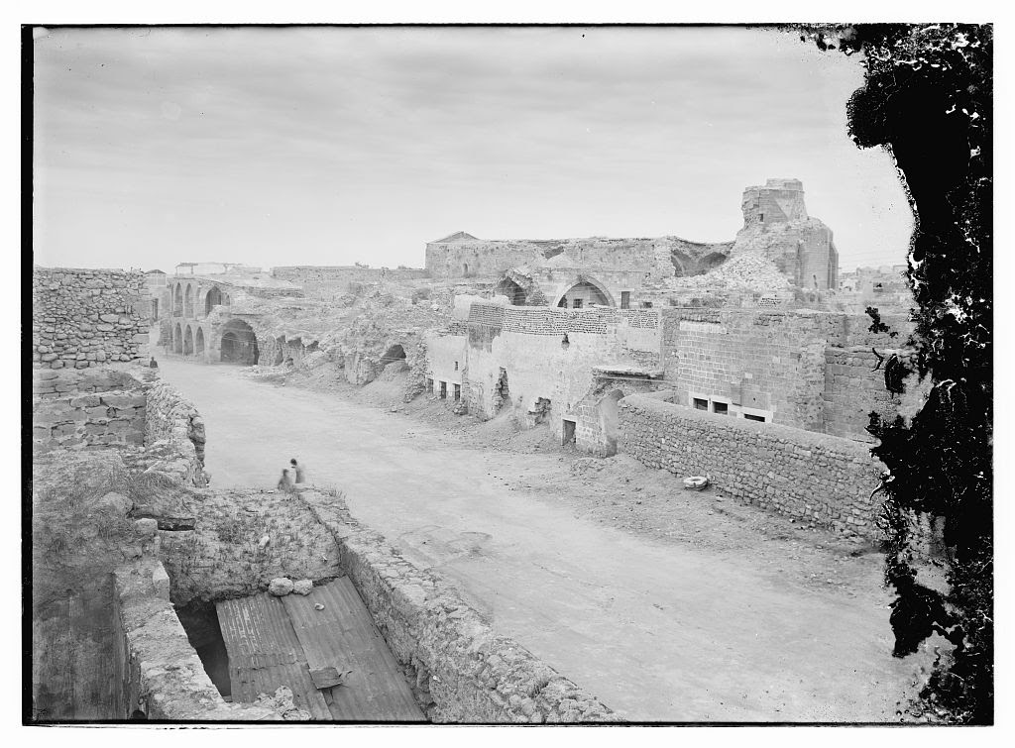
Micah 7
¹¹ In the day when your walls are to be built,
In that day the decree shall go far and wide.
¹² In that day they shall come to you
From Assyria and the fortified cities,
From the fortress to the River,
From sea to sea,
And mountain to mountain.
¹³ Yet the land shall be desolate
Because of those who dwell in it,
And for the fruit of their deeds.
Notes:
Excavators found some houses that had been destroyed during the construction of the wall. This may be referenced in Isaiah 22:10: “You counted the houses in Jerusalem, and demolished houses so you could have material to reinforce the wall” (NET).
tb010910261

Slide 28
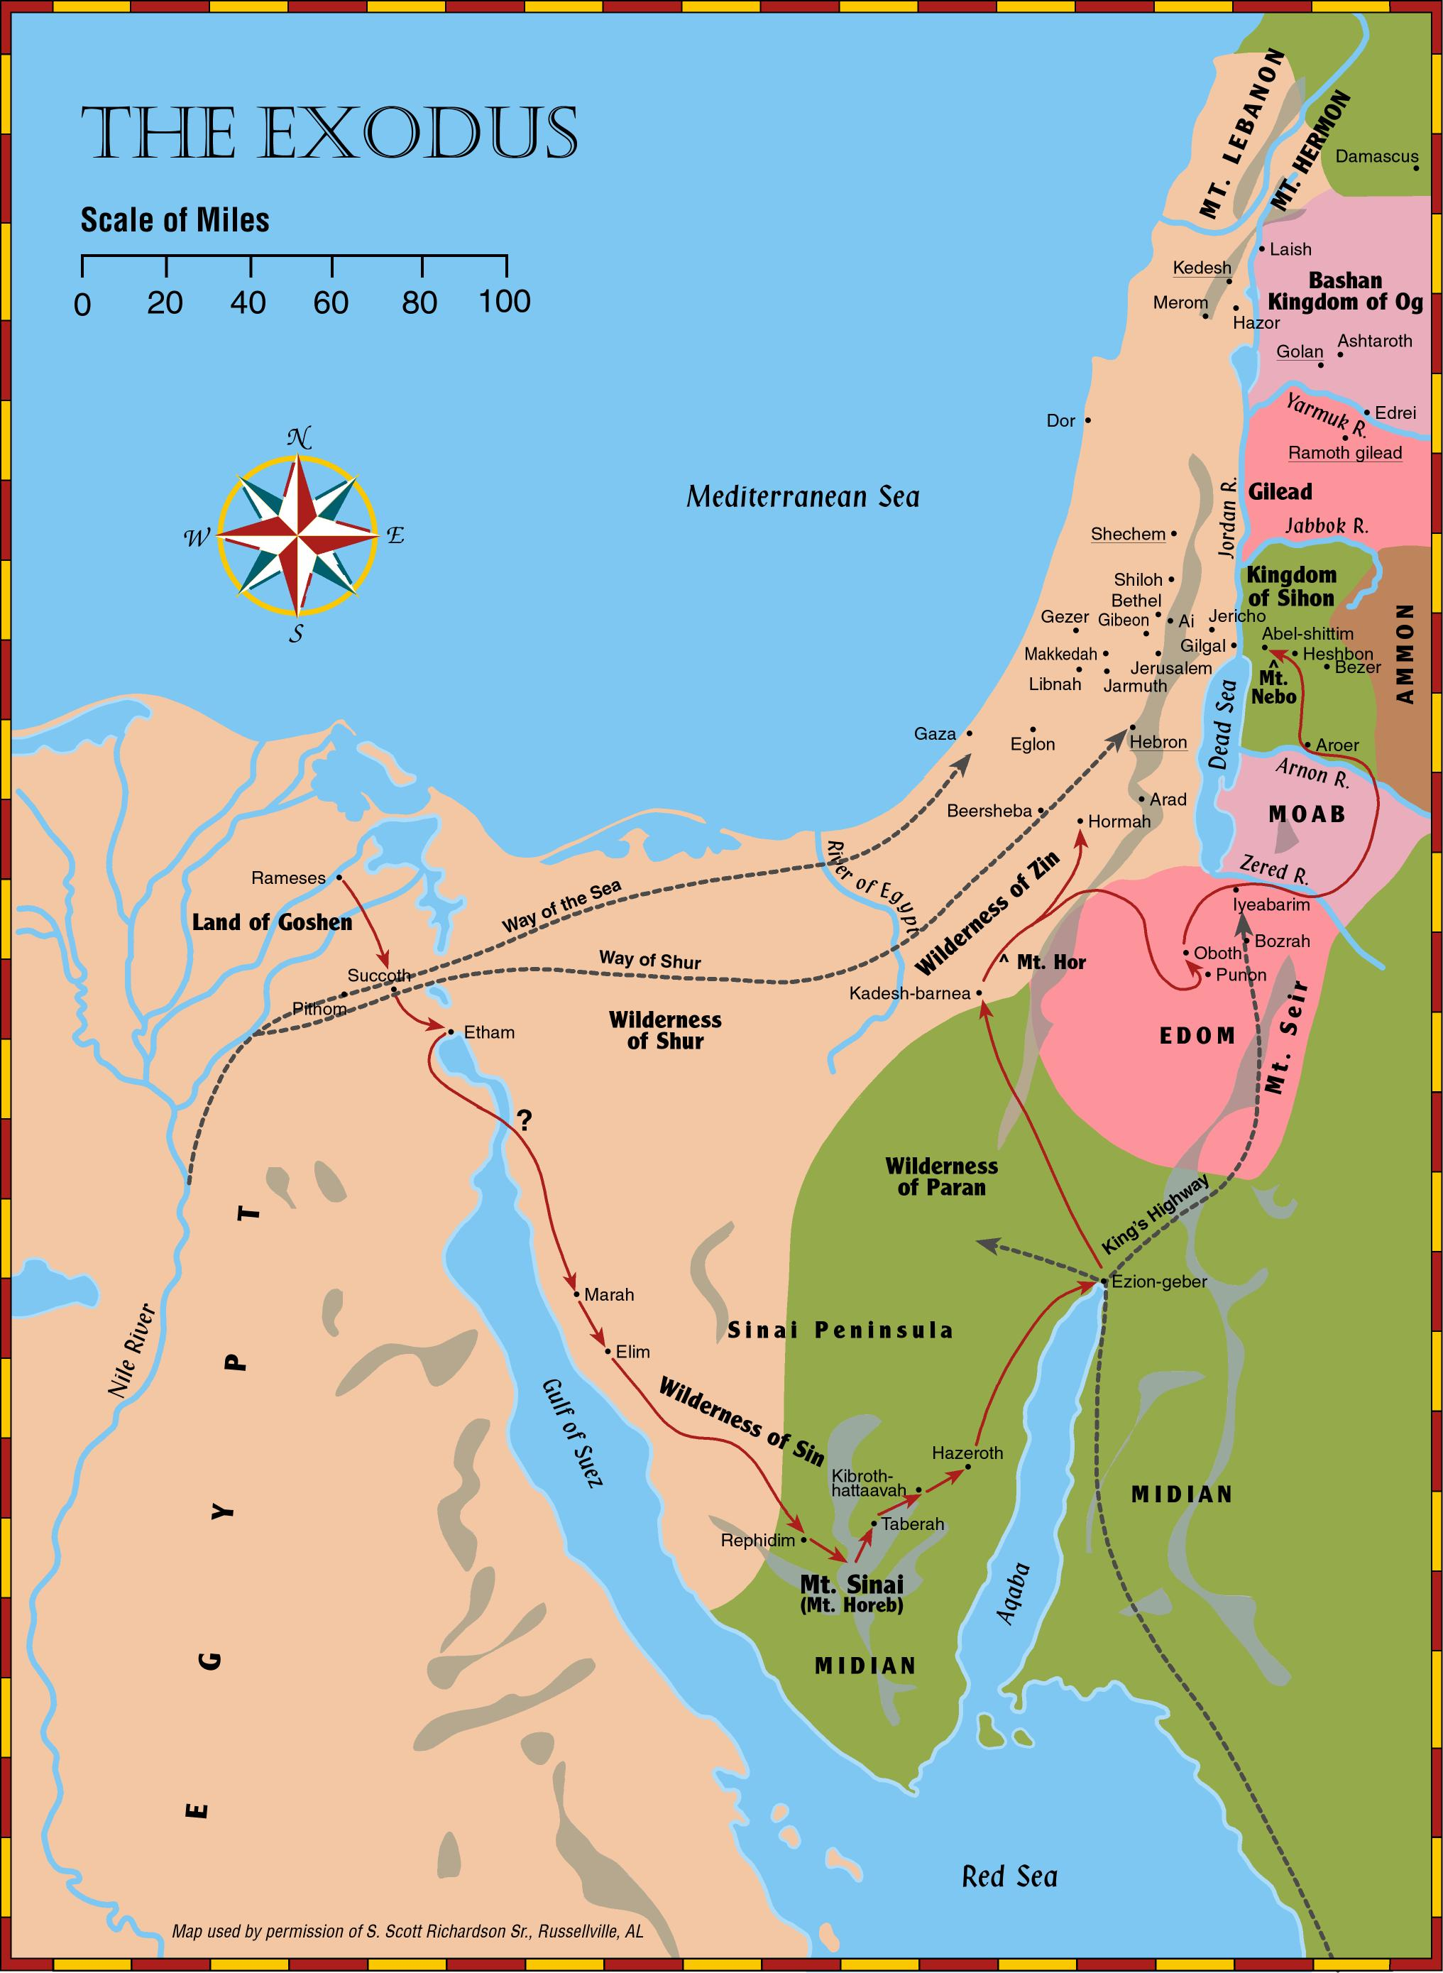
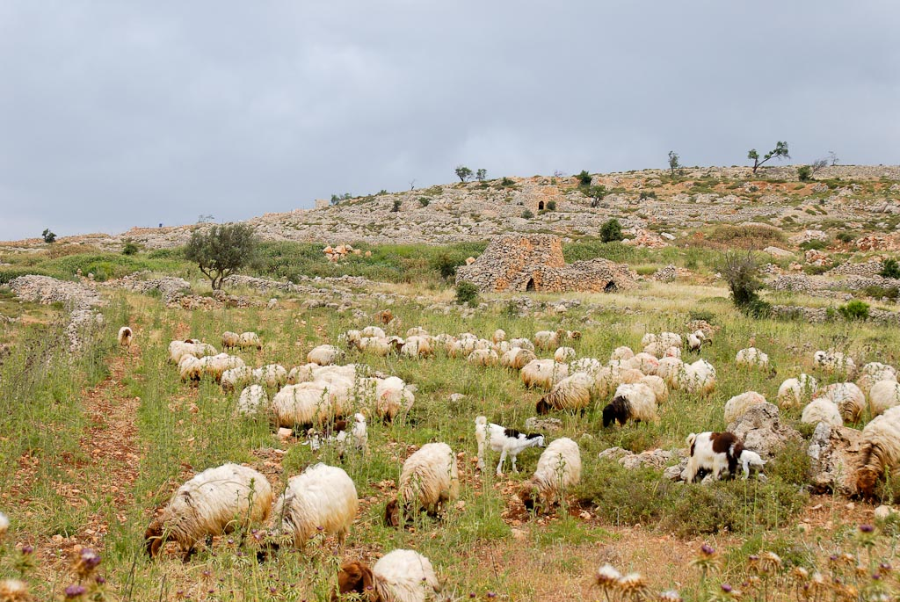
Micah 7
¹⁴ Shepherd Your people with Your staff,
The flock of Your heritage,
Who dwell solitarily in a woodland,
In the midst of Carmel;
Let them feed in Bashan and Gilead,
As in days of old.
Promise of Final Salvation
Sheep and watchtower near Ophrah, Ephraim
Notes:
This map is intended to help users locate the places which appear in the photographs in this presentation. The map therefore does not represent or label every geographic feature, and the sites are a mixture of modern and ancient place names.

Slide 29
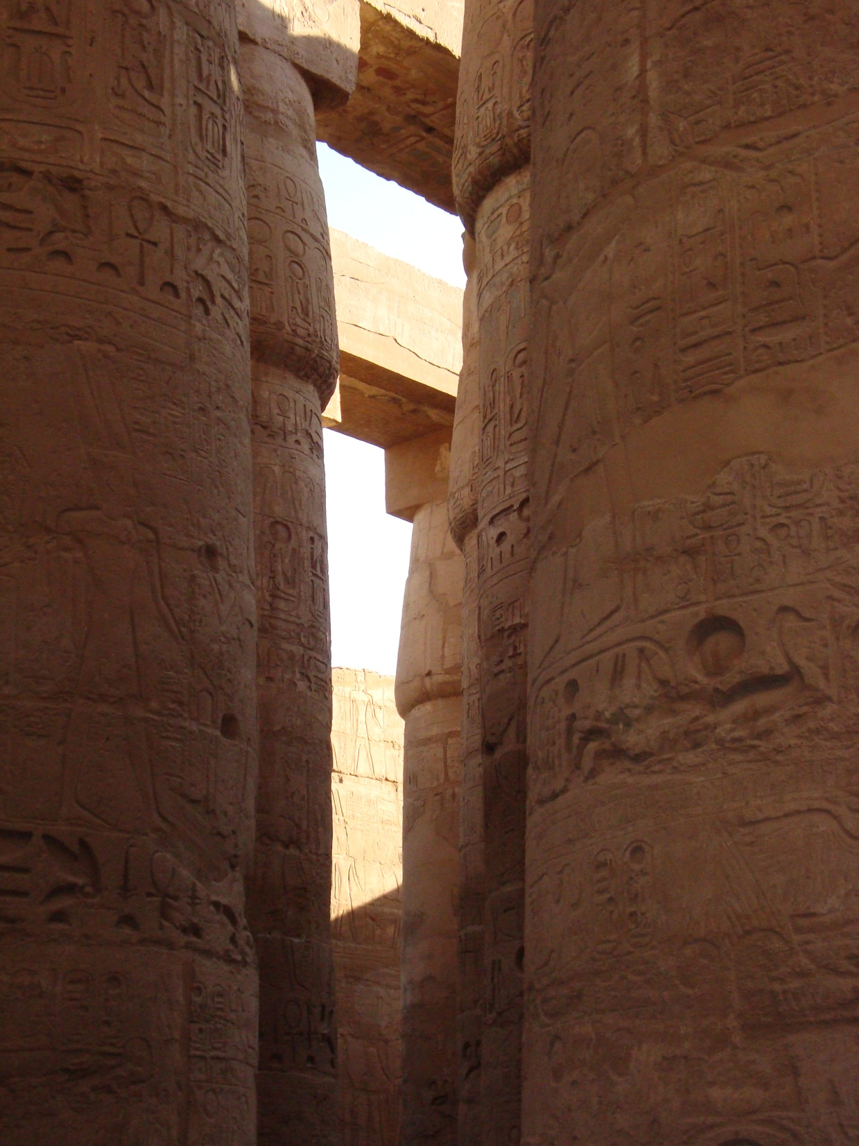
How does the Lord respond to their request in verse 15?
Promise of Final Salvation
Micah 7
¹⁵ “As in the days when you came out of the land of Egypt,
I will show them wonders.”
Notes:
This map is intended to help users locate the places which appear in the photographs in this presentation. The map therefore does not represent or label every geographic feature, and the sites are a mixture of modern and ancient place names.

Slide 30
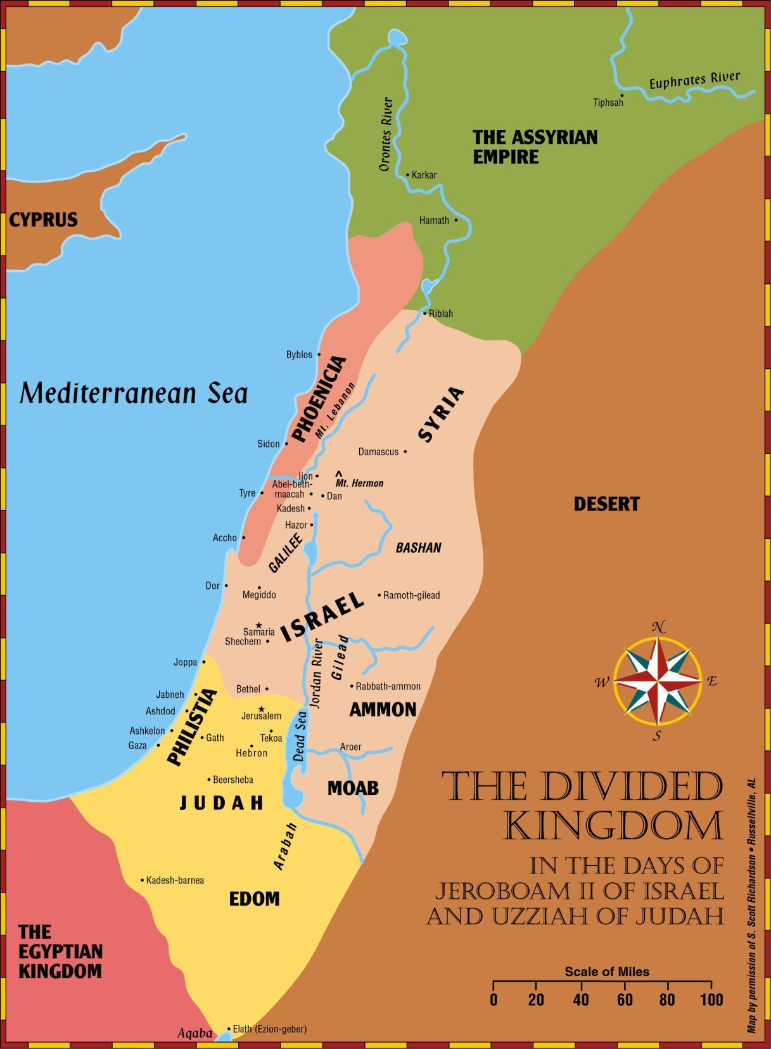
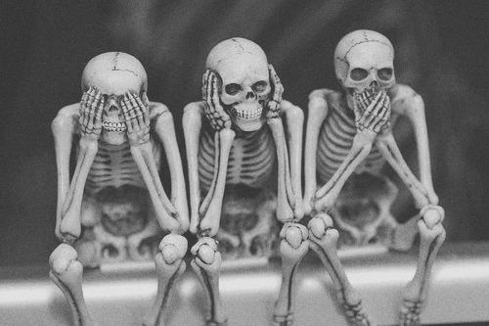
How will the other nations react to that as stated in verses 16 to 17?
Promise of Final Salvation
Micah 7
¹⁶ The nations shall see and be ashamed of all their might;
They shall put their hand over their mouth;
Their ears shall be deaf.
¹⁷ They shall lick the dust like a serpent;
They shall crawl from their holes like snakes of the earth.
They shall be afraid of the Lord our God,
And shall fear because of You.

Slide 31
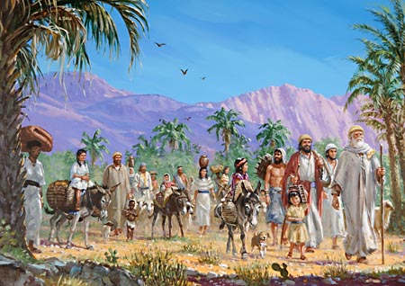
What promises from God are listed in verses 18 to 20?
Promise of Final Salvation
Micah 7:18-20
Who is a God like You,
Pardoning iniquity
And passing over the transgression of the remnant of His heritage?
He does not retain His anger forever,
Because He delights in mercy.
¹⁹ He will again have compassion on us,
And will subdue our iniquities.
You will cast all our sins
Into the depths of the sea.
²⁰ You will give truth to Jacob
And mercy to Abraham,
Which You have sworn to our fathers
From days of old.
How are promises from God fulfilled?

Slide 32
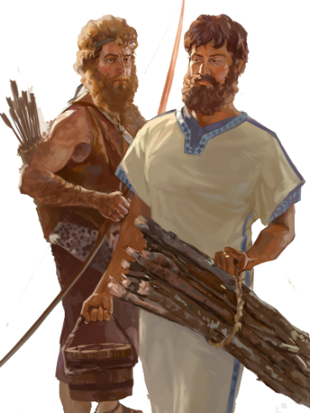
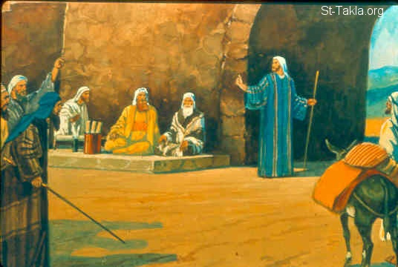
845 BC days Jehoram/Joram? Son of Jehoshaphat
Obadiah tells Edom it be punished for actions against Judah
Do not put confidence in physical fortresses
Look at history between Edom & Israel – need to treat kin kindly
Jonah 780 BC
Joel 830 BC
735 BC days of Jotham, Ahaz & Hezekiah
Micah tell Rulers, Priest, Judges, People of Judah
You are behaving like Israel therefore
& you need To Hear God

Slide 33
Obadiah, Jonah, Joel,&Micah

