Slide 1
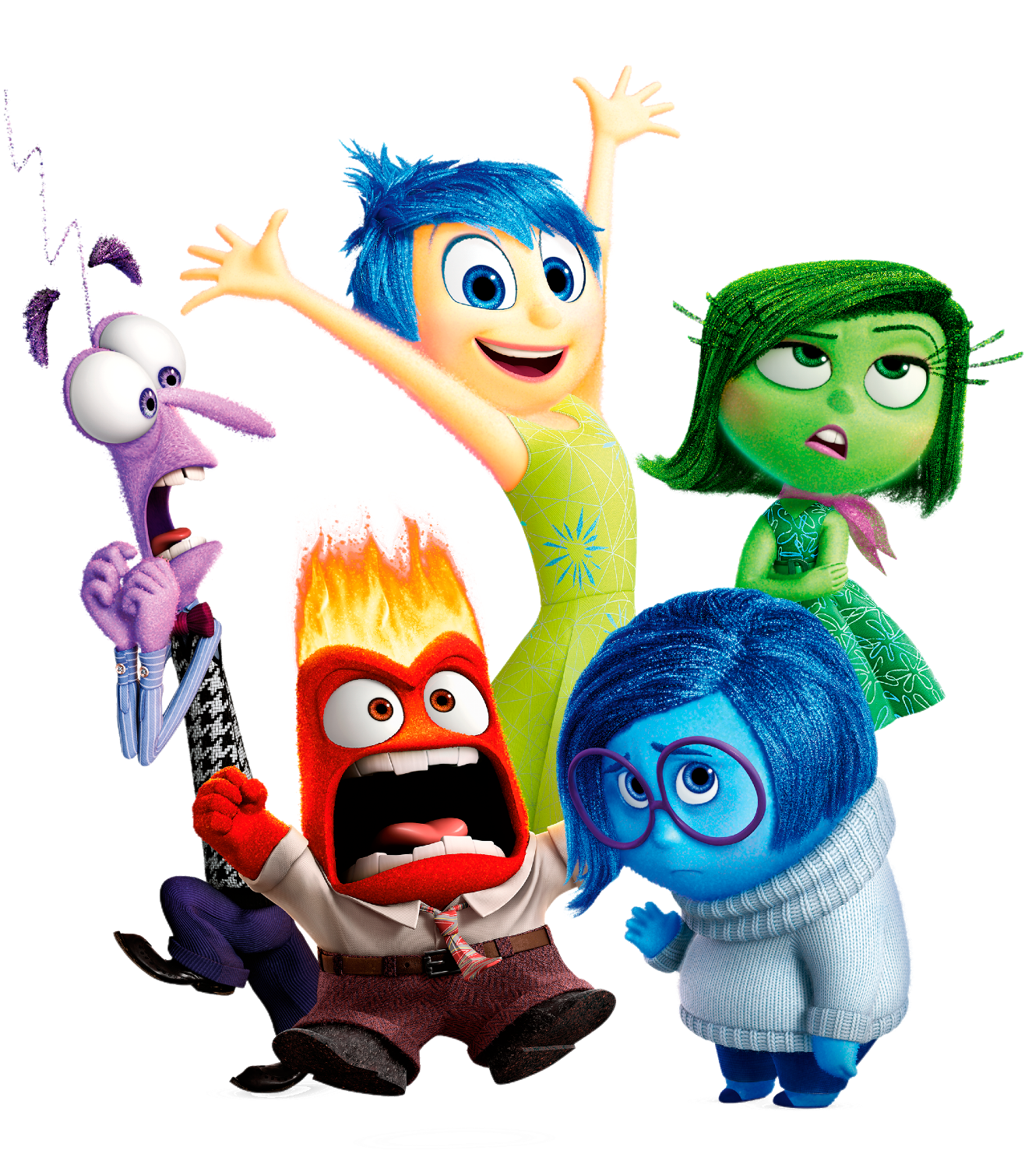
Hebrews
Lesson Eight: Covenant & Sacrifice

Slide 3
Riley had a happy life in Minnesota
Great family, great house, great yard, great friends, great hockey team
Family moves to San Francisco
Stressed-out family, nasty house, no yard, no friends, broccoli pizza
Her endurance breaks down at school
Anger’s Idea: Go back to Minnesota, where we were happy!

Slide 4
Riley had a happy life in Minnesota
Great family, great house, great yard, great friends, great hockey team
Family moves to San Francisco
Stressed-out family, nasty house, no yard, no friends, broccoli pizza
Her endurance breaks down at school
Anger’s Idea: Go back to Minnesota, where we were happy!
The Hebrews had a great life
Serving God via Moses and the Law at a beautiful Temple in Jerusalem
Then these Jews accepted Christ
Suffered persecution, financial losses, prison, social isolation
Their endurance was breaking down
They were thinking: Why not go back to Judaism?

Slide 5
Lest we drift
Straighten
Pay Attention
Angels
1:4-2:15
Joy set before Him
God speaks
1:1-3
In his son
Sorrowful
Why Lower?
Strengthen
Pursue Peace
Endured Cross
Enduring foR
12:4-11
Discipline
Prepare
12:12-17
to Endure
Purification
Right Hand
Despising Shame
Short of Grace
Righteousness
Bitterness
Encourage
Looking to Jesus
12:2-3
Hold Firm
Run with Endurance
Esau
No Evil Hearts
2:17-18
Moses
Joshua
3-4
Be Diligent
JESUS IS OUR
7-10:18
GREAT HIGH PRIEST
Have Faith
Miss Rest
God’s Word
Cloud of
Witnesses
10:32-12:1
Hold Fast
Throw Away
Need Endurance
Shaking
4:14-16
Sinai
12:18-29
AND Zion
Gratitude & Service
Reveremce & Awe
Draw Near
Consuming Fire
Immaturity
Suffering of Christ
Falling Away
Aaron
5:1-10
MelchizEdek
Judgment
Draw Near
Vengeance
Hold Fast
SINCE Therefore
10:19-25
LET US
For if we go
10:26-31
on sinning
Stir Up
Faith & Patience
Anchor of Hope
Encourage
Fury of Fire
Terrifying
Closing
13
exhortations
Hebrews

Slide 6
SACRIFICE
ORDER & OATH
TABERNACLE
JESUS IS OUR
7-10:18
GREAT HIGH PRIEST
COVENANT
MINISTRY
PROMISES
Hebrews

Slide 7
HEBREWS 5
HEAVEN
SON
GOD
GOD
GOD
MELCHIZEDEK
KING
PRIEST
GOD
SON
AARON
TITHE
“You are My Son, Today I have begotten You.”
Psalm 2:7
BLESSING
TABERNACLE
ABRAHAM
LEVI
LEVI
LEVI
LEVI
ISAAC
BULL
SON
COVENANT
PROMISES
COVENANT
PROMISES
LAND
NATION
SEED
MAN
SON
MAN
MAN
MAN
MAN
MAN
EARTH
MAN
MAN
MAN
MAN

Slide 8
HEBREWS 5
HEAVEN
SON
GOD
GOD
GOD
MELCHIZEDEK
KING
PRIEST
GOD
SON
AARON
TITHE
BLESSING
The Lord has sworn and will not change His mind, “You are a priest forever According to the order of Melchizedek.”
Psalm 110:4
TABERNACLE
ABRAHAM
LEVI
LEVI
LEVI
LEVI
ISAAC
BULL
SON
COVENANT
PROMISES
COVENANT
PROMISES
LAND
NATION
SEED
MAN
SON
MAN
MAN
MAN
MAN
MAN
EARTH
MAN
MAN
MAN
MAN

Slide 9
HEBREWS 7
HEAVEN
SON
GOD
GOD
GOD
MELCHIZEDEK
KING
PRIEST
The Greatness of Melchizedek
GOD
SON
King of Peace (Salem)
King of Righteousness
Priest of God Most High
Made like the Son of God
Gave Abraham a blessing
Received tithe from Abraham …
... and even Levi! (in his loins)
Was not a relative of Abraham
Superior even to the one with the promises from God
AARON
TITHE
BLESSING
TABERNACLE
ABRAHAM
LEVI
LEVI
LEVI
LEVI
ISAAC
BULL
SON
COVENANT
PROMISES
COVENANT
PROMISES
LAND
NATION
SEED
MAN
SON
MAN
MAN
MAN
MAN
MAN
EARTH
MAN
MAN
MAN
MAN

Slide 10
HEBREWS 7
HEAVEN
SON
GOD
GOD
GOD
MELCHIZEDEK
KING
PRIEST
GOD
The Eternal Priesthood
SON
AARON
TITHE
BLESSING
The Lord has sworn and will not change His mind, “You are a priest forever According to the order of Melchizedek.”
Psalm 110:4
¹¹Now if perfection was through the Levitical priesthood … what further need was there for another priest to arise according to the order of Melchizedek, and not be designated according to the order of Aaron?
TABERNACLE
ABRAHAM
LEVI
LEVI
LEVI
LEVI
ISAAC
BULL
SON
COVENANT
PROMISES
COVENANT
PROMISES
LAND
NATION
SEED
MAN
SON
MAN
MAN
MAN
MAN
MAN
EARTH
MAN
MAN
MAN
MAN

Slide 11
HEBREWS 7
HEAVEN
SON
GOD
GOD
GOD
MELCHIZEDEK
KING
PRIEST
GOD
The Eternal Priesthood
SON
AARON
Physical Requirement
Power of an Indestructible Life
TITHE
BLESSING
TABERNACLE
Many Priests who keep dying
ABRAHAM
One Who holds His priesthood permanently
LEVI
LEVI
LEVI
LEVI
Repeated sacrifices for both people & priests
Sacrificed Himself Once for All
ISAAC
BULL
SON
COVENANT
PROMISES
COVENANT
PROMISES
LAND
NATION
SEED
Without an Oath
With an Oath
MAN
SON
MAN
MAN
MAN
MAN
MAN
Weak Men
Perfect Son
EARTH
MAN
MAN
MAN
MAN

Slide 12
HEBREWS 7
HEAVEN
SON
GOD
GOD
GOD
MELCHIZEDEK
KING
PRIEST
GOD
The Eternal Priesthood
SON
AARON
For when the priesthood is changed, of necessity there takes place a change of law also.
TITHE
BLESSING
TABERNACLE
ABRAHAM
LEVI
LEVI
LEVI
LEVI
ISAAC
BULL
SON
COVENANT
PROMISES
COVENANT
PROMISES
LAND
NATION
SEED
MAN
SON
MAN
MAN
MAN
MAN
MAN
EARTH
MAN
MAN
MAN
MAN

Slide 13
HEBREWS 7
HEAVEN
SON
GOD
GOD
GOD
MELCHIZEDEK
KING
PRIEST
GOD
The Eternal Priesthood
SON
AARON
For when the priesthood is changed, of necessity there takes place a change of law also.
TITHE
BLESSING
TABERNACLE
ABRAHAM
LEVI
LEVI
LEVI
LEVI
Weakness
Uselessness
Makes Nothing Perfect
Better Hope
Better Covenant
ISAAC
BULL
SON
COVENANT
PROMISES
COVENANT
PROMISES
LAND
NATION
SEED
MAN
SON
MAN
MAN
MAN
MAN
MAN
EARTH
MAN
MAN
MAN
MAN

Slide 14
HEBREWS 7
HEAVEN
SON
GOD
GOD
GOD
MELCHIZEDEK
KING
PRIEST
GOD
The Eternal Priesthood
SON
MAN
MAN
SON
SON
AARON
TITHE
MAN
MAN
BLESSING
SON
SON
²⁵ Therefore He is able also to save forever those who draw near to God through Him, since He always lives to make intercession for them.
MAN
SON
TABERNACLE
ABRAHAM
LEVI
LEVI
LEVI
LEVI
ISAAC
BULL
SON
COVENANT
PROMISES
COVENANT
PROMISES
LAND
NATION
SEED
MAN
MAN
MAN
SON
EARTH
MAN
MAN

Slide 15
HEBREWS 7
HEBREWS 8
HEAVEN
SON
SON
SON
GOD
SON
GOD
GOD
SON
SON
MELCHIZEDEK
KING
PRIEST
GOD
The Eternal Priesthood
SON
MAN
MAN
AARON
¹ Now the main point in what has been said is this: we have such a high priest, who has taken His seat at the right hand of the throne of the Majesty in the heavens, ² a minister in the sanctuary and in the true tabernacle, which the Lord pitched, not man.
For it was fitting for us to have such a high priest, holy, innocent, undefiled, separated from sinners and exalted above the heavens…
Hebrews 7:26
MAN
TITHE
For it was fitting for Him, for whom are all things, and through whom are all things, in bringing many sons to glory, to perfect the author of their salvation through sufferings.
Hebrews 2:10
MAN
BLESSING
MAN
TABERNACLE
ABRAHAM
LEVI
LEVI
LEVI
LEVI
ISAAC
BULL
SON
COVENANT
PROMISES
COVENANT
PROMISES
LAND
NATION
SEED
MAN
MAN
MAN
SON
EARTH
MAN
MAN

Slide 16
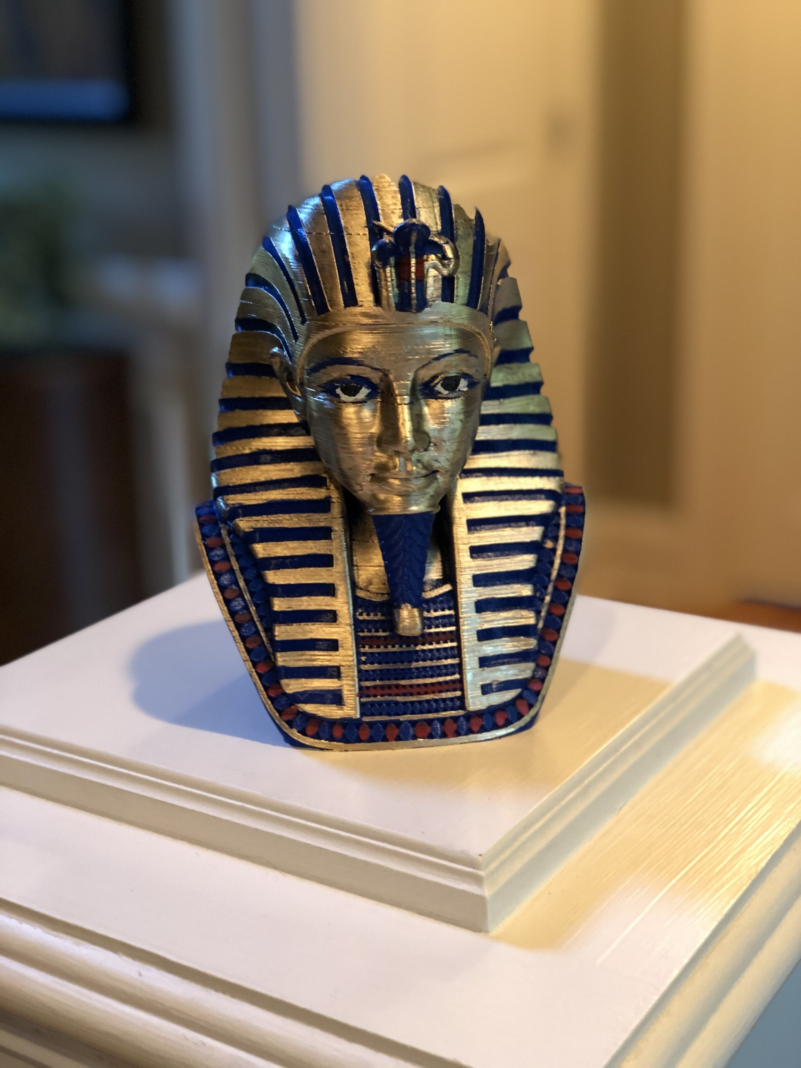
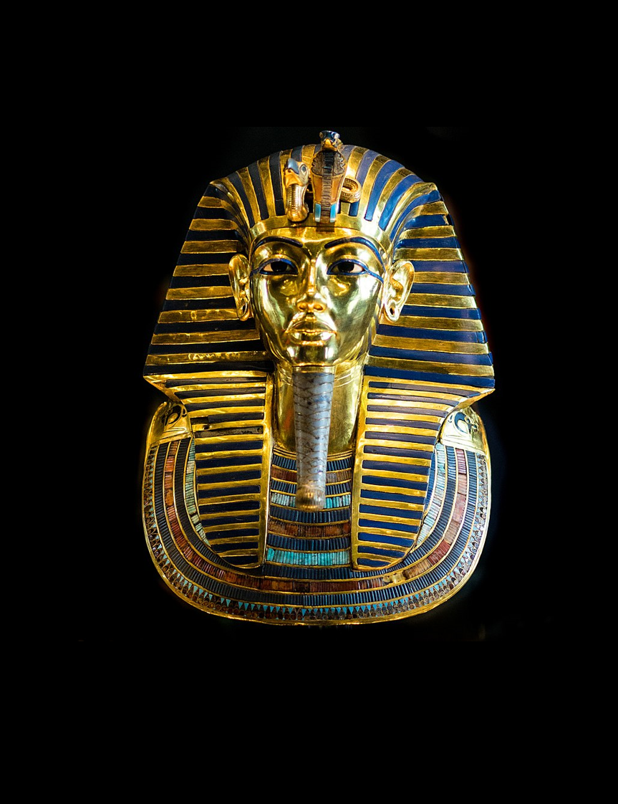
HEBREWS 8
HEAVEN
SON
SON
SON
GOD
SON
GOD
GOD
SON
SON
MELCHIZEDEK
KING
PRIEST
GOD
SON
MAN
MAN
AARON
TITHE
MAN
MAN
BLESSING
MAN
TABERNACLE
ABRAHAM
Earthly
Heavenly
LEVI
LEVI
LEVI
LEVI
Shadow
True
ISAAC
BULL
Man Pitched
Lord pitched
SON
COVENANT
PROMISES
Copy
Pattern
COVENANT
PROMISES
LAND
NATION
SEED
MAN
MAN
MAN
SON
EARTH
MAN
MAN

Slide 17
HEBREWS 8
HEAVEN
SON
SON
SON
GOD
SON
GOD
GOD
SON
Jeremiah 31
SON
MELCHIZEDEK
KING
PRIEST
⁷ For if that first covenant had been faultless, there would have been no occasion sought for a second.
⁶But now He has obtained a more excellent ministry, by as much as He is also the mediator of a better covenant, which has been enacted on better promises.
GOD
Not like the covenant which I made with their fathers
SON
MAN
MAN
AARON
TITHE
⁸ For finding fault with them, He says,
“Behold, days are coming, says the Lord, When I will effect a new covenant…
MAN
MAN
BLESSING
(Stone)
Hearts & Minds
MAN
TABERNACLE
ABRAHAM
(Broken)
God & People
LEVI
LEVI
LEVI
LEVI
¹³ When He said, “A new covenant,” He has made the first obsolete. But whatever is becoming obsolete and growing old is ready to disappear.
(Ignorance)
All will know Me
(No Forgiveness)
Forgiveness of Sin
ISAAC
BULL
SON
COVENANT
PROMISES
COVENANT
PROMISES
LAND
NATION
SEED
MAN
MAN
MAN
SON
EARTH
MAN
MAN

Slide 18
HEBREWS 9
HEAVEN
SON
SON
SON
GOD
SON
GOD
GOD
SON
SON
¹¹ But when Christ appeared as a high priest of the good things to come…
MELCHIZEDEK
KING
PRIEST
GOD
SON
MAN
MAN
AARON
TITHE
Outer Tabernacle
True Tabernacle
MAN
MAN
BLESSING
MAN
TABERNACLE
Blood of Animals
His Own Blood
ABRAHAM
⁸ The Holy Spirit is signifying this, that the way into the holy place has not yet been disclosed while the outer tabernacle is still standing, ⁹ which is a symbol for the present time.
LEVI
LEVI
LEVI
LEVI
Continually Enter
Once For All
Cleanse Flesh
Clease Conscience
ISAAC
BULL
Until time of reformation
Eternal Redemption
SON
COVENANT
PROMISES
COVENANT
PROMISES
LAND
NATION
SEED
¹⁴ …to serve the living God?
MAN
MAN
MAN
SON
EARTH
MAN
MAN

Slide 19
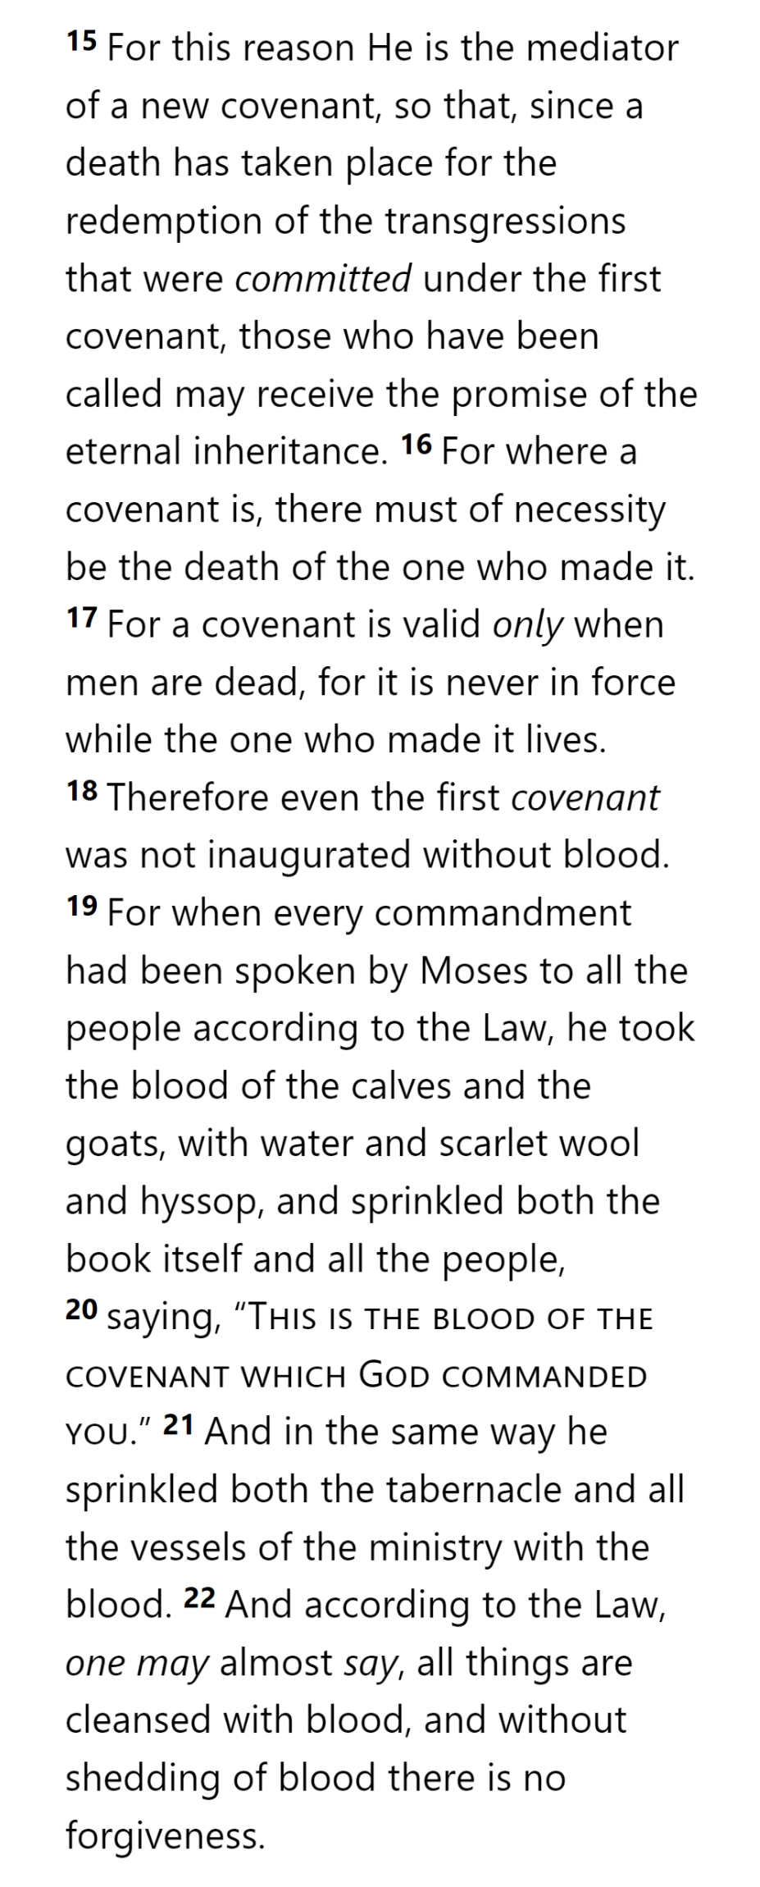
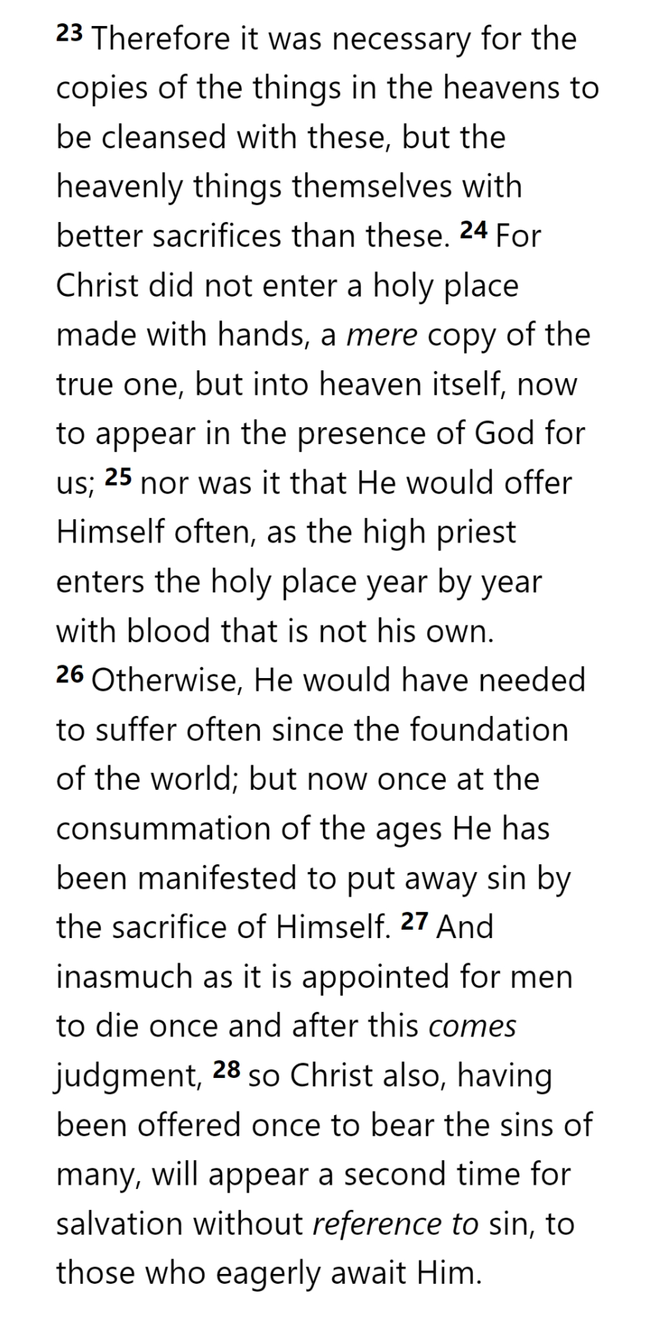
HEAVEN
SON
SON
SON
GOD
SON
GOD
GOD
SON
SON
MELCHIZEDEK
KING
PRIEST
GOD
SON
MAN
MAN
AARON
TITHE
MAN
MAN
BLESSING
MAN
TABERNACLE
ABRAHAM
LEVI
LEVI
LEVI
LEVI
ISAAC
BULL
SON
COVENANT
PROMISES
COVENANT
PROMISES
LAND
NATION
SEED
MAN
MAN
MAN
SON
EARTH
MAN
MAN

Slide 20
HEAVEN
SON
SON
SON
GOD
SON
GOD
GOD
SON
SON
MELCHIZEDEK
KING
PRIEST
GOD
SON
MAN
MAN
AARON
TITHE
MAN
MAN
BLESSING
MAN
TABERNACLE
ABRAHAM
LEVI
LEVI
LEVI
LEVI
ISAAC
BULL
SON
COVENANT
PROMISES
COVENANT
PROMISES
LAND
NATION
SEED
MAN
MAN
MAN
SON
EARTH
MAN
MAN

Slide 21
HEAVEN
SON
SON
SON
GOD
SON
GOD
GOD
SON
SON
MELCHIZEDEK
KING
PRIEST
GOD
SON
MAN
MAN
AARON
TITHE
MAN
MAN
BLESSING
MAN
TABERNACLE
ABRAHAM
LEVI
LEVI
LEVI
LEVI
ISAAC
BULL
SON
COVENANT
PROMISES
COVENANT
PROMISES
LAND
NATION
SEED
MAN
MAN
MAN
SON
EARTH
MAN
MAN

Slide 22
HEAVEN
SON
SON
SON
GOD
SON
GOD
GOD
SON
SON
MELCHIZEDEK
KING
PRIEST
GOD
SON
MAN
MAN
AARON
TITHE
MAN
MAN
BLESSING
MAN
TABERNACLE
ABRAHAM
LEVI
LEVI
LEVI
LEVI
ISAAC
BULL
SON
COVENANT
PROMISES
COVENANT
PROMISES
LAND
NATION
SEED
MAN
MAN
MAN
SON
EARTH
MAN
MAN

Slide 23
HEAVEN
SON
SON
SON
GOD
SON
GOD
GOD
SON
SON
MELCHIZEDEK
KING
PRIEST
GOD
SON
MAN
MAN
AARON
TITHE
MAN
MAN
BLESSING
MAN
TABERNACLE
ABRAHAM
LEVI
LEVI
LEVI
LEVI
ISAAC
BULL
SON
COVENANT
PROMISES
COVENANT
PROMISES
LAND
NATION
SEED
MAN
MAN
MAN
SON
EARTH
MAN
MAN

Slide 24
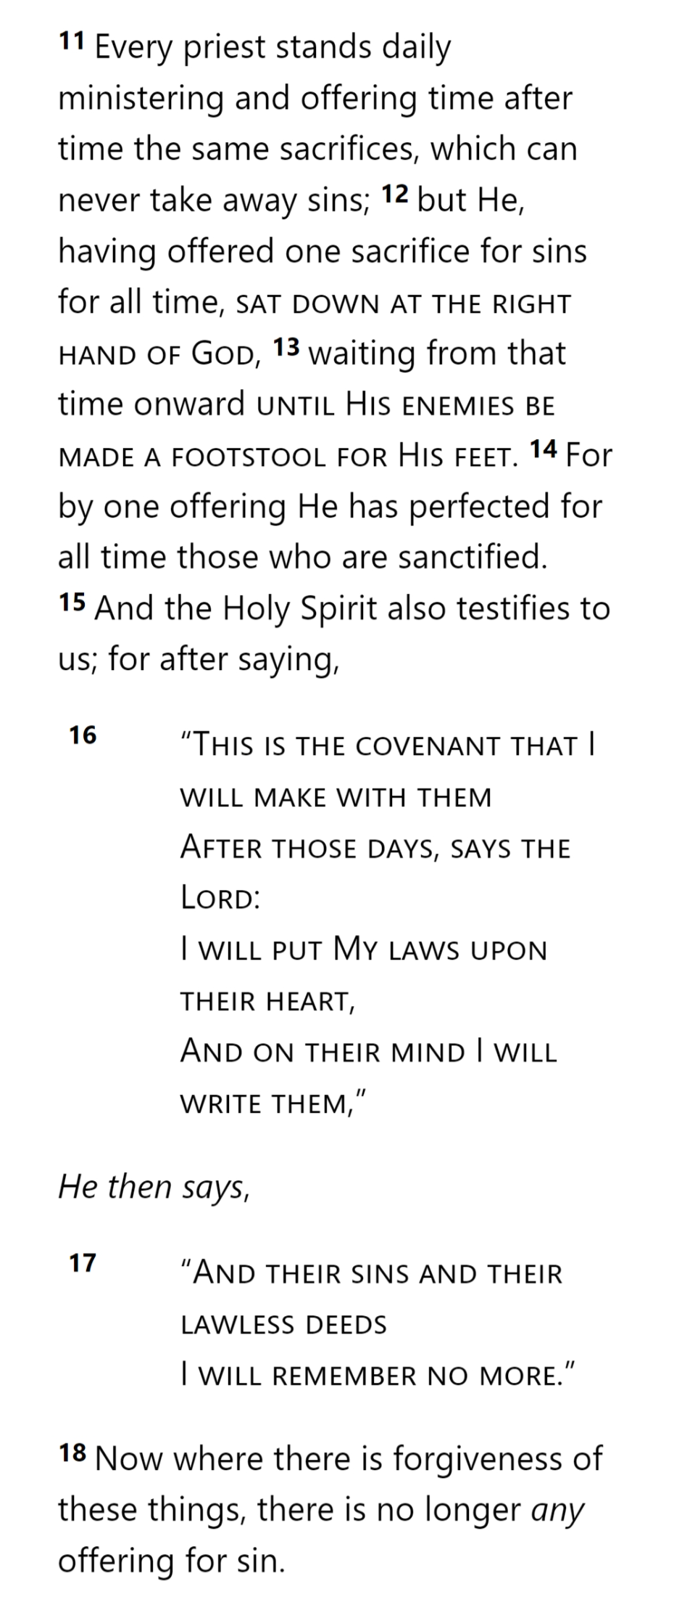
HEAVEN
SON
SON
SON
GOD
SON
GOD
GOD
SON
SON
MELCHIZEDEK
KING
PRIEST
GOD
SON
MAN
MAN
AARON
TITHE
MAN
MAN
BLESSING
MAN
TABERNACLE
ABRAHAM
LEVI
LEVI
LEVI
LEVI
ISAAC
BULL
SON
COVENANT
PROMISES
COVENANT
PROMISES
LAND
NATION
SEED
MAN
MAN
MAN
SON
EARTH
MAN
MAN

Slide 25
HEAVEN
SON
SON
SON
GOD
SON
GOD
GOD
SON
SON
MELCHIZEDEK
KING
PRIEST
GOD
SON
MAN
MAN
AARON
TITHE
MAN
MAN
BLESSING
MAN
TABERNACLE
ABRAHAM
LEVI
LEVI
LEVI
LEVI
ISAAC
BULL
SON
COVENANT
PROMISES
COVENANT
PROMISES
LAND
NATION
SEED
MAN
MAN
MAN
SON
EARTH
MAN
MAN

Slide 26
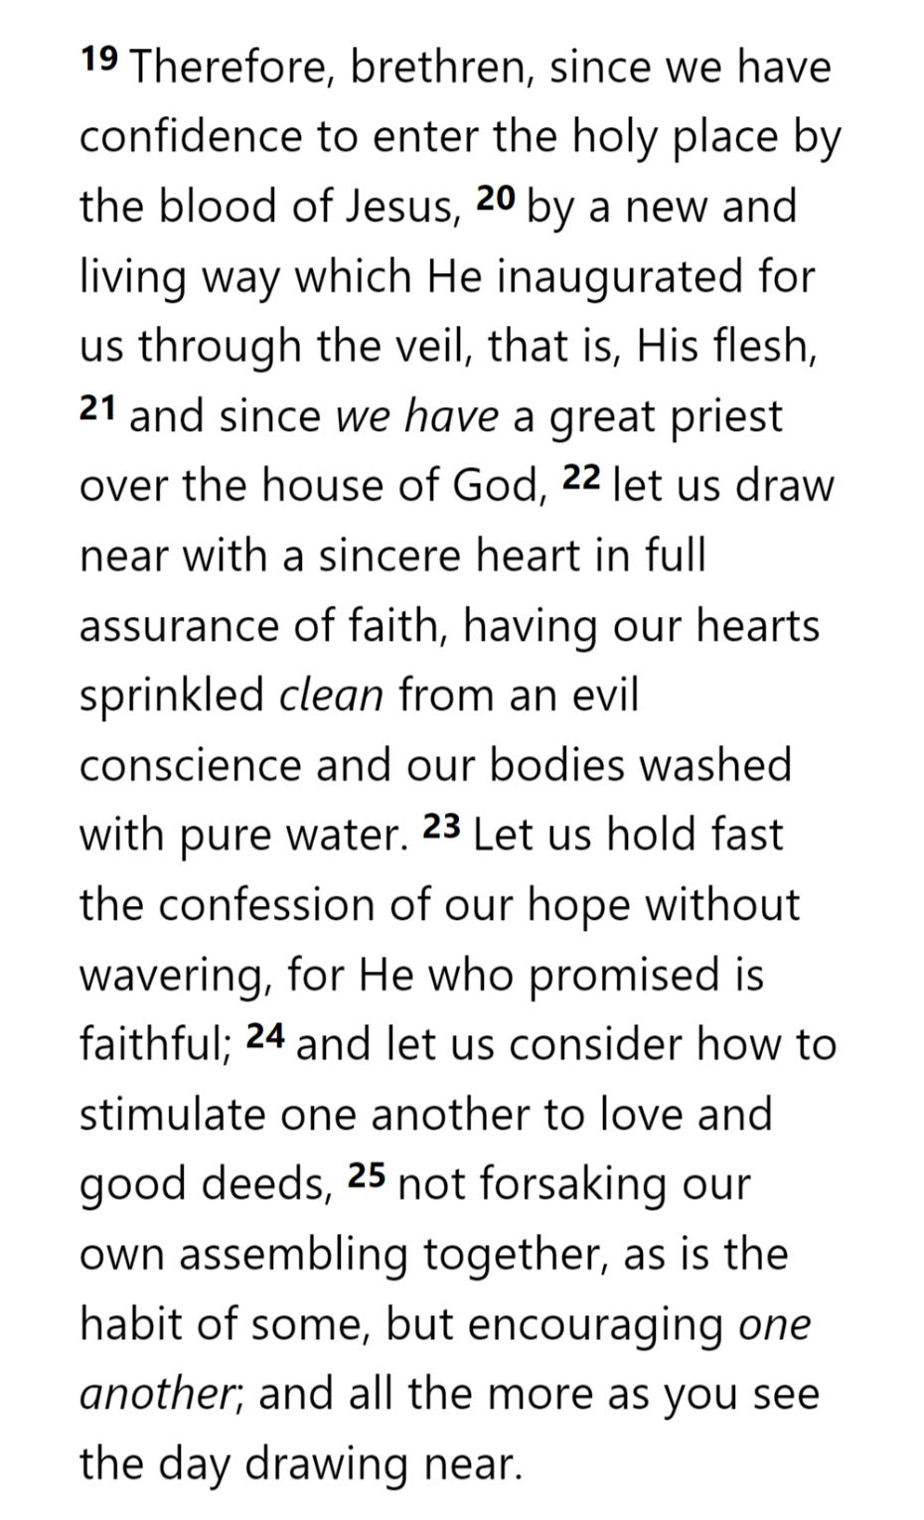
HEAVEN
SON
SON
SON
GOD
SON
GOD
GOD
SON
SON
MELCHIZEDEK
KING
PRIEST
GOD
SON
MAN
MAN
AARON
TITHE
MAN
MAN
BLESSING
MAN
TABERNACLE
ABRAHAM
LEVI
LEVI
LEVI
LEVI
ISAAC
BULL
SON
COVENANT
PROMISES
COVENANT
PROMISES
LAND
NATION
SEED
MAN
MAN
MAN
SON
EARTH
MAN
MAN

Slide 27
HEAVEN
SON
SON
SON
GOD
SON
GOD
GOD
SON
SON
MELCHIZEDEK
KING
PRIEST
GOD
SON
MAN
MAN
AARON
TITHE
MAN
MAN
BLESSING
MAN
TABERNACLE
ABRAHAM
LEVI
LEVI
LEVI
LEVI
ISAAC
BULL
SON
COVENANT
PROMISES
COVENANT
PROMISES
LAND
NATION
SEED
MAN
MAN
MAN
SON
EARTH
MAN
MAN

