Slide 1
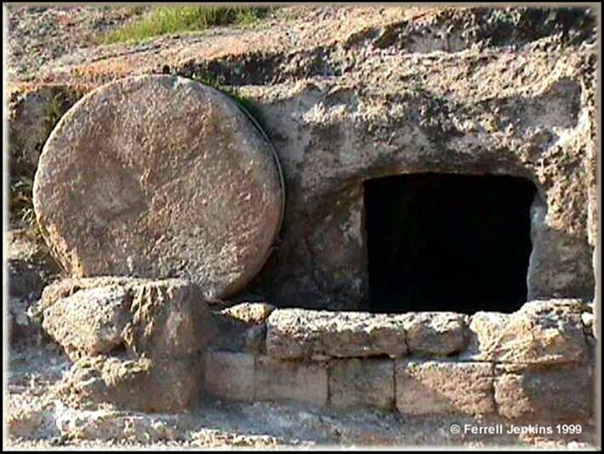
Gospel of Matthew
Lesson 13 - Chapter 28

Slide 2
Darkness, Death & Victory (27:45-50)
The Darkness (vs. 45)
From 6th hour until 9th hour (12:00 pm – 3:00 pm)
Bitterness & Mourning due to Judgement (Amos 8:9-10)
His Death Brings A New Exodus (Death of Firstborn -10th Plague, Preceded by 3 Days of Darkness - 9th Plague Ex. 10:22)
Crying Out (vs. 46-50)
Crying Out Psalm 22 - “Eli Eli lama sabachthani?” “My God, My God, why have You forsaken Me?
Jews Expected Elijah to Return (vs. 49; 2 Kings 2:16; Malachi 4:5)
Looks Bad (Gal. 3:13; 2 Cor. 5:21), But Ends in Victory (Psalm 22:24, 27)
“Loud Cry” (vs. 50; Victory Shout – Not Shallow Breaths)

Slide 3
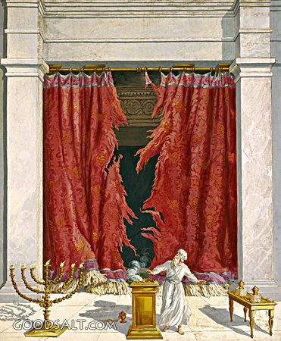
Phenomena at Death (27:51-54)
Phenomena at Death (vs. 51-54)
Torn Veil (vs. 51)
Nature of Curtain
Separated Holy Place from Most Holy Place (Exodus 26:33)
Cherubim Woven Into It (Exodus 26:31; cf. Genesis 3:24)
Barrier Between Man & God Torn Apart
Earth Shook (51)
Shaking at Mt. Sinai (Ex. 20: 18-19)
Prophecy of another “shaking” but of the heavens and earth (Haggai 2:6)
Old Law replaced by an Unshakable Kingdom (Heb. 12:25-29)
- Tombs Opened & Saints Raised After His Resurrection (vs 52-53)
Dramatically illustrated that Christ destroyed death by His death (I Cor. 15:20; Heb 2:14-15)
Confession of Callous Centurion (vs. 54)
Therefore, brethren, since we have confidence to enter the holy place by the blood of Jesus, ²⁰ by a new and living way which He inaugurated for us through the veil, that is, His flesh, ²¹ and since we have a great priest over the house of God, ²² let us draw near with a sincere heart in full assurance of faith, (Heb. 10:19-22)

Slide 4
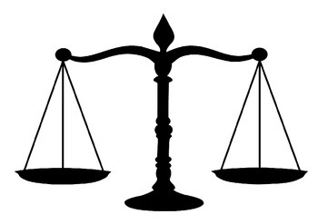
When Jesus Died: “And behold…”(Mt 27:51-53)
Veil of the temple was torn from top to bottom
Earth shook and the rocks were split
Tombs were opened and many bodies of the saints who had fallen asleep were raised
Soldiers reacted –. Now the centurion, and those who were with him keeping guard over Jesus, when they saw the earthquake and the things that were happening, became very frightened and said, “Truly this was the Son of God!”(24:54)
Atonement was complete – If you put sin on one side of a scale, what balances out the other side is Hell, eternal banishment from God. That is justice. God can have no fellowship with darkness and once we sin we are separated from God. God in His infallible sense of justice knew the only thing that would enable Him to show mercy and the scales still be balanced is for Jesus to die
The purchase price for Christ’s Church was paid. We have been bought with the greatest purchasing price ever paid for anything, the blood of Jesus Christ. Eph 5:25-27; I Peter 1:19. The cross is the trysting place where love and justice meet. I John 2:1
SIN
HELL

Slide 5
Burial (27:57-61)
The Women (27:55-56)
Financially Supported Jesus (Luke 8:2-3)
Not Allowed as “Witnesses” or “Disciples” In Ancient World
Joseph of Arimathea
Mentioned in All Four Gospels
Respected Member of Council (Mark 15:43)
Good & Righteous Man; Hadn’t Consented to Jesus’ Death (Luke 23:50-5)
Wealthy Disciple (Matthew 27:57)
“Secret” Disciple (John 19:38)
Asked Pilate for the body and with Nicodemus (Jn. 19:39) prepared His body and laid Him in his own tomb.
Buries Jesus Before Sundown (Had Only Three Hours; cf. Deut. 21:22-23)
And Mary Magdalene was there, and the other Mary, sitting opposite the grave. (vs. 61)
Luke 23:54-56 – It was the preparation day, and the Sabbath was about to begin. ⁵⁵ Now the women who had come with Him out of Galilee followed, and saw the tomb and how His body was laid. ⁵⁶ Then they returned and prepared spices and perfumes. And on the Sabbath they rested according to the commandment
Both Women & Joseph Serving/Investing in the Kingdom – Jesus’ Kingdom brings a new type of community

Slide 6
“All authority has been given to Me in heaven and on earth.”
(Matthew 28:18)
The greatest authority ever claimed.
Perfect description of a king (monarch) with all authority
How did Jesus back up that claim?
Jesus said - If I do not do the works of My Father, do not believe Me; but if I do them, though you do not believe Me, believe the works, (John 10:37-38)
The ultimate miracle is his resurrection. Greater evidence for this miracle than others.
This is the fundamental basis for our faith. It was the cornerstone of apostolic preaching. Everything rests on the factuality of this one event.
Therefore having overlooked the times of ignorance, God is now declaring to men that all people everywhere should repent, ³¹ because He has fixed a day in which He will judge the world in righteousness through a Man whom He has appointed, having furnished proof to all men by raising Him from the dead.” (Acts 17:30-31)

Slide 7
The Resurrection – What if it is not factual? (I Cor 15:12-19)
Now if Christ is preached, that He has been raised from the dead, how do some among you say that there is no resurrection of the dead? ¹³ But if there is no resurrection of the dead, not even Christ has been raised; ¹⁴ and if Christ has not been raised, then our preaching is vain, your faith also is vain. ¹⁵ Moreover we are even found to be false witnesses of God, because we testified against God that He raised Christ, whom He did not raise, if in fact the dead are not raised. ¹⁶ For if the dead are not raised, not even Christ has been raised; ¹⁷ and if Christ has not been raised, your faith is worthless; you are still in your sins. ¹⁸ Then those also who have fallen asleep in Christ have perished. ¹⁹ If we have hoped in Christ in this life only, we are of all men most to be pitied.
Christianity is unique among the religions of the world because its validity rests on the historicity of this one claim that Jesus rose from the dead.

Slide 8
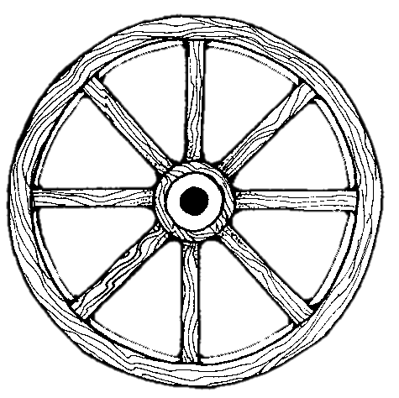
Resurrection is at the Heart and Core of all we believe (I Cor. 15:14-18)
All assaults on our faith must be filtered through this reality.
We must be absolutely convicted of this one fact, that the tomb was empty because Jesus was resurrected.
Christ’s Work
Christ’s Deity
Preaching
Res. Of
Christ
Our Hope
Our Faith
Hope for the dead
Evangelism
Rem. of Sins

Slide 9
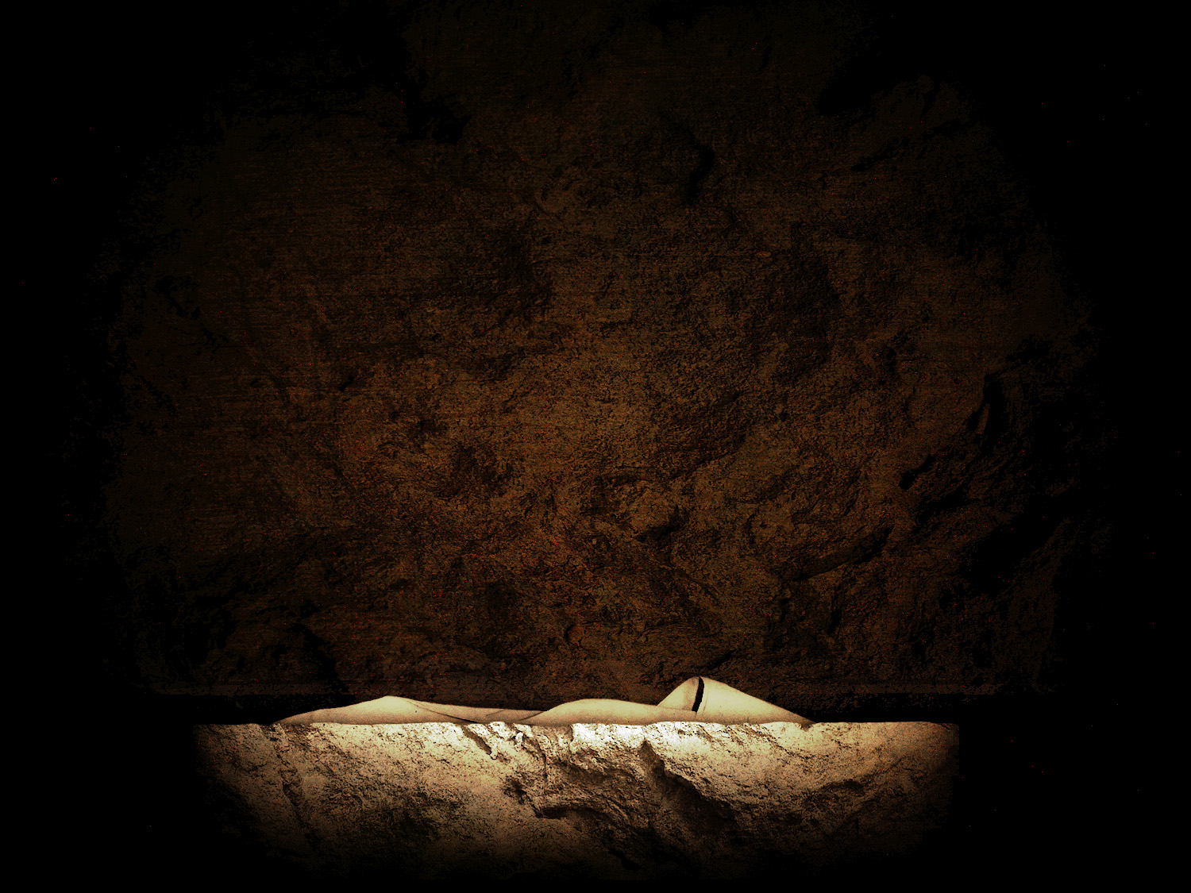
The Empty Tomb - Foretold
Then some of the scribes and Pharisees said to Him, “Teacher, we want to see a sign from You.” ³⁹ But He answered and said to them, “An evil and adulterous generation craves for a sign; and yet no sign will be given to it but the sign of Jonah the prophet; ⁴⁰ for just as Jonah was three days and three nights in the belly of the sea monster, so will the Son of Man be three days and three nights in the heart of the earth. Matthew 12:38–40
9

Slide 10
The Empty Tomb - Precautions
Now on the next day, the day after the preparation, the chief priests and the Pharisees gathered together with Pilate, ⁶³ and said, “Sir, we remember that when He was still alive that deceiver said, ‘After three days I am to rise again.’ ⁶⁴ “Therefore, give orders for the grave to be made secure until the third day, otherwise His disciples may come and steal Him away and say to the people, ‘He has risen from the dead,’ and the last deception will be worse than the first.” ⁶⁵ Pilate said to them, “You have a guard; go, make it as secure as you know how.” ⁶⁶ And they went and made the grave secure, and along with the guard they set a seal on the stone.
Matthew 27:62–64
Notes:
The Jewish leaders to some level understood what he had said so they tried to prevent the theft of his body. Somehow the disciples didn’t understand it.
The first fraud would be Jesus’ Messianic claim, the last a faked resurrection.

Slide 11
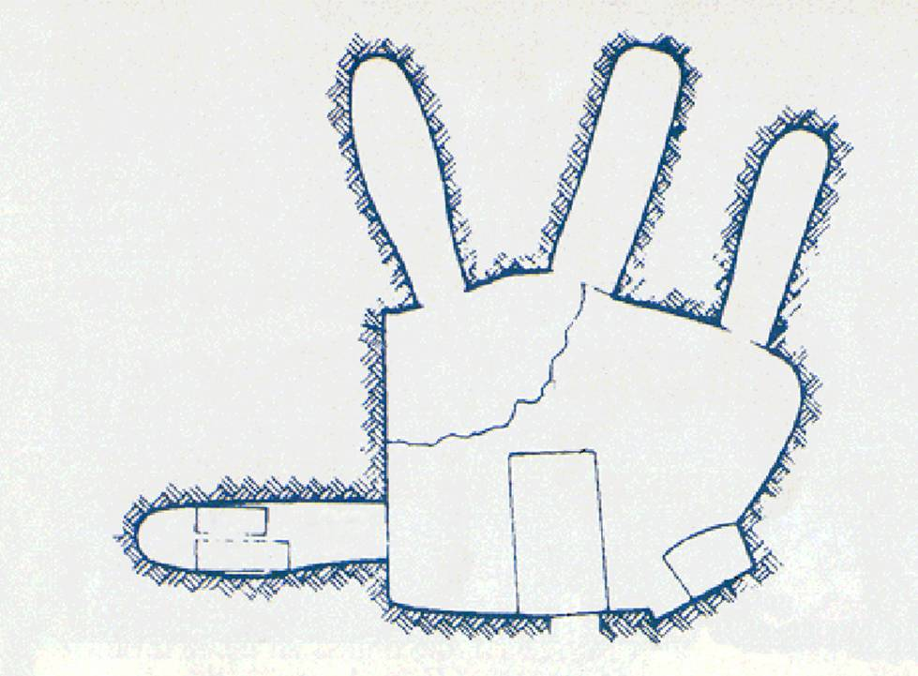
First Century
Tomb

Slide 12
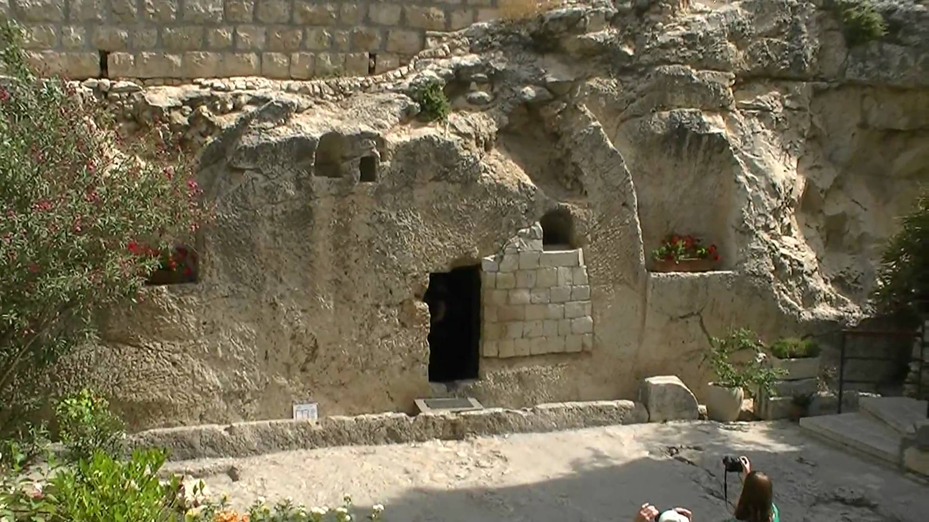
“Laid In A New Tomb” - Mt 27:57-61
Cut out of solid rock
One way in or out
No chance for escape
First Century Garden Tomb in Jerusalem

Slide 13
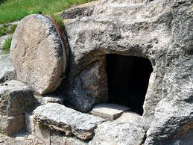
Stone Door
About a ton
No escape
Women worried about who would help them - Mk 15:46
Notes:
One of the reasons why there was no chance of escape is the stone that was fashioned into a wheel was too heavy to move

Slide 14
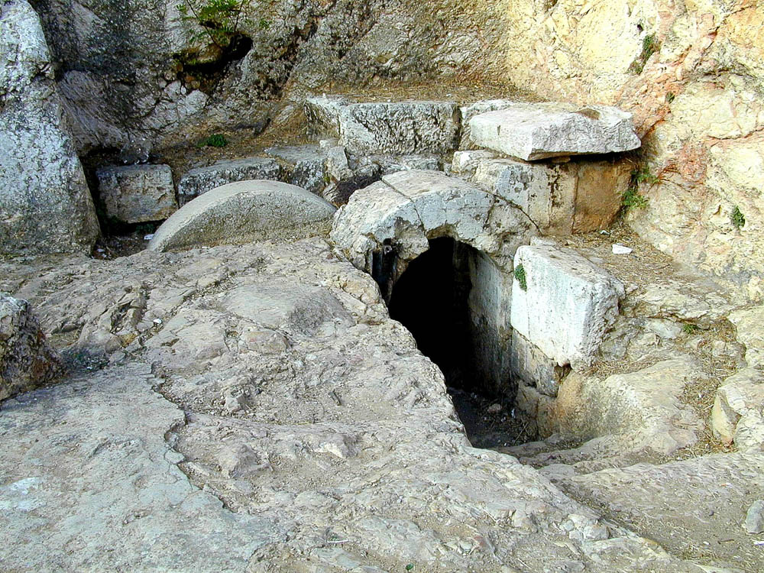
28:2
Notes:
This tomb is located in the western cemetery of Jerusalem, not far from the King David Hotel. Though identified last century with the family tomb of Herod because of its fine qualities, it almost certainly is not. It does provide a fine image of what a tomb looks like when the rolling stone has been rolled away.
tb061800201

Slide 15
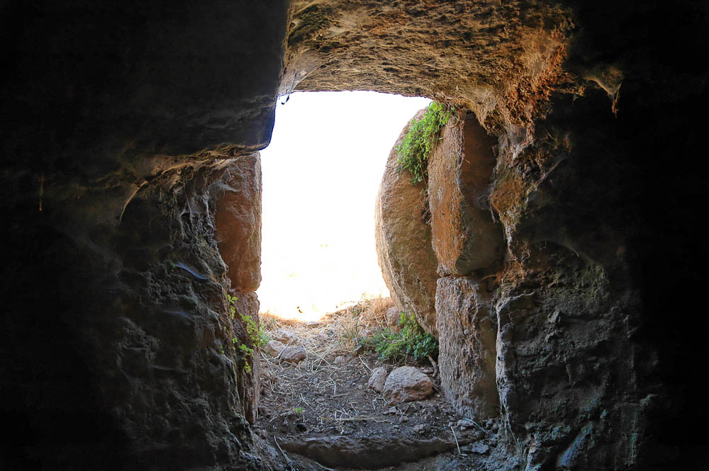
Rolling stone from inside the tomb at Tell Hesban
Notes:
tb061304085

Slide 16
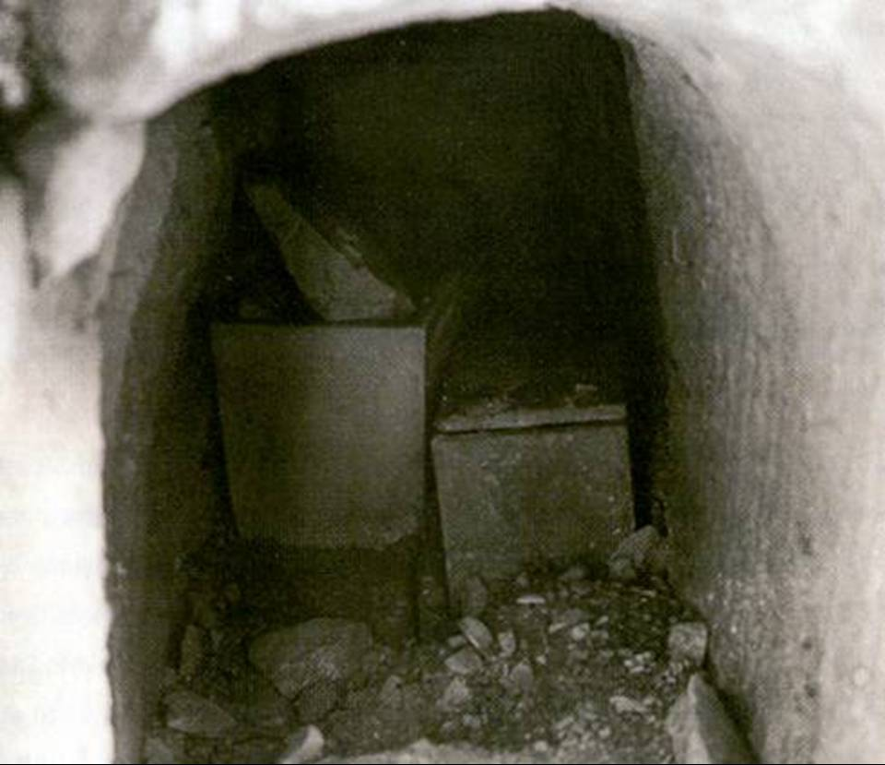
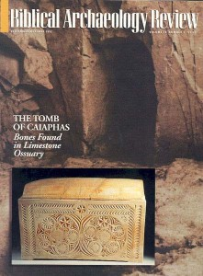
Discovered in 1990 south of Jerusalem by workers widening a road.

Slide 17
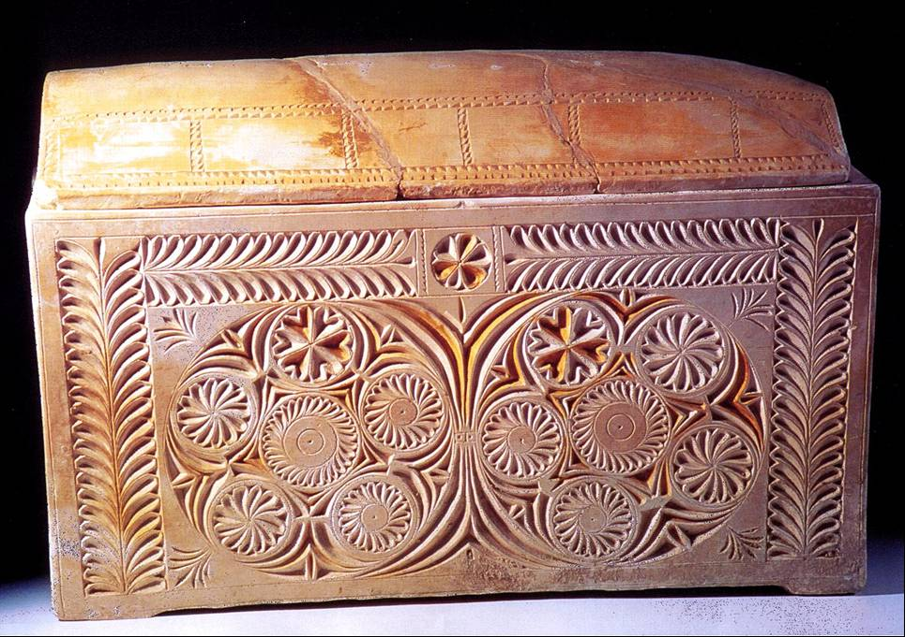
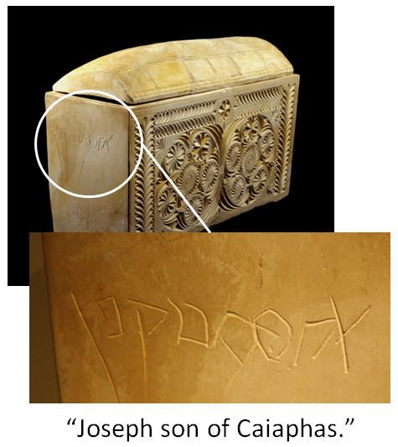
Joseph, son of Caiaphas, commonly known as "Caiaphas" in the New Testament, was the Roman-appointed Jewish high priest of the Jerusalem temple from 18 to 36 C.E. Caiaphas was mentioned in the New Testament and by the historian Josephus Flavius: "… Gratus deprived him of it, and gave the high priesthood to Simon, the son of Camithus; and when he had possessed that dignity no longer than a year Joseph Caiaphas was made his successor. When Gratus had done those things, he went back to Rome, after he had tarried in Judea eleven years, when Pontius Pilate came as his successor." (Ant.XVIII.33–35) Josephus refers to Caiaphas as "Joseph who was called Caiaphas of the high priesthood" (Ant.XVIII.95).

Slide 18
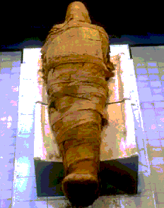
Burial Preparation
About 100 lbs of myrrh & Aloes – John 19:39
Bound in linen - John 19:40
Head napkin detail (Jn 20:7)
Bound in a resin (myrrh)
No “escape”
Difficult to remove
³⁹ Nicodemus, who had first come to Him by night, also came, bringing a mixture of myrrh and aloes, about a hundred pounds weight. ⁴⁰ So they took the body of Jesus and bound it in linen wrappings with the spices, as is the burial custom of the Jews. (John 19:39-40)

Slide 19
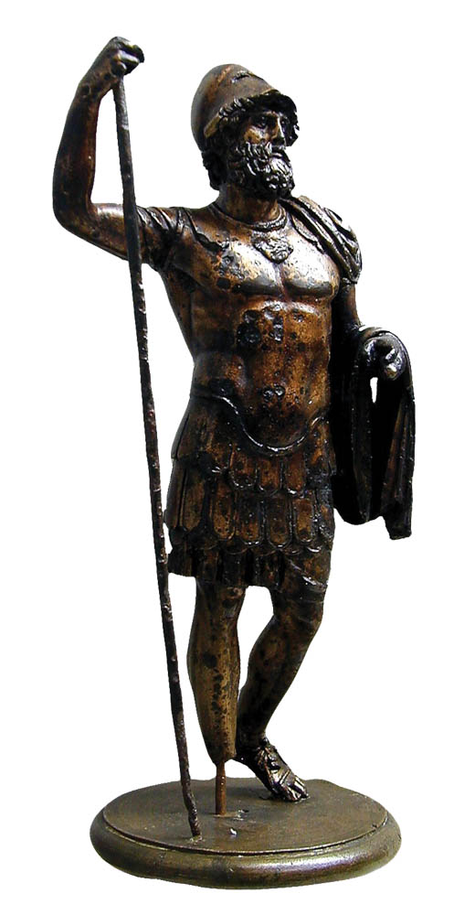
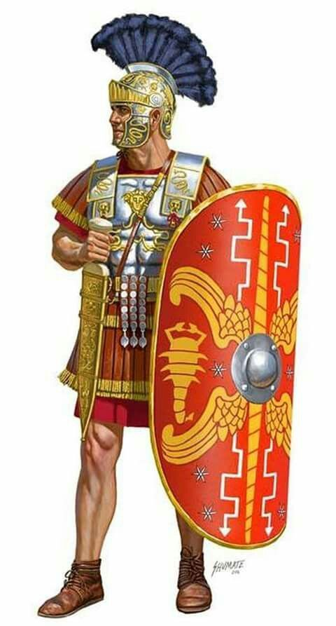
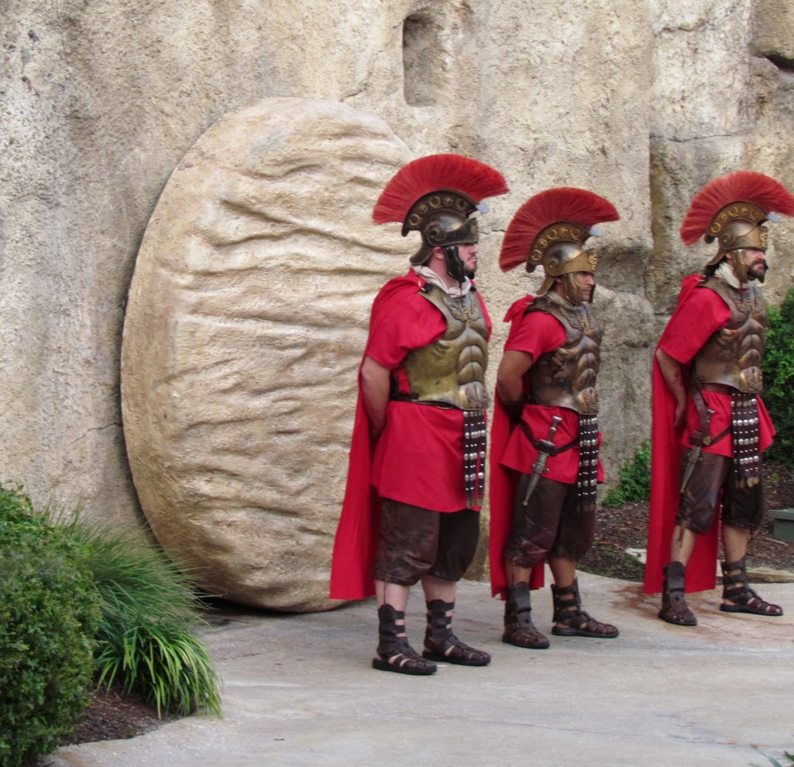
Guards
highly trained and disciplined guards (cf Acts 12:4)
Round the clock shifts
Consequences for failure
Note: May have been Jewish guards instead of Roman.

Slide 20
Matthew 28:1-7
Now after the Sabbath, as it began to dawn toward the first day of the week, Mary Magdalene and the other Mary came to look at the grave.
All agree that it was on “the ﬁrst day of the week” that the women came “very early in the morning” (Luke 24:1), “while it was still dark” (John 20:1), probably arriving “when the sun had risen” (Mark 16:2)
“Mary, the mother of James and Joseph” (27:56). Mark informs us that Salome, the mother of James and John was with them (Mark 16:1), while Luke adds that Joanna, and “other women” were also present (Luke 24:10)
Mark explains that the purpose of their visit was to bring spices to anoint Jesus’ body (Mark 16:1).
The two Mary's (and possibly some of these same women) watched while Joseph and Nicodemus had buried Jesus (27:59-61; John 19:38-40). They saw “how his body was laid” (Luke 23:55), and “where he was laid” (Mark 15:47).
Notes:
Did these women know where the body had been laid?
As we learned in the previous chapter the two Marys (and possibly some of these same women) watched while Joseph and Nicodemus had buried Jesus (27:61; John 19:38-40). They saw “how his body was laid” (Luke 23:55), and “where he was laid” (Mark 15:47). The onset of the Sabbath day had prevented the women from making the ﬁnal preparations of Jesus’ body, but they had prepared the “spices and fragrant oils” customarily used for burial before resting on the Sabbath (Luke 23:56a).
28 Now after the Sabbath, as it began to dawn toward the first day of the week, Mary Magdalene and the other Mary came to look at the grave. ² And behold, a severe earthquake had occurred, for an angel of the Lord descended from heaven and came and rolled away the stone and sat upon it. ³ And his appearance was like lightning, and his clothing as white as snow. ⁴ The guards shook for fear of him and became like dead men. ⁵ The angel said to the women, “Do not be afraid; for I know that you are looking for Jesus who has been crucified. ⁶ He is not here, for He has risen, just as He said. Come, see the place where He was lying. ⁷ Go quickly and tell His disciples that He has risen from the dead; and behold, He is going ahead of you into Galilee, there you will see Him; behold, I have told you.”
⁸ And they left the tomb quickly with fear and great joy and ran to report it to His disciples. ⁹ And behold, Jesus met them and greeted them. And they came up and took hold of His feet and worshiped Him. ¹⁰ Then Jesus *said to them, “Do not be afraid; go and take word to My brethren to leave for Galilee, and there they will see Me.”
¹¹ Now while they were on their way, some of the guard came into the city and reported to the chief priests all that had happened. ¹² And when they had assembled with the elders and consulted together, they gave a large sum of money to the soldiers, ¹³ and said, “You are to say, ‘His disciples came by night and stole Him away while we were asleep.’ ¹⁴ And if this should come to the governor’s ears, we will win him over and keep you out of trouble.” ¹⁵ And they took the money and did as they had been instructed; and this story was widely spread among the Jews, and is to this day.
The Great Commission
¹⁶ But the eleven disciples proceeded to Galilee, to the mountain which Jesus had designated. ¹⁷ When they saw Him, they worshiped Him; but some were doubtful. ¹⁸ And Jesus came up and spoke to them, saying, “All authority has been given to Me in heaven and on earth. ¹⁹ Go therefore and make disciples of all the nations, baptizing them in the name of the Father and the Son and the Holy Spirit, ²⁰ teaching them to observe all that I commanded you; and lo, I am with you always, even to the end of the age.”

Slide 21
Matthew 28:1-7
Now after the Sabbath, as it began to dawn toward the first day of the week, Mary Magdalene and the other Mary came to look at the grave. ² And behold, a severe earthquake had occurred, for an angel of the Lord descended from heaven and came and rolled away the stone and sat upon it. ³ And his appearance was like lightning, and his clothing as white as snow. ⁴ The guards shook for fear of him and became like dead men.

Slide 22
Matthew 28:1-7
Now after the Sabbath, as it began to dawn toward the first day of the week, Mary Magdalene and the other Mary came to look at the grave. ² And behold, a severe earthquake had occurred, for an angel of the Lord descended from heaven and came and rolled away the stone and sat upon it. ³ And his appearance was like lightning, and his clothing as white as snow. ⁴ The guards shook for fear of him and became like dead men. ⁵ The angel said to the women, “Do not be afraid; for I know that you are looking for Jesus who has been crucified. ⁶ He is not here, for He has risen, just as He said. Come, see the place where He was lying. ⁷ Go quickly and tell His disciples that He has risen from the dead; and behold, He is going ahead of you into Galilee, there you will see Him; behold, I have told you.”
Luke records that the angel quoted Jesus to say, “The Son of Man must be delivered into the hands of sinful men, and be cruciﬁed, and the third day rise again” (Luke 24:7)
The prominence of women in the story of Jesus

Slide 23
Matthew 28:8-10
And they left the tomb quickly with fear and great joy and ran to report it to His disciples. ⁹ And behold, Jesus met them and greeted them. And they came up and took hold of His feet and worshiped Him. ¹⁰ Then Jesus said to them, “Do not be afraid; go and take word to My brethren to leave for Galilee, and there they will see Me.”
It is a powerful evidence of the reliability of the biblical record of the resurrection that the word of women is the ﬁrst testimony offered.
Heb. 2:9 – they forsook and failed Jesus, yet he calls them his brethren

Slide 24
Matthew 28:11-15
¹¹ Now while they were on their way, some of the guard came into the city and reported to the chief priests all that had happened. ¹² And when they had assembled with the elders and consulted together, they gave a large sum of money to the soldiers, ¹³ and said, “You are to say, ‘His disciples came by night and stole Him away while we were asleep.’ ¹⁴ And if this should come to the governor’s ears, we will win him over and keep you out of trouble.” ¹⁵ And they took the money and did as they had been instructed; and this story was widely spread among the Jews, and is to this day.
Those who had plotted Jesus’ death are now confronted with the truth of his resurrection from eyewitnesses, and commit fraud in order to conceal its reality.

Slide 25
Dialogue With Trypho
c. AD 165
“You have sent chosen and ordained men throughout all the world to proclaim that a godless and lawless heresy had sprung from one Jesus, a Galilean deceiver, whom we crucified, but his disciples stole him by night from the tomb where he was laid when unfastened from the cross, and now deceive men by asserting that he has risen from the dead and ascended to heaven.” (Dialogue 108)
Why is this an absurd claim?

Slide 26
Stolen Body Theory
Disciples stole it
Consider the fear and mental state of the disciples
How could they without waking the guards? (how did the guards know who stole the body if they were asleep?)
Transformation of disciples from fear and doubt to boldness
Why give your lives for a lie?
The fact that neither the guards or the “grave robbers” were punished for their crimes demonstrates the implausibility of this false claim.

Slide 27
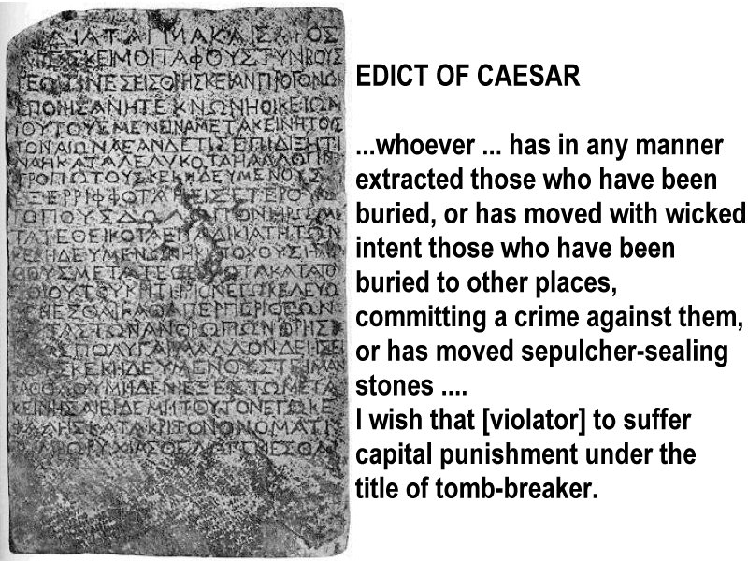
The Nazareth Inscription – marble inscription believed to date to the first century

Slide 28
Stolen Body Theory
Enemies stole it (Jewish/Roman authorities)
What motive would they have? They asked for guards to prevent it.
Could have produced the dead body and destroyed “Christianity”
Neither explains the conversion of Paul & James
Jesus’ brothers did not believe in him (John 7:3-5)
Paul persecuted Christians
Why the radical alteration of character in both men?
What was Paul’s motive? Look at the physical consequences of his faith. (2 Cor. 11:23-27; Phil 3:5-10)

Slide 29
Facts To Be Accounted For
Jesus actually lived
Death by Roman cross
Buried according to Jewish custom
known, new grave site, anyone could go see it
Tomb believed empty by both friend and foe, Jew and Roman
many eyewitnesses of Jesus alive!
Even skeptics believed (James, brother of Jesus, Paul)
Guards remained
Disciples preached a real resurrection . . .
. . . even to the point of death!
Church quickly began in Jerusalem
Sunday became day of worship
Notes:
33

Slide 30
I Corinthians 15
²⁰ But now Christ has been raised from the dead, the first fruits of those who are asleep²³ But each in his own order: Christ the first fruits, after that those who are Christ’s at His coming,… ²⁴ then comes the end, when He hands over the kingdom to the God and Father, when He has abolished all rule and all authority and power.
⁵¹ Behold, I tell you a mystery; we will not all sleep, but we will all be changed, ⁵² in a moment, in the twinkling of an eye, at the last trumpet; for the trumpet will sound, and the dead will be raised imperishable, and we will be changed. ⁵³ For this perishable must put on the imperishable, and this mortal must put on immortality. ⁵⁴ But when this perishable will have put on the imperishable, and this mortal will have put on immortality, then will come about the saying that is written, “Death is swallowed up in victory. ⁵⁵ O death, where is your victory? O death, where is your sting?” ⁵⁶ The sting of death is sin, and the power of sin is the law; ⁵⁷ but thanks be to God, who gives us the victory through our Lord Jesus Christ. ⁵⁸ Therefore, my beloved brethren, be steadfast, immovable, always abounding in the work of the Lord, knowing that your toil is not in vain in the Lord.

Slide 31
Matthew 28:16-20
But the eleven disciples proceeded to Galilee, to the mountain which Jesus had designated. ¹⁷ When they saw Him, they worshiped Him; but some were doubtful. ¹⁸ And Jesus came up and spoke to them, saying,
Matthew is aware that the Eleven had already seen Christ in Jerusalem, when their doubts were removed. The “some” presupposes a larger gathering than the Eleven only”. Could be the time Jesus appeared to “over five hundred at once” (I Cor 15:6)

Slide 32
“The Great Commission”
“exousia” - “the power of rule or government” - His rule is not limited.
“All authority has been given to Me in heaven and on earth. ¹⁹ Go therefore and make disciples of all the nations, baptizing them in the name of the Father and the Son and the Holy Spirit, ²⁰ teaching them to observe all that I commanded you; and lo, I am with you always, even to the end of the age.”
“Disciple” = Learner, Follower
“Preach the gospel” - Mk 16:15
Satan offered him ‘all the kingdoms of the world and the glory of them; now, by the way of suffering obedience, he has received far more than Satan could offer, all authority in heaven and on earth.

Slide 33
What is this “Gospel”?
Now I make known to you, brethren, the gospel which I preached to you, which also you received, in which also you stand, ² by which also you are saved, if you hold fast the word which I preached to you, unless you believed in vain. ³ For I delivered to you as of first importance what I also received, that Christ died for our sins according to the Scriptures, ⁴ and that He was buried, and that He was raised on the third day according to the Scriptures, ⁵ and that He appeared… (1 Cor. 15:1-4)
“…declared to be the Son of God with power… by the resurrection from the dead” (Romans 1:4)

Slide 34
“The Great Commission”
“All authority has been given to Me in heaven and on earth. ¹⁹ Go therefore and make disciples of all the nations, baptizing them in the name of the Father and the Son and the Holy Spirit, ²⁰ teaching them to observe all that I commanded you; and lo, I am with you always, even to the end of the age.”

Slide 35
Promise to Abraham fulfilled through Jesus Christ
Matthew 28:19 "Go therefore and make disciples of all the nations, baptizing them in the name of the Father and the Son and the Holy Spirit,
Genesis 22:18 "And in your seed all the nations of the earth shall be blessed . . .”
Matthew 1:1 The book of the genealogy of Jesus Christ, the son of David, the son of Abraham.

Slide 36
Making Disciples
Convincing a prospect that a certain teacher or university is best for him is not enough to make him a student.
Two things are necessary:
-- Formal enrollment
-- Instruction
These are necessary to be disciples of Jesus – Note what this involves.

Slide 37
Enrollment Plus Instruction
Go therefore and make disciples of all the nations, baptizing them in the name of the Father and of the Son and of the Holy Spirit, teaching them to observe all things that I have commanded you;”
Enrollment + Instruction

Slide 38
“The Great Commission”
The Promise
“All authority has been given to Me in heaven and on earth. ¹⁹ Go therefore and make disciples of all the nations, baptizing them in the name of the Father and the Son and the Holy Spirit, ²⁰ teaching them to observe all that I commanded you; and lo, I am with you always, even to the end of the age.”
Bookends with 1:23 - and they shall call His name Immanuel,” which translated means, “God with us.
The Greatest Authority ever claimed.
The Greatest Challenge ever issued.
The Widest Area ever envisioned
The Simplest Method to be employed
The Wisest message ever proclaimed
The Greatest assurance ever offered

