Slide 1
The People Who Walked in Darkness Have Seen a Great Light (Isaiah 9:2)
Embry Hills – Jan 2023

Slide 2
The People…Have Seen a Great LIght
Geography, History, Characters, Context
Signs and Sons
Response and Consequences
Darkness & Light
Take-aways

Slide 3
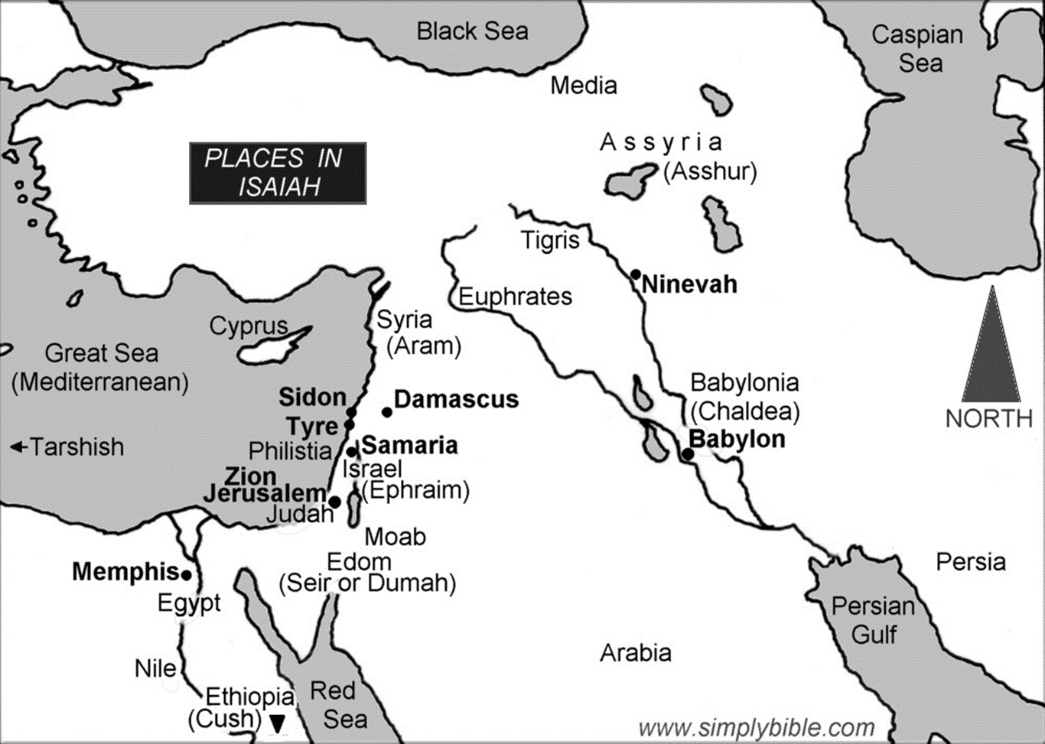
National Powers in Isaiah’s Time

Slide 4
Historical Timeline
Assyrian Captivity
Israel (Northern)
Israel (United Kingdom)
Return
Judah (Southern)
Babylonian Captivity
= Isaiah (starts in 740 BC)

Slide 5
Characters
Isaiah – Prophet called by God (see Is 6)
Ahaz – Bad King of Judah (Jerusalem, House of David) (735 – 728 BC)
Pekah – King of Israel (Samaria, Ephraim), Son of Remaliah (740 – 730 BC)
Rezin – King of Syria (Aram, Damascus)
Tiglath-Pileser – King of Assyria (744 – 727 BC)
Shalmaneser – King of Assyria (726 – 722 BC)
Sennacherib – King of Assyria (704 – 681 BC)

Slide 6
The Immediate Circumstance
734-732 BC - Assyria is a threat to Palestine and Syria
Syria and Israel (North) join together against Assyria
Rezin & Pekah try to depose Ahaz (II Kgs 16:5; Is 7:6)
Ahaz, a bad king in Judah, is under attack/threatened

Slide 7
Isaiah Context
Chap 1-5 – General Condemnation Jerusalem
Chap 6 – Vision of Jehovah, Call of Isaiah
Chap 7-12 – Ahaz Incident (with Prophecies)

Slide 8
The People…Have Seen a Great LIght
Geography, History, Characters, Context
Signs and Sons
Response and Consequences
Darkness & Light
Take-aways

Slide 9
Isaiah’s Emphasis on Signs
Dt 18:21-22 – Evidence of God’s true prophet
And if you say in your heart, ‘How shall we know the word which the Lord has not spoken?’— ²² when a prophet speaks in the name of the Lord, if the thing does not happen or come to pass, that is the thing which the Lord has not spoken; the prophet has spoken it presumptuously; you shall not be afraid of him.
Is 7:11 – Ahaz told to ask for a [difficult] sign, but won’t
“Ask a sign for yourself from the Lord your God; ask it either in the depth or in the height above.” ¹² But Ahaz said, “I will not ask, nor will I test the Lord!”
Is 7:14 – God to give a sign
Therefore the Lord Himself will give you a sign…
Is 8:18 – Isaiah’s children are signs (see Heb 2:13)
Here am I and the children whom the Lord has given me! We are for signs and wonders in Israel

Slide 10
Signs and Sons
A Remnant Shall Return
7:3 Then the Lord said to Isaiah, “Go out now to meet Ahaz, you and Shear-Jashub your son, at the end of the aqueduct from the upper pool, on the highway to the Fuller’s Field…”
7:14 Therefore the Lord Himself will give you a sign: Behold, the [a] virgin shall conceive and bear a Son, and shall call His name Immanuel.
7:16 For before the [a*] Child shall know to refuse the evil and choose the good, the land that you dread will be forsaken by both her kings.
God With Us
הָעַלְמָ֗ה hā-‘al-māh
הַנַּ֔עַר han-na-‘ar
*See, for example, Num 11:27

Slide 11
New Testament Connections
7:14 A virgin conceives: the sign of “God-with-us”
Behold, the virgin shall be with child, and bear a Son, and they shall call His name Immanuel, which is translated, “God with us.” (Mat 1:23)
8:14 God to be both a sanctuary and a stumbling block
“Behold, this Child is destined for the fall and rising of many in Israel, and for a sign which will be spoken against … that the thoughts of many hearts may be revealed.” (Lk 2:34-35, & Rom 9:33; I Pet 2:8)
Notes:
Luke 2:34 – the presentation before Simeon

Slide 12
Signs and Sons
Speed the Spoil, Hasten the Booty
8:3 Then I went to the prophetess, and she conceived and bore a son. Then the Lord said to me, “Call his name Maher-Shalal-Hash-Baz; ⁴ for before the child shall have knowledge to cry ‘My father’ and ‘My mother,’ the riches of Damascus and the spoil of Samaria will be taken away before the king of Assyria.”

Slide 13
The People…Have Seen a Great LIght
Geography, History, Characters, Context
Signs and Sons
Response and Consequences
Darkness & Light
Take-aways

Slide 14
The Response of Ahaz & the Nation
734-732 BC - Assyria is a threat to Palestine and Syria
Syria and Israel (North) join together against Assyria
Rezin & Pekah try to depose Ahaz (II Kgs 16:5; Is 7:6)
Ahaz, a bad king in Judah, is under attack/threatened
Ahaz tries an alliance (bribe) with Assyria (II Kgs16:7-9)
Ahaz meets with Tiglath-Pileser in Damascus (II Kgs 16:10)
Ahaz copies the altar at Damascus (II Kgs 16:10-18)

Slide 15
Consequences (Isaiah 7:17; 8:7-8)
^{7:17} The Lord will bring the king of Assyria upon you and your people and your father’s house—days that have not come since the day that Ephraim departed from Judah…
^{8:7} Now therefore, behold, the Lord brings up over them
The waters of the River [Euphrates], strong and mighty—
The king of Assyria and all his glory;
He will go up over all his channels and go over all his banks.
⁸ He will pass through Judah,
He will overflow and pass over,
He will reach up to the neck;
And the stretching out of his wings
Will fill the breadth of Your land, O Immanuel.
God With Us

Slide 16
Consequences
734-732 BC - Assyria is a threat to Palestine and Syria
Syria and Israel (North) join together against Assyria
Rezin & Pekah try to depose Ahaz (II Kgs 16:5; Is 7:6)
Ahaz, a bad king in Judah, is under attack/threatened
Ahaz tries an alliance (bribe) with Assyria (II Kgs16:7-9)
Ahaz meets with Tiglath-Pileser in Damascus (II Kgs 16:10)
Ahaz copies the altar at Damascus (II Kgs 16:10-18)
In ~10 years Samara will fall to Assyria (Shalmaneser) (II Kgs 17)
In ~30 years Judah will almost fall to Assyria (Sennacherib) (II Kgs 18-19)

Slide 17
The People…Have Seen a Great LIght
Geography, History, Characters, Context
Signs and Sons
Response and Consequences
Darkness & Light
Take-aways

Slide 18
Darkness (Isaiah 8:11-21)
Rejecting signs (evidence) & messages of God (8:19)
Accusing God’s prophets of “conspiracy” [treason, evil] (8:11-12, compare to Amos 7:10)
Seeking alternative “spiritual” guidance (8:19)
Seeking answers from the “dead” (8:19)
Suffering, and then blaming/cursing God (8:21)
Finding only trouble, darkness, gloom in the earth (8:22)

Slide 19
Light from an Unlikely Place (Is 9)
^{9:1} Nevertheless the gloom will not be upon her who is distressed,
As when at first He lightly esteemed the land of Zebulun and the land of Naphtali,
And afterward more heavily oppressed her,
By the Way of the sea, beyond the Jordan,
In Galilee of the Gentiles.
² The people who walked in darkness have seen a great light;
Those who dwelt in the land of the shadow of death,
Upon them a light has shined.

Slide 20
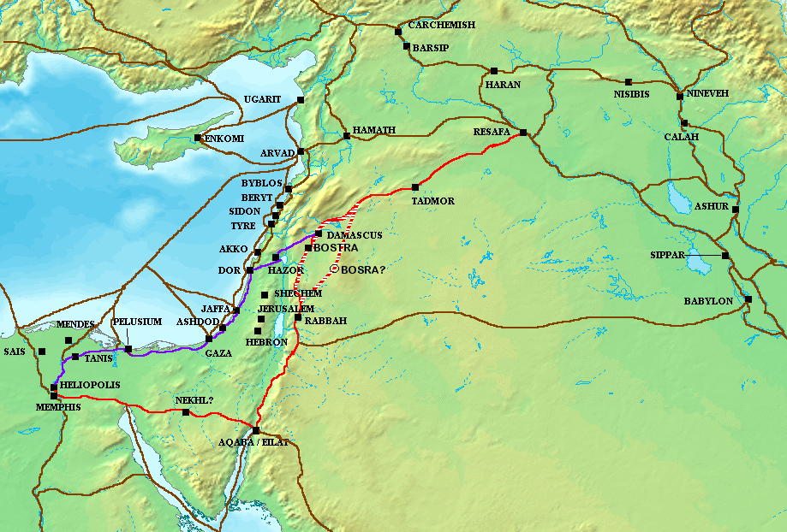
VIA MARIS
https://en.wikipedia.org/wiki/Via_Maris

Slide 21
Light from an Unlikely Place (Is 9)
^{9:1} Nevertheless the gloom will not be upon her who is distressed,
As when at first He lightly esteemed the land of Zebulun and the land of Naphtali,
And afterward more heavily oppressed her,
By the way of the sea, beyond the Jordan,
In Galilee of the Gentiles.
² The people who walked in darkness have seen a great light;
Those who dwelt in the land of the shadow of death,
Upon them a light has shined.

Slide 22
Signs and Sons
8:3 Then I went to the prophetess, and she conceived and bore a son. Then the Lord said to me, “Call his name Maher-Shalal-Hash-Baz; ⁴ for before the child shall have knowledge to cry ‘My father’ and ‘My mother,’ the riches of Damascus and the spoil of Samaria will be taken away before the king of Assyria.”
9:6 For unto us a Child is born, Unto us a Son is given… And His name shall be…

Slide 23
New Testament Connections
9:1-2 A Great Light seen in Zebulun and Naphtali
…The people who sat in darkness have seen a great light, and upon those who sat in the region and shadow of death Light has dawned. (Mat 4:16, and see Lk 2:32)
9:16 A son given to rule eternally as God, …on David’s throne
¹¹ For there is born to you this day in the city of David a Savior, who is Christ the Lord…
¹⁴“Glory to God in the highest, and on earth peace, goodwill toward men!” (Lk 2:11,14)
Notes:
Matt 4:16 is Matthew’s commentary as Jesus begin His Galilean ministry, just after the Temptations
Luke 2:11, 14 is the announcement of the angel to the shepherds
Luke 2:30-32 – [Simeon says:] “For my eyes have seen Your salvation ³¹ Which You have prepared before the face of all peoples, ³² A light to bring revelation to the Gentiles, And the glory of Your people Israel.”

Slide 24
The People…Have Seen a Great LIght
Geography, History, Characters, Context
Signs and Sons
Response and Consequences
Darkness & Light
Take-aways

Slide 25
God’s Purposes at Work
Establishment of God’s Son as King (Is 9:6)
Establishment of God’s multi-national “House” (Is 2:1-4)
Preservation of David’s Throne (Is 9:7)
Preservation of a Remnant of Judah (Is 1:9)
Punishment of Jerusalem & Judah (Is 1:4)
Destruction of Israel (Samaria) by Assyria
Judgment on Syria, Assyria, and Babylon
Confirmation of Isaiah the Prophet (Is 7:10-11; 8:16-18)
Notes:
Judgment on Assyria (Is 10:5ff)
On Babylon (Is 13-14)

Slide 26
Take-Aways
Complexity in our world is beyond man’s understanding, prediction, or management
Man’s plans, without God, are misguided
God is ruling—always working His purposes
God’s ultimate purpose is “God-with-us”
God gives signs and offers sanctuary from evil
God’s Son is either a sanctuary or stumbling block

Slide 27
Isaiah 8:13-15
The Lord of hosts, Him you shall hallow; Let Him be your fear and let Him be your dread. ¹⁴ He will be as a sanctuary, But a stone of stumbling and a rock of offense To both the houses of Israel, As a trap and a snare to the inhabitants of Jerusalem. ¹⁵ And many among them shall stumble; They shall fall and be broken, be snared and taken.”
“Behold, this Child is destined for the fall and rising of many in Israel, and for a sign which will be spoken against ³⁵ …that the thoughts of many hearts may be revealed.” (Lk 2:34-35)
Notes:
“stumbling block” – see Luke 2:34; Rom 9:33; I Pet 2:8

