Slide 1
Acts
Class #8: The SECOND journey (15:36 – 18:22)

Slide 3
Acts 15:1-35 Must Gentiles Be Circumcised and Keep Moses’ Law?
Peter (7-11)
Paul/Barnabas (12)
James (13-21)
God chose to use my mouth to preach to Gentiles
He gave them the Holy Spirit and purified their hearts by faith (they were not commanded to become Jews)
We are saved by grace through faith, not works of the law (yoke)
“… and they listened to Barnabas and Paul as they related what signs and wonders God had done through the among the Gentiles.”
“And with this the words of the prophets agree, just as it is written…” (v.15)

Slide 5
“Let us return and visit…”
ACTS 15:36 – 16:5

Slide 7
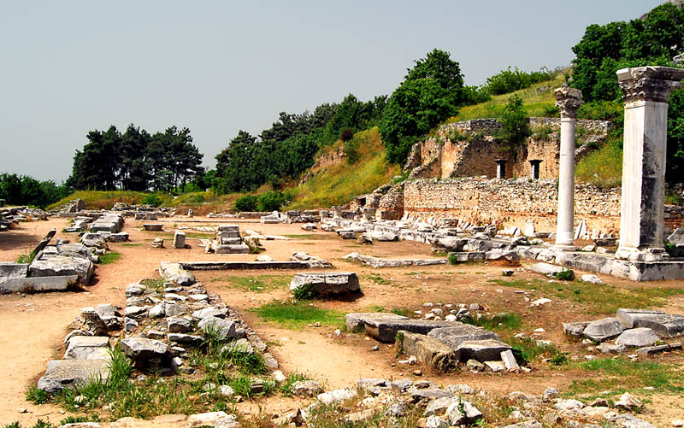
Philippi Acts 16:11-40
Lydia (v.11-15, 40)
The Jailer (v.25 - 39)
The Slave Girl and Owners (v.16 - 24)

Slide 9
Thessalonica Acts 17:1-9
“… he reasoned with them from the Scriptures, explaining and proving that it was necessary for the Christ to suffer and to rise from the dead, and saying, ‘This Jesus, whom I proclaim to you, is the Christ.’” (v.2-3)
“These men who have turned the world upside down have come here also, and Jason has received them, and they are all acting against the decrees of Caesar, saying that there is another king, Jesus.” (v.6-7)

Slide 11
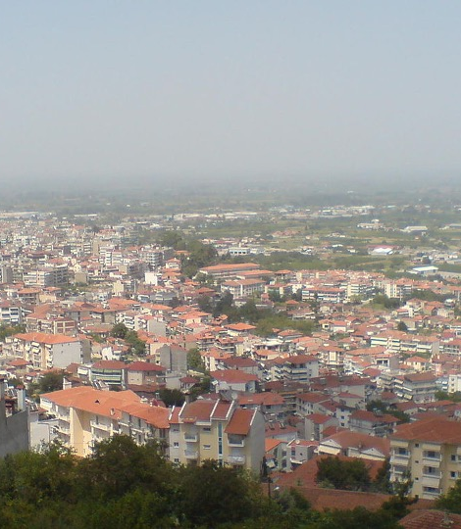
Berea Acts 17:10-15
“Now these Jews were more noble than those in Thessalonica; they received the word with all eagerness, examining the Scriptures daily to see if these things were so.” (v.11)

Slide 13
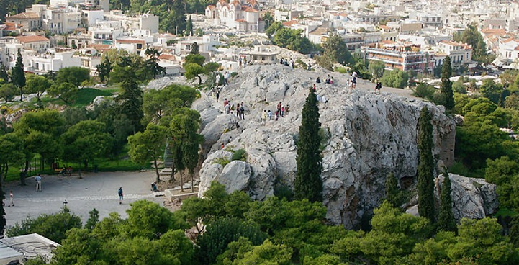
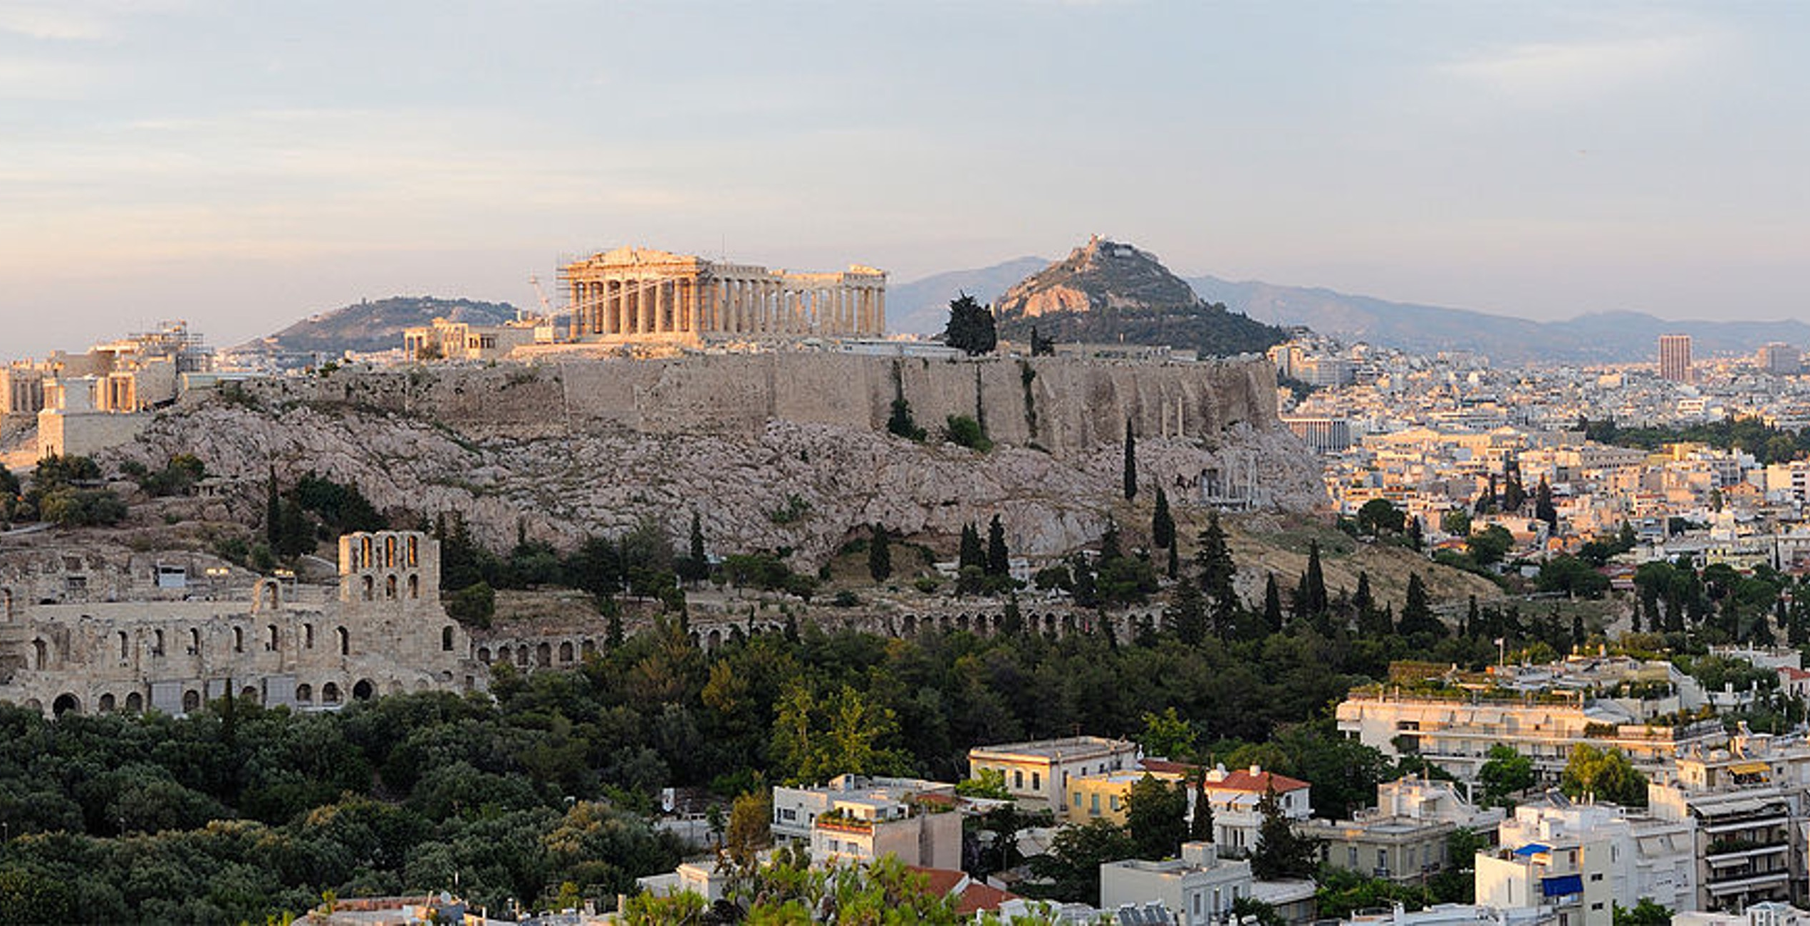
Athens Acts 17:16-34
“Being then God’s offspring, we ought not think that the divine being is like gold or silver or stone, an image formed by the art and imagination of man. The times of ignorance God overlooked, but now he commands all people everywhere to repent, because he has fixed a day on which he will judge the world in righteousness by a man whom he has appointed; and of this he has given assurance to all by raising him from the dead.” (v.29-31)

Slide 15
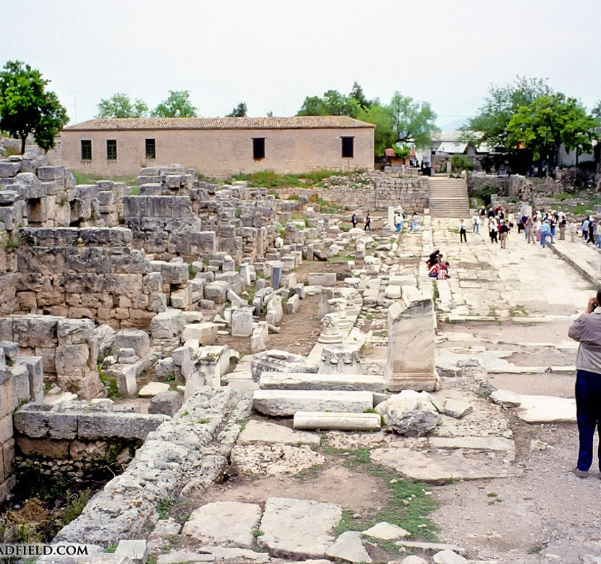
Corinth Acts 18:1-17
“And the Lord said to Paul one night in a vision, ‘Do not be afraid, but go on speaking and do not be silent, for I am with you, and no one will attack you to harm you, for I have many in this city who are my people.’ And he stayed a year and six months…”

Slide 17
The Third Journey
NEXT TIME

