Slide 1
Abraham
The Friend of God
Lesson Six
The Hagar Plan
Scan or join at slido.com #embryhills

Slide 2
In Genesis 15, God reveals new details to Abram about his future. Which of these is NOT one of those details?
ⓘ Start presenting to display the poll results on this slide.

Slide 3
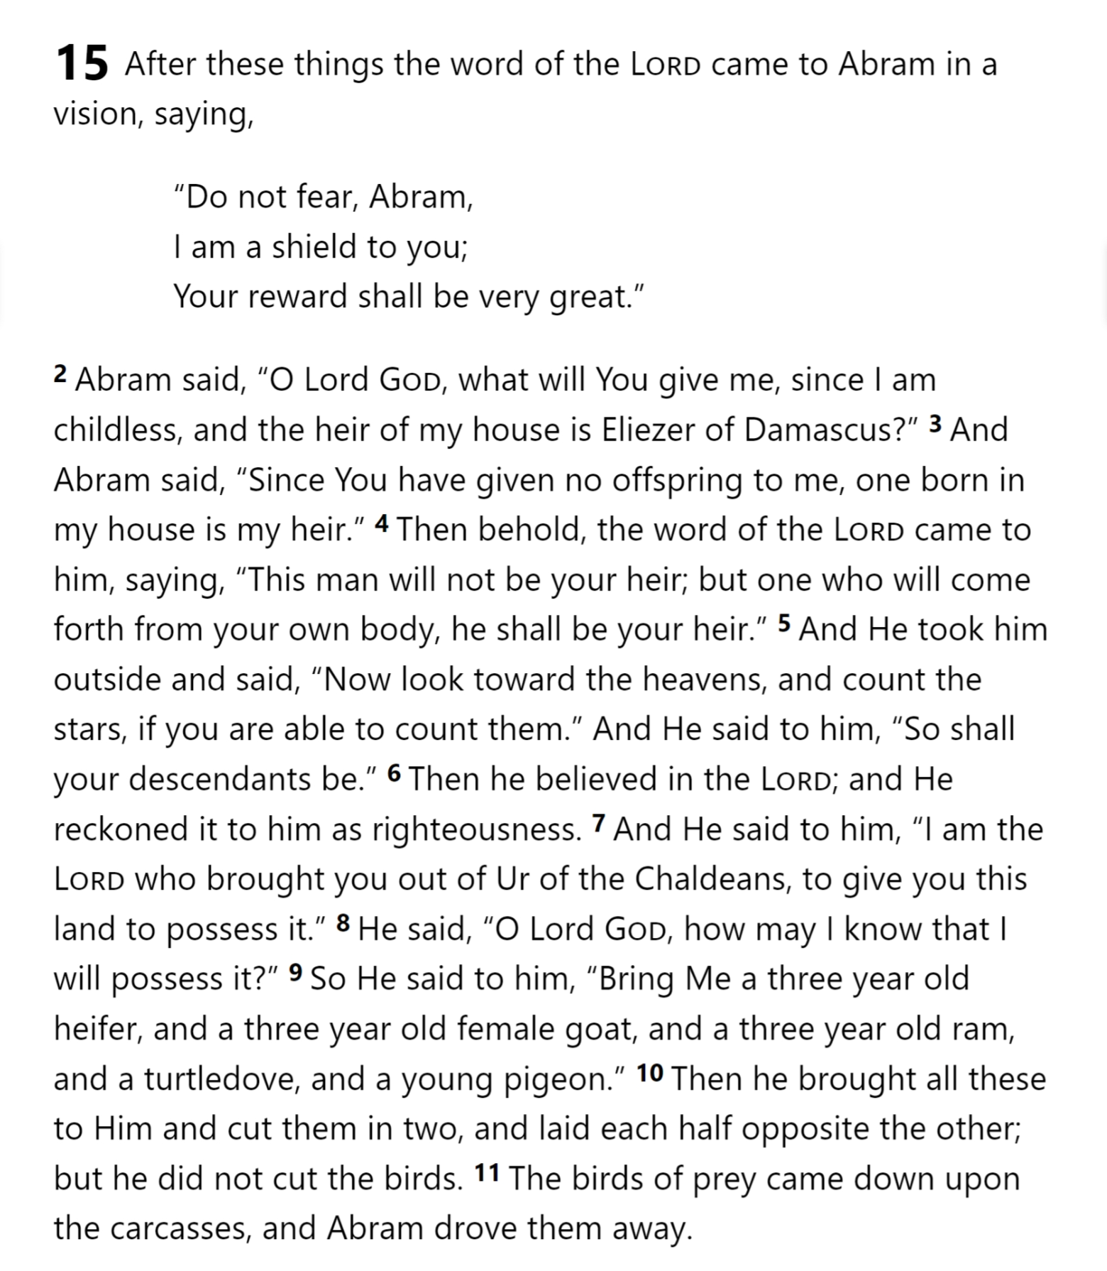
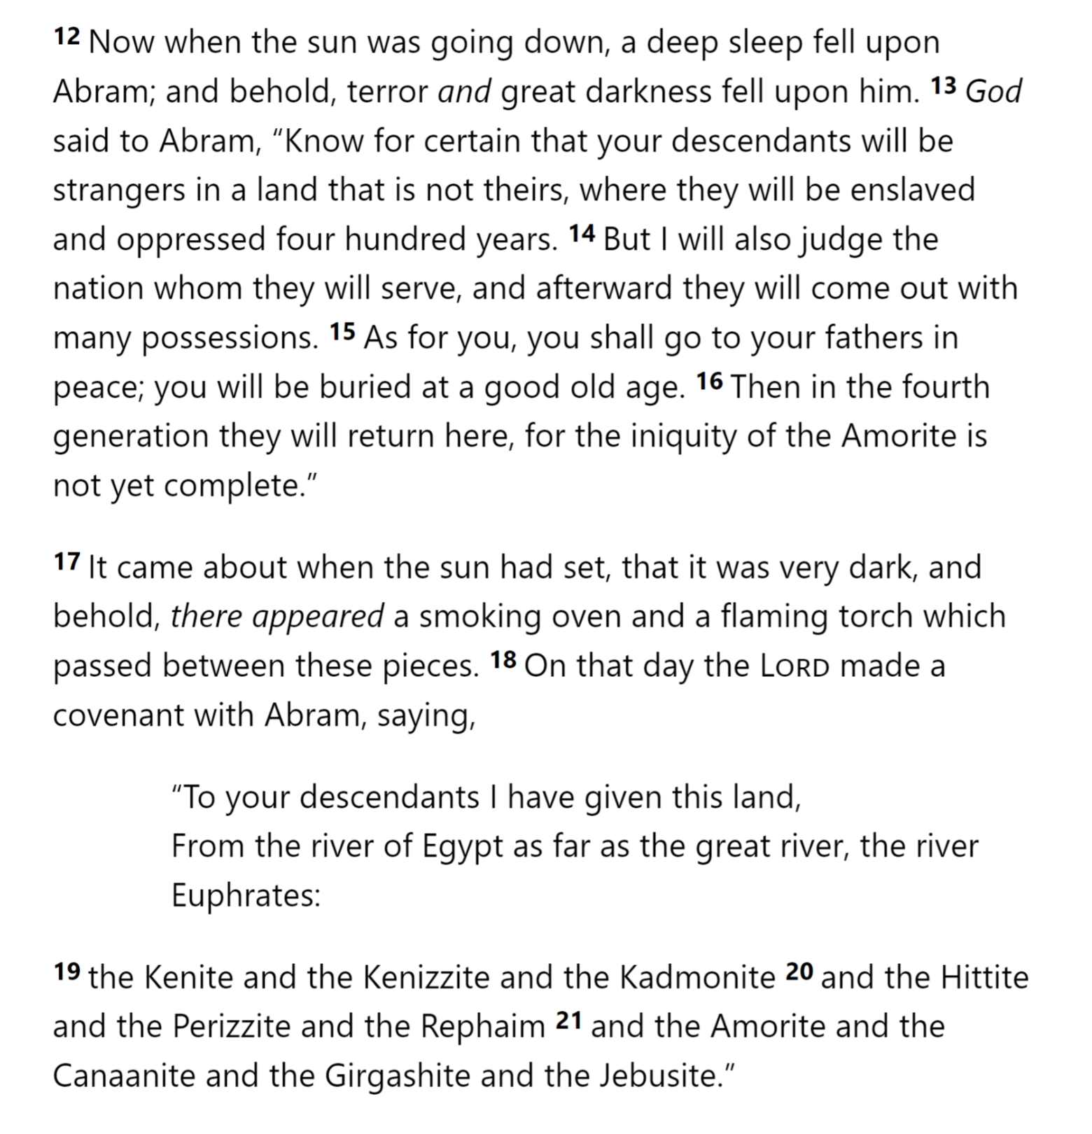
Genesis 15

Slide 4
Genesis 15

Slide 5
Genesis 15

Slide 6
Genesis 15

Slide 7
Genesis 15

Slide 8
Genesis 15

Slide 9
Why would God make Abram and Sarai wait for so long to give them the child of promise?
ⓘ Start presenting to display the poll results on this slide.

Slide 10
According to Romans 4, Abraham believed God could enable Sarah to bear him a child because he believed what?
ⓘ Start presenting to display the poll results on this slide.

Slide 11
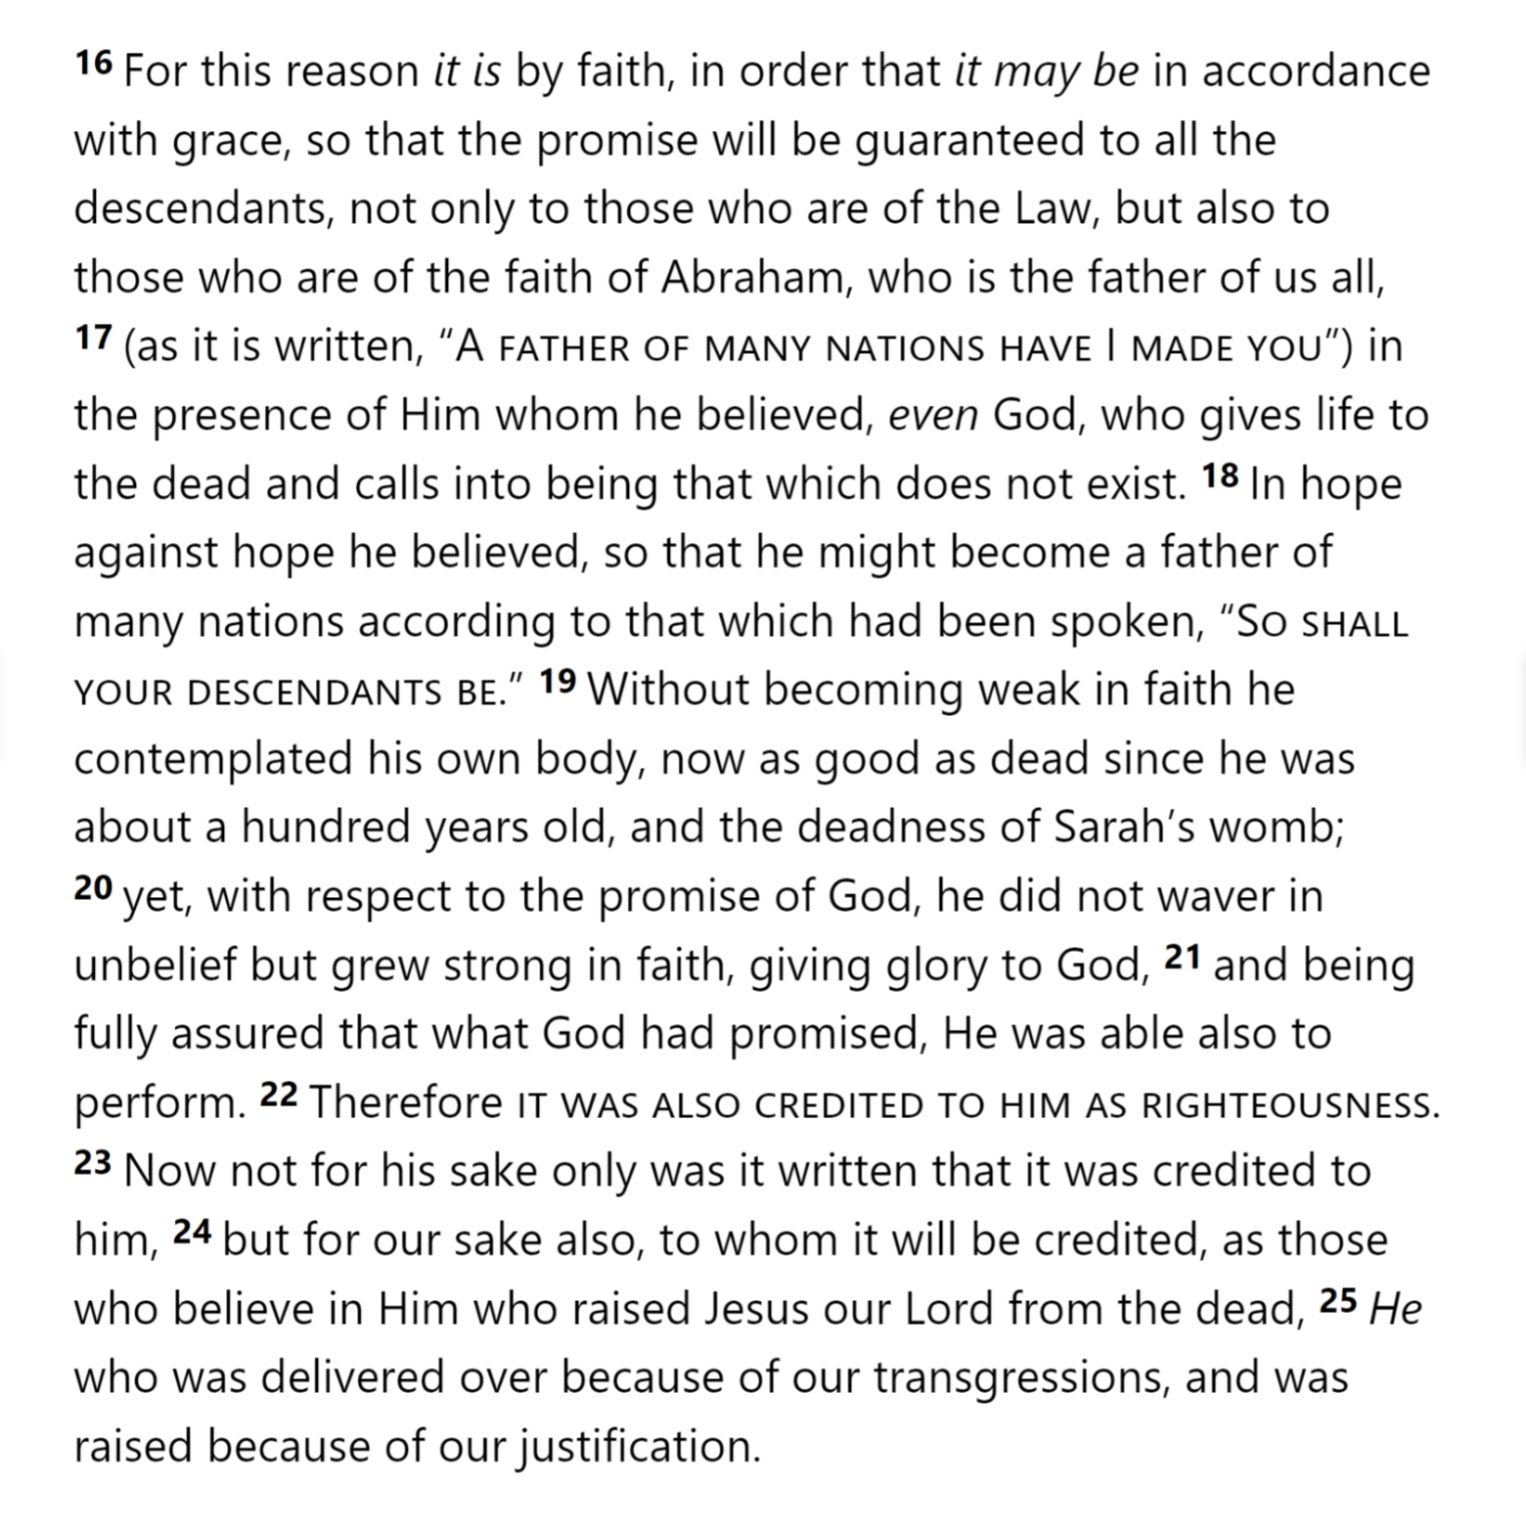
Romans 4

Slide 12
Romans 4

Slide 13
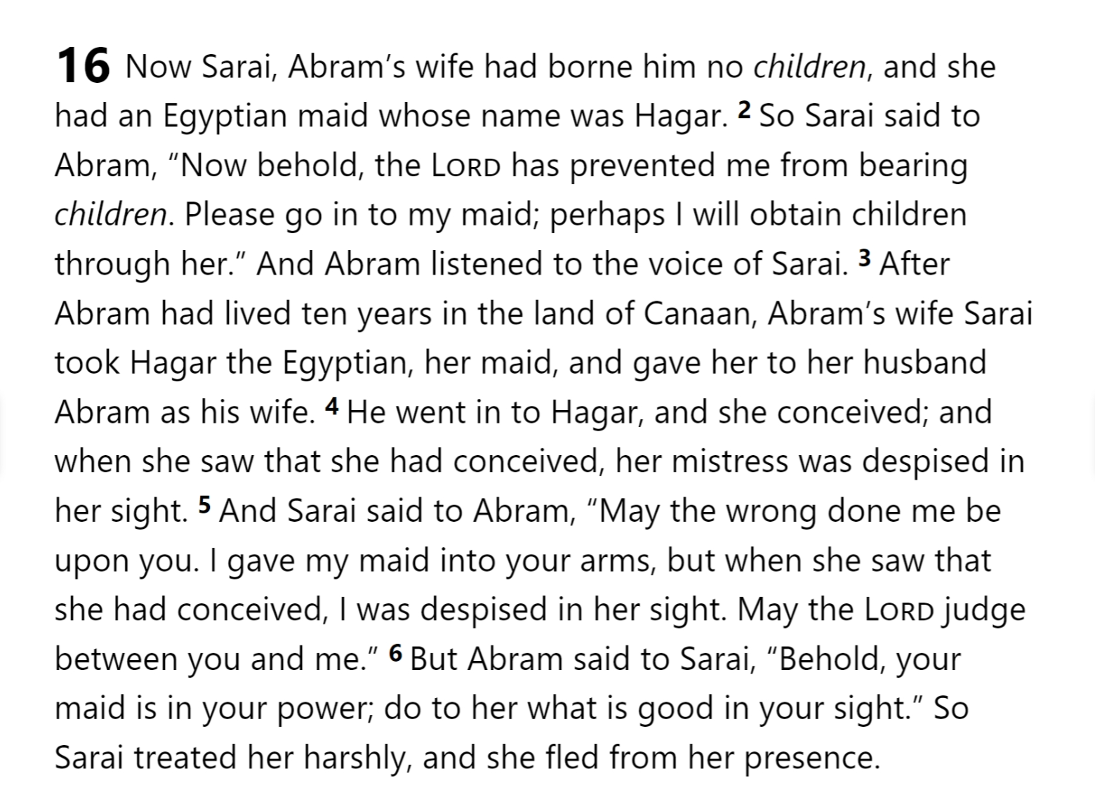
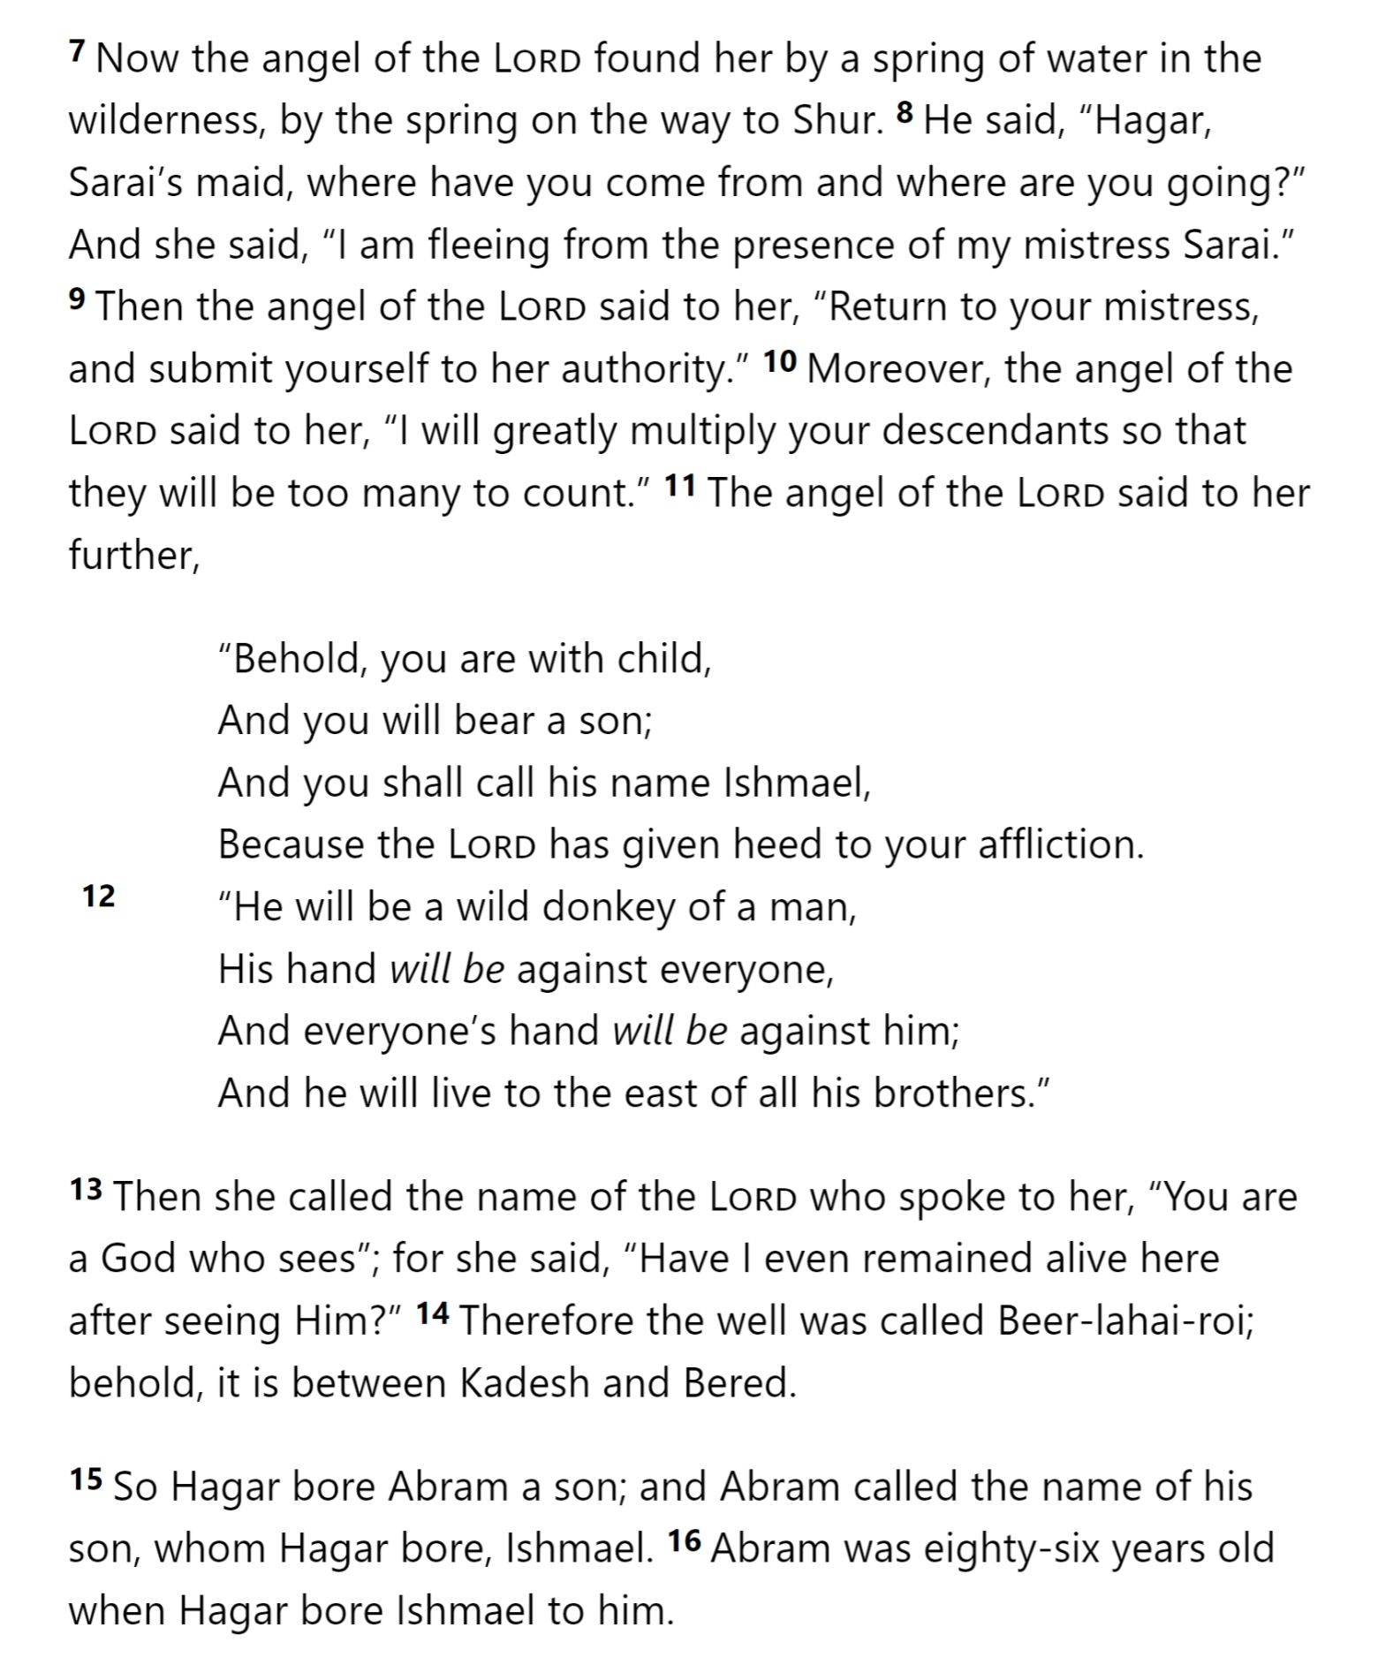
Genesis 16

Slide 14
Genesis 16

Slide 15
Genesis 16

Slide 16
Genesis 16

Slide 17
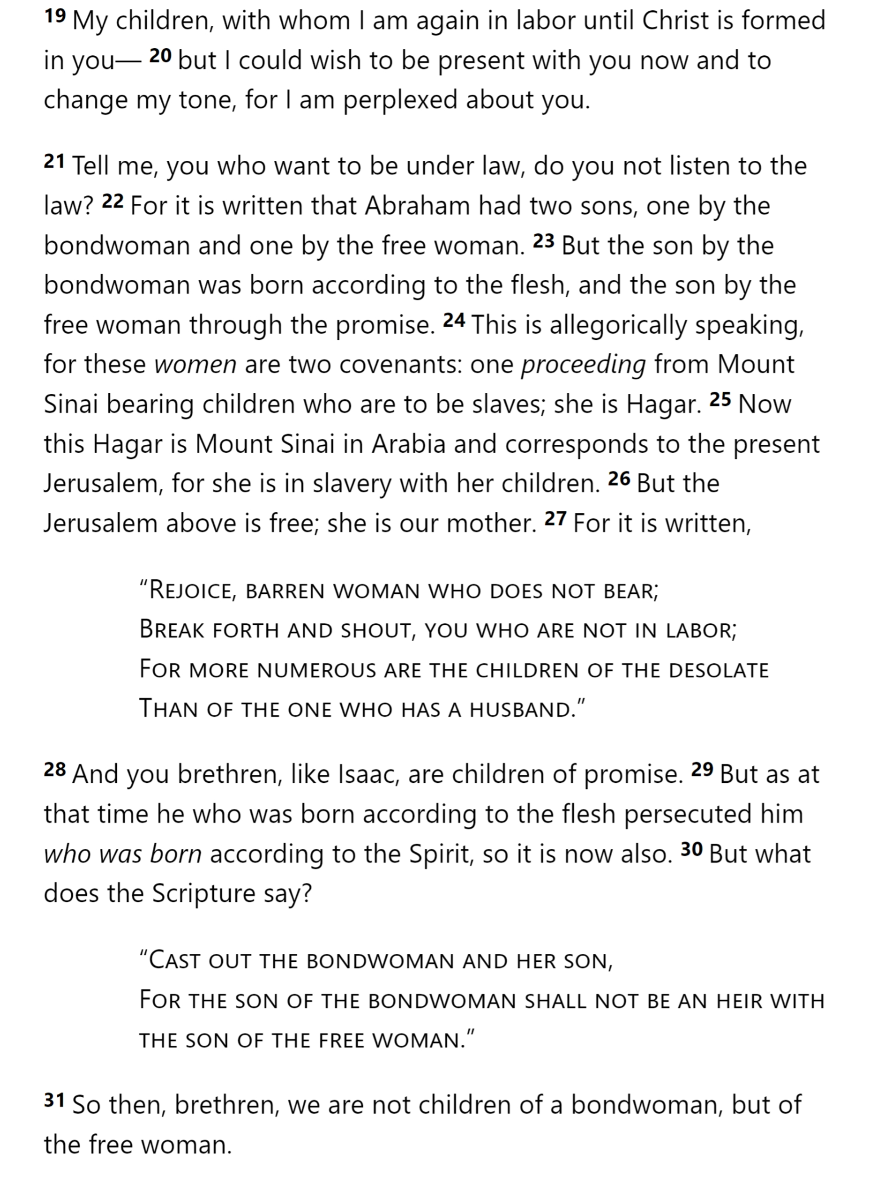
Galatians 4

Slide 18
Sarai
Hagar
Mother
Free woman
Bondwoman
Son
Isaac
Ishmael
Birth
of Spirit & Promise
of Flesh
City
Jerusalem above
Present Jerusalem
Covenant
(New)
Sinai
Children
Free in Christ
Slavery (to Law)

Slide 19
The well named Beer-lahai-roi is mentioned only two other times in the Old Testament. In both cases, it is associated with what character?
ⓘ Start presenting to display the poll results on this slide.

Slide 20
Abraham
The Friend of God

