Slide 1
Pre-class assignment
Please remember to sit further up…
Yes, you.
Discuss with those around you:
Separate Jesus from the cross for a moment, what was the cross? If you were living in the 1st century how would you have viewed it?

Slide 2
We’ll read from John’s account of the crucifixion of Christ. John 19:1-7, 16-19, 23-24, 28-30

Slide 3
The Cross (L3)
the humiliation of the cross

Slide 4
Class Schedule
April 16 | The God of life dies
April 19 | Why the Messiah needed to die
April 23 | The humiliation of the corss
April 26 | The Cross and the Resurrection - in the eyes of Matthew
April 30 | The Cross and the Resurrection - in the eyes of Mark
May 3 | The Cross and the Resurrection - in the eyes of Luke
May 7 | The Cross and the Resurrection - in the eyes of John
May 10 | The Cross from Jesus’ eyes - what He sees
May 14 | The Cross from Jesus’ eyes - what He said
May 17 | How the Cross affected Jesus’ ministry
May 21 | The Cross and Resurrection - in the acts of the Apostles
May 24 | The Gospel of the cross - in our lives
May 28 | The Gospel of the Resurrection

Slide 5
The cross from Jesus’ eyes
Philippians 2
Christ Jesus, 6 who, although He existed in the form of God, did not regard equality with God a thing to be grasped, 7 but emptied Himself, taking the form of a bond-servant, and being made in the likeness of men. 8 Being found in appearance as a man, He humbled Himself by becoming obedient to the point of death, even death on a cross.

Slide 6
The cross from Jesus’ eyes
Philippians 2
Christ Jesus, 6 who, although He existed in the form of God, did not regard equality with God a thing to be grasped, 7 but emptied Himself, taking the form of a bond-servant, and being made in the likeness of men. 8 Being found in appearance as a man, He humbled Himself by becoming obedient to the point of death, even death on a cross.
The cross would’ve been humiliating to man, how much more so God.

Slide 7
The cross from Jesus’ eyes
Philippians 2
Christ Jesus, 6 who, although He existed in the form of God, did not regard equality with God a thing to be grasped, 7 but emptied Himself, taking the form of a bond-servant, and being made in the likeness of men. 8 Being found in appearance as a man, He humbled Himself by becoming obedient to the point of death, even death on a cross.
Far before the cross, Jesus had taken multiple steps of humiliation.

Slide 8
The humiliation of God the Son (before the cross)
God emptied Himself and became man.
Became a man (John 1:1-3;14)
Born of a woman (Gen 3:15; Gal 4:4; Mat 1:25)
Born Jewish – Bethlehem (Ez. 2:23; Mic 5:2; Mat 2:5-6)
No “majestic form/majesty"/appearance that we should be drawn to Him (Is. 53:2; Mk 6:3; Lk. 4:24; Jn. 1:43 Jn. 6:42, 7:41)
God the man became a servant
He served sinners and tax collectors (Mark 2:13-17)
He served the Gentiles (Matt. 15:22-28)
He washed the disciples' feet (John 13:2-8)
Far before the cross, Jesus had taken multiple steps of humiliation.

Slide 9
The humiliation of the cross
Matthew 27:35 And when they had crucified Him, they divided up His garments among themselves by casting lots. | Mark 15:24 And they *crucified Him, and *divided up His garments among themselves, casting lots for them to decide what each man should take.
Luke 23:33 When they came to the place called The Skull, there they crucified Him and the criminals, one on the right and the other on the left. | John 19:18 There they crucified Him, and with Him two other men, one on either side, and Jesus in between.

Slide 10
It was nothing for the Romans to crucify a man

Slide 11
The cross to Romans was the most shameful way of dying, but it was common
To use the word was offensive to most Romans.
It’s where we derive the word for excruciating.
It was something that they reserved only for slaves and their enemies.
Cicero called crucifixion the "extreme and final punishment of slaves" (servitutis extremum summumque supplicium, contra Verres 2.5.169), and the "cruelest and most disgusting punishment." (crudelissimum taeterrimumque suplicium, ibid 2,5. 165.)
Why was Jesus’ death so notable?

Slide 12
The cross to Romans was the most shameful way of dying, but it was common
To use the word was offensive to most Romans.
It’s where we derive the word for excruciating.
It was something that they reserved only for slaves and their enemies.
Cicero called crucifixion the "extreme and final punishment of slaves" (servitutis extremum summumque supplicium, contra Verres 2.5.169), and the "cruelest and most disgusting punishment." (crudelissimum taeterrimumque suplicium, ibid 2,5. 165.)
It’s the most incredible happenstance of human history.
Because Jesus existed and He was far more than just a man.

Slide 13
The cross was far more brutal than we can imagine, but Jesus knew it’d be
Mark 14:33 And He *took with Him Peter and James and John, and began to be very distressed and troubled.34 And He *said to them, “My soul is deeply grieved to the point of death; remain here and keep watch.”35 And He went a little beyond them, and fell to the ground and began to pray that if it were possible, the hour might pass Him by.
Luke 22:44 And being in agony He was praying very fervently; and His sweat became like drops of blood, falling down upon the ground.
With a brief exception in the garden of Gethsemane, no divine intervention whether from the Father or of His own will spare Jesus the man from experiencing the complete justice reserved for sin.

Slide 14
Pains before the cross
Mental agony knowing that He’s going to die.
Emotional hurt of being betrayed and abandoned by your closest friends.
John 18:22 When He had said this, one of the officers standing nearby struck Jesus, saying, “Is that the way You answer the high priest?”
Luke 22:63 Now the men who were holding Jesus in custody were mocking Him and beating Him, 64 and they blindfolded Him and were asking Him, saying, “Prophesy, who is the one who hit You?” 65 And they were saying many other things against Him, blaspheming.

Slide 15
Pains before the cross
Mental, emotional, some physical pain.
John 19:1 Pilate then took Jesus and scourged Him.

Slide 16
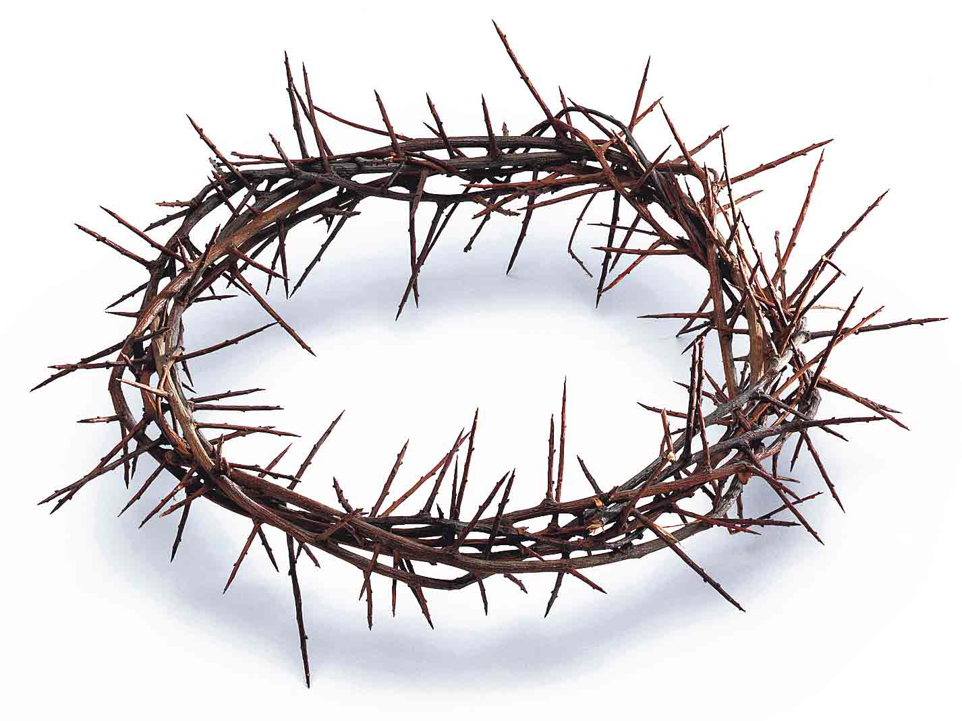
Pains before the cross
Mental, emotional, some physical pain.
John 19:1 Pilate then took Jesus and scourged Him.
John 19:2 And the soldiers twisted together a crown of thorns and put it on His head, and put a purple robe on Him.

Slide 17
Pains before the cross
Mental, emotional, some physical pain.
John 19:1 Pilate then took Jesus and scourged Him.
John 19:2 And the soldiers twisted together a crown of thorns and put it on His head, and put a purple robe on Him.
Mark 15:16 The soldiers took Him away into the palace, and they *called together the whole Roman cohort. 17 They *dressed Him up in purple, and after twisting a crown of thorns, they put it on Him; 18 and they began to acclaim Him, “Hail, King of the Jews!” 19 They kept beating His head with a reed, and spitting on Him, and kneeling and bowing before Him. 20 After they had mocked Him, they took the purple robe off Him and put His own garments on Him. And they *led Him out to crucify Him.
John 19:16 So he then handed Him over to them to be crucified.

Slide 18
The way to the cross
Juan 19:17 They took Jesus, therefore, and He went out, bearing His own cross, to the place called the Place of a Skull, which is called in Hebrew, Golgotha.
Matthew 27:32 As they were coming out, they found a man of Cyrene named Simon, whom they pressed into service to bear His cross.
It’s about .5 mile walk there. He’s been turned over to the Roman soldiers (typically group of 5) they’re trying to maintain order and make sure that the condemned gets to the cross alive.
It’s unlikely that Jesus is carrying the full cross.

Slide 19
The cross
Matthew 27:35 And when they had crucified Him, they divided up His garments among themselves by casting lots. | Mark 15:24 And they *crucified Him, and *divided up His garments among themselves, casting lots for them to decide what each man should take.
Luke 23:33 When they came to the place called The Skull, there they crucified Him and the criminals, one on the right and the other on the left. | John 19:18 There they crucified Him, and with Him two other men, one on either side, and Jesus in between.

Slide 20
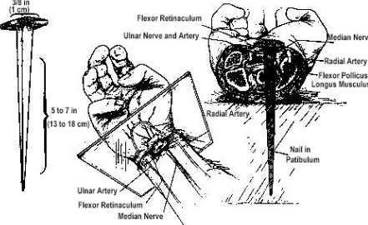
The cross
Once there the Roman soldiers would get to work.
They would stretch out His arms to nail Him to the crossbeam.
2 soldiers would then typically get on the criminal. One on his chest and the other on his legs to keep him from moving.
Then a large 5–7-inch nail was driven through the hand. Typically, at the wrist.
It’s important to think about this, if it was through the palm, it wouldn’t have held the body.
Two possible options: it was driven at an angle and forced to come out of the wrist or forced through the wrist itself.

Slide 21
The cross
The criminal’s hands were nailed so that he had to use his back to lift himself up to breathe.
Afterwards they would lift the prisoner up on the vertical beam.
Imagine the pain whenever the soldiers would let him go and the full weight is being felt on the cross.
Then lastly, they would drive a nail through his feet. Probably in the middle of the foot to not break bones.

Slide 22
And so the body, in excruciating pain, would desperately search for a way to find relief.
But there wasn’t any.
Loss of blood, shock, heart attack, suffocation.
And while this was going on, it was quite a spectacle for the people watching.

Slide 23
Luke 23:46 And Jesus, crying out with a loud voice, said, “Father, into Your hands I commit My spirit.” Having said this, He breathed His last.

Slide 24
The cross of Jesus
In history there is no moment that did more to shape the world, that did more to change the world, that changed the direction of time, more than the crucifixion ever did.
It is an event that is universal and uniquely personal.
It is seemingly insignificant in its moment, and yet life altering for everyone who has ever lived.
It is the moment that all of history leads to and at all times since is measured against but why?

Slide 25
The cross of Jesus
Because He rose on the third day.
Because He conquered sin and death.
Because we can see the severity of sin, God's justice and his love for us.
Because the God of life, gave us life once more.

Slide 26
When I survey the wondrous cross
When I survey the wondrous cross
On which the Prince of glory died,
My richest gain I count but loss,
And pour contempt on all my pride.

Slide 27
When I survey the wondrous cross
Forbid it, Lord, that I should boast,
Save in the death of Christ my God!
All the vain things that charm me most,
I sacrifice them through His blood.

Slide 28
When I survey the wondrous cross
See from His head, His hands, His feet,
Sorrow and love flow mingled down!
Did e’er such love and sorrow meet,
Or thorns compose so rich a crown?

Slide 29
When I survey the wondrous cross
His dying crimson, like a robe,
Spreads o’er His body on the tree;
Then I am dead to all the globe,
And all the globe is dead to me.

