Slide 1
Common Ground Question:
What evidence of Christ-like love do you see in your brothers and sisters at Embry Hills?
(John 13:34-35)
Notes:
Concern for children’s spiritual growth.
Generosity.
Helpfulness in sickness, sadness, etc...
Rejoicing together on happy occasions.
Greeting one another with gladness.
Mourning together in sad times.
Praying for each other.
Respect and Cooperation together.

Slide 2
Notes:
How does love impact holiness?
#1 – It motivates our holiness.
#2 – It reinforces our holiness.
#3 – It demands / simplifies our holiness.

Slide 3
#1. God’s Love Provides A Way For Us To Become Holy People.
Notes:
Hebrews 6:15 – does one act of impatience disqualify us from becoming a patient person – certainly not.
In fact, in our impatience, when things STILL don’t go as hoped – we are forced to be more patient.

Slide 4
The Great Love of God
But God, being rich in mercy, because of His great love with which He loved us, ⁵ even when we were dead in our transgressions, made us alive together with Christ (by grace you have been saved), ⁶ and raised us up with Him, and seated us with Him in the heavenly places in Christ Jesus, ⁷ so that in the ages to come He might show the surpassing riches of His grace in kindness toward us in Christ Jesus. (Ephesians 2:4-7)
Notes:
Luke 7 – we see His great love when we’ve been forgiven much.
We see His great love when we learn more about Him.

Slide 5
The Great Love of God
5 Aspects of God’s Love
The Love of the Father, Son, & Spirit for One Another.
John 3:35, 14:31
The Love of God to Care For All of His Creation.
Matthew 5:45, Genesis 8:21
The Love of God to Redeem & Save Man From His Sins.
Romans 5:8, John 3:16
The Love of God to Adopt & Bless His Covenant People.
Psalm 5:11-12, 1 John 3:1-3
The Love of God to Discipline People for Our Good.
Hebrews 12:6
Notes:
(D.A. Carson) (in his list #4 is Calvinism).
God is Love.
He is more than the author of Love.
He is more than the source of Love.
He is Love. His very nature is love and this is in perfect harmony with his justice, power, and eternal being.

Slide 6
#2. Love Motivates Holiness In Our Christian Relationships.
Notes:
Hebrews 6:15 – does one act of impatience disqualify us from becoming a patient person – certainly not.
In fact, in our impatience, when things STILL don’t go as hoped – we are forced to be more patient.

Slide 7
Colossians 3:12-14
1. Elect: God’s choice
¹² So, as those who have been chosen of God, holy and beloved, put on a heart of compassion, kindness, humility, gentleness and patience; ¹³ bearing with one another, and forgiving each other, whoever has a complaint against anyone; just as the Lord forgave you, so also should you. ¹⁴ Beyond all these things put on love, which is the perfect bond of unity.
2. Set Apart As God’s
3. Deep, Constant Love Towards Us
Over & Above
Clothe With…
Agape
Perfection: Upright, True, & Complete
Ligaments, Binder
Notes:
The perfect bonder.
There is nothing else the binds us together so perfectly.
Love binds us together more perfectly than common enemies or fears.
Love binds us together more perfectly than common goals or hopes.
Love binds us together more perfectly than circumstances or shared interests.
Love binds us together more perfectly than other virtues such as gratitude or patience.
Like the perfect application of super glue to a broken vase.
Like the perfect welding of joints on the frame of a car.
Like the perfect straps to hold a baby in their carseat.
Look back at 3:11 – God is bringing together people from all backgrounds to be ONE IN CHRIST. Let us love GOD and love ONE Another – it will see us through any challenge we face.
SAME UNIFYING MESSAGE is found in:
Galatians 5:13-14

Slide 8
Love Motivates Us To Excel In Every Quality We’ve Studied This Segment.
I’m more content when I’m filled by love.
I’m more humble when I’m seeking the best for others.
I’m more pure when I love others instead of lust.
I’m more gentle when love prevails over anger.
I’m more honest when love cast out fears.

Slide 9
Love Motivates Us To Excel In Every Quality We’ve Studied This Segment.
I’m more kind when love overlooks hurts.
I’m more connected when love welcomes me.
I’m more peaceful when love gives me hope.
I’m more zealous when I love God’s ways.
I’m more patient when love seeks to serve.

Slide 10
#3. Love Reinforces Holiness In Our Walk with God.
Notes:
Hebrews 6:15 – does one act of impatience disqualify us from becoming a patient person – certainly not.
In fact, in our impatience, when things STILL don’t go as hoped – we are forced to be more patient.

Slide 11
Love & Holiness Reinforce Each Other
“…it is a mistake to allow one aspect of biblical truth to drown out others. Likewise, it is a mistake to conceive of love for God in a way that divorces passion for him from obedience to him.”
Holiness
Love
Notes:
The more I love God – the more I will choose things that are holy.
The more I choose things that are holy – the more love I will possess and display.
Ephesians 4:2,
Ephesians 4:16
Living a holy life is inseparable from loving God.
Loving God motivates us to live a Holy Life.
Living a Holy Life includes behaving in a holy manner towards others. We can’t claim to love God and mistreat people God cares about.

Slide 12
Love & Holiness Reinforce Each Other
The steadfast love of God should thrill us as “better than life” (Ps. 63:3). But as the case of Jonah reminds us, it is possible for God’s love to become nothing more than a sterile fact that we recite and resent (Jonah 4:2).
Jesus similarly warns that in the last days, as “lawlessness” increases, “the love of many will grow cold” (Matt. 24:12). In a hostile world, surrounded with temptations to idolatry and given to hardness of heart, we can sustain a holy life only through passionate love for God and appreciation of his love for us.

Slide 13
Paul’s Love for the Corinthians Wonderfully Illustrates God’s Love For Us.
Suffering (2 Corinthians 6:4-5)
Removes all doubt that You are being selfish.
Trust (2 Corinthians 6:6-7)
I believe You ARE good and will DO good.
Special (2 Corinthians 6:8-10)
I know You well and see greatness that others overlook.
Welcome (2 Corinthians 6:11-13)
I am happy that You desire a relationship with me.
Separation (2 Corinthians 6:14-16)
I give up whatever interferes in our relationship.
Devotion (2 Corinthians 6:17-18)
I care about You and I’m committed to You.
“Therefore, having these promises, beloved, let us cleanse ourselves from all defilement of flesh and spirit, perfecting holiness in the fear of God.” (2 Cor. 7:1)
Notes:
No one can say, “I love God, I just choose to regularly do the things that make Him angry and me happy – all the time.). That is loving ourselves and wanting what God has.
Suffer - 2 Cor. 6: 4-5
Trust – 2 Cor. 6:6-7
Special – 2 Cor. 6:8-10
Welcome – 2 Cor. 6:11-13
Devoted Commitment – 2 Cor. 6:14-16
Forsaking Others – 2 Cor. 6:17-18
2 Cor. 7:1 – Promised Togetherness
When Others Have Suffered To Bless Us.
It removes any doubt that they are motivated by selfishness.
When Others Demonstrate Admirable Qualities.
We trust them. They are good and will do good.
When We Recognize They Are Special.
We know them better and see a side others overlook.

Slide 14
Loving God vs. Wanting What He Has
Psalm 103:9-18
Vs.
Proverbs 19:4, Luke 15:12,29
Notes:
We are prone to wander away from God.
We are prone to wander away from one another.
Our love keeps bringing us back.
There is a HUGE difference between trying to avoid being punished and ACTUALLY loving God.
If I don’t want to leave sin in the past and move towards God… Do I love Him as much as I think?

Slide 15
#4. Love Excludes Unholiness From Our Lives.
Notes:
We Always Seek To Please Those We Truly Love.
To walk in holiness, we must remember that loving God includes seeking to please Him. And He is pleased by our obedience to His commands. (2 Timothy 2:4, 1 Corinthians 7:32-34)
Love Draws Us Closer To God & To The Things That Please God

Slide 16
1 Peter 2:9
Matthew 6:24
1 John 2:15-17
James 4:4

Slide 17
#5. Love Encompasses The Holy Character & Conduct We Encourage In One Another.
Notes:
Love Encompasses The Holy Conduct We Live By.

Slide 18
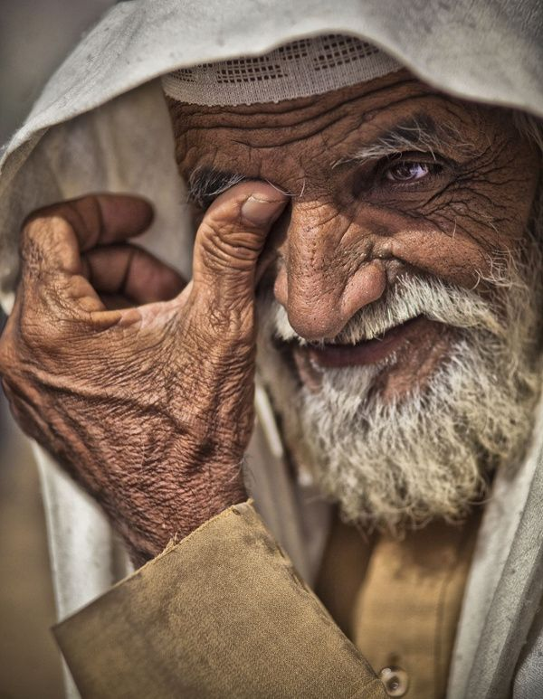
The blessed John the Evangelist lived in Ephesus until extreme old age. His disciples could barely carry him to church and he could not muster the voice to speak many words. During individual gatherings he usually said nothing but, "Little children, love one another." The disciples and brothers in attendance, annoyed because they always heard the same words, finally said, "Teacher, why do you always say this?" He replied with a line worthy of John: "Because it is the Lord's commandment and if it alone is kept, it is sufficient.” – Jerome’s Comm. on Gal. 6:10

