Slide 1
Common Ground Question… In a fast-paced world where instant gratification is often emphasized, why do you think patience is still considered such a valuable virtue?
James 5:7-12
Impact on Relationships – 1 Corinthians 13:4
Common Observation Growth Takes Time
Lack of Control Over Difficulties
Notes:
We all have to wait… for the oven to pre-heat…. For the exercise to pay off… For the vacation to start… To find the one you want to marry…
Why is waiting seen as a good thing…
Patience is a virtue that brings good things, and helps us make the most out of bad things. So it’s extremely useful.

Slide 2
Practical Christian Living
Wholehearted Devotion to Jesus
Lesson Twelve • James 5:7-12
Larry Brown & Phillip Shumake
Embry Hills church of Christ
July – September 2023
Notes:
Gen. 27:18-24

Slide 3
OUTLINE OF JAMES
Chapter 1 - Stand With Confidence
Chapter 2 - Stand With Compassion
Chapter 3 - Speak With Care
Chapter 4 - Submit with Contrition
Chapter 5 - Share With Concern
Notes:
CHAP 1 - CONFIDENCE
Trials – There are benefits in trials
Temptations – God only gives what is good, Know that
The gospel can “keep your souls saved”
Therefore – you must be doers of the word
CHAP 2 – COMPASSION
Showing favoritism is sinful (poor vs rich)
Saving , true faith should move you to action
CHAP 3 – CARE
We all need to learn to control our tongues
Practice what you preach
CHAP 4 – CONTRITION (REPENTANCE)
Whose will do you seek? You own or God’s
Submit to God, Serve God, Be a Friend of God and not of this world
Draw near to God, Humble yourself to God
CHAP 5 – CONCERN
Share in possessions – wealth will rot
Share in patience – Job
Share in prayer

Slide 4
James 5:1-6
Four Warnings To The Wealthy
They “Stored Up” Their Unused Wealth .
They “Withheld” What Others Earned.
They “Lived Luxuriously” Not Considering The Future.
They Used Their Influence To Condemn The “Righteous.”
These Are Defining Choices
“Humble yourselves in the presence of the Lord, and He will exalt you.” (4:10)
Notes:
Be careful not to IDOLIZE the wealthy who abuse their influence and resources…
Mark 10:21-27
²¹ Looking at him, Jesus felt a love for him and said to him, “One thing you lack: go and sell all you possess and give to the poor, and you will have treasure in heaven; and come, follow Me.” ²² But at these words ^{[g]}he was saddened, and he went away grieving, for he was one who owned much property.
²³ And Jesus, looking around, *said to His disciples, “How hard it will be for those who are wealthy to enter the kingdom of God!” ²⁴ The disciples were amazed at His words. But Jesus *answered again and *said to them, “Children, how hard it is to enter the kingdom of God! ²⁵ It is easier for a camel to go through the eye of a needle than for a rich man to enter the kingdom of God.” ²⁶ They were even more astonished and said to Him, “^{[h]}Then who can be saved?” ²⁷ Looking at them, Jesus *said, “With people it is impossible, but not with God; for all things are possible with God.”

Slide 5
JAMES CHAPTER 5: SHARE WITH CONCERN
Share In Possessions (5:1-6)
Consternation from Wealth (5:1)
Corrosion of Wealth (5:2-3)
Condemnation in Wealth (5:4-6)
Share In Patience (5:7-12)
Essence of Patience (5:7-9)
Examples of Patience (5:10-11)
Evidence of Patience (5:12)
Share In Prayer (5:13-20)
Sensitivity to Needs (5:13)
Supplication for Needs (5:14-18)
Significance of Needs (5:19-20)
Notes:
James picks up in chapter 5 where he left off in chapter 4
He continues to discuss arrogance and selfishness
Life is to uncertain - Don’t leave God out of you plans “If the Lord wills…”
“So speak and so act as though you are about to be judged”
This is not a formula, but an attitude
Now that you know the right thing to do… you are obligated to do it.
5:1 – starts with the verb “age” = come on!
“Go on now, you rich people. I am going to tell you what is going to happen to you. Just because you succeeded in making money without seeking God’s help, do you really think you have achieved something? You think the money you’ve accumulated is a blessing to you, but it really is the greatest curse you can imagine.”
Is James talking to Christians in this passage or non-Christians? It appears that James is denouncing all rich (1:10; 2:6). It applies to all greedy!
BELIEVERS: There is a tendency to be envious of the rich and therefore what James says is a warning. These people that are oppressing them needed to be put in their proper perspective before the church
Psa 73:3-5; Prov 30:8-9
Some is James audience thought too much of wealth (2:1ff) and wanted to put the rich on a pedestal in hope of getting something in return. (Psalms 73:3ff)
Matt 6:24 – can’t serve two masters
NON BELIEVERS: Warnings to them and a call to repentance
If he is talking to non-Christians that James uses what is called an “apostrophe” (a turning aside from the direct subject matter to address others; speaking to an imaginary group/ persons).
It appears that James is not dealing with the rich Christians (1:9-11) but the rich in 2:6-7.
Does not call them “brother” and he does not call them to repent (implied) Jonah, Jer 18:7-8.
Seems that James has given up on them.
Then why would James it if they were not going to read it? Unlikely the Assyrians ever saw the words of Isaiah (10:1-34), or the Babylonians (Isa 13:1-22) but it was written to show Christians that justice would prevail and that they should not be envious (see 5:7ff)
The rich are often condemned (Prov 11:25-28; 1 Tim 6:9-10; Lk 6:24; 18:24; Amos 3:10)

Slide 6
James 5:7-9
Essence of Patience
“Patience” - To set the timer on our temper. (7)
1:3 (hupomone) Patience with things, 5:7 (makrothumia) with people
Why? - The Lord is coming - it is at Hand! (8)
Strengthen Your Hearts (8) – Prop yourself up, make stable the inner man
He will take care of it.
His 2nd Coming Should be looked forward to (Not Dreaded)
“Coming”-Close, Presence, Proximity, Used to describe the Visit of a King
It is real, It is certain, You can trust it, You Can Look Forward to it
Do Not Complain, The Judge is “Standing at the door” (9)
Christ is near. He is in position to enter suddenly and unexpectedly
He is ready to accomplish His purpose
2 Thess 1:3-10 – When Persecuted – LOVE! God will do Justice
1 Peter 4:19 – Suffering? Trust in God!
Notes:
"Present active imperative, "stop groaning against one another"
Complaining is a very real temptation and various professed believers haven't faired very well when facing hardship (1 Corinthians 10:1-12).
Sometimes, when we are bombarded by problems of those outside of…our family, our church….our tempers often get short with each other. Sometimes we take our frustrations out on those closest to us….'Do not let the pressure that is brought to bear on you from outside cause you to be unchristian with each other'…..
Mt. 7:1-5
God isn't impressed with people who complain.

Slide 7
Common Ground Question… Chapter 4:14 urges us to live with the brevity of life in mind, and now chapter 5:8-9 urges us to live with the coming judgment of God in mind. Why is it important to think of Jesus’ return as very near?
James 5:7-9
Notes:
Because it could be any moment – we are to be alert and ready.
Because it helps us put our choices in perspective. Not getting upset about things that don’t matter.
Because it helps us not seek vengeance. Knowing He will judge, removes the pressure we might feel.
"The reminder that 'the Judge is standing right at the door' should be a caution that judgment may not be some hazy, theoretical, far-distant event"
The above expression doesn't mean that James believed that Jesus was going to come that day. Rather, Jesus stands ready to judge and could come at any moment. "the day of retribution for the evil is certain and sure and the one who shall administer punishment should be regarded as at the door, ready to enter at any time…..It was therefore vitally important that those to whom James wrote should open the door without advance notice and discover that instead of waiting patiently and faithfully for him they were fretful, dissatisfied and morose, and engaged in quarrels among themselves" (Woods p. 280).

Slide 8
James 5:10-11
Examples of Patience
What do trials Produce?
Joy, Patience, Perfection, Wisdom, Pure Faith, Humility, Crown of Life.
Farmer - Must Work and Wait to Harvest (7-9)
The Work and the Rain must come before the Harvest.
Notes:
"we counted those blessed who endured"-"Endured"-"remain instead of fleeing, stand one's ground, hold out, endure in trouble, affliction, persecution" (Arndt p. 845). Note: We count them blessed now, when the long-range goal is kept in mind, we can see that endurance is more than worth it (Romans 8:18). See (Matthew 10:22; 2 Timothy 2:12; James 1:12; 1 Peter 2:20).

Slide 9
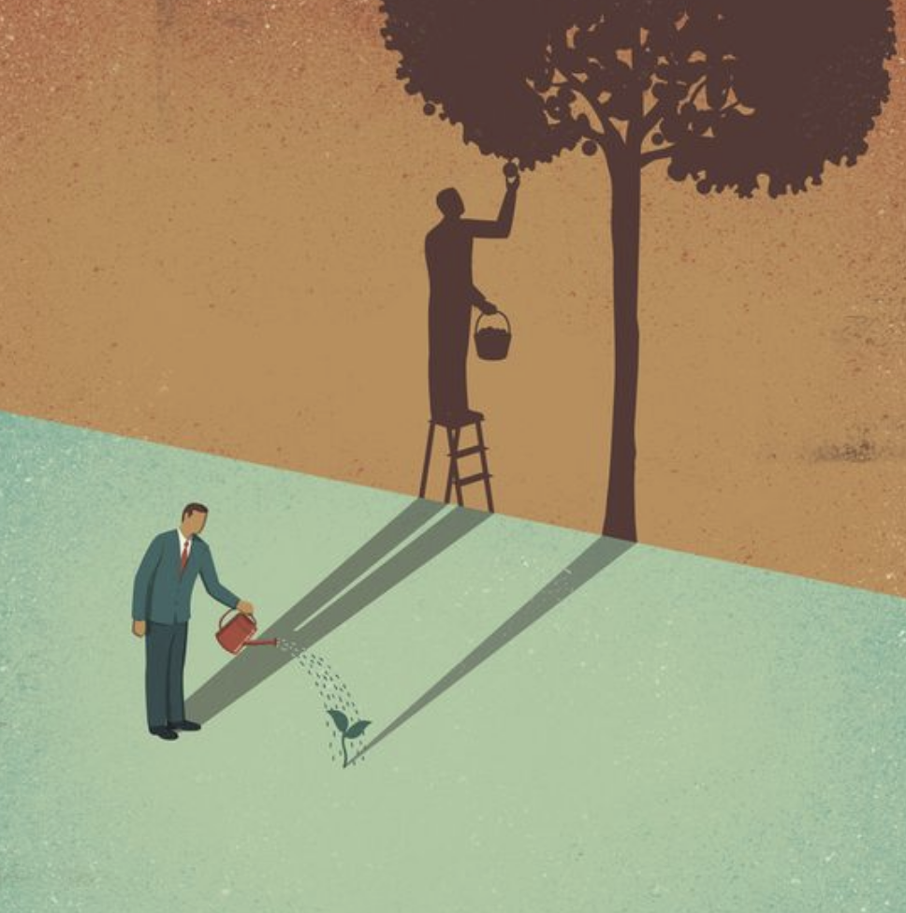
Common Ground Question… What “early” and “late” rains do we often need to wait for in our relationships, work lives, education?
James 5:7-12
Notes:
Farmers have to wait – and we have to wait for good things too. This is how God created the world to operate for our good!
Common Ground Question… Everyone can relate to challenges in relationships, the job market, and learning new information? In these type of situations, what would the “early” and “late” rains represent? For instance, if you want to retire, you need to wait for…
You want to retire – but you have to wait for…
You want to learn a new language – but you have to wait for…
You want to

Slide 10
James 5:7-9
Essence of Patience
In His time, in His time He makes all things beautiful In His time
Lord please show me everyday As you're teaching me your way That You do just what you say In Your time
In Your time, in Your time You make all things beautiful In Your time
Lord my life to you I bring May each song I have to sing Be to you a lovely thing In Your time
Notes:
Though the answer may not be, what we hoped that it would be, you will answer faithfully in Your Time.

Slide 11
James 5:10-11
Examples of Patience
What do trials Produce?
Joy, Patience, Perfection, Wisdom, Pure Faith, Humility, Crown of Life.
Farmer - Must Work and Wait to Harvest (7-9)
The Work and the Rain must come before the Harvest.
Prophets - Suffered Affliction, Yet Patiently (10)
They persisted
Job – (11)
“Seen the end of the Lord” - purpose, aim, goal, design of God
“Compassion and Mercy” - He will relieve them.
Those who endure are Blessed (Happy) (11)
Matt 5:10-12, 5:44
Notes:
Though the answer may not be, what we hoped that it would be, you will answer faithfully in Your Time.
THE PROPHETS…
They were his messengers.
They were confident in His purposes.
They were enduring many hardships: exile, rejection, death threats…
Amos 7:12 – the “experts” told Amos to leave, his message wasn’t welcome.
Jeremiah 36:5 – restricted from going to the Temple.
1 Kings 22:24 – slapped in the face.
Doesn’t it make you realize we don’t have anything to complain about!
Matt. 5:44 – let us love our enemies AND PRAY FOR THOSE…

Slide 12
James 5:10-11
Examples of Patience
How Job Was Tried…
By loss of wealth (1:13-17)
By loss of children (1:18-19)
Devices of Satan
Loss of physical health (2:7-9)
Rebuke of his friends (2:11ff)
By mental distress (3:1ff)
Conduct of his wife (2:9)
Desire to question God (13,14)
Lessons From Job…
We will not escape trials
Trials will end
The faithful will triumph
Old Testament examples sustain us
A faithful Christian will bear any form of trial rather than forsake God!
Job 42:10-17 – God Blessed more than his beginning
Notes:
We need to remember that Job didn't always handle his sufferings in a perfect manner (Job 3:3,11). And yet he never gave into his wife's suggestion to curse God and die (2:9).
In spite of all the agonizing questions which tore at his heart, Job maintained his faith in God (13:15; 19:25). And maybe more importantly than anything else, when God confronted Job about some of the wrong things which Job had said (Job 38-41), Job immediately acknowledged his ignorance and sin (42:1-6).
Job is a man who has many questions, who is hurting, has lost wealth, children, the confidence of his wife and close friends, who humbly accepts a rebuke from the God who has let this all happen to him! The good news is that even though we might fail to react to suffering in a godly manner, we can at any point during the trial acknowledge our sin and benefit from the trial. If we have a bad day during a trial, if we blow it---the case isn't hopeless, we can repent and handle the trial as we should today!

Slide 13
Common Ground Question… James connects patience to the nearness of God, judgment of God, and the compassion/mercy of God. So why should it be even easier for Christians to be patient than unbelievers?
James 5:7-12
Notes:
James chapter 4 reminds us that there is more much involved in being a Christian than just planning ahead or using your talents, abilities and financial resources in a prudent manner. All self-starters, all conservative thinkers, and all hard workers are not necessarily right with God. More is needed to be right with God than rugged individualism.

Slide 14
James 5:12
Evidence of Patience
Flippant Use Of God’s Name
Swear Not: To invoke the name of God; To Utter an oath
Oath: An appeal to God to witness the truth of a statement.
An irreverent or careless use of a sacred name.
Honesty
Jews did not bind all oaths
Only those that had a specific reference to God.
What James Condemns:
Rash Statements made during hardships to One’s Accusers
Calling Down Divine Threats On One’s Opponents
The Abuse of Making Oaths
Notes:
"But above all"-especially (Robertson p. 63). James is not saying that the abusing of oaths is worse than murder or adultery, but in light of the context, "in all one's attempts to avoid expressing impatience toward tormentors, he should first of all avoid swearing" (Kent p. 181). "he is saying that the most common response of the human heart to problems and difficulties is to say the wrong thing" (Draper p. 154).
Note****Suffering doesn't exempt us from the need to control our speech. Unfortunately, some people seem to think that harsh and sinful words spoken during the heat of battle are excused or morally justified.
"do not swear"-"to affirm, promise, threaten, with an oath" (Thayer p. 444). Jesus emphasized the same truth (Matthew 5:34).
"either by heaven or by earth"-"Much evidence exists that oathtaking was greatly abused at that time---not only in the form of profanity, whereby God's name was employed meaninglessly in flippant swearing, but also in the clever schemes of the rabbis to explain some formulas are more binding than others" (Kent pp. 181-182). "There was a distinction---especially in the Jewish world---between oaths which were binding and oaths which were not binding…..The result of this was that men became experts in evasive swearing; and it became a matter of skill and sharp practice to find an oath which was not binding" (Barclay p. 149). (See Matthew 23:16-22).
(Not an excuse to refuse to answer in court… Matt 26: 62-64, Jesus answered… ⁶² The high priest stood up and said to Him, “Do You not answer? What is it that these men are testifying against You?” ⁶³ But Jesus kept silent. And the high priest said to Him, “I ^{[t]}adjure You by the living God, that You tell us whether You are ^{[u]}the Christ, the Son of God.” ⁶⁴ Jesus *said to him, “You have said it yourself; nevertheless I tell you, ^{[v]}hereafter you will see the Son of Man sitting at the right hand of Power, and coming on the clouds of heaven.”

Slide 15
James 5:12
Evidence of Patience
“…but your yes is to be yes, and your, no, no, so that you may not fall under judgment.” (5:12b, Mt 5:37)
“…the point is clear that the believer's word should always be trustworthy without the need of an oath to make it believable.”
“Better is a poor man who walks in his integrity Than he who is perverse in speech and is a fool.” (Prov 19:1)
Notes:
"But above all"-especially (Robertson p. 63). James is not saying that the abusing of oaths is worse than murder or adultery, but in light of the context, "in all one's attempts to avoid expressing impatience toward tormentors, he should first of all avoid swearing" (Kent p. 181). "he is saying that the most common response of the human heart to problems and difficulties is to say the wrong thing" (Draper p. 154).
Note****Suffering doesn't exempt us from the need to control our speech. Unfortunately, some people seem to think that harsh and sinful words spoken during the heat of battle are excused or morally justified.
PETER quotes from Psalm 34:12-13
¹² Who is the man who desires life And loves length of days that he may see good? ¹³ Keep your tongue from evil And your lips from speaking deceit.
"do not swear"-"to affirm, promise, threaten, with an oath" (Thayer p. 444). Jesus emphasized the same truth (Matthew 5:34).
"either by heaven or by earth"-"Much evidence exists that oathtaking was greatly abused at that time---not only in the form of profanity, whereby God's name was employed meaninglessly in flippant swearing, but also in the clever schemes of the rabbis to explain some formulas are more binding than others" (Kent pp. 181-182). "There was a distinction---especially in the Jewish world---between oaths which were binding and oaths which were not binding…..The result of this was that men became experts in evasive swearing; and it became a matter of skill and sharp practice to find an oath which was not binding" (Barclay p. 149). (See Matthew 23:16-22).
(Not an excuse to refuse to answer in court… Matt 26: 62-64, Jesus answered… ⁶² The high priest stood up and said to Him, “Do You not answer? What is it that these men are testifying against You?” ⁶³ But Jesus kept silent. And the high priest said to Him, “I ^{[t]}adjure You by the living God, that You tell us whether You are ^{[u]}the Christ, the Son of God.” ⁶⁴ Jesus *said to him, “You have said it yourself; nevertheless I tell you, ^{[v]}hereafter you will see the Son of Man sitting at the right hand of Power, and coming on the clouds of heaven.”

Slide 16
Preparing For Our Next Class… Rather than saying something we are going to regret, what should a Christian be doing while they are waiting on the Lord?
James 5:7-12
Notes:
James chapter 4 reminds us that there is more much involved in being a Christian than just planning ahead or using your talents, abilities and financial resources in a prudent manner. All self-starters, all conservative thinkers, and all hard workers are not necessarily right with God. More is needed to be right with God than rugged individualism.

Slide 17
Practical Christian Living
Wholehearted Devotion to Jesus
Lesson Twelve • James 5:7-12
Larry Brown & Phillip Shumake
Embry Hills church of Christ
July – September 2023

