Slide 1
Rearing Children in a Dangerous World

Slide 2
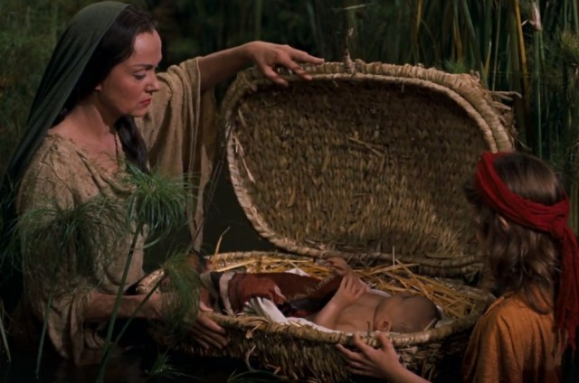
“By faith Moses, when he was born, was hidden three months by his parents, because they saw the child was beautiful, and they were not afraid of the king’s edict. By faith Moses, when he was grown up, refused to be called the son of Pharoah’s daughter” Heb 11:23ff

Slide 3
Amram and Jochebed Taught Their Children
Life is about trusting in God (Hebrews 11: 23)
Life is about choices not circumstances (v 24)
Life is about exercising self-control (vs 25-26)
Life is about desiring God’s work (vs 27-28)

