Slide 2
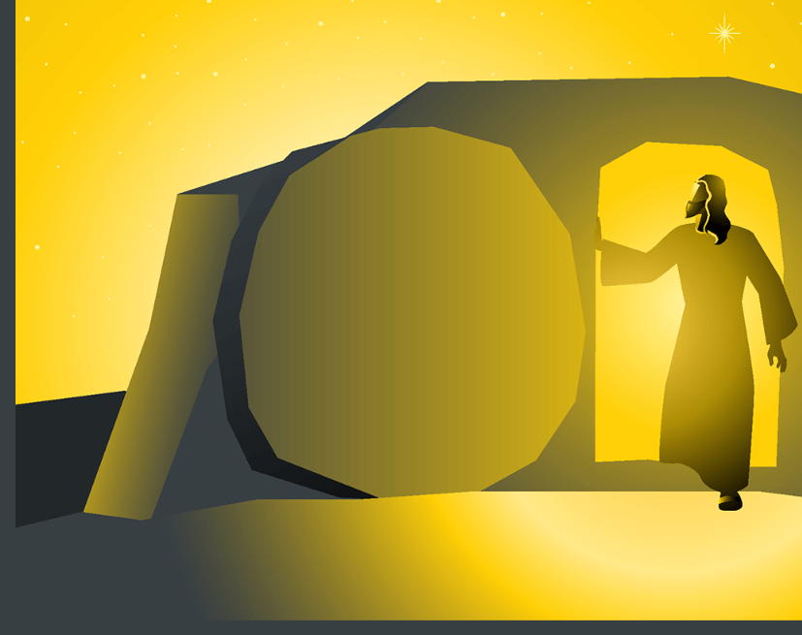
The Impact of The Resurrection
“Death is swallowed up in victory.” ⁵⁵ “O death, where is your victory? O death, where is your sting?” ⁵⁶ The sting of death is sin, and the power of sin is the law. ⁵⁷ But thanks be to God, who gives us the victory through our Lord Jesus Christ. ⁵⁸ Therefore, my beloved brothers, be steadfast, immovable, always abounding in the work of the Lord, knowing that in the Lord your labor is not in vain. 1 Corinthians 15:54-58
Matthew 28:1-10: ​¹ Now after the Sabbath, toward the dawn of the first day of the week, Mary Magdalene and the other Mary went to see the tomb. ² And behold, there was a great earthquake, for an angel of the Lord descended from heaven and came and rolled back the stone and sat on it. ³ His appearance was like lightning, and his clothing white as snow. ⁴ And for fear of him the guards trembled and became like dead men. ⁵ But the angel said to the women, “Do not be afraid, for I know that you seek Jesus who was crucified. ⁶ He is not here, for he has risen, as he said. Come, see the place where he lay. ⁷ Then go quickly and tell his disciples that he has risen from the dead, and behold, he is going before you to Galilee; there you will see him. See, I have told you.” ⁸ So they departed quickly from the tomb with fear and great joy and ran to tell his disciples. ⁹ And behold, Jesus met them and said, “Greetings!” And they came up and took hold of his feet and worshiped him. ¹⁰ Then Jesus said to them, “Do not be afraid; go and tell my brothers to go to Galilee, and there they will see me.” Matthew 28:1-10

Slide 3
The Impact of The Resurrection
Did the Resurrection Really Happen?
Why Did the Resurrection Have to Happen?
What Happens to Me Because of the Resurrection?

Slide 4
Did the Resurrection Happen?
Theories Against the Resurrection
Swoon Theory
Theft Theory
Never Placed in the Tomb Theory
The Passover Plot Theory
Hallucination Theory
The Telepathic or Telegram Theory
The Contemporary Seance Theory.
The Body of Jesus Evaporated Theory
1 Corinthians 15:3-5
Died
Buried
Raised
Appeared
³ For I delivered to you as of first importance what I also received: that Christ died for our sins in accordance with the Scriptures, ⁴ that he was buried, that he was raised on the third day in accordance with the Scriptures, 5 and that he appeared to Cephas, then to the twelve … 1 Corinthians 15:3-5

Slide 5
Did the Resurrection Happen?
⁶ The Pharisees went out and immediately held counsel with the Herodians against him, how to destroy him. Mark 3:6
JESUS HAD ENEMIES
Mark 3:6 – sought to Destroy Him
They Killed Him to Silence Him
They Killed Him to Stop Him
But God Had Other Plans
Acts 2:23-24 23 this Jesus, you crucified and killed by the hands of lawless men. 24 God raised him up, loosing the pangs of death, because it was not possible for him to be held by it.
Acts 2:32 32 This Jesus God raised up
“for if this plan or this undertaking is of man, it will fail; ³⁹ but if it is of God, you will not be able to overthrow them.” Acts 5:38-39

Slide 6
Why Did the Resurrection Happen?
²⁵ The woman said to him, “I know that Messiah is coming (he who is called Christ). When he comes, he will tell us all things.” ²⁶ Jesus said to her, “I who speak to you am he.” John 4:25-26
Jesus Was Who He Said He Was
I Am the Way
I Am the Truth
I Am the Life
I Am the Vine
I Am the Bread of Life
I Am the Light of the World
I Am the Door
I Am the Resurrection
Claims about His Resurrection
Romans 1:3-4 - Declared to be the Son of God – By His Resurrection; Matt 16.21; 17.22; 20.18-19 -
Our Justification Hinges On it
Romans 4:25 – Delivered, Raised for our Justification
¹⁸ This was why the Jews were seeking all the more to kill him, because not only was he breaking the Sabbath, but he was even calling God his own Father, making himself equal with God. John 5:18
Jesus said to him, “I am the way, and the truth, and the life. No one comes to the Father except through me. John 14:6
²⁵ who was delivered up for our trespasses and raised for our justification. Romans 4:24-25

Slide 7
Lord’s Supper

Slide 8
What Happens to Me?
It Should Change the Way You Think
Romans 8:5-8 – think on spiritual things
It Changes Your Purpose
1 Corinthians 15:58 – Steadfast, immovable, Abounding in the Work of the Lord
It Changes what you Do
Acts 17:30 – will judge the world
It Changes Who You Live For
2 Corinthians 5:9 – make it our aim to please Him
It Changes How You Live – Get Ready
2 Corinthians 5:10 – judgement
Colossians 2:10-14 ¹² having been buried with him in baptism, in which you were also raised with him through faith in the powerful working of God, who raised him from the dead. ¹³ And you, who were dead in your trespasses and the uncircumcision of your flesh, God made alive together with him, having forgiven us all our trespasses, ¹⁴ by canceling the record of debt that stood against us with its legal demands. This he set aside, nailing it to the cross.

Slide 10
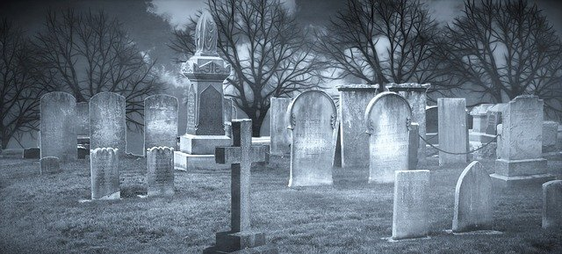

Slide 11
Did the Resurrection Happen?
JESUS HAD ENEMIES
Mark 3:6 – sought to Destroy Him
They Killed Him to Silence Him
They Killed Him to Stop Him
But God Had Other Plans
Acts 2:23-24 23 this Jesus, you crucified and killed by the hands of lawless men. 24 God raised him up, loosing the pangs of death, because it was not possible for him to be held by it.
Acts 2:32 32 This Jesus God raised up

