Slide 1
Prophecy from God
Notes:
Possible Slant – how to talk to an atheist about Bible prophecy. Aron Ra – popular Athiest on Twitter (X) claims Bible prophecy is ambiguous!
I want to point out today how specific it truly is!
I need to point out that these prophecies are specific. These prophecies are well-documented. These prophecies are far in advance of the events.
Or – how to use SPECIFIC prophecy to start a conversation about God who wants to be worshipped in the specifics too.
Acts 7:51-52. Prophecy should not be ignored!

Slide 2
What Prophecy Proves
The Only Way To Accurately Predict Future Events 100% of the Time Is With GOD.
Deuteronomy 18:18-22
Prophecy Verifies God’s Message.
Prophecy Prepares God’s People.
Prophecy Reinforces Our Faith.
Notes:
18 I will raise up a prophet from among their countrymen like you, and I will put My words in his mouth, and he shall speak to them all that I command him. 19 It shall come about that whoever will not listen to My words which he shall speak in My name, I Myself will require it of him. 20 But the prophet who speaks a word presumptuously in My name which I have not commanded him to speak, or which he speaks in the name of other gods, that prophet shall die.’ 21 You may say in your heart, ‘How will we know the word which the Lord has not spoken?’ 22 When a prophet speaks in the name of the Lord, if the thing does not come about or come true, that is the thing which the Lord has not spoken. The prophet has spoken it presumptuously; you shall not be afraid of him.
Ask for any sign – God gives the sign of the virgin.
1 Corinthians 14:3 ESV /
On the other hand, the one who prophesies speaks to people for their upbuilding and encouragement and consolation.

Slide 3
Topics & Details
Biblical Prophecy Addresses Personal, National, & Spiritual Events.
Genesis 12:1-3 or Daniel 2:36, 44-45
The Death of Jezebel 1 Kings 21:23,
2 Kings 9:29-37
The Destruction of Jerusalem
Luke 21:20-24
Holy Spirit at Pentecost
Joel 2:28-32, Acts 2:5-21
Notes:
Details: This one may be more detailed than we even want, because it is really gross. But 1 Kings 21 – and 2 Kings 9 – describe very specifically the horrible death she would face as a punishment for her wickedness. The point is to recognize these bad things weren’t just the result of random chance – but were God’s response to her evil.

Slide 4
Topics & Details
We Have Biblical Prophecies That Are Specific, Well-Documented, & Far In Advance of The Event.
Psalm 22:16-18, Luke 23:33-34
“they pierced my hands and my feet”
“for my clothing they cast lots”
Prophesied:
1011 – 971 BC
Fulfilled:
30 AD
Time Span: 1,000 Years!
Notes:
Bible Prophecy is IMPRESSIVE…
Every prophet spoke about different time periods, so Not every prophecy is specific. Not every prophecy is far in advance.
But some are SO specific, SO clear, and SO far in advance – you must be impressed.
How do we know this is about JESUS? Is that something Christians just like to claim? NO! Jesus himself calls out this passage so that we will understand the connection!
TRANSITION… how do we know that psalm wasn’t just written after the fact? Because 100 years before Jesus lived, the dead sea scrolls were copied and we have them!

Slide 5
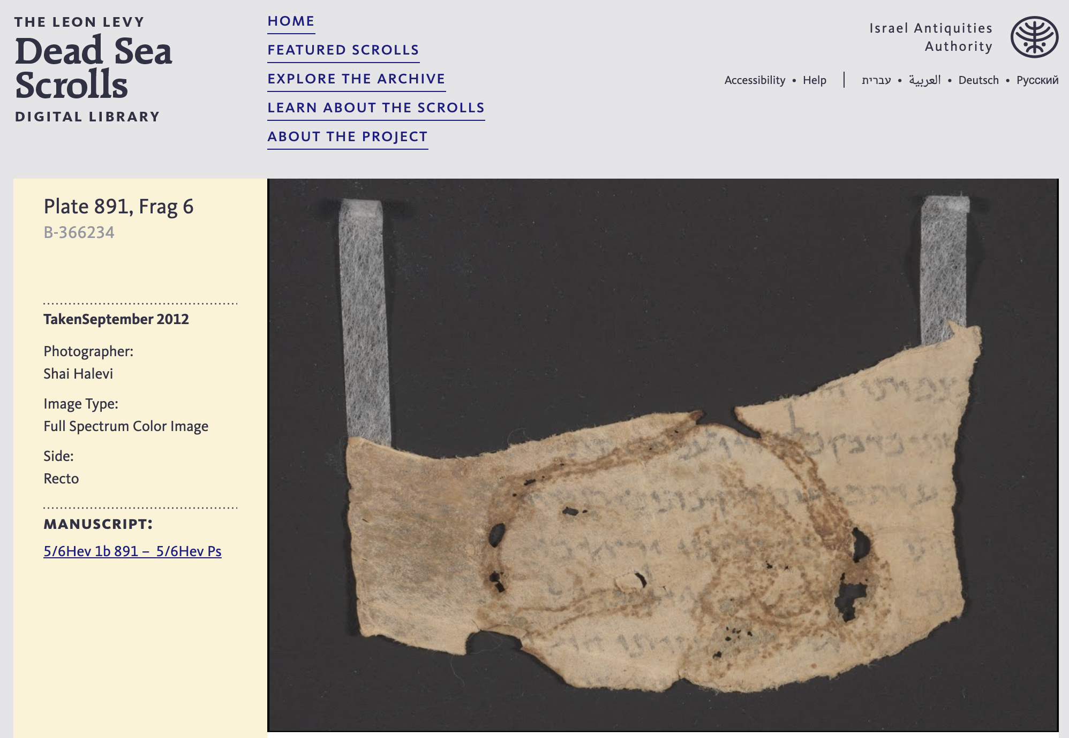
Notes:
The Dead Sea Scroll of Psalm 22 dates to 100 B.C.
So written by David 1,000 years before it occurred.
Physical copy available 100 years before it occurred.

Slide 6
Topics & Details
We Have Biblical Prophecies That Are Specific, Well-Documented, & Far In Advance of The Event.
Psalm 22:16-18
Notes:
Bible Prophecy is IMPRESSIVE…
Every prophet spoke about different time periods, so Not every prophecy is specific. Not every prophecy is far in advance.
But some are SO specific, SO clear, and SO far in advance – you must be impressed.

Slide 7
Notes:
The Dead Sea Scroll of Psalm 22 dates to 100 B.C.
So written by David 1,000 years before it occurred.
Physical copy available 100 years before it occurred.

Slide 8
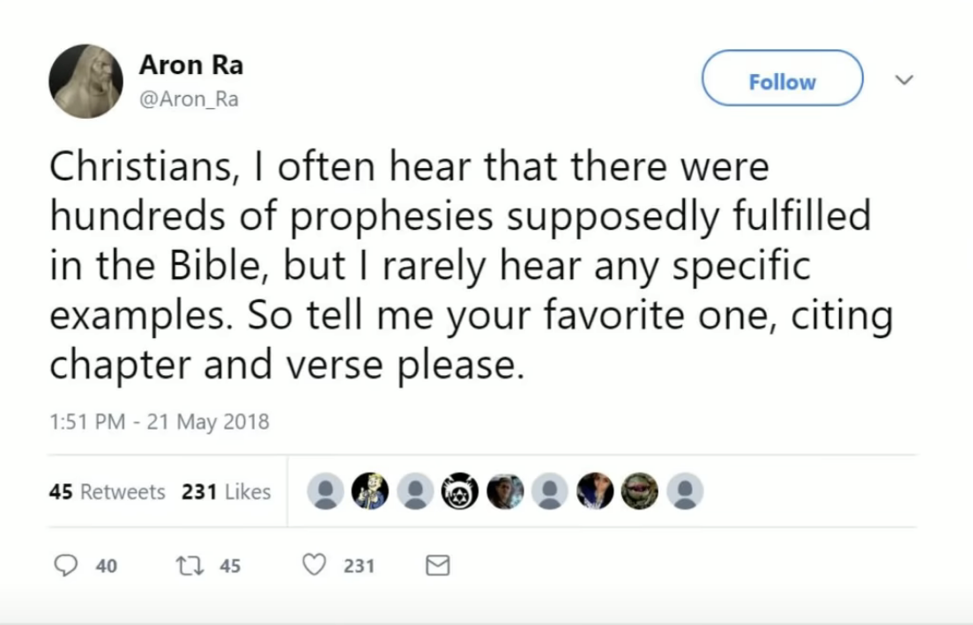
Notes:
¹⁶ But they mocked God’s messengers, despised his words and scoffed at his prophets until the wrath of the Lord was aroused against his people and there was no remedy.
2 Chron. 36:16
Jeremiah 18:18
¹⁸ They said, “Come, let’s make plans against Jeremiah; for the teaching of the law by the priest will not cease, nor will counsel from the wise, nor the word from the prophets. So come, let’s attack him with our tongues and pay no attention to anything he says.”

Slide 9
Impressive Prophecies
Joshua Prophesies The Consequences of Rebuilding The City of Jericho.
Joshua 6:26, 1 Kings 16:29, 33-34
Prophesied:
1399 BC
Fulfilled:
870 – 850 BC
Time Span:
530 Years
Notes:
Could point to Messianic – place of birth, death of babies, etc…
Ahab’s reign – 3 different scholarly caluculations. All + or – 5 years. Point is… What Joshua said would happen 530 years earlier - is exactly what happened!

Slide 10
Impressive Prophecies
Isaiah Prophesies The Reign of Cyrus And His Release of The Jewish People.
Isaiah 44:28, 45:1, Ezra 1:1-4 (Jer. 25:12)
Prophesied:
740 - 690 BC
Fulfilled:
537 BC
Time Span:
100 - 150 Years
Notes:
This event is not only recorded in the Bible, but also described as the general practices of Cyrus…. (Also good to know that the NT attributes the entire book to Isaiah – not just the first chapters as some doubters try to suggest.)
The text of the cylinder denounces the deposed Babylonian king Nabonidus as impious and portrays Cyrus as pleasing to the chief god Marduk. It describes how Cyrus had improved the lives of the citizens of Babylonia, repatriated displaced peoples and restored temples and cult sanctuaries.^{[130]} Although not mentioned specifically in the text, the repatriation of the Jews from their "Babylonian captivity" has been interpreted as part of this general policy.^{[131]}

Slide 11
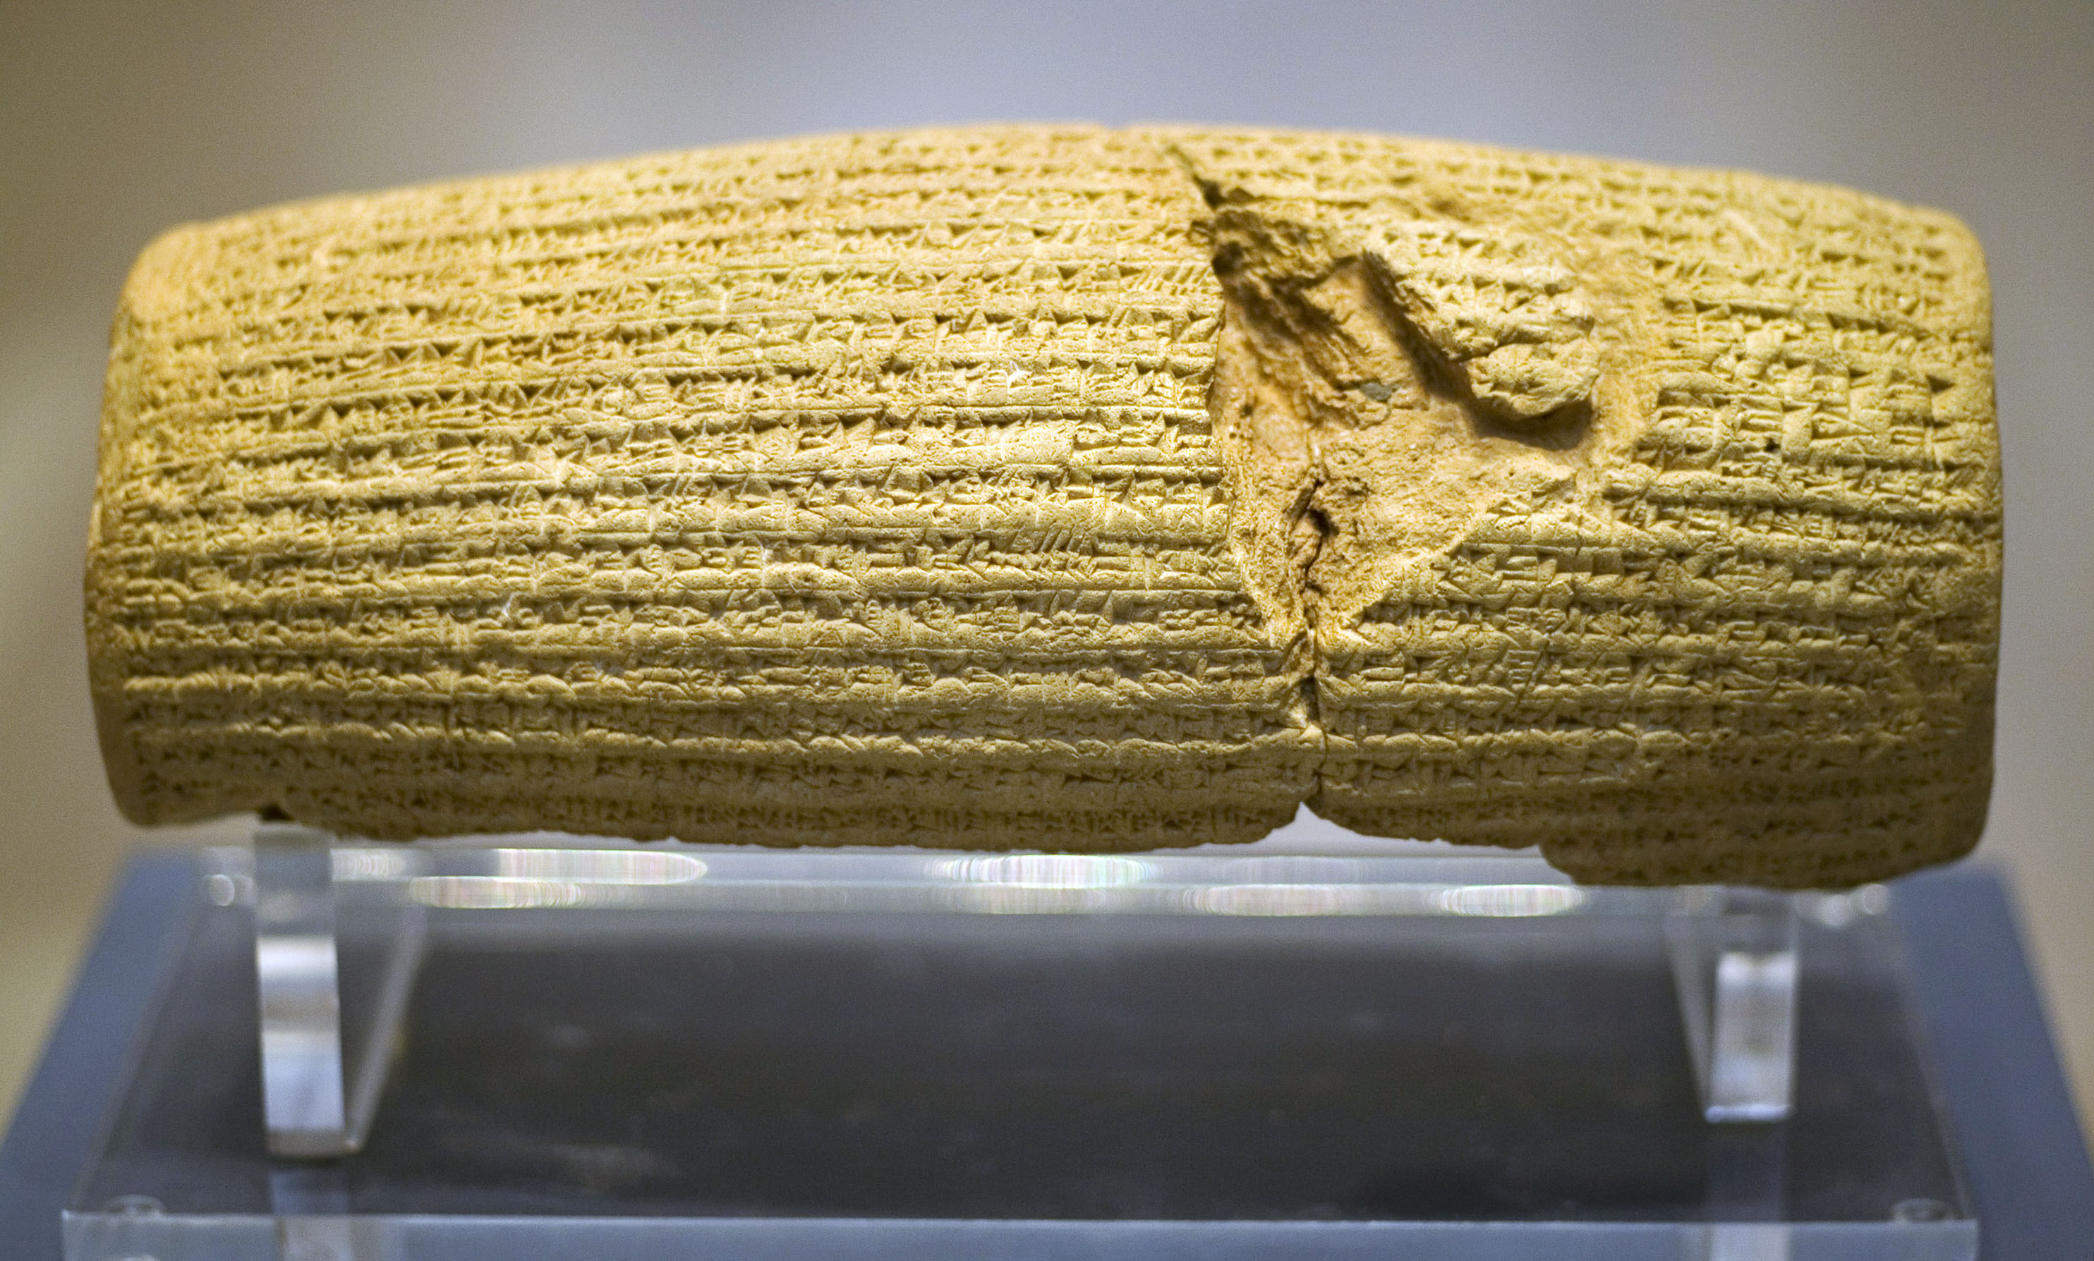
Notes:
The Cyrus Cylinder (Persian: استوانه کوروش‎, romanized: Ostovane-ye Kūrosh) or Cyrus Charter (منشور کوروشManshūre Kūrosh) is an ancient clay cylinder, now broken into several pieces, on which is written a declaration in Akkadian cuneiform script in the name of Persia's Achaemenid king Cyrus the Great.^{[2][3]} It dates from the 6th century BC and was discovered in the ruins of Babylon in Mesopotamia (modern Iraq) in 1879.^{[2]} It is currently in the possession of the British Museum, which sponsored the expedition that discovered the cylinder. It was created and used as a foundation deposit following the Persian conquest of Babylon in 539 BC, when the Neo-Babylonian Empire was invaded by Cyrus and incorporated into his Persian Empire.

Slide 12
Impressive Prophecies
Ezekiel Prophesies The Destruction of Tyre By “Many Nations” In Great Detail.
Ezekiel 26:1-12
Prophesied:
586 BC
Fulfilled:
585 BC 332 BC
Time Span:
Few Months, 254 Years
Notes:
Ezekiel’s prophetic message is one of the easiest to place in an accurate time frame. In verse 2 of the rst chapter, the prophet noted that his visions and prophecies began “in the fth year of King Johoiachin’s captivity.” The date for this captivity is virtually unanimously accepted as 597 B.C. during the second deportation of citizens from Judea to Babylon, which is documented in detail in 2 Kings 24:10-20. Furthermore, not only is the deportation recorded in the biblical account, but the ancient Chaldean records document it as well (Free and Vos, 1992, p. 194). Since Ezekiel’s visions began ve years after the deportation, then a rm date of 592 B.C. can be established for the beginning of his prophecy. The prophet supplies other specic dates such as the seventh year (20:1), the ninth year (24:1), the eleventh year (26:1), and the latest date given as the twenty-seventh year (29:17) [Note: for an outline see Archer, 1974, pp. 368-369].
Due to the rmly established dating system that Ezekiel chose to use for his prophecy, the date of the prophecy regarding the city of Tyre, found in chapter 26, can be accurately established as the eleventh year after 597, which would be 586 B.C.

Slide 13
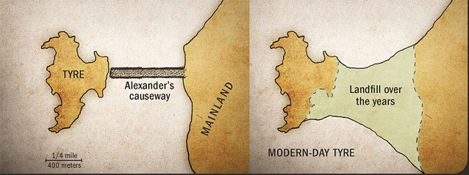

Slide 14
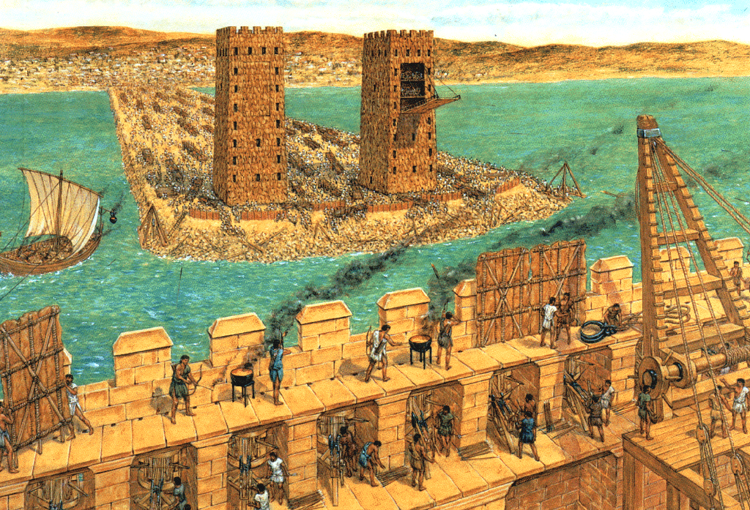

Slide 15
Impressive Prophecies
More Than Any Other Event, The Prophets Spoke In Detail About The Life of Jesus Christ.
Micah 5:2, Zechariah 9:9, 11:12, Isaiah 53
Prophesied:
Birth - 700 BC Betrayal – 520 - 470 BC Death – 739 - 681 BC
Fulfilled:
26-30 AD
Time Span:
700 Years, 500 Years, 700 Years

Slide 16
Impressive Prophecies
“Men of Galilee,” they said, “why do you stand here looking into the sky? This same Jesus, who has been taken from you into heaven, will come back in the same way you have seen him go into heaven.”
Acts 1:11
Notes:
The Lord is not slow in keeping his promise, as some understand slowness. Instead he is patient with you, not wanting anyone to perish, but everyone to come to repentance.
2 Peter 3:9

Slide 17
Prophecy from God
Notes:
Possible Slant – how to talk to an atheist about Bible prophecy. Aron Ra – popular Athiest on Twitter (X) claims Bible prophecy is ambiguous!
I want to point out today how specific it truly is!
I need to point out that these prophecies are specific. These prophecies are well-documented. These prophecies are far in advance of the events.
Or – how to use SPECIFIC prophecy to start a conversation about God who wants to be worshipped in the specifics too.
Acts 7:51-52. Prophecy should not be ignored!

