Slide 1
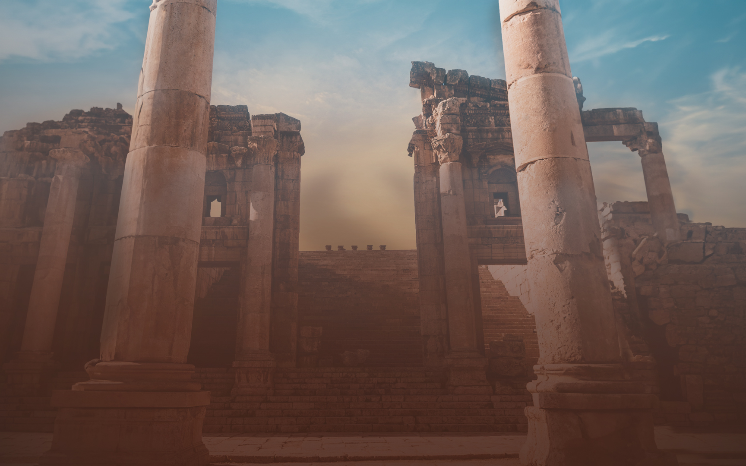

Slide 2
The Struggle Wasn’t New…
“But recall the former days when, after you were enlightened, you endured a hard struggle with sufferings, sometimes being publicly exposed to reproach and affliction, and sometimes being partners with those so treated. For you had compassion on those in prison, and you joyfully accepted the plundering of your property, since you knew that you yourselves had a better possession and an abiding one.” (10:32-34)

Slide 3
Lesson Titles | Sundays at 6 PM
Intro: Fixing Our Eyes on Jesus | September 17, 2023
Focusing Our Eyes on Jesus:
The Author and Perfector of Faith | October 15, 2023
The Joy Set Before Him | November 19, 2023
Enduring the Cross, Despising the Shame | December 17, 2023
Sitting at the Right Hand of God’s Throne | January 21, 2024
The Same Yesterday, Today, and Tomorrow | February 18, 2024
Living Like Jesus:
Laying Aside Every Weight and Sin | March 17, 2024
Sharing in His Holiness | April 21, 2024.
Seeking the City to Come | May 19, 2024
Loving Sacrificially | June 16, 2024
Rejecting Strange Teaching | July 21, 2024
Conclusion: Jesus Working in Us | August 18, 2024

Slide 4
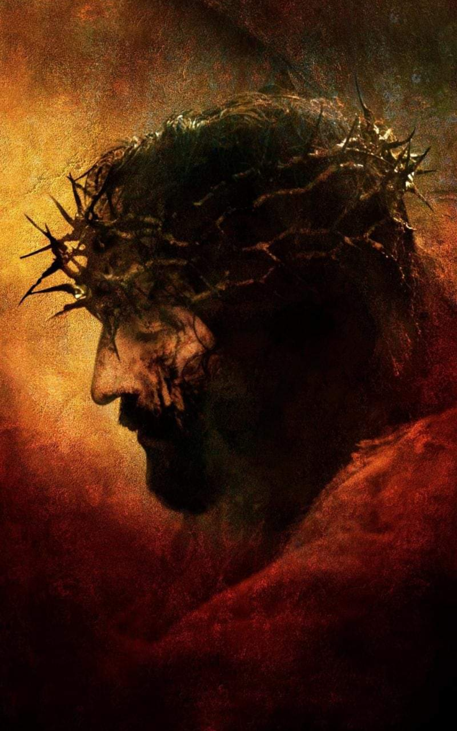
² “looking to Jesus, the founder and perfecter of faith, who for the joy that was set before him endured the cross, despising the shame, and is seated at the right hand of the throne of God.”

Slide 5
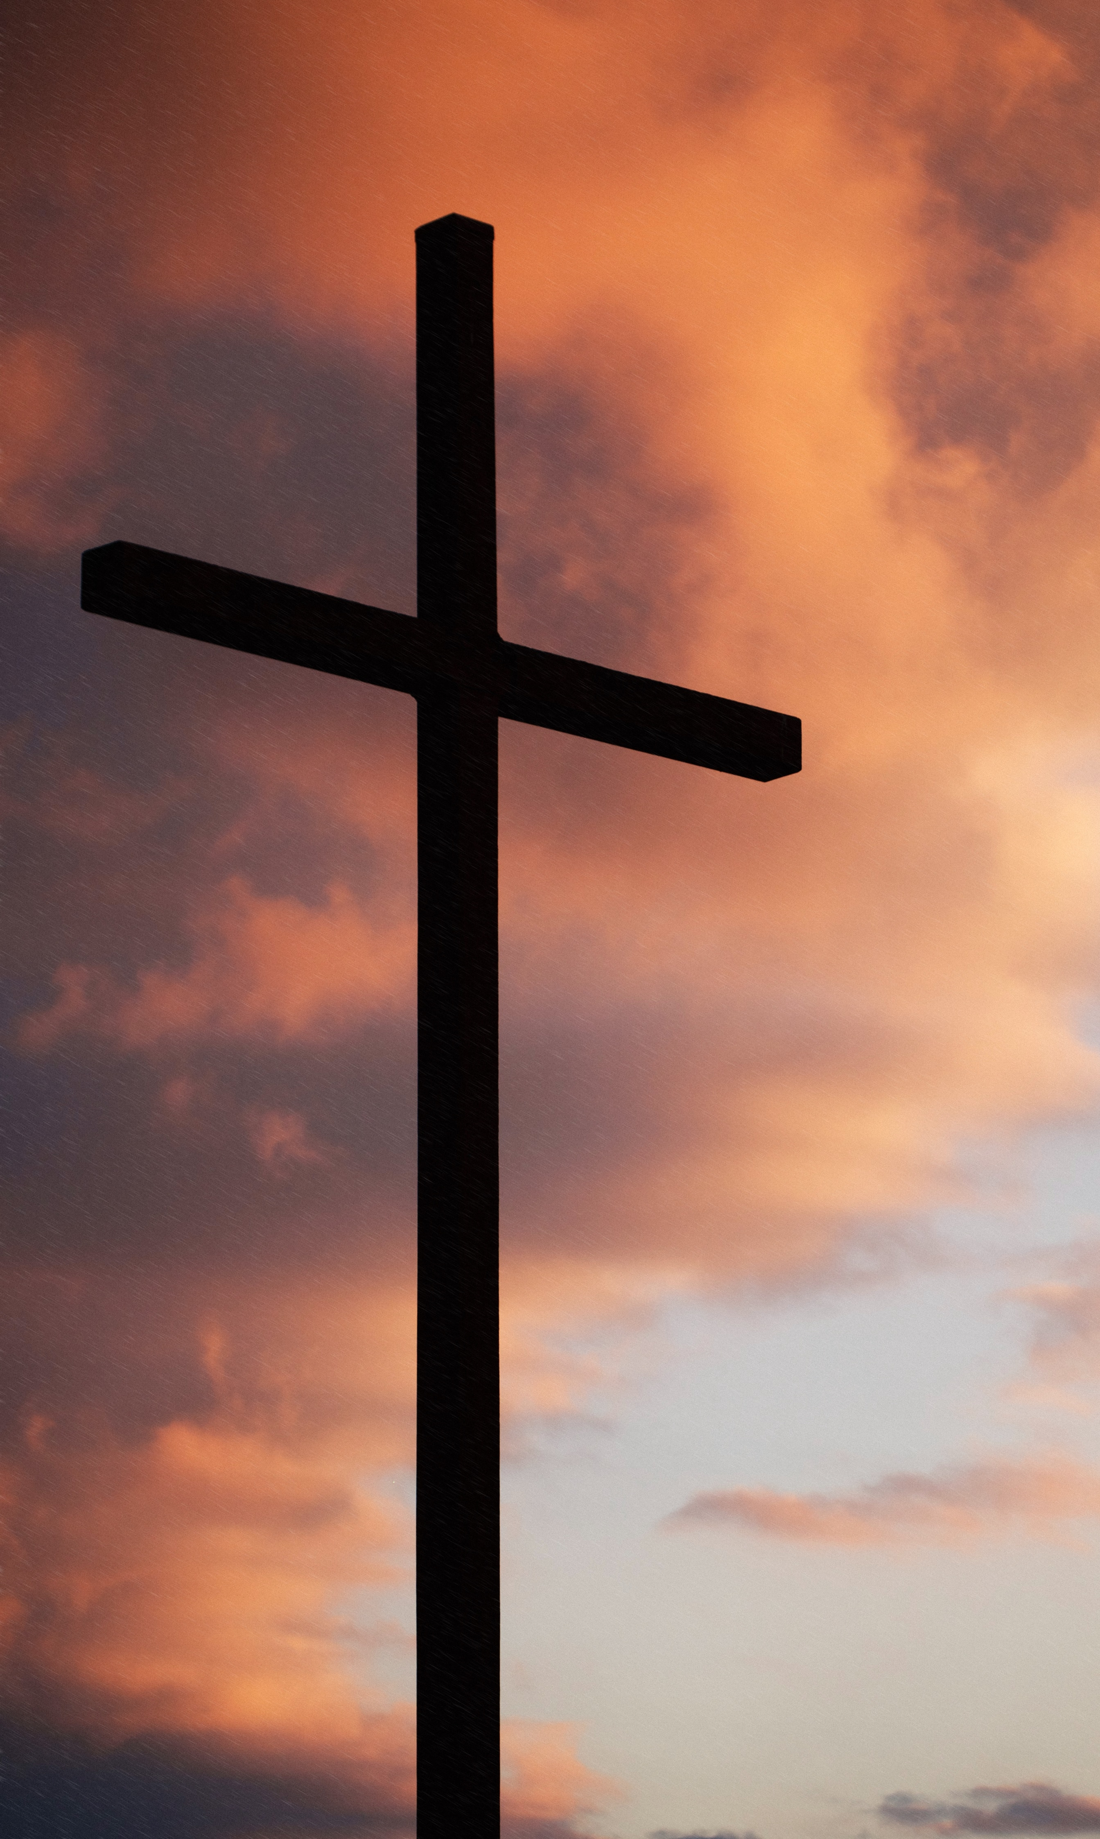
Struck and Beaten “And some began … to cover his face and to strike Him … And the guards received him with blows.” (Mk. 14:65).
The Crown of Thorns “And twisting together a crown of thorns, they put it on him.” (Mk. 15:17). “And they were striking his head with a reed.” (Mk. 15:19)
Scourging “Then Pilate took Jesus and flogged him.” (John 19:1, cf. Mk. 15:15)
Crucifixion “and he went out, bearing his own cross … There they crucified him. (John 19:17-18)

Slide 6
² “looking to Jesus, the founder and perfecter of faith, who for the joy that was set before him endured the cross, despising the shame, and is seated at the right hand of the throne of God.”

Slide 7
Despising the Shame
“Despising”
“Shame”
“To look down on with disrespect or aversion’; ‘to regard as negligible, worthless, or distasteful.” (M-W)
“However, in Greek, to despise … normally has the milder sense of ‘to disregard’ or ‘to think little or nothing’… (McClister)
Disregarded” (NET, NLT)
“Then they left the presence of the council, rejoicing that they were counted worthy to suffer dishonor for the name.” (Acts 5:41)
“A painful emotion caused by consciousness of guilt, shortcoming, or impropriety (?); a condition of humiliating disgrace or disrepute.” (M-W)

Slide 8
“The nation is in serious trouble, and personal dreams have been shattered. Thus the hiking trails at nearby Pukhansan National Park have become a sort of hide-out for newly unemployed businessmen. Too embarrassed to tell their families the bad news, the men continue to leave their homes each morning dressed in work attire but head for the mountains instead of their offices. Judging from the efforts to maintain appearances—and thereby preserve honor—reflected in the above quotation, certain high-group Koreans apparently value honor more highly than they value truth. The same is the case for much of the Mediterranean world.”
(Los Angeles Times, January 14, 1998, PART ‘A.’, per Hellerman 2000)

Slide 9
Crucifixion was considered the appropriate punishment for slaves, bandits, prisoners of war, and revolutionaries.
Public trials served as status degradation rituals, which labelled the accused as a shameful person
Flogging and torture, especially the blinding of the eyes and the shedding of blood, generally accompanied the sentence…
The condemned were forced to carry the cross beam.
The victim’s property, normally clothing, was confiscated…
The victim lost power and thus honor through pinioning of hands and arms, especially the mutilation of being nailed to the cross.
Executions served as crude forms of public entertainment, where the crowds ridiculed and mocked the victims…
Death by crucifixion was often slow and protracted.
In many cases, victims were denied honorable burial.
“Victims would thus experience themselves as progressively humiliated and stripped entirely of public respect or honor.” (Neyrey)

Slide 10
Spitting “And some began to spit on him…” (Mk. 14:65) “And they were striking his head with a reed and spitting on him …” (Mk. 15:19) “And they will mock him and spit on him and flog him and kill him.” (Mk. 10:34)
Ridicule “And when they had mocked him, they stripped him of the [scarlet] robe and put his own clothes on him…” (Mt. 27:31) “And Herod with his soldiers treated him with contempt and mocked him. Then, arraying him in splendid clothing, he sent him back to Pilate.” (Lk. 23:11)
Heaping Insults
“And those who passed by derided him … Those were crucified with him also reviled him.
(Mk. 15:29-32)

Slide 11
And us?

Slide 12
“But recall the former days when, after you were enlightened, you endured a hard struggle with sufferings, sometimes being publicly exposed to reproach and affliction, and sometimes being partners with those so treated.” (10:32-33)
“He considered the reproach of Christ greater wealth than the treasures of Egypt, for he was looking to the reward.” (11:26)
“Therefore let us go to him outside the camp and bear the reproach he endured.” (13:13)

Slide 13
Isaiah 50
⁴ The Lord God has given me the tongue of those who are taught, that I may know how to sustain with a word him who is weary. Morning by morning he awakens; he awakens my ear to hear as those who are taught. ⁵ The Lord God has opened my ear, and I was not rebellious; I turned not backward. ⁶ I gave my back to those who strike, and my cheeks to those who pull out the beard; I hid not my face from disgrace and spitting.
⁷ But the Lord God helps me; therefore I have not been disgraced; therefore I have set my face like a flint, and I know that I shall not be put to shame.

Slide 14
Isaiah 50
⁸ He who vindicates me is near. Who will contend with me? Let us stand up together. Who is my adversary? Let him come near to me. ⁹ Behold, the Lord God helps me; who will declare me guilty? Behold, all of them will wear out like a garment; the moth will eat them up.
¹⁰ Who among you fears the Lord and obeys the voice of his servant? Let him who walks in darkness and has no light trust in the name of the Lord and rely on his God.

Slide 15
Isaiah 50
¹¹ Behold, all you who kindle a fire, who equip yourselves with burning torches! Walk by the light of your fire, and by the torches that you have kindled! This you have from my hand:
you shall lie down in torment.

Slide 16
God defines real honor and shame.
Set your face like a flint.
Engage.

Slide 17
“5 Have this mind among yourselves, which is yours in Christ Jesus, 6 who, though he was in the form of God, did not count equality with God a thing to be grasped, 7 but emptied himself, by taking the form of a servant, being born in the likeness of men. 8 And being found in human form, he humbled himself by becoming obedient to the point of death, even death on a cross. 9 Therefore God has highly exalted him and bestowed on him the name that is above every name, 10 so that at the name of Jesus every knee should bow, in heaven and on earth and under the earth, 11 and every tongue confess that Jesus Christ is Lord, to the glory of God the Father.” (Philippians 2:5-11)

