Slide 2
Summary
A study of parables that call us to radically change our hearts and actions to be true kingdom citizens. We want to find specific changes to make as we start a new year of service to God.

Slide 3
Year-End Study Goals
To improve our skill in reading and applying Jesus’ parables
To better understand the nature of God’s Kingdom and our roles within it
To make specific changes to our thinking and daily lives to be better Kingdom citizens
Notes:
Goal 1: Depending on how you count, there are between 30 and 50 parables in the Gospels. We will only consider 12 parables, but we hope to learn how to read parables better so we’ll benefit from all 30 (or 50) as we all continue to study.
Goal 2: If we are to be transformed, we have to know what we should transform into. These parables will give us a stronger foundation for growth by improving our knowledge of what the Kingdom is and what our roles within it should be.
Goal 3: Building on that foundation, we each need to find specific changes to make to our hearts and actions, and then commit to making those changes. The new year is a great time to start this transformation.

Slide 4
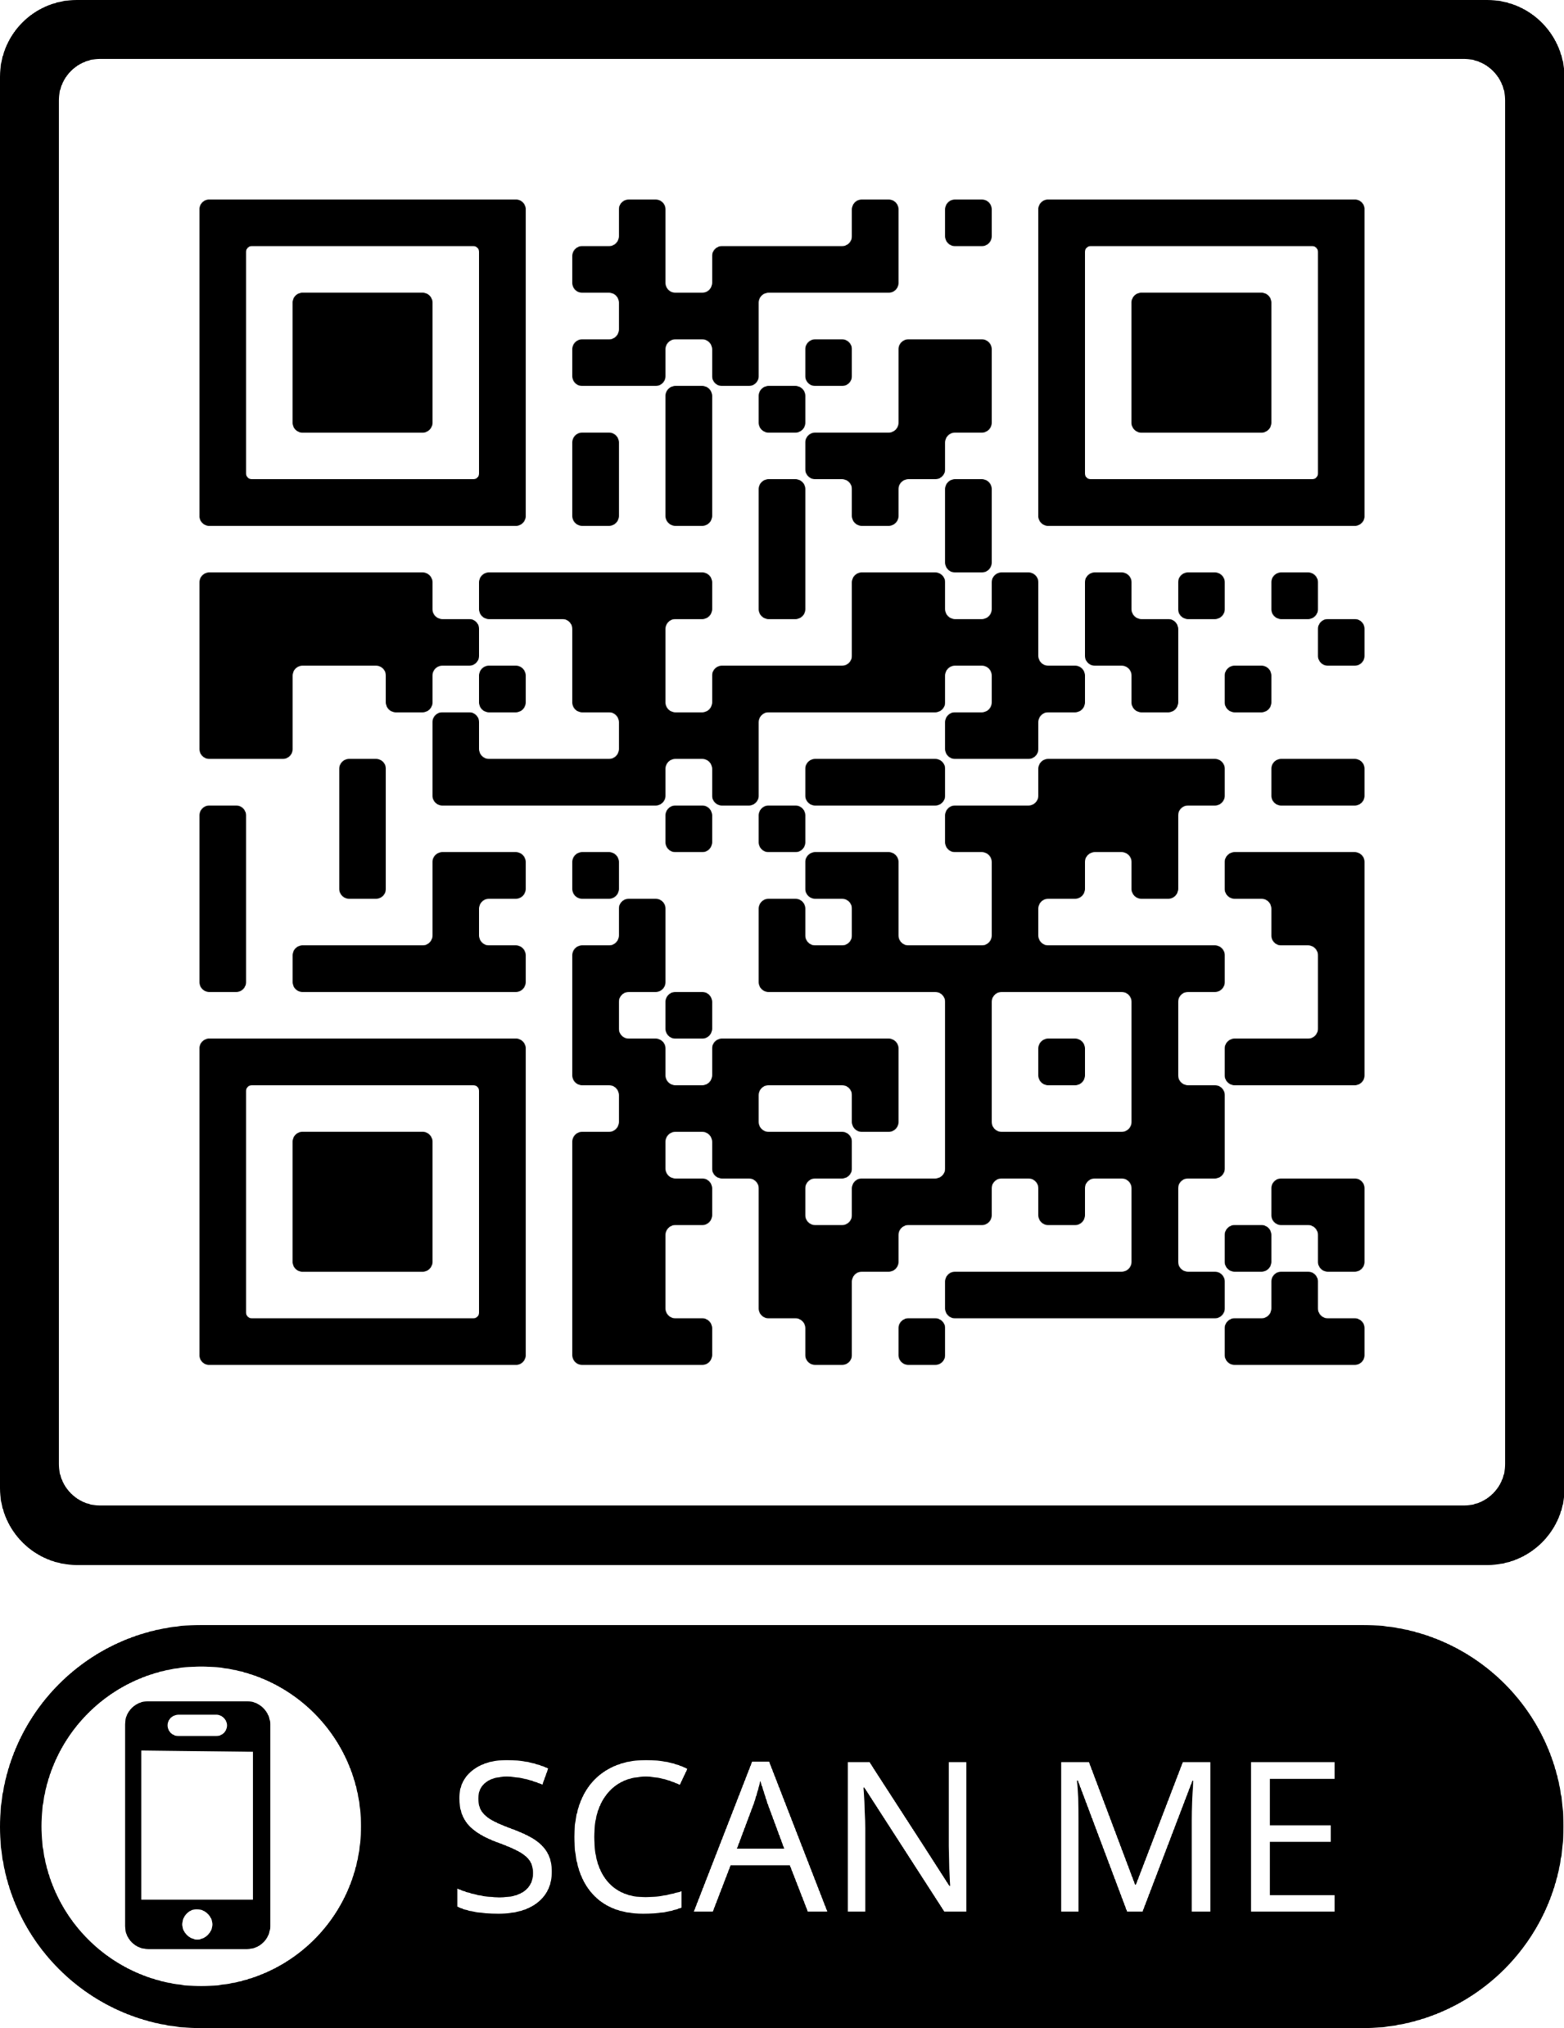
Further Reading

Slide 6
Objectives
Describe 3 foolish things the foolish virgins did
List at least 3 activities we can engage in to be “on the alert” as we wait for the Lord
Explain how we sometimes ask to borrow others’ spiritual oil

Slide 7
What message has Jesus been emphasizing in Matthew 24? Consider especially 24:44.
Text Question 1

Slide 8
Building Toward Judgment
No one knows the day or the hour, 24:36
Like the coming of the flood, vv.37-39
Some taken (judged) and some left (saved), vv.40-41
Therefore, be on the alert, 24:42
Be like one who expects a thief, vv.43-44
Be like the sensible [phronimos: wise] slave, vv.45-47
Responsible, thoughtful, discreet, cautious
Expecting and prepared for the master’s return
Don’t be like the evil slave, vv.48-51
Irresponsible, presumptuous, even rebellious
Not expecting or prepared for the return

Slide 9
Key Phrases in Matthew 24
Be on the alert
You do not know the day…
“See to it that no one misleads you,” v.4
“When you see all these things, […] He is near,” v.33
“They were eating and drinking, marrying and giving in…” v.38
“Be on the alert,” v.42
“He would have been on the alert,” v.43
“For this reason you must also be ready,” v.44
“On a day he does not ex-pect him…” v.50
Disciples: “When will these things happen?” v.3
“Of that day and hour no one knows…” v.36
“They did not [know, ASV, KJV] until the flood came,” v.39
“You do not know which day…” v.42
“If [he] had known at what time of night the thief was coming…” v.43
“[He] is coming at an hour when you do not think He will,” v.44
“…at an hour which he does not know,” v.50
Notes:
There’s a contrast all through 24 between those who are on the alert and expecting, and those who are not.

Slide 10
Building Toward Judgment
The Parable of the Ten Virgins, 25:1-13
The Parable of the Talents, 25:14-30
Each person will be judged by how they managed what they were given in trust, vv.14-28
Those who are unprepared are cast into darkness, vv.29-30
Description of the Final Judgment, 25:31-46
Those who used the opportunities they had are accepted, vv.34-40
Those who did not use the opportunities are rejected, vv.41-46
Notes:
Talents: emphasizes giving an account of our actions
Judgment: Emphasizes receiving final judgment for our actions
There’s a gap here: how did we get from “be ready” to “you’ll be judged by your deeds”?

Slide 11
Matthew 25:1-13 (NASB 95)
¹ Then the kingdom of heaven will be comparable to ten virgins, who took their lamps and went out to meet the bridegroom. ² Five of them were foolish, and five were prudent. ³ For when the foolish took their lamps, they took no oil with them, ⁴ but the prudent took oil in flasks along with their lamps. ⁵ Now while the bridegroom was delaying, they all got drowsy and began to sleep. ⁶ But at midnight there was a shout, “Behold, the bridegroom! Come out to meet him.” ⁷ Then all those virgins rose and trimmed their lamps. ⁸ The foolish said to the prudent, “Give us some of your oil, for our lamps are going out.” ⁹ But the prudent answered, “No, there will not be enough for us and you too; go instead to the dealers and buy some for yourselves.” ¹⁰ And while they were going away to make the purchase, the bridegroom came, and those who were ready went in with him to the wedding feast; and the door was shut. ¹¹ Later the other virgins also came, saying, “Lord, lord, open up for us.” ¹² But he answered, “Truly I say to you, I do not know you.” ¹³ Be on the alert then, for you do not know the day nor the hour.

Slide 12
Matthew 25:1-13 (NASB 95)
¹ Then the kingdom of heaven will be comparable to ten virgins, who took their lamps and went out to meet the bridegroom. ² Five of them were foolish, and five were prudent. ³ For when the foolish took their lamps, they took no oil with them, ⁴ but the prudent took oil in flasks along with their lamps. ⁵ Now while the bridegroom was delaying, they all got drowsy and began to sleep. ⁶ But at midnight there was a shout, “Behold, the bridegroom! Come out to meet him.” ⁷ Then all those virgins rose and trimmed their lamps. ⁸ The foolish said to the prudent, “Give us some of your oil, for our lamps are going out.” ⁹ But the prudent answered, “No, there will not be enough for us and you too; go instead to the dealers and buy some for yourselves.” ¹⁰ And while they were going away to make the purchase, the bridegroom came, and those who were ready went in with him to the wedding feast; and the door was shut. ¹¹ Later the other virgins also came, saying, “Lord, lord, open up for us.” ¹² But he answered, “Truly I say to you, I do not know you.” ¹³ Be on the alert then, for you do not know the day nor the hour.

Slide 13
List things the foolish virgins did right in the parable.
Thought Question 1

Slide 14
Five Were Foolish
What they did right:
Showed up
Brought lamps
Waited for the groom
Responded to the call

Slide 15
List things the foolish virgins did wrong in the parable.
Thought Question 1

Slide 16
Five Were Foolish
What they did right:
What they did wrong:
Showed up
Brought lamps
Waited for the groom
Responded to the call
Did not bring oil
Did not use the time they had to get oil
Tried to borrow oil from the others

Slide 17
Subsidiary Application:
We can’t borrow some-one else’s spiritual oil.

Slide 18
Trying to Borrow Others’ Oil
Expecting to be accepted in judgment for just showing up to services
Counting on our heritage (church or personal)
Having convictions we haven’t studied ourselves
Expecting Bible class teachers to equip our kids
Being a member of the “right” church
Not preparing our faith for a spiritual crisis
Saying “Somebody ought to do [blank]”

Slide 19
Main Application:
We always need to have our lamps filled and ready.

Slide 20
Consider 1 Thessalonians 5:5-11. What actions can we take to “be on the alert” as we wait for the bridegroom?
Thought Question 3

Slide 21
Being Alert and Sober
1 Thessalonians 5:5-11
⁵ for you are all sons of light and sons of day. We are not of night nor of darkness; ⁶ so then let us not sleep as others do, but let us be alert and sober. ⁷ For those who sleep do their sleeping at night, and those who get drunk get drunk at night. ⁸ But since we are of the day, let us be sober, having put on the breastplate of faith and love, and as a helmet, the hope of salvation. ⁹ For God has not des-tined us for wrath, but for ob-taining salvation through our Lord Jesus Christ, ¹⁰ who died for us, so that whether we are awake or asleep, we will live together with Him. ¹¹ Therefore encourage one another and build up one another, just as you also are doing.
Don’t waste time, v.7
Sleeping (idleness/laziness)
Drunkenness (distraction/ dissipation)
Demonstrate faith and love, v.8
Be prepared to defend yourself and others against temptation
Demonstrate our hope of salvation, v.8
Living in expectation of it, v.9
Build fellowship, v.11
Encourage each other to live this way
Strengthen each other to be stronger and more faithful

Slide 22
How to Be on the Alert in 2024
Start each day with the thought that Jesus will return
Attend every Bible class session
Do every lesson before class
Attend every worship service and “extra” session
Make a plan to overcome your biggest sin
Find or become an accountability partner
Build new relationships with 3 members
Get rid of distractions/things that dissipate your focus
Watch less news, sports, YouTube, streaming, etc.
Spend less time browsing/shopping online

Slide 25
Year-End Study Schedule
Date | Topic | Application | Session | Speaker
Sun, Dec 17 | Parable of the Soils Mark 4:1-23 | Learning to Understand the Parables | AM Sermon | Bill Sanchez
Wed, Dec 20 | Parable of the Friend at Midnight Luke 11:5-13 | Learning Persistence in Prayer | Bible Class | Ryan Poe
Sun, Dec 24 | Parable of the Rich Fool Luke 12:13-21 | Learning to Reject Materialism | Bible Class | Marty Broadwell
Wed, Dec 27 | Parable of Laborers in the Vineyard Matthew 20:1-16 | Learning to Rejoice in Kingdom Growth | Bible Class | Russ LaGrone
Sun, Dec 31 | Parable of the Wedding Feast Matthew 22:1-14 | Learning to Submit to God’s Standards | Bible Class | Phillip Shumake
Sun, Dec 31 | Parables of the Kingdom Matthew 13, 18 | Learning to Be Better Kingdom Citizens | PM Service | Various
Wed, Jan 3 | Parable of the Ten Virgins Matthew 25:1-13 | Learning to Maintain Our Commitment | Bible Class | Mason Broadwell
Notes:
Material in multiple locations in the foyer; will also be online.

