Slide 1
Hebrews
Lesson Six: Convinced of Better Things

Slide 3
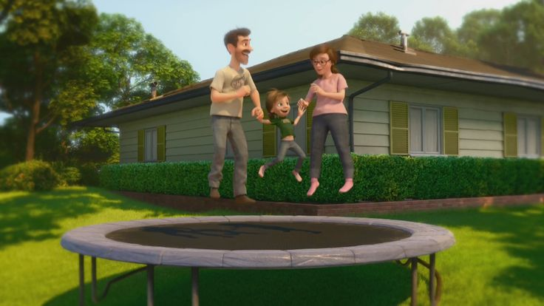
Great Family
Great House
Great Yard
Great Friends
Great Hockey Team
Happy
Life

Slide 4
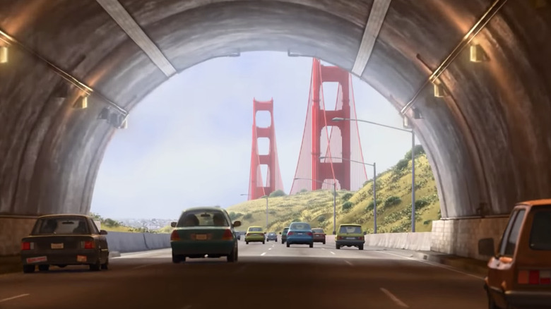
Hopeful
Change
Happy
Life

Slide 5
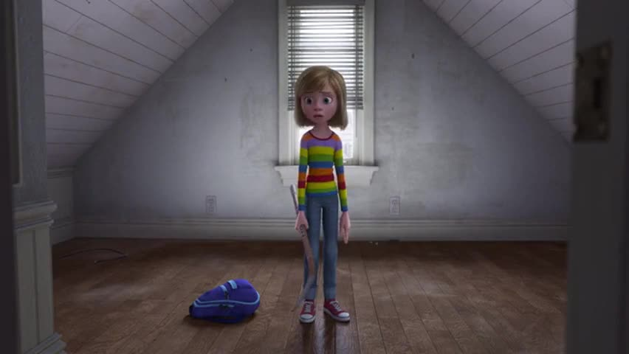
Ugly House
Nasty Room
Stressed
Parents
Broccoli Pizza!
Fails Hockey Tryouts
Hard
Struggles
Hopeful
Change
Happy
Life

Slide 6
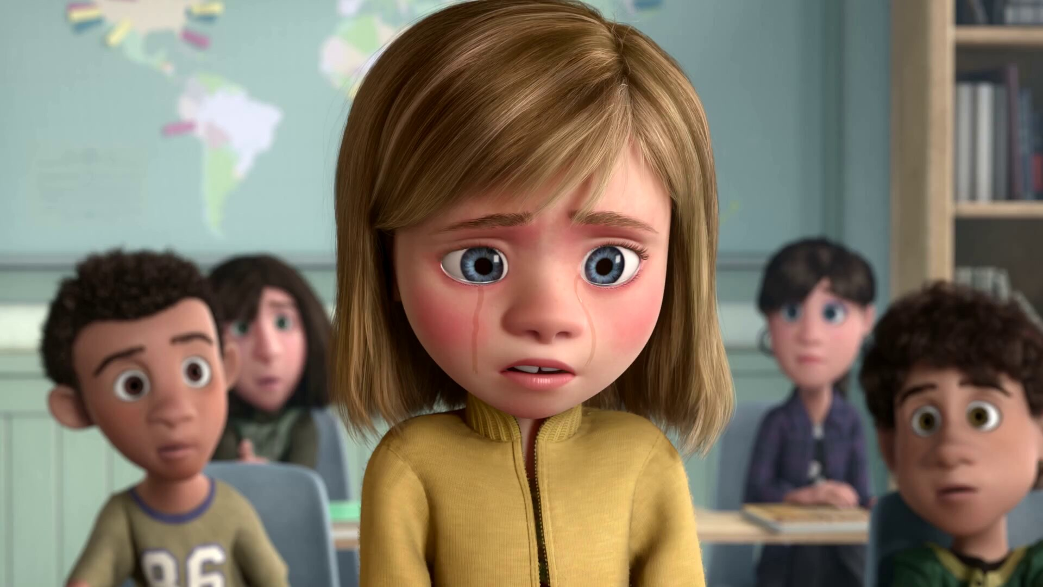
Emotional
Crisis
Hard
Struggles
Hopeful
Change
Happy
Life

Slide 7
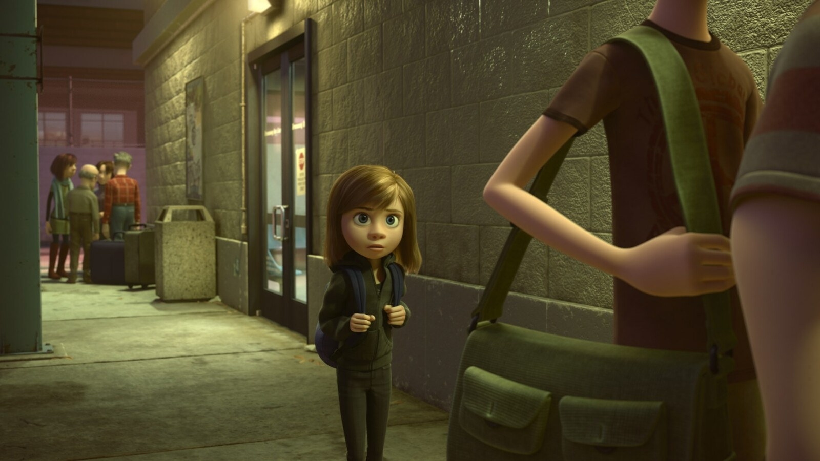
Emotional
Crisis
Hard
Struggles
Hopeful
Change
Happy
Life
Go Back!

Slide 8
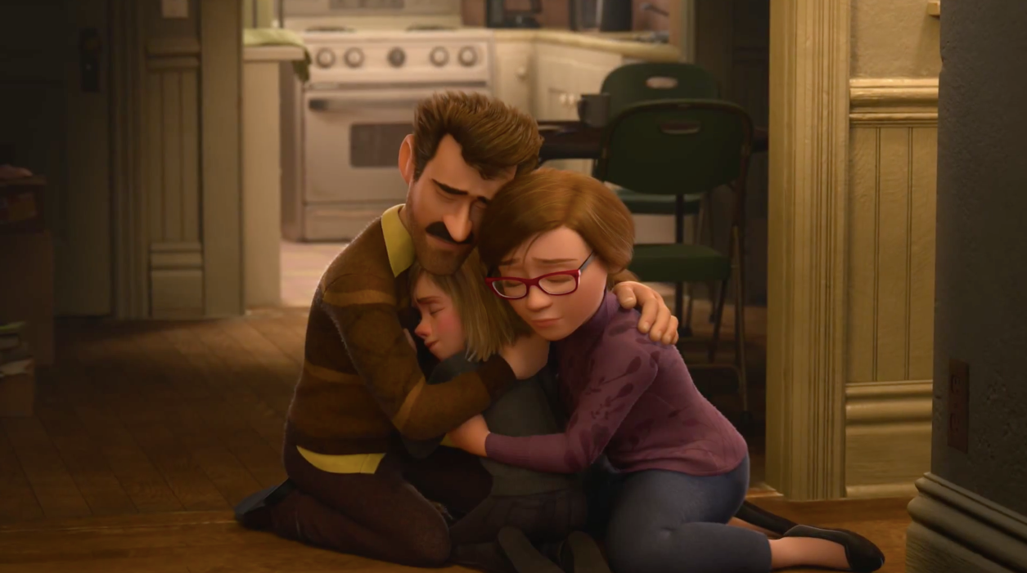
Seek
Help
Emotional
Crisis
Hard
Struggles
Hopeful
Change
Happy
Life
Go Back!

Slide 9
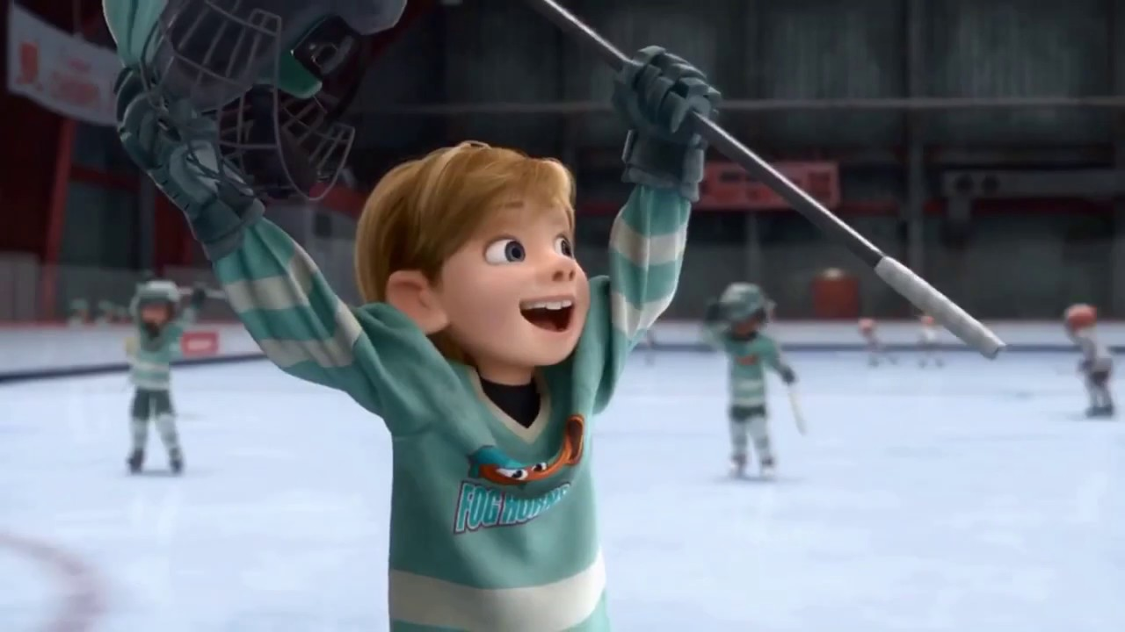
Better
Life
Seek
Help
Emotional
Crisis
Hard
Struggles
Hopeful
Change
Happy
Life
Go Back!

Slide 10
10:32-34
Hebrews
Better
Life
Seizure of Property
Moses, Law, Traditions
Public Ridicule
Became Christians
Secure Community
Sent to Prison
Seek
Help
Emotional
Crisis
Temple & Feasts
Hard
Struggles
Hopeful
Change
Happy
Life
Harden your hearts
Throw away your confidence
Shrink back
Grow weary
Lose heart
Go Back!
DO NOT

Slide 11
“…let us press on to maturity…”
Better
Life
JESUS IS OUR
7-10:18
GREAT HIGH PRIEST
“Beloved, we are convinced of better things concerning you…”
Seek
Help
Emotional
Crisis
Hard
Struggles
Hopeful
Change
Happy
Life
Harden your hearts
Throw away your confidence
Shrink back
Grow weary
Lose heart
Go Back!
DO NOT

Slide 12
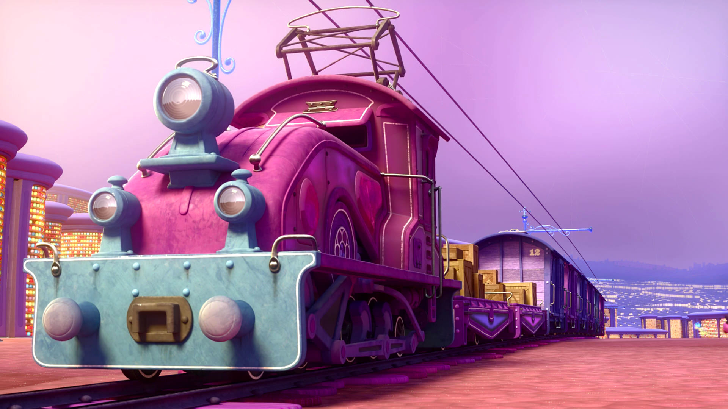
Train of Thought

Slide 13
Train of Thought

Slide 14
TABERNACLE
COVENANT
ORDER & OATH
JESUS IS OUR
7-10:18
GREAT HIGH PRIEST
SACRIFICE
promises
MINISTRY
Train of Thought

Slide 15
Sorrowful
Straighten
Lest we drift
Enduring foR
12:4-11
Discipline
Pay Attention
Joy set before Him
Angels
1:4-2:16
God has spoken
1:1-3
In his son
Strengthen
Pursue Peace
Why Lower?
Right Hand
Righteousness
Prepare
12:12-17
to Endure
Endured Cross
Right Hand
Short of Grace
Purification
Despising Shame
Bitterness
Encourage
Suffering
FIXING OUR
12:2-3
Eyes On Jesus
Esau
Hold Firm
Faithful
Run with Endurance
2:17-18
Merciful
No Evil Hearts
Able to Help
Moses
Joshua
3-4
Be Diligent
MINISTRY
Have Faith
promises
SACRIFICE
COVENANT
TABERNACLE
ORDER & OATH
JESUS IS OUR
7-10:18
GREAT HIGH PRIEST
Miss Rest
God’s Word
THE CLOUD
10:32-12:1
OF witnesses
Shaking
Hold Fast
Throw Away
Need Endurance
Time of Need
4:14-16
Gratitude & Service
Reveremce & Awe
Grace to Help
Sinai
12:18-29
AND Zion
Draw Near
Consuming Fire
Immaturity
Suffering of Christ
Falling Away
Aaron
5:1-10
Melchi
zEdek
Judgment
Draw Near
Vengeance
Hold Fast
SINCE Therefore
10:19-25
LET US
For if we go
10:26-31
on sinning
Stir Up
Faith & Patience
Anchor of Hope
Encourage
Fury of Fire
Terrifying
5:11-6:20
Closing
13
exhortations
Train of Thought

Slide 16
GOD
God has spoken
1:1-3
In his son
SON
Right Hand
Purification
JESUS IS OUR
7-10:18
GREAT HIGH PRIEST
MAN

Slide 17
THE OATH
GOD
Angels
1:4-2:16
SON
God has spoken
1:1-3
In his son
Right Hand
Purification
ANGELS
JESUS IS OUR
7-10:18
GREAT HIGH PRIEST
MAN

Slide 18
THE OATH
HOLY
SPIRIT
GOD
Lest we drift
Pay Attention
Angels
1:4-2:16
SON
God has spoken
1:1-3
In his son
Right Hand
Purification
ANGELS
JESUS IS OUR
7-10:18
GREAT HIGH PRIEST
MAN
MAN
MAN
MAN
MAN

Slide 19
THE OATH
HOLY
SPIRIT
GOD
Lest we drift
Pay Attention
Angels
1:4-2:16
SON
God has spoken
1:1-3
In his son
Why Lower?
Right Hand
Purification
JESUS IS OUR
7-10:18
GREAT HIGH PRIEST
MAN
MAN
MAN
MAN
MAN

Slide 20
THE OATH
HOLY
SPIRIT
GOD
Lest we drift
Pay Attention
Angels
1:4-2:16
God has spoken
1:1-3
In his son
Why Lower?
Right Hand
Purification
JESUS IS OUR
7-10:18
GREAT HIGH PRIEST
MAN
MAN
SON
MAN
MAN
MAN
SON
SON

Slide 21
HOLY
SPIRIT
GOD
Lest we drift
Pay Attention
Angels
1:4-2:16
God has spoken
1:1-3
In his son
Why Lower?
Right Hand
Purification
JESUS IS OUR
7-10:18
GREAT HIGH PRIEST
SON
SON
MAN
MAN
SON
MAN
MAN
MAN

Slide 22
THE OATH
HOLY
SPIRIT
GOD
Lest we drift
Pay Attention
Angels
1:4-2:16
God has spoken
1:1-3
In his son
SON
Why Lower?
Right Hand
Purification
JESUS IS OUR
7-10:18
GREAT HIGH PRIEST
SON
MAN
MAN
SON
MAN
MAN
MAN

Slide 23
THE OATH
HOLY
SPIRIT
GOD
Lest we drift
Pay Attention
Angels
1:4-2:16
God has spoken
1:1-3
In his son
SON
Why Lower?
Right Hand
Purification
MAN
MAN
MAN
MAN
JESUS IS OUR
7-10:18
GREAT HIGH PRIEST
SON
SON
SON
SON
SON
MAN
SON

Slide 24
THE OATH
HOLY
SPIRIT
GOD
Lest we drift
Pay Attention
Angels
1:4-2:16
God has spoken
1:1-3
In his son
SON
Why Lower?
Right Hand
Purification
SON
SON
SON
SON
MAN
MAN
MAN
MAN
JESUS IS OUR
7-10:18
GREAT HIGH PRIEST
SON
MAN
SON

Slide 25
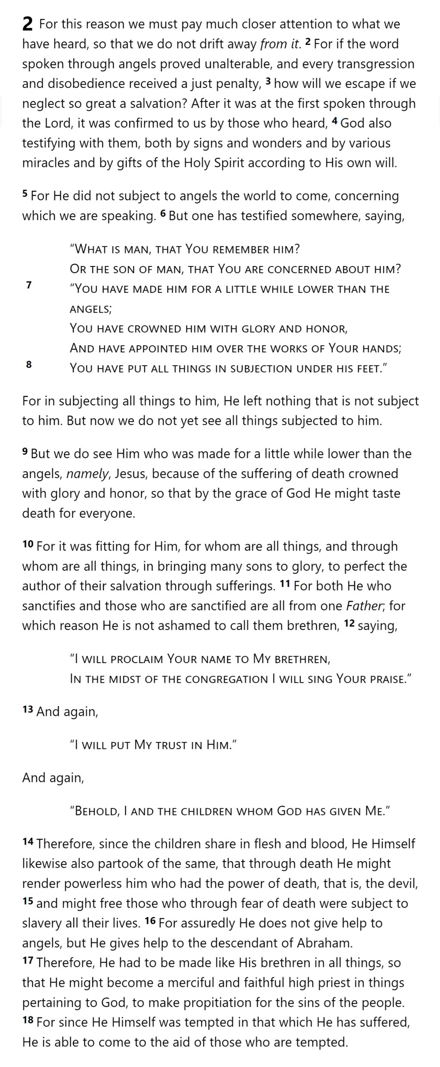
THE OATH
HOLY
SPIRIT
GOD
SON
SON
SON
SON
SON
ANGELS
Lest we drift
Pay Attention
Angels
1:4-2:16
God has spoken
1:1-3
In his son
Why Lower?
Right Hand
MAN
MAN
MAN
MAN
Purification
Suffering
SON
Faithful
2:17-18
Merciful
Able to Help
JESUS IS OUR
7-10:18
GREAT HIGH PRIEST
MAN
SON
Hebrews 2

Slide 26
THE OATH
Lest we drift
Pay Attention
Angels
1:4-2:16
HOLY
SPIRIT
GOD
God has spoken
1:1-3
In his son
Why Lower?
Right Hand
SON
Purification
Suffering
SON
SON
SON
SON
Encourage
ANGELS
Faithful
2:17-18
Hold Firm
Merciful
No Evil Hearts
Able to Help
Moses
Joshua
3-4
Be Diligent
JESUS IS OUR
7-10:18
GREAT HIGH PRIEST
MAN
MAN
MAN
MAN
Miss Rest
God’s Word
SON
MAN
SON
Hebrews 2

Slide 27
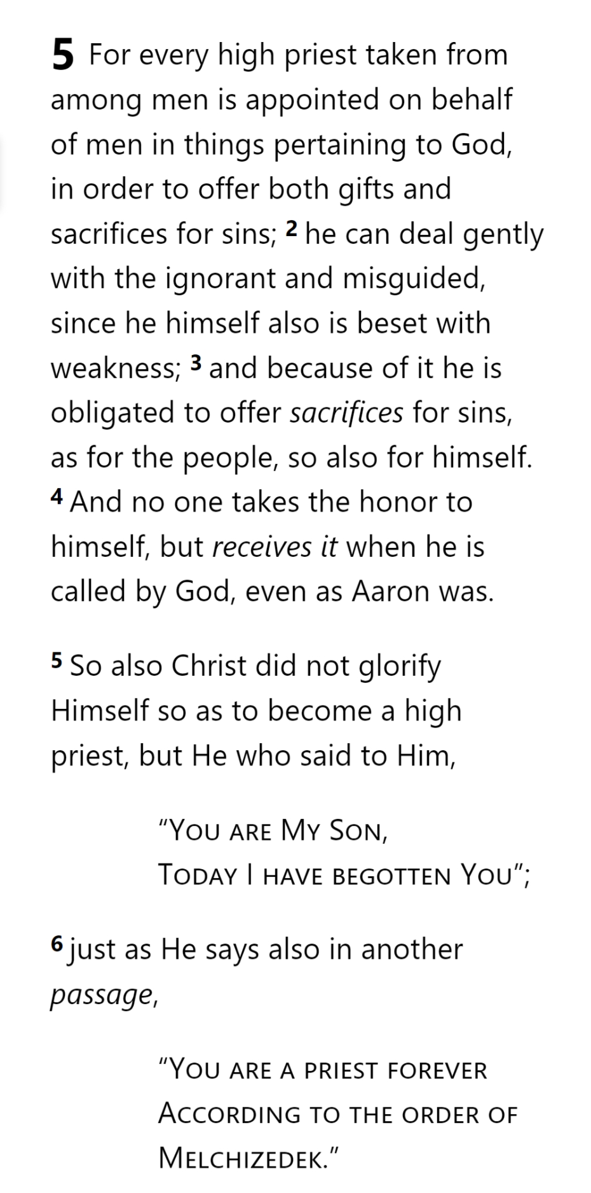
Lest we drift
Pay Attention
Angels
1:4-2:16
God has spoken
1:1-3
In his son
Why Lower?
Right Hand
Purification
Encourage
Suffering
Hold Firm
Faithful
2:17-18
Merciful
No Evil Hearts
Able to Help
Moses
Joshua
3-4
Be Diligent
MINISTRY
promises
SACRIFICE
COVENANT
TABERNACLE
ORDER & OATH
JESUS IS OUR
7-10:18
GREAT HIGH PRIEST
Miss Rest
God’s Word
Hold Fast
Time of Need
4:14-16
Grace to Help
Draw Near

Slide 28
Lest we drift
Pay Attention
Angels
1:4-2:16
God has spoken
1:1-3
In his son
Why Lower?
Right Hand
Purification
Encourage
Suffering
Hold Firm
Faithful
2:17-18
Merciful
No Evil Hearts
Able to Help
Moses
Joshua
3-4
Be Diligent
MINISTRY
promises
SACRIFICE
COVENANT
TABERNACLE
ORDER & OATH
JESUS IS OUR
7-10:18
GREAT HIGH PRIEST
Miss Rest
God’s Word
Hold Fast
Time of Need
4:14-16
Grace to Help
Draw Near
Aaron
5:1-10

Slide 29
Lest we drift
From Among Men
Pay Attention
Angels
1:4-2:16
God has spoken
1:1-3
In his son
Why Lower?
Right Hand
Purification
Encourage
Suffering
Hold Firm
Faithful
2:17-18
Merciful
No Evil Hearts
Able to Help
Moses
Joshua
3-4
Be Diligent
MINISTRY
promises
SACRIFICE
COVENANT
TABERNACLE
ORDER & OATH
JESUS IS OUR
7-10:18
GREAT HIGH PRIEST
Miss Rest
God’s Word
Hold Fast
Time of Need
4:14-16
Grace to Help
Draw Near
Aaron
5:1-10

Slide 30
From Among Men
Representative

Slide 31
From Among Men
Representative
Offer Sacrifices

Slide 32
From Among Men
Representative
Offer Sacrifices
Compassionate

Slide 33
From Among Men
Representative
Offer Sacrifices
Compassionate
Knows Weakness

Slide 34
From Among Men
Representative
Offer Sacrifices
Compassionate
Knows Weakness
Atones for Men

Slide 35
From Among Men
Representative
Offer Sacrifices
Compassionate
Knows Weakness
Atones for Men
Without Sin

Slide 36
From Among Men
Representative
Offer Sacrifices
Compassionate
Knows Weakness
Atones for Men
Without Sin
Appointed by God

Slide 37
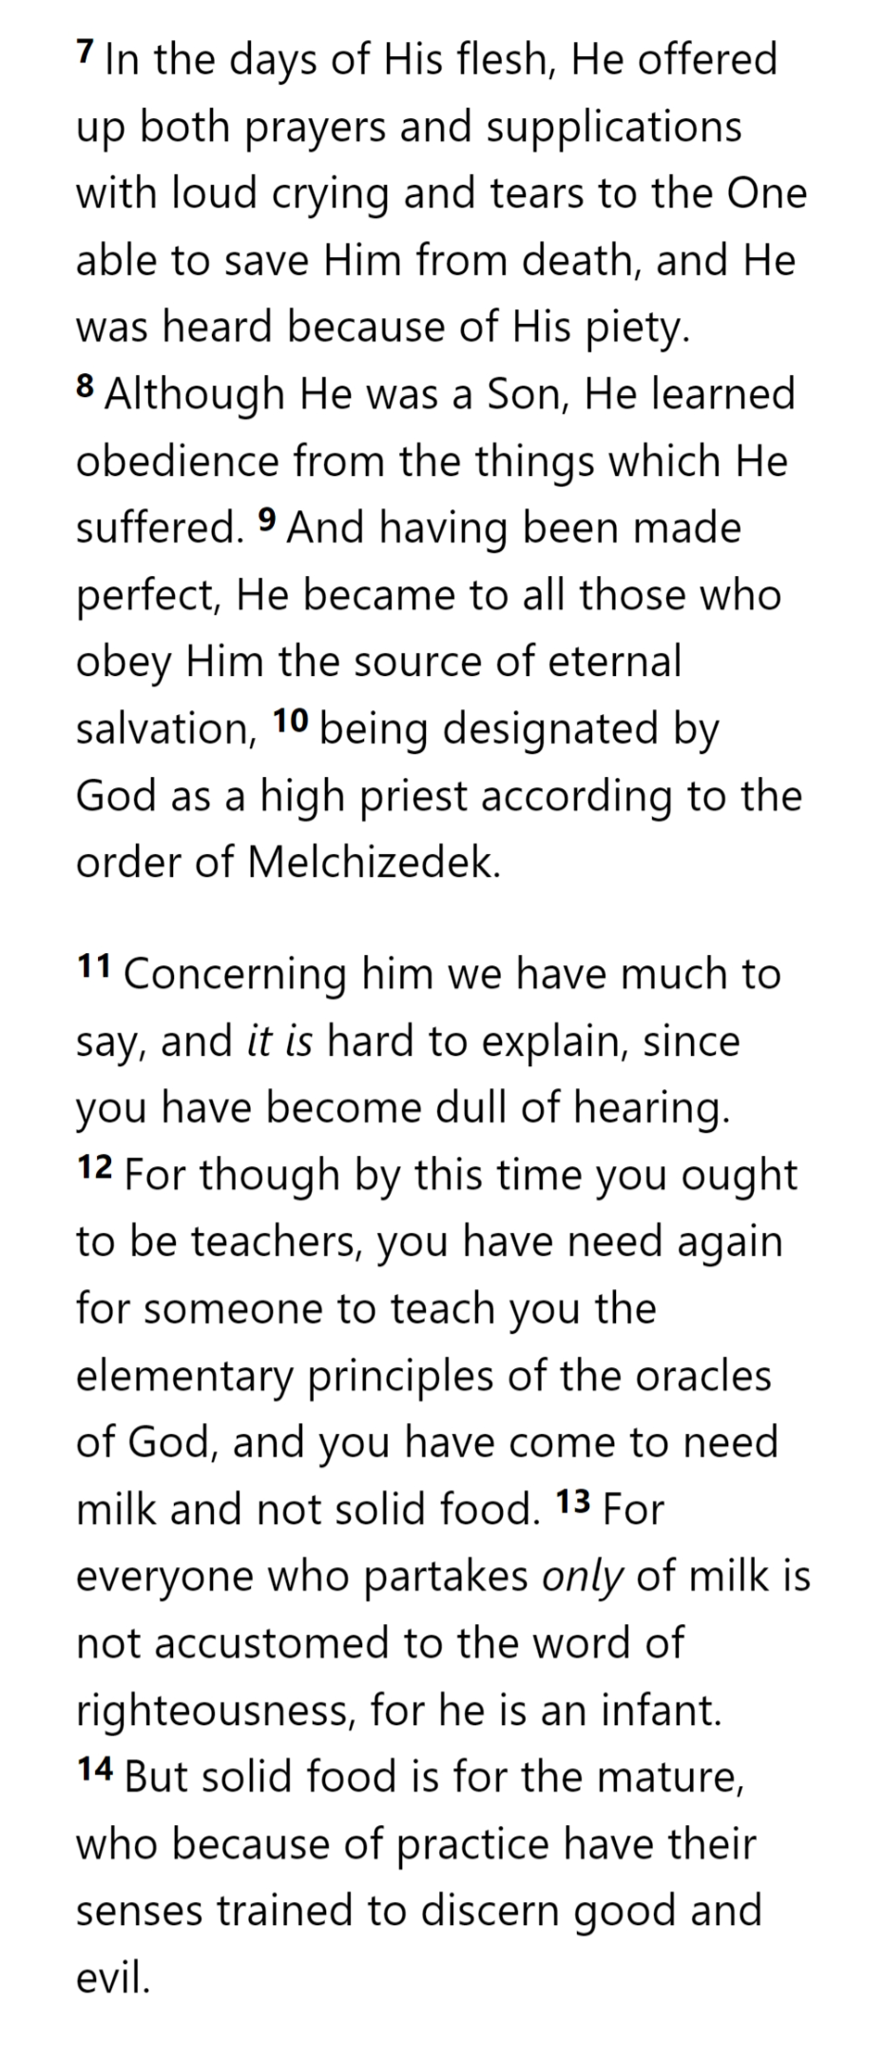
From Among Men
Representative
Offer Sacrifices
Compassionate
Knows Weakness
Atones for Men
Without Sin
Appointed by God

Slide 38
From Among Men
Representative
Offer Sacrifices
Compassionate
Knows Weakness
Atones for Men
Without Sin
Appointed by God

Slide 39
Lest we drift
Pay Attention
Angels
1:4-2:16
God has spoken
1:1-3
In his son
Why Lower?
Right Hand
Purification
Encourage
Suffering
Hold Firm
Faithful
2:17-18
Merciful
No Evil Hearts
Able to Help
Moses
Joshua
3-4
Be Diligent
MINISTRY
promises
SACRIFICE
COVENANT
TABERNACLE
ORDER & OATH
JESUS IS OUR
7-10:18
GREAT HIGH PRIEST
Miss Rest
God’s Word
Hold Fast
Time of Need
4:14-16
Grace to Help
Draw Near
Immaturity
Suffering of Christ
Falling Away
Aaron
5:1-10
Melchi
zEdek
Faith & Patience
Anchor of Hope
5:11-6:20

Slide 40
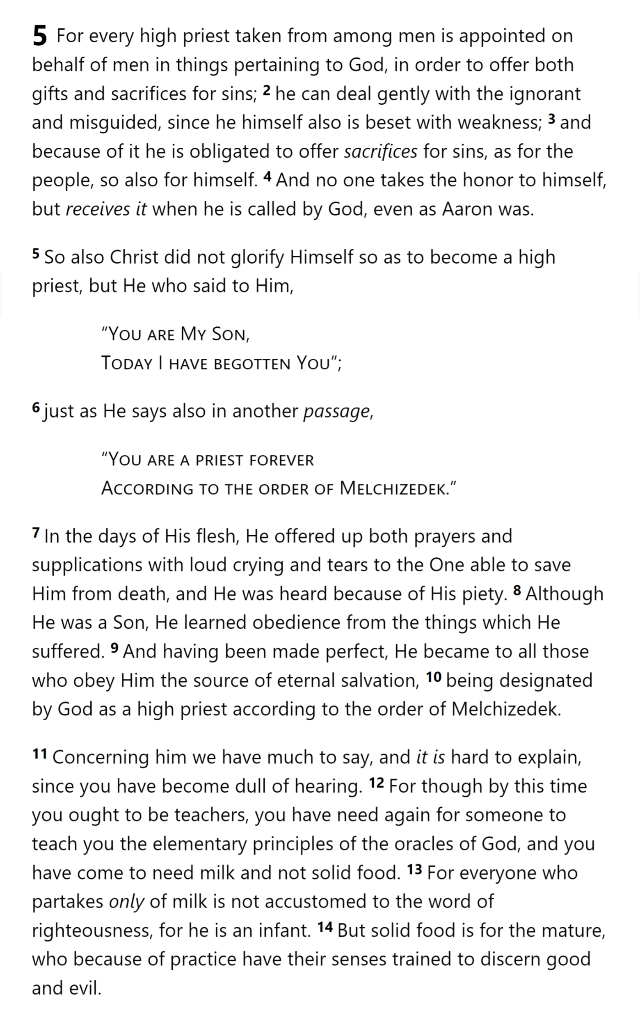
Immaturity
Hebrews 6

Slide 41
Falling Away
Hebrews 6

Slide 42
Falling Away
Hebrews 6

Slide 43
Faith & Patience
Hebrews 6

Slide 44
Faith & Patience
Hebrews 6

Slide 45
Faith & Patience
Anchor of Hope
Hebrews 6

Slide 46
Hebrews

