Slide 1
Warm up
Name the books of the New Testament that Paul wrote.
True or false: Paul wrote half the New Testament.
Number of preaching trips Paul went on?
Final letter Paul wrote?
What are character traits in Paul that you would like to have?

Slide 2
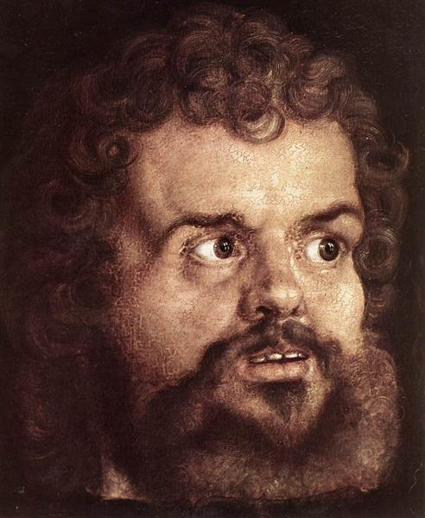
LIFE and epistles OF PAUL
Embry Hills
Feb – April, 2024
Paul the Apostle
Albrecht Durer, 1526

Slide 3
WHAT DID PETER GET FROM PAUL?
Had him in his home (Gal. 1:18)
Worked with him (Gal. 2:7-9)
Was corrected by him (Gal. 2:11ff)
Loved him (2 Peter 3:15)
Recognized the wisdom given to him (2 Peter 3:15)
Learn and stand firm in what he wrote (2 Peter 3:16)

Slide 4
What did Timothy get from Paul?
“You, however, have followed my teaching, my conduct, my aim in life, my faith, my patience, my love, my steadfastness, my persecutions and sufferings” (2 Timothy 3:10-11)
Message
Character
Brotherhood
Suffering

Slide 5
What are we supposed to get from Paul’s life?
What did John Mark get from Paul? Demas? What we get from him will depend on us.
Imitators of me (1 Cor. 11:1; Php. 4:9; 2 Tim. 3:10; etc.)
By the end of class: 2 paragraphs. 1st, what aspect of Paul caught my attention the most, and where did I see it? 2nd, what are several small, concrete ways I can imitate him?

Slide 6
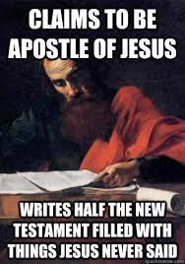
THE Mind of Christ 1 Cor. 2:16
“The right way to look at [Paul’s epistles] Is to regard them as the continuation of Christ’s own teaching. They contain the thoughts which Christ carried away from the earth with him unuttered.” (Stalker, 17) What are some teachings that dominate Paul’s writings that factored less heavily in Jesus’ words?
“In him, Jesus Christ went forth to evangelize the world, making use of his hands and feet, his tongue and brain and heart, for doing the work which in his own bodily presence he had not been permitted by the limit of his mission to accomplish.” (Stalker 19). What especially? (John 10:16)

Slide 7
Things TO know by the time we finish
Key verses
What we are supposed to get from Paul (2 Tim. 3:10-11)
Paul had the mind of Christ (1 Cor. 2:16)
The great lesson of Paul’s life (1 Tim. 1:16)
Where Paul’s story begins (Gal. 1:15)
A few others along the way…
Fill in a basic timeline of Paul’s life
Fill in maps of 1, 2, and 3 missionary journeys
Name the NT books written by Paul. Basic content and where they fit into Paul’s life

Slide 8
EVENTS dateable by connection to external sources
Difficult to date
Famine in the reign of Claudius
Jews expelled from Rome, 49ad
Gallio proconsul of Achaia
Administrations of Felix and Festus
etc.
Conversion of Cornelius (though see Acts 15:7; “early days”)
Preaching to Gentiles
Visit to Jerusalem of Galatians 2
Galatians

Slide 9
(attempted) timeline of Paul’s life
S. Hall
Blue Letter Bible
Conybeare & Howson
BEE
Stalker
Bruce
30
33
35
35-46
46
47-48
48?
49
c. 4 BC Jesus born
c. 0 AD Paul born
30 Jesus died, Pentecost
31 Stoning of Stephen
33-34 Paul converted in Damascus
Paul goes to Arabia
35 Paul returns to Damascus
36 Paul goes to Jerusalem – 2 weeks
Paul goes to Tarsus
45 Paul brought to Antioch
46-47 2nd visit to Jerusalem. Acts 11, Gal. 2?
Peter’s visit to Antioch
Peter imprisoned, James martyred
47-48 1st journey
? Letter to Galatians?
49 Visit Jerusalem – conference. Gal. 2?
50 Paul in Antioch, 15:36
34
34
36
36
39
40-42
43
44
44
46-49
57
50
c. 5
32
34
34-37
37
37
37-46
47
47
48-49
51
49
30
36
37
38
39-43
44
45
48-49
50
30
35
35-37
38-43
44
46-47
51
50

Slide 10
Blue Letter Bible
Conybeare & Howson
Stalker
S. Hall
BEE
51
52
53
57
54
54
54
57
57
58
59
59
61
63
63-66
67
49
51
52
51
53
53
53
54
56
57
57
59
60
62
63
66
51
52
53
57
54 spri
54 su
54 fall
57
57
58
59
60
61
62
63
63-66
68
50
51
51
51
53
54
54
57
57
58
59
61-62
62
62-67
63
67-69
68
50
51
52
?
53
53
54
54
54
57
57
59
60
61-62
63
63-67
63
67-68
68
2nd journey starts
1 Thessalonians. At Corinth
2 Thessalonians. At Corinth
Galatians?
Leave Corinth
Jerusalem at Pentecost
Starts 3rd journey
1 Corinthians. At Ephesus
2 Corinthians. At Ephesus
Lands at Caesarea and goes to Jerusalem
Felix
Festus
Arrives in Rome. Imprisoned. Philmn, Col, Eph, Phi. At Rome
Released from Roman imprisonment
Further missionary work (Macedonia, Asia, Spain?)
1 Timothy, from Macedonia. Titus, from Ephesus. 2nd imprisonment and martyrdom under Nero
2 Timothy, from Rome

Slide 11
Course calendar
L | Date | Subject | Texts | Dates
1 | 25-Feb-24 | Background, youth and persecution | Acts 7-8 | 0 – 34
2 | 28-Feb-24 | Conversion until Antioch | Acts 9-11,22,26; Gal. 1-2 | 34 – 45
3 | 3-Mar-24 | 1st preaching tour; controversy over Gentile converts | Acts 13:1 – 15:35; Gal. 4-6 | 46 – 49
4 | 6-Mar-24 | 1st preaching tour; controversy over Gentile converts | Acts 13:1 – 15:35; Gal. 4-6 | 46 – 49
5 | 10-Mar-24 | 2nd preaching tour; epistles from 2nd tour | Acts 15:36 – 18:22; 1&2 Thess. | 50 – 54
6 | 13-Mar-24 | 2nd preaching tour; epistles from 2nd tour | Acts 15:36 – 18:22; 1&2 Thess. | 50 – 54
7 | 17-Mar-24 | 3rd preaching tour; epistles from 3rd tour | Acts 18:23 – 20:38; Romans, 1&2 Cor. | 54 – 58
 | 20-Mar-24 | (No class)
8 | 24-Mar-24 | 3rd preaching tour; epistles from 3rd tour | Acts 18:23 – 20:38; Romans, 1&2 Cor. | 54 – 58
9 | 27-Mar-24 | Imprisonment in Caesarea | Acts 21-26 | 58 – 59
10 | 31-Mar-24 | Journey to Rome; prison epistles | Acts 27-28; Eph., Phi., Col., Phlm. | 60 – 61
11 | 3-Apr-24 | Journey to Rome; prison epistles | Acts 27-28; Eph., Phi., Col., Phlm. | 60 – 61
12 | 7-Apr-24 | Life after Acts; preacher epistles | 1&2 Timothy, Titus | 62 – 68
13 | 10-Apr-24 | Overflow and review

Slide 12
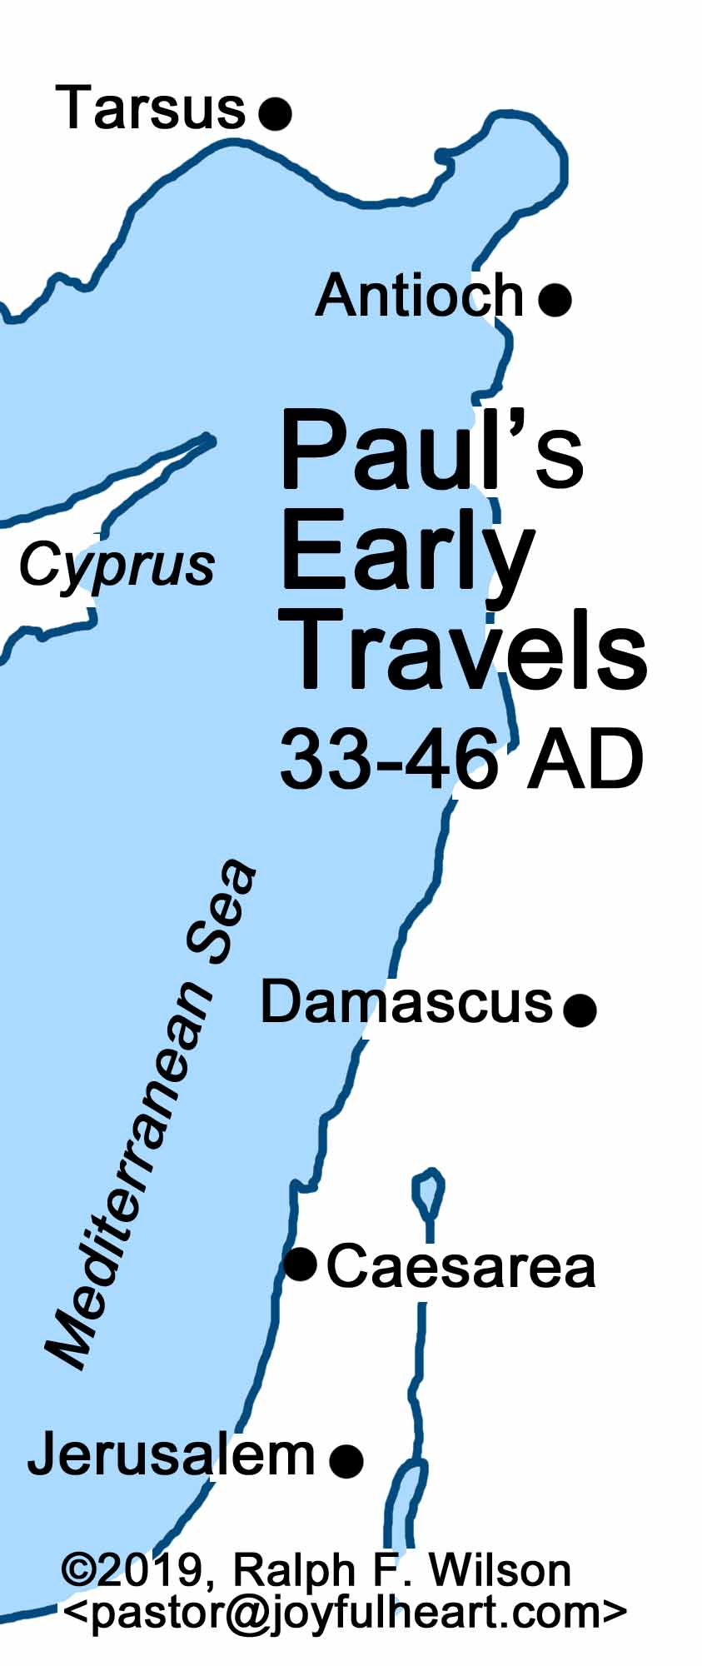
Paul’s youth
Set apart before birth (Gal. 1:15)
Born in Tarsus
Probably a few years younger than Jesus
Called a young man in Acts 7:58
Called an old man in Philemon 1:9
Parents were Roman citizens (Acts 22:25-28)
Tarsus was a significant city (Acts 21:39) in Cilicia
Parents were strict Jews (Phi. 3:5)
Learned trade as tent maker (Acts 18:3)
Sent to be educated in Jerusalem, school of Gamaliel (Acts 22:3)
Pharisee (Acts 26:4-5)
What does his name mean? Benjaminite (Rom. 11:1), persecuting Messiah
It does seem that he was not in Jerusalem at the time of Jesus’ ministry

Slide 13
WHAT PAUL THOUGHT
THE TRUTH
Php 3:4 I myself have reason for confidence in the flesh also. If anyone else thinks he has reason for confidence in the flesh, I have more: 5 circumcised on the eighth day, of the people of Israel, of the tribe of Benjamin, a Hebrew of Hebrews; as to the law, a Pharisee; 6 as to zeal, a persecutor of the church; as to righteousness under the law, blameless.
Acts 26:14: ‘Saul, Saul, why are you persecuting me? It is hard for you to kick against the goads.’

Slide 14
PAUL: ZEALOUS PERSECUTOR
HINDSIGHT PERSPECTIVE:
1Co 15:9 For I am the least of the apostles, unworthy to be called an apostle, because I persecuted the church of God.
Foremost sinner (1 Tim. 1:15)
PERSONAL SUMMARIES:
“I persecuted the church of God violently and tried to destroy it” (Gal. 1:13)
I persecuted this Way to the death (Acts 22:4)
Raging fury against them (Acts 26:11)
REASONS:
“I was advancing in Judaism beyond many of my own age among my people, so extremely zealous was I for the traditions of my fathers.” Gal. 1:14
I myself was convinced that I ought to do many things in opposing the name of Jesus of Nazareth. 26:9
Acted ignorantly in unbelief (1 Ti 1:15)

Slide 15
PAUL: ZEALOUS PERSECUTOR (Acts 7-9)
First description of Saul: 7:51-53
Guarded robes of Stephen’s stoners (Acts 7:58). Meaning (8:1; 22:20)
Beneficiary of Stephen’s intercession – 7:60
Paul – Stephen
Suffered similarly
Debated with and life sought by Hellenists, 6:9 with 9:29, 21:27, 24:18
Stoned by Jewish mob, ch. 14
Accused before council speaking against law (23:29; consider 23:6; 26:5)
Vision of Jesus (23:11)
Other similarities – almost a replacement for Stephen
Public preaching/debating
Recounting story of Israel – Acts 13:16ff
Calling on the name of the Lord – Acts 22:16
Praying for Jews – Rom. 10:1

Slide 16
PAUL: ZEALOUS PERSECUTOR (Acts 7-9)
Saul never shows surprise at persecution. He understands Jewish mindset. He doesn’t ask for mercy or tolerance.
Participates in (spearheads?) persecution, 8:1,3
Contrast devout men
“ravaging” – other translations: “made havoc,” “laid waste,” “destroying,” “harassed bitterly,” “devastate,” “inflict great harm,” “went on a rampage”
Merciless. Imagine this!
Entering houses
Repeatedly
Dragging
Men and women
Prison. Trial? Crime?
Ironically, first act to spread the gospel, 8:4
Breathing threats and murder, 9:1. Meaning?
Contrast Philip, 8:40
Access to high priest. Desire to advance?
Was this the first city? “foreign cities”
Later experiences these things
Plot to kill, 9:23, etc.
Involvement of High Priest (23:2, 14-15)
Persecuted to foreign cities (Acts 14:19; 17:13; 25:9)
Parallels the disciples, 8:4, zeal, message to synagogues
Bound to Jerusalem – imagine
Well known, 9:13-14; Gal. 1:13

