Slide 1
Hebrews
Lesson Thirteen: Final Exhortations

Slide 3
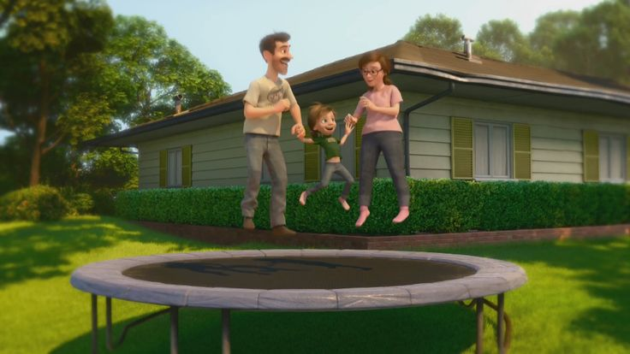
Great Family
Great House
Great Yard
Great Friends
Great Hockey Team
Happy
Life

Slide 4
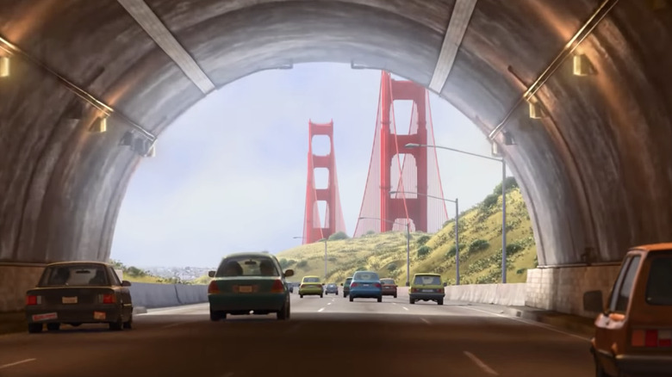
Hopeful
Change
Happy
Life

Slide 5
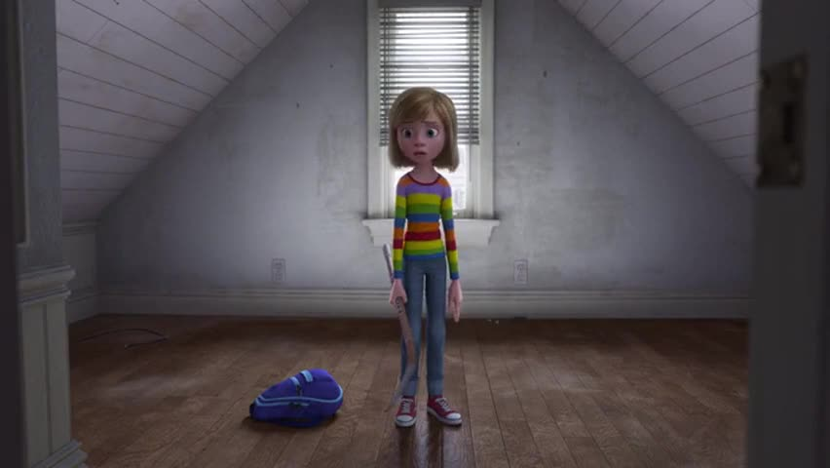
Ugly House
Nasty Room
Stressed
Parents
Broccoli Pizza!
Fails Hockey Tryouts
Hard
Struggles
Hopeful
Change
Happy
Life

Slide 6
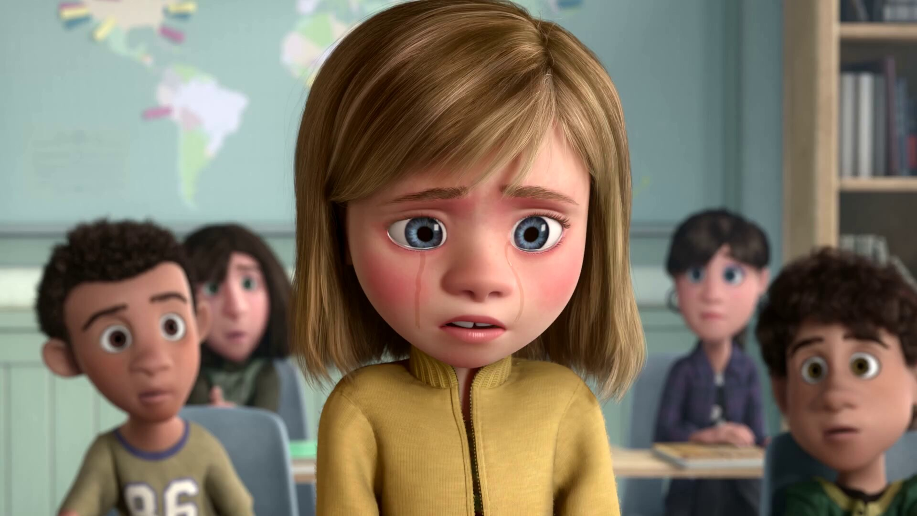
Emotional
Crisis
Hard
Struggles
Hopeful
Change
Happy
Life

Slide 7
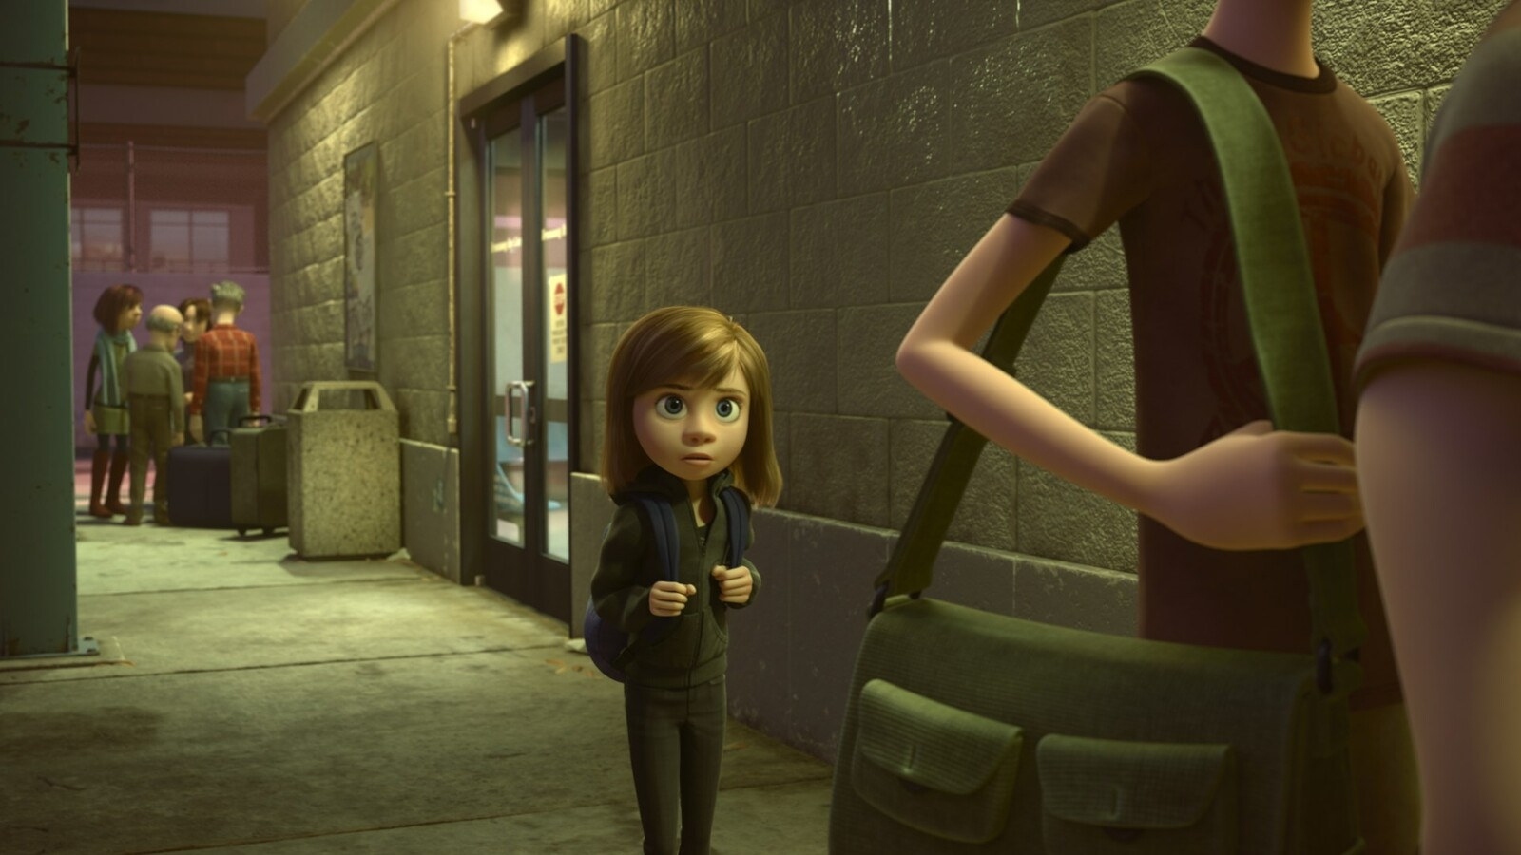
Emotional
Crisis
Hard
Struggles
Hopeful
Change
Happy
Life
Go Back!

Slide 8
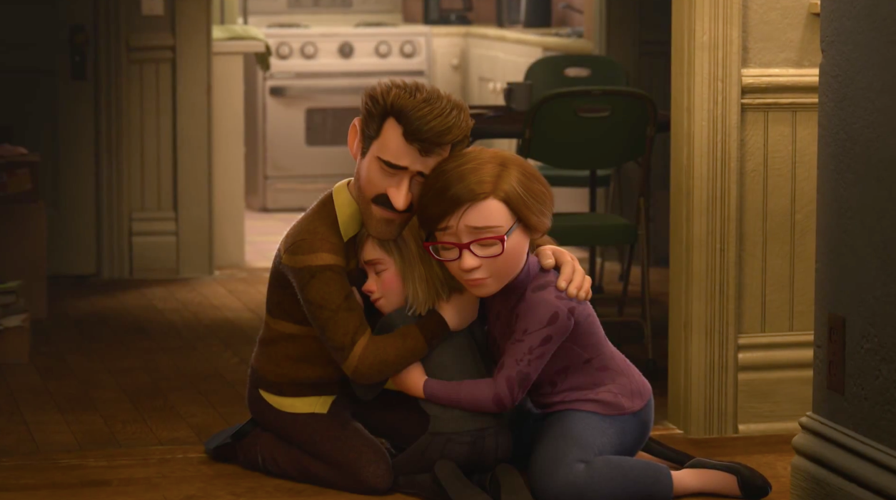
Seek
Help
Emotional
Crisis
Hard
Struggles
Hopeful
Change
Happy
Life
Go Back!

Slide 9
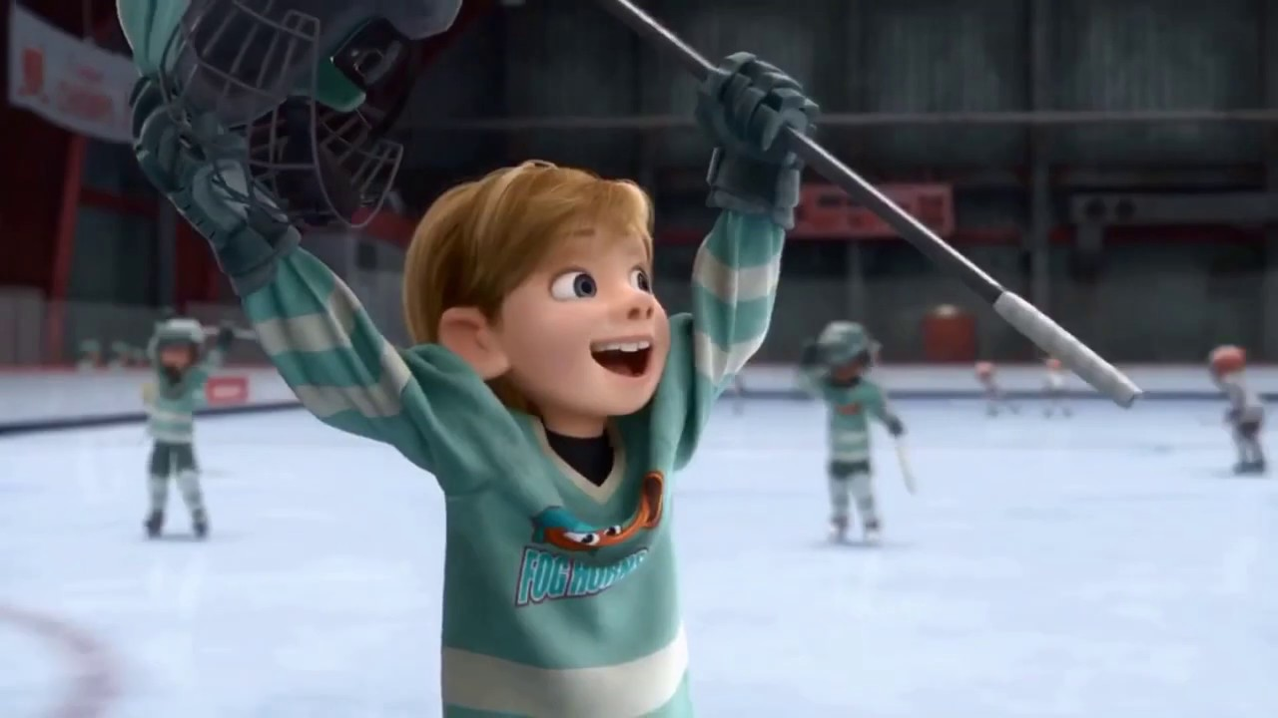
Better
Life
Seek
Help
Emotional
Crisis
Hard
Struggles
Hopeful
Change
Happy
Life
Go Back!

Slide 10
10:32-34
Hebrews
Better
Life
Seizure of Property
Moses, Law, Traditions
Public Ridicule
Became Christians
Secure Community
Sent to Prison
Seek
Help
Emotional
Crisis
Temple & Feasts
Hard
Struggles
Hopeful
Change
Happy
Life
Harden your hearts
Throw away your confidence
Shrink back
Grow weary
Lose heart
Go Back!
DO NOT

Slide 11
JESUS IS OUR
7-10:18
GREAT HIGH PRIEST
Better
Life
Seek
Help
Emotional
Crisis
Hard
Struggles
Hopeful
Change
Happy
Life
Harden your hearts
Throw away your confidence
Shrink back
Grow weary
Lose heart
Go Back!
DO NOT

Slide 12
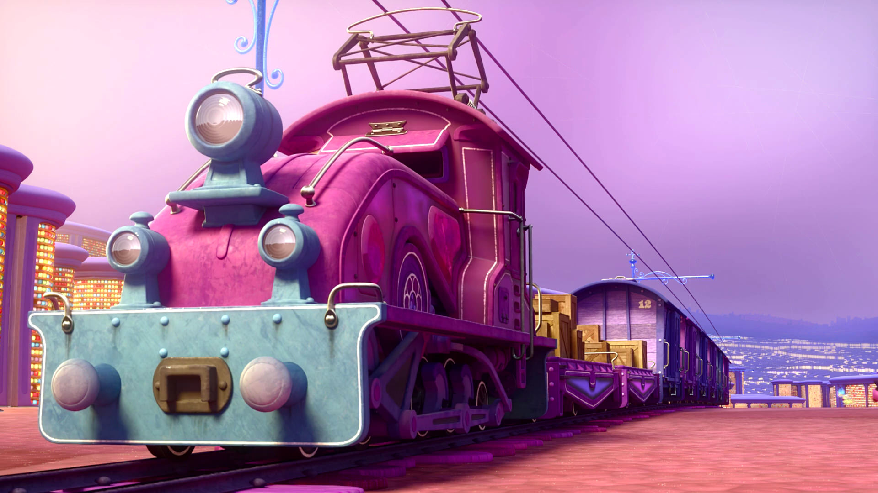
Train of Thought

Slide 13
Train of Thought

Slide 14
TABERNACLE
COVENANT
ORDER & OATH
JESUS IS OUR
7-10:18
GREAT HIGH PRIEST
SACRIFICE
promises
MINISTRY
Train of Thought

Slide 15
Sorrowful
Straighten
Lest we drift
Enduring foR
12:4-11
Discipline
Pay Attention
Joy set before Him
Angels
1:4-2:16
God has spoken
1:1-3
In his son
Strengthen
Pursue Peace
Why Lower?
Right Hand
Righteousness
Prepare
12:12-17
to Endure
Endured Cross
Right Hand
Short of Grace
Purification
Despising Shame
Bitterness
Encourage
Suffering
FIXING OUR
12:2-3
Eyes On Jesus
Esau
Hold Firm
Faithful
Run with Endurance
2:17-18
Merciful
No Evil Hearts
Able to Help
Moses
Joshua
3-4
Be Diligent
MINISTRY
Have Faith
promises
SACRIFICE
COVENANT
TABERNACLE
ORDER & OATH
JESUS IS OUR
7-10:18
GREAT HIGH PRIEST
Miss Rest
God’s Word
THE CLOUD
10:32-12:1
OF witnesses
Shaking
Hold Fast
Throw Away
Need Endurance
Time of Need
4:14-16
Gratitude & Service
Reveremce & Awe
Grace to Help
Sinai
12:18-29
AND Zion
Draw Near
Consuming Fire
Immaturity
Suffering of Christ
Falling Away
Aaron
5:1-10
Melchi
zEdek
Judgment
Draw Near
Vengeance
Hold Fast
SINCE Therefore
10:19-25
LET US
For if we go
10:26-31
on sinning
Stir Up
Faith & Patience
Anchor of Hope
Encourage
Fury of Fire
Terrifying
5:11-6:20
Closing
13
exhortations
Train of Thought

Slide 16
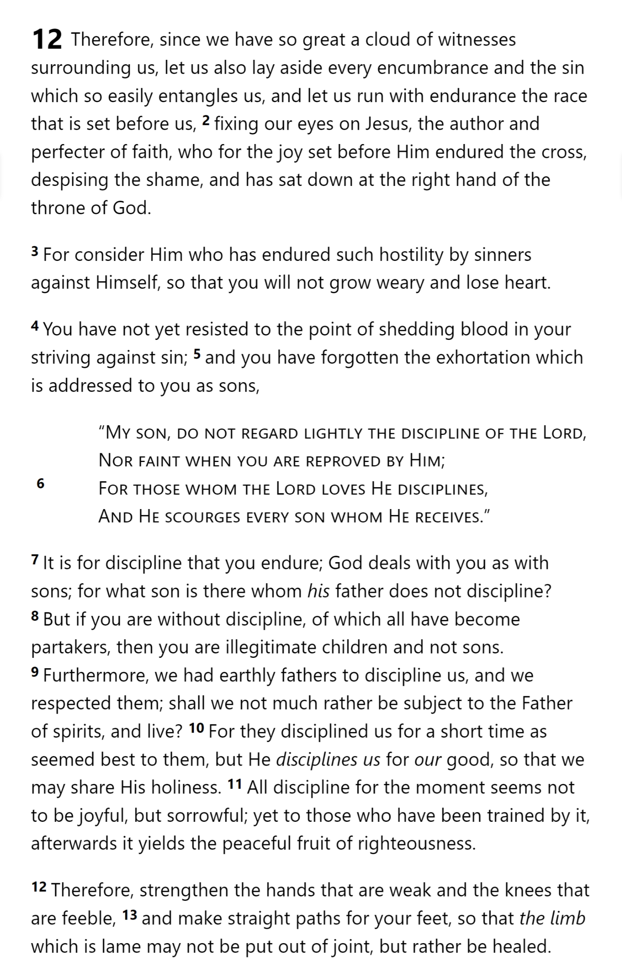
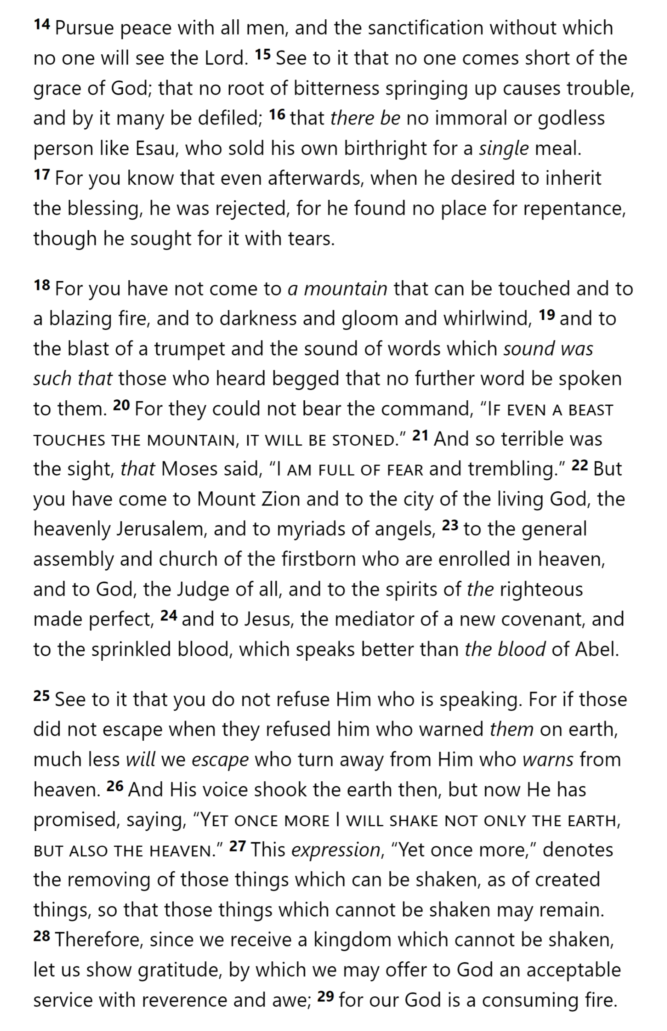
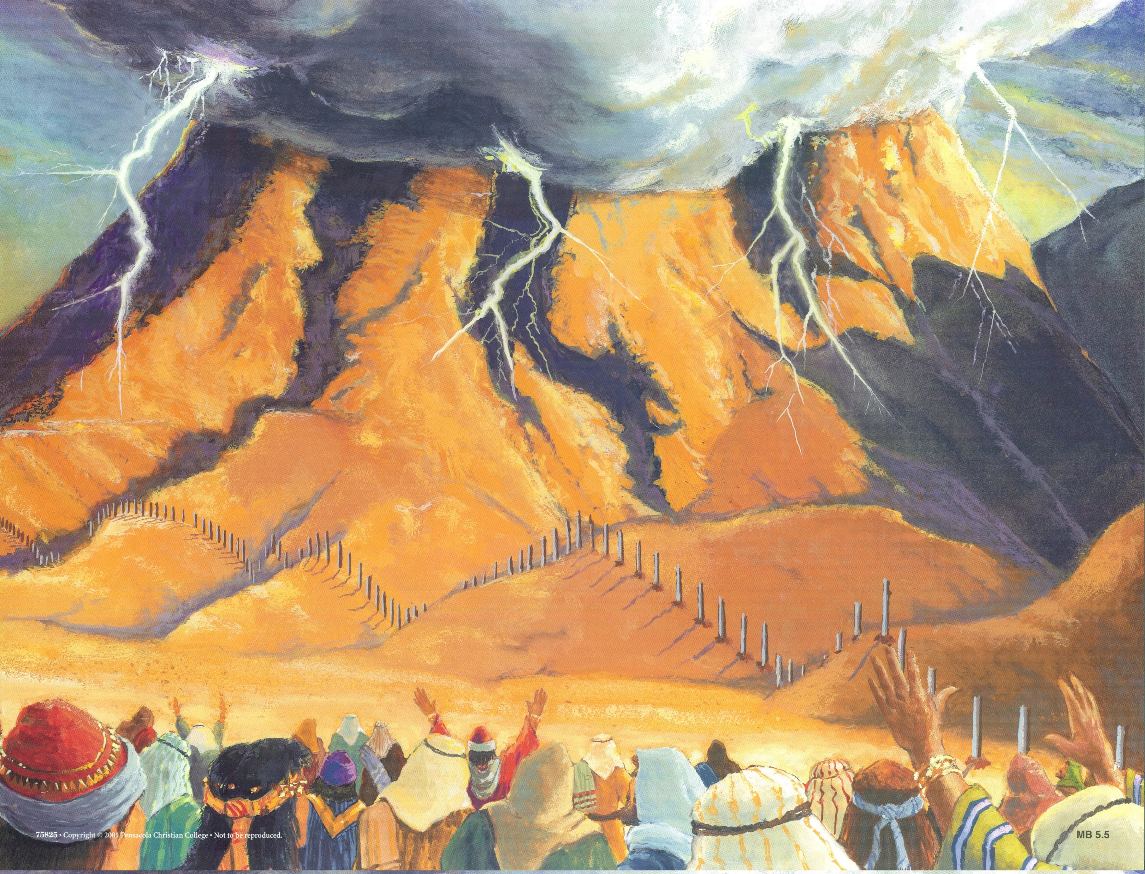
HOLY
SPIRIT
GOD
SON
SON
SON
SON
SON
MAN
MAN
MAN
MAN
SON
COVENANT
MAN
SON
Hebrews 12

Slide 17
HOLY
SPIRIT
GOD
SON
SON
SON
SON
SON
MAN
MAN
MAN
MAN
SON
COVENANT
MAN
SON
Hebrews 12

Slide 19
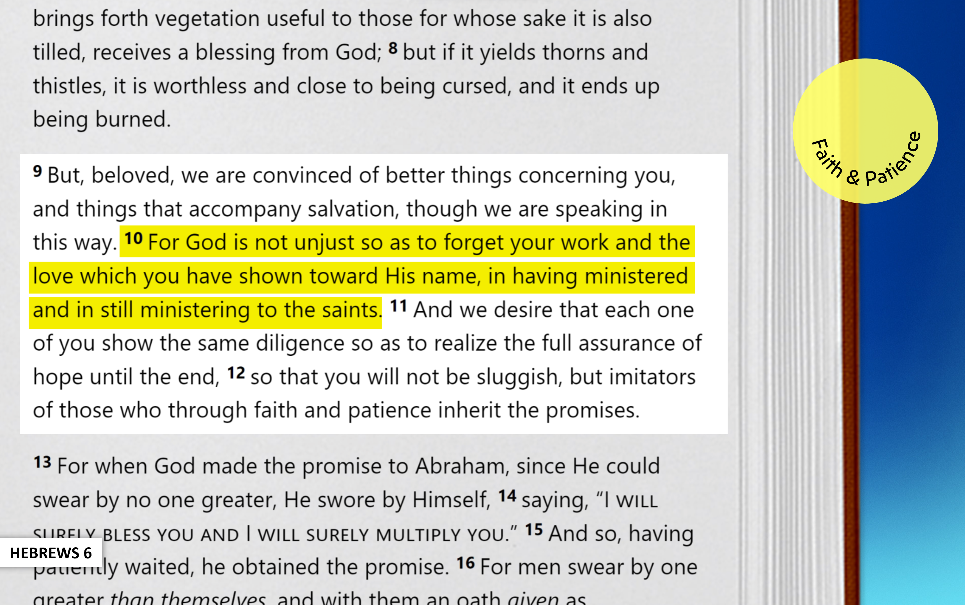
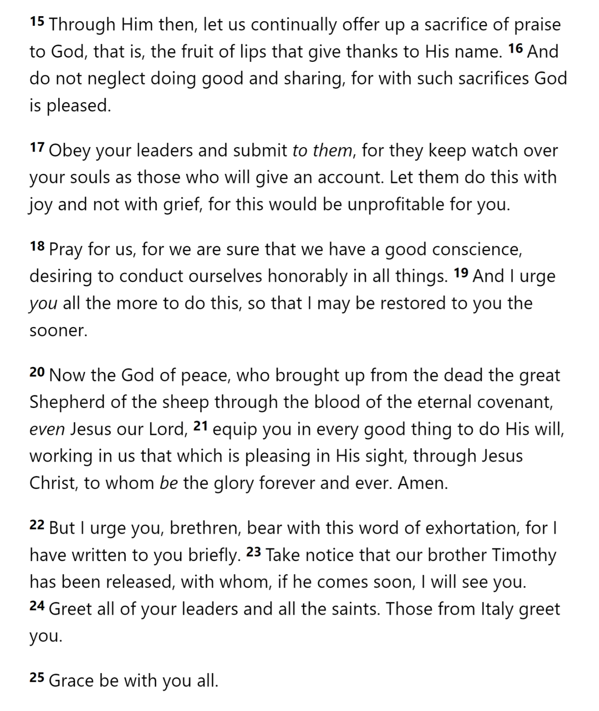
Brotherly Love
Hospitality
Victims of Suffering
Sexual Morality
Material Things
Past Leaders
False Teaching
Sacrifices
Current Leaders
Pray for Teachers
Hebrews 13

Slide 20
Brotherly Love
Hospitality
Victims of Suffering
Sexual Morality
Material Things
Past Leaders
False Teaching
Sacrifices
Current Leaders
Pray for Teachers
Hebrews 13

Slide 21
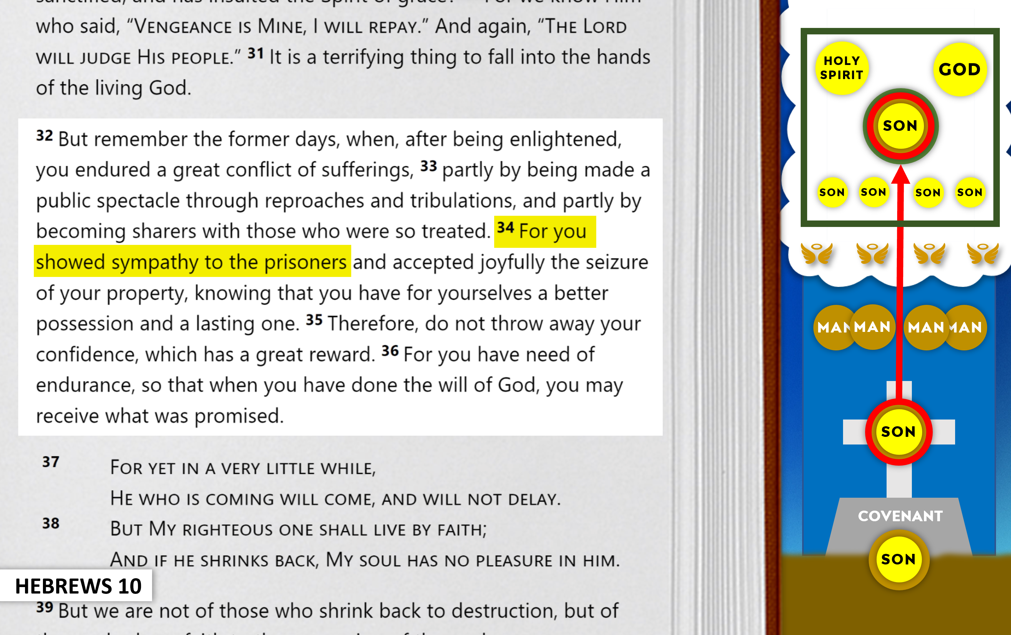
Brotherly Love
Hospitality
Victims of Suffering
Sexual Morality
Material Things
Past Leaders
False Teaching
Sacrifices
Current Leaders
Pray for Teachers
Hebrews 13

Slide 22
Brotherly Love
Hospitality
Victims of Suffering
Sexual Morality
Material Things
Past Leaders
False Teaching
Sacrifices
Current Leaders
Pray for Teachers
Hebrews 13

Slide 23
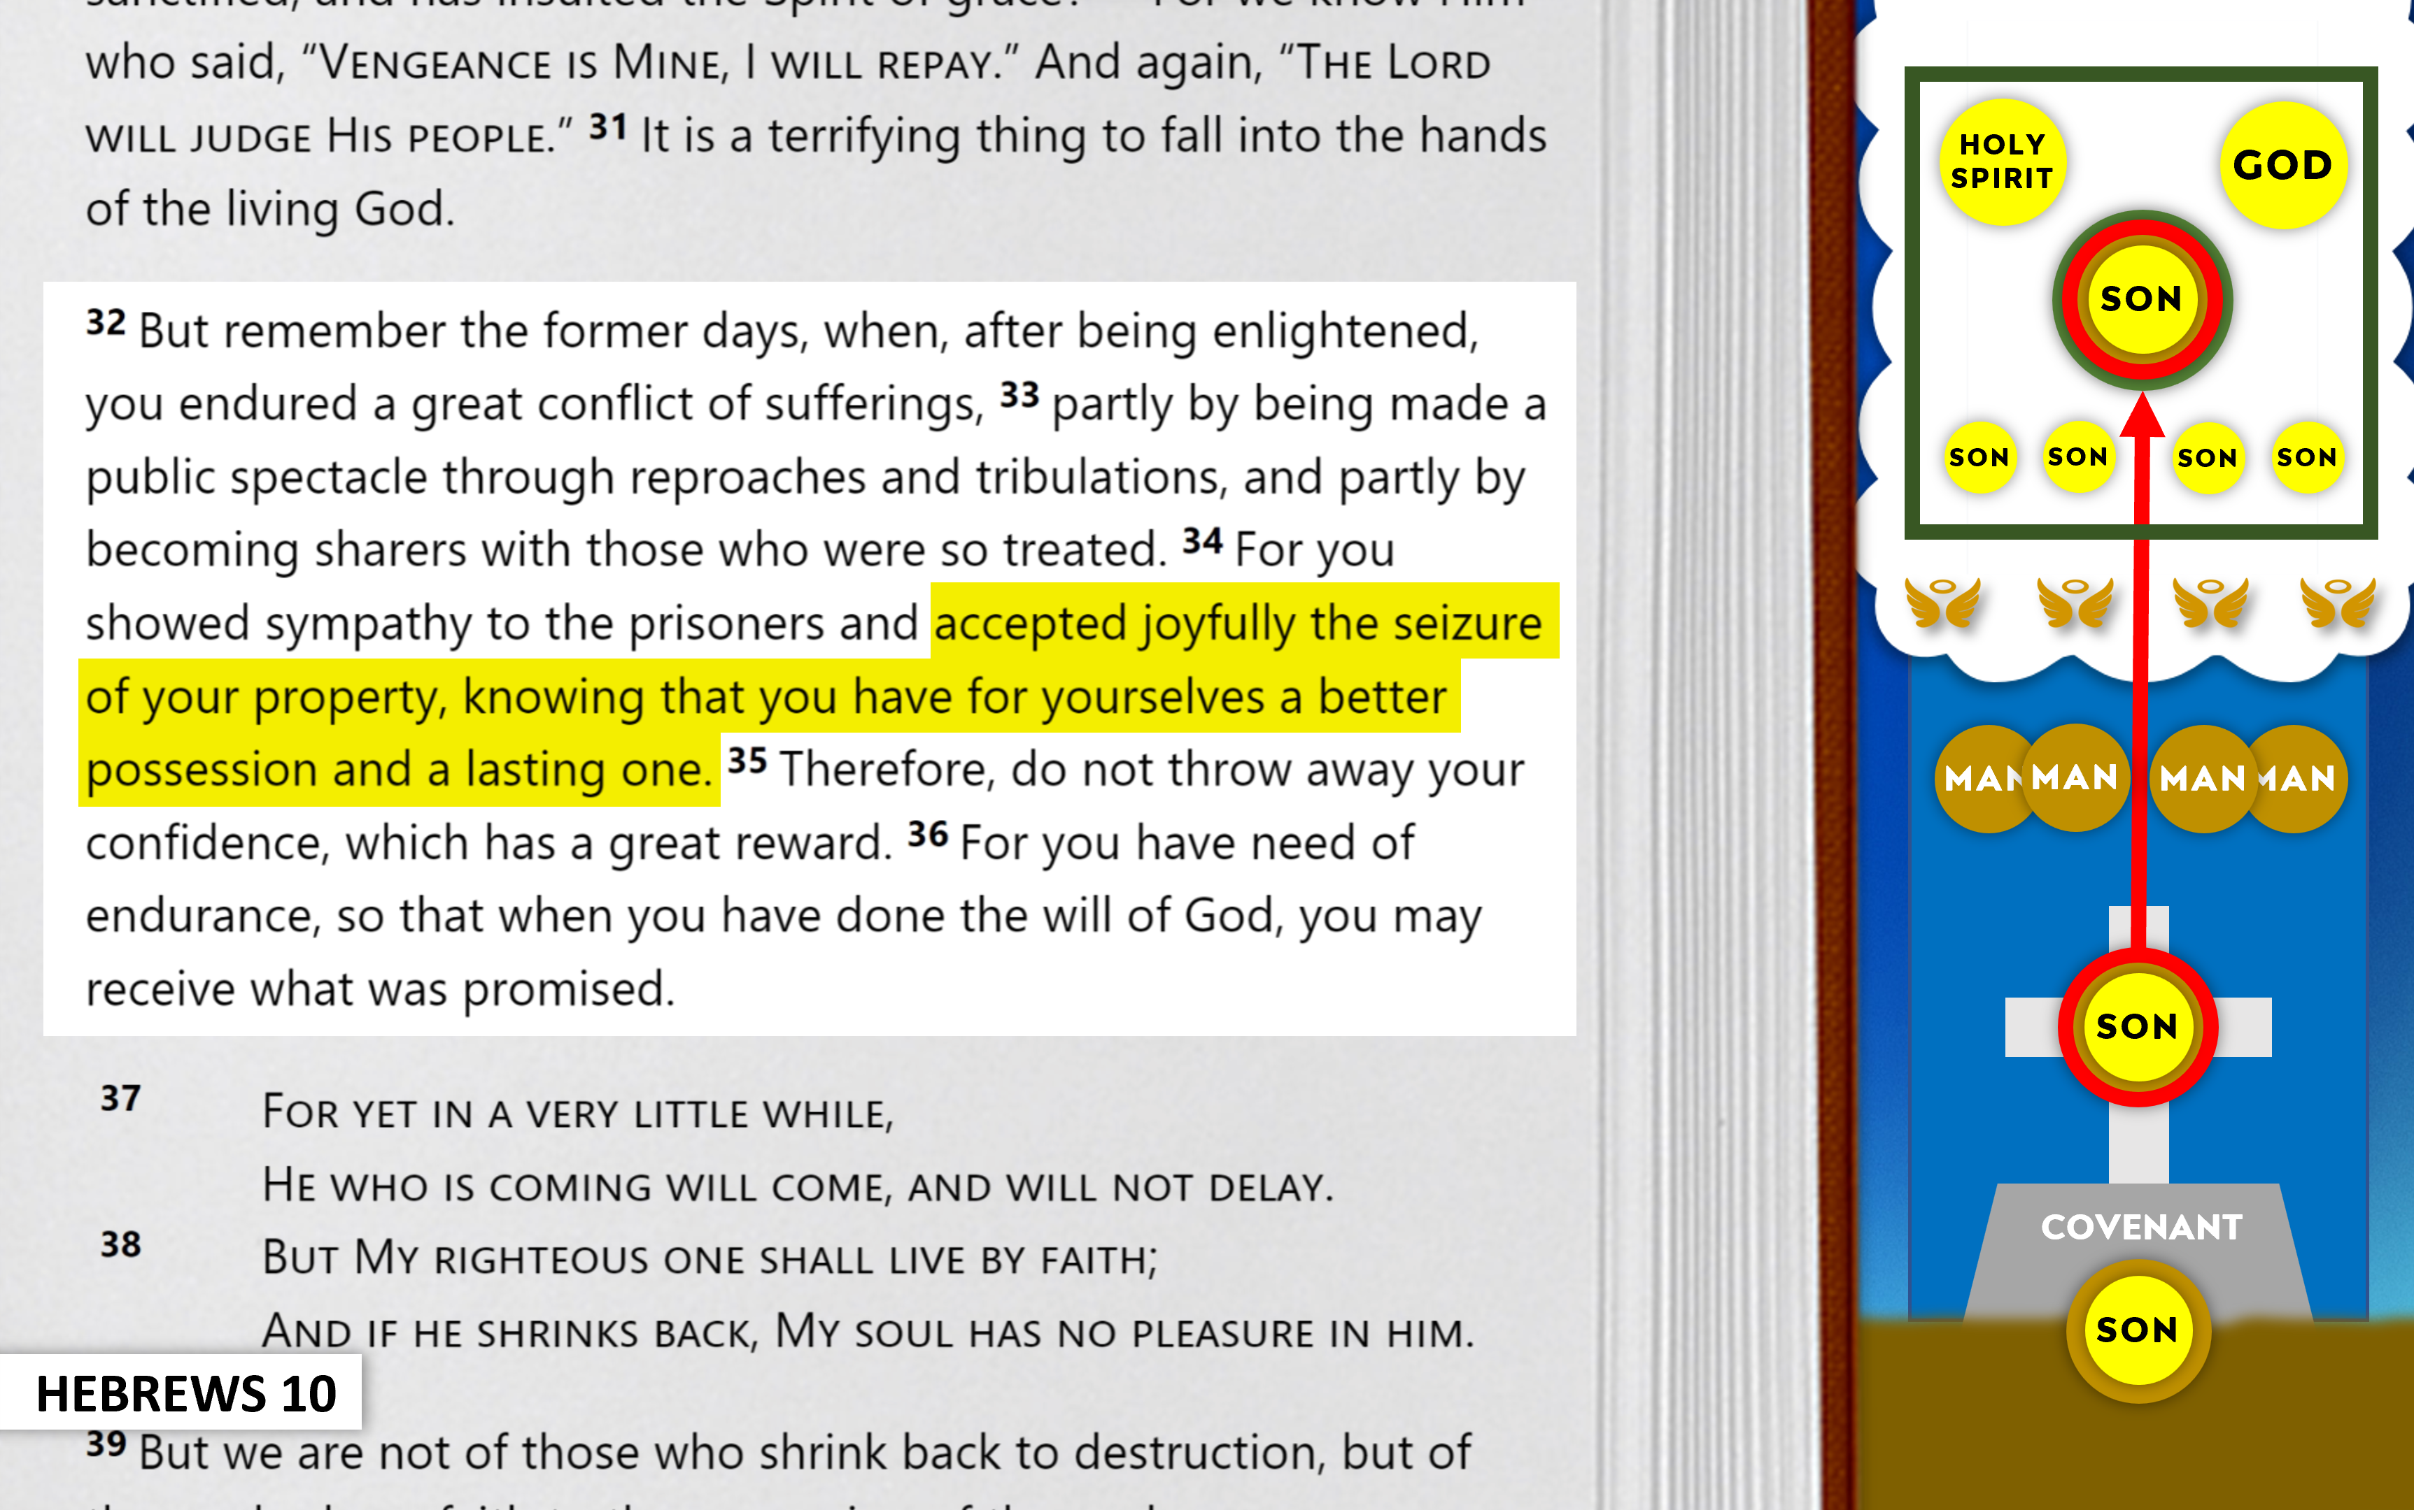
Brotherly Love
Hospitality
Victims of Suffering
Sexual Morality
Material Things
Just as I have been with Moses, I will be with you; I will not fail you or forsake you. ⁶ Be strong and courageous…
Past Leaders
False Teaching
Sacrifices
Current Leaders
Pray for Teachers
Hebrews 13

Slide 24
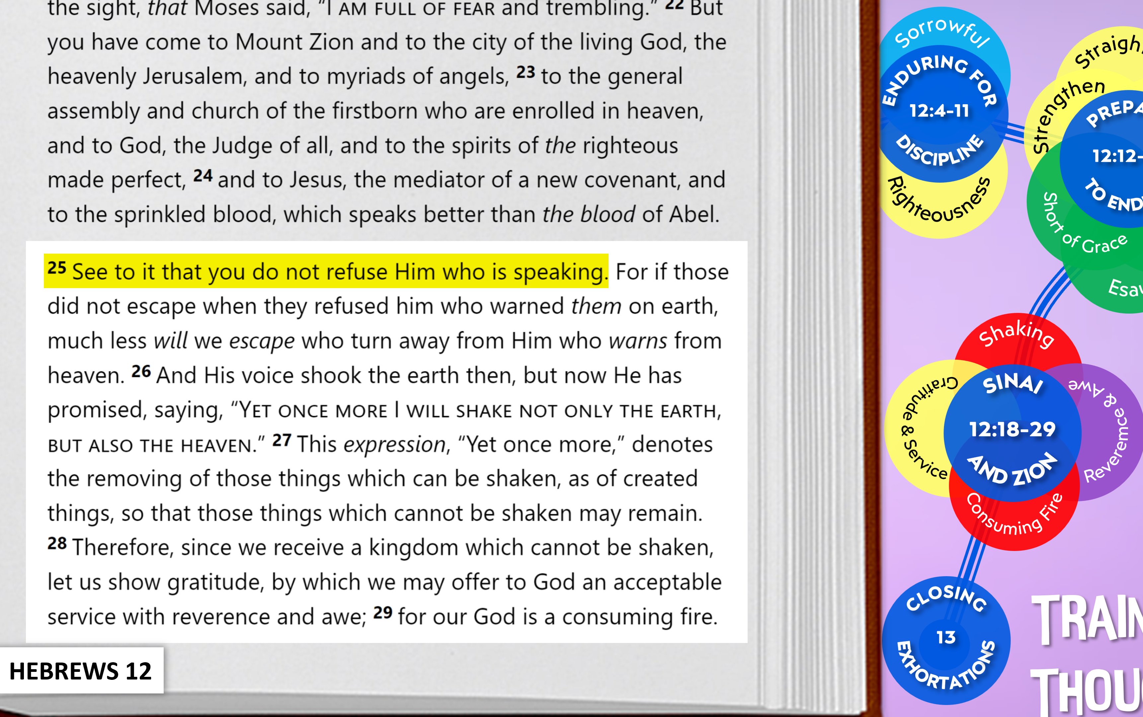
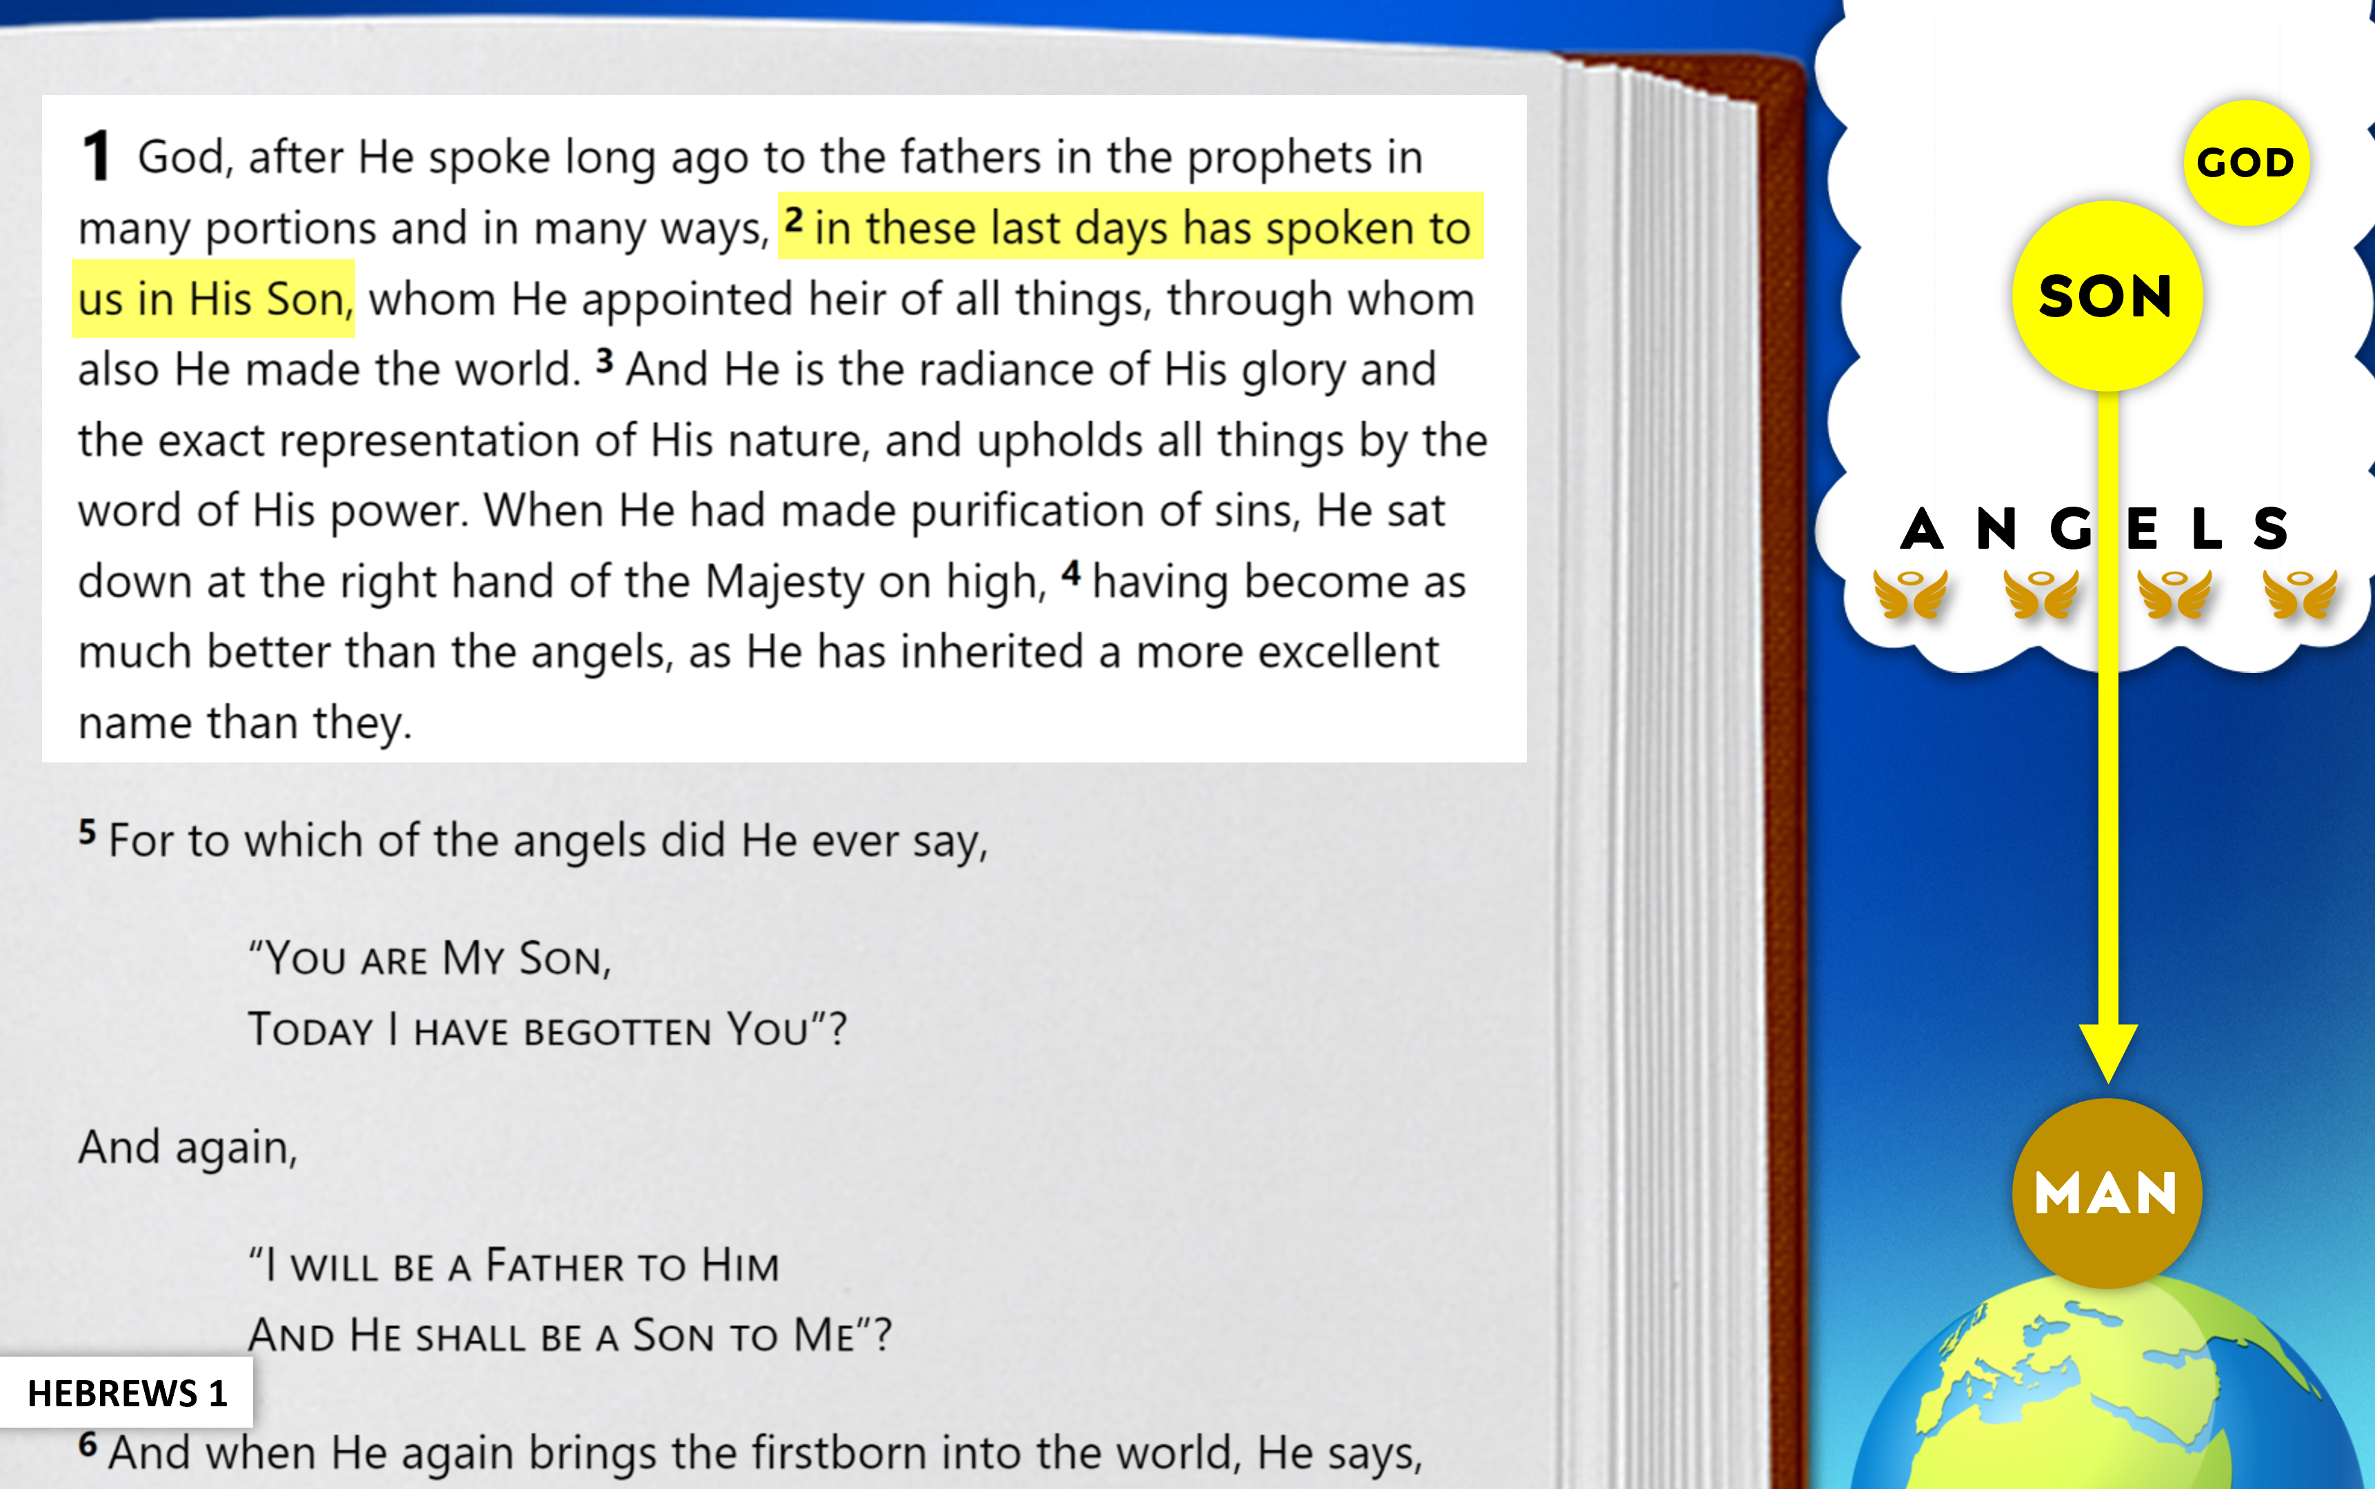
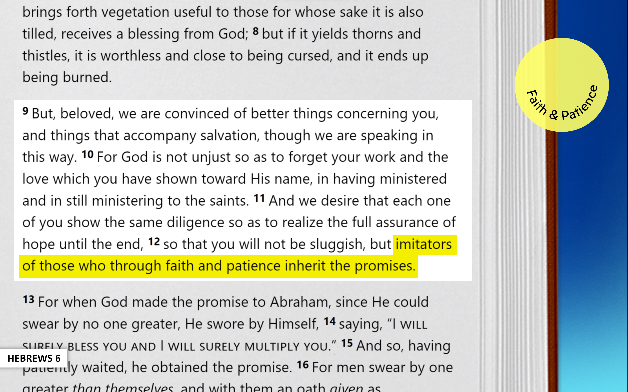
Brotherly Love
Hospitality
Victims of Suffering
Sexual Morality
Material Things
Past Leaders
False Teaching
Sacrifices
Current Leaders
Pray for Teachers
Hebrews 13

Slide 25
Brotherly Love
Hospitality
Victims of Suffering
Sexual Morality
Material Things
Past Leaders
False Teaching
Sacrifices
Current Leaders
Pray for Teachers
Hebrews 13

Slide 26
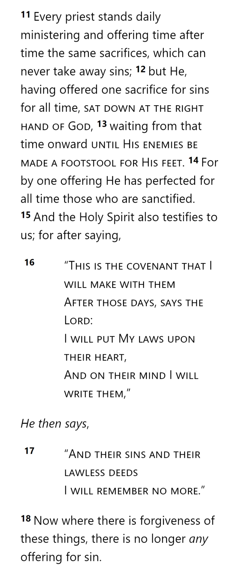
GOD
THE OATH
HOLY
SPIRIT
GOD
AARON
SON
SON
SON
SON
SON
TABERNACLE
LEVI
LEVI
LEVI
MAN
MAN
MAN
MAN
BULL
SON
BULL
CITY
COVENANT
COVENANT
MAN
MAN
MAN
SON
MAN
MAN
MAN
Hebrews 13

Slide 27
Brotherly Love
Hospitality
Victims of Suffering
Sexual Morality
Material Things
Past Leaders
False Teaching
Sacrifices
Current Leaders
Pray for Teachers
Hebrews 13

Slide 28
Brotherly Love
Hospitality
Victims of Suffering
Sexual Morality
Material Things
Past Leaders
False Teaching
Sacrifices
Current Leaders
Pray for Teachers
Hebrews 13

Slide 29
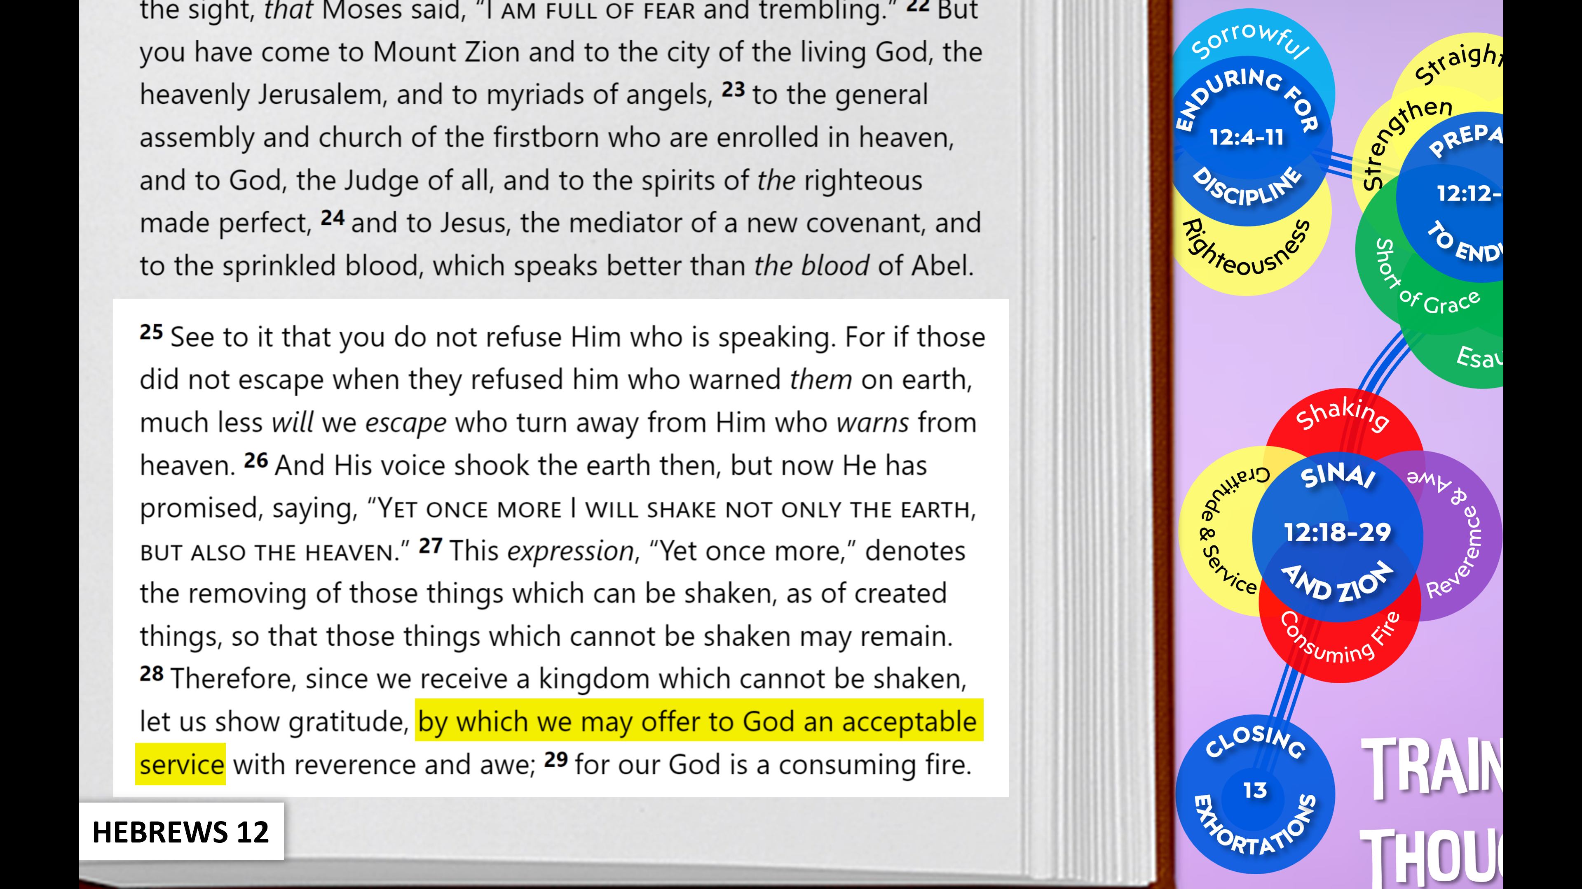
Brotherly Love
Hospitality
Victims of Suffering
Sexual Morality
Material Things
Past Leaders
False Teaching
Sacrifices
Current Leaders
Pray for Teachers
Hebrews 13

Slide 30
Our Service in Suffering
Our Leadership in Suffering
Our Service that Pleases God
Brotherly Love
Past Leaders
Hospitality
False Teaching
Victims of Suffering
Sacrifices
Sexual Morality
Current Leaders
Material Things
Pray for Teachers
Hebrews 13

Slide 31
Hebrews

