Slide 2
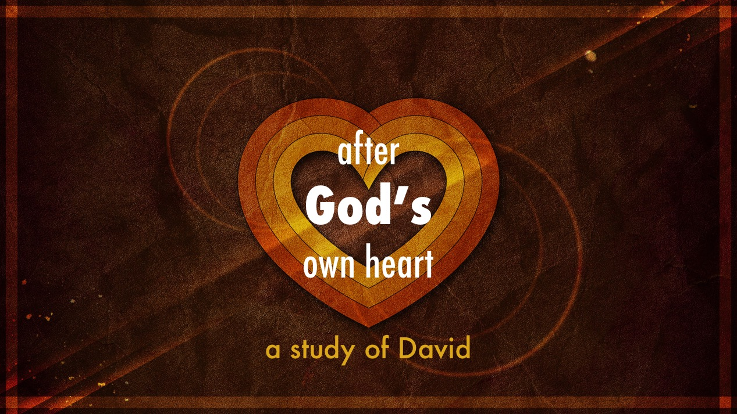

Slide 3
Psalm 59
Psalm 52
Psalm 56 Psalm 34
Psalm 142
Psalm 63
Psalm 54

Slide 4

Trials are not the result of God’s disfavor
(Psalm 59.4,9-10)
God isn’t to blame for evil, He’s the solution!
(Psalm 52.1-7)
A heart that trusts God thinks correctly about trials

Slide 5
Understands that experiencing fear is not a lack of faith (Psalm 56.3,8; 142.1-4)
Finds in God the remedy (Psalm 56.11;
142.5-6)
A heart that trusts God thinks correctly about fear

Slide 6
Knows that he is not strong enough
(Psalm 142.6; 54.1-5)
Believes in deliverance before deliverance occurs (Psalm 59.16ff; 52.8-9; 142.7; 54.7; 34.19-21)
A heart that trusts God thinks correctly about the solution

