Slide 2


Slide 3
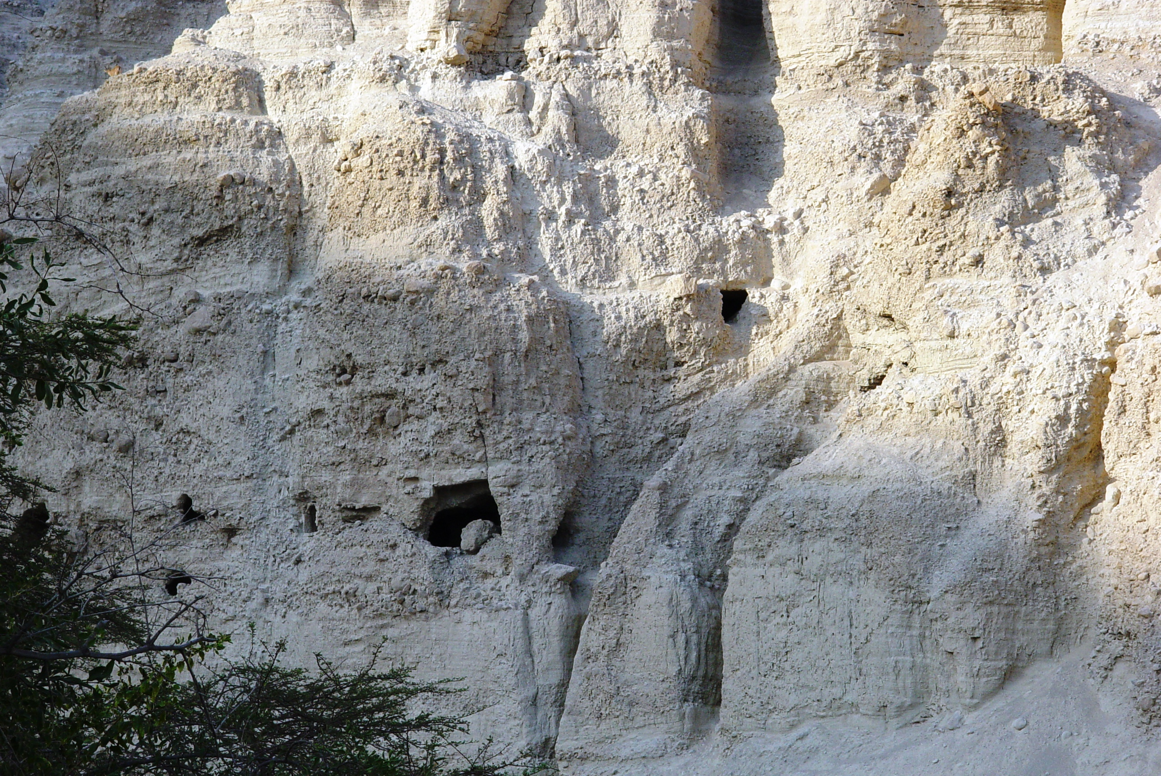
Bibleplaces.com

Slide 4
Yielding to God…
Bibleplaces.com

Slide 5
Yielding to God is more than obeying
Bibleplaces.com

Slide 6
Yielding to God doesn’t make life easier
Bibleplaces.com

Slide 7
Yielding to God can make a powerful impression
Bibleplaces.com

Slide 8
Yielding to God is the result of faith
Bibleplaces.com

Slide 9
Yielding to God secures His blessing
Bibleplaces.com

