Slide 1
Warm up Paul – VERSES TO REMEMBER (feel welcome to look up verses if needed)
Where Paul’s story begins
The great lesson of Paul’s life
First description of Paul
Paul’s youth: his viewpoint
Paul’s youth: Christ’s viewpoint
Paul (as apostle) has the mind of Christ
Acts 7:51-53
Acts 26:14
Php 3:4-6
1 Tim. 1:16
Gal 1:15
1 Cor. 2:16

Slide 2
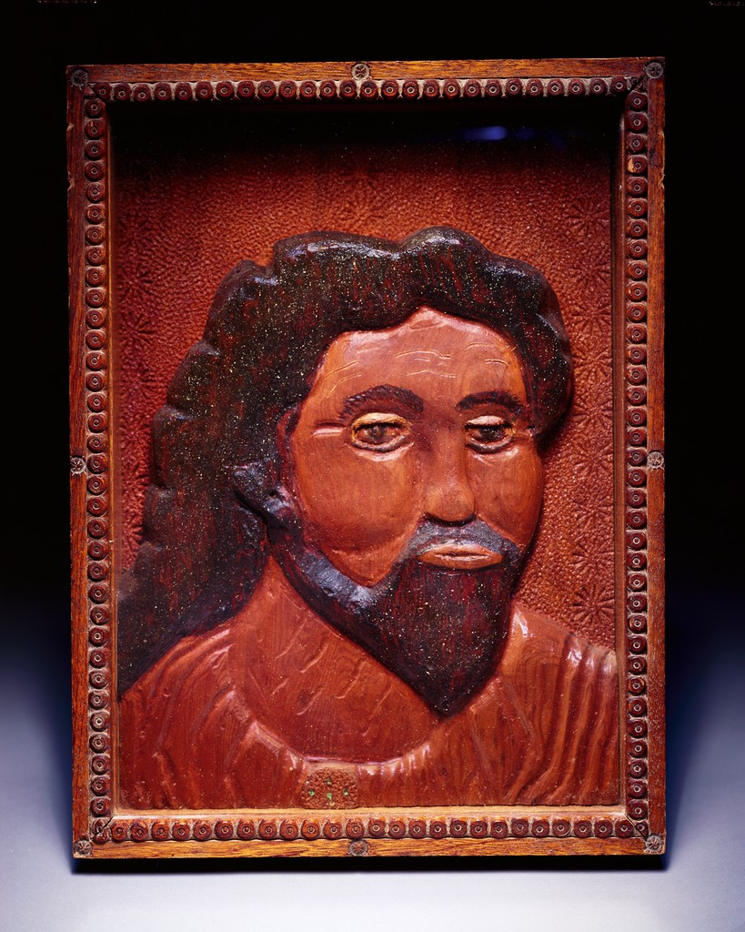
LIFE and epistles OF PAUL
Embry Hills
Feb – April, 2024
LESSON 2
Conversion to Antioch
St. Pablo the Apostle
Ulysses Davis (American, 1914–1990)

Slide 3
Course calendar
L | Date | Subject | Texts | Dates
1 | 25-Feb-24 | Background, youth and persecution | Acts 7-8 | 0 – 33
2 | 28-Feb-24 | Conversion until Antioch | Acts 9-11,22,26; Gal. 1-2 | 33 – 46
3 | 3-Mar-24 | 1st preaching tour; controversy over Gentile converts | Acts 13:1 – 15:35; Gal. 4-6 | 47 – 49
4 | 6-Mar-24 | 1st preaching tour; controversy over Gentile converts | Acts 13:1 – 15:35; Gal. 4-6 | 47 – 49
5 | 10-Mar-24 | 2nd preaching tour; epistles from 2nd tour | Acts 15:36 – 18:22; 1&2 Thess. | 50 – 54
6 | 13-Mar-24 | 2nd preaching tour; epistles from 2nd tour | Acts 15:36 – 18:22; 1&2 Thess. | 50 – 54
7 | 17-Mar-24 | 3rd preaching tour; epistles from 3rd tour | Acts 18:23 – 20:38; Romans, 1&2 Cor. | 54 – 58
 | 20-Mar-24 | (No class)
8 | 24-Mar-24 | 3rd preaching tour; epistles from 3rd tour | Acts 18:23 – 20:38; Romans, 1&2 Cor. | 54 – 58
9 | 27-Mar-24 | Imprisonment in Caesarea | Acts 21-26 | 58 – 59
10 | 31-Mar-24 | Journey to Rome; prison epistles | Acts 27-28; Eph., Phi., Col., Phlm. | 60 – 61
11 | 3-Apr-24 | Journey to Rome; prison epistles | Acts 27-28; Eph., Phi., Col., Phlm. | 60 – 61
12 | 7-Apr-24 | Life after Acts; preacher epistles | 1&2 Timothy, Titus | 62 – 68
13 | 10-Apr-24 | Overflow and review

Slide 4
APPROX. TIMELINE – PAUL’S LIFE
Birth in Tarsus, education in Jerusalem, zealous Pharisee, persecutor
0 AD
10
20
30
40
50
60
70 AD
Jesus’ death
Stephen stoned

Slide 5
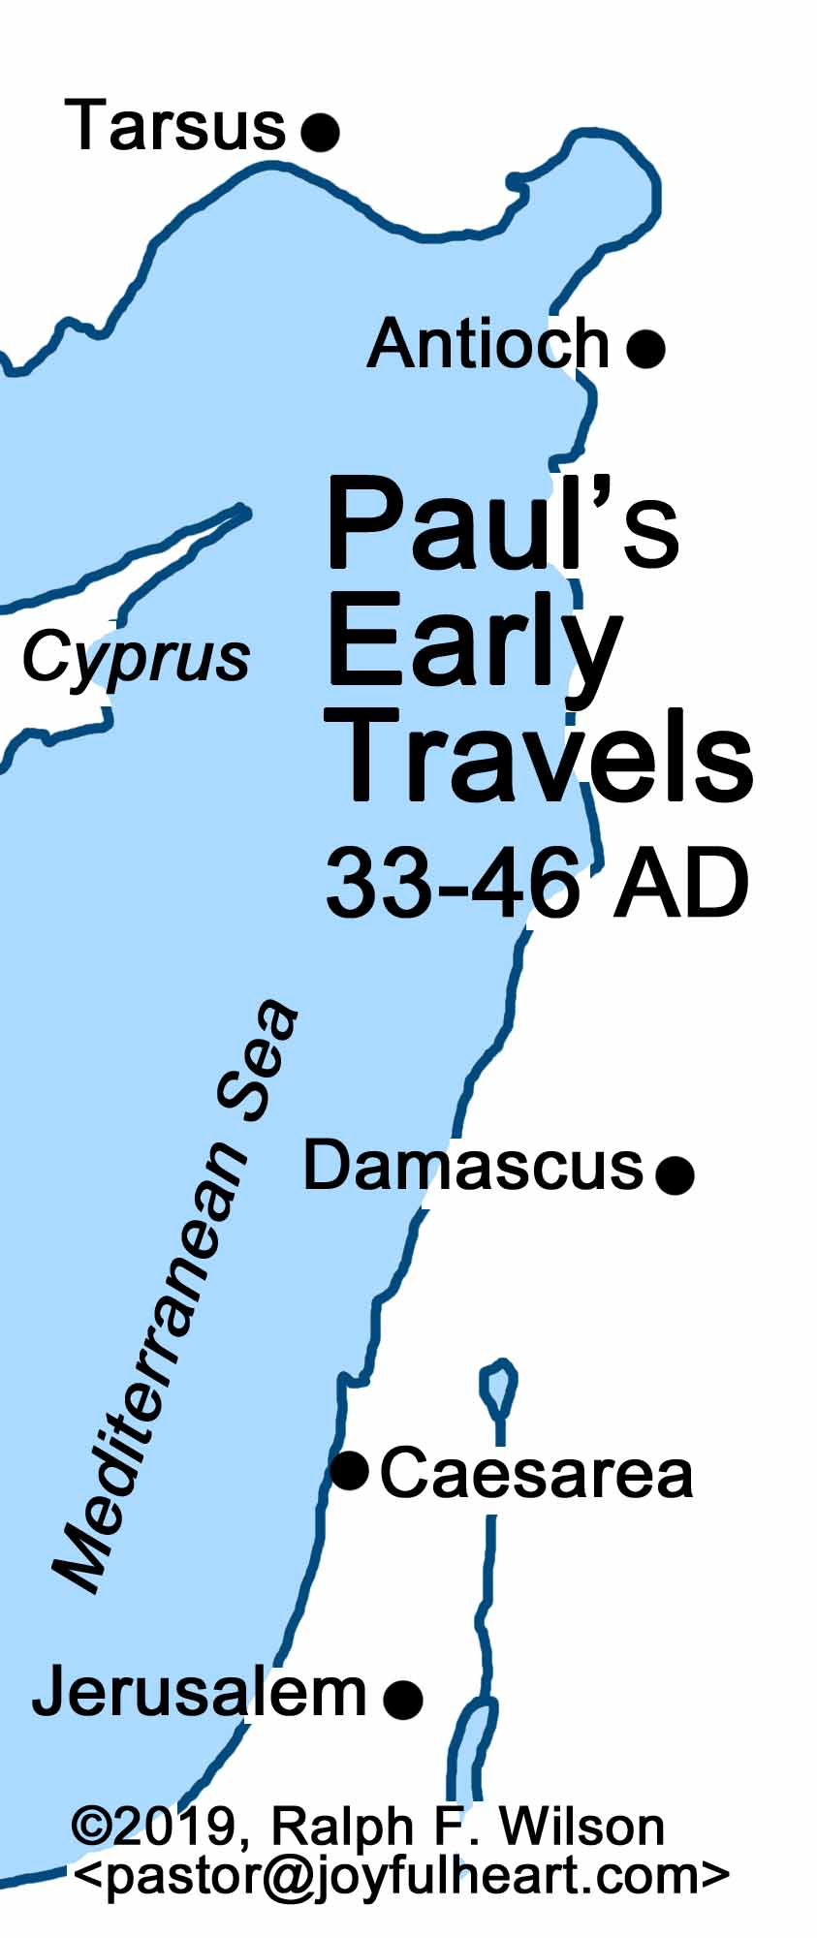
Paul’s youth
Set apart before birth (Gal. 1:15)
Born in Tarsus
Probably a few years younger than Jesus
Called a young man in Acts 7:58
Called an old man in Philemon 1:9
Parents were Roman citizens (Acts 22:25-28)
Tarsus was a significant city (Acts 21:39) in Cilicia. Paul knew Greeks.
Parents were strict Jews (Phi. 3:5). Wealthy? (Php. 4:12)
Learned trade as tent maker (Acts 18:3)
Sent to be educated in Jerusalem, school of Gamaliel (Acts 22:3)
Pharisee (Acts 26:4-5)
What does his name mean? Benjaminite (Rom. 11:1), persecuting Messiah, chasing from city to city, slaughtering priests
It does seem that he was not in Jerusalem at the time of Jesus’ ministry
Was Paul a member of the Sanhedrin?

Slide 6
(attempted) timeline of Paul’s life
S. Hall
Blue Letter Bible
Conybeare & Howson
BEE
Stalker
Bruce
30
33
35
35-46
46
47-48
48?
49
c. 4 BC Jesus born
c. 0 AD Paul born
30 Jesus died, Pentecost
31 Stoning of Stephen
33-34 Paul converted in Damascus
Paul goes to Arabia
35 Paul returns to Damascus
36 Paul goes to Jerusalem – 2 weeks
Paul goes to Tarsus
45 Paul brought to Antioch
46-47 2nd visit to Jerusalem. Acts 11, Gal. 2?
Peter’s visit to Antioch
Peter imprisoned, James martyred
47-48 1st journey
? Letter to Galatians?
49 Visit Jerusalem – conference. Gal. 2?
50 Paul in Antioch, 15:36
34
34
36
36
39
40-42
43
44
44
46-49
57
50
c. 5
32
34
34-37
37
37
37-46
47
47
48-49
51
49
30
36
37
38
39-43
44
45
48-49
50
30
35
35-37
38-43
44
46-47
51
50

Slide 7
APPROX. TIMELINE – PAUL’S LIFE
Tarsus, Gamaliel, zealous, persecutor
Damascus/Arabia (3 years),
Visit to Jerusalem,
Syria/Cilicia,
Antioch (1 year)
30
40
50
60
70 AD
Cross
1st visit to Jerusalem
2nd visit to Jerusalem
Stephen
Peter visits Antioch

Slide 8
PAUL: ZEALOUS PERSECUTOR
HINDSIGHT PERSPECTIVE:
1Co 15:9 For I am the least of the apostles, unworthy to be called an apostle, because I persecuted the church of God.
Foremost sinner (1 Tim. 1:15). We should agree! (Rom. 5:10)
PERSONAL SUMMARIES:
“I persecuted the church of God violently and tried to destroy it” (Gal. 1:13)
I persecuted this Way to the death (Acts 22:4)
Raging fury against them (Acts 26:11)
REASONS:
“I was advancing in Judaism beyond many of my own age among my people, so extremely zealous was I for the traditions of my fathers.” Gal. 1:14
I myself was convinced that I ought to do many things in opposing the name of Jesus of Nazareth. 26:9
Acted ignorantly in unbelief (1 Ti 1:15)

Slide 9
PAUL: ZEALOUS PERSECUTOR (Acts 7-9)
Saul never shows surprise at persecution. He understands Jewish mindset. He doesn’t ask for mercy or tolerance.
Participates in (spearheads?) persecution, 8:1,3
Contrast devout men
“ravaging” – other translations: “made havoc,” “laid waste,” “destroying,” “harassed bitterly,” “devastate,” “inflict great harm,” “went on a rampage”
Merciless. Imagine this!
Entering houses
Repeatedly
Dragging
Men and women
Prison. Trial? Crime?
Ironically, first act to spread the gospel, 8:4
Breathing threats and murder, 9:1. Meaning?
Contrast Philip, 8:40
Access to high priest. Desire to advance?
Was this the first city? “foreign cities”
Later experiences these things
Plot to kill, 9:23, etc.
Involvement of High Priest (23:2, 14-15)
Persecuted to foreign cities (Acts 14:19; 17:13; 25:9)
Parallels the disciples, 8:4, zeal, message to synagogues
Bound to Jerusalem – imagine
Well known, 9:13-14; Gal. 1:13

Slide 10
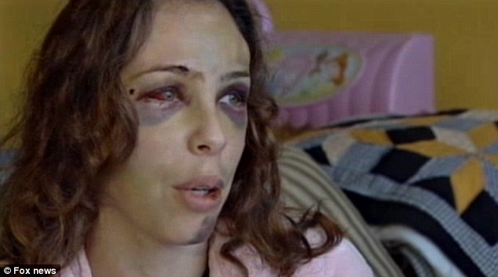
(Acts 22, 26)
1 TIM 1:12-17
Binding and delivering to prison (22:4)
Men and women
Well known to Jewish leadership
Letters to bring Christians in bonds to Jerusalem to be punished (cf. 25:9)
Beat believers (22:19; cf. 2 Cor. 11:24)
Voice/vote for death (26:10; cf. 22:22)
Punished them often in all the synagogues
Tried to make them blaspheme
Chased them to foreign cities
Blasphemer,
Persecutor (hunter)
Insolent opponent
shamefully and outrageously and aggressively insulting [to Him]
[religious] terrorism (OJB)

Slide 11
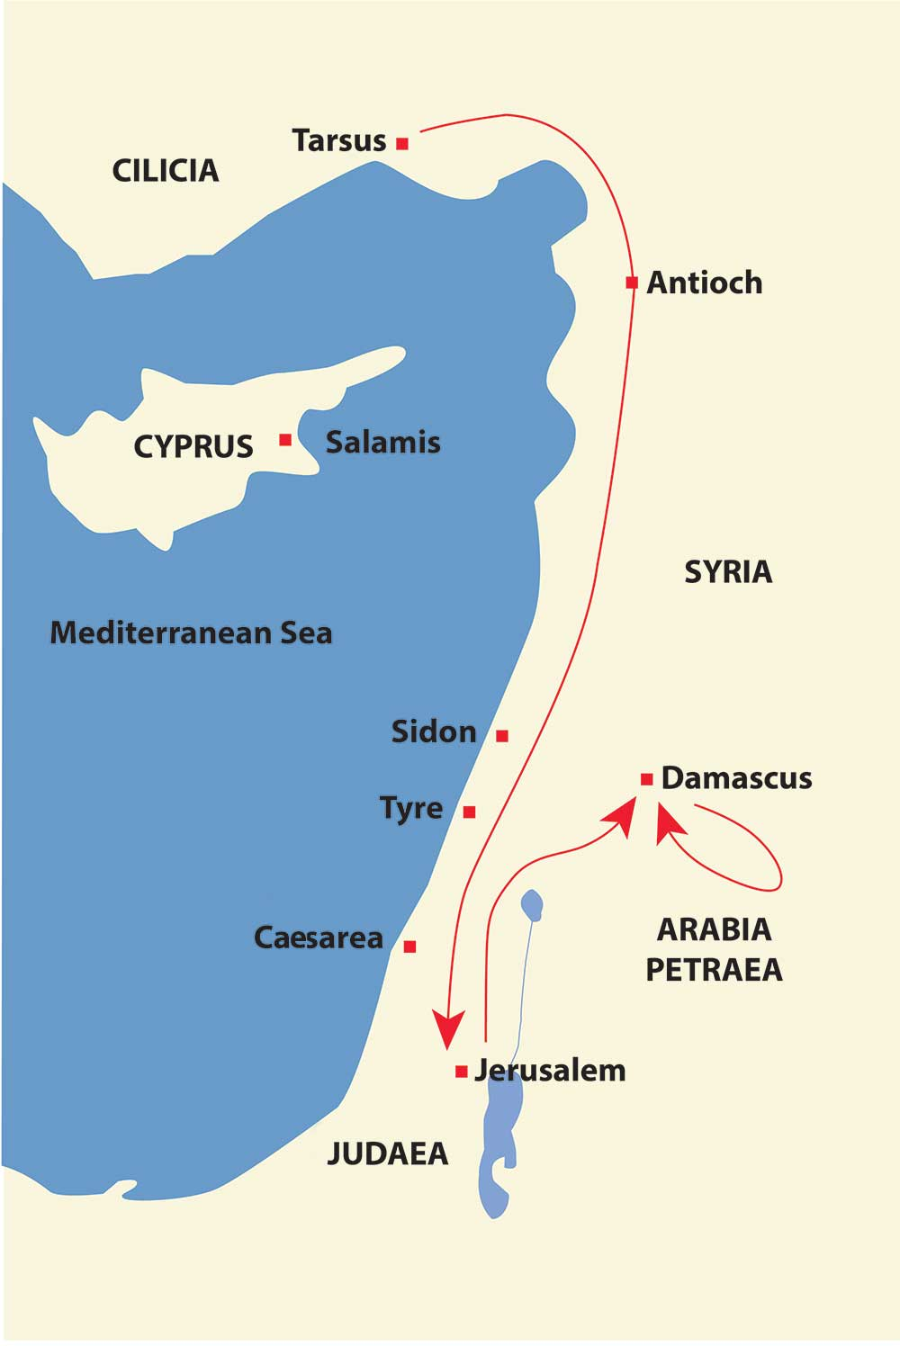

Slide 12
PAUL: CONVERSION
Context: God turning a missionary persecutor in missionary to Gentiles
Narrator: Luke
Context: Before riotous Jewish crowd
Narrator: Paul (didn’t get to finish)
Context: Before Agrippa and Festus
Narrator: Paul
Ch. 9
Ch. 22
Ch. 26

Slide 13
PAUL: CONVERSION
ACTS 9 | ACTS 22 | ACTS 26
3 Now as he went on his way, he approached Damascus, and suddenly a light from heaven shone around him. | 6 “As I was on my way and drew near to Damascus, about noon a great light from heaven suddenly shone around me. | 13 At midday, O king, I saw on the way a light from heaven, brighter than the sun, that shone around me and those who journeyed with me.
4 And falling to the ground, he heard a voice saying to him, “Saul, Saul, why are you persecuting me?” | 7 And I fell to the ground and heard a voice saying to me, ‘Saul, Saul, why are you persecuting me?’ | 14 And when we had all fallen to the ground, I heard a voice saying to me in the Hebrew language, ‘Saul, Saul, why are you persecuting me? It is hard for you to kick against the goads.’
5 And he said, “Who are you, Lord?” And he said, “I am Jesus, whom you are persecuting. 6 But rise and enter the city, and you will be told what you are to do.” | 8 And I answered, ‘Who are you, Lord?’ And he said to me, ‘I am Jesus of Nazareth, whom you are persecuting.’ … 10 And I said, ‘What shall I do, Lord?’ And the Lord said to me, ‘Rise, and go into Damascus, and there you will be told all that is appointed for you to do.’ | 15 And I said, ‘Who are you, Lord?’ And the Lord said, ‘I am Jesus whom you are persecuting. 16 But rise and stand upon your feet, for I have appeared to you for this purpose, to appoint you as a servant and witness to the things in which you have seen me and to those in which I will appear to you, 17 delivering you from your people and from the Gentiles—to whom I am sending you 18 to open their eyes, so that they may turn from darkness to light and from the power of Satan to God, that they may receive forgiveness of sins and a place among those who are sanctified by faith in me.’

Slide 14
PAUL: CONVERSION
ACTS 9 | ACTS 22 | ACTS 26
7 The men who were traveling with him stood speechless, hearing the voice but seeing no one. | 9 Now those who were with me saw the light but did not understand the voice of the one who was speaking to me.
8 Saul rose from the ground, and although his eyes were opened, he saw nothing. So they led him by the hand and brought him into Damascus. | 11 And since I could not see because of the brightness of that light, I was led by the hand by those who were with me, and came into Damascus.
9 And for three days he was without sight, and neither ate nor drank.
10 Now there was a disciple at Damascus named Ananias. The Lord said to him in a vision, “Ananias.” And he said, “Here I am, Lord.” 11 And the Lord said to him, “Rise and go to the street called Straight, and at the house of Judas look for a man of Tarsus named Saul, for behold, he is praying, 12 and he has seen in a vision a man named Ananias come in and lay his hands on him so that he might regain his sight.” | 12 “And one Ananias, a devout man according to the law, well spoken of by all the Jews who lived there,

Slide 15
PAUL: CONVERSION
13 But Ananias answered, “Lord, I have heard from many about this man, how much evil he has done to your saints at Jerusalem. 14 And here he has authority from the chief priests to bind all who call on your name.”
15 But the Lord said to him, “Go, for he is a chosen instrument of mine to carry my name before the Gentiles and kings and the children of Israel. 16 For I will show him how much he must suffer for the sake of my name.”

Slide 16
PAUL: CONVERSION
17 So Ananias departed and entered the house. And laying his hands on him he said, “Brother Saul, the Lord Jesus who appeared to you on the road by which you came has sent me so that you may regain your sight and be filled with the Holy Spirit.” 18 And immediately something like scales fell from his eyes, and he regained his sight. | 13 came to me, and standing by me said to me, ‘Brother Saul, receive your sight.’ And at that very hour I received my sight and saw him. 14 And he said, ‘The God of our fathers appointed you to know his will, to see the Righteous One and to hear a voice from his mouth; 15 for you will be a witness for him to everyone of what you have seen and heard.
Then he rose and was baptized; 19 and taking food, he was strengthened. | 16 And now why do you wait? Rise and be baptized and wash away your sins, calling on his name.’

Slide 17
PAUL: CONVERSION
PERSONAL SUMMARY: “But when he who had set me apart before I was born, and who called me by his grace, was pleased to reveal his Son to me, in order that I might preach him among the Gentiles…” (Gal. 1:15-16)
Did Paul see Jesus?
(Acts 9:17, 27; 22:14; 26:16; 1 Cor. 9:21; 15:8)
Was it a subjective vision, hallucination, etc? What was Paul’s concept of resurrection? Other witnesses, miracles associated?
Why was it necessary to see Jesus? (Acts 1:22; 1 Cor. 15:15)
Does this open the door to modern day visions of Jesus?

Slide 18
PREACHER TO THE GENTILES
Acts 9: Jesus’ plans:
Chosen instrument
Name – contrast v. 14 (carry my name, travelling to foreign lands), Gentiles, Kings, Israel
Suffering
Gal. 1:16 in order that I might preach him among the Gentiles
Acts 26:18 with Romans 15:15-16

Slide 19
*Took 15+ years
PREACHER TO THE GENTILES
Jesus’ mission (Acts 1:8) and prophecy (Acts 2:17)
There are Hellenists (Acts 2:5) and proselytes from beginning (Acts 6:5)
Stephen’s stoning (Acts 7:51-53) and Paul’s persecution (Acts 8:4)
Samaritans
Acts 8
Saul’s conversion
Acts 9
Cornelius
Acts 10
Antioch
Acts 11
Jerusalem visits
Acts 22:21; Gal. 2?
Saul’s journeys
Acts 13:1; 14:27
Continuing controversy
Acts 15

Slide 20
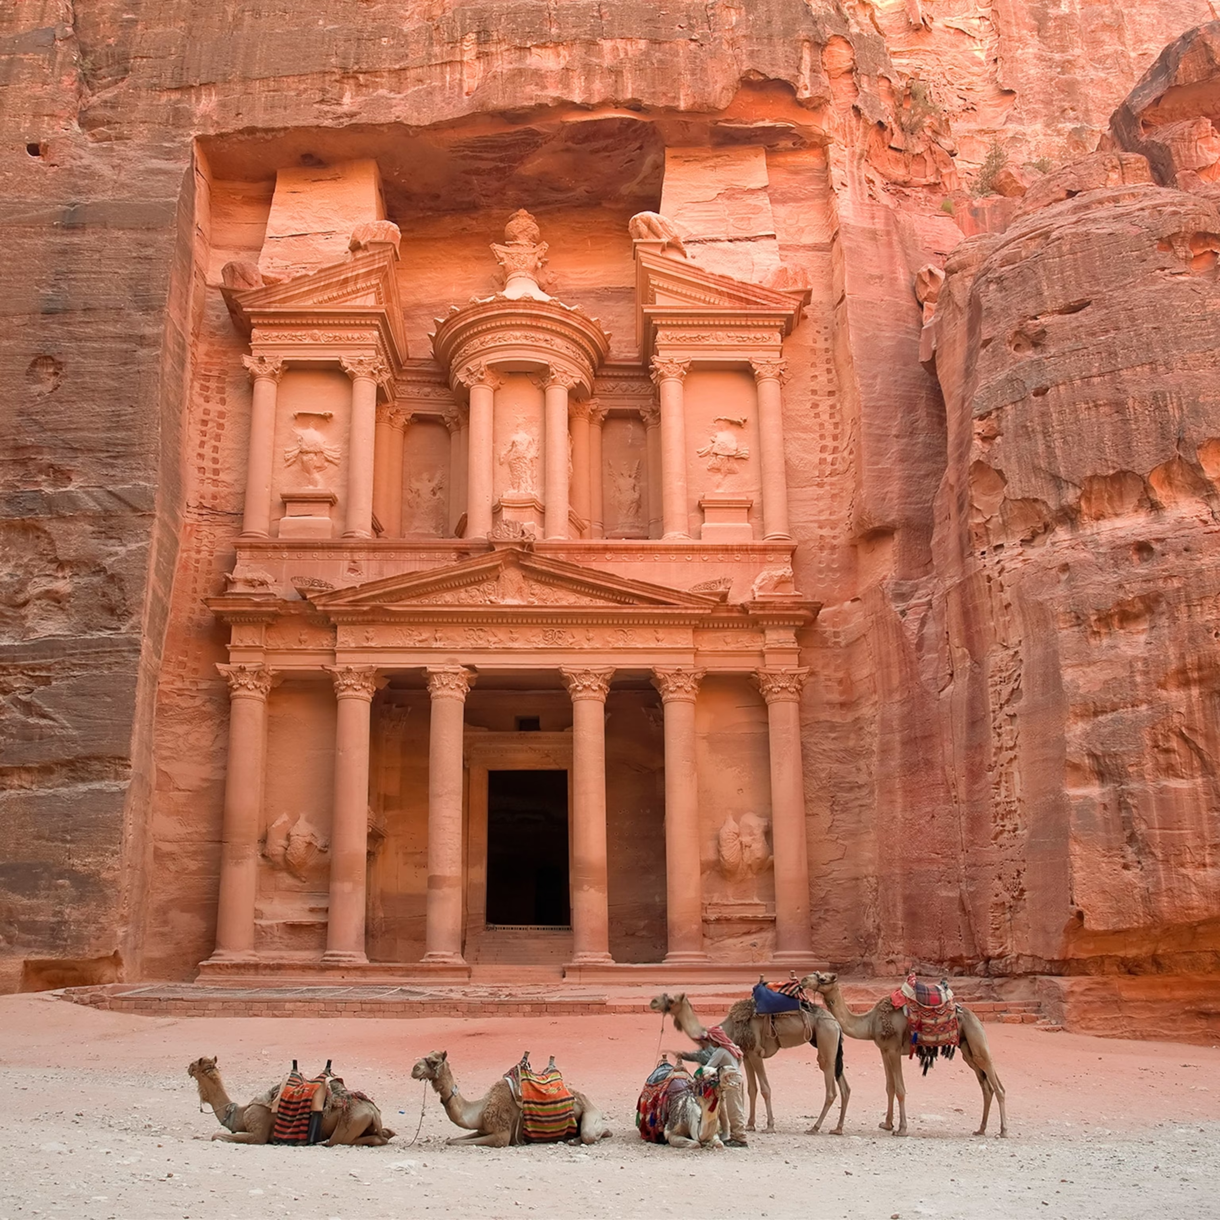
CONVERSION TO 1st journey (1/2)
Several days in Damascus, 9:20
“Immediately” began to proclaim – synagogues (Gal. 1:11-12)
Amazed, cf. John 9:8, Acts 3:10; Mark 5:15
Confounding, proving – cf. 6:9,10; 9:29
“Many days” elapse, 9:23.
Arabia? 3 years, Gal. 1:18.
Bruce: preaching to Nabatean kingdom, p. 86, based on 2 Cor. 11:32,33 referring to Nabatean king Aretas.
Greeks? Only in synagogues? (Acts 22:21?; 26:20?)

Slide 21
CONVERSION TO 1st journey (2/2)
“When he came to Jerusalem” 9:26
Fear, Barnabas intercedes
Stays with Peter 2 weeks and only sees him and James (Gal. 1:18-19)
Moving freely, speaking boldly
Hellenists. Want to kill. Cf. 6:9ff. Vision from Jesus, Acts 22:17-21
Sent to Tarsus, Gal. 1:21. How long was he there? (Gal. 1:18; 2:1; Acts 11:26)
What are some events that might have taken place in this period? (2 Cor. 11:25 – 12:10)
Why no information on Arabia or Tarsus? We are limited to what the point of Luke and Paul’s narrative is!
Church in peace – cf. 2:46f, 4:32ff; 5:1ff; 6:7 – bookend statements indicating resolution. This ends the Stephen episode. 12:24 contrast method.

Slide 22
ANTIOCH (1/2)
11:19 is a lengthy period
Movement to Phoenicia, Cyprus, Antioch
Greeks (contrast to “Jews alone”). Hellenists (ESV) would not be noteworthy
Yet must be after Cornelius (Acts 15:7)
11:22 Bros. in Jerusalem support (similar to 8:14; maybe 9:31,32,36)
Barnabas is Cyprian
Tarsus not far – Barnabas knew value (9:27,28; knew Paul’s commission?)

Slide 23
ANTIOCH (2/2)
Spent 1 year teaching
Agabus, famine, contribution to Judea. Show of relationship
Paul went to Judea with contribution. Must be the second visit to Jerusalem (Gal. 2:1-10), assuming Paul doesn’t skip over it (which would be contrary to his purpose)
Goes up upon revelation
Barnabas and Titus accompany
Controversy from false brethren
Took the occasion for private meeting – Peter, James, John – laid out gospel to Gentiles. Right hand of fellowship
Just remember the poor (Acts 11:29,30)
Peter comes to Antioch and Paul has to condemn him.
Acting hypocritically, not in accordance with gospel

Slide 24
EXERCISE
Complete: But I received _______ for this reason, that in me, as the _________, Jesus Christ might display his ________ patience as an _________ to those who were to believe in him for eternal life. (1 _________ 1:16)
Name the place:
Paul’s birth
Paul’s rebirth
Name some events following Stephen’s stoning that led to the door to the Gentiles being opened

