Slide 1
Warm up - MATCH
Home base; where Holy Spirit sends out
Sergius Paulus and Elymas
John Mark leaves
Synagogue sermon
Healing of lame man; Paul stoned
Perga of Pamphylia
Antioch of Pisidia
Lystra of Lycaonia/Galatia
Antioch of Syria
Paphos of Cyprus

Slide 2
Course calendar
L | Date | Subject | Texts | Dates
1 | 25-Feb-24 | Background, youth and persecution | Acts 7-8 | 0 – 33
2 | 28-Feb-24 | Conversion until Antioch | Acts 9-11,22,26; Gal. 1-2 | 33 – 46
3 | 3-Mar-24 | 1st preaching tour; controversy over Gentile converts | Acts 13:1 – 15:35; Gal. 4-6 | 47 – 49
4 | 6-Mar-24 | 1st preaching tour; controversy over Gentile converts | Acts 13:1 – 15:35; Gal. 4-6 | 47 – 49
5 | 10-Mar-24 | 2nd preaching tour; epistles from 2nd tour | Acts 15:36 – 18:22; 1&2 Thess. | 50 – 54
6 | 13-Mar-24 | 2nd preaching tour; epistles from 2nd tour | Acts 15:36 – 18:22; 1&2 Thess. | 50 – 54
7 | 17-Mar-24 | 3rd preaching tour; epistles from 3rd tour | Acts 18:23 – 20:38; Romans, 1&2 Cor. | 54 – 58
 | 20-Mar-24 | (No class)
8 | 24-Mar-24 | 3rd preaching tour; epistles from 3rd tour | Acts 18:23 – 20:38; Romans, 1&2 Cor. | 54 – 58
9 | 27-Mar-24 | Imprisonment in Caesarea | Acts 21-26 | 58 – 59
10 | 31-Mar-24 | Journey to Rome; prison epistles | Acts 27-28; Eph., Phi., Col., Phlm. | 60 – 61
11 | 3-Apr-24 | Journey to Rome; prison epistles | Acts 27-28; Eph., Phi., Col., Phlm. | 60 – 61
12 | 7-Apr-24 | Life after Acts; preacher epistles | 1&2 Timothy, Titus | 62 – 68
13 | 10-Apr-24 | Overflow and review

Slide 3
JERUSALEM CONFERENCE – THE ISSUE
The Southern Baptist Convention, the nation's largest Protestant denomination, has moved dramatically to bar women from holding leadership roles in its churches.
The organization voted overwhelmingly yesterday to finalize the expulsion of two churches for having female pastors…
Albert Mohler, President, Southern Baptist Theological Seminary:
It's a matter of biblical commitment, a commitment to the scripture that unequivocally, we believe, limits the office of pastor to men. It is an issue of biblical authority.
https://www.pbs.org/newshour/show/southern-baptist-convention-bans-female-pastors-ejecting-several-churches-in-the-process#:~:text=The%20Southern%20Baptist%20Convention%2C%20the,churches%20for%20having%20female%20pastors.
There are two main questions to be answered at the 2024 General Conference of the United Methodist Church. The answer to both questions will have a significant impact on the future of the UMC and will require local congregations’ thoughtful consideration regarding their own affiliation with the denomination.
The first question will be whether the delegates will vote to adopt the proposed revised social principles, and the second, whether the delegates will vote to adopt a proposed regionalization plan.
https://daltontomich.com/the-two-main-issues-for-the-united-methodist-general-conference-2024-and-how-to-prepare-your-congregation-for-the-outcomes/
Men from Judea – teaching (not from apostles), v. 24 (cf. Gal. 2:12; 1 Jn 2:19)
Their position stated (2, 5)
Their theology: Jesus is the Messiah, but Law is what saves
Great debate
Determination: go to Jerusalem. Is this a church council?
Members of church A teach a problematic doctrine in church B. Church B sends representative members to church A (the source) to address the issue.
Paul and Barnabas knew the truth.
There are apostles – source of authority.
Paul (in my view of chronology) had no doubt what the other apostles would say.

Slide 4
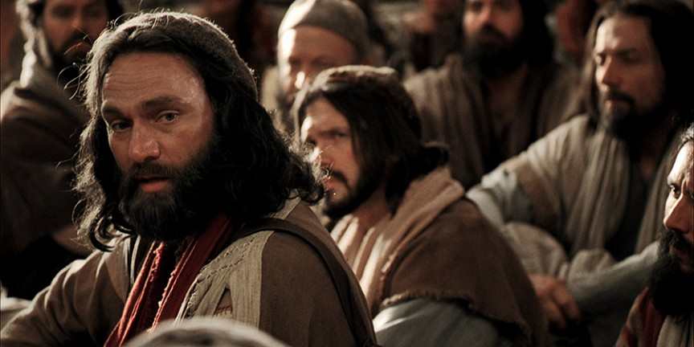
JERUSALEM CONFERENCE: DEBATE
Phoenicia/Samaria – describing – joy
Jerusalem – rec’d – church, apostles, elders
Much debate. No opposing arguments mentioned here, but implicit in many places in polemic sections of Paul’s epistles (e.g. Rom. 3:31; 6:1; 7:7; 9:19; 11:1; Gal. 3:19, 21)
Peter:
God’s choice (15:7)
God’s witness (8). Approved example
God’s attitude (9). Cf. Gal. 3:28
Imposing the yoke of the law (10) = opposing (cf. Gal. 5:1-4)
Salvation is by grace…for Jews also
Barnabas (name first) and Paul
Signs and wonders – necessary conclusion
James (Gal. 2:12)
Prophets (Amos 9:11,12). Direct statement
Write: No trouble, but holy people (Lev. 17-18)
If they want to follow law, they can

Slide 5
JERUSALEM CONFERENCE - LETTER
Who made the decision? (15:22,28; 16:4)
Why send Judas and Silas?
V. 23 – same status
Result – v. 31
Who got this letter? (v. 23). Who else needs it? (15:36, 41; 16:4)

Slide 6
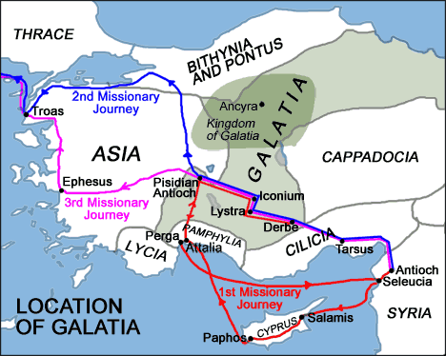
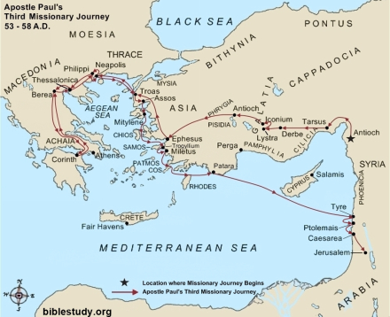
GALATIANS
When written? And to whom?
Paul preached to them (1:8). They were Gentiles (4:8). Some Jews were trying to circumcise them (6:12ff)
Galatia is a region. There were important cities in the north and in the south. Paul visited the south on the first journey. He “went through” Galatia on second journey (16:6). He “went from one place to the next through the region of Galatia” on the 3rd journey. Given the lack of particular indicators in the book, the book could fit in any of these contexts.
However, the theme dovetails with the situation of Acts 15, so we will consider it here.

Slide 7
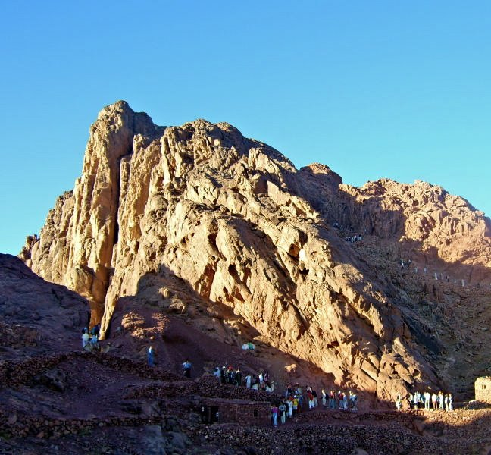
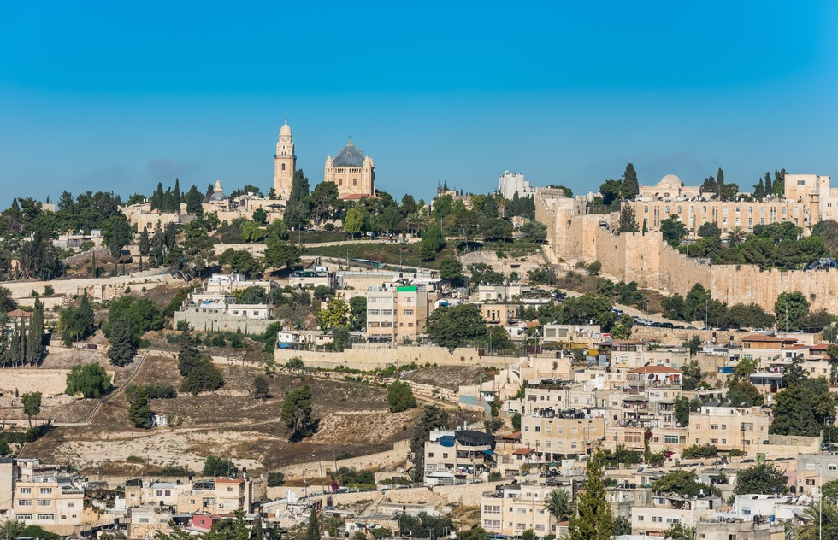
GALATIANS
Defense of apostleship
“1:11 For I would have you know, brothers, that the gospel that was preached by me is not man's gospel. 12 For I did not receive it from any man, nor was I taught it, but I received it through a revelation of Jesus Christ.”
Justification by faith, not law
3:10-14. Law doesn’t justify; it curses. Jesus redeemed us from the curse by becoming a curse, and our faith in Him saves us.
Why the law then? History and the Bible summed up in 3:21ff.
Exhortations to godliness
“5:16 But I say, walk by the Spirit, and you will not gratify the desires of the flesh.”

Slide 8
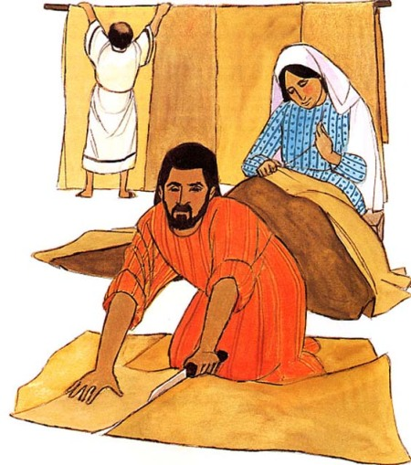
LIFE and epistles OF PAUL
Embry Hills
Feb – April, 2024
LESSONS 5-6
2nd preaching tour, epistles from 2nd preaching tour
https://biblicaljoy.wordpress.com/2010/10/09/heading-to-ephesus-with-priscilla-and-aquila/

Slide 9
Blue Letter Bible
Conybeare & Howson
Stalker
S. Hall
BEE
51
52
53
57
54
54
54
57
57
58
59
59
61
63
63-66
67
49
51
52
51
53
53
53
54
56
57
57
59
60
62
63
66
51
52
53
57
54 spri
54 su
54 fall
57
57
58
59
60
61
62
63
63-66
68
50
51
51
51
53
54
54
57
57
58
59
61-62
62
62-67
63
67-69
68
50
51
52
?
53
53
54
54
54
57
57
59
60
61-62
63
63-67
63
67-68
68
2nd journey starts
1 Thessalonians. At Corinth
2 Thessalonians. At Corinth
Galatians?
Leave Corinth
Jerusalem at Pentecost (?)
Starts 3rd journey
1 Corinthians. At Ephesus
2 Corinthians. At Ephesus
Lands at Caesarea and goes to Jerusalem
Felix
Festus
Arrives in Rome. Imprisoned. Philmn, Col, Eph, Phi. At Rome
Released from Roman imprisonment
Further missionary work (Macedonia, Asia, Spain?)
1 Timothy, from Macedonia. Titus, from Ephesus. 2nd imprisonment and martyrdom under Nero
2 Timothy, from Rome

Slide 10
APPROX. TIMELINE – PAUL’S LIFE
Tarsus, Gamaliel, zealous, persecutor
Damascus/Arabia (3 years),
Visit to Jerusalem,
Syria/Cilicia,
Antioch (1 year)
1st preach. trip
2nd preaching trip
30
40
50
60
70 AD
Cross
Galatians?
1st visit to Jerusalem
2nd visit to Jerusalem
Stephen
Peter visits Antioch
Jerus. conference
1 & 2 Thessalonians

Slide 11
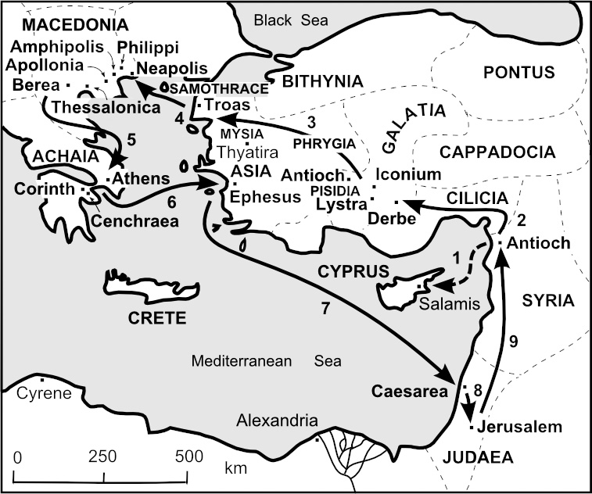
2nd journey
Timothy: age? (2 Tim. 2:22)
Why wasn’t Timothy circumcised? (1 Cor. 7:18ff)
Why circumcise? (1 Cor. 9:19ff)
What lessons does Timothy learn?
Teaching, character, treatment of brothers, suffering (2 Tim. 3:10ff)
Split - Barnabas
Timothy, letter

Slide 12
HOMEWORK
Tell the story of what happened in your city (on the 2nd journey) from Timothy’s eyes
What did he learn (from Paul’s character and teaching)?
What light do the epistles shine on what was happening?
PHILIPPI
Acts 16:11-40
Phi. 1:2-5; 2:19-22; 3:17-21; 4:10-17
THESSALONICA
Acts 17:1-14
1 Thess. 1:1 – 3:10
2 Thess. 1:1-4; 2:1-2; 3:6-15
CORINTH
Acts 18:1-18
1 Cor. 1:1 – 2:4; 3:5-15; 4:14-17; 9:1-23; 11:2; 15:3-11; 16:15-16

Slide 13
WARM UP - MATCH
Lydia, slave girl, jailer
Reasoning, mob, Jason
Jews noble-minded
Discourse in Areopagus
Tent-making, Gallio, 1.5 years
Berea
Athens
Corinth
Thessalonica
Philippi

Slide 14
Course calendar
L | Date | Subject | Texts | Dates
1 | 25-Feb-24 | Background, youth and persecution | Acts 7-8 | 0 – 33
2 | 28-Feb-24 | Conversion until Antioch | Acts 9-11,22,26; Gal. 1-2 | 33 – 46
3 | 3-Mar-24 | 1st preaching tour; controversy over Gentile converts | Acts 13:1 – 15:35; Gal. 4-6 | 47 – 49
4 | 6-Mar-24 | 1st preaching tour; controversy over Gentile converts | Acts 13:1 – 15:35; Gal. 4-6 | 47 – 49
5 | 10-Mar-24 | 2nd preaching tour; epistles from 2nd tour | Acts 15:36 – 18:22; 1&2 Thess. | 50 – 54
6 | 13-Mar-24 | 2nd preaching tour; epistles from 2nd tour | Acts 15:36 – 18:22; 1&2 Thess. | 50 – 54
7 | 17-Mar-24 | 3rd preaching tour; epistles from 3rd tour | Acts 18:23 – 20:38; Romans, 1&2 Cor. | 54 – 58
 | 20-Mar-24 | (No class)
8 | 24-Mar-24 | 3rd preaching tour; epistles from 3rd tour | Acts 18:23 – 20:38; Romans, 1&2 Cor. | 54 – 58
9 | 27-Mar-24 | Imprisonment in Caesarea | Acts 21-26 | 58 – 59
10 | 31-Mar-24 | Journey to Rome; prison epistles | Acts 27-28; Eph., Phi., Col., Phlm. | 60 – 61
11 | 3-Apr-24 | Journey to Rome; prison epistles | Acts 27-28; Eph., Phi., Col., Phlm. | 60 – 61
12 | 7-Apr-24 | Life after Acts; preacher epistles | 1&2 Timothy, Titus | 62 – 68
13 | 10-Apr-24 | Overflow and review

Slide 15
GENTILES NOT TO OBSERVE THE LAW OF MOSES
Was anyone at the time of his call uncircumcised? Let him not seek circumcision. 1 Cor 7:18 (cf. Php 3:2; Gal. 5:12)
You observe days and months and seasons and years! I am afraid I may have labored over you in vain. Gal 4:10-11
Look: I, Paul, say to you that if you accept circumcision, Christ will be of no advantage to you. I testify again to every man who accepts circumcision that he is obligated to keep the whole law. Gal. 5:2,3
Therefore let no one pass judgment on you in questions of food and drink, or with regard to a festival or a new moon or a Sabbath. Col 2:16

Slide 16
2nd journey
Lydia, slave girl, jailer
Vision, Luke
Forbidden
- Asia
Split - Barnabas

Slide 17
HOMEWORK
Tell the story of what happened in your city (on the 2nd journey) from Timothy’s eyes
What did he learn (from Paul’s character and teaching)?
What light do the epistles shine on what was happening?
PHILIPPI
Acts 16:11-40
Phi. 1:2-5; 2:19-22; 3:17-21; 4:10-17
THESSALONICA
Acts 17:1-14
1 Thess. 1:1 – 3:10
2 Thess. 1:1-4; 2:1-2; 3:6-15
CORINTH
Acts 18:1-18
1 Cor. 1:1 – 2:5; 3:5-15; 4:14-17; 9:1-23; 11:2; 15:3-11; 16:15-16

Slide 18
2nd journey
Paul Thess. verbs: reason, explain, prove
Jew Thess. verbs: form mob, set in uproar, attack, drag, shout (cf. 16:19ff, incl. accusation).
Berea verbs: receive, examine, see if so, believe
How could Spirit desire this? (16:6ff; 2 The. 3:3f)
Women (16:13f; 17:4, 12). Cf. 17:6
Lydia, slave girl, jailer
Noble
Vision, Luke
Forbidden
- Asia
Preach, mob
Aquila, Priscilla, synagogue, 1.5 years
Mars Hill
Split - Barnabas
Short stay
Haircut
Timothy, letter
Some time
Preaching Christ crucified (1 Cor. 1:18 – 2:5; 15:3-11)
Belief & baptism (Acts 18:8; 1 Cor. 1:13ff; 12:13; 16:15-16)
Preachers are servants (1 Cor. 3:5; 4:1)
Same rules in every church (4:17; 7:17; 11:2; 14:33; etc.)
Greeted
?

Slide 19
Settled, comfortable Christianity while you pursue earthly gain | Adventure in the faith, throwing earthly comfort to the wind while you serve the Lord with your few days
Be ever vigilant that you’re not pushing your resources too far | Spend and be spent
Choices that set you up for success and ease and a good retirement | Choices that put you in the best position to serve the Lord and then trust in the Lord´s provision
Inward focused | Outward focused
Got the heavy lifting done when you got baptized | Push the boundaries of the kingdom
Everybody in their own bubble | Real exertion in emotions, sharing of life, real brotherhood
Leave people to themselves when they get troublesome | Perfect patience

Slide 20
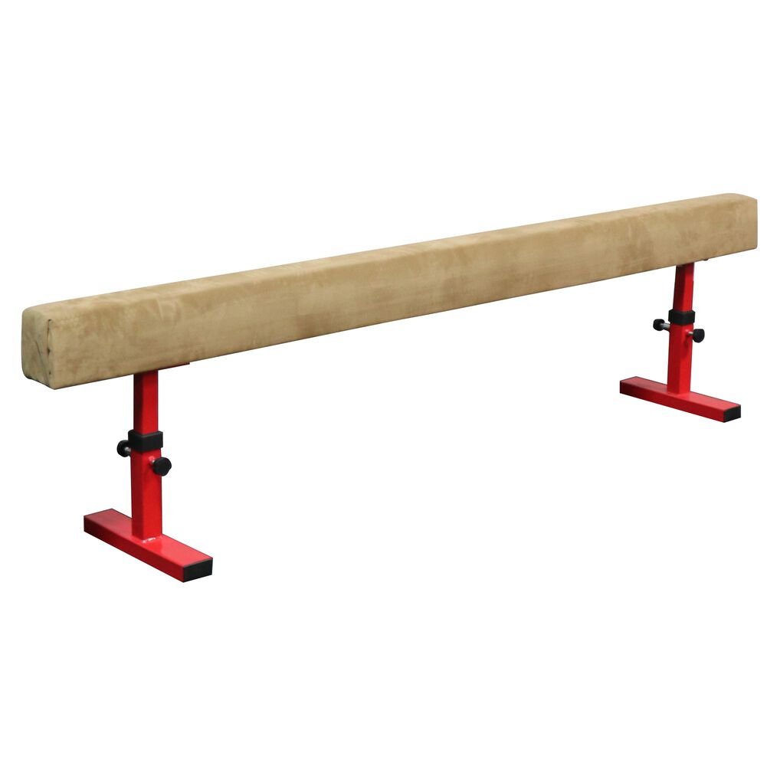
Settled, comfortable Christianity while you pursue earthly gain | Adventure in the faith, throwing earthly comfort to the wind while you serve the Lord with your few days
Be ever vigilant that you’re not pushing your resources too far | Spend and be spent
Choices that set you up for success and ease and a good retirement | Choices that put you in the best position to serve the Lord and then trust in the Lord´s provision
Inward focused | Outward focused
Got the heavy lifting done when you got baptized | Push the boundaries of the kingdom
Everybody in their own bubble | Real exertion in emotions, sharing of life, real brotherhood
Leave people to themselves when they get troublesome | Perfect patience

Slide 21
FOR THOUGHT
What kind of model of Christianity are we setting for young people?

Slide 22
1 and 2 Thessalonians
Did Paul have a deep concern for these brethren? Why or why not? (1 The. 1:3 – 2:12)
Paul was forced to leave Thessalonica because of persecution. What are some obstacles these new Christians would have faced? How does 2 The. 1:5-12 address this?
What teaching seems to have come very “early” in their life as Christians? (1 The. 4:13-18; 5:1-8; 2 The. 1,2) What does it suggest about its importance for us?
Compare 1 Thess 4:1-8 with the letter from Jerusalem.
What other area does Paul address in 2 Thess. 3:1-15?

Slide 23
OBEYABLE ACTS - PAUL
Evangelistic goals:
Prayer goals:
Brotherly love goals:
Mentoring goals:
Teaching goals:
Holiness goals:
Church goals:
Knowledge goals:

